Slide 1

ILLiad Document Delivery
March 20, 2020
Timothy Jackson

Slide 2
Agenda
FAQ and LibGuide updates
Copyright
Document Delivery Configuration
IDS Logic and Document Delivery
Document Delivery Workflows
www.suny.edu

Slide 3
Emergency Closing Procedures
COVID-19 LibGuide: https://slcny.libguides.com/libraries-COVID19
Closing Procedures FAQ: https://slcny.libanswers.com/faq/286209
  Turning off Lending in ILLiad/OCLC
  Turning of borrowing and lending overdue notices in ILLiad
IDS Logic can be used to batch update due dates in ILLiad, but it cannot update due dates in OCLC (and that’s ok)
Due dates: Make sure your patrons aren’t being told to return materials, and don’t worry about anything else
www.suny.edu

Slide 4
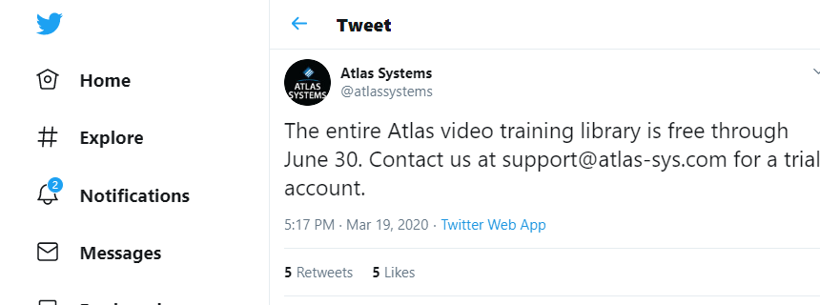
Atlas Video Training Library
Atlas Video Training Library is free through June 30
Contains many training videos on ILLiad configuration and workflows
Contact support@atlas-sys.com for trial account
www.suny.edu

Slide 5
Copyright & COVID-19
Many copyright experts in the library field believe we can expand our interpretation of fair use in light of the COVID-19 pandemic
Public Statement of Library Copyright Specialists: https://tinyurl.com/tvnty3a
  Signed or endorsed by more than 200 librarians throughout the U.S.
  “It is evident that making materials available and accessible to students in this time of crisis will almost always be a fair use. As long as we are being thoughtful in our analysis and limiting our activities to the specific needs of our patrons during this time of crisis, copyright law supports our uses.“
Basecamp post with additional resources: https://public.3.basecamp.com/p/P16LnhiCgdHYAmMSzFhnLGDa
www.suny.edu

Slide 6
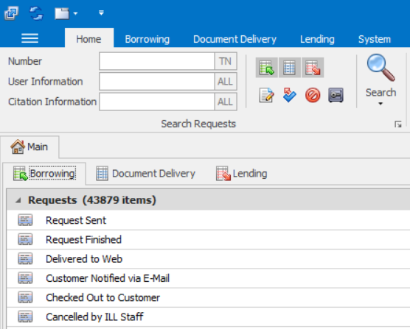
ILLiad Document Delivery
ILLiad can delivery electronic copies of articles and book chapters through the Document Delivery module
Functionality is very similar to Lending module, so implementing document delivery services should not require much training
Amount of configuration work needed to implement document delivery isn’t overwhelming, and that configuration work is very similar to Borrowing and Lending configuration
www.suny.edu

Slide 7
Document Delivery Configuration
www.suny.edu

Slide 8
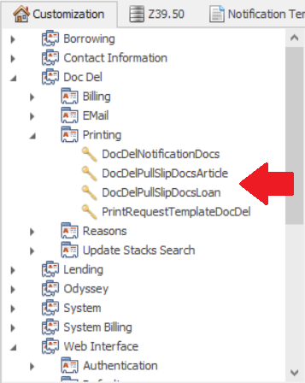
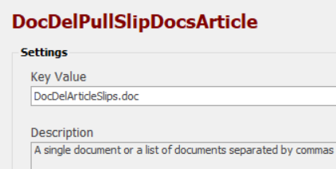
ILLiad Document Delivery – Pull Slips
Document Delivery pull slips are configured separately from Lending
Keys that determine which pull slip templates are used for Doc Del are found in Doc Del | Printing
  DocDelPullSlipDocsArticle
  DocDelPullSlipDocsLoan
www.suny.edu

Slide 9
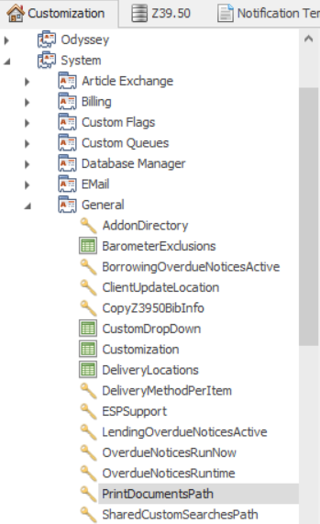
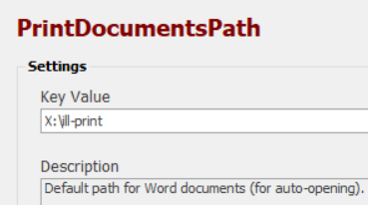
ILLiad Document Delivery – Pull Slips
ILLiad print templates can be stored on a shared drive or on each PC where the ILLiad client is installed
Determined by the PrintDocumentsPath key
Can be found in System | General
www.suny.edu

Slide 10
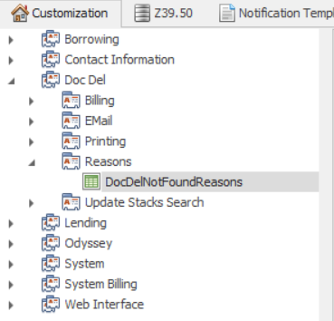
ILLiad Document Delivery – Reasons for Cancellation
Like Borrowing and lending, Document Delivery has its own Reasons for Cancellation table
DocDelNotFoundReasons
Located in Doc Del | Reasons
Configured in the same manner as Borrowing and Lending tables
www.suny.edu

Slide 11
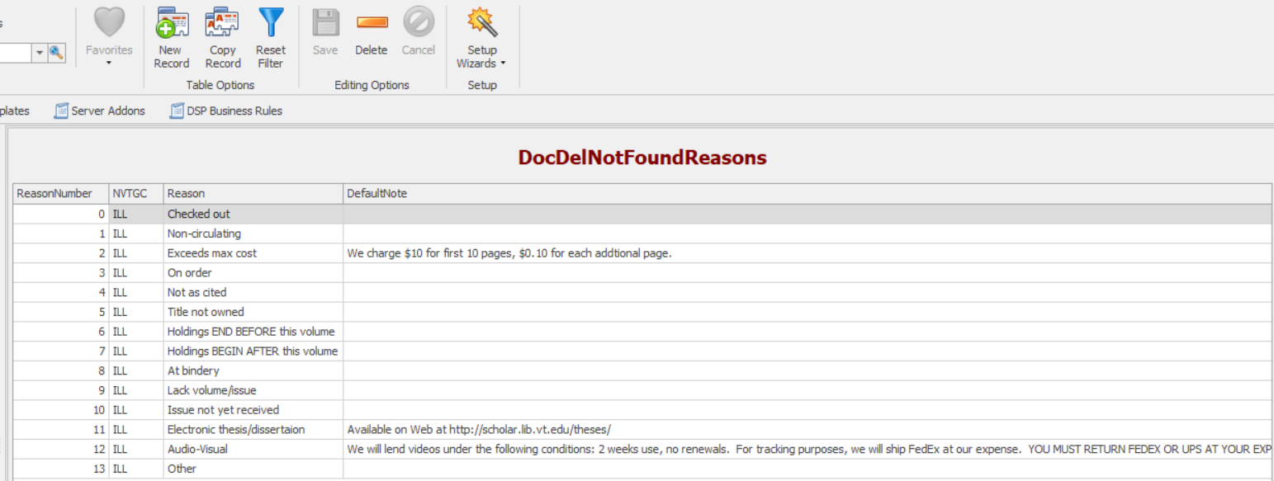
ILLiad Document Delivery – Reasons for Cancellation
www.suny.edu

Slide 12
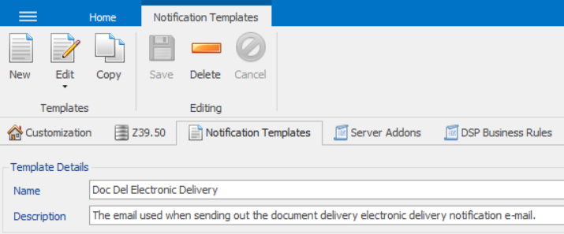
ILLiad Document Delivery – Notification Emails
Document Delivery uses the “Doc Del Electronic Delivery” notification template when notifying users that an article has been delivered electronically
Document Delivery uses the “Doc Del Cancellation Article” notification template when notifying users that an article request has been cancelled
You will need need to edit these template in the Notifications Tab of the Customization Manager
You may want to simply reuse the bodies of the “Borrowing Electronic Delivery” and “Borrowing Cancellation Article” notification templates
www.suny.edu

Slide 13
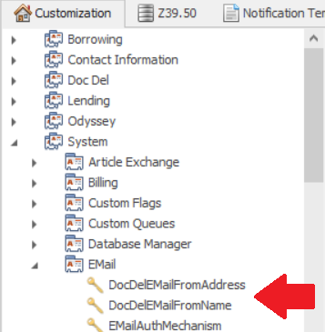
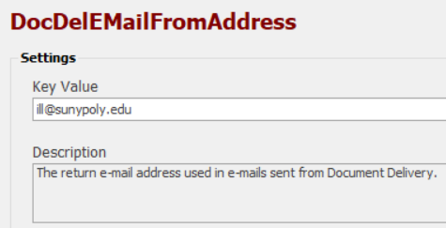
ILLiad Document Delivery – Notification Emails
You will also need to configure the following keys in the Customization manager
  DocDelEMailFromAddress
  DocDelEMailFromName
Both of those keys can be found in System | EMail
www.suny.edu

Slide 14
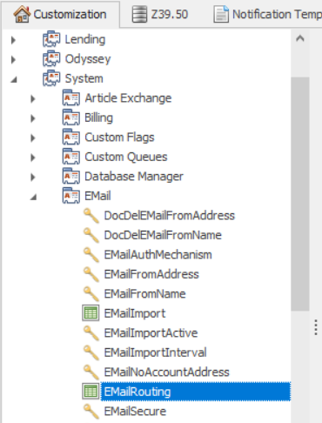
ILLiad Document Delivery – Email Routing
You can configure Email Routing rules for Document Delivery in the same manner as Borrowing and Lending
Allow you to send custom emails
Configured in EMailRouting table
  Found in System | Email
Enter “Doc Del” into the ProcessType field
www.suny.edu

Slide 15
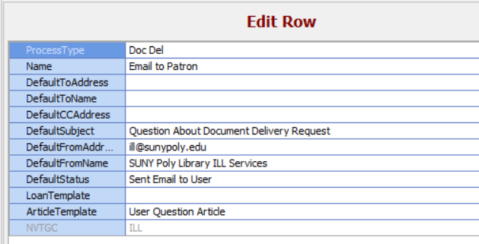
ILLiad Document Delivery – Email Routing
www.suny.edu

Slide 16
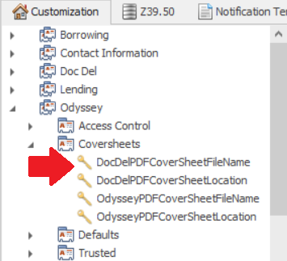
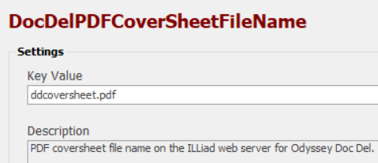
ILLiad Document Delivery – PDF Cover Sheet
ILLiad can automatically attach a cover sheet to every PDF it delivers
Document Delivery PDF cover sheet is configured separately from Borrowing
Keys found in Odyssey | Coversheets
  DocDelCoverSheetFileName
  DocDelCoverSheetFileLocation
www.suny.edu

Slide 17
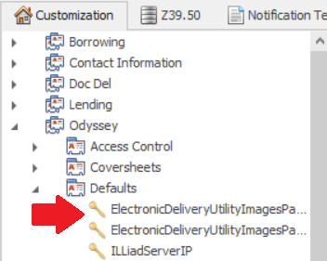
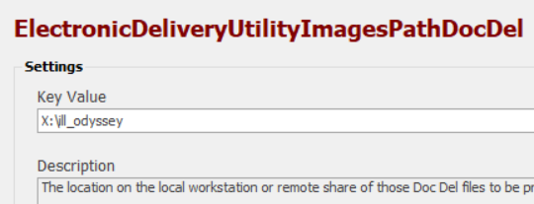
ILLiad Document Delivery – Electronic Delivery Utility
Electronic Delivery Utility automatically processes files saved to a directory
  File name must equal Transaction Number
  Request must be in In Stacks Searching (lending) or In DD Stacks Searching (doc del) queue
Configuration keys are in Odyssey | Defaults
  ElectronicDeliveryUtilityImagesPathDocDel
www.suny.edu

Slide 18
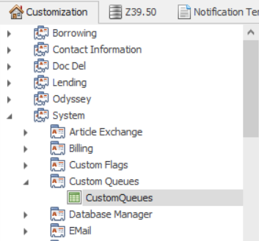
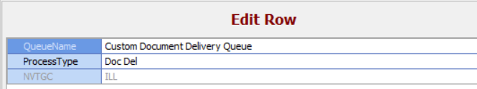
ILLiad Document Delivery – Custom Queues
It is possible to create custom Document Delivery queues
Configured in CustomQueues table
  Found in System | Custom Queues
Enter “Doc Del” in the ProcessType field
www.suny.edu

Slide 19
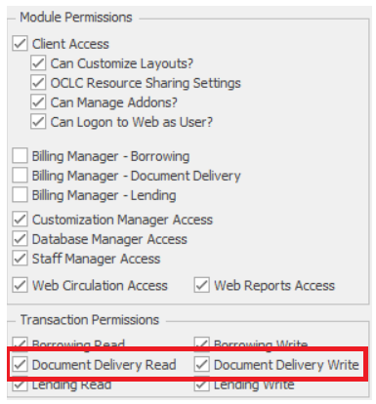
ILLiad Document Delivery – Staff Manager
Staff doing work in Document Delivery must be given read and write permissions to Document Delivery in the ILLiad Staff Manager
Check Document Delivery Read and Document Delivery Write boxes under Transaction Permissions for each staff account
www.suny.edu

Slide 20
Document Delivery Workflows
www.suny.edu

Slide 21
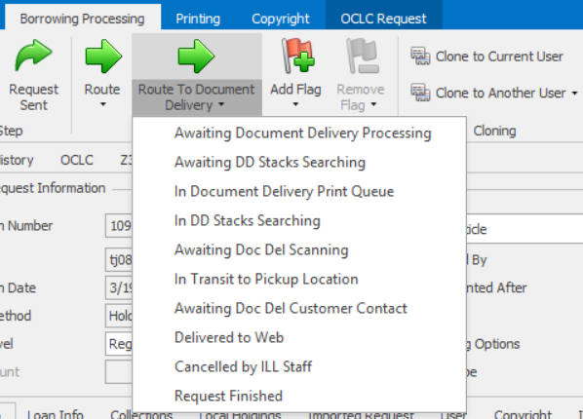
ILLiad Document Delivery – Workflow
Article and Book Chapter requests initially land in the Awaiting Copyright Clearance queue in Borrowing
If you find that the book or journal is available in your library, you can manually route the request to Document Delivery by using the Route To Document Delivery Button
www.suny.edu

Slide 22

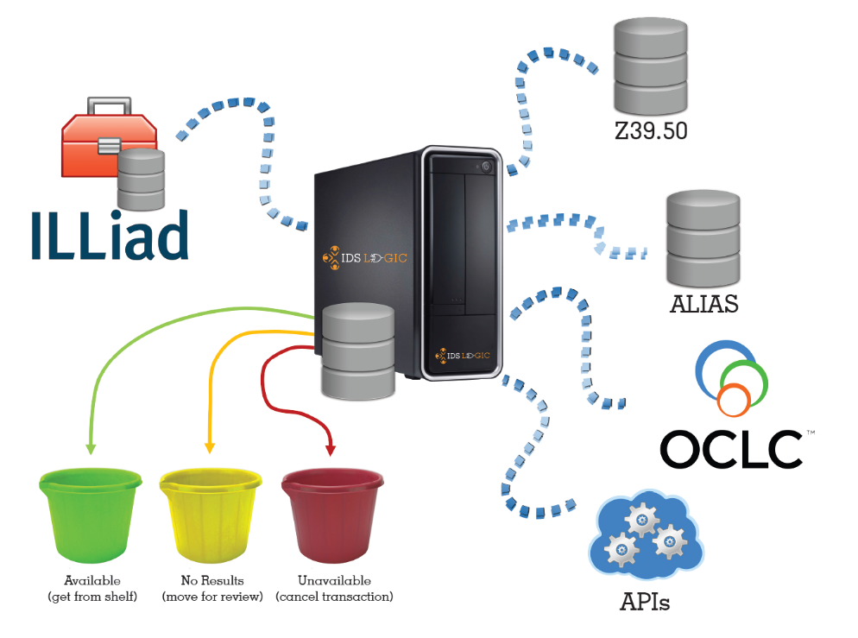
ILLiad Document Delivery – Workflow
IDS Logic can automate the process of identifying borrowing requests for locally held materials
Article Gateway & ALIAS can both check article requests
  You’ll need to look up location and call number
Borrowing Availability Service can check book chapter requests
  Location and call number provided automatically
  Request must have ISBN
Requests for locally held items can be automatically routed to Document Delivery
Email logic@idsproject.libanswers.com if you’d like to implement any of this
www.suny.edu

Slide 23
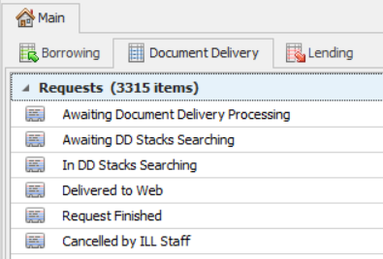
ILLiad Document Delivery – Workflow
Document Delivery workflows very similar to Lending workflows
Document Delivery queues:
  Awaiting Document Delivery Processing
  Awaiting DD Stacks Searching
  In DD Stacks Searching
  Delivered to Web
  Request Finished
  Cancelled by ILL Staff
You can create custom Document Delivery queues if you wish to customize you workflow
www.suny.edu

Slide 24
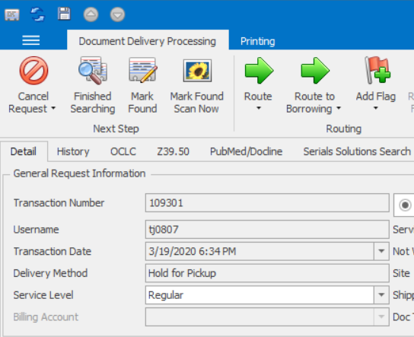
ILLiad Document Delivery – Workflow
Awaiting Document Delivery Processing queue functions like the Awaiting Lending Request Processing queue
Once you’ve found the item and entered the needed information in the Call Number and Location Fields, you can click the Finished Searching button
Request then routed to Awaiting DD Stacks Searching
www.suny.edu

Slide 25
ILLiad Document Delivery – Workflow
You can use the Forward to Borrowing button to move the request to Borrowing if you need to obtain the item from another library
You can route to a different Document Delivery queue by clicking the Route button
You can add a Flag by clicking the Add Flag button
If you find the item online, you can use the Mark Found Scan Now to deliver the item
www.suny.edu

Slide 26
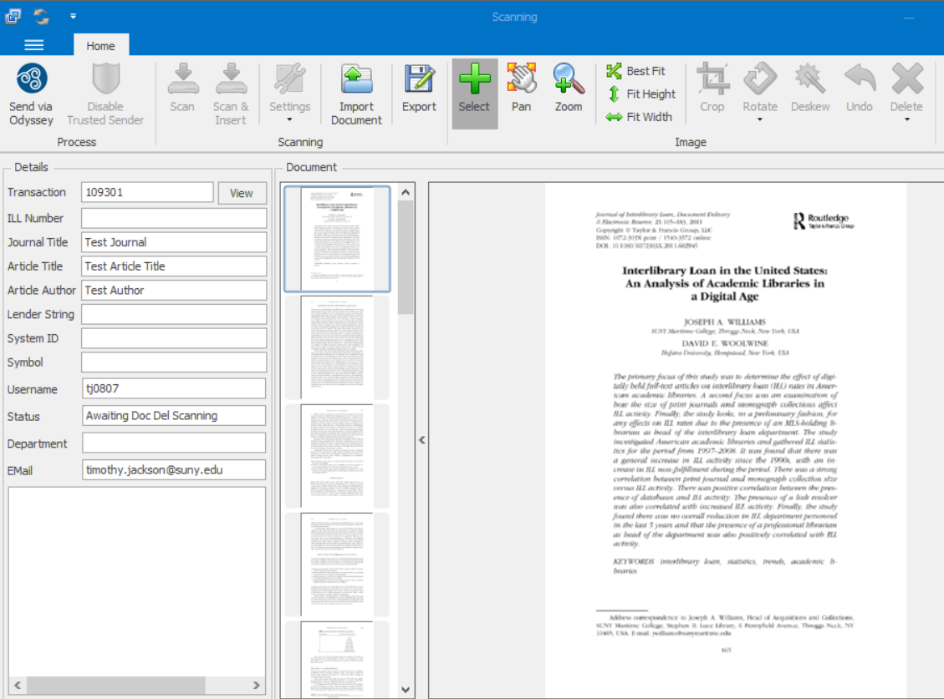
ILLiad Document Delivery – Workflow
Save the file to your PC
Click the Import Document button
Select the file you saved
Click the Send via Odyssey button
User will receive email and request will move to Delivered to Web
www.suny.edu

Slide 27
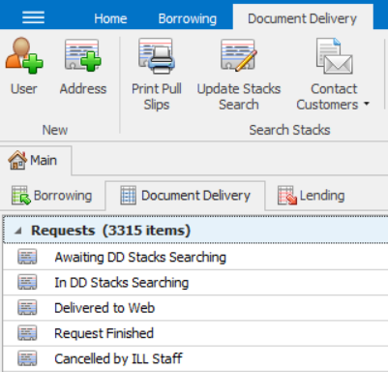
ILLiad Document Delivery – Workflow
Awaiting DD Stacks Searching functions like the Awaiting Stacks Searching queue in Lending
Click the Print Pull Slips button to print pull slips (equivalent to clicking the Print Stacks Search Items button in Lending)
Printed requests move to the Awaiting DD Stacks Searching queue (equivalent to the Awaiting Stacks Searching queue in Lending)
Once you have the requested item in hand, click the Update Stacks Search button (equivalent to clicking the Update Stacks Search Results button in Lending)
www.suny.edu

Slide 28
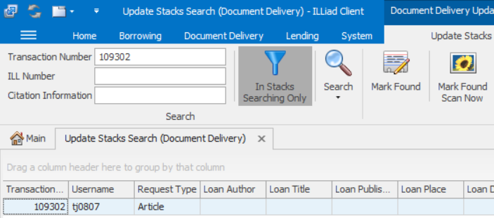
ILLiad Document Delivery – Workflow
Enter the TN into the Transaction Number field
Click Search button
Click Mark Found Scan Now button
Scanning window will open
www.suny.edu

Slide 29
ILLiad Document Delivery – Workflow
ILLiad’s scanning interface is pretty limited in functionality
Pages must be manually cropped one at a time, which slows down scanning significantly
If you anticipate scanning at a high volume, you should consider scanning in Adobe and using the Electronic Delivery Utility to process the file
Atlas Documentation:
  https://support.atlas-sys.com/hc/en-us/articles/360011808394-Configuring-the-Electronic-Delivery-Utility
www.suny.edu

