Slide 1
Fulfillment: intro to alma, User management, roles, and searching
Shared Library Services Platform Project
Logan Rath

Slide 2
Welcome & Getting Started
Welcome & Getting Started
Alma Overview & Basic Searching
Roles & User Management

Slide 3
Intro to Alma
Alma is a web-based system, no more clients
Works on any device with a web browser
Not restricted to campus IP addresses by default
The vocabulary is new, not hard, just new.
Fulfillment: Circulation + Course Reserves + Resource Sharing
Alma = Back end; Primo VE = Front end

Slide 4
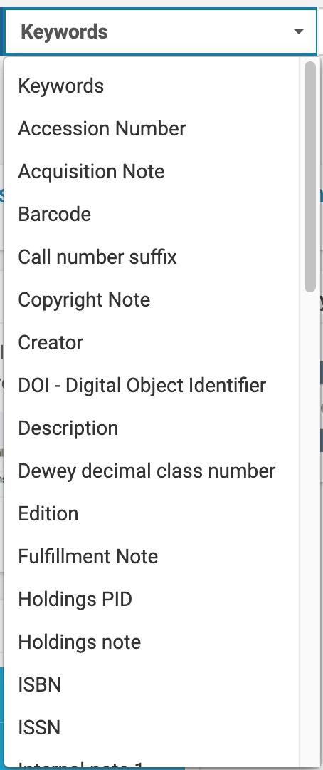
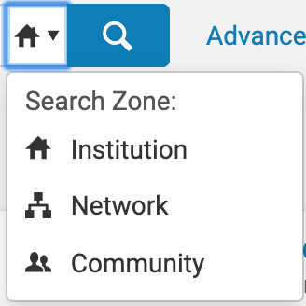
Basic Searching

Slide 5
Institution Zone (IZ)
The Alma institution is the basic level of data and workflow management in Alma.
Think: Aleph + Journals Knowledgebase combined

Slide 6
Network Zone (NZ)
The Network Zone is the central consortial infrastructure for SUNY. The major component of the Network Zone is the shared bibliographic database of all SUNY physical materials (books, DVDs, CDs, etc.). Other centralized management such as configuration for resource sharing is housed in the NZ.
Think: SUNY-wide services (kind of like public libraries)

Slide 7
Community Zone (CZ)
The Community Zone is the global knowledgebase of electronic resources that ExLibris maintains, allowing all Alma subscribers to link their local holdings to this resource. Collections linked to the CZ automatically receive updates from the CZ, reducing the need for campuses to locally manage collections.
Think: A WorldCat of e-resources but only for Alma customers

Slide 8
Library
The Alma library is comprised of one or more physical locations, each of which is normally housed in a single building or in several buildings in close physical proximity. A library may have several locations within it, such as the circulation desk and digital archiving. Each Alma Institution can have multiple Alma libraries.

Slide 9
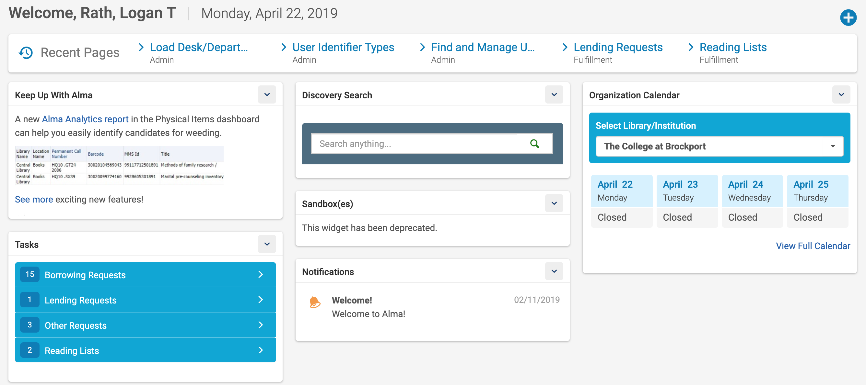
Navigating Alma’s Home Page

Slide 10
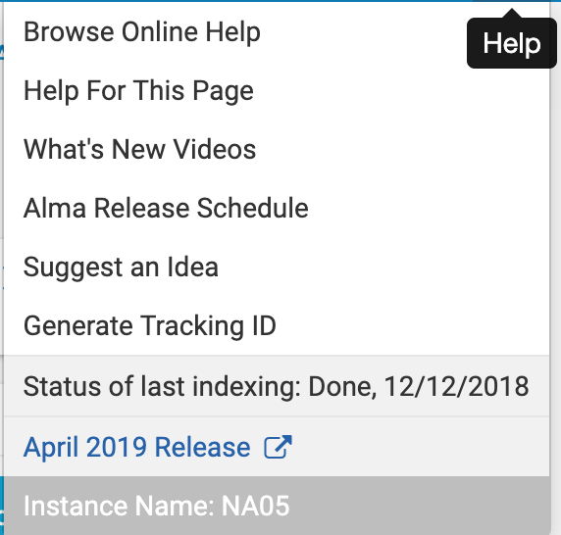
Alma Menu

Slide 11
Roles
Roles decide what a user can and cannot do in Alma
If you don’t see a screen that I see, we have different roles.
Anyone who can assign roles can give you the appropriate roles.

Slide 12
About Roles
Field | Description
Role name | The name of the role.
Scope | This field is mandatory, even though the field appears without a red asterisk. For roles that always apply to the entire institution, the scope is set to the institution and cannot be changed. For roles set on the library/campus level, select the campus/library (or the institution, if it is available) to which the role applies. After selecting the scope, some roles require additional information in the Role Parameters section, such as a service unit or circulation desk. Select the required values for these parameters, as described in User Roles – Descriptions and Accessible Components. To add multiple libraries/campuses, add the role to the user multiple times, selecting a different library/campus each time. If you reduce a user's scope to library-level from institution-level, or remove a library-level scope from a user, the user can no longer manage those entities that are assigned to him/her but are now out of scope.
Status | Select whether the role is active or inactive.
Expiry date | The date after which the role becomes inactive.

Slide 13
Fulfillment Roles See table in ExLibris documentation
Circulation Desk Manager
Circulation Desk Operator
Circulation Desk Operator – Limited
Course Reserves Manager
Course Reserves Operator
Course Reserves Viewer
Fulfillment Administrator
Fulfillment Services Manager
Fulfillment Services Operator
Requests Operator
Resource Sharing Partners Manager
Work Order Operator

Slide 14
Types of Users
 | Internal | External
Staff | Staff accounts managed completely inside Alma | Staff accounts that use Network Logons
Public | Community Users, Others Managed Completely Inside Alma | Patron Accounts
External users are users loaded from your external SIS system (Banner, etc.)
Users that are not part of that system (Banner, etc.) are defined as internal (i.e Community Borrower).
Internal Users may not require external authentication. This is useful when LDAP, Shibboleth are “down” for any reason. This is a best practice in the event that your authentication is unavailable and you need to log in.

Slide 15
Student Information System (SIS) Loads
If the user’s record is external and loaded from your SIS any fields loaded from the SIS cannot be edited in Alma. You should be able to add information to blank fields, but won’t be able to change information in fields filled by the SIS. (e.g. address, personal identifiers).

Slide 16
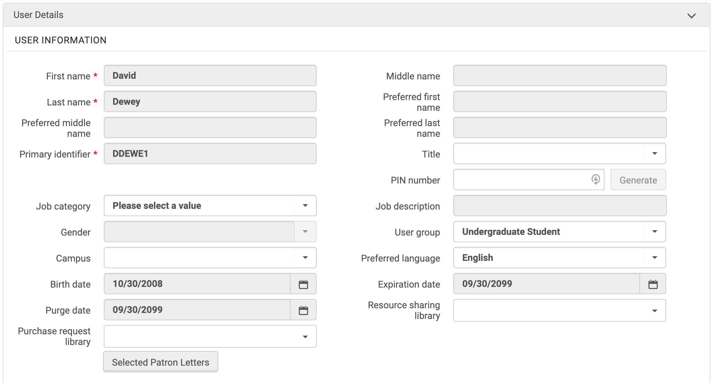
Example of SIS fields (grey background)

Slide 17
Why would I want to edit a user?
You may want to edit a patron’s user record if:
They cannot check out a book or place a hold
They are not receiving notifications
They cannot log into their patron account
You may want to edit a staff user record if:
They cannot perform a necessary task in Alma
They cannot log into Alma (password, expiration date)

Slide 18
How do I edit a user record? (Method 1)
Fulfillment → Manage Patron Services
Scan Card or type External ID
Click “Edit User Info”
Make Changes
Click “Update User”

Slide 19
How do I add/edit roles?
Admin → Manage users
Search for patron
Click the ellipses button
Click edit
Scroll down
Add role or Add from Profiles

Slide 20
What are profiles?
Profiles are sets of roles so that you can easily give staff multiple privileges in one go. Scenarios include:
Student workers
Groups of staff with similar privileges
Anytime you want to save time if more than one person will ever need that same set of privileges

Slide 21
How do I add profiles?
Configuration Menu → User Management
Roles and Registration → Profiles
+ New Profile
See the documentation

Slide 22
Questions?
Thanks!

