Slide 1
Best Practice Sharing Meeting
NCQA Y2 Cohort
Final Meeting
April 27, 2023, 8:00-9:30am

Slide 2

Agenda
8:00 am | Welcome | Nelly Burdette
8:05 am | Practice Report Outs: | All
9:10 am | Overview of Upcoming CTC-RI Projects | Linda Cabral
9:20 am | Wrap up | Liz Cantor and Kristin David
NRI Pediatrics
CNEMG Family Care Center
Anchor Medical Lincoln
Anchor Medical Warwick
Anchor Medical Providence
Brown Medicine
Barrington Pediatric Associates
Aquidneck Pediatrics
Hasbro Children’s Hospital Pediatric Primary Care
Funded by UnitedHealthcare

Slide 3
Housekeeping
Please…
  Mute yourself when not speaking
  If possible, turn your video on, especially when speaking
  Feel free to put questions in the chat
Note: This meeting will be recorded and posted on the CTC-RI IBH webpage: https://www.ctc-ri.org/integrated-behavioral-health/tele-ibh-and-ncqa-bh-learning-collaborative

Slide 4
NRI Pediatrics
What has been the most valuable change or transformation for your practice as a result of this project?
  Our PDSA for the project focused on improving visits for ADHD med checks.
    COVID related issues created a significant need to improve here.
  Our new workflow to identify patients who need/are overdue for med checks enabled us to follow our patients better and monitor adherence to medication.
  Over the course of 6 months, through both in-person and telehealth, we significantly improved our visit numbers.

Slide 5
NRI Pediatrics
What questions/concerns do you have about sustaining your IBH program moving forward?
  Our biggest concern is still the need to hire a clinician!!
  We have the majority of other necessary workflow supports in place.

Slide 6
Family Care Center,
Care New England Medical Group
What has been the most valuable change or transformation for your practice as a result of this project?
We have improved our ability to implement and track outpatient BH referrals to increase collaborative communication with specialty mental health providers within CNE and outside, thereby assisting patients to access outpatient BH care.
  IBH Providers have the same order/referral mechanism available to MDs
  CNE Referral Hub processes BH referrals similar to medical referrals
  Tracking needs improvement: via Referral Hub / other mechanism…
  We are actively creating an IBH Community Health Liaison position to work together with the primary care team, which will improve our ability to refer and track.

Slide 7
Family Care Center,
Care New England Medical Group
What questions/concerns do you have about sustaining your IBH program moving forward?
  Continued advocacy for IBH within system of care
  Continued support for IBH practice development from practice leadership
  Preventing IBH Provider Burnout
    Ability to move away from fee-for-service model
    Funding for IBH Community Health Liaison, Additional IBH Providers
  Workforce Development, Education
  Opportunities for ongoing mentorship and community

Slide 8
Anchor Medical Associates – Lincoln & Warwick
What has been the most valuable change or transformation for your practice as a result of this project?
* value of the electronic medical record in expanding ability to screen for mental health disorders
ie. PHQ 9, GAD 2/7 and AUDIT-C/AUDIT

Slide 9
Anchor Medical Associates – Lincoln & Warwick
What questions/concerns do you have about sustaining your IBH program moving forward?
  * Accessibility/Availability

Slide 10
Anchor Medical Associates Providence
What has been the most valuable change or transformation for your practice as a result of this project?
  Deeper understanding of IBH for providers/staff
  Workflow development (screening, referrals)
  Plan to apply for IBH distinction

Slide 11
Anchor Medical Associates Providence
What questions/concerns do you have about sustaining your IBH program moving forward?
  IBH staffing
  IBH specific training opportunities

Slide 12
Barrington Pediatric Associates
The most valuable change for our practice as a result of the project is expanding our screenings to include a screener for substance abuse. The CRAFFT screener is a health screening tool designed to identify substance use, substance-related riding/ driving risk and substance use disorder among youth ages 12-21 years of age. We are using the CRAFFT 2.1+N which contains additional questions about tobacco and nicotine use – which has better helped us to assess and develop a plan for vaping and cessation.

Slide 13
Barrington Pediatric Associates
My concerns moving forward would be yearly submissions and keeping up with changes and requirements.

Slide 14
Brown Medicine
What questions/concerns do you have about sustaining your IBH program moving forward?
Post pandemic utilization of behavioral health is at a all time high.
  Maintaining adequate staffing for patient population.
  Challenges with limited available referrals options for patients in need of higher level of care.
Insurance reimbursement challenges and frequent changes require recurrent adjustment.

Slide 15
Brown Medicine
What has been the most valuable change or transformation for your practice as a result of this project?
Through participating in this program, we have achieved NCQA Behavioral Health distinction for two of our practice locations.
The distinction has provided a foundation pertaining to documentation and process flows to ensure we created an Integrated Behavioral Health program based on best practices.
Brown Medicine is currently pursuing NCQA Behavioral Health distinction for our remaining PCMH practice locations.

Slide 16
Aquidneck Pediatrics
What has been the most valuable change or transformation for your practice as a result of this project?
The implementation and documentation of evidence-based clinical decision supports has been extremely helpful as it provides a consistent and organized plan of care for our patients.
The establishment of a behavioral health referral tracking process has greatly improved the communication between our office and the treating behavioral health provider’s office and has led to more comprehensive and effective care for each patient.

Slide 17
Aquidneck Pediatrics
What questions/concerns do you have about sustaining your IBH program moving forward?
Billing and collecting copays for behavioral health services provided within the office, this is something that we have no experience with.

Slide 18
Hasbro Children’s Hospital Primary Care
What has been the most valuable change or transformation for your practice as a result of this project?
We were delighted to discover that we have provided quality IBH care within our practice, but this project allowed us to more clearly define our work. The NCQA project provided a valuable guide for more clarity in our evaluation and auditing of our behavioral health protocols currently being utilized in the Hasbro pediatric clinic.
The NCQA criteria helped define expected standards of practice for assessment and referral based on patient screenings such as the PHQ-9 and CRAFFT survey tools.
It has fostered the development of renewed workflows for tracking referrals with a focus on routine follow-up to ensure patients connect to services.
The project reinforced the use of evidence-based practices to ensure quality mental health services are offered to families of the pediatric clinic.

Slide 19
Hasbro Children’s Hospital Primary Care
What questions/concerns do you have about sustaining your IBH program moving forward?
The evaluation and auditing process guided the development of workflows which are sustainable and accessible for mental health clinicians and providers in the pediatric clinic. The primary concern for sustaining the IBH practice is a matter of training current and future social work, staff and other team members.
Workflows have been written up which outline assessment, referral and tracking expectations in anticipation of maintaining consistent use of IBH protocols.

Slide 20
CTC-RI Projects
Expanding IBH Capacity in Pediatrics using CHWs
  Key Staff: Linda Cabral and Liz Cantor
  Timeline: Call for Applications: due May 1st, Implementation: May 2023 – April 2024
Healthy, Happy Teams
  Key Staff: Nelly Burdette and Kristin David
  Timeline: Call for Applications: due May 4th, Implementation: May – December 2023
Incentivizing Community BH Providers to enter into IBH arrangements
  Key Staff: Nelly Burdette, Kristin David, Liz Cantor
  Timeline: Call for Applications: Summer 2023
Want to stay informed? Click here to sign up for our newsletter!
Notes:
Paste into chat: https://ctc-ri.org/news-events/pcmh-news-and-articles/monthly-newsletters

Slide 21
CTC-RI Projects
Restrictive Eating Disorders in Children
  Key Staff: Christina Tortolani and Liz Cantor
  Timeline: Call for Applications: July 2023, Implementation: September 2023-August 2024
IBH Clinician Training – Workforce Development
  Key Staff: Kristin David and Liz Cantor
  Timeline: Call for Applications: August 2023, Class Start: October 2023
Want to stay informed? Click here to sign up for our newsletter!
Notes:
Paste into chat: https://ctc-ri.org/news-events/pcmh-news-and-articles/monthly-newsletters

Slide 22
Save the Date – CTC Annual Conference

Slide 23
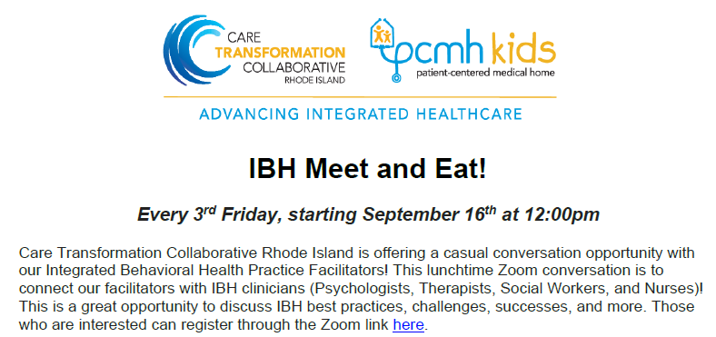
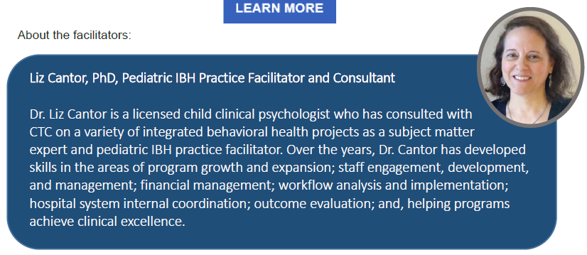
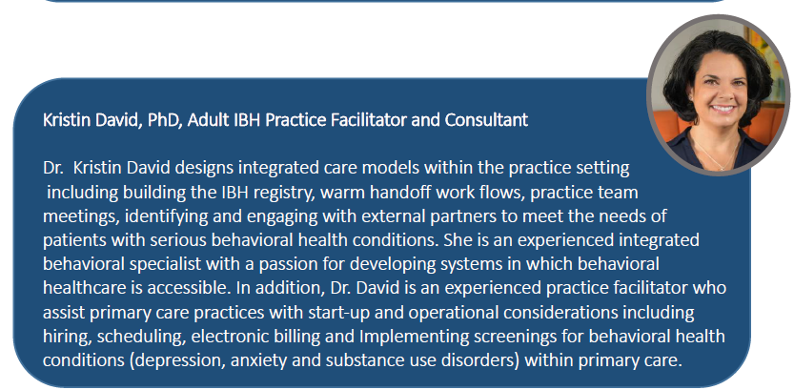
Join us every 3rd Friday!
To add this to your calendar, email edwyer@ctc-ri.org and the link will be sent!

Slide 24
NCQA BH Distinction Readiness–
Status Summary
Received NCQA BH Distinction
Ready to Apply for NCQA BH Distinction
Application
Brown Medicine
Aquidneck
CNEMG
Anchor Medical Providence
Continuing to work towards IBH Distinction
(Looking to hire IBH clinician)
Anchor Medical Lincoln
Anchor Medical Warwick
NRI
Barrington
Hasbro

Slide 25
NCQA Y2 Wrap Up
Incentive payment to be sent end of May 2023
Payment is dependent on meeting project requirements, not application submission
CTC-RI contact for stipend: edwyer@ctc-ri.org
Practices will be eligible to receive up to $10,000 infrastructure/incentive financial payments during the funding period as outlined below.
Infrastructure Payment May 2022 ($5,000)
Infrastructure Payment May 2023
($2,500 at completion of learning collaborative, $2,500 at submission of application or action plan)

Slide 26
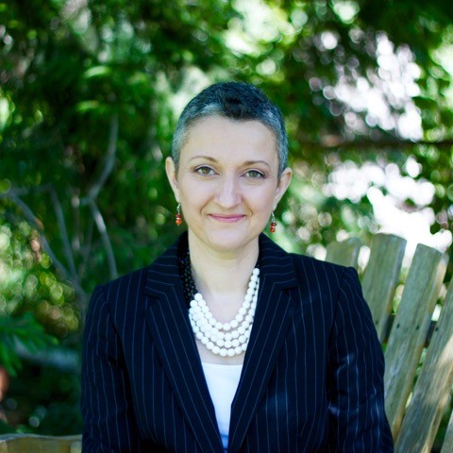
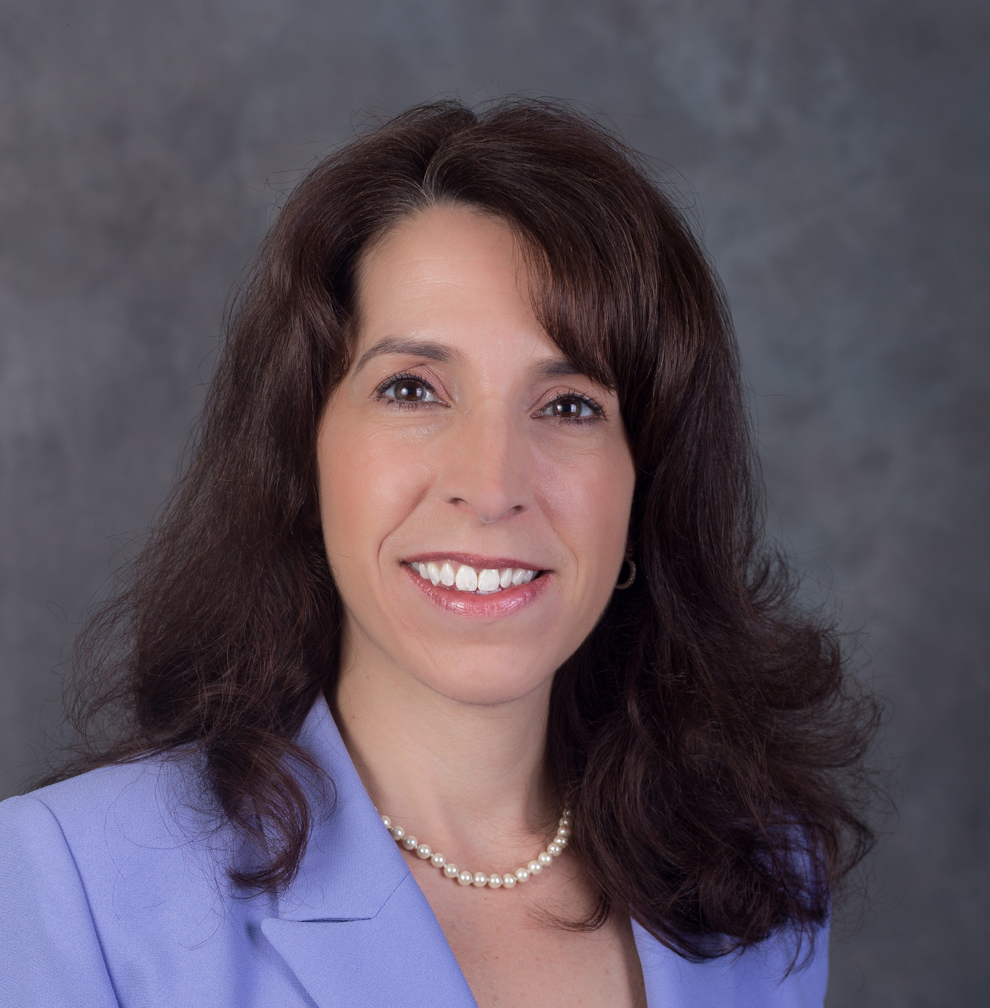
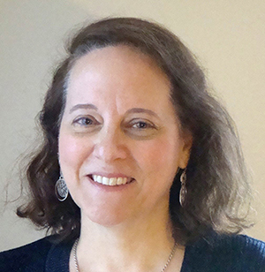

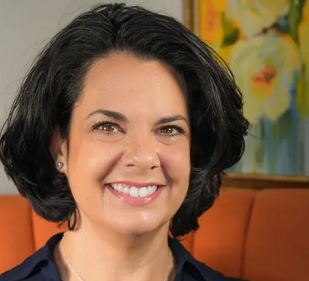
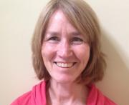
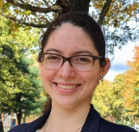

Questions? Contact Us
Nelly Burdette, PsyD
Senior IBH Program Leader
nellyburdette@gmail.com
Linda Cabral, MM
Senior Program Manager
lcabral@ctc-ri.org
Liz Cantor, PhD
Practice Facilitator
liz.cantor@gmail.com
Debra Hurwitz, MBA, BSN, RN
Executive Director
dhurwitz@ctc-ri.org
Susanne Campbell, RN, MS,
PCMH CCE
Senior Program Administrator
scampbell@ctc-ri.org
Kristin David, PhD
Practice Facilitator
drkristindavid@gmail.com
Edyth Dwyer, MPA, MPH
Program Coordinator
edwyer@ctc-ri.org
26

