Slide 1
Clinical Strategy Committee: PCP//Specialist Oversight Update
October 21, 2022

Slide 2
Primary Care/Specialist Collaboration Progress Report & Key Strategic Questions
CTC-RI PCP-Specialist Oversight Committee Charter
Aim: Improve coordination & alignment between primary care/specialists through a multi-pronged statewide approach
Oversee CTC, Lifespan & Integra/Care New England participation in a 2-year commitment to AAMC’s Project CORE/eConsult program
Collaboration with payers to improve access, reduce low value referrals
Engage specialists and other stakeholders in support of multi-payer statewide effort Goal to implement payment policy by Oct 1, 2023
Funding by Health Plans: Unitedhealthcare, BCBSRI, Tufts
AAMC CORE program used – Coordinating Optimal Referral Experience (through enhanced referrals and econsults)
Completed eConsults $35 to PCP/$35 to specialists ($70 total)
Use of EHR eConsult templates; clear clinical question
Specialist replies with recommendations/next steps so PCP can continue managing patient’s care
Replies expected in < 72 hours 4) eConsult not converted to a referral for an in-person visit

Slide 3
Primary Care/Specialist Collaboration Progress Report & Key Strategic Questions
Key Strategic Questions:
How do we best use the statewide multi-stakeholder partnership to improve PCP/specialist alignment and communication?
How can we strengthen and ensure sustainability for the CORE program (enhanced ref/econsults)?
How can we effectively engage health plans and self-insured employers?
Support tactics for PCPs & specialists to optimize patient care:
Solicit input from specialists and PCPs for enhanced collaboration and provider adoption
Develop value statement for econsults with ongoing feedback and education for patients, PCPs, specialists, employers
Define universal referral guidelines and communication tools
Consider development and implementation of specialist scorecards
Create specialist compact agreements where appropriate

Slide 4
Project CORE Goals (AAMC)
By improving communication, coordination and culture between primary care providers and specialists, the CORE model aims to:
Improve timely access to specialty care
Improve quality and experience for patients and providers
Enhance primary care comprehensiveness
Control costs of care
Engage providers and establish a culture of collaboration to increase standardization in care delivery

Slide 5
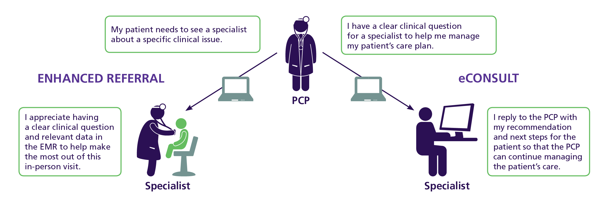
Enhancing Referrals with Point-of-Care Decision Support in the EMR (AAMC)
Problem-Specific Decision Support Through:
Pre-referral evaluation & management guidance
Clear clinical question
Relevant data (tests, labs)
Co-management preference

Slide 6
Implementing CORE eConsults in the EHR (AAMC)
eConsult Overview:
Implemented in EMR alongside the referral workflow
Condition specific templates
Initiated by a PCP to a designated specialist colleague
Typically, straight forward, low-acuity issues (answerable with data available in the EMR)
< 3 business day response
specialist can recommend in-person visit
RVU credit to PCP & specialist for completed eConsult

Slide 7
CORE Implementation at Lifespan CTC-RI Update October 21, 2022
Sent or completed to Date:
eConsults: 10
Engaging clinicians
Enhanced Referrals: 210
Modified preference lists
Phase 2: Nov 2022
Cardiology
Rheumatology
OB Medicine
Concussion
Neurology
Referring PCPs:
LPG Primary Care
TMH/Chapman IM Clinics (Nov)
Coastal Medical (Holding)
Phase 1: June 2022
Pediatric GI
Adult GI
Psychiatry
Notes:
High quality eConsults are:
– Focused questions that a specialist can reasonably answer without knowledge of the patient’s entire medical history
– Answerable using only the information available in the EMR
– Answerable within three business days, without an in-person visit
“It’s an easy, quick way to ask a question to a specialist without feeling like you are placing an undue burden on the specialist. I believe it’s also nice for the patient to get a quick answer on a question that the PCP is unsure about. It offers the patient reassurance and saves them time and money when a seeing a specialist is not indicated.”

Slide 8
EConsults and Enhanced Referral Volume by Specialty
Specialty Department | E – Consults (YTD) | Enhanced Referrals (YTD)
Pediatric GI | 0 | 7
Adult GI | 2 | 186
Psychiatry | 8 | 17
Cardiology
Rheumatology
OB Medicine
Concussion
Neurology
Notes:
High quality eConsults are:
– Focused questions that a specialist can reasonably answer without knowledge of the patient’s entire medical history
– Answerable using only the information available in the EMR
– Answerable within three business days, without an in-person visit
“It’s an easy, quick way to ask a question to a specialist without feeling like you are placing an undue burden on the specialist. I believe it’s also nice for the patient to get a quick answer on a question that the PCP is unsure about. It offers the patient reassurance and saves them time and money when a seeing a specialist is not indicated.”

Slide 9
eConsults
Connecting Primary Care & Specialists

Slide 10
eConsult patrons
Center for Medicare & Medicaid Innovation (CMMI)​
The Peterson Center on Healthcare​
CPC+​
Notes:
In 2020, Arkansas Blue Cross was approached by CMMI and the Peterson Center on Healthcare to participate in a pilot to evaluate the use of eConsults in a commercial population. We were the only payer selected to participate in the pilot, which was and is a high honor.
In partnership with CMMI, we focused on CPC+ practices and once Primary Care First began, we included PCF practices as well. We’ll share more details about the pilot in just a moment.
Throughout the process, though, we saw and still see eConsults as a way to differentiate ourselves in the market.

Slide 11
eConsults concept
The idea:
Eliminate information-sharing barriers between primary care providers and specialists
Facilitate quick and clear consultations between primary care providers and specialists
Make an eConsult a commercially reimbursable service
Notes:
One way we can differentiate ourselves is through consumer experience.
eConsults allows a PCP to communicate asynchronously with a specialist, share clinical details about the patient’s condition, and get clinical guidance from a specialist on how to best treat the patient. Nearly 85% of the eConsults completed during the pilot resulted in the specialist recommending the patient stay in the care of the PCP.
This creates quicker care for the patient because they don’t need to make an appointment with a specialist, which can take months to get. The patient also doesn’t have to take off of work for the specialist visit, nor do they need additional tests or examinations that the specialist would have completed.
Instead, the PCP is able to contact the patient and advise them of their care plan based on the clinical guidance provided by the specialist.
So, the pilot sought to determine if eConsults could be a reimbursable service for a commercial population.
TURN OVER TO AMANDA

Slide 12
eConsults pilot results
Pilot ended on 7/31/22
1,042 eConsults completed across all payers.
Adding additional clinics to an extended pilot.
Independent evaluation by Mathematica
Formative – November 2022
Summative – March 2023
“The behind-the-scenes consults aren't documented. I like the formal documentation so that it can be referenced later.”
-PCP, health system
One thought she wanted to do a radioactive iodine uptake study on a patient, but decided to seek an eConsult, where an endocrinologist informed her that is an outdated approach, now a simple blood test is all that is needed. She has used this with others and saved health care cost in the process.
-PCP, health system
Notes:
Amanda
Initial pilot ended in July.
1,042 econsults completed across all payers and clinics.
UAMS is continuing to add additional specialties to their EMR platform built alongside CORE.
PCP feedback from the pilot was overwhelmingly positive. We’ve seen a draft of a part of the evaluation that Mathematica is completing. Here are a couple of quotes from PCPs in the pilot.
Post-pilot
Met with 2 more Aledade practices
Allowing peds patients and take advantage of ConferMED’s pediatric specialties.

Slide 13
Value of eConsults
Right
Care
Right
Place
Right
Time
Notes:
Through the value we’ve seen in the pilot Arkansas Blue Cross has recently approved eConsults as a reimbursable service for our commercial population in 2023. We truly believe right care, right place, and the right time is the mantra of eConsults.
Specialists and PCPs alike will be able to utilize eConsults through the work that CORE has done in Arkansas at our academic health system and through our work with independent providers.
NOTES FOR QUESTIONS IF NEEDED
Commercial reimbursement approved on 10/18/22
Billable codes
99451 (specialist)
99452 (PCP)
Suppress cost share on eConsults where allowed (e.g. HDHP plan cost share cannot be suppressed due to IRS regulations

Slide 15
Patient Centered Medical Home Pilot (2010)
Episodes of Care (2012)
State Innovation Model (2013)
Comprehensive Primary Care Initiative (2012)
Patient Centered Medical Home (2014)
Comprehensive Primary Care Plus (2017)
Primary Care First (2020)

Slide 16
Northwest
Arkansas
Journey to Value Based Care

Slide 18
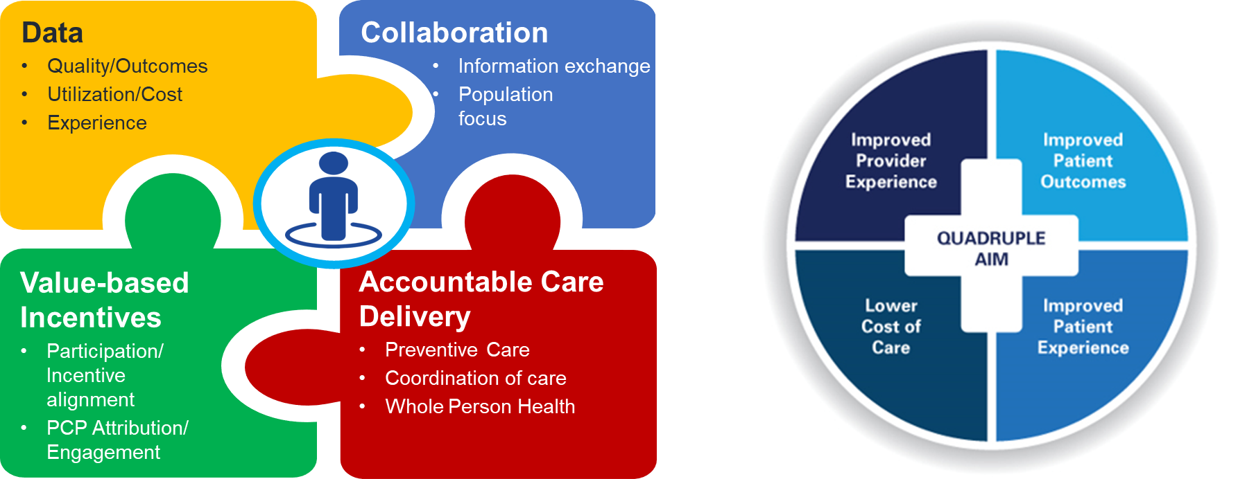
VBP Design → Outcomes

Slide 19
Stakeholders
Employer groups
Healthcare providers
Community leaders/partners
19

Slide 20
NWA Value-based Healthcare Coalition
Goal development & strategy
VBP design
Quality Committee
STEERING COMMITTEE ARCHITECTURE
ASO participation agreement signed by J.B. Hunt, Walmart and Tyson Foods
NWA providers agreed to include ASO lives in existing CHI models
Stakeholders meet quarterly, face-to-face
PCP alignment / benefits design
Performance monitoring
Health coaching

Slide 21
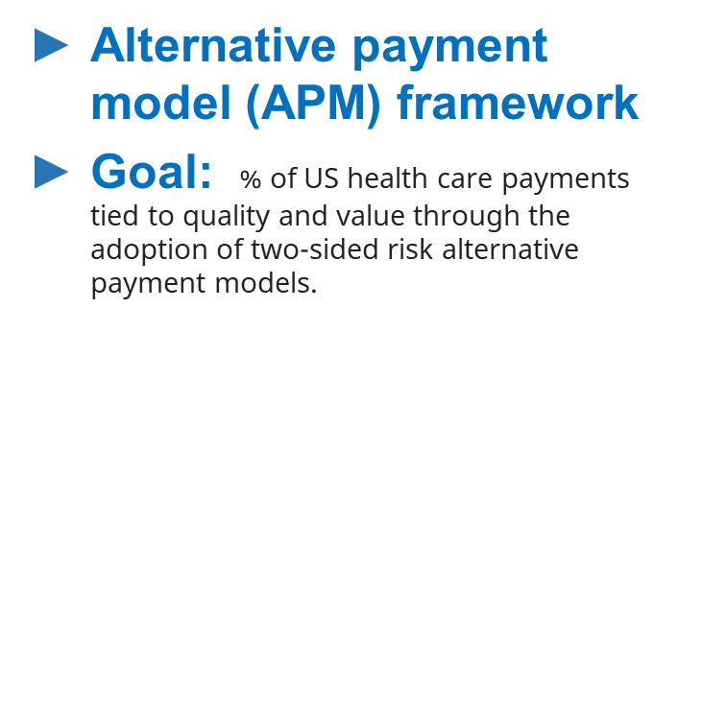
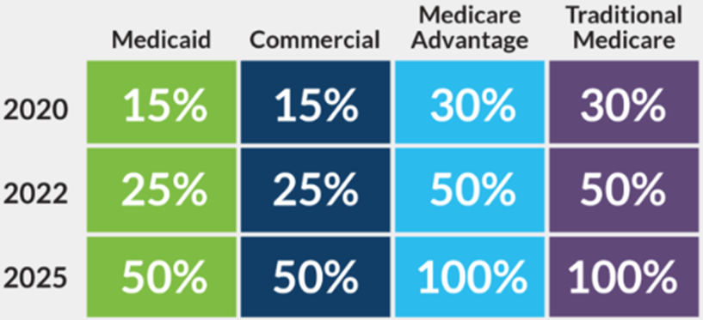
HCPLAN APM

Slide 22
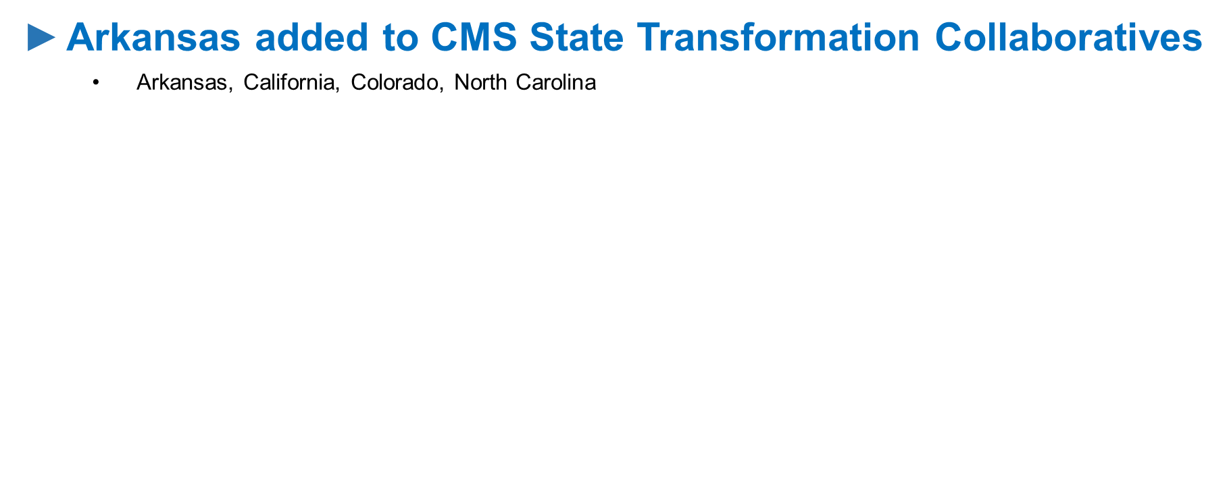
State Transformation Collaborative

Slide 23
NWA
Behavioral Health strategy

Slide 24
What is working well in NWA- BH?
Community Collaboration/ support
Resources through HARK tool and referrals that get people solutions
School’s willingness to help
Community Clinics within the Hispanic community
Great training programs for social work, community health workers and the psychology field
The fact that overwhelmed and overstretched providers still show up everyday for those who most need their services
Three words:
community, collaboration & commitment
NWA Behavioral Health Strategy
Stakeholder responses
June 9, 2022

Slide 25
Biggest BH challenges in NWA Categories
Workforce
Stigma/Barriers/Discrimination/Equity
Resources & Assets
Policy / Payment
NWA Behavioral Health Strategy
Stakeholder responses
June 9, 2022

Slide 26
NWA Behavioral Health Strategy Charter
Goals
Better outcomes
Improved client experience
Lower costs, and
Improved provider experience
The goals will be developed through a concrete understanding of the nodes of influence within the NWA behavioral health landscape. The knowledge gained will facilitate the Collaborative’s decision making process in determining strategic positioning, partnerships, and key strategies in the achievement of the goals.
The key stakeholders in this endeavor will include community based organizations, educators, employers, law enforcement, payors, policymakers, providers, and other key stakeholders as needed.

Slide 27
NWA Behavioral Health Strategy Charter
Stakeholders
Arisa
Arkansas Behavioral Health Integrated Network
Arkansas Blue Cross and Blue Shield
Arkansas Children's Hospital
Arkansas Crisis Center
Arkansas Medicaid
Blue & You Foundation
Bella Vista Fire & EMS Community
City of Fayetteville
Community Clinic
Fayetteville Police
Growing in Healing
HARK
Marshallese Educational Initiative
Mercy Hospital
Northwest Arkansas Council
Northwest Health System
Rogers Fire Department
SHARE- HIE
Springwoods Behavioral Health
The Joshua Center
UAMS NWA
University of Arkansas Psychology Dept
Washington Regional Medical Center
Whole Health Institute
Community Health workers

Slide 28
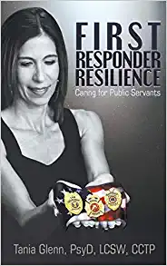
Multi- StakeholderCommunity
Training
Peer Support Training
Tania Glenn, PsyD, LCSW, CCTP
September 20th & 21st @ the Rogers Fire Department
Sponsored by NWA Council & Arkansas Blue Cross and Blue Shield
Fire Department, Police, EMT, Hospital staff, Social and community workers etc..
Overall Objective
The overall objective of this course is to arm public safety professionals with the knowledge and tools to mitigate critical incident stress and burnout in fellow employees, as well as to assist them with daily stressors.

Slide 29
Healthcare Innovation

Slide 30
Arkansas Blue Cross and Blue Shield Healthcare Innovation Lab
Collaboration to achieve creative healthcare solutions for better health, better care, better cost and burden reduction
Multi-disciplinary teams
Community engagement
University of Arkansas
30

Slide 32
