Slide 1
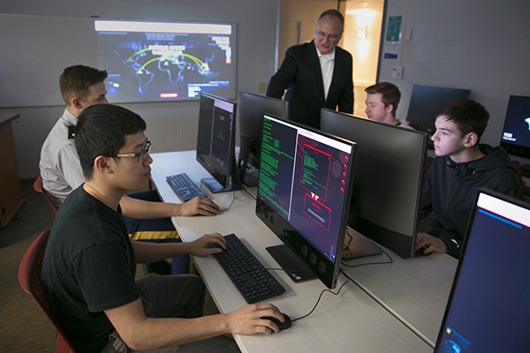
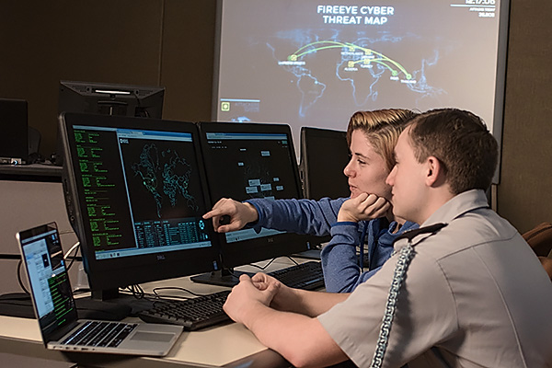
Teaching Ethical Car Hacking to K-12 Students Dr. Bryson Payne, Director & Professor GREM, GPEN, CEH, CISSP NICE K12 Cybersecurity Education Conference December 10, 2019

Slide 2
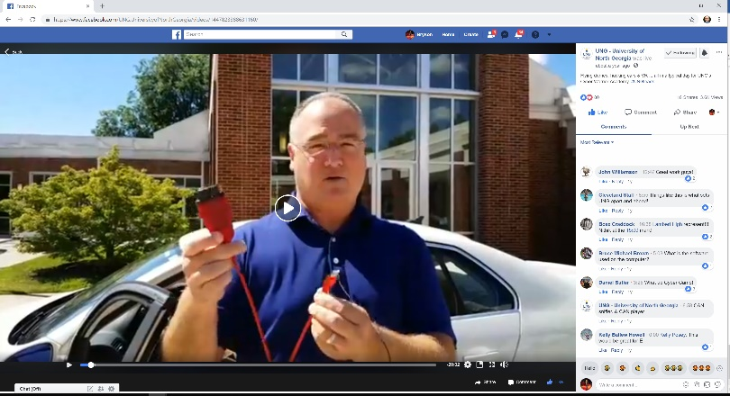
Why Teach Car Hacking?
Internet-connected and self-driving cars have become more commonplace – “datacenters on wheels”
Highly publicized hacks against production cars in the news
Securing smart cars is matter of public and individual safety
Integrates well into an ethical hacking/forensics/cyber course or program of study, across all 7 NICE CWF categories

Slide 3
What is Ethical Hacking?
Ethical Hacking: Testing systems for weaknesses with explicit permission from the owner
Often uses the same tools attackers use to find and exploit vulnerabilities: Kali Linux, Metasploit, and multiple platforms
Practical, useful, hands-on; Usually includes recommending fixes and improvements to secure (or harden) systems and networks
Provides the why answer to cyber hygiene like good passwords, applying updates, keeping good backups, etc.

Slide 4
Cars: Our Biggest IoT Devices
Automobiles increasingly sophisticated – but CAN bus network protocol is largely unchanged since 1991
2016 Ford F150 unveiled at CES: 150 million lines of code?!?!
2019 Tesla Model 3 has 60 ECUs (electronic control units)
Many attack surfaces: Bluetooth, Wi-Fi, 4G LTE, USB, OBD-II
Car hacking shares similarities with hacking other networked (Internet of Things or IoT) devices: network sniffer, open-source tools, reverse engineering

Slide 5
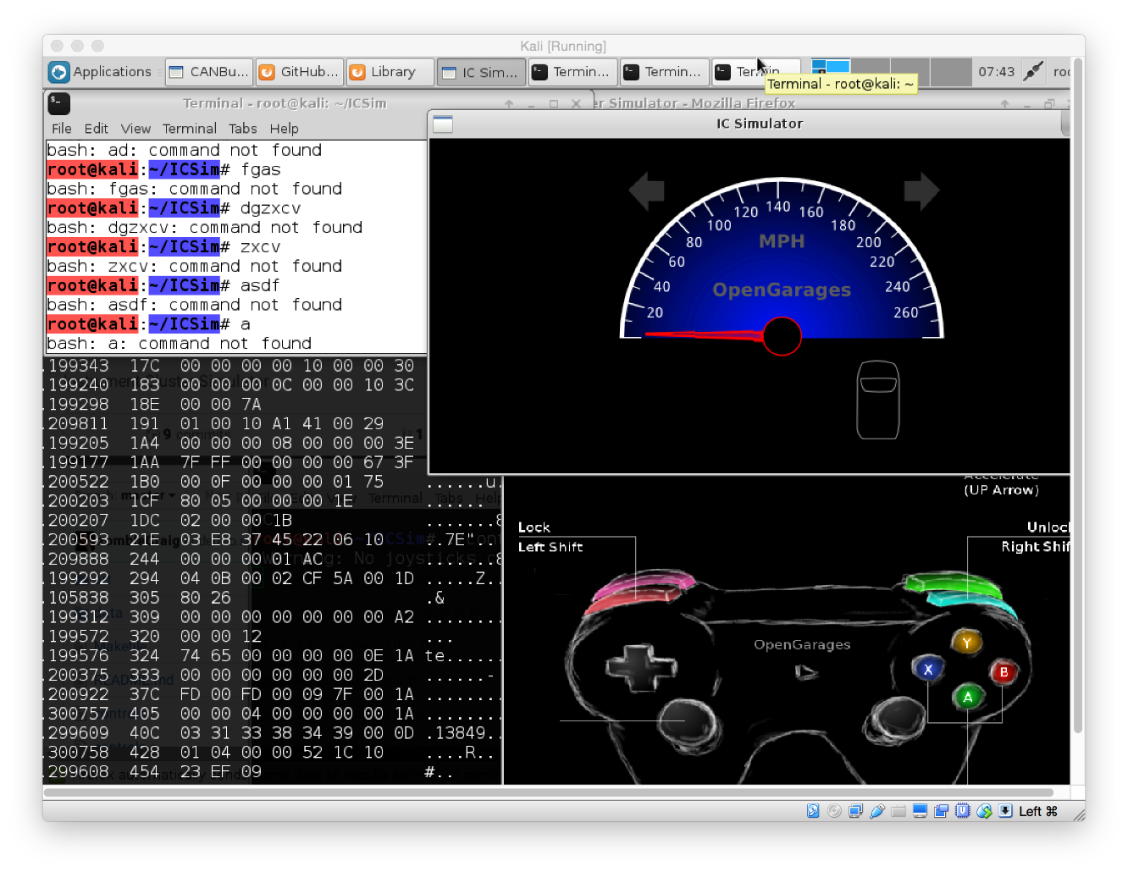
Open-Source Toolkits for Car Hacking
CAN Utilities (can-utils) included in some Linux distros
Instrument Cluster Simulator (ICSim) from OpenGarages.org
Easy to set up on Kali Linux (used in other ethical hacking, forensics, and cyber courses) or Ubuntu/other Linux desktop

Slide 6
Implementation (4 lines)
Virtual machine running Kali Linux (VBox, VMware)
Dependencies:
sudo apt-get update sudo apt-get install libsdl2-dev libsdl2-image-dev sudo apt-get install can-utils
Install ICSim:
git clone https://github.com/zombieCraig/ICSim.git

Slide 7
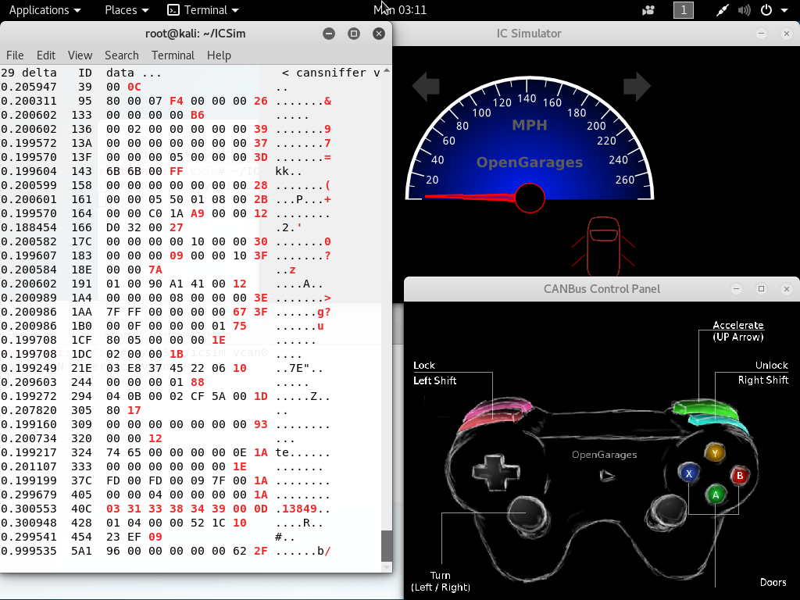
Implementation (cont)
Prepare Virtual CAN Network:
sh ICSim/setup_vcan.sh
Verify vcan0 network link:
ifconfig
Run ICSim in three terminal windows:
❶ ~/ICSim/icsim vcan0 ❷ ~/ICSim/controls vcan0 ❸ cansniffer -c vcan0

Slide 8
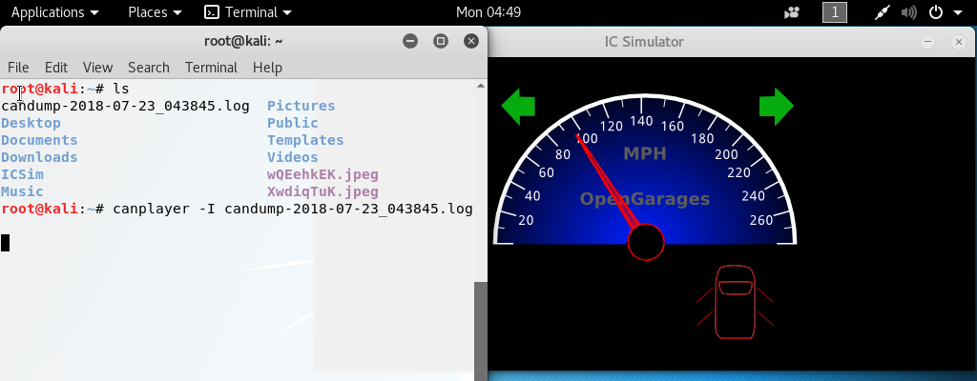
Replay Attack
Replay attack is classic, works on IoT devices
Capture CAN bus packets:
candump -l vcan0 {-l is lowercase “L” for ‘log’}
Replay CAN bus packets:
canplayer -I candump-2018-07-23_083845.log
Turn off controller window, ICSim will run from log data – can simulate unlocking doors while driving 95 MPH with brakes!

Slide 9
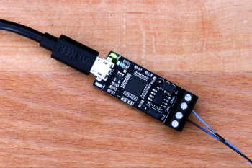
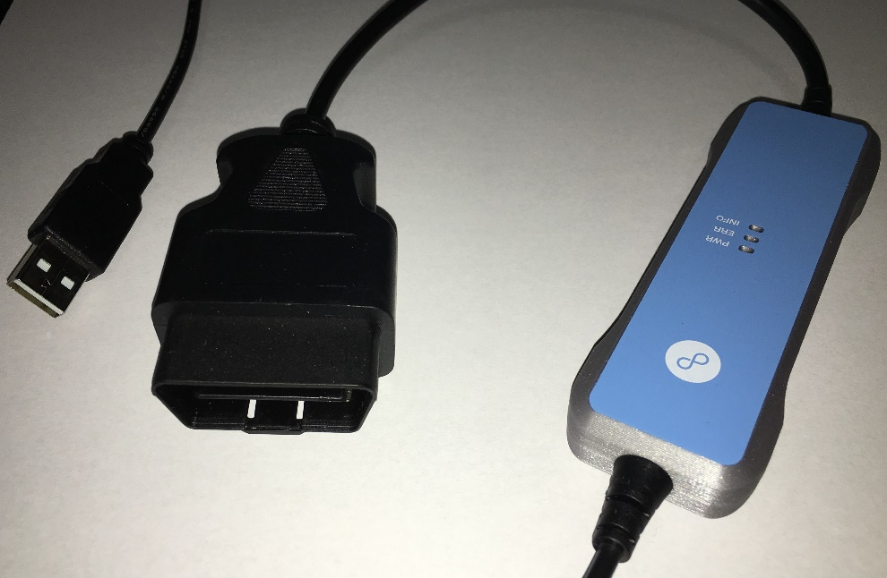
Car Hacking on a Real Automobile
Cheapest: CANable $29.95 – shown here-> from canable.io – direct wiring to CAN pins
Less MacGyver-ish and more durable: CANtact ($65) plus OBD-CAN cable ($10)
Best all-in-one: Korlan USB2CAN adapter ($70) from 8devices.com
sudo modprobe can sudo slcand /dev/ttyACM0 can0 sudo ip link set up can0 \ type can bitrate 500000

Slide 10
Conclusion
You can set up free, open-source car-hacking labs for your classes and for your own research
Go to BrysonPayne.com for a shortened/condensed version of these instructions (free)
My new book, Hacking for Kids, comes out in the Spring, on pre-sale in Amazon now ☺ and includes car hacking chapter

