Slide 1
Audio Description
Leveling the visual playing field

Slide 2
Introductions
Rebecca Oling, Director of Digital Accessibility, SUNY Purchase
Stacie Taylor and Brian Edwards of Digital Campus–SWANK
Sarah Brennan Alexander Street (Proquest) Senior Product Manager of Academic Video Online
Michele Spitz “Woman of her Word” AD producer, narrator, sponsor and consultant

Slide 3
What is Audio Description
Sample venues for Audio Description:
live theatre/event
museum/exhibit
movie theatre/streaming/commercials
Hunger Games example
“audio track narrates relevant visual elements”
Types of Audio Description
Standard
Extended
Notes:
Extended doesn’t need to be constrained by the natural pauses of a video

Slide 4
Legal Landscape: Where is Audio Description
ADA 1990
Title II requires AD for public entities
Title III requires AD for places of public accommodation, including private organizations that provide public accommodation
FCC
21st Century Communications and Video Accessibility Act (“CVAA”): any content that airs on television must have captions on the online version. (2010)
2018 Requires top commercial networks and affiliates to provide minimum 50 hours (focused on children’s programming and prime time)
1973 Rehabilitation Act
Sec 504
prohibits discrimination against individuals with disabilities in public or private institutions, programs, or activities that receive federal financial assistance
Agencies must provide auxiliary aids
Section 508 (1998, refresh 2017)
requires federal electronic and information technology to be accessible to people with disabilities, including employees and members of the public.
WCAG 2.0 requires AD for online videos
Notes:
https://www.fcc.gov/audio-description
https://www.accessibilityassociation.org/s/membership
Charter Communications now offers “Spectrum Access”, a new smartphone app—a multi-functioning innovation for accessing film, DVDs, streaming videos and even major performing arts events.
https://beta.ada.gov/web-guidance/

Slide 5
Recent Shifts: Where are we?
2016 Amendment to Title III ADA requires movie theaters to:
Have a specified number of captioning devices and audio description devices
Based on the number of digitally equipped auditoriums
No requirement for theaters that are analog only
American Council for the Blind v. Netflix
EIT Policies and Local/State
NY State Implementing Chapter 219 of NYS Ed Law (2004)
Timely provision of alternate format materials in higher ed setting (shared responsibility of publishers and manufacturers)
Locally SUNY Electronic Information Accessibility
Notes:
FCC Audio Description page (stay tuned in)
Twitter is my best nudge

Slide 6
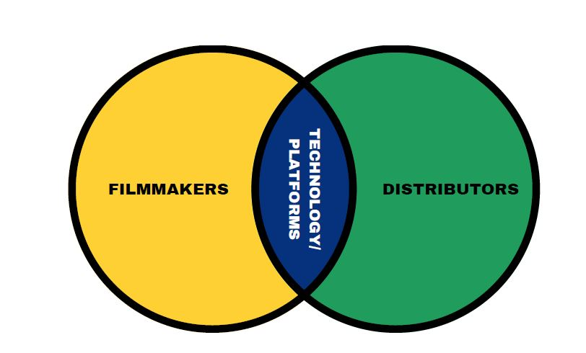
Audio Description in Process
Notes:
Venn diagram showing two interlocking circles for filmmakers and distributors. The overlapping section is marked technology/platform

Slide 7
Initial Stage/Roadmap: Digital Campus (SWANK)
Stacie Taylor and Brian Edwards
Roughly 1500 DVDs and Blu-rays currently with Audio Description (AD) language tracks
Actively acquiring AD digital files from our studio partners
Current systematic limitations exposing AD to users
Digital Campus development roadmap

Slide 8
Efficient/Active Stage: Alexander Street, a ProQuest Company
Sarah Brennan - Product Manager Sr. of Academic Video Online (an academic streaming video database)
We don’t receive audio description from our partners
We react to accommodation requests - use a 3rd party to add AD upon request (at no charge to the library).
We strive for a 2-3 week turnaround time
All AD titles then get added into the database, so they are available to all users, and we are slowly building our library of AD titles.

Slide 9
Michele Spitz “Woman of Her Word”
AD producer, narrator, sponsor and consultant
‘21 Sundance panel “Ensuring Media Accessibility Through AD”
Teaches the Respectability Summer Lab on AD
Many workshops with colleges (upcoming Montclair next spring AD course)
Notes:
A respected leader and a visionary and we are grateful to have her with us today.
Value of AD in the level of classroom ingestion and digestion
Onus is on the distri

Slide 10
Takeaways for Filmmakers
If they don’t design with AD from the start, they need to shop the film around to connect with a distributor who
Might charge fees for subtitles, CC, and AD
Might reduce their outlay by engaging artificial intelligence tech to create the AD track which is likely to be sub par–leading that audience to think the film is awful
Might offload the AD to a sep file or “app” thus separating those with needs

Slide 11
Educating Filmmakers Best Practices
Use Universal Design approach to consider AD from the start
AD can provide another potential creative path
Young filmmakers are encouraged to consider their audiences more widely
Lack of “specialised publications on teaching accessibility and its integration to industry workflows in the context of filmmaking courses” (Lopez 2020)
“Explorations of AD with film students can help boost their analytical skills”

Slide 12
Advocacy Lessons–Keep it simple, Keep at it
Follow leaders on social media
Track needs and speak up
Work within consortia to engage with accessibility best practices
Ensure accessibility in policy documents to help advocacy
Notes:
https://www.acb.org/
Gail Williamson KMR (casting)
Joel Snyder
Danielle Demchick (dpd casting.com and on the board of respectability)
https://www.press.umich.edu/9708722/academic_ableism
https://dcmp.org/search?q=video+books&t=l
https://imaginationvideobooks.org/
https://www.dicapta.com/en/
https://bridgemultimedia.com/about-us/
https://www.fwd-doc.org/

Slide 13
Citations
Franzen, Ricarda. “One Ear on the Stage and One in the Audience? – Audio Description and Listening to Theatre as Dramaturgical Exercise.” South African Theatre Journal, vol. 32, no. 1, Jan. 2019, pp. 48–62, https://doi.org/10.1080/10137548.2019.1614975.
Implementing Chapter 219 of the Laws of 2003. https://www.p12.nysed.gov/specialed/publications/persprep/chap219.htm. Accessed 26 Apr. 2022.
Jay T Dolmage. Academic Ableism: Disability and Higher Education. University of Michigan Press, 2017, https://resolver.ebscohost.com/Redirect/PRL?EPPackageLocationID=2418090.15315533.51193291&epcustomerid=s2947694.
Lopez, Mariana, et al. “Enhancing Audio Description: Accessible Filmmaking, Sound Design and the Importance of Educating Filmmakers.” Media Practice and Education, vol. 21, no. 4, Oct. 2020, pp. 289–304, https://doi.org/10.1080/25741136.2020.1832830.

