Slide 1

Wolf Trap District
Roundtable
September 12, 2024

Slide 2

Pledge

Slide 3
Welcome
New to Roundtable?
Please introduce yourself!

Slide 4
Agenda
Welcome and Pledge
Award(s)
Questions about Read-ahead
Council Announcements
General Announcements
Program
Breakout Sessions
Cracker Barrel/Networking (Optional; NLT 9pm)
Next Meeting: October 10, 2024 - at Thoreau MS, Vienna, VA

Slide 5
District and other Award(s)

Slide 6
Questions/Clarification about Read-ahead?

Slide 7
Council Announcements
Web Site Updates – NCAC is making ‘til 11/1/24 – some downtime
District Changes in my.scouting.org – still being worked
July – Dec – Renewal notices, via email, to registered Adults/Youth
  Bills individual youth/adults both National and NCAC Fees
  Units can choose to pay but will pay every 30-60 days
  Still working on Scholarship processes
  Renewal Aids – Individuals; Unit Coordinators
Key 3 replacement error – my.scouting.org (60 days)

Slide 8
General Announcements

Slide 9

Current 2024 Wolf Trap Calendar
Sep 28, 2024 – Life to Eagle Seminar(In Person), St James Catholic Church, Falls Church, VA
Oct 18-20, 2024 – Fall Camporee, Camp Rock Enon, Gore, VA
Nov 02, 2024 – Scouting for Food (Tags)
Nov 09, 2024 – Scouting for Food (Pick-up)
Nov 10, 2024 – Flags In (Veterans Day), National Memorial Park, Falls Church, VA
Feb 22, 2025 – University of Scouting, Alexandria, VA
Mar 08, 2025 – WTD MB Day, Fairfax Presbyterian Church

Slide 10
STEM
09/07/24 – Scouts BSA STEM MB and NOVA Workshop, Fredricksburg, MD
NCAC STEM contact is Bruce Donlin (bruce.donlin@scouting.org; 240-395-0601)
Ancient Earth: Birth of the Sky (on PBS) - link
Anytime – DC STEM Trek- Showcases 24 government agencies, private organizations and monuments related to the tenets upon which STEM is based. Two hikes - 10.57 miles, or 4.75 miles
Ancient Earth: Birth of the Sky (on PBS) - link
Anytime – DC STEM Trek- Showcases 24 government agencies, private organizations and monuments related to the tenets upon which STEM is based. Two hikes - 10.57 miles, or 4.75 miles

Slide 11
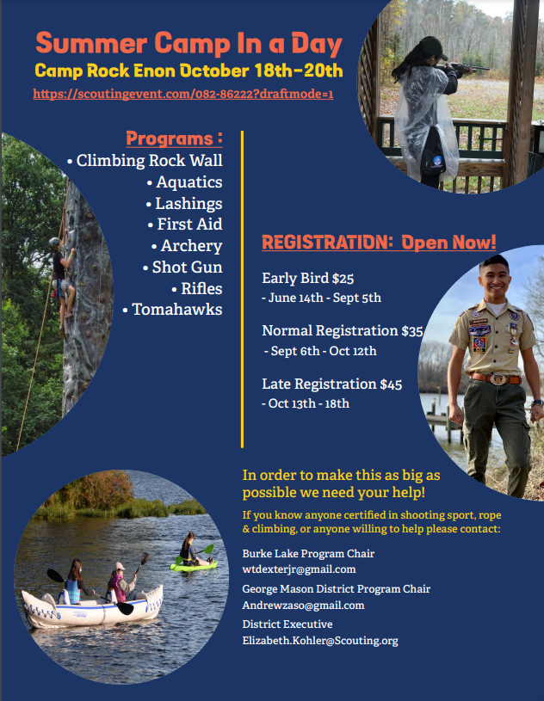
Fall Camporee

Slide 12
Breakout Sessions

Slide 13
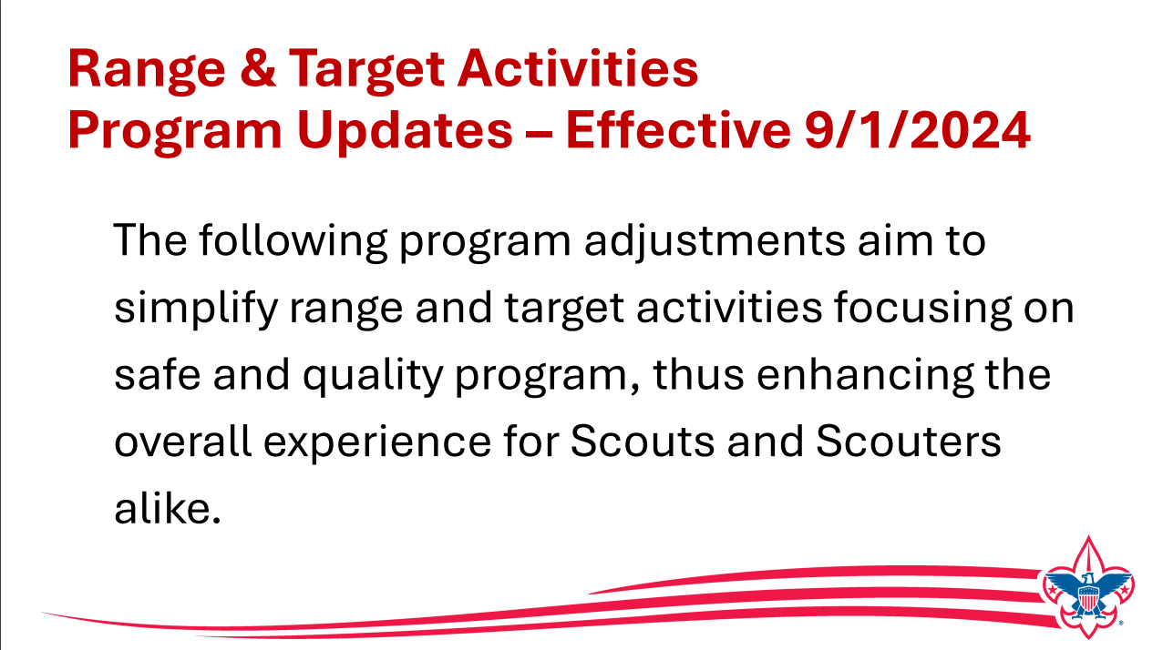

Slide 14
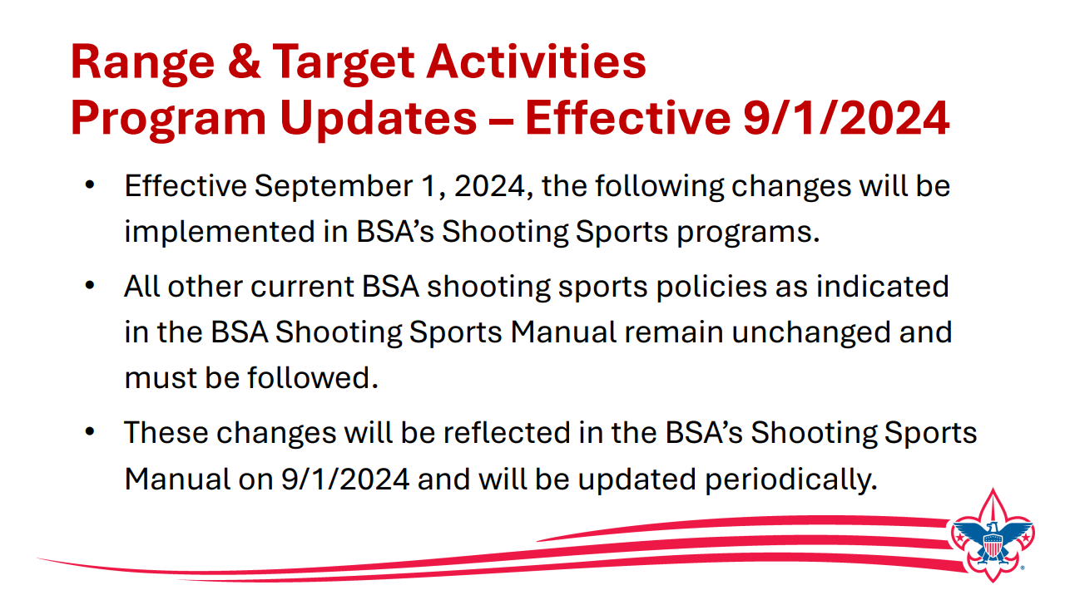

Slide 15


Slide 16
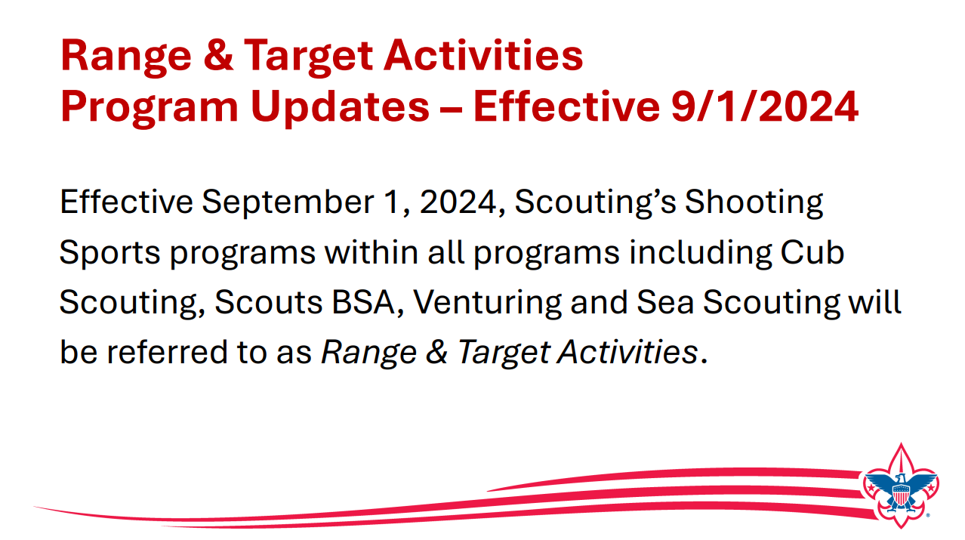

Slide 17
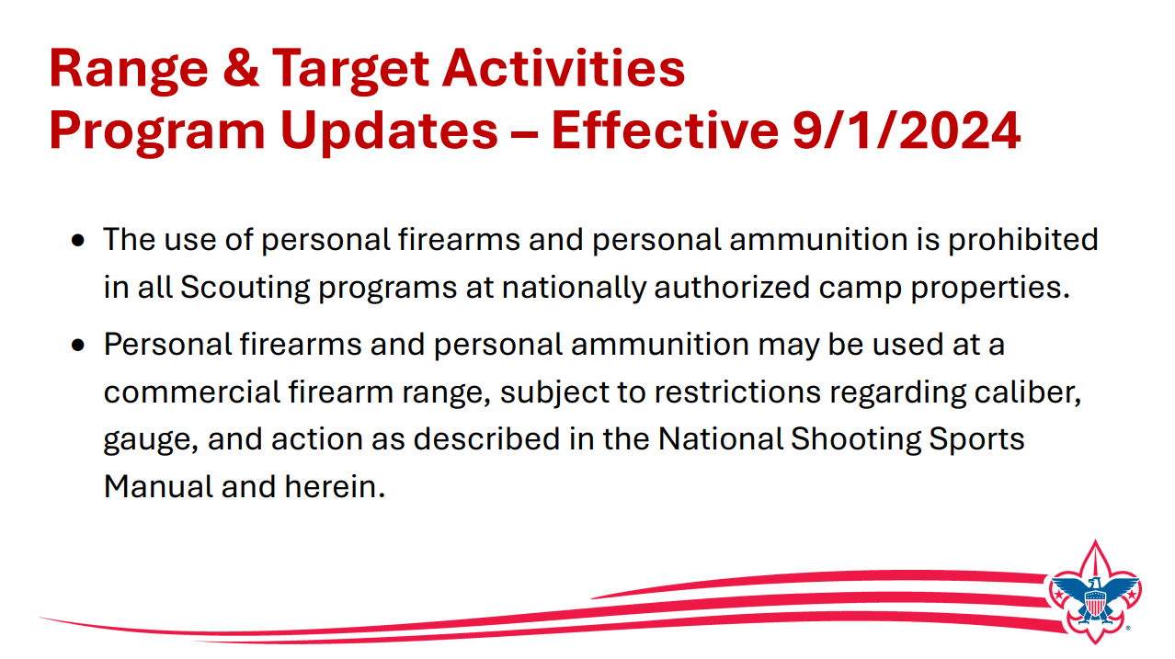

Slide 18
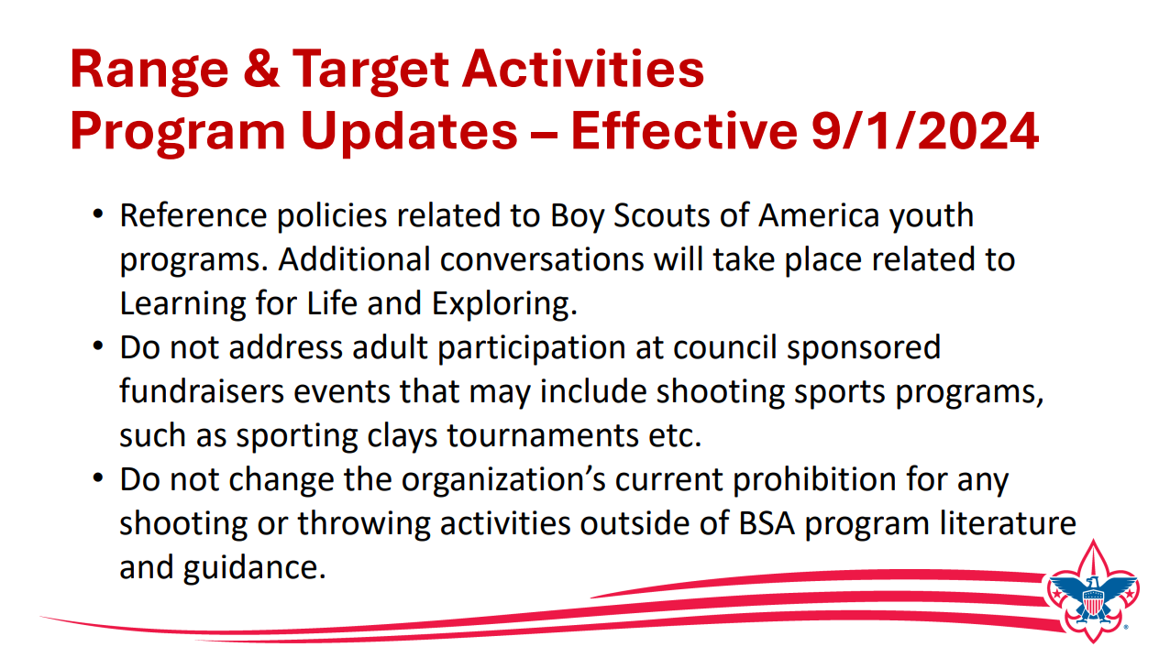

Slide 19
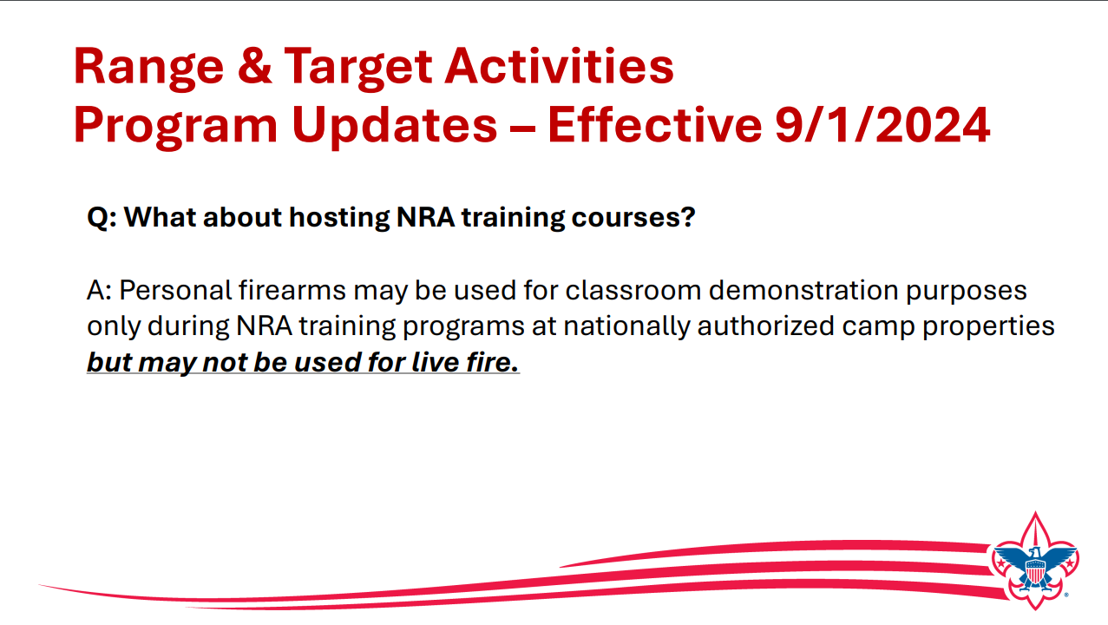

Slide 20
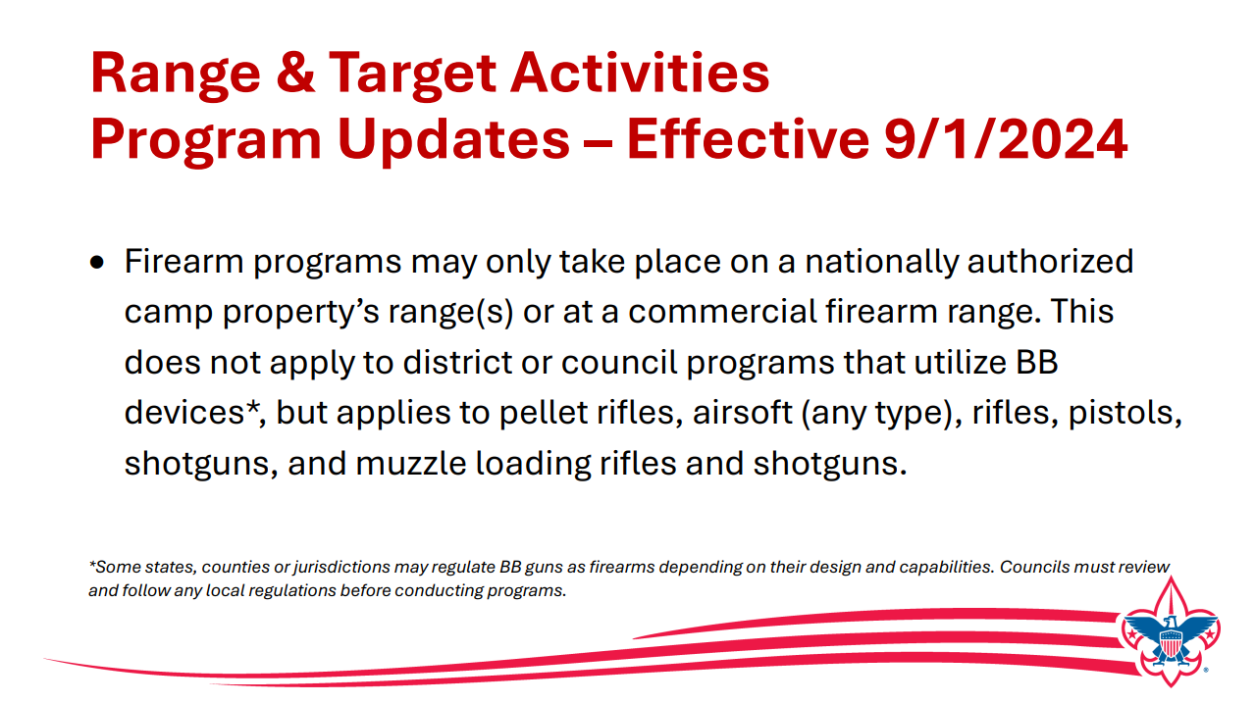

Slide 21
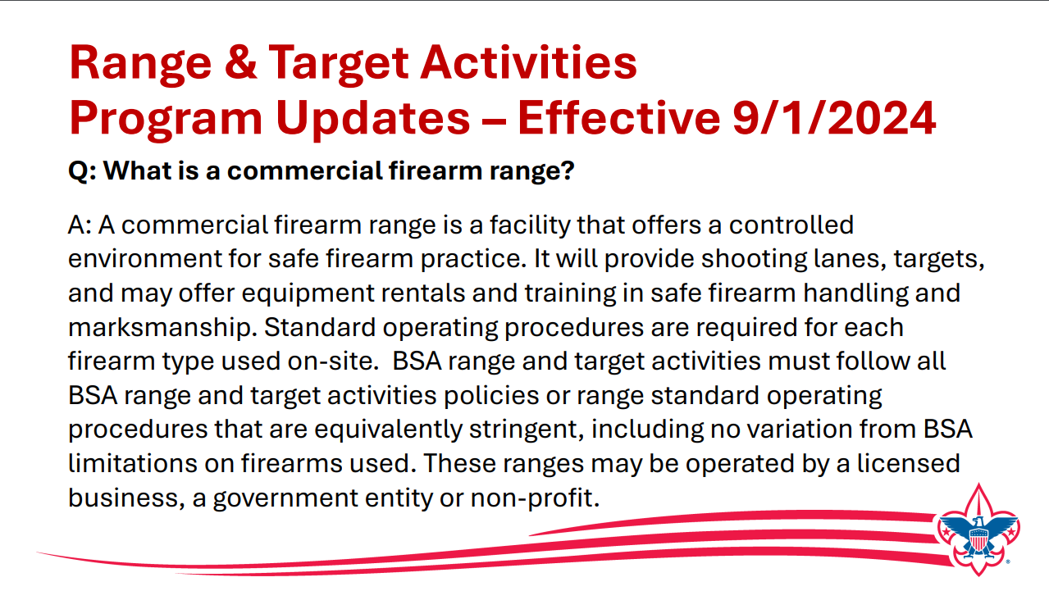

Slide 22
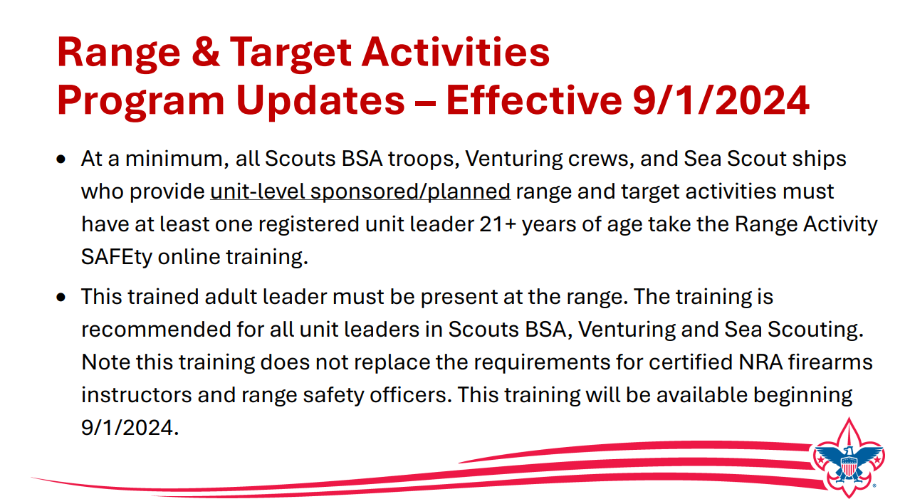

Slide 23
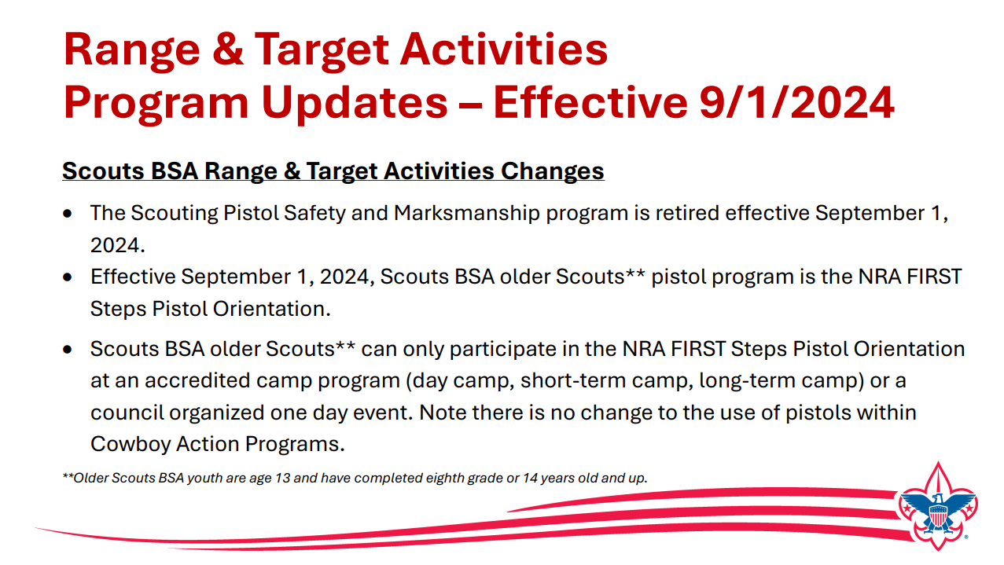

Slide 24
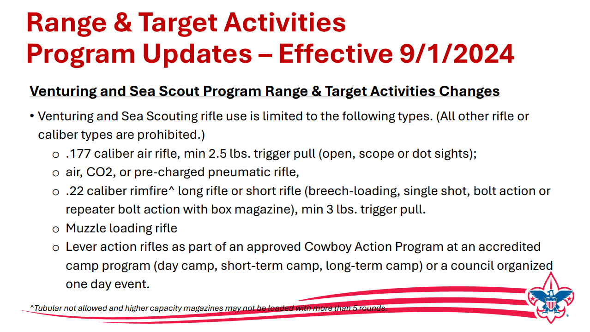

Slide 25
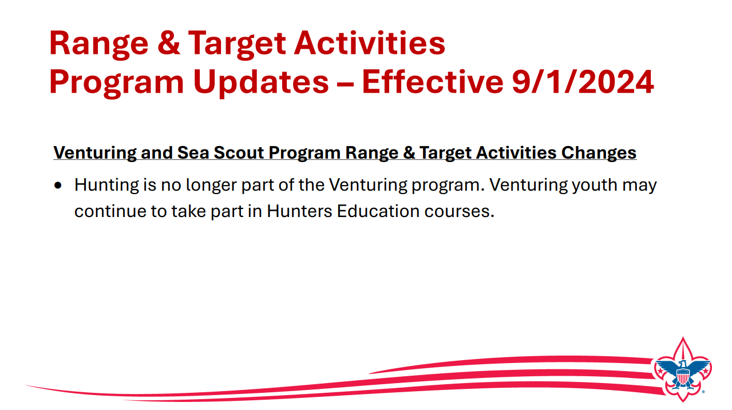

Slide 26
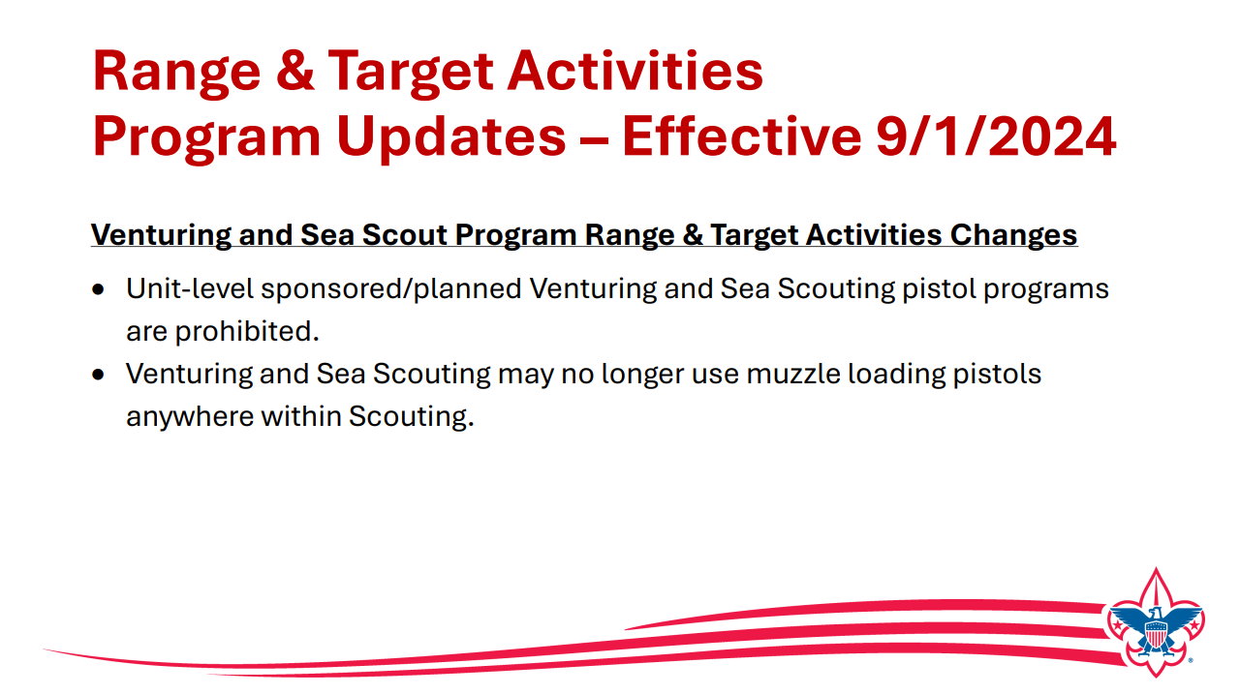

Slide 27
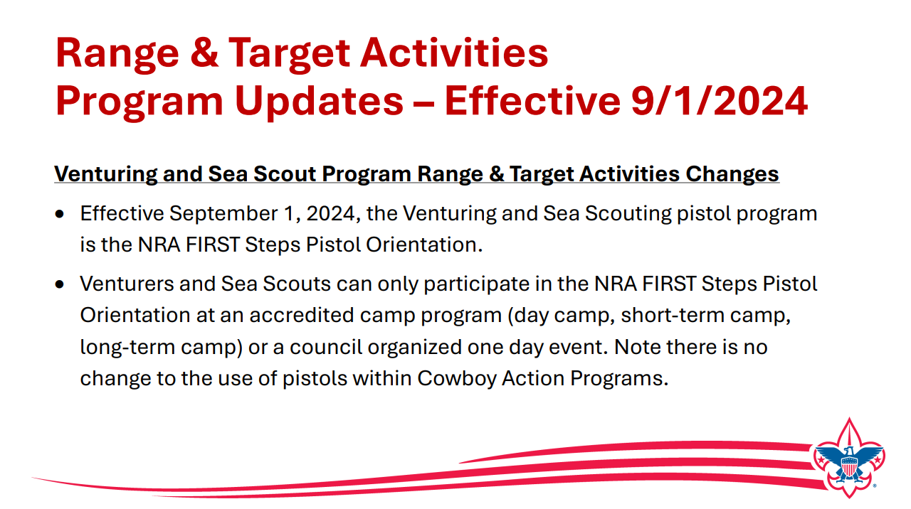

Slide 28
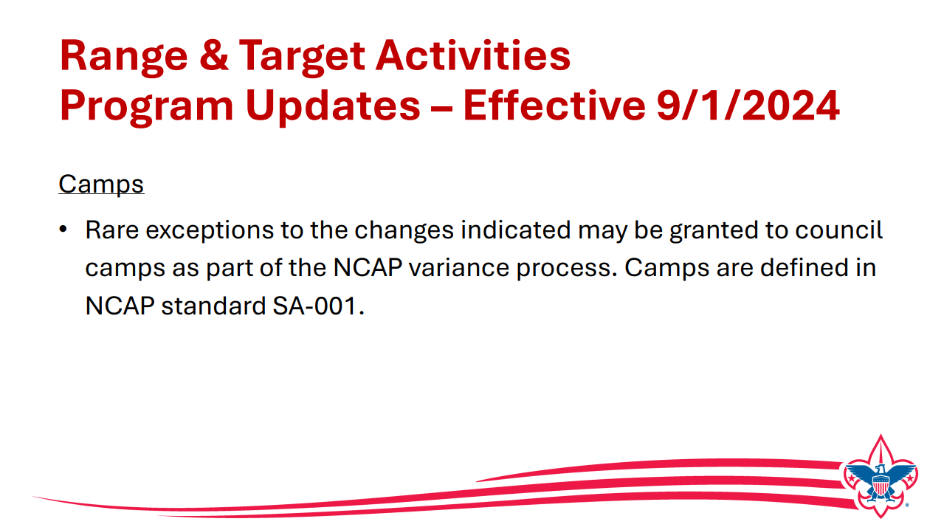

Slide 29
Positive Aspects of Range and Target Activities
Range and target activities are part of the Olympic and Paralympic Games.
Range and target activities do not require participants to start at an early age to be successful.
Age does not seem to be a factor in learning range and target activities.
Range and target activities are for everyone.
Range and target activities may be featured as both a winter sport and a summer sport.
Range and target activities may offer individual participation, team participation, or both at the same time.

Slide 30
Positive Aspects (cont.)
Students who have participated in range and target activities report a marked improvement in their ability to concentrate when they apply the principles of these sports to their academic pursuits.
Range and target activities have a reputation for high sportsman.
People with physical disabilities can compete at high levels of competition in range and target activities.
College scholarships are awarded in range and target activities.

Slide 31


Slide 32
Other Resources
  Guide to Safe Scouting with changes indicated
  Shooting Sports Manual(will be updated periodically)
  Shooting Sports FAQs (will continue to be updated prior to 9/1)
  Stay Informed through the Trail to Adventure Blog (Scroll to bottom of page to subscribe to bi-monthly newsletter)
  Questions ? Email outdoorprograms@scouting.org.

Slide 33
Time for Cracker Barrel
Minutes and slides available on the WTD web site (District Resources, Roundtable). Password is “GMDRT”
Next meeting – Oct 10, 2024, at Thoreau Middle School

Slide 34
Backup Slides

Slide 35
Scouts Deserve a Trained Leader
Wolf Trap Training site: https://www.ncacbsa.org/george-mason/training/
2024
Cub Leader Position Specific (C40)
  Available on-line (117 min),
  09/14/24 – Alexandria, VA, 09/21/24 – Herndon, VA, 11/02/24 – Alexandria, VA; 12/07/24 – Alexandria, VA; 01/11/25 – Alexandria, VA; 02/01/25 – Alexandria, VA; 03/08/25 – Alexandria, VA; 04/05/25 – Alexandria, VA; 05/03/25 – Alexandria, VA
Cub Scout Den Leader Specific (C42)
  Available on-line (125 min)
  09/14/24 – Alexandria, VA; 09/21/24 – Herndon, VA; 11/02/24 – Alexandria, VA; 12/07/24 – Alexandria, VA; 01/11/25 – Alexandria, VA; 02/01/25 – Alexandria, VA; 03/08/25 – Alexandria, VA; 04/05/25 – Alexandria, VA; 05/03/25 – Alexandria, VA
Basic Adult Leader Outdoor Orientation (BALOO;C32) – BALOO consists of two sessions, an online portion (https://my.scouting.org, Menu, My Training, Cub Scouts, Catalog, search on BALOO) that takes 35 minutes and a hands-on overnight session. The overnight sessions are listed below.
  09/28/24 – 09/29/24 – Davidsonville, MD (Email riverhawktraining@gmail.com before registering)
  10/04/24 – 10/05/24 – Huntingtown, MD (Call Chip 808-499-5390 for permission before registering)
  10/05/24 – 10/06/24 – Camp Snyder, Haymarket, VA (Contact vbonifera@yahoo.com before registering)
  10/12/24 – 10/13/24 – Middleburg, VA (email Roger cub-scout-training@powhatan-scouting.org for permission to register)
  11/02/24 – 11/03/24 – Camp Sinoquipe, Winchester, VA (Request permission to attend)
  11/16/24 – 11/17/24 – Lorton, VA (Contact Dominick dscscouting@aol.com for permission to register)
  03/29/25 – 03/30/25 – TBD, VA (Request permission to attend)
  06/14/25 – 06/15/25 – Lorton, VA (Contact Dominick dscscouting@aol.com for permission to register)
Scoutmaster Position Specific Training(S24)
  Available on-line (192 min)
  09/14/24 – Alexandria, VA; 09/21/24 – Herndon, VA; 11/02/24 – Alexandria, VA; 12/07/24 – Alexandria, VA
  01/11/25 – Alexandria, VA; 02/01/25 – Alexandria, VA; 03/08/25 – Alexandria, VA; 04/05/25 – Alexandria, VA; 05/03/25 – Alexandria, VA
Introduction to Outdoor Leadership Skills (IOLS; S11)
  09/09/24 & 09/14/24-09/15/24 – Zoom and Camp Snyder, Haymarket, VA
  10/04/24 – 10/05/24 – Huntingtown, MD (Call Chip 808-499-5390 for permission before registering)
  10/05/24 – 10/06/24 – Camp Snyder, Haymarket, VA (Contact lozanoreng@gmail.com before registering)
  10/12/24 – 10/13/24 – Middleburg, VA (Call Walt 703-599-5667 for permission to register)
  11/16/24 – 11/17/24 – Lorton, VA (Contact Dominick dscscouting@aol.com for permission to register)
  06/14/25 – 06/15/25 – Lorton, VA (Contact Dominick dscscouting@aol.com for permission to register)
Back Country Outdoor Leadership Skills (BCOLS) - 09/21/24 (Alexandria, VA) & 10/19/24 – 10/20/24 (Markham, VA)
Miscellaneous:
Climbing Level 1 Instructor Training
Sept 7-8 at Great Falls Park, 7:30 AM to 5:00 PM. Details
Sept 21-22 at Sugarloaf Mountain, 8:15 AM to 5:00 PM. Details
Outdoor Ethics/Leave No Trace (D78)
Outdoor Ethics Newsletter
09/30/24 & 10/05/24, Leave No Trace, Germantown, MD
10/19/24 – Outdoor Ethics Orientation Course, Brandywine, MD
10/19/24 – Outdoor Ethics Guide, Brandywine, MD
Scouterhorn Operations Training
10/19/24 – Camp Snyder, Haymarket, VA
11/16/24 – Camp Snyder, Haymarket, VA
Trainer’s Edge (H96)
09/10/24
12/07/24
University of Scouting
02/22/2025, Alexandria, VA (2024 Course Materials available on Basecamp)
Wilderness First Aid/CPR/AED (N02)
09/28/24 – 09/29/24 – Camp Snyder, Haymarket, VA
10/26/24 – 10/27/24 – Camp Snyder, Haymarket, VA
11/23/24 – 11/24/24 – Camp Snyder, Haymarket, VA
12/14/24 – 12/15/24 – Camp Snyder, Haymarket, VA
Wood Badge (A90)
09/13/24 – 09/15/24 – Camp Snyder, Haymarket, VA
Youth Protection Training (YPT)
Online (72 minutes)
2025
BCOLS:
Spring: 03/01/25 & 4/26-27/25
Fall: 09/20/25 & 10/18-19/25
Trainers Edge: 08/09/25 & 12/06/25
University of Scouting: 02/22/25
Wood Badge:
Spring: 4/4-6/25 & 5/3-4/25
Fall: 09/12-14/25 & 10/4-5/25

Slide 36
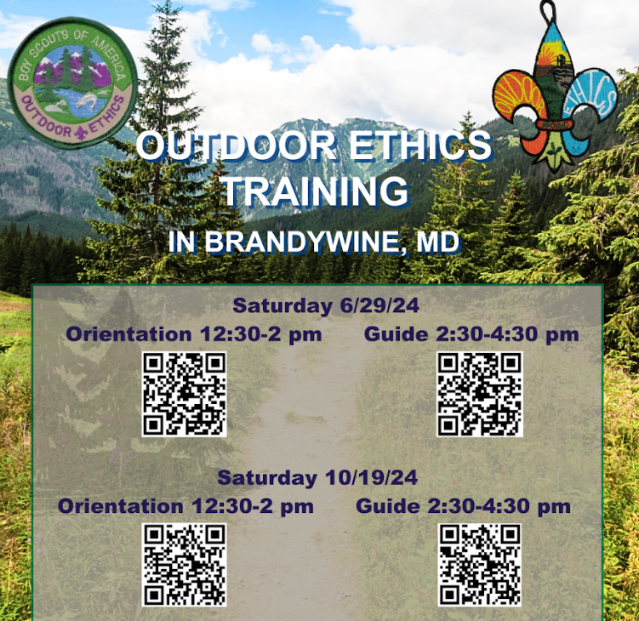
Outdoor Ethics

Slide 37
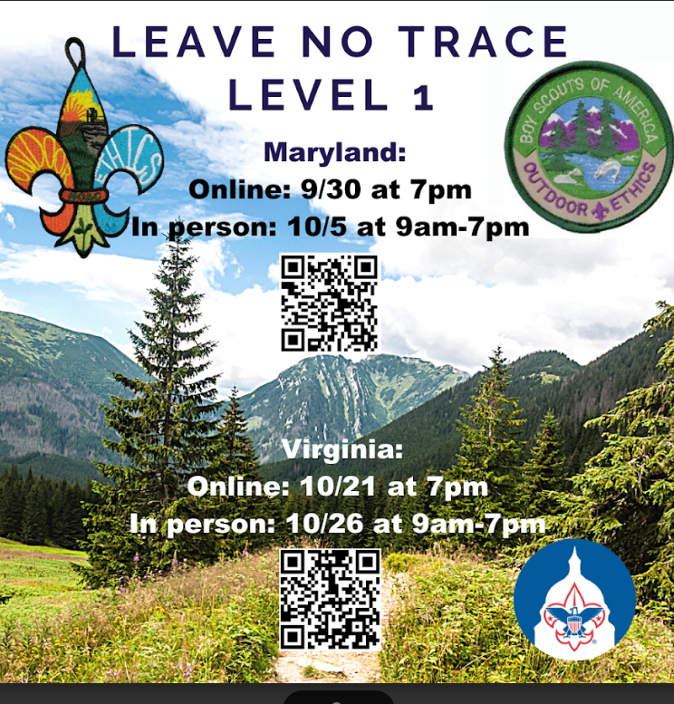
Leave No Trace

Slide 38
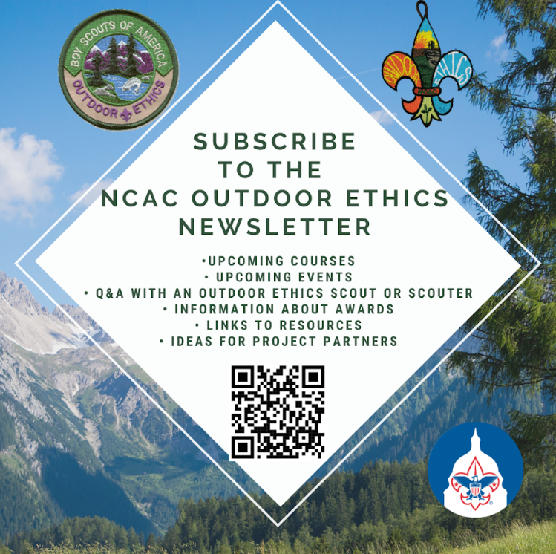
Outdoor Ethics
Newsletter

Slide 39


Merit Badges
The online Merit Badge Counselor registration.
New Merit Badge Counselors must complete online merit badge counselor training, in addition to YPT. Be sure the counselor uses his/her legal name – no nicknames.
Merit Badge Counselors, or the unit Dean/Leader, also need to scan and send Margee the Merit Badge application form listing the badges the counselor is applying to teach and providing a justification of his/her qualifications.
Youth Protection Training is the essential first step. Don’t hit “send” on the application without it!
Contact Margee if you have questions at GM.MB.Dean@hotmail.com.
Did you know:
The National Council does not limit the number of merit badges a youth may earn from one counselor, though a unit leader is permitted to do so, as long as the same limit applies to all Scouts in the unit. Ideally, Scouts should work with a variety of adults. (GTA 7.0.0.3)
Partial Merit Badges have no expiration except the Scout’s 18th birthday. (GTA 7.0.3.3)
Due to the BSA policies related to Youth Protection and two-deep leadership, a merit badge counselor must have another adult present during all merit badge counseling sessions. However, the parent or legal guardian of the Scout may serve as the second adult. This parent or legal guardian does not have to be a registered leader.
If the requirements for a merit badge differ between the merit badge pamphlet and the current edition of Scouts BSA Requirements, the requirements in the Scouts BSA Requirements book supersede all others.

Slide 40

GM High
Adventure
Members of the High Adventure Committee are available to assist units in planning and training for their upcoming high adventure trips – Contact Brian Heath for more information
Important notes for this month
  Registration for BSA’s high adventure bases - https://www.scouting.org/outdooradventures/open4adventure/
    2025 treks – Registration for all high adventure bases are now open
    2026 treks – Registration for Philmont treks will open this fall
2024 NCAC-Organized High Adventure Trips
  11-12 year old Scout High Adventure Experience - Sept 28-29 - Prince William Forest
  Joshua Tree with Climbing Committee - Winter Break 2024/25 (Gathering interest)
2025 NCAC-Organized High Adventure Trips
  Sawtooth Mountain, ID Trip - 06/21 to 06/29/2025 - $1,385 per person – Ask for details
High Adventure Preparation Training
  Back Country Outdoor Leadership Skills - Virginia session
    Fall 2024: 9/21/2024 (classroom), 10/19-20 (overnight) - Registration Link
Other Training
  Paddle Craft Safety Training: Aug 24-25, Sept 7-8
National High Adventure Base Quick Links
  Philmont: https://www.philmontscoutranch.org/register/
  Northern Tier: https://www.ntier.org/provisional-scout-connections/
  Sea Base: https://www.bsaseabase.org/scouts/scout-connections/
  Summit: https://www.summitbsa.org/registration/scoutconnections/
Other High Adventure Bases
  Adirondack High Adventure Area: https://public.3.basecamp.com/p/hLgsVbk7Suju6cuDzQQJaEn4
  Maine High Adventure Area: https://www.mainehighadventure.org/
  Montana Outdoor High Adventure Base: https://montanabsa.org/camps/high-adventure/
Other useful links for high adventure information and opportunities
  NCAC High Adventure website - https://www.ncacbsa.org/high-adventure/
  List of units with available slots in their upcoming high adventure trips - https://public.3.basecamp.com/p/xWpkdrKHKAA9pCzwmHMNdbWb
Sept 2024
Notes:
Sea Base Trip on Jul 29-Aug 3, 2024 - FULL

Slide 41
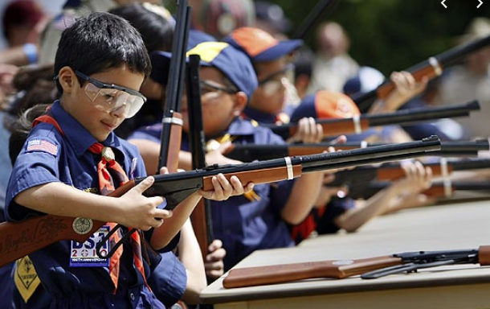
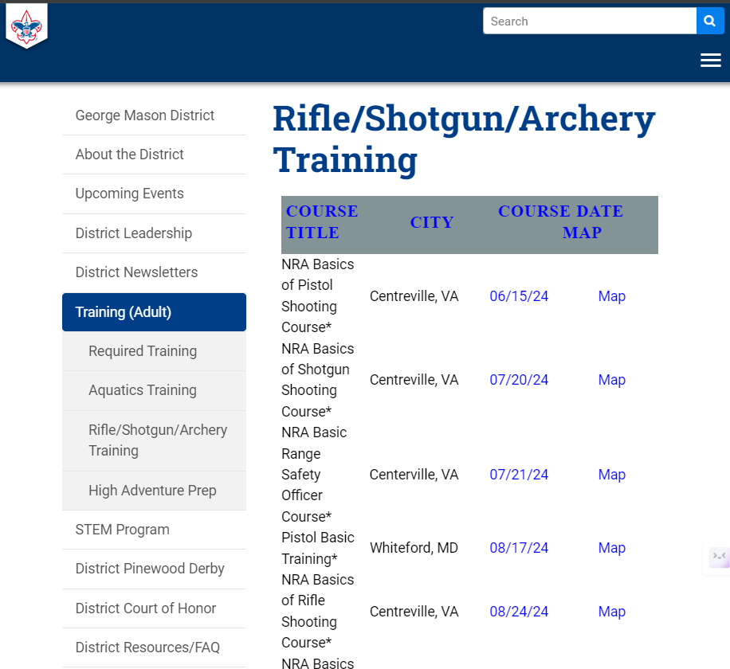
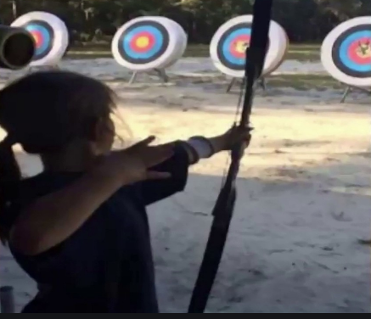
Range and Target Activities
Requests for Shooting Events – Lead Time!
  50+ scouts - 6mos
  Less than 50 scouts - 3mos
Shooting on private land:
  Requirements
  Permissions/protocols
R&TA web page
R&TA Instructor Classes

Slide 42
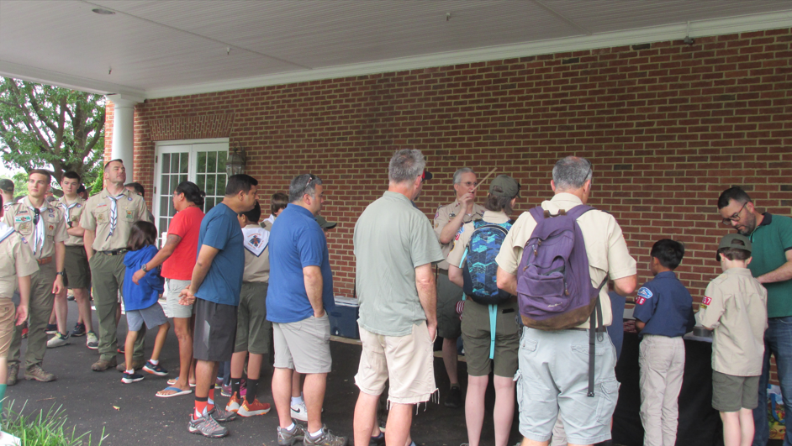
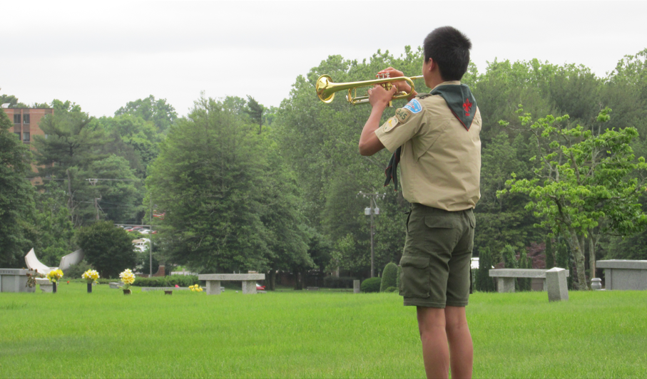
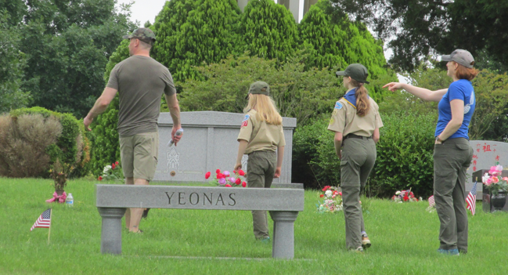
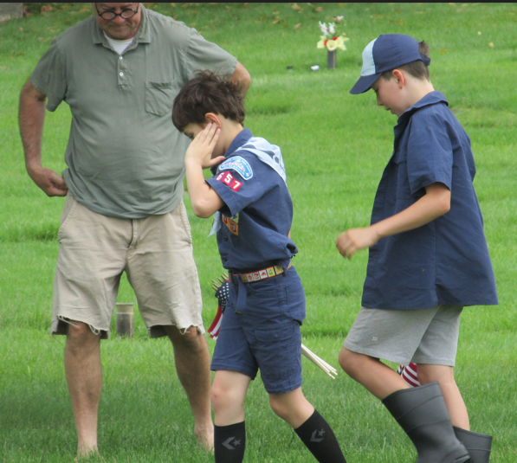
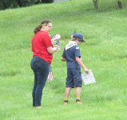
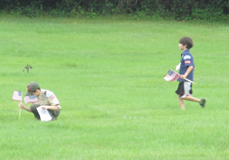
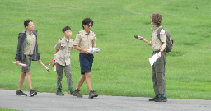
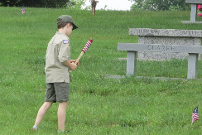
Flags In
Honoring veterans by placing flags on graves at the National memorial Park in Falls Church, VA
Veterans Day (Sunday) – 11/10/24 at 10am

Slide 43
Order of the Arrow
  Brian Fleck is Chapter Advisor.
  2024 Dues can be paid online: https://wipit470.org/dues.html
  Registrations open online https://wipit470.org/index.html under “Events”

