Slide 1
Healthy Tomorrows Quarterly Meeting
February 27, 2023
Care Transformation Collaborative of RI
5/12/2022
Prepared by Care Transformation Collaborative of RI
‹#›

Slide 2
Agenda
Topic | Presenter | Time
Welcome and Review of Agenda | Susanne Campbell, Senior Program Administrator, CTC-RI | 12:00pm - 12:05pm
Team Updates | Hasbro and BVCAP Westerly PAT and Narragansett Bay Pediatrics East Bay Health Center and EBCAP HFA PCHC and Meeting Street | 12:05pm - 12:35pm
RI FV Data and Post program Survey Results | Sara Remington, RIDOH Kim Nguyen-Leite, Program Coordinator, CTC-RI | 12:35pm - 12:50pm
Parent Lead - Learning Collaborative Reflections | Kiana Cruz, Parent Lead | 12:50pm – 12:55pm
Meeting Close and Next Steps | Kim Nguyen-Leite, Program Coordinator, CTC-RI Susanne Campbell, Senior Program Administrator, CTC-RI | 12:55pm - 1:00pm
5/12/2022
Prepared by Care Transformation Collaborative of RI
‹#›

Slide 3
Hasbro and BVCAP
5/12/2022
Prepared by Care Transformation Collaborative of RI
‹#›

Slide 4
Hasbro and BVCAP
Family Experience
Family Information
Child <3 years of age, Up to date on immunizations except for flu and COVID.
FOB is enlisted in military, and has no communication with mom or child.
Previous DV concerns with father of younger sibling, and was occasionally caring for both children. Currently only visiting biological child, outside of the home. Relationship is inconsistent.
Family Visiting Engagement
Family visitor started working with the family in March 2022
Visits take place consistently, at least twice per month.
Family Visiting Support for Family
FV referred to EI. Both children enrolled in Seven Hills EI due to low scoring assessments provided by FV.
FV collaborated with mom to discuss goals.
FV was also able to discuss other possibilities for what would benefit the child during the sedation, such as a dental cleaning. (to be completed at a later date)
Case Conference
Each team was able to stay updated on what’s happening with the family and ways to support the family. Hasbro was able to gain perspective on the child and the relationship with the parent. The family visitor was able to confirm the child’s constant state of activity and the family’s concerns about how to best provide care for the child. Mom is concerned that the child will be turned away from specialists because of his inability to sit still. Hasbro appreciates the insights into this child’s behavior, which helps in understanding how best to support him.
5/12/2022
Prepared by Care Transformation Collaborative of RI
‹#›

Slide 5
Healthy Tomorrows
WPS-PAT-Narragansett Bay Pediatrics

Slide 6
Learning Collaborative Activities
Successful Collaboration of Care
Case Conferences
Communication with identified point person between case conferences
Leveraging the EHR to capture data
Notes:
(Insert cadence and quantity for initial speaking point) This opportunity has given us a path to share information with providers on a quarterly basis and also a as needed basis. When parents enter their visit with providers they are reassured that the provider has most of the information that has been disclosed to the providers and leaves more time for the parents to ask questions and update on and new information necessary. The providers at Narragansett Bay have been open and available to WPS PAT Parent Educators at all times.
This opportunity has given us a path to share information with providers on a quarterly basis and also a as needed basis. When parents enter their visit with providers they are reassured that the provider has most of the information that has been disclosed to the providers and leaves more time for the parents to ask questions and update on and new information necessary. The providers at Narragansett Bay have been open and available to WPS PAT Parent Educators at all times.

Slide 7
Successes and Challenges
Successes
Success #1 PE DK has had great success with providing updated information to NBP about a child who is a patient and is receiving EI services and has started the process for ASD screening. The success of this was seen with the Parent of the child attending a sick visit and was happy to know that the provider had all the updated information about the child's upcoming screenings and testing. This made it possible for the parents to not have to repeat all the information to another party. This was also successful because it allowed the parent to ask questions and receive information from a medical standpoint.
Success #2 MC had great success with supporting a PAT participant and NBP patient during a visit in Dec 2022.
Success #3 NBP has signed a MOU agreement with WPS PAT
Challenges
Challenge #1 Some referrals refused HV services
Challenge #2 Kidsnet not having up to date information on Home Visiting Services
Challenge #3 Team referrals process and HV knowledge

Slide 8
Patient/Family Story
“ Hola mi nombre es RS y vivo en BI yo tenía muchos problemas para atender citas al Pediatra en Hasbro Hospital debido a transportación, cancelaciones en el ferry, horarios etc. Mi Educador de Padres me sugirió que cambiara a mi hijo a NBP. NBP estaba abierto a tomar a mi niño como nuevo paciente muy rápido. PE y personal de NBP me ayudaron a que los reportes fueran transferidos en poco tiempo. Mi PE me acompañó a la primera cita con el pediatra y fue maravilloso ver como el doctor estuvo abierto a que ella atendiera la cita con nosotros, preguntas y respuestas fueron contestadas en mi propio lenguaje y además el doctor nos facilitó tiempo y espacio para que nos reunimos después de la consulta con el.
Hoy me siento segura con los servicios que hoy está recibiendo mi niño por la buena coordinación que hay entre mi pediatra y mi PE.”

Slide 9
Patient/Family Story
Hi, my name is RS, and I live in block island, I used to have a lot of trouble attending my son’s appointments with the pediatrician at Hasbro hospital, due to transportation, ferry cancellations, appointment schedules, etc. in one of our home visits my parent educator suggested that I switch my son to receive care at Narragansett Bay Pediatrics. NBP was open to taking my son as a new patient very quickly, and pat program and NBP supported me in getting my son’s record transferred from Hasbro hospital in a short period of time.
My PE joined us at our first doctor appointment at NBP and the service coordination between her and my doctor was wonderful. Doctor B was open to let her attend our visit, and during this visit, all my questions were answered by the Doctor in my own language. the PE also shared information about my son’s development, and the best of all it was that doctor facilitated time and a space to meet with my PE for our regular pat meeting after the appointment.
After all, I like that NBP supported me when my PE call them to schedule an appointment, retrieve immunization records, etc.
I am so glad that I signed a consent form for care coordination between NBP and the PAT program because I feel confident that I am receiving the services that my son needs.

Slide 10
East Bay Health Center and EBCAP
5/12/2022
Prepared by Care Transformation Collaborative of RI
‹#›

Slide 11
East Bay Health Center and EBCAP
Successes
Two successful case conference occurred
The teams have committed to meeting quarterly to review shared families and strengthen the relationships established through the process.
Staff have been trained on referral process
EBCAP has put together a one-pager for staff with information on the programs and the referral process.
The teams have established a workflow for referrals and a place to document referrals and notes from case conferences.
FV prepared PowerPoint to share with clinical staff.
FV was able to track down historical data on a shared patient.
Set up Microsoft Teams location for referrals and documenting.
5/12/2022
Prepared by Care Transformation Collaborative of RI
‹#›

Slide 12
East Bay Health Center and EBCAP HFA
Challenges
Staffing
Difficulty timing meetings so that a provider can attend
Nowhere to document care coordination in notes
5/12/2022
Prepared by Care Transformation Collaborative of RI
‹#›

Slide 13
PCHC and Meeting Street
5/12/2022
Prepared by Care Transformation Collaborative of RI
‹#›

Slide 14
PCHC and Meeting Street
Successes
PCHC was able to increase communication with the family visiting program through the monthly collaboration meeting between both practices
Point persons were identified for the practice and the family visiting agency
Family visiting program able to present family visiting overview to one of the clinics and provide posters as requested.
Increased referrals
Use of KidsNet to identify families receiving FV. Karla gained login access to all PCHC sites.
5/12/2022
Prepared by Care Transformation Collaborative of RI
‹#›

Slide 15
PCHC and Meeting Street
Challenges
Limited staff at both practices
Not a lot of patients are enrolled in the visiting program from the piloting clinic
5/12/2022
Prepared by Care Transformation Collaborative of RI
‹#›

Slide 16
PCHC and Meeting Street
Patient/Family Story
Family had missed multiple appointments with pediatrician, practice had concerns regarding patient not gaining weight, Family visiting program was able to address barriers to get to appointments, and able to provide education to patient’s mom and reconnect the patient with the pediatrician.
Family visiting program was able to connect patients with different programs such as EI based on information received from the practice.
5/12/2022
Prepared by Care Transformation Collaborative of RI
‹#›

Slide 17
RI Data
Timeframe: July 1, 2022 – December 31, 2022
Healthy Families America highlights:
97% of primary caregivers were screened for depression during the enrollment period (PHQ-9)
Over 82% of children enrolled had their most recent well child visit
Over 73% of children enrolled that needed support after a developmental screening were either evaluated by Early Intervention or received a similar type of support to a child’s development
Parents as Teachers highlights:
85% of children enrolled had their most recent well child visit
Over 95% of caregivers enrolled reported that they sang songs, read or told stories to their children every day during a typical week
90% of primary caregivers were screened for interpersonal violence during the enrollment period (OAS).
Nurse-Family Partnership highlights:
80% of children enrolled during the time period were sleeping safely- always put to sleep on their back, without soft bedding, no bed sharing
83% of enrolled moms were breastfeeding their infants at six months of age
Over 96% of enrolled mothers were screened for substance use disorder (DAST-10)
General
Approximately over 7,300 visits were done during the time period (HFA & PAT)
5/12/2022
Prepared by Care Transformation Collaborative of RI
‹#›

Slide 18
FV Post Program Survey Results
Nine (9) survey respondents from four (4) FV agencies
How often do you communicate with:
5/12/2022
Prepared by Care Transformation Collaborative of RI
‹#›
Notes:
Pre-program survey data:
30% (3 responses) – regularly, at times intervals

Slide 19
Practice Post Program Survey Results
Seven (7) survey respondents from four (4) practices
How often do you communicate with:
5/12/2022
Prepared by Care Transformation Collaborative of RI
‹#›
Notes:
Pre-program survey data:
0% (0 responses) – regularly, at times intervals

Slide 20
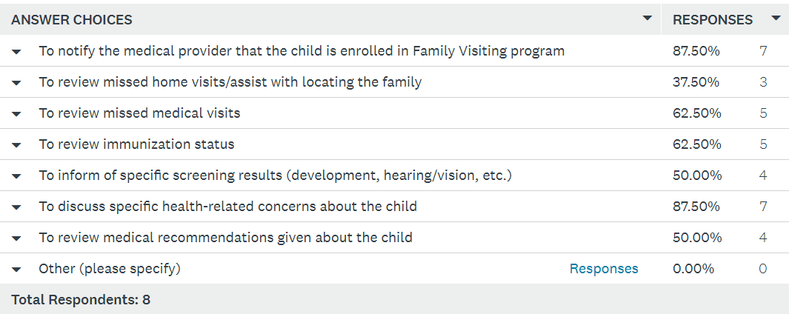
FV Post Program Survey Results
Please identify the typical reasons your Family Visiting program contacts your paired Primary Care provider team:
5/12/2022
Prepared by Care Transformation Collaborative of RI
‹#›
Notes:
Pre-program survey data: similar distribution of responses

Slide 21
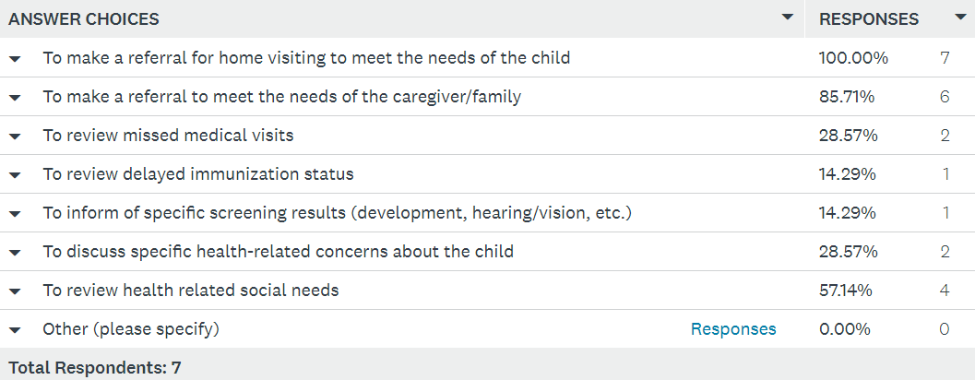
Practice Post Program Survey Results
Please identify the typical reasons your Primary Care provider team contacts your paired Family Visiting program:
5/12/2022
Prepared by Care Transformation Collaborative of RI
‹#›
Notes:
Pre-program survey data:
2 responses – To make a referral for home visiting to meet the needs of the child
2 responses – to make a referral to meet the needs of the caregiver/family
1 response – to inform of specific screening results, to discuss specific health-related concerns about the child, to review health related social needs

Slide 22
Post Program Survey Results
What methods of communication do you typically use to contact your paired partner?
Family Visiting Pediatric Practice
5/12/2022
Prepared by Care Transformation Collaborative of RI
‹#›
Notes:
Pre-program survey data FV:
Case Conference Meeting – 3 respondents
Pre-program survey data practice:
3 responses – phone call
0 responses – case conference

Slide 23
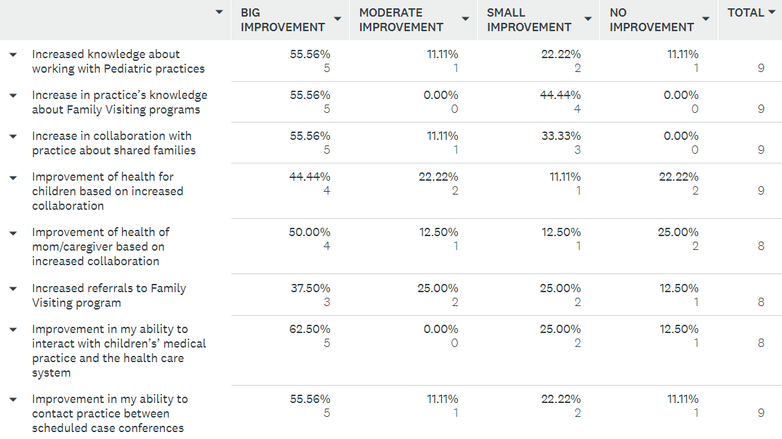
FV Post Program Survey Results
To what degree has working with a paired Primary Care Team resulted in:
5/12/2022
Prepared by Care Transformation Collaborative of RI
‹#›
Notes:
FV goals for collaborative:
Increase in practice’s knowledge about Family Visiting programs
All other areas were rated similarly important

Slide 24
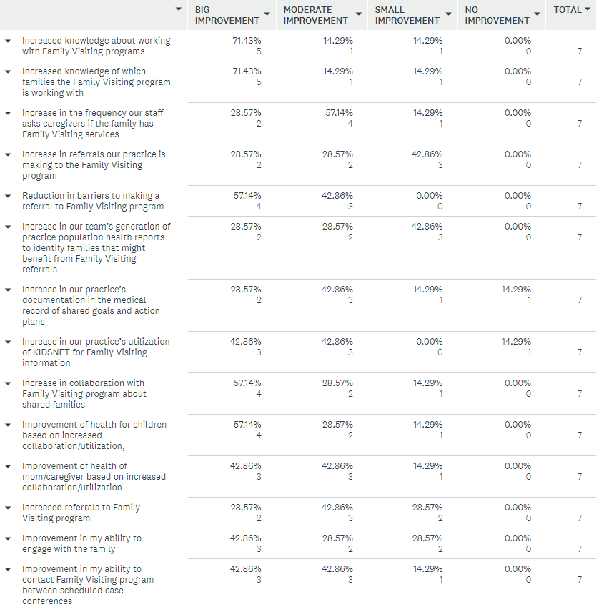
Practice Post Program Survey Results
To what degree has working with a paired Family Visiting Team resulted in:
5/12/2022
Prepared by Care Transformation Collaborative of RI
‹#›
Notes:
Practice goals for collaborative:
Reduction in barriers to making a referral to Family Visiting program
Improvement of health for children based on increased collaboration/utilization
Improvement of health of mom/caregiver based on increased collaboration/utilization

Slide 25
Post Program Survey Results
Discussion
If the learning collaborative was not as successful as hoped, what would you change or do differently?
5/12/2022
Prepared by Care Transformation Collaborative of RI
‹#›

Slide 26
Full Post Program Survey Results
Pediatric Practice
https://www.surveymonkey.com/stories/SM-KueswrHNipoOj0tFvBZZOg_3D_3D/
Family Visiting
https://www.surveymonkey.com/stories/SM-9sQMgS3KFOtABiEvgXsREQ_3D_3D/
5/12/2022
Prepared by Care Transformation Collaborative of RI
‹#›

Slide 27
Parent Lead
My experience in participating in Healthy Tomorrows over the past year
Being a part of healthy Tomorrow’s has given me the opportunity to reflect on how Important it is to have a team and extra support as a mom it made me realize how lucky I am to have my family and programs like family visiting that have given me knowledge and access to useful resources in the community It’s been A pleasure working with you all and giving you guys my input and real lived experience I’ve had being a part of family visiting. Although I still have a long way to go my son Jayvien and I are extremely grateful for all your help and dedication I had all the supports I needed to succeed in this journey called motherhood.
Family visiting participating in pediatric visits
I never had the opportunity to have my family visitor join my sons doctors visit due to the pandemic and covid restrictions however, I feel that it would have been very helpful to have someone join the visit it can be very
overwhelming as a first time parent. one thing I found helpful was the my family visitor would go over what to expect for each visit and what immunizations and milestones he was reaching and also if I had any concerns.
What I want people to remember when working with families
What I would like people to remember is to be as resourceful as possible anything helps and it can really impact these families lives small or big it’s the little things that matter. One amazing family visitor can be change a child`s life put your all in this!
5/12/2022
Prepared by Care Transformation Collaborative of RI
‹#›

Slide 28
Closing and Next Steps
March 2023 - Cohort 3 meets with Practice facilitator
April 24, 2023 – Cohort 3 Quarterly Learning Collaborative Meeting
5/12/2022
Prepared by Care Transformation Collaborative of RI
‹#›

Slide 29
Thank you Stay Safe and Healthy
5/12/2022
Prepared by Care Transformation Collaborative of RI
‹#›

Slide 30
www.ctc-ri.org
CTC-RI
5/12/2022
Prepared by Care Transformation Collaborative of RI
‹#›

