Slide 2
NC AHEC Overview
This slide deck can be used as an orientation tool for new staff or as a helpful resource for staff who want to learn more about other areas within NC AHEC.
For presentations with partners, check out About NC AHEC

Slide 3
NC AHEC
The mission of the NC AHEC Program is to provide and support educational activities and services with a focus on primary care in rural communities and those with less access to resources to recruit, train, and retain the workforce needed to create a healthy North Carolina.
Our vision is a state where everyone in North Carolina is healthy and supported by an appropriate and well-trained health workforce that reflects the communities it serves.
3

Slide 4
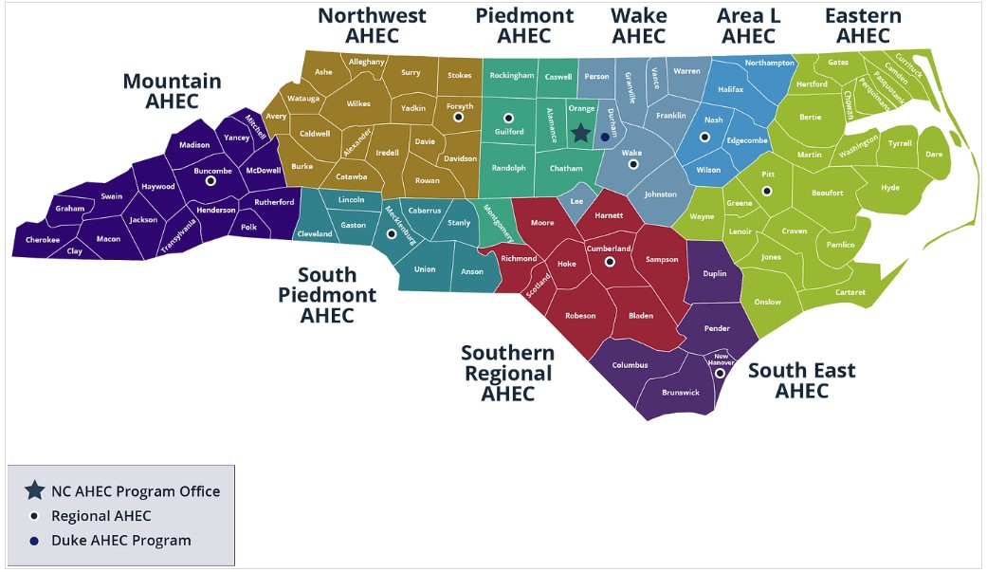
NC AHEC MAP

Slide 5
NC AHEC – CORE STRATEGIES
NC AHEC provides and coordinates services and support to achieve our results.
Recruit
Train
Retain
To ensure an appropriate supply of trainees/students to pursue health careers, particularly those who reflect their communities
To encourage health professions trainees/students and healthcare professionals to practice in interprofessional and primary care settings in rural and under-resourced communities
To retain the health workforce with a focus on the diversity of providers, interprofessional teams, and primary care settings in rural and under-resourced communities
5

Slide 6
NC AHEC – ORIGINATION
NC AHEC evolved to leverage NC’s medical schools and community hospitals to respond to national and state concerns with the supply, distribution, retention, and quality of health professionals
A national focus on the health care workforce coincided with a growing effort in NC to establish statewide community training for health professionals and to reverse a trend toward shortages and uneven distribution of primary care physicians in the state’s rural areas.
Interview with Dr. Cutchin on AHEC’s History
The NC General Assembly approved and funded a plan to create a statewide network of nine AHEC regions in partnership with NC medical schools and community hospitals.
The NC AHEC Program began in 1972 with three AHEC regions under a federal AHEC contract with the UNC Chapel Hill School of Medicine.
By 1975, all nine AHECs were operational.
1970s
1972
1974
1975
There are AHECs across the country in other states- to find out more about national efforts visit NAO
6

Slide 7
REGIONAL AHECS – GOVERNANCE & EXPENDITURES
AHEC | 501(c)(3) or Contractual Agreement
Area L | 501(c)(3)
Eastern | 501(c)(3)
Piedmont | Moses H. Cone Memorial Hospital
Mountain | 501(c)(3)
Northwest | Wake Forest University Health Sciences
South East | Novant Health New Hanover Regional Medical Center, LLC
South Piedmont | Wake Forest University Health Sciences/Atrium Health
Southern Regional | 501(c)(3)
Wake | WakeMed
Duke AHEC Program Office | Supports Southern Regional AHEC
7

Slide 8
NC AHEC PROGRAM – STATE FUNDING EXPENSES, FY23
Total NC AHEC Expenditure = $48,730,103
8

Slide 9
Operating More Like A System
Define the use of state funds: 5-year operating contract
Define the work: Annual Work Statement
Measure the work: Performance Measures
Improve the work: RBA and our Strategic Plan
Align finances and the work: Unallocated funds & Budget Guidelines
This positions us to:
respond to opportunities
understand gaps and opportunities for alignment and efficiency
demonstrate need for additional funding
FY23-25
Strategic Plan

Slide 10
Infusing Results-Based Accountability (RBA) Concepts in NC AHEC
The NC AHEC Strategic Plan adopted Results-Based Accountability as our framework to translate strategies into program results.
RBA teaches there are two types of accountability: population accountability and performance accountability. Being accountable for the performance of our programs is our direct responsibility. We use data and disciplined thinking to tell how much we do, how well we do it, and most importantly, if anyone is better off from the service(s) we provide.
RBA “turn the curve thinking” ensures accountability for the performance of our programs and demonstrates our contribution toward achieving the NC AHEC population result: “Everyone in North Carolina is healthy and supported by an appropriate and highly competent health workforce that reflects the communities it serves.”
Each AHEC and the Program Office have at least one certified RBA professional as their in-house resource.
Notes:
Claire
What is RBA?
RBA is a straightforward method of measuring impact that starts with the aim in mind and works backward to the means. It is a method of thinking and doing that can be used to enhance the lives in communities, cities, counties, states, countries, and program performance.
RBA was developed by Mark Friedman and described in his book Trying Hard is Not Good Enough.
RBA is being used in all 50 States and in more than a dozen countries around the world to create measurable change in people’s lives, communities, and organizations.
Give examples of who using it
Where is RBA being used in North Carolina?
SHA -SHIP
CHA-CHIP-SOTCH
Strategic Plans
Hospitals/health systems beginning to use it in their community health improvement work
Funders

Slide 11
NC AHEC – CORE SERVICE LINES
NC AHEC weaves through all sectors of health care education and workforce.
Health Careers & Workforce Diversity
Student Services
Graduate Medical Education Support
Continuing Professional Development
Practice Support
Library Services
11

Slide 12
CONTINUING PROFESSIONAL DEVELOPMENT (CPD)

Slide 13
Continuing Professional Development
NC AHEC meets the ever-evolving education and training needs of health professionals.
Healthcare providers and healthcare teams, particularly in rural and under-resourced communities, have access to coordinated, innovative, and efficient training activities that addresses their needs.
13

Slide 14
Continuing Professional Development (CPD) Our continuing professional development (CPD) programs are important resources that provide health care professionals with the training and continuing education they need to meet state licensure and specialty certification and to stay abreast of new research, emerging technologies, and the latest innovations and advancements in their fields.
Over 57,000 unique participants
Over 9,500 events offered
100 counties covered
300,000 participants
Provide CPD services for occupations within the following disciplines: Allied Health, Behavioral Health, Continued Medical Education (CME), Nursing, Oral Health, Pharmacy, Public Health
Credit requirements vary by accreditation
Regional AHEC CPD staff structure varies, and some staff work with multiple disciplines
Programs are often taught by health sciences faculty from universities and health centers, bringing university experience to NC communities
Programs are planned based on needs assessments, partner requests, contracted work
Delivery formats include in-person events, live webinars, modules, and more
View current offerings in the Visual Course Catalog
*FY23 Data

Slide 15
Discipline Groups vs. Discipline Chairs
7 Discipline Groups
Disciplines: Allied Health, Behavioral Health, CME, Nursing, Oral Health, Pharmacy, Public Health
Composition: Regional AHEC CPD experts; group is Chaired by elected Regional AHEC representative
Facilitate communication and partnership between Regions within discipline
Develop statewide goals for discipline
Collaborate on CPD activities, when appropriate
Form relationships with partners doing work in the discipline area
Discipline Chairs
Composition: Chair of each of the seven discipline groups
Develop, share, and execute initiatives that pertain to statewide training and education needs of an interprofessional workforce
Create clear expectations about how disciplines are to work collaboratively
Assure effective communication about statewide interprofessional continuing education activities
Discipline Chairs
Allied Health Chair
Behavioral Health Chair
Pharmacy Chair
Public Health Chairs
CME Chair
Nursing Chair
Oral Health Chair

Slide 17
E-Learning Software and Tools Support CPD
Learning Management System
Content authoring tools
Virtual conferencing
Cloud storage and collaboration
Video/audio management
Translation and closed captioning
Each region has an eLearning resource that serves as a connection point to the PO
Trainings on products are available via PO or product vendors
License ownership varies (NC AHEC, PO, region- or project-specific)

Slide 18
AHEC Learning Academy (ALA)
The AHEC Learning Academy (ALA) is a centralized approach to developing the NC AHEC Program and its workforce. The professional development offered through the ALA can be utilized by all service lines and staff within the NC AHEC system.
One Regional AHEC assesses needs and plans at least four ALAs throughout the calendar year.
Recordings of previous ALAs can be found on the AHEC Resource Hub.

Slide 19
Want to Learn More?
Join the NC AHEC Staff Mailing List
Visit the NC AHEC Internal Depository

