Slide 1
Sets and jobs
Shared Library Services Platform Project
Jennifer Koerber

Slide 2
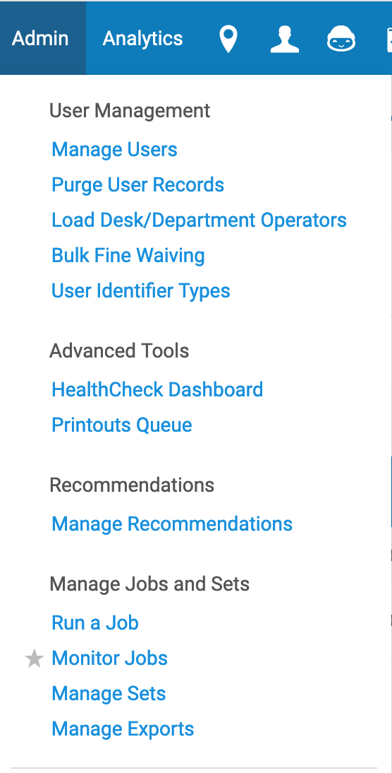
Agenda
Sets and Their Uses
Logical Sets
Itemized Sets
Itemizing Logical Sets (got all that?)
Running Jobs - Overview
Prep for Running Jobs

Slide 3
Sets

Slide 4
About Sets
Sets are saved groups of records in Alma that can be used for:
Bulk changes or actions using jobs
Monitoring groups of items going through a process (a group of items all going through digitization, for instance)
Maintaining personal lists of records that you want quick access to (if you're a reference librarian, you can set up lists of favorite resources, or if you're in Acquisitions, you can keep a set of materials purchased for specific reasons)
There are two types of sets:
Logical sets are the dynamic results of a saved query in Alma
Itemized sets are static lists of records, where you individually add members to the set

Slide 5
Creating Sets
Logical Sets
Run a search – either Basic or Advanced – and click the Save Query button
Fill in the Set Details and then Save
Go to Manage Sets and choose Results from the ... menu to see the results of the query at that moment
Itemized Sets
Go to Manage Sets >> Add Set >> Itemized
Fill in the Set Details and then Save
Go to Manage Sets and choose Members from the ... menu
Click Add Members
Search for records to add, then click on the check box and Add Selected
Click Done when you’re done adding records

Slide 6
Logical sets

Slide 7
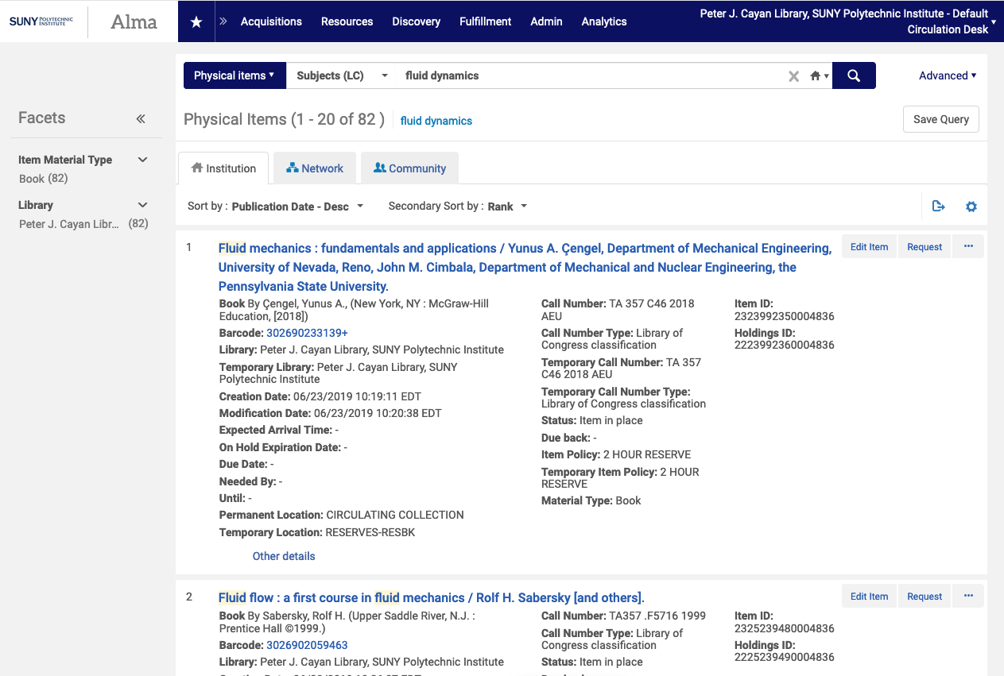
Notes:
Logical Sets – Start with a query and click on Save Query when you’re ready to create your set.

Slide 8
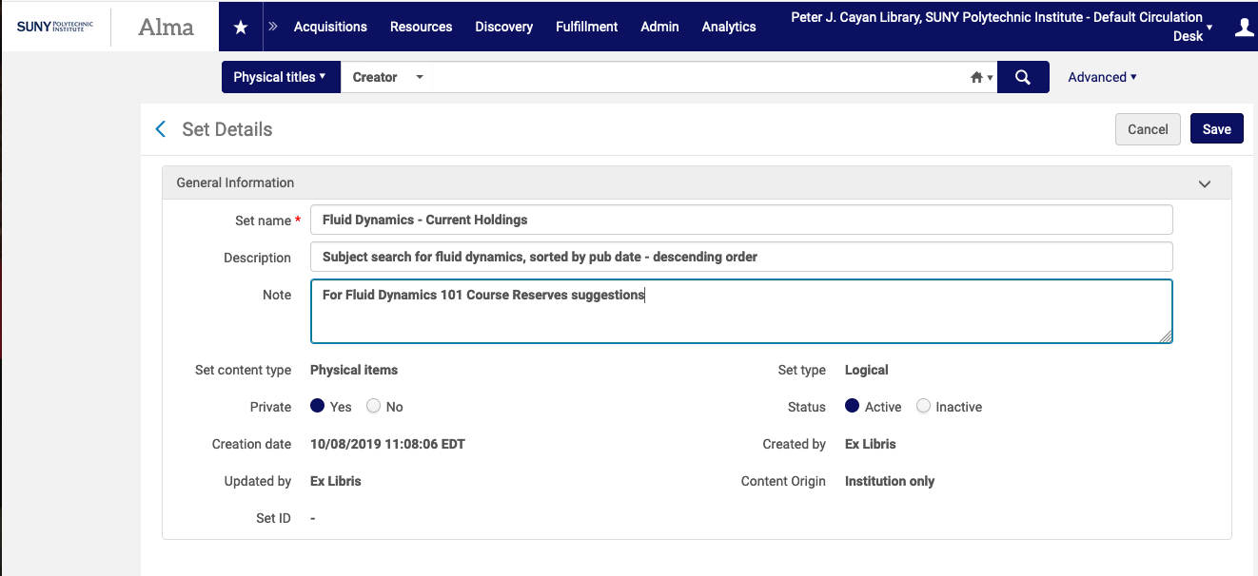
Notes:
Add the Set Details. The Content Type will be the Search type you used. Click Save when you’re done.

Slide 9
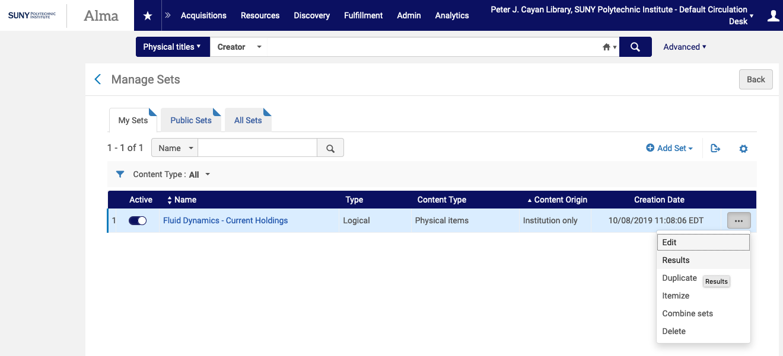
Notes:
To see the current results of your query, go to Admin >> Manage Sets >> and click on the ellipsis for your set. Choose Results.

Slide 10
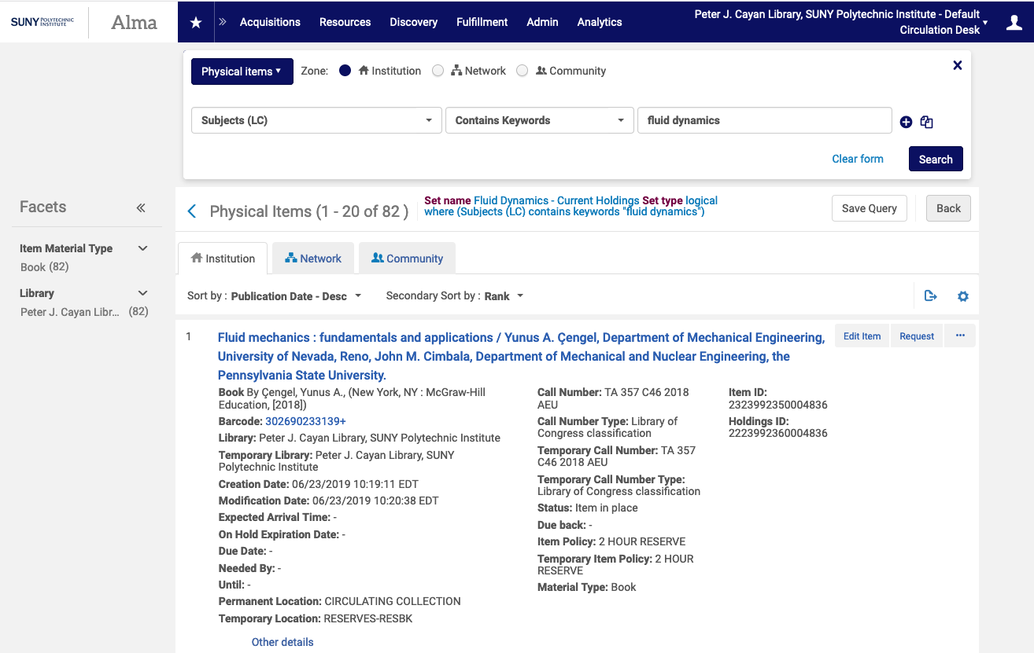
Notes:
This will open up the set with the current results, in whatever sort order you saved. You can edit the query at this point and resave it, or resort the results to find what you need.

Slide 11
Itemized sets

Slide 12
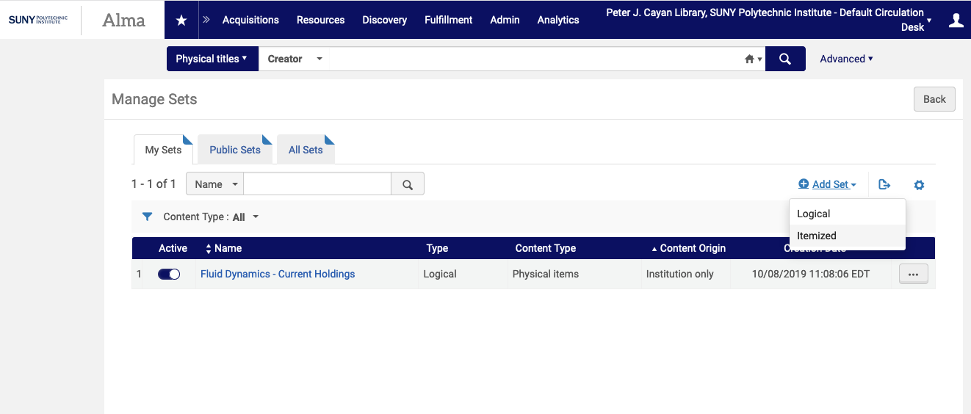
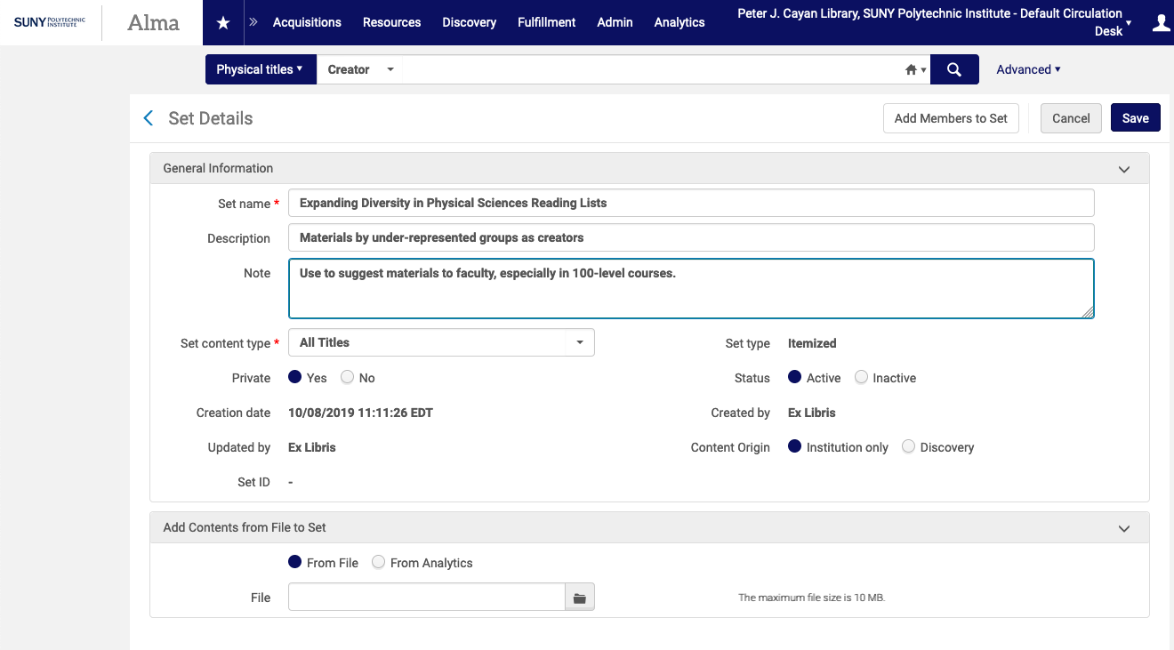
Notes:
To create an itemized set, go to Admin >> Manage Sets >> Add Set >> Itemized. Add the Set Details and choose the Set Content Type.

Slide 13
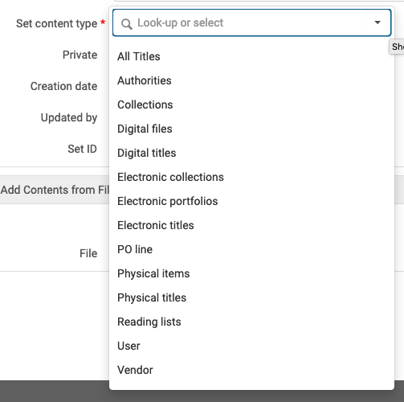
Notes:
You can only have one type of record per set. If you choose All Titles, you’ll get all formats of Bibliographic records; if you choose Electronic titles or Physical titles, you’ll get only those formats for bibs.
Once you’ve chosen your Set content type and filled in the rest of the details, click Save in the upper right corner.

Slide 14
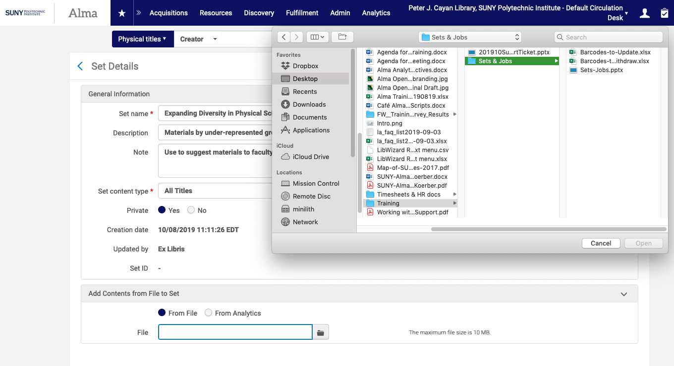
Notes:
You can use a file of unique identifiers – MMSIDs, barcodes, POL #s, etc. – to auto-populate a set. To add contents from a file to the set, click on the folder icon, find the spreadsheet or text file with your unique identifiers, click Open, and then save your set.

Slide 15
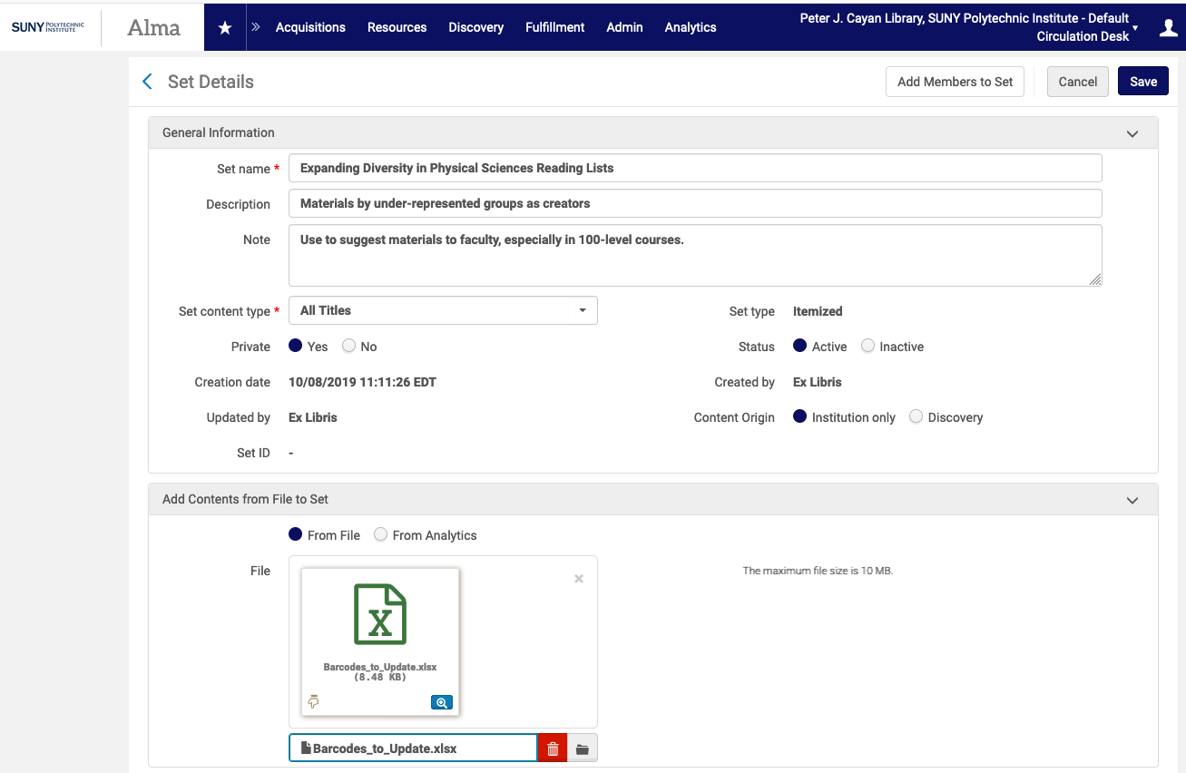
Notes:
Once you upload the file, the screen will look like this. Click Save in the upper right.

Slide 16
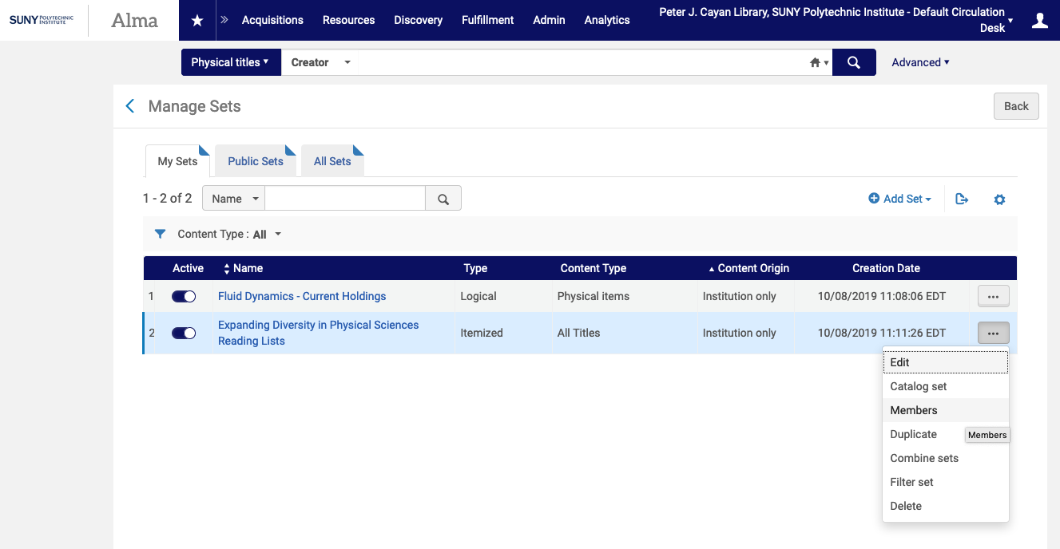
Notes:
You’ll return to the Manage Sets page. To add or view the members of the set, click on the ellipsis and then Members.

Slide 17
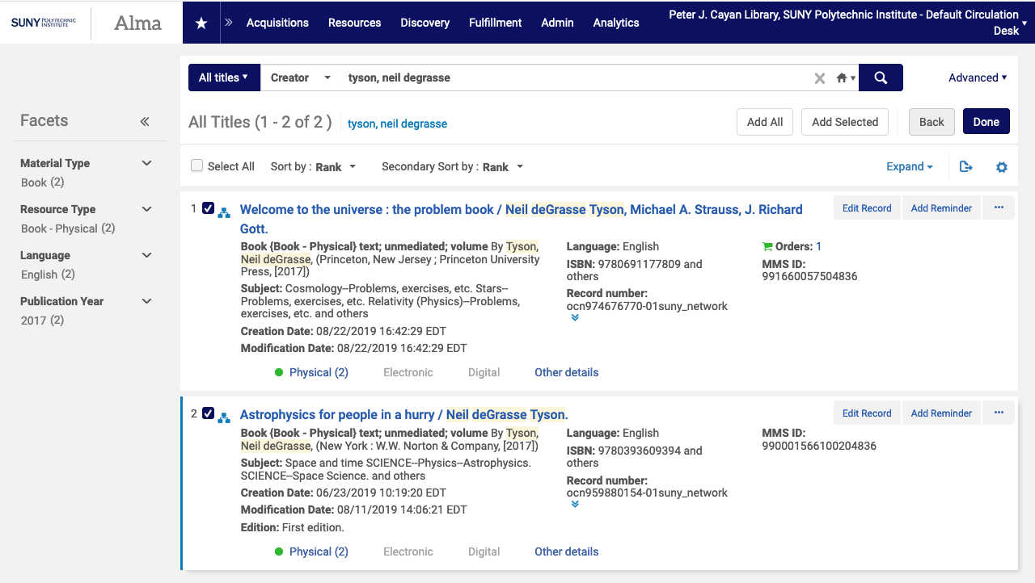
Notes:
To add members to the set, click on Add Members.
Search for the records you want to add.
As you find them, click on the tickybox to the left and then Add Selected at the top. You can select any number of records from a single search result screen, but only from one screen at a time.
When you’re done adding records, click on Done. Don’t forget to do this, or you’ll wonder why it’s still there 2 hours later when you’re doing something else entirely. ☺

Slide 18
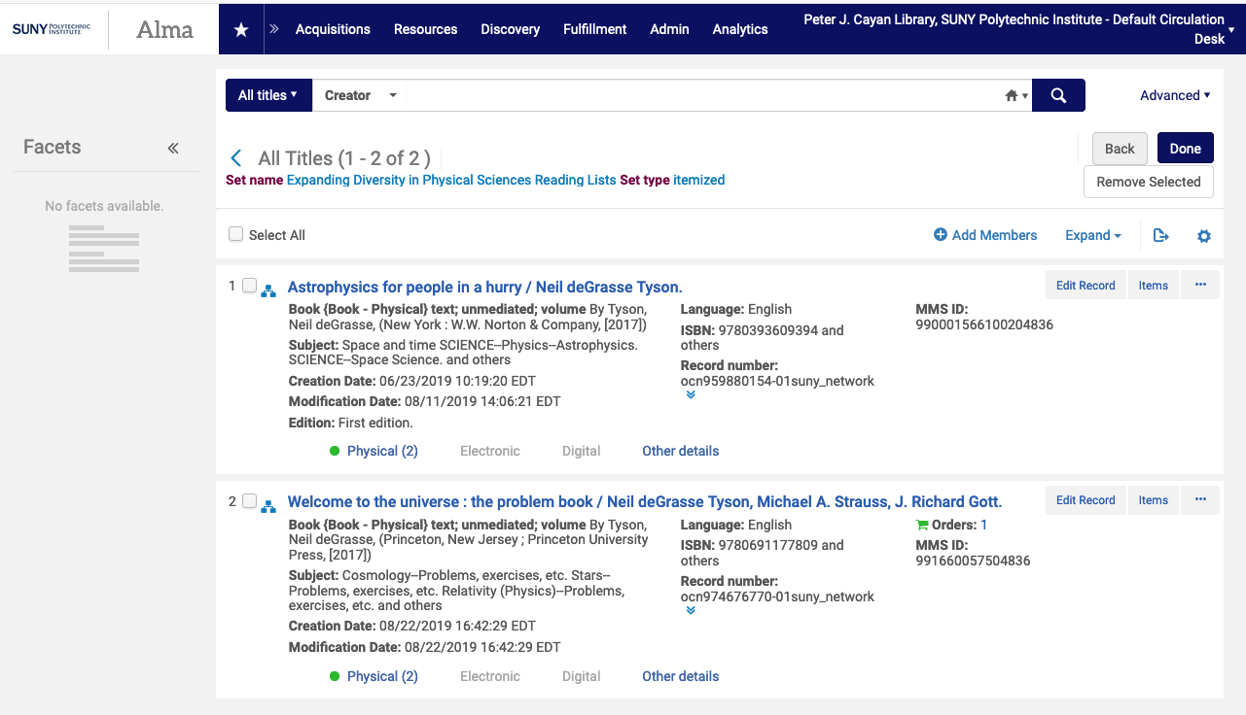
Notes:
As you add them, the records will appear in the set.

Slide 19
Itemizing a logical set

Slide 20
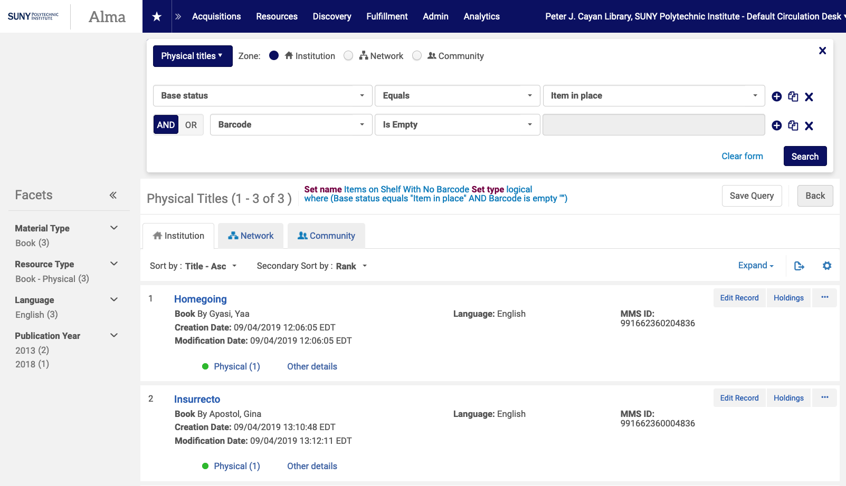
Notes:
A way to save yourself time in creating itemized sets, or to capture the current results of a logical set, is to itemize a logical set. It’s the same as the Save As function in Microsoft Word or other programs.
First, run your query and save it to create a logical set.
Note the “is empty” operator – very useful for fields like barcode, item policy, notes, and more.

Slide 21
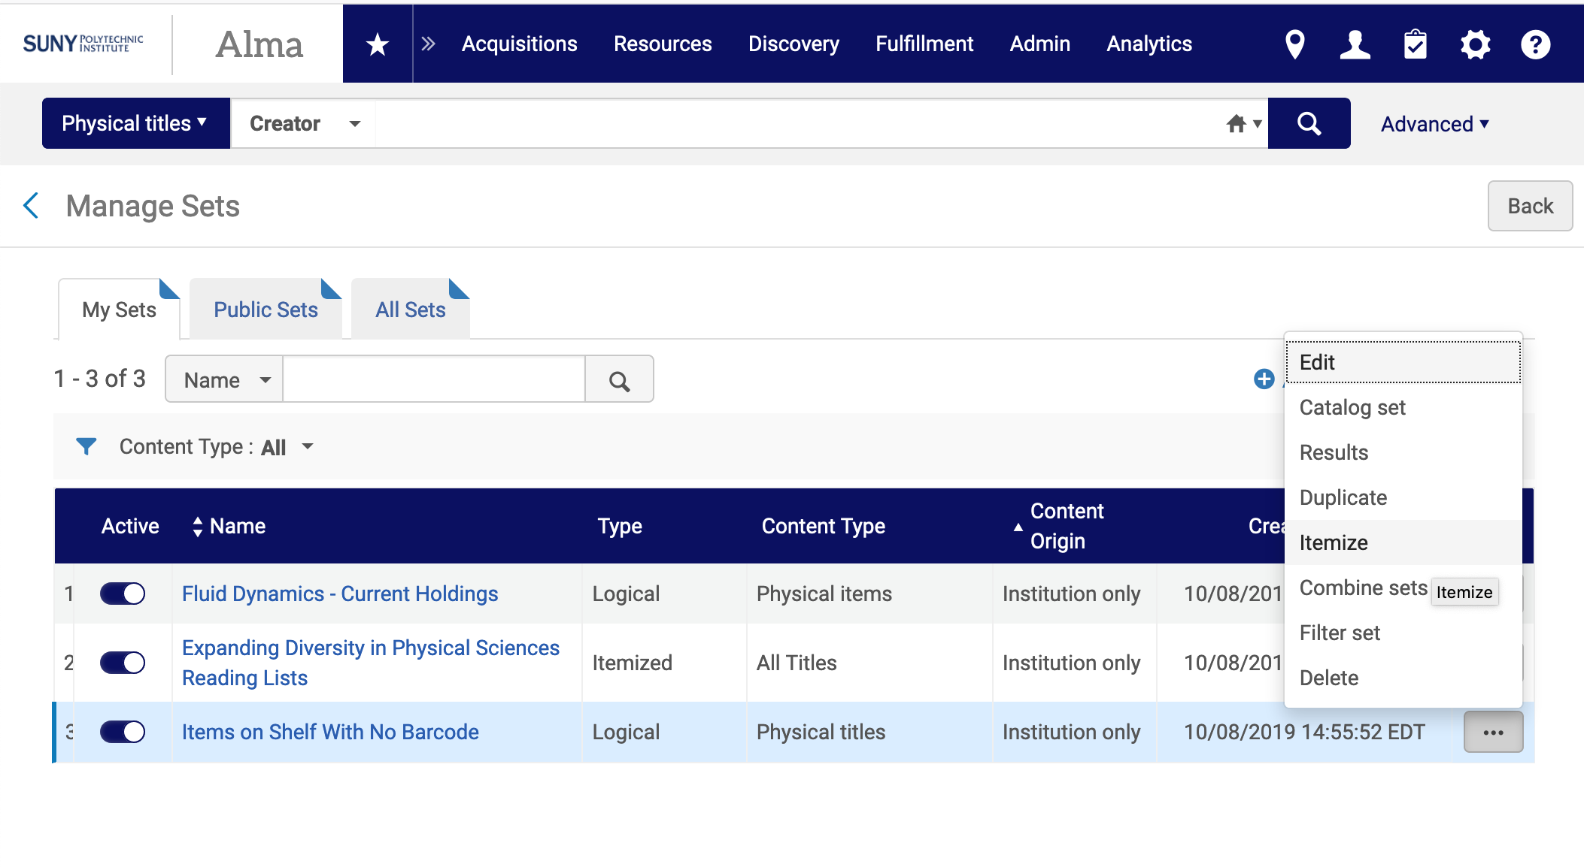
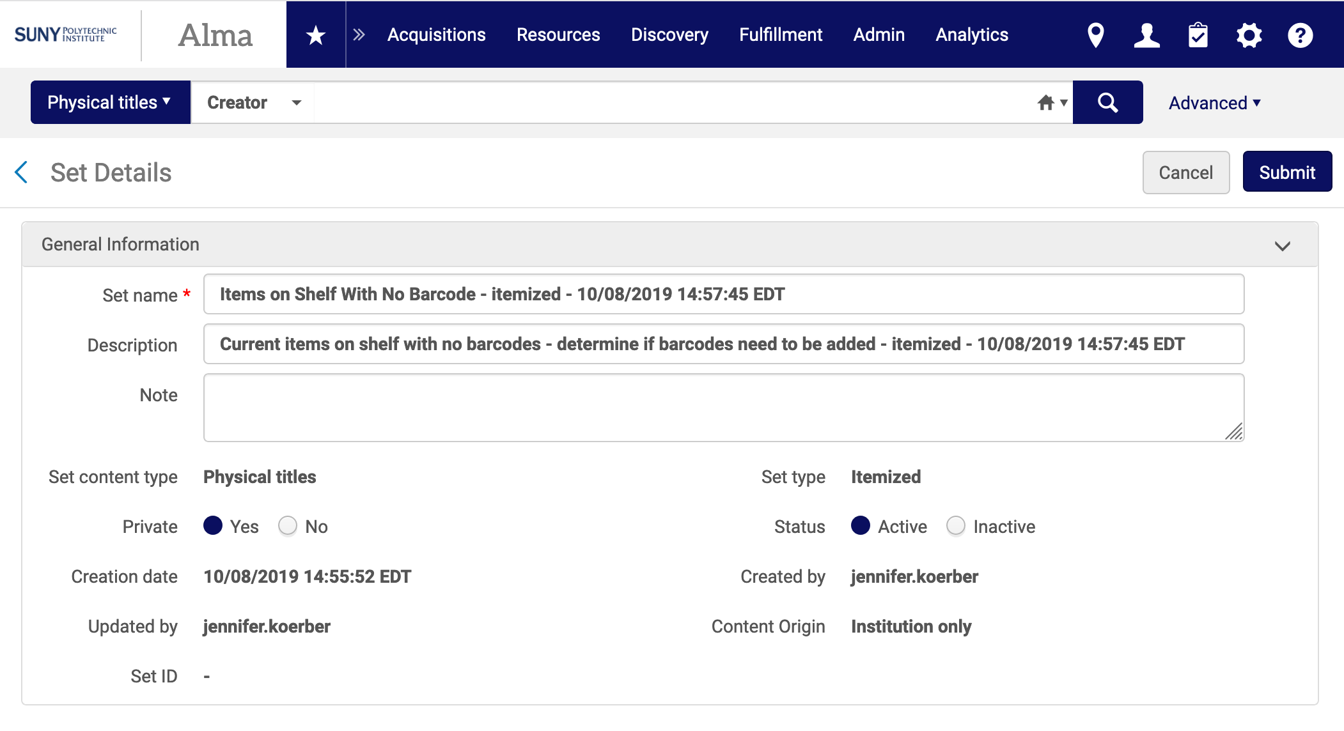
Notes:
Once you’ve created your logical set, go to Admin >> Manage Sets and click on the ellipsis for the set you want to itemize.
Choose Itemize.
You’ll set the Set Details with “- itemized – date and time” added to the set name and description. You can leave these as is, or edit them to suit your needs.
Click Submit when you’re done. This submits the Itemize a Set job.

Slide 22
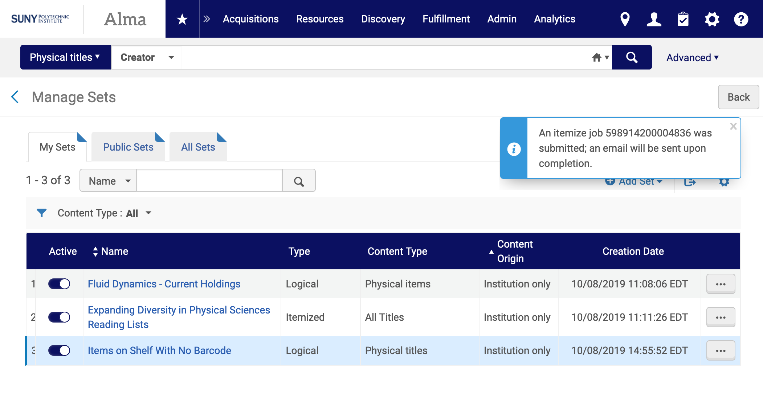
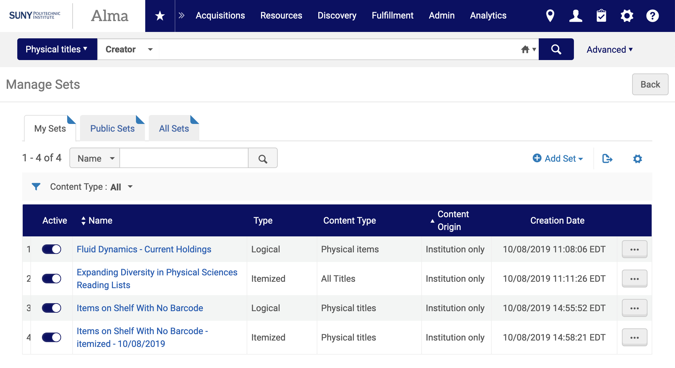
Notes:
The job runs, and when it’s done, you can refresh the Manage Sets page to see your new itemized set. Click on the ellipsis, and then Members to see the members of this new set.

Slide 23
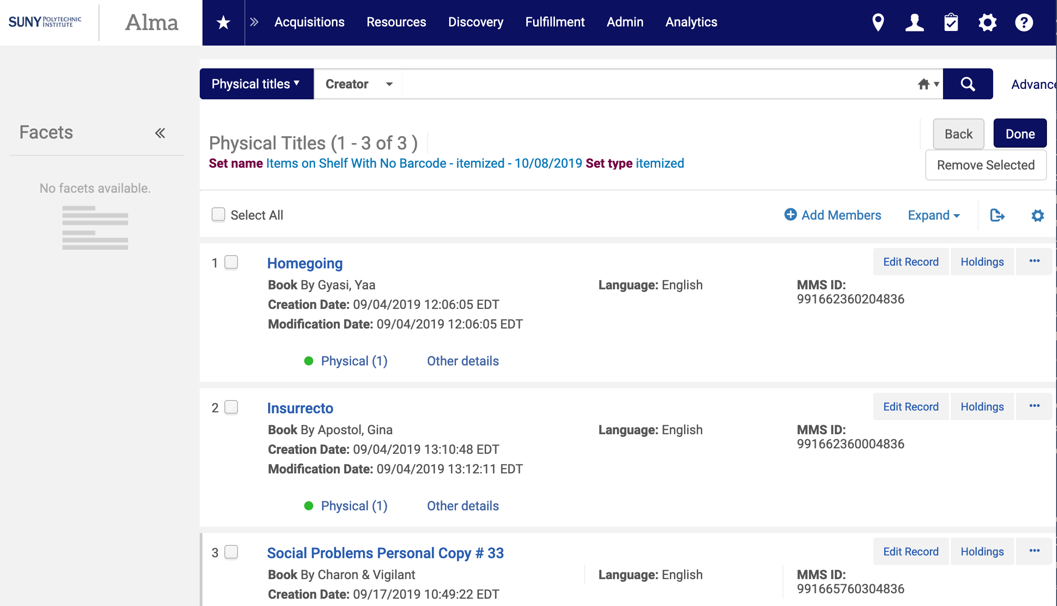
Notes:
Now, if needed, you can remove or add records from the set, depending on what you’re using it for. Again, this lets most of the work get done by a query, and then you can fine-tune the set once you’ve itemized it.

Slide 24
Jobs

Slide 25
Running a Job
Read through and understand the parameters for your job. This is critical to avoid unintended consequences.
Create the set to run your job on
Go to Admin >> Run a Job
Find the job you want to run and select it, then click Next
Find the set you want, select it, then click Next
Choose the parameters you want to change by ticking the box, filling in the new value, and choosing the condition
When you’re done, click Submit
Go to Admin >> Monitor Jobs >> History tab to view the results of your job.
Click on Report from the ... menu to see details on the job

Slide 26
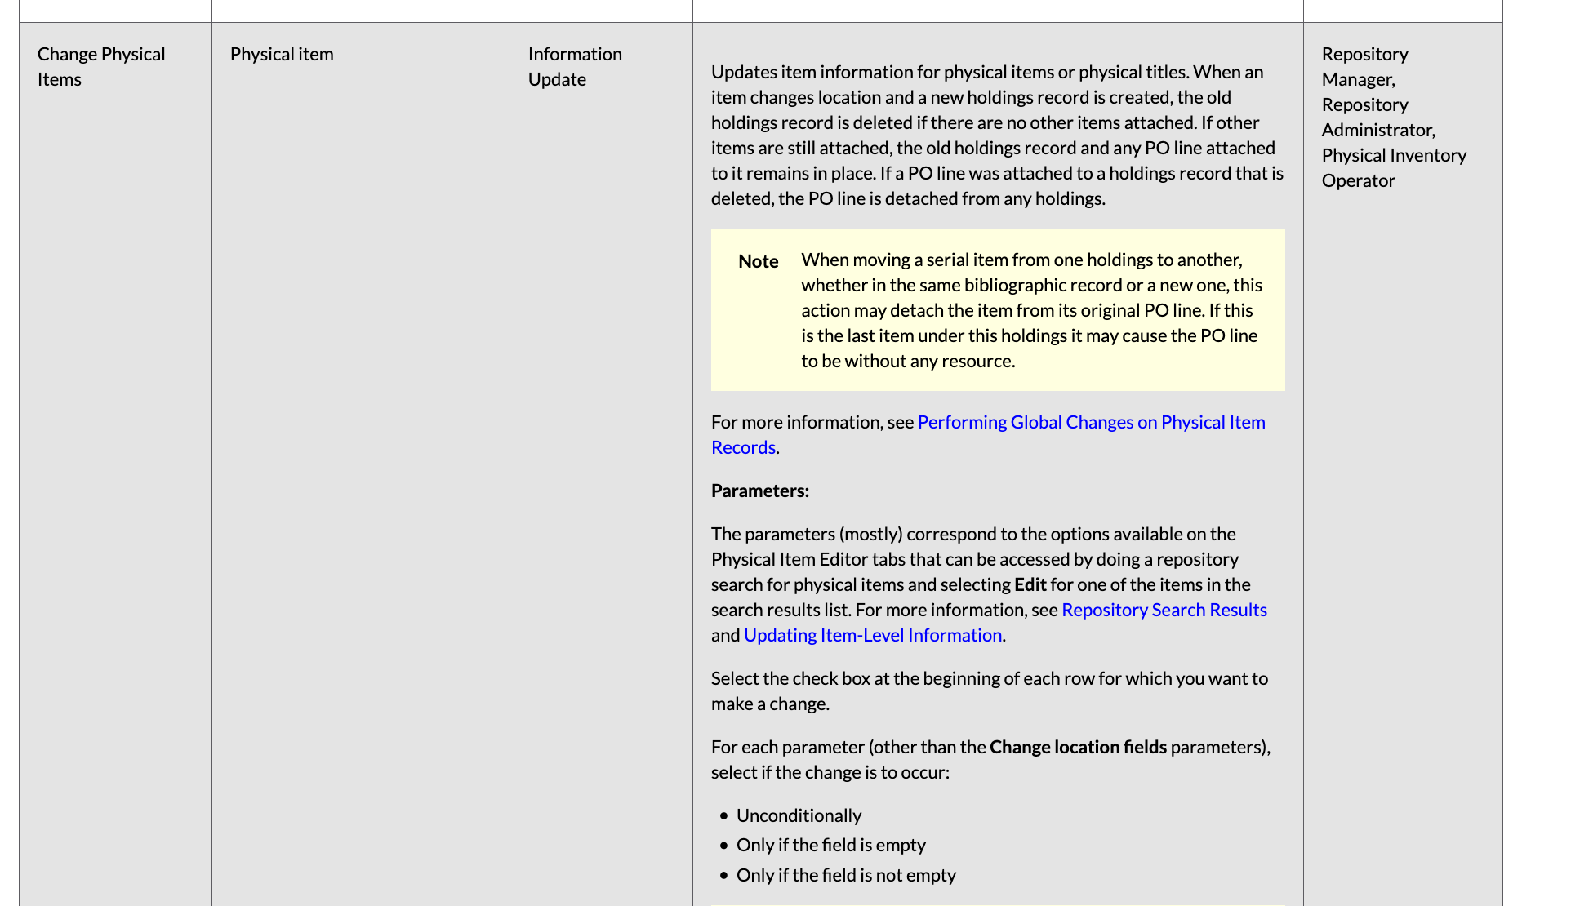
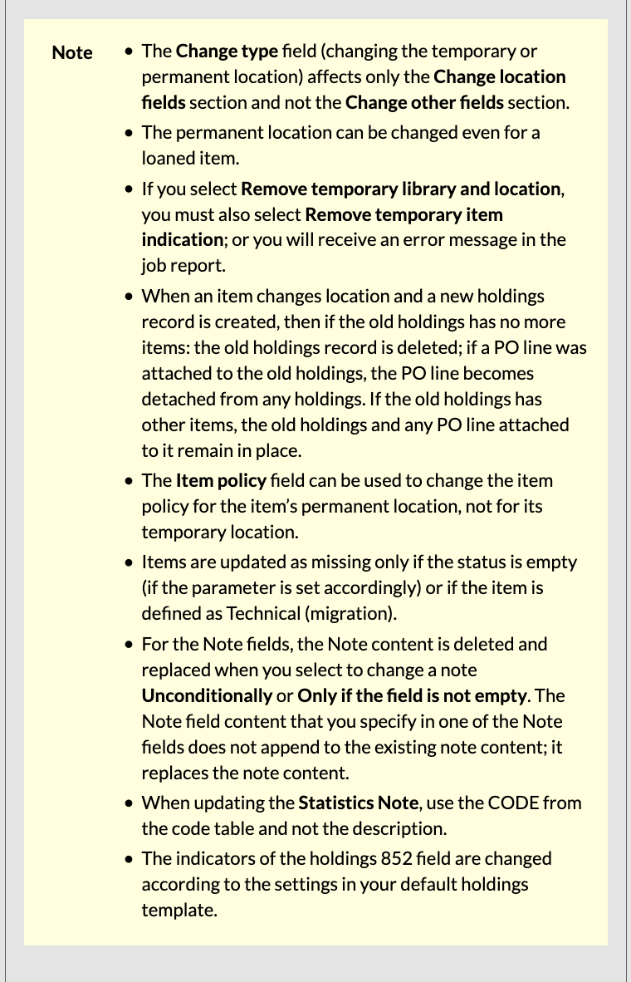
https://knowledge.exlibrisgroup.com/Alma/Product_Documentation/010Alma_Online_Help_(English)/050Administration/070Managing_Jobs/020Running_Manual_Jobs_on_Defined_Sets#Manual_Jobs_and_Their_Relevant_Parameters
Notes:
Before you start working on a set, make sure you read and understand the parameters for the job you’re going to run. The full list of jobs and all their details is found on Running Manual Jobs on Defined Sets, in the Ex Libris Knowledge Center. These are the parameters for the Change Physical Items job.

Slide 27
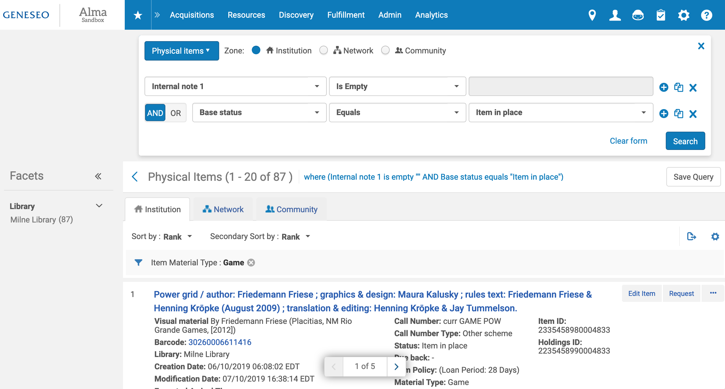
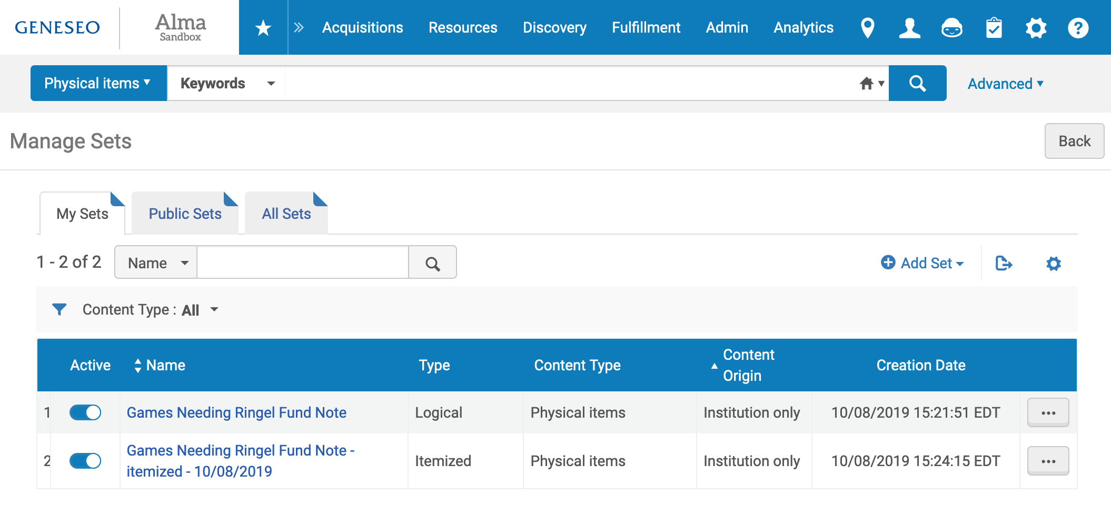
Notes:
First step is to create a set, including itemizing a logical set to make sure only the records you want to affect are affected.
In this example, I’m going to add a note on the new Games collection purchased and maintained by the Ringel Fund to all of the current games that will be part of that collection.

Slide 28
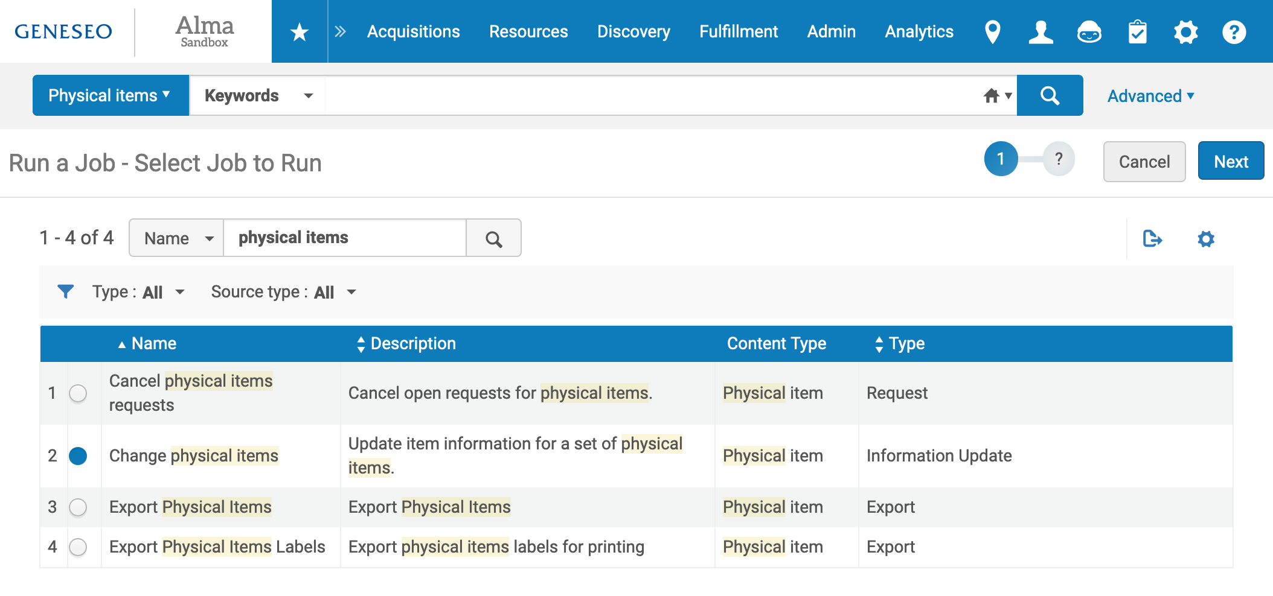
Notes:
Once my set is ready, I start to run the job. Go to Admin >> Run a Job and find and select the job you want to run. Use the search box on the page to find the job if there’s a long list. Click the radio button next to the job, then click Next.

Slide 29
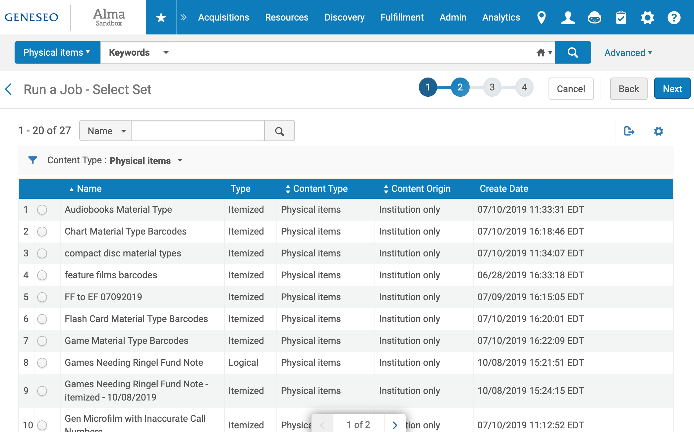
Notes:
Find the set you want to run the job on and select it, then click Next.

Slide 30
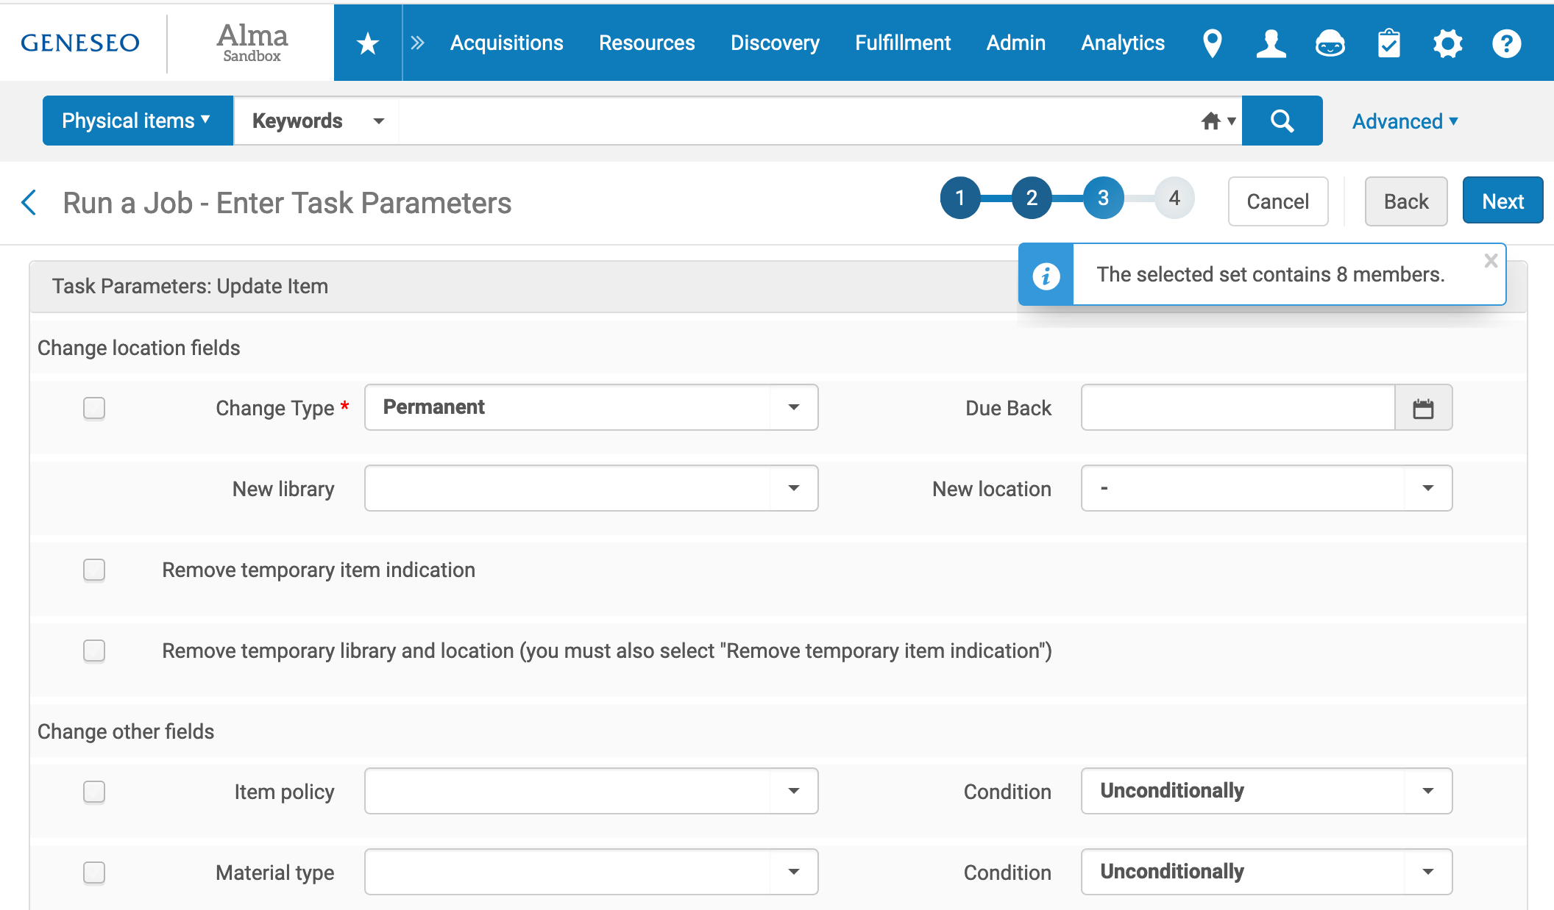
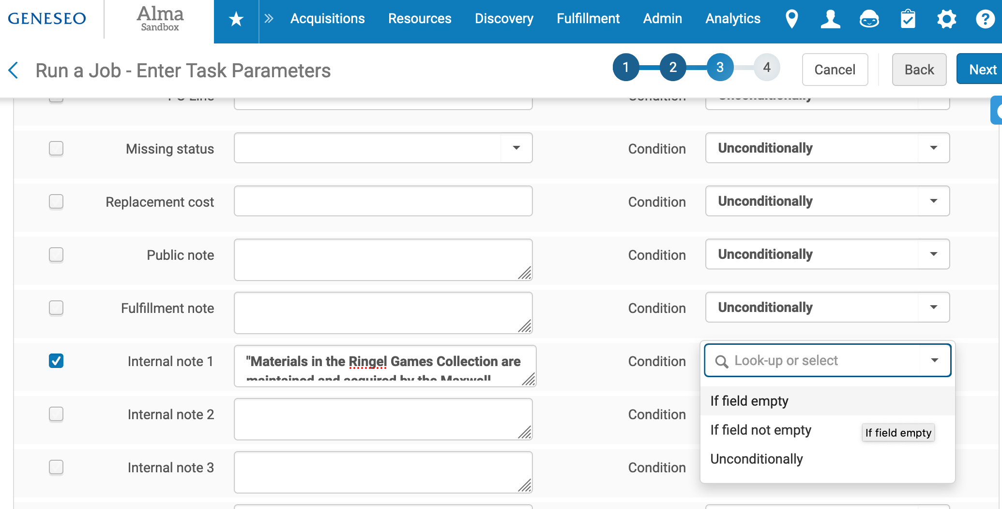
Notes:
Here’s where your prep work pays off. Choose the parameters for the job – the fields you want to change and what you want them to change to. Tick the box to the left of each field you want to change, add the new information, and then choose how you want to apply the change.
If field empty will only make the change if the field is currently empty (to add notes to an empty field, but not overwrite any existing notes, for instance)
If field not empty will only make the change if there is information in that field already (to update an existing note on some records but not add notes to other records in the set, for example)
Unconditionally means the change will be made on all records, regardless of what is or isn’t in the field already.
When you’re done setting the parameters of the job, click Next.

Slide 31
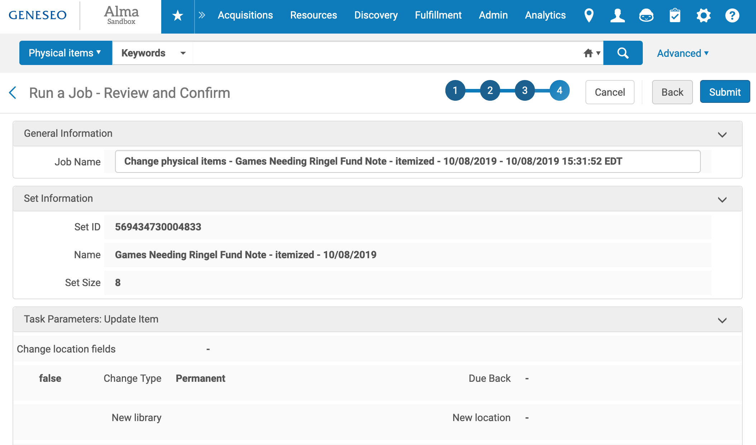
Notes:
You’ll get a confirmation screen that lets you review all the parameters, whether or not you’ve indicated that something should change (the true/false column), what those changes are, and how they’re applied.
When you’ve finished reviewing, you can click Back to go fix any errors or click Submit to submit the job.

Slide 32
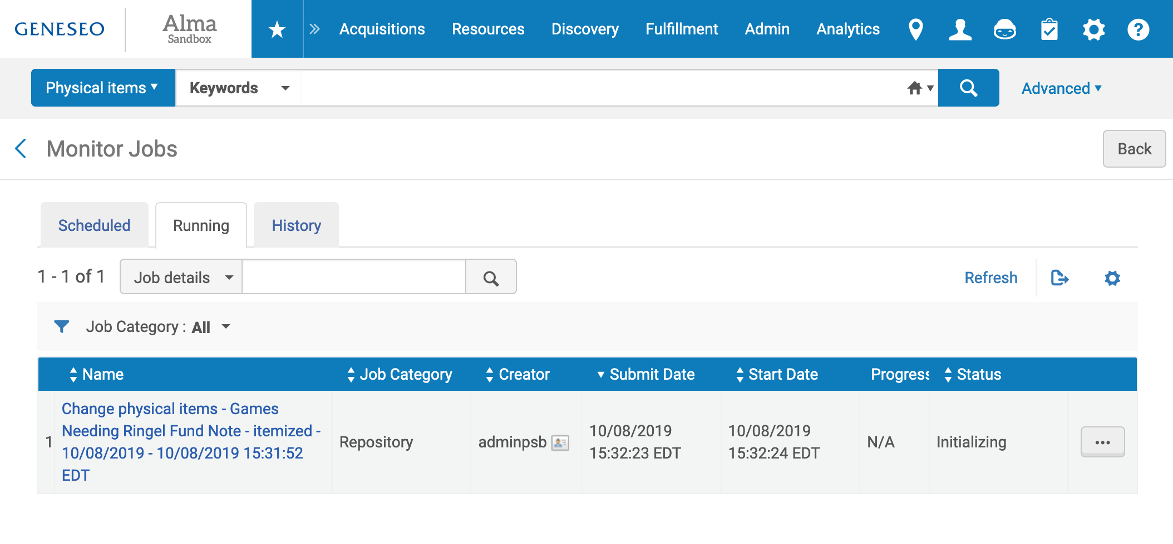
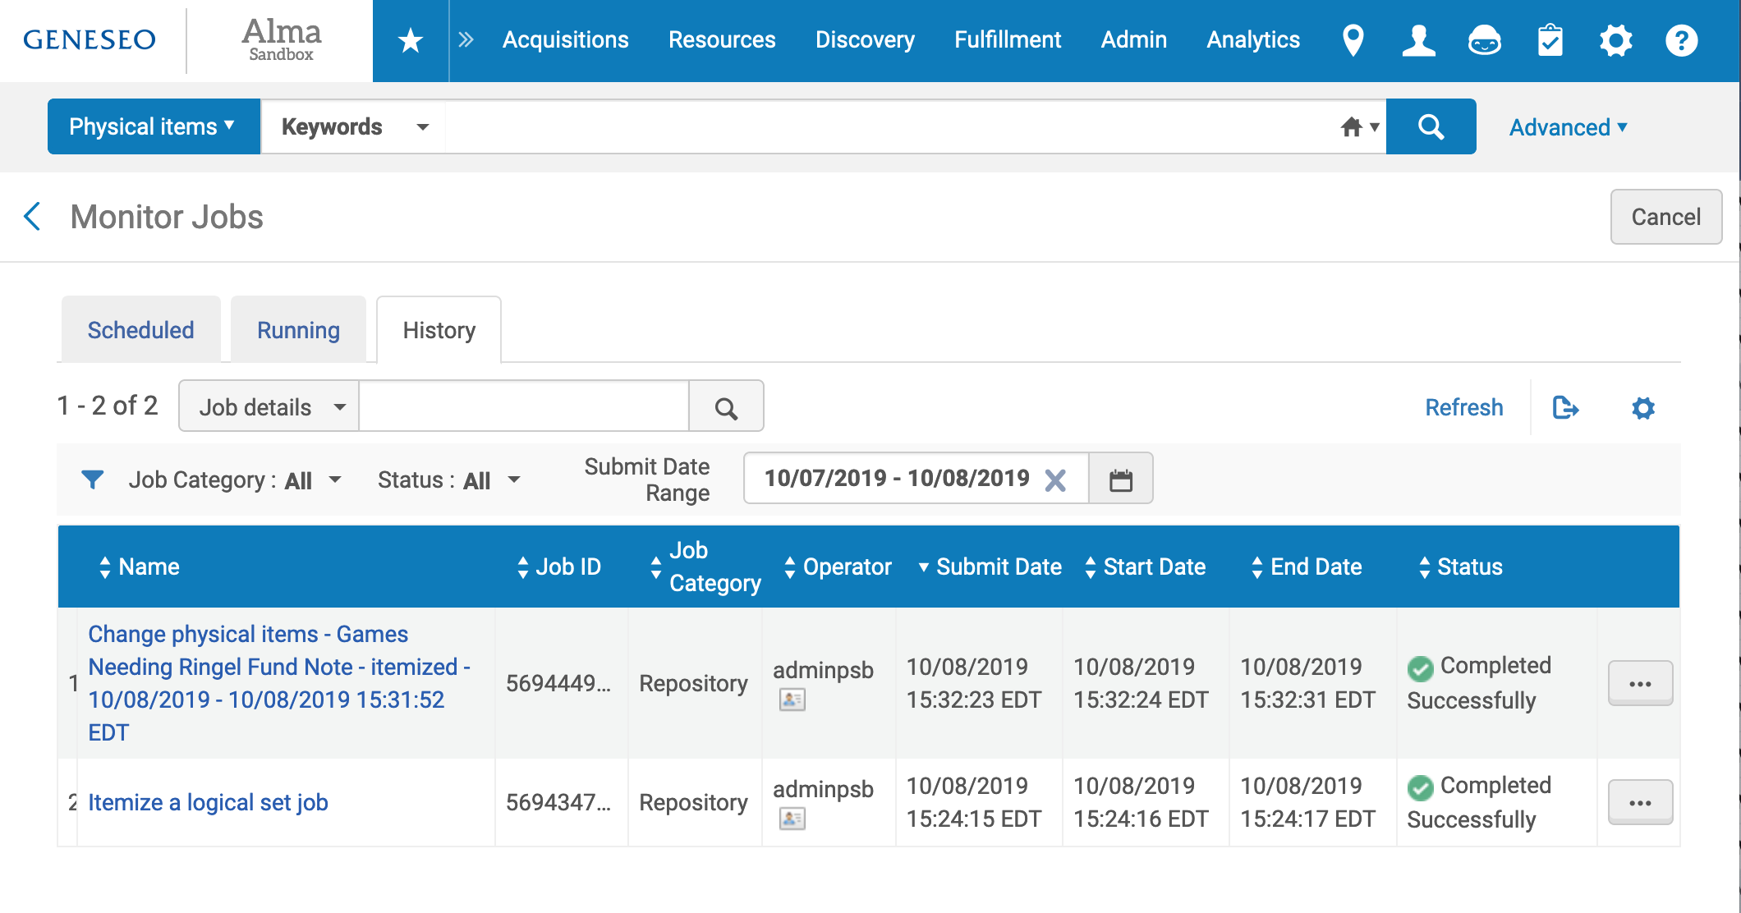
Notes:
When you submit the job, you’ll be taken to the Monitor Jobs screen, on the Running tab. That’s where the status of your job will update as it’s running; refresh the page to see the changes. For small jobs, by the time you refresh the first time, the job will be done and move to the History tab.
On the History tab, you can see all of the jobs run in the past 24 hours, what their final status was, and choose to see the report for each job.

Slide 33
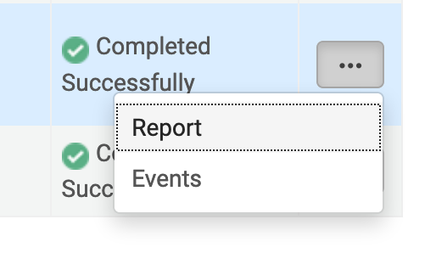
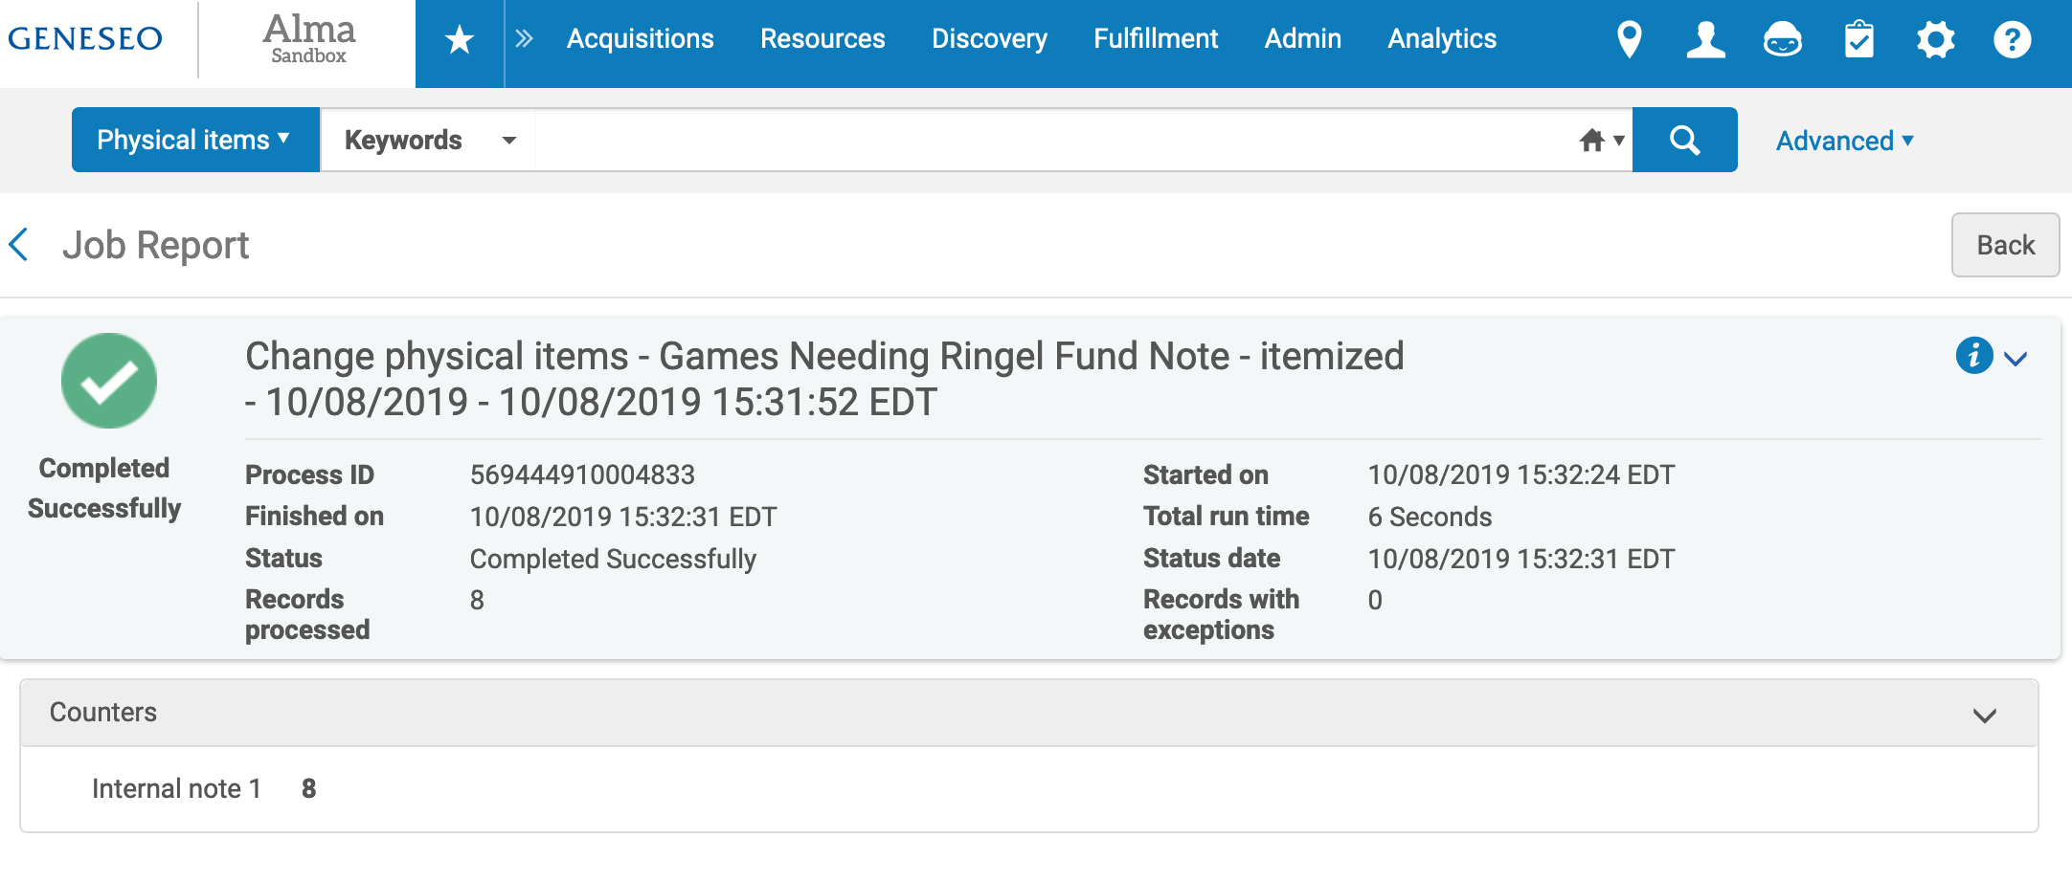
Notes:
Click on the ellipsis and Report to see a report of what happened during a particular job.
The Job Report will give different information, depending on the job that you ran. In addition to the counters (things that were changed) there may be downloadable events or error files you can open and review.

Slide 34
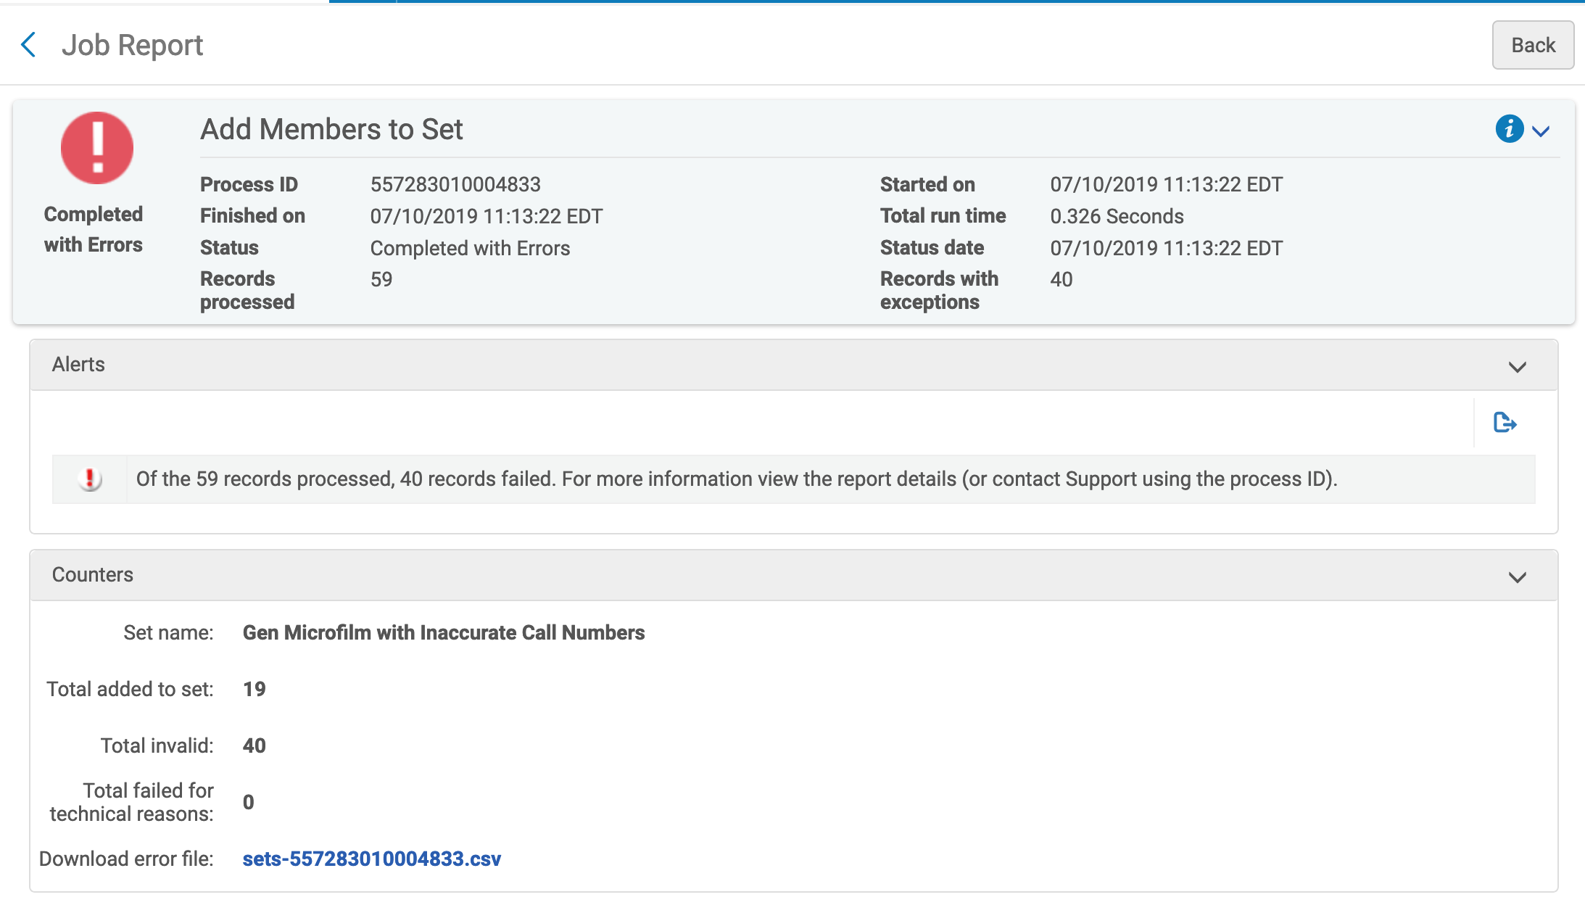
Notes:
If there’s an error, you can Download the error file and review it to see what failed and why. Then you can go back and update your set, your parameters, or both as needed.

Slide 35
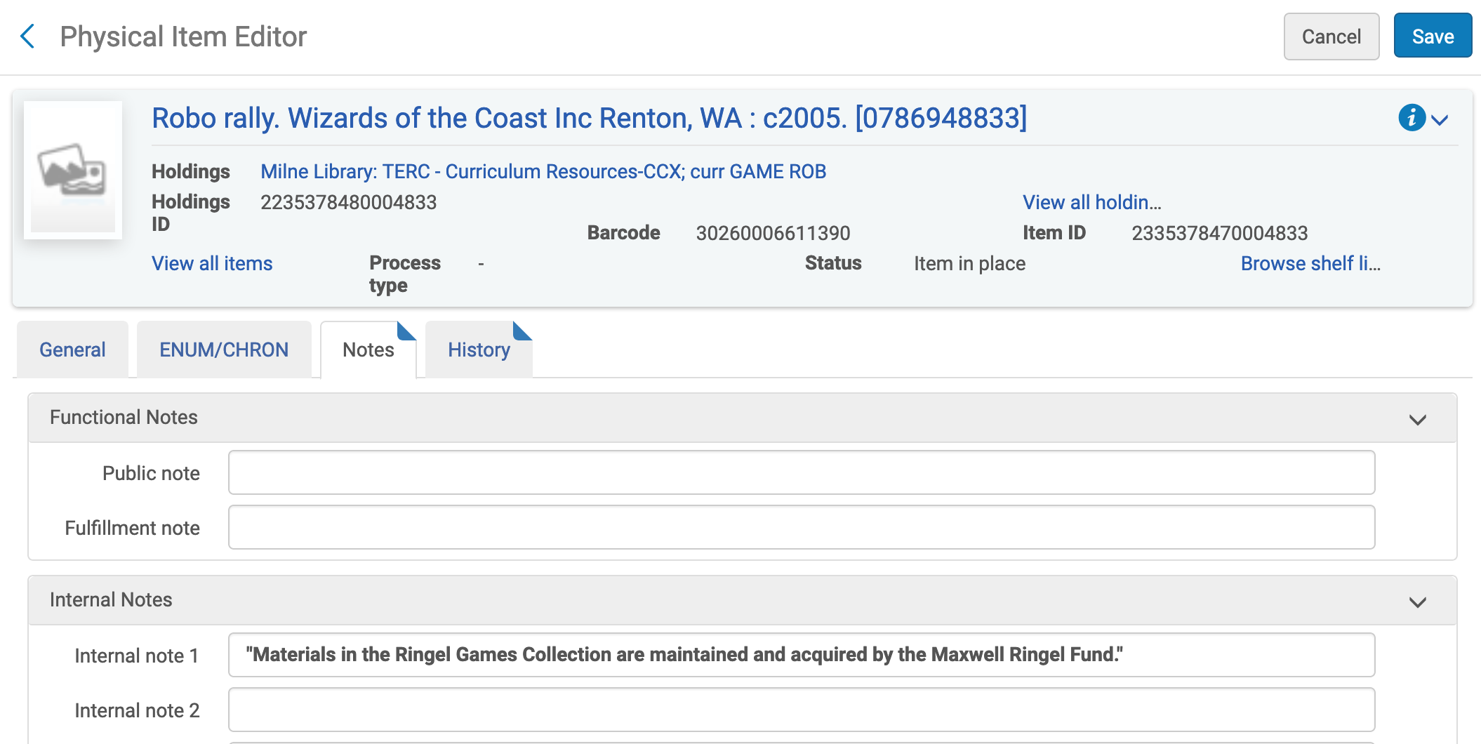
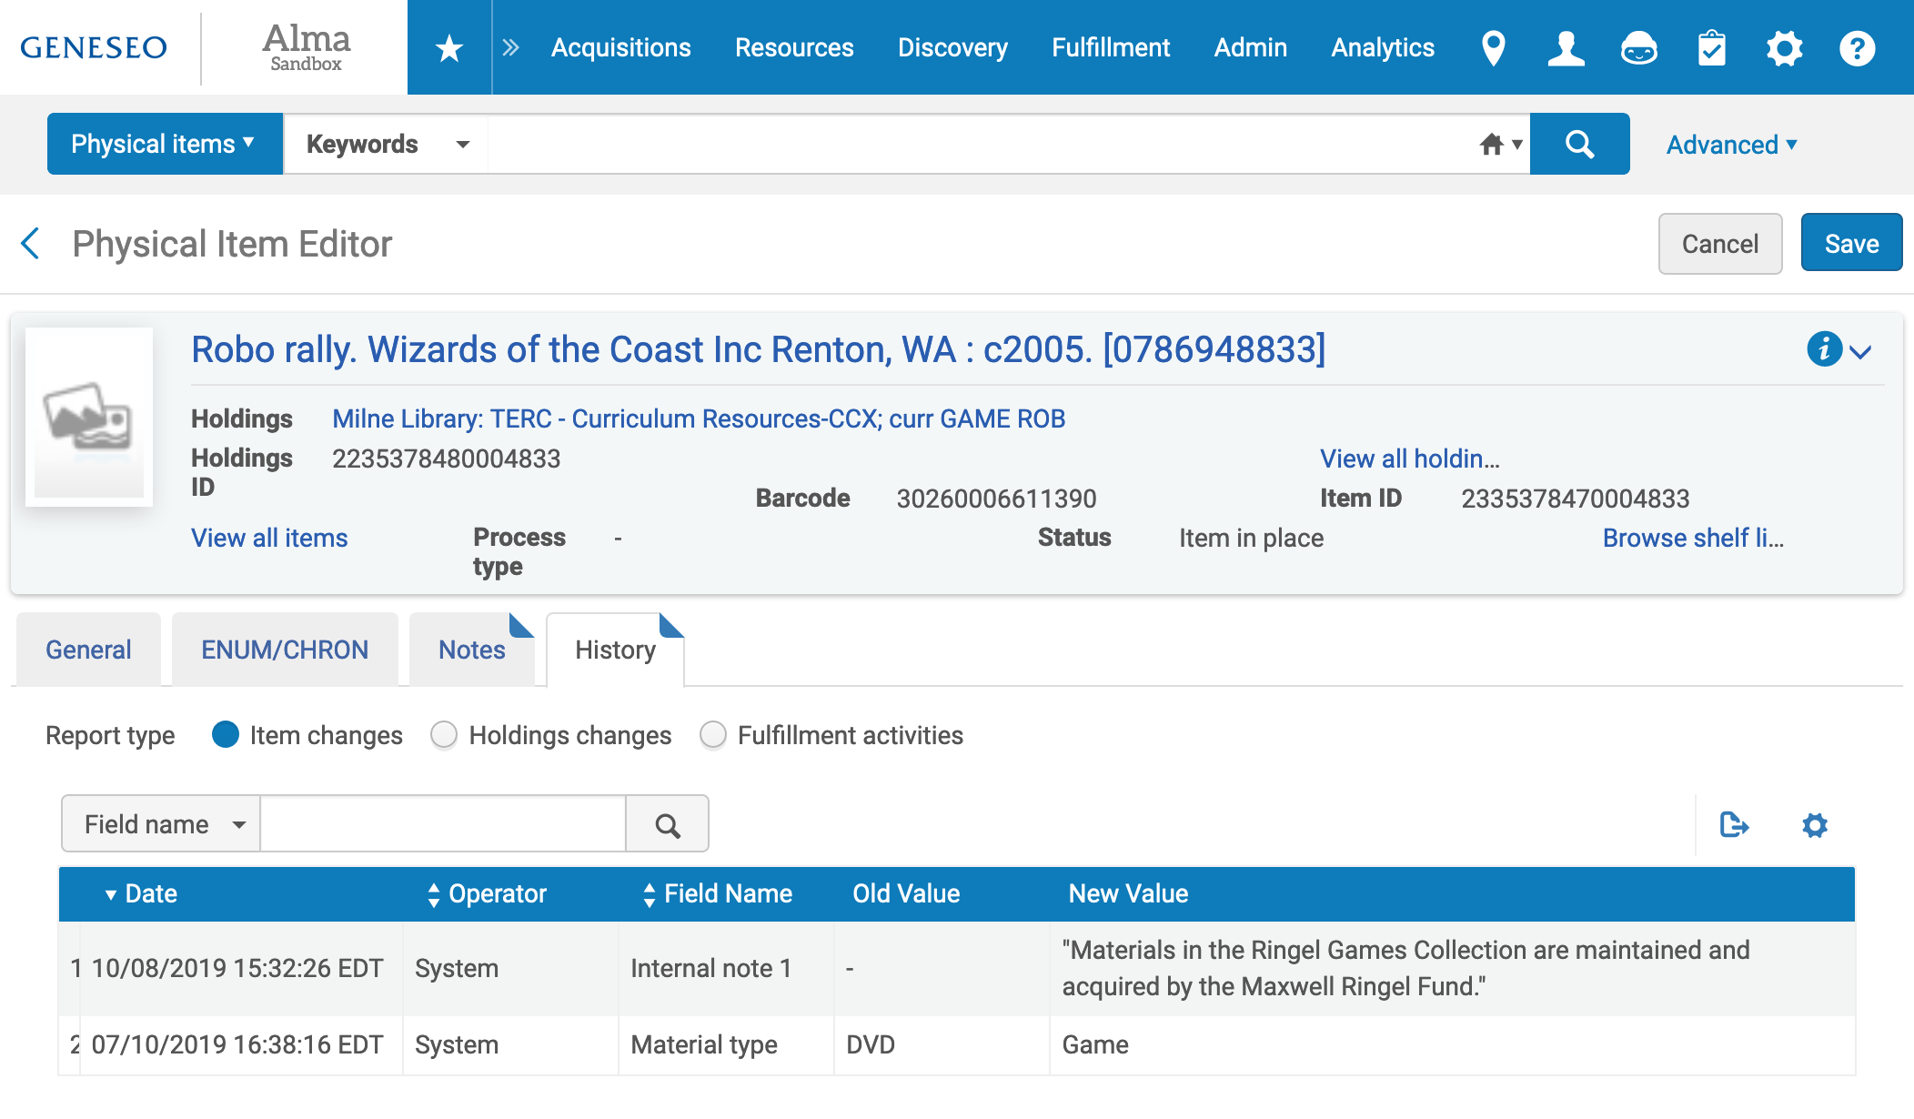
Notes:
Another way to review changes is to review the records that were change. For the Change Physical Items job, we can go into the Physical Item Editor for an item, see the new information under the General or Notes tabs, and also see a history of the changes on the history tab.

Slide 36
Questions?
https://slcny.libguides.com/training-sets-jobs

