Slide 1
Pediatric Weight Management ECHO® Session Topic:
Presenter(s): Jenny Warnick, PhD
Date: June 15, 2023
PLEASE NOTE: Project ECHO case consultations do not create or otherwise establish a provider-patient relationship between any clinician and any patient whose case is being presented in a project ECHO setting

Slide 2
Welcome
This session will be recorded for educational and quality improvement purposes
Please do not provide any protected health information (PHI) during any ECHO session
Introduce Yourself
Microphones
Agenda
Please turn on your video
Please enter your name and organization in the chat box
Please mute your microphone when not speaking
Introduction
Lecture
Case
Close
Discussion

Slide 3
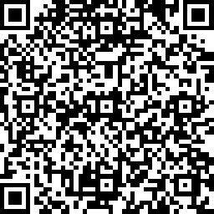
CME Credits (currently available for MDs, PAs, Rx, RNs, NPs, PsyD, PhD)
CME Credits – Please request session credits when filling out the evaluation at the end of the meeting.
Evaluation/Credit Request Form: https://www.surveymonkey.com/r/PediWtMgmtCMEEvaluation
The AAFP has reviewed ‘Advancing Community-Oriented Comprehensive Primary Care Through Improved Care Delivery Design and Community Health,’ and deemed it acceptable for AAFP credit. Term of approval is from 09/15/2022 to 09/15/2023. Physicians should claim only the credit commensurate with the extent of their participation in the activity.
NPs and RNs can also receive credit through AAFP’s partnership with the American Nurses Credentialing Center (ANCC) and the American Academy of Nurse Practitioners Certification Board (AANPCB).
Notes:
Linda

Slide 4
Agenda
Time | Topic | Presenter
7:30 – 7:35 AM | Welcome & Introductions | Linda & Liz
7:35 – 8:00 AM | Didactic: Self-monitoring & Engagement | Jenny Warnick
8:00 - 8:10 AM | Case Presentation | Jon Dooley
8:10 - 8:25 AM | Discussion | All
8:25 – 8:30 AM | Wrap up; Evaluation; Announcements | Linda
Notes:
Liz Introduce Vania

Slide 5
Today’s Faculty
Jennifer Warnick, PhD, is an Assistant Professor (Research) of Psychiatry and Human Behavior at the Alpert Medical School of Brown University and a Research Scientist at the Weight Control and Diabetes Research Center at The Miriam Hospital. Dr. Warnick earned her PhD in pediatric clinical psychology from the University of Florida in 2020. Her research interests focus on improving the health and wellbeing of youth. Her works focuses on youth who have diabetes, disordered eating behaviors, and weight concerns. Dr. Warnick is particularly driven to help youth improve their self-concept while addressing their health-related risks. Regarding her current projects, she was the PI of a Bray Fellowship Award from Brown Medical School in which she was able to adapt an evidence-based weight management intervention for adolescents with type 1 diabetes. She is currently the PI of a NIDDK-funded K23 Career Development Award, where she will test the preliminary effects of that intervention. Dr. Warnick is also a Co-I on a JDRF-funded trial testing the efficacy of an ACT-based intervention to treat persons with comorbid diabetes and eating disorders. Dr. Warnick's long-term goals are to continue developing and disseminating evidence-based treatments to youth to reduce their risk for cardiovascular disease and eating disorders.

Slide 6
Disclosures
Session presenters have no financial relationships with a commercial entity producing healthcare-related products used on or by patients. If CME credits are offered, all relevant financial relationships of those on the session planning committee have been disclosed and, if necessary, mitigated.

Slide 7
Learning Objectives
Understand the pros and cons of self-monitoring for weight change
Describe various forms of developmentally appropriate self-monitoring strategies specific to obesity
Explain the various stages of patient engagement throughout obesity assessment and treatment
Develop strategies for increasing patient and family engagement in obesity treatment

Slide 8
Self-Monitoring 101
What is self-monitoring?
Systematic observation and recording of target behaviors
What behaviors are useful to self-monitor for pediatric obesity?
Dietary consumption
Physical activity engagement
Minutes of sedentary time/screen time
Weight

Slide 9
Self-monitoring 101
Self-monitoring of behaviors (i.e., diet consumption, exercise) strongly associated with weight loss, regardless of demographic differences (Germann et al., 2007; Salaens & McGrath, 2003)
Increased self-monitoring of PA and sedentary time associated with positive change (Epstein et al., 2000)
Consistency matters!
Self-monitoring of >75% of all foods eaten/wk associated with weight loss; <50% not associated with weight loss (Boutelle et al., 1998)

Slide 10
Self-Monitoring Methods
What is the best way to self-monitor (e.g., app, paper diary)?
What is the best way to monitor specific behaviors (e.g., calories, snacks only, minutes of activity, pedometer, etc.)?

Slide 11
Self-Monitoring Methods
What is the best way to self-monitor (e.g., app, paper diary)?
What is the best way to monitor specific behaviors (e.g., calories, snacks only, minutes of activity, pedometer, etc.)?
Answer = It depends….

Slide 12
Self-Monitoring Methods
Paper vs. technology
Personal preference – may not be what you expect
Research inconsistent
In adult studies, effect is equivalent (Wang et al., 2018)
More research needed in child studies (Darling et al., 2017; Turner et al., 2015)
Small-medium, non-significant effect of PA monitoring via mHealth
Small significant effect on diet monitoring via mHealth
Barriers mHealth self-monitoring for to pediatric patients
Age to use some apps
Access mobile technology
Ability to understand data output
Privacy and safety concerns (i.e., messaging)

Slide 13
Self-Monitoring Methods
Diet/Food
Calories
Traffic Light System
Food Groups/MyPlate
Activity
Minutes
Steps
Days
Sedentary Time
Minutes
Types of Activities
Chunks of Time
Weight
Once/week
Photos or Diary
App

Slide 14
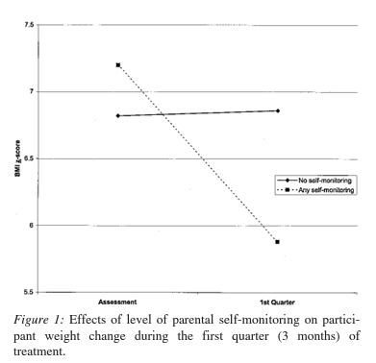
Self-Monitoring: Influences
Parental modeling
Children whose parents who modeled self-monitoring of themselves were more likely to self-monitor and lose weight (Germann et al., 2007; Kirschenbaum et al., 2005)
Parental support key for some, particularly younger children
Parental oversight NOT helpful for teens

Slide 15
Self-Monitoring: Influences
Incentives and/or positive praise
Sticker charts for younger children
Marble jars/colored popsicle sticks
Immediate prizes → larger prizes
Non-food rewards (e.g., outings, choosing family activity, etc.)
Specific labeled praise
Natural consequences (i.e., increased energy, improved mood, feeling stronger)
Pair with something already doing

Slide 16
Self-Monitoring: What’s Not Helpful
Most generic weight-management and/or behavioral management apps are NOT evidence-based and may not be helpful (Wearing et al., 2014)
Encourage weighing no more than 1x/wk, at the same time of day, with emptied pockets and light clothing
Look out for signs of anxiety related to weighing
Weight is not in our control, behaviors like eating/activity are. Do not assume that someone isn’t trying to make changes if their weight does not change
Do not recommend calorie counting for anyone with a history of disordered eating. They should receive more direct supervision and/or consider traffic light or my plate tracking.

Slide 17
Engagement
How do I get someone to engage in treatment?

Slide 18
Engagement
How do I get someone to engage in treatment?
Answer = Not one size fits all

Slide 19
Engagement
Darling, K. E., Warnick, J., Guthrie, K. M., Santos, M., & Jelalian, E. (2023). Weight management engagement for teens from low-income backgrounds: Qualitative perspectives from adolescents and caregivers. Journal of Pediatric Psychology, jsad008.

Slide 20
Engagement
Low rates of engagement, especially with teens and Medicaid recipients
Barriers:
Stigma and shame
Not believing it is a problem
Lack of specific direction on behavior change
Too large of expectations for change
Transportation/time
Other life stressors/prioritizing other things
Access to produce, safe place to exercise, etc.

Slide 21
Engagement
Facilitators
Parental encouragement/support
Health concerns for parents only (teens are not motivated by this)
Connection with providers
Frequent check-ins
Identifying specific motivators for change (often NOT health-related)
SMART goals chosen by patient (with support)
Incentives
Helpful problem solving and normalizing/validating challenges

Slide 22
Engagement
Important reminder: Do not assume you know the reason someone is not engaged in treatment. Could be multifaceted. May not have to do with motivation.
Listen, Validate, Ask Questions
Convey you are on the same team

Slide 23
References
Boutelle, K. N., & Kirschenbaum, D. S. (1998). Further support for consistent self‐monitoring as a vital component of successful weight control. Obesity research, 6(3), 219-224.
Browne, V. R., Bruno, D. M., Dhuper, S., & Afable, A. (2022). Insights into the challenges and facilitators to physical activity among brooklyn teens enroled in a weight management programme. Health Expectations, 25(4), 1832-1843.
Darling, K. E., & Sato, A. F. (2017). Systematic review and meta-analysis examining the effectiveness of mobile health technologies in using self-monitoring for pediatric weight management. Childhood Obesity, 13(5), 347-355.
Epstein, L. H., Paluch, R. A., Gordy, C. C., & Dorn, J. (2000). Decreasing sedentary behaviors in treating pediatric obesity. Archives of pediatrics & adolescent medicine, 154(3), 220-226.
Germann, J. N., Kirschenbaum, D. S., & Rich, B. H. (2007). Child and parental self-monitoring as determinants of success in the treatment of morbid obesity in low-income minority children. Journal of pediatric psychology, 32(1), 111-121.
Hampl, S., Paves, H., Laubscher, K., & Eneli, I. (2011). Patient engagement and attrition in pediatric obesity clinics and programs: results and recommendations. Pediatrics, 128(Supplement_2), S59-S64.
Kirschenbaum, D. S., Germann, J. N., & Rich, B. H. (2005). Treatment of morbid obesity in low‐income adolescents: effects of parental self‐monitoring. Obesity Research, 13(9), 1527-1529.
Salaens, B. E., & McGrath, A. M. (2003). Self-monitoring adherence and adolescent weight control efficacy. Children’s Health Care, 32, 137–152
Turner, T., Spruijt‐Metz, D., Wen, C. F., & Hingle, M. D. (2015). Prevention and treatment of pediatric obesity using mobile and wireless technologies: a systematic review. Pediatric obesity, 10(6), 403-409.
Wang, J., Cai, C., Padhye, N., Orlander, P., & Zare, M. (2018). A behavioral lifestyle intervention enhanced with multiple-behavior self-monitoring using mobile and connected tools for underserved individuals with type 2 diabetes and comorbid overweight or obesity: pilot comparative effectiveness trial. JMIR mHealth and uHealth, 6(4), e4478.
Wearing, J. R., Nollen, N., Befort, C., Davis, A. M., & Agemy, C. K. (2014). iPhone app adherence to expert-recommended guidelines for pediatric obesity prevention. Childhood Obesity, 10(2), 132-144.

Slide 24
Resources

Slide 25
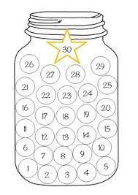
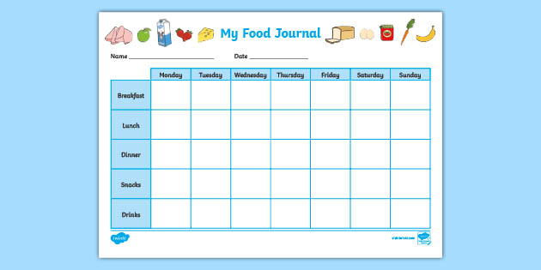
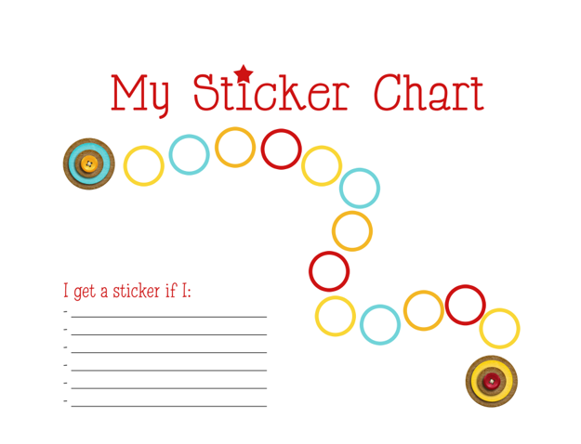
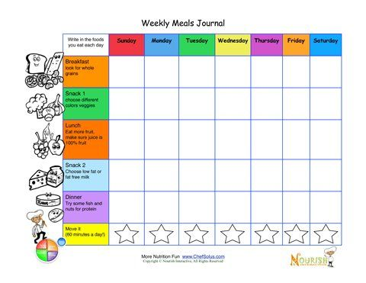
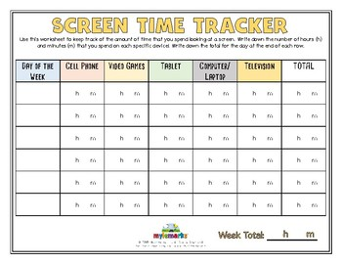
Resources

Slide 26
Contact information
Jennifer_Warnick@brown.edu
401-793-8757

Slide 27
Pediatric Weight Management ECHO® Case Presentation
Presenter(s): Jon Dooley, MD
Date: June 15, 2023
Contact Info: St. Joseph Health Center, 456-2406
PLEASE NOTE: Project ECHO case consultations do not create or otherwise establish a provider-patient relationship between any clinician and any patient whose case is being presented in a project ECHO setting
Care Transformation Collaborative of RI
Prepared by Care Transformation Collaborative of RI

Slide 28
Reasons for Selecting this Case
Do Not Include PHI
Why did you choose this case? | Lack of engagement in treatment/making changes
What questions do you have for the group? | How do you engage patients where the whole family has obesity before complications develop? How to help families recognize the seriousness of the condition?

Slide 29
Basic Patient Information
Do Not Include PHI
Age | 15
Gender Identity | Male
Race/Ethnicity | Hispanic
Current Weight and Height | Weight: 393lbs Height: 6ft 1.2in
 | BMI 50 – class 3 – severe obesity
How long has the patient had concerning growth trends? | From an early age – we started seeing him in 2018
How long has this individual been in your care? | October 2022 – only seen him twice
Insurance type (Commercial, Medicaid, Uninsured, Other) | Neighborhood Medicaid
Current BMI and BMI%/Obesity class

Slide 30
Relevant Background
Do Not Include PHI
Relevant medical and/or behavioral comorbidities | Exercise-induced asthma, elevated blood pressure without diagnosis of hypertension, eczema History of sleep apnea that improved after tonsil removal
Relevant medications | None
Relevant lab results | Normal: CBC, liver tests, thyroid tests Cholesterol 186 His A1c is 5.5
Relevant BH Screening results | PHQ9 score of 11, HEADSS negative (school stress, sleep pxs)
Relevant SDOH Screening results | Negative

Slide 31
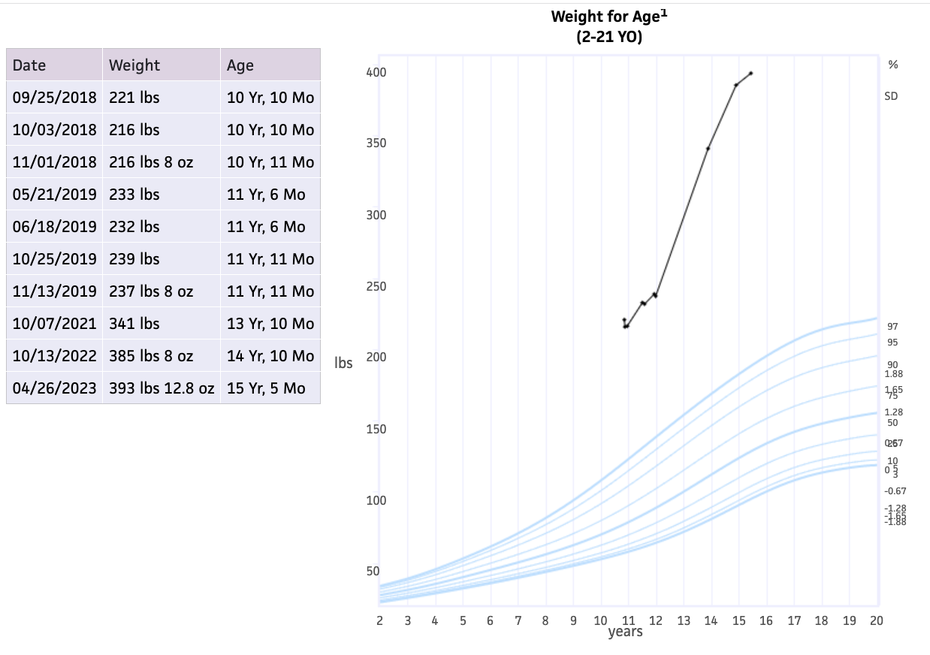
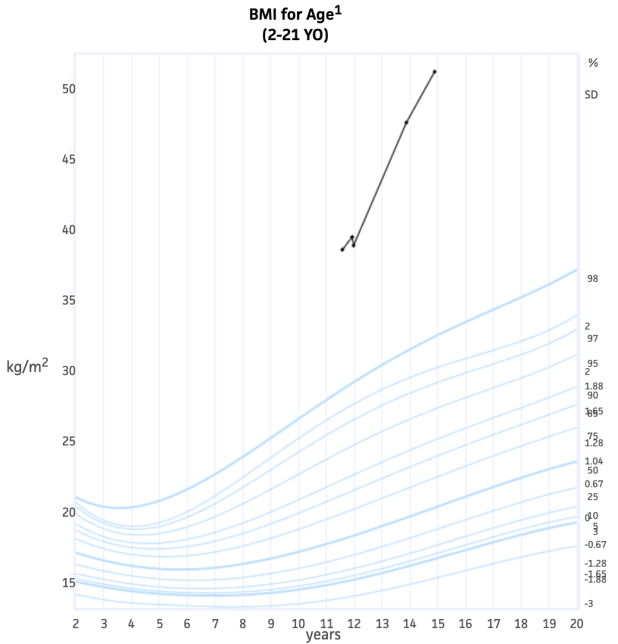
Growth Curve
Do Not Include PHI

Slide 32
Relevant Social History
Do Not Include PHI
Relevant obesity related family history? | Mom and all 3 sibs are obese Mom had liposuction/abdominoplasty this year
Family/patient history of trauma? | No significant traumas But history of behavior struggles in 2018; saw IBHC briefly
School related concerns? | 10th grade, As and Bs, no history of bullying or school problems
Other social history concerns? | Single mother; father not in the picture

Slide 33
Patient /Family Strengths?
Do Not Include PHI
He is a great guy, polite, respectful, cooperative
Mom expresses concern about him…
There has been some attention to follow ups (tonsils)

Slide 34
Nutrition
Do Not Include PHI
What interventions have been tried? How responsive has the family been to nutrition intervention? | Referred but declined nutrition 3x Weight check appt – no shows and no changes
What barriers have the family identified for improving nutrition? | Educational barrier? Eating addiction issues?
Does the patient have any of the following: Excessive hunger Night-time eating or binging Sneaking food Other | Eating out of boredom Night snacking, especially alone in his room
Other concerns with nutrition/eating (such as cultural considerations)? | High carb cultural food diet at home

Slide 35
Physical Activity
Do Not Include PHI
What interventions had been tried? How responsive has the family been to physical activity recommendations? | None, no sports, no free gym membership, no after school or summer activities
Does the patient engage in regular physical activity? (yes/no) Please describe | No
Is screen time a significant part of the patient’s social time? (yes/no) Please describe | Yes – he escapes to his room to use internet and play video games
Other concerns with physical activity/exercise (such as physical restrictions, access, environmental safety)? | Environment, transportation

Slide 36
How did you try to engage the patient/family?
Do Not Include PHI
Offered close follow up
– they came for one and didn’t make change (cutting sugary drinks), and also no-showed for 2 appts
Offered visits with IBH team
– they did not call, a call by IBH clinician went unanswered
Offered social work help to assist with finding gym membership, summer programs
– chose not to wait to speak with her
Offered referrals x 3 for outside nutritionist (we do not have in-house)
– no appts made
Next: employing our newly hired community health worker
Any other ideas??

Slide 37
Reasons for Selecting this Case
Do Not Include PHI
Why did you choose this case? | Lack of engagement in treatment/making changes
What questions do you have for the group? | How do you engage patients where the whole family has obesity before complications develop? How to help families recognize the seriousness of the condition?

Slide 38
Recommendations:
Engaging with the mom
Great idea to connect with her, may segue with her weight issues/procedures
Communication language barrier can be difficult
Asking what is most important to her?
May be a lack of modeling around him for exercising; Cultural differences, with Hispanic families there may be reluctance to exercise. Boys of this age group can be expected to start “doing it himself” but they often need more guidance (does he have anyone to exercise with?)
Speaking with teen
Move towards a lifestyle conversation, rather than weight specifically (talk about mood)
What motivates him? “Taking weight off the table, what makes you feel good?”
To get a “foot in the door” can mean a phone call, telehealth call, connecting informally on any personal level with teen can make it easier for him to open up
Does the teen feel more protected at his size?
Lack of self esteem?
PHQ score can be a concern
Role of medication/surgery?
Trying to get medication management
Mom had a tummy tuck; does she see surgery as the solution? Need her perspective
Do Not Include PHI

Slide 39
CME Credits (currently available for MDs, PAs, Rx, RNs and NPs)
Please provide us your feedback!
Evaluation/Credit Request Form: https://www.surveymonkey.com/r/PediWtMgmtCMEEvaluation
Please request CME credits when filling out the evaluation at the end of the meeting
The AAFP has reviewed ‘Advancing Community-Oriented Comprehensive Primary Care Through Improved Care Delivery Design and Community Health,’ and deemed it acceptable for AAFP credit. Term of approval is from 09/15/2022 to 09/15/2023. Physicians should claim only the credit commensurate with the extent of their participation in the activity.
NPs and RNs can also receive credit through AAFP’s partnership with the American Nurses Credentialing Center (ANCC) and the American Academy of Nurse Practitioners Certification Board (AANPCB).
Notes:
Linda

Slide 40
Announcements
Next Session: Thursday July 20th, 7:30-8:30am
Topic: Practice Sharing
Practice Presentations
July
Atlantic
TriCounty
SJHC
Westerly
August
Santiago
Waterman
Anchor

