Slide 2
NC AHEC Overview
This slide deck can be used as an orientation tool for new staff or as a helpful resource for staff who want to learn more about other areas within NC AHEC.
For presentations with partners, check out About NC AHEC

Slide 3
NC AHEC
The mission of the NC AHEC Program is to provide and support educational activities and services with a focus on primary care in rural communities and those with less access to resources to recruit, train, and retain the workforce needed to create a healthy North Carolina.
Our vision is a state where everyone in North Carolina is healthy and supported by an appropriate and well-trained health workforce that reflects the communities it serves.
3

Slide 4
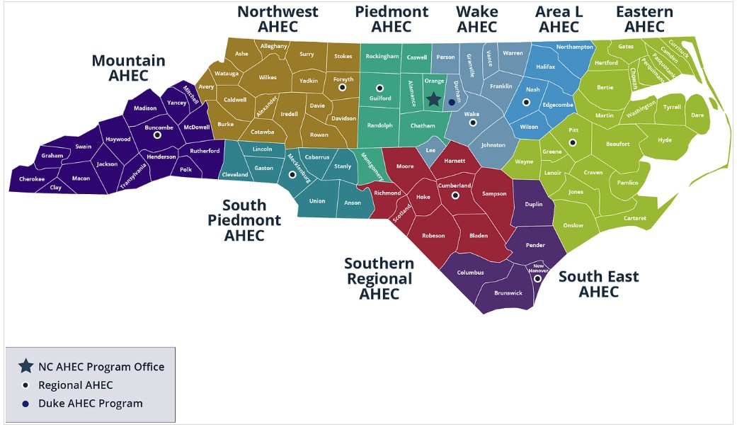
NC AHEC MAP

Slide 5
NC AHEC – CORE STRATEGIES
NC AHEC provides and coordinates services and support to achieve our results.
Recruit
Train
Retain
To ensure an appropriate supply of trainees/students to pursue health careers, particularly those who reflect their communities
To encourage health professions trainees/students and healthcare professionals to practice in interprofessional and primary care settings in rural and under-resourced communities
To retain the health workforce with a focus on the diversity of providers, interprofessional teams, and primary care settings in rural and under-resourced communities
5

Slide 6
NC AHEC – ORIGINATION
NC AHEC evolved to leverage NC’s medical schools and community hospitals to respond to national and state concerns with the supply, distribution, retention, and quality of health professionals
A national focus on the health care workforce coincided with a growing effort in NC to establish statewide community training for health professionals and to reverse a trend toward shortages and uneven distribution of primary care physicians in the state’s rural areas.
Interview with Dr. Cutchin on AHEC’s History
The NC General Assembly approved and funded a plan to create a statewide network of nine AHEC regions in partnership with NC medical schools and community hospitals.
The NC AHEC Program began in 1972 with three AHEC regions under a federal AHEC contract with the UNC Chapel Hill School of Medicine.
By 1975, all nine AHECs were operational.
1970s
1972
1974
1975
There are AHECs across the country in other states- to find out more about national efforts visit NAO
6

Slide 7
REGIONAL AHECS – GOVERNANCE & EXPENDITURES
AHEC | 501(c)(3) or Contractual Agreement
Area L | 501(c)(3)
Eastern | 501(c)(3)
Piedmont | Moses H. Cone Memorial Hospital
Mountain | 501(c)(3)
Northwest | Wake Forest University Health Sciences
South East | Novant Health New Hanover Regional Medical Center, LLC
South Piedmont | Wake Forest University Health Sciences/Atrium Health
Southern Regional | 501(c)(3)
Wake | WakeMed
Duke AHEC Program Office | Supports Southern Regional AHEC
7

Slide 8
NC AHEC PROGRAM – STATE FUNDING EXPENSES, FY23
Total NC AHEC Expenditure = $48,730,103
8

Slide 9
Operating More Like A System
Define the use of state funds: 5-year operating contract
Define the work: Annual Work Statement
Measure the work: Performance Measures
Improve the work: RBA and our Strategic Plan
Align finances and the work: Unallocated funds & Budget Guidelines
This positions us to:
respond to opportunities
understand gaps and opportunities for alignment and efficiency
demonstrate need for additional funding
FY23-25
Strategic Plan

Slide 10
Infusing Results-Based Accountability (RBA) Concepts in NC AHEC
The NC AHEC Strategic Plan adopted Results-Based Accountability as our framework to translate strategies into program results.
RBA teaches there are two types of accountability: population accountability and performance accountability. Being accountable for the performance of our programs is our direct responsibility. We use data and disciplined thinking to tell how much we do, how well we do it, and most importantly, if anyone is better off from the service(s) we provide.
RBA “turn the curve thinking” ensures accountability for the performance of our programs and demonstrates our contribution toward achieving the NC AHEC population result: “Everyone in North Carolina is healthy and supported by an appropriate and highly competent health workforce that reflects the communities it serves.”
Each AHEC and the Program Office have at least one certified RBA professional as their in-house resource.
Notes:
Claire
What is RBA?
RBA is a straightforward method of measuring impact that starts with the aim in mind and works backward to the means. It is a method of thinking and doing that can be used to enhance the lives in communities, cities, counties, states, countries, and program performance.
RBA was developed by Mark Friedman and described in his book Trying Hard is Not Good Enough.
RBA is being used in all 50 States and in more than a dozen countries around the world to create measurable change in people’s lives, communities, and organizations.
Give examples of who using it
Where is RBA being used in North Carolina?
SHA -SHIP
CHA-CHIP-SOTCH
Strategic Plans
Hospitals/health systems beginning to use it in their community health improvement work
Funders

Slide 11
NC AHEC – CORE SERVICE LINES
NC AHEC weaves through all sectors of health care education and workforce.
Health Careers & Workforce Diversity
Student Services
Graduate Medical Education Support
Continuing Professional Development
Practice Support
Library Services
11

Slide 12
GRADUATE MEDICAL EDUCATION (GME)

Slide 13
Graduate Medical Education (Residency) Support
NC AHEC improves the distribution and retention of primary care physicians.
We help support—and in rural and underserved areas of the state, operate—the residency programs necessary for primary and community care. Residents in AHEC-based and AHEC-supported primary care residencies stay to practice in NC, particularly in rural and under-resourced communities.
13
NC AHEC

Slide 14
UME/GME
UME= Medical school
Has not been a significant part of AHEC role- Medical education precepting is a developing part of the service line
GME= Graduate Medical Education
AHEC started in large part to support community-based GME and contribute to solving access problems away from large cities
Most of the resources are pass through funds designated as ‘stipend’ and ‘non-stipend’ dollars

Slide 15
Funds
Stipend Funds
293.1 positions, $11,790 each, $3,455,649 total
Almost all primary care, mostly family medicine
Awarded to Cabarrus Family Medicine, Duke University, EAHEC, MAHEC, NWAHEC, Piedmont, SEAHEC, South Piedmont, SRAHEC, UNC, and Wake AHEC
In many cases, these resources were critical to launching new family medicine residency programs
Non-stipend funds
More focused on innovation, faculty development, and faculty support
Awarded to most regional AHECs, including EAHEC, NWAHEC, Piedmont, SEAHEC, South Piedmont, SRAHEC, MAHEC, and Wake

Slide 16
General Organization
Relationship of Regional AHEC to GME varies
In two cases (MAHEC and SRAHEC) the AHEC is the sponsoring institution of the residency
In other cases, the relationship varies due to such factors as dual roles (AHEC director leads GME at institution), position of AHEC in health system (independent agency versus hospital department) and historical relationship
There is no service line group for GME because some AHECs have a less active role in GME

Slide 17
GME Collaborative
Quarterly meeting of GME administrative leadership to problem solve and network
Annual in-person meeting
Quarterly meetings of Designated Institutional Officials (DIOs)
Other support of primary care workforce development
State Health Improvement Plan (SHIP) Primary Care Work Group
NC AHEC HNC2030 Primary Care workgroup

Slide 18
Support for Community-Based GME (In Development)
Faculty Development
Staff Development
Mentorship
Networking
Coaching

Slide 19
Want to Learn More?
Join the NC AHEC Staff Mailing List
Visit the NC AHEC Internal Depository

