Slide 1

Advanced Discovery: Authentication and My Account
February 19, 2020
Michelle Eichelberger
Michelle.Eichelberger@suny.edu

Slide 2
Plan for Today
Review all of the Primo VE patron login options
Learn what patrons gain by logging in
Understand how factoring in the user group or user dictates what is displayed when searches are conducted
Understand how to configure advanced authentication services
Understand what is displayed in My Account and how it can be configured. Learn how to post notifications in a patron's account
Not going to cover SIS load, how to set up patron accounts, etc., just the front end
www.suny.edu

Slide 3
Primo VE Logins
Primo/Alma login:
What patrons use to get access to My Library Card, see request options, see loan details, etc. E.g. CAS, SAML
Proxy:
What patrons use to get access to content outside of the IP range registered with the vendor. E.g. Ezproxy, OpenAthens
ILLiad:
What patrons use to request content not available through SUNY Resource Sharing. E.g. articles, other electronic content
www.suny.edu

Slide 4
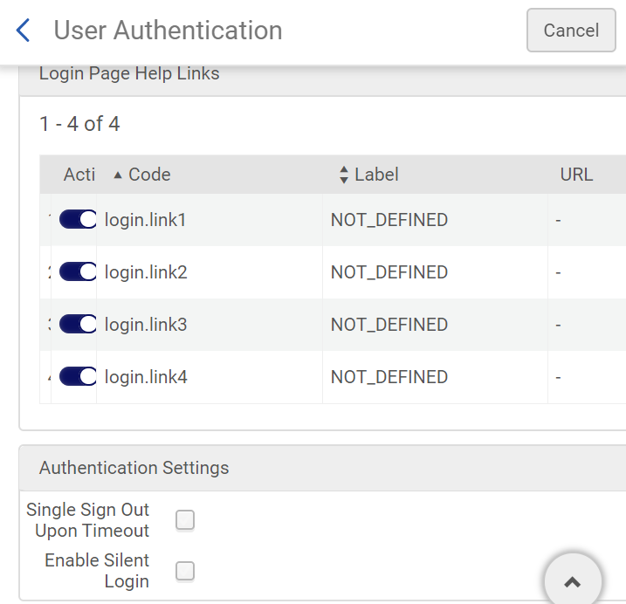
Primo VE Logins
Why can’t we just have one login that work for everything?
Can set it up to be the same login system (CAS, etc.) but it won’t automatically log patron into all three at same time
Silent login activation (Discovery->Authentication->User Authentication, scroll down. This can log patron into Primo if they’re already logged into Banner or Blackboard or something else using same login system. Not foolproof.
www.suny.edu

Slide 5
Primo VE Logins
Because you can’t automatically login to all three systems, leaves you with choices:
What do you want to make your patrons login to see?
  Proxy: they’re used to having to login from stand-alone databases or previous discovery systems. If you allow fulfillment to show without logging in then patrons needs just one login to get to article off-site
  ILLiad request option: do you want to put this behind the “login in to see request options” button? Then patron has to login to see the request, then login to ILLiad to place the request.
  Do you want to activate content that can’t be seen without logging in, like the EBSCO scope?
  How strongly do you feel about patrons being able to see item policy info for loans?
  Do you want to force login to do anything in Primo? Can make it challenging for troubleshooting, hard for guests to use, etc.
  Do you have request options like Reprints Desk that you only want certain groups to see?
www.suny.edu

Slide 6
Primo VE Login Pros and Cons
Pros:
Access to My Library Card:
Can renew items, check fines, track holds and requests, see messages from library staff, etc.
Can save research, set up search alerts
Real-time Loan info:
Full record will give information about their item policy rights, whether material is loanable, etc.
Request:
Request options will show right away, don’t have to login to see button
Cons:
Can be a barrier to access:
Patron might be an on-campus guest with no account
Patron might be in a hurry and just need one article
Another SUNY library staff member might be trying to use a different Primo instance to troubleshoot a local issue
Patron might have lost their account info (less likely these days, but possible)
www.suny.edu

Slide 7
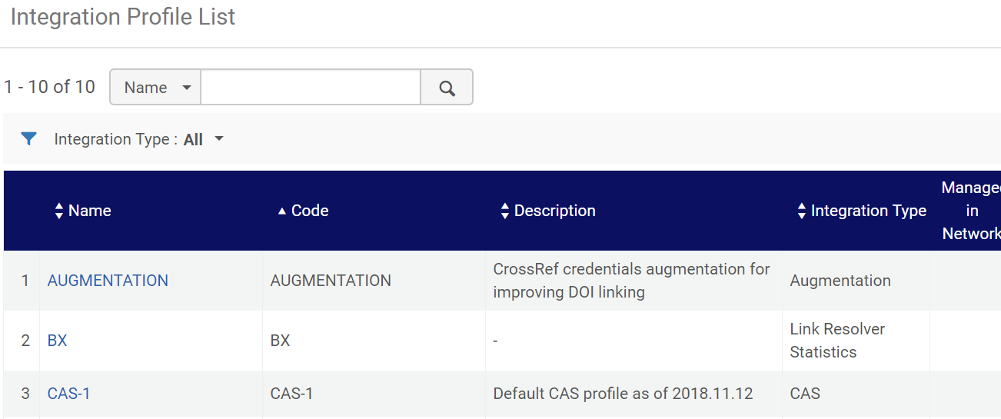
Primo VE Login Configuration
Where do login options come from?
Alma type is out of the box – for community users or anyone who doesn’t have account on your integrated system (CAS, SAML, etc.). You manage password and expiration in user account.
You add all other login integration in General->External Systems->Integration Profiles
Can have up to 5 login options
www.suny.edu

Slide 8
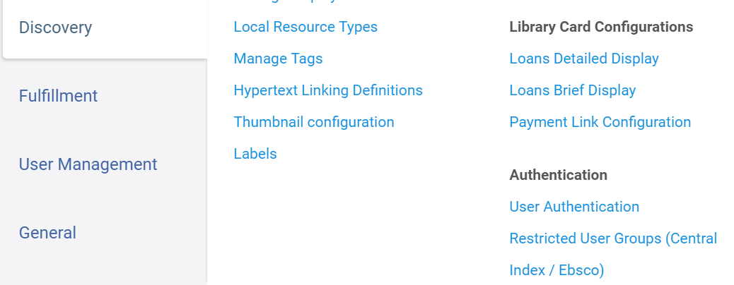
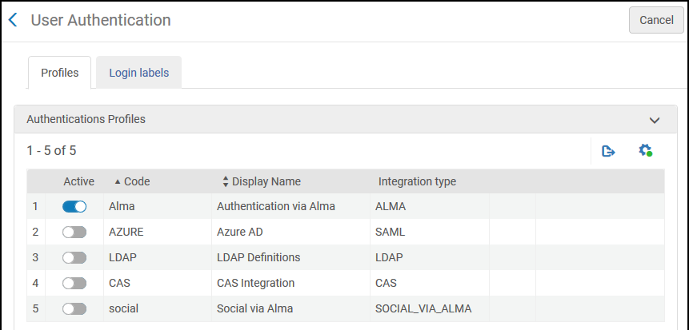
Primo VE Login Configuration
Once integration profiles are set up, options should show in Discovery->Authentication->User Authentication
You can decide which ones you want to use
If you only choose one, the patron will be taken immediately to login page
www.suny.edu

Slide 9
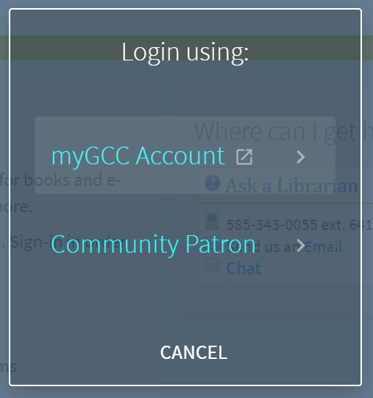
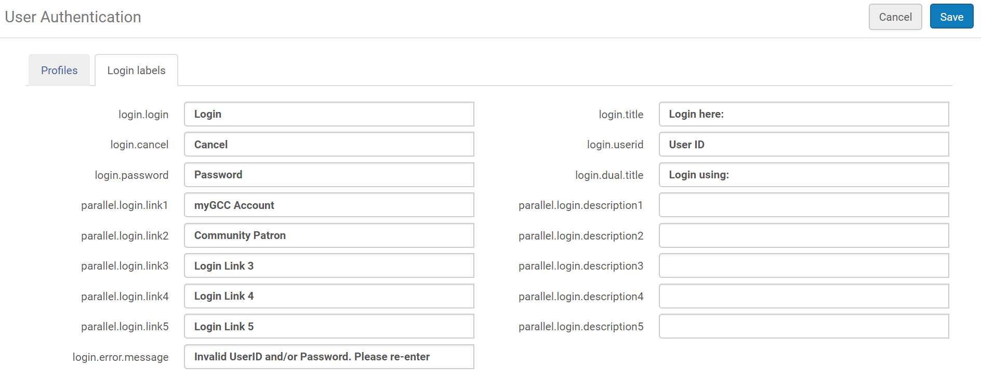
Primo VE Login Configuration
If you choose more than one authentication method, the patron will be given a choice as to which one they want to use. You can configure the language on that selection page.
www.suny.edu

Slide 10
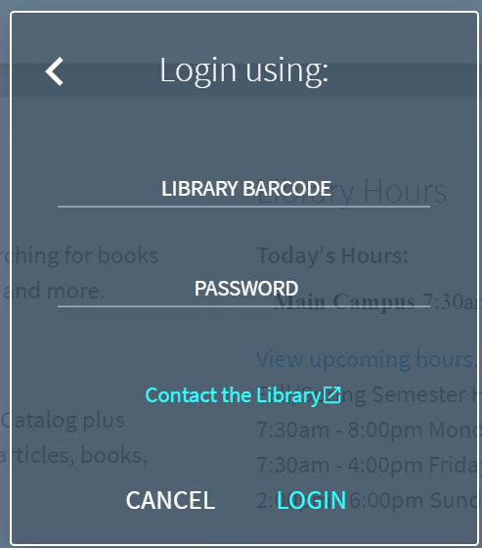
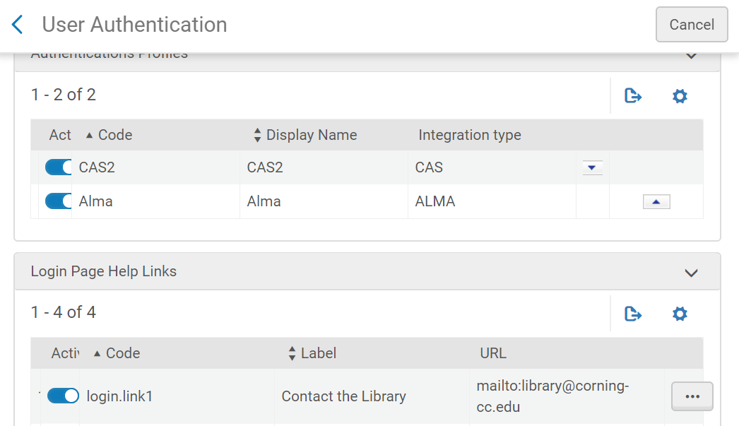
Primo VE Login Configuration
You can also configure the help information for the Alma login.
Can probably also change css for Alma login box by inspecting element and finding codes.
www.suny.edu

Slide 11
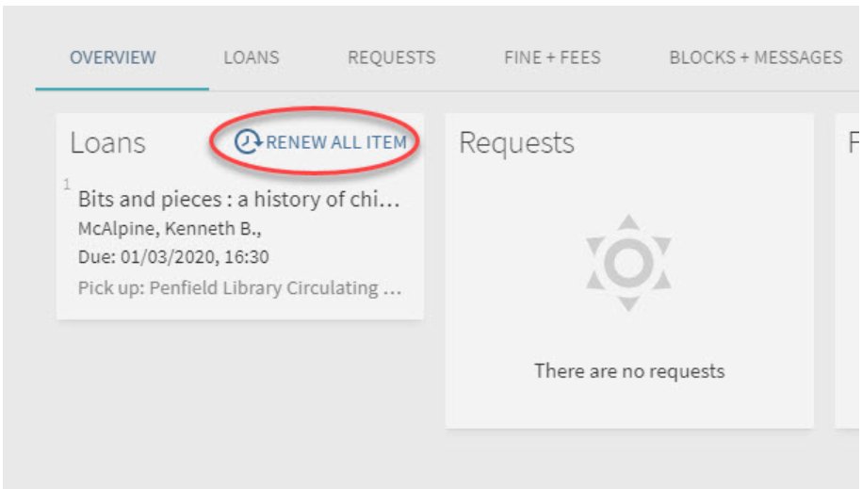
Configuring My Library Card - Advanced
Covered basics in Designing Primo VE: 6 month tune-up
Basecamp hide “Renew All”: Juan Denzer’s code:
/* My Libray Card Section*/
prm-loans-overview .md-button {
display:none;
}
Add to custom.css file, will hide on Overview page, if you want to suppress on Loans page will need to inspect code to find correct piece to hide. Initial trial made all “renew” options disappear on Loans tab.
www.suny.edu

Slide 12
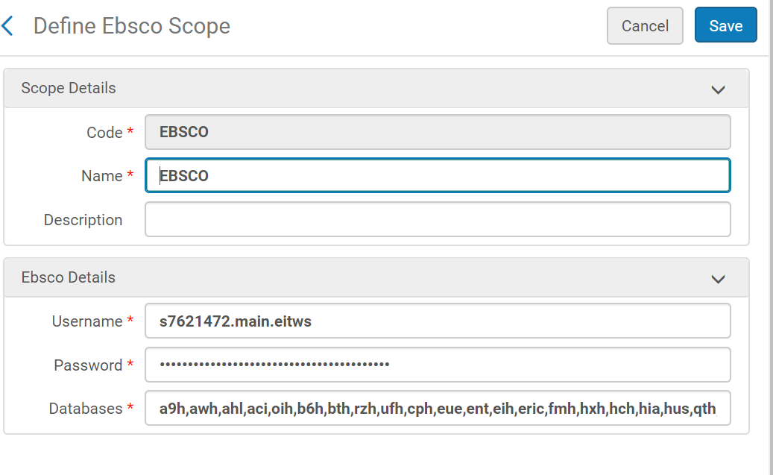
Hiding Content by User Group: EBSCO Scope
Ex Libris set up EBSCO scope for all SUNY campuses. Can see it in Discovery->Search Configuration->Search Profiles, Other Indexes tab
Discovery Working Group recommended not using it as a scope because you have to be logged into Primo to get results, the facets are different from Alma and PCI content facets, etc.
www.suny.edu

Slide 13
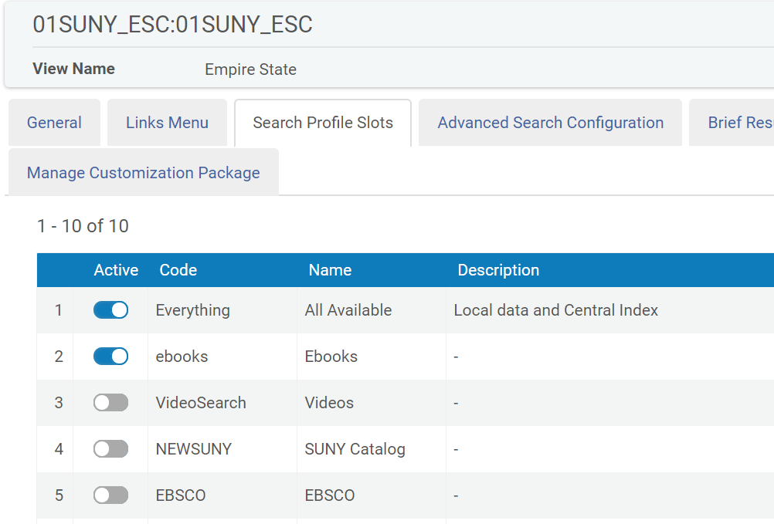
Hiding Content by User Group: EBSCO Scope
If you did want to turn it on, you’d activate it in your View Configuration, Search Profile Slots tab
www.suny.edu

Slide 14
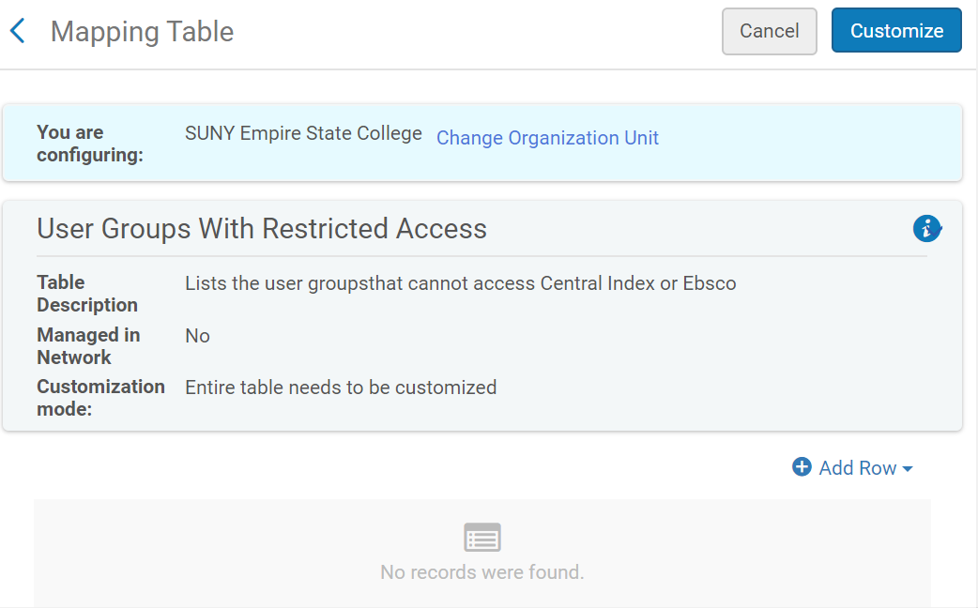
Hiding Content by User Group: EBSCO Scope
Can hide content from Central Index (articles, book chapters) and EBSCO scope from user groups
www.suny.edu

Slide 15
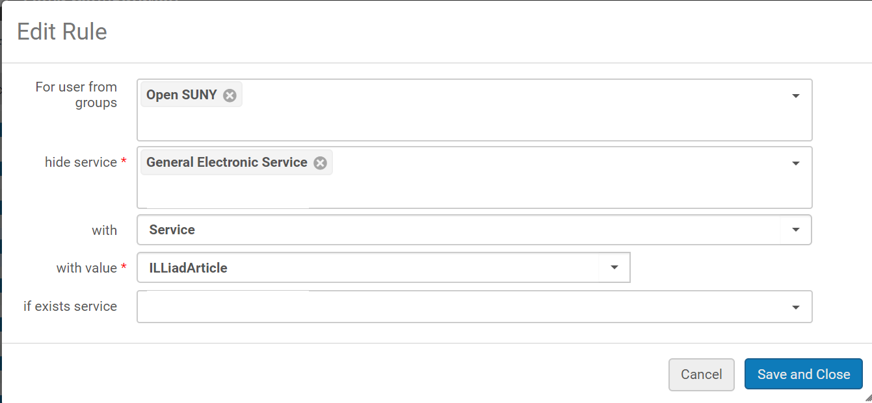
Hiding Content by User Group: Display Logic
Keep in mind that if you want to hide a service or collection by user group, ALL users will have to login to see it because otherwise Primo won’t know whether or not to display for that patron. Can’t hide for one group and leave showing before login for another.
E.g. Can’t hide ILLiad for community patrons but leave it outside of login for everyone else.
www.suny.edu

Slide 16
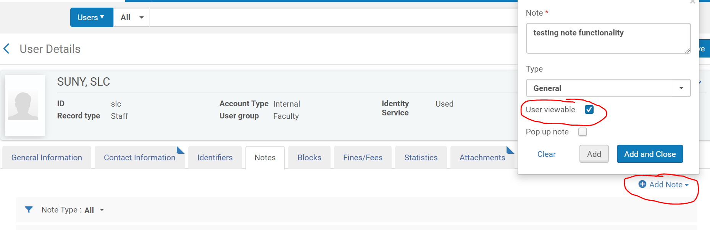
Patron messages
Add a message in a patron’s my library card
www.suny.edu

Slide 17
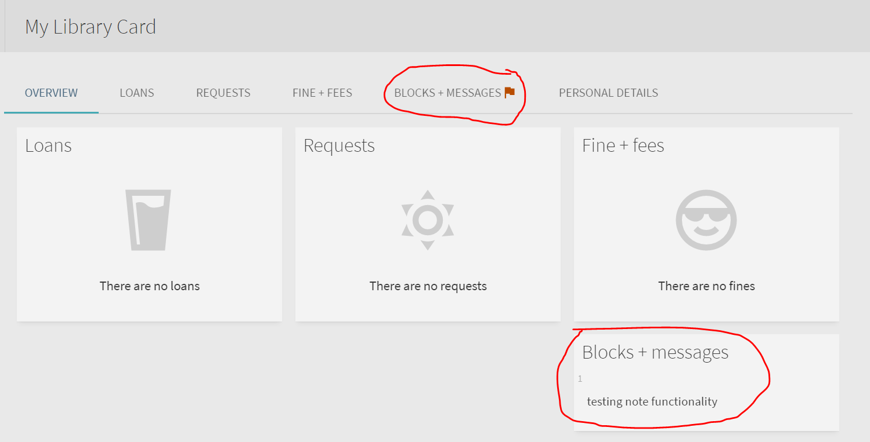
Patron messages
Flag in Blocks & Messages and appears in bottom right
www.suny.edu

Slide 18
References
https://knowledge.exlibrisgroup.com/Primo/Product_Documentation/020Primo_VE/030Authentication_Configuration/010Configuring_User_Authentication_for_Primo_VE
https://slcny.libguides.com/training-primo-discovery/authentication
www.suny.edu

