Slide 1
MSP-50: Policy for Deleting, Withdrawing, and Suppressing materials in the Institutional Zone
Shared Library Services Platform Project
Maggie McGee

Slide 2
MSP-50: Policy for Deleting/Withdrawing/Suppressing in the IZ
MSP-50: Policy for Deleting/Withdrawing/Suppressing material in the Institutional Zone
Policy Justification: MSP-27 from the SMSP states that bare NZ records should not be deleted from the NZ. A standard policy as to how withdrawals in the IZ are handled is necessary to produce more accurate analytics reports, as well as improve searching and retrieval of records in Alma
MSP-50 is based upon Cal State’s Withdrawals (Operational Policy)
MSP-50 was reviewed and approved by the SLC LSP Advisory Board on July 1, 2019

Slide 3
SMSP
SMSP guiding principles are used in the creation of MSP policies and procedures
The SMSP recommendations encourage withdrawing old acquisitions data and records in Alma to better inform acquisitions and analytics going forward
Suppressing deleted bib records in Alma is not recommended
Alma pricing is based upon number of bib records
Keeping withdrawn bib records and suppressing them will create clutter in the Alma environment and cost us more SUNY-wide
Notes:
Our Alma pricing is also based on # of bib records. At 5 years, our pricing will be subject to review of our environment. Just want to make sure that we're deleting these bib records in a way that these won't be seen as active bib records by EXL. The pricing per bib record is pretty minimal (I think .01 cents per bib record). But, this question will come up, and we should probably add something about it here.

Slide 4
MSP-50: Policy for Deleting/Withdrawing/Suppressing in the IZ
MSP-50 Deletions or Withdrawals of Materials in the Institution Zone Policy justification:
Deletions or withdrawals of individual institutions’ materials are performed in the IZ. SLC needs a standard policy on how deletions and withdrawals are handled to ensure more accurate analytics reports as well as better searching and retrieval of records in Alma.
For example, if one is creating a collection analysis via analytics or SRU (Search/Retrieve via URL https://developers.exlibrisgroup.com/alma/integrations/sru/) to find the number of copies of a certain title owned ACROSS THE SUNY SYSTEM, it is extremely difficult to distinguish items that are generally part of a collection from those that have been moved to a special “withdrawn” location.
This policy complements MSP-27, which states that individual institutions cannot delete NZ records, but must request these deletions of the NZ Administrator, who will perform the deletions. Individual institutions should not delete any records from the NZ.

Slide 5
MSP-50: Policy for Deleting/Withdrawing/Suppressing in the IZ
MSP-50 Deletions or Withdrawals of Materials in the Institution Zone Policy justification:
SMSP recommendation: Move outdated data into another database or spreadsheet. SMSP strongly recommends removing outdated acquisitions data and records from Alma. Current data will better inform Acquisitions and Analytics, as well as minimizing future cost and liability. It is important to remember that the Alma contract will be renegotiated in 5 years, and the price of the new contract will be based partially on the size of the database. In addition, keeping financial data longer than 7 years carries liability. Retaining other data longer than necessary violates SUNY and New York State records retention policies.
SUNY records retention policy clearly states: “When the SUNY Schedule does not cover a particular record, SUNY campuses are to defer to the New York State schedule (available on the State Archives website) for the proper retention period.” The SUNY Schedule does not cover library operations, but the New York State schedule covers several types of files used in library operations on pages 67-69. The appropriate actions for types of files routinely kept in an LSP such as Alma include:
Cataloging records: “Destroy catalog record when associated material is permanently removed from the collection or after record is revised or superseded.”
Collection acquisitions records: “Destroy when obsolete or superseded.”
Serial subscription records: “Destroy when obsolete or superseded.”
N.B. Deletion of bibliographic, holding, or item records does not remove them from Alma. Deleted records can be found through Analytics. Order records will be searchable by title, even when items have been withdrawn or deleted.

Slide 6
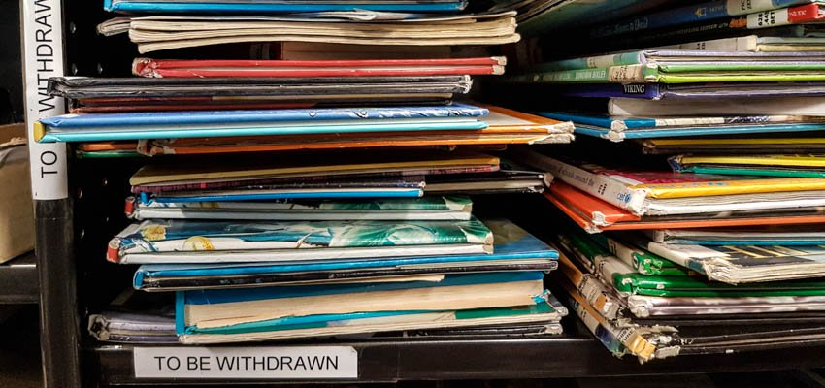
Deleting Bib, Holding, and Item record Information
Deleting bib, holdings, and items records does not remove them completely from Alma
Order records will be searchable by title in Alma, even though the bib records have been withdrawn and/or deleted in Alma
Deleted bib, holdings, and item records can be found using analytics
The need to distinguish between “real” withdrawals and deletions due to errors was taken into account when creating MSP-50

Slide 7
Withdrawing aN individual Item in Alma

Slide 8
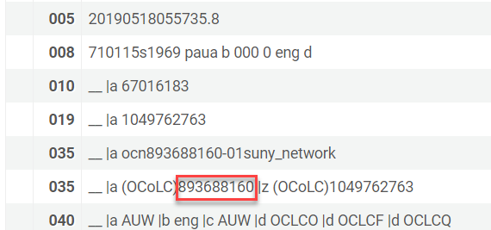
Withdrawing an Individual Item in Alma
Perform a repository search for All titles>Keywords>[scan barcode] for the item in hand
If you are using publishing profile continue onto step 3
Click on the title link to go to the MARC record view
Copy the OCLC number (035) from the MARC record view
Go to OCLC Connexion and remove your holdings for this record

Slide 9
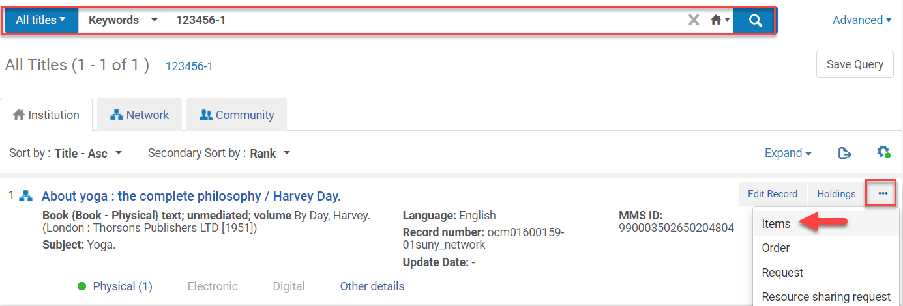
Withdrawing an Individual Item in Alma
Click Items from the ellipses

Slide 10
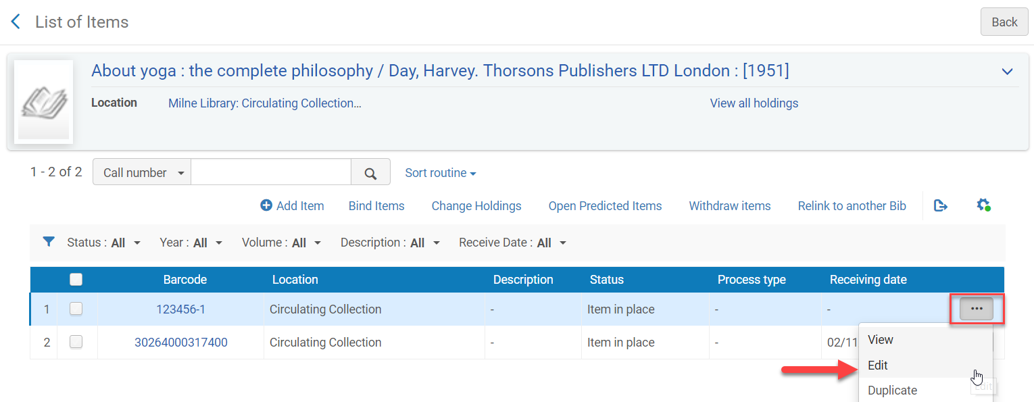
Withdrawing an Individual Item in Alma
Verify the item in hand is the item being deleted
Click Edit from the ellipses of the item being withdrawn

Slide 11
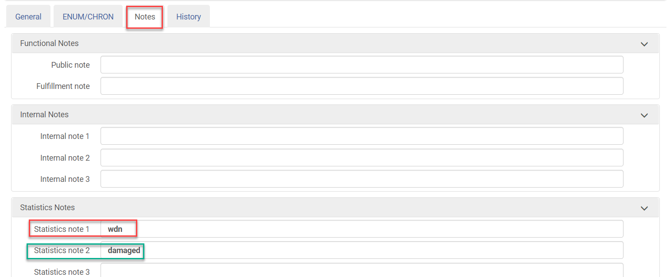
Withdrawing an Individual Item in Alma
Click on the Notes Tab
Type wdn in the Statistics note 1 field
Mandatory in order to keep statistics on withdrawn items in Alma using Analytics
Type the reason why the item is being withdrawn in the Statistics note 2 field
Optional
Click Save

Slide 12
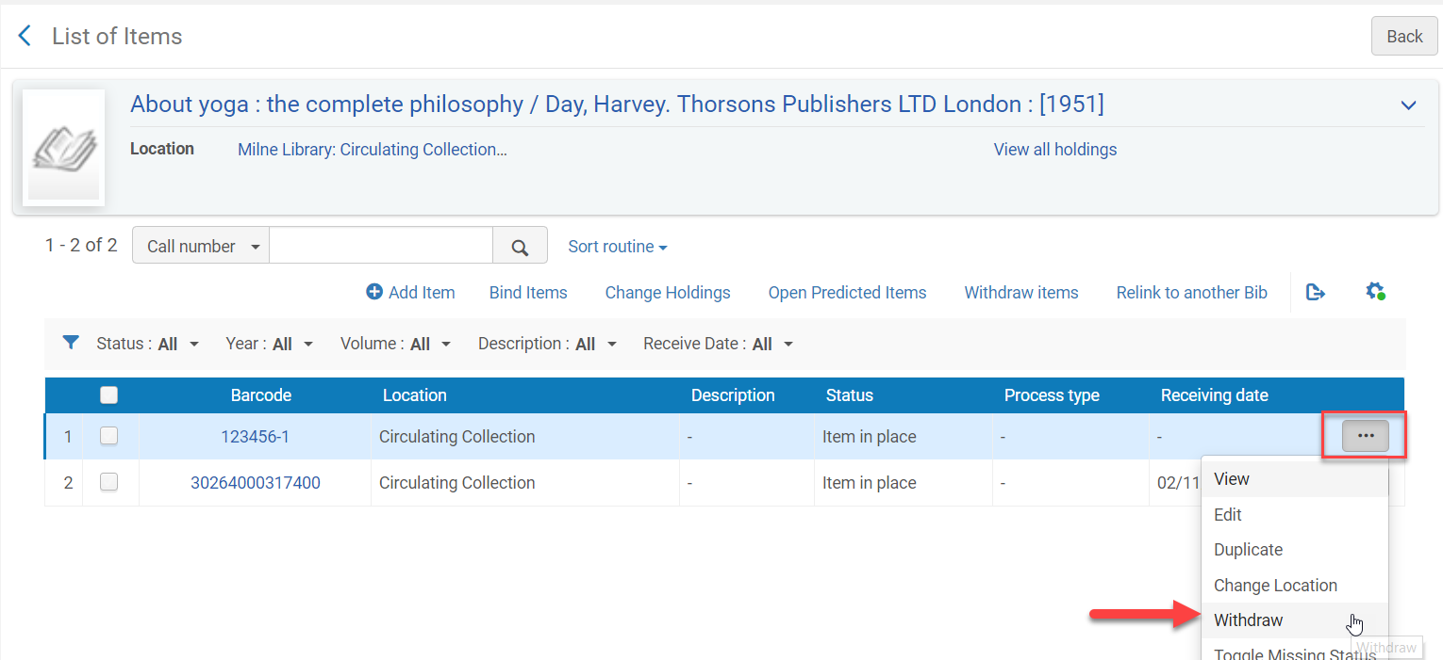
Withdrawing an Individual Item in Alma
Click Withdrawn from the ellipses of the item being withdrawn

Slide 13
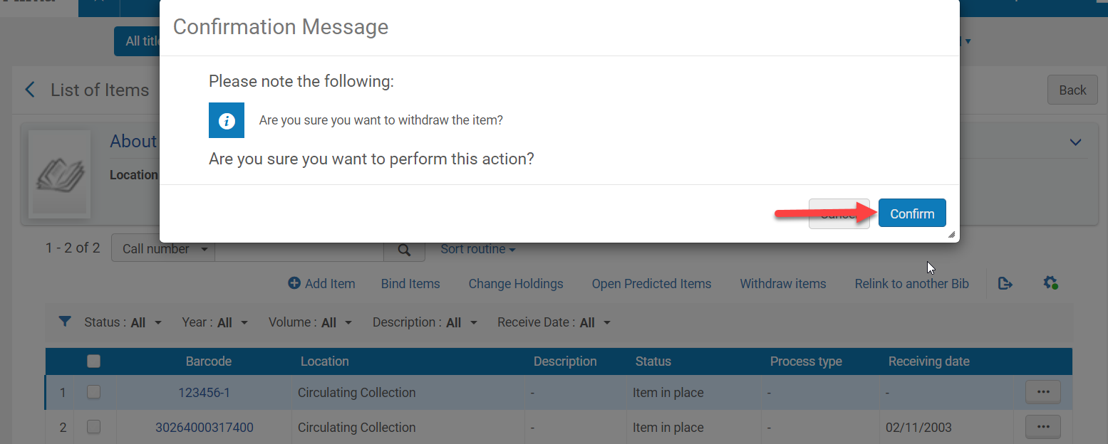
Withdrawing an Individual Item in Alma
Click Confirm when the Confirmation Messages appears
If this is not the last item for the holdings record you are done
If this is the last item for the holdings record continue onto step 12

Slide 14
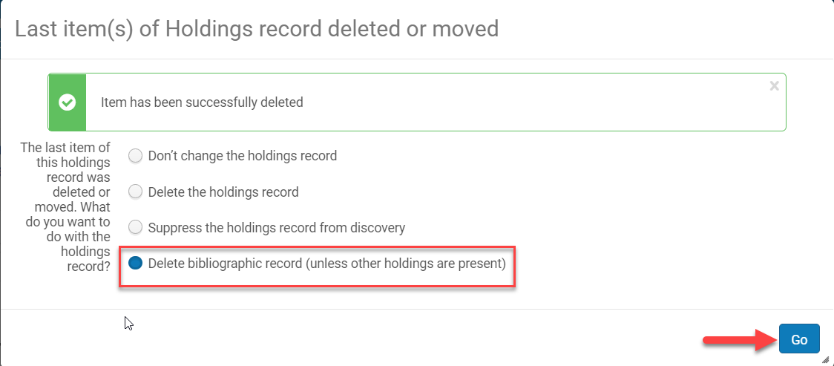
Withdrawing an Individual Item in Alma
Select “Delete bibliographic record (unless other holdings are present)” if this if the last item and holdings record
Click Go
The bib record/holdings/items have been removed from your IZ and unlinked from the NZ

Slide 15
Withdrawing a Set of Items (Batch Withdrawal) in Alma

Slide 16
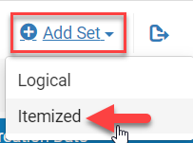
Withdrawing a Set of Items (Batch Withdrawal in Alma)
Open an excel spreadsheet or a basic text editor
Type the word Barcode in the first row of the first column for Excel
Type the word Barcode in the first line of a text editor
Scan in the barcodes
Make sure each barcode is in a separate row or line
Go to Admin>Manage Jobs and Sets>Manage Sets
Click on Add Sets
Choose Itemized
Sets Details screen opens
Set Name: [name the set]
Set Content Type: Physical Items
Private: No
Upload the excel or text file
Click Save

Slide 17
Withdrawing a Set of Items (Batch Withdrawal in Alma)

Slide 18
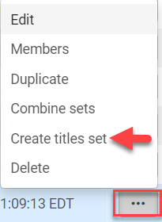
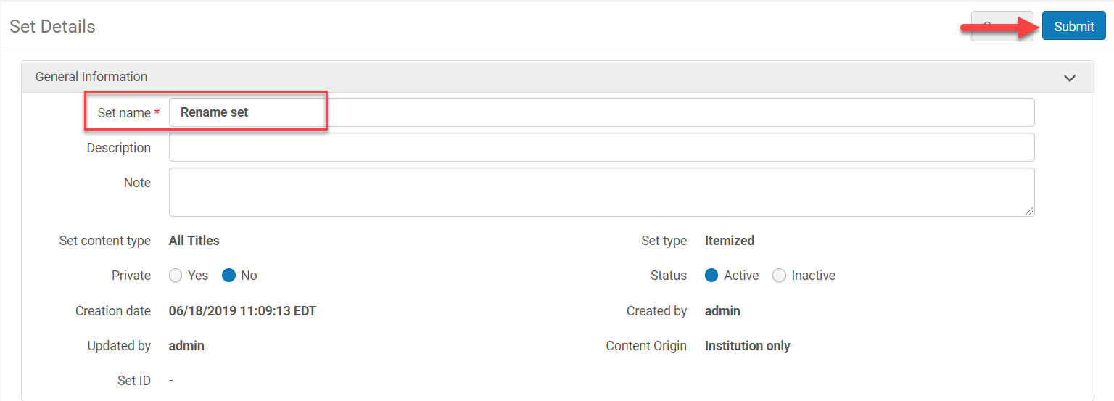
Withdrawing a Set of Items (Batch Withdrawal in Alma)
An Alma job will run to create a set
If your campus is not using publishing profiles you can create a title set from the physical item set to be used to remove holdings from OCLC Connexion:
From the ellipses of the set click Create titles set
Rename the set
Click Submit
Click Confirm
A job runs to create the set

Slide 19
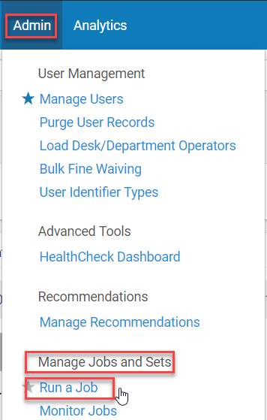
Withdrawing a Set of Items (Batch Withdrawal in Alma)
For campuses that need to distinguish between withdrawals and deletions
Go to Admin>Manage Jobs and Sets>Run a Job
Select the Change physical items job
Click Next
Select the set
Click Next

Slide 20
Withdrawing a Set of Items (Batch Withdrawal in Alma)

Slide 21
Withdrawing a Set of Items (Batch Withdrawal in Alma)
Click in the check box next to Statistics note 1
Type in wdn
If you are using Statistics note 2 check the box next to that and type in the reason the item is being withdrawn
Click Next

Slide 22
Withdrawing a Set of Items (Batch Withdrawal in Alma)
Click Submit
Click Confirm when the Confirmation Message pops-up

Slide 23
Withdrawing a Set of Items (Batch Withdrawal in Alma)
Go to Admin>Manage Jobs and Sets>Run a job
Select the Withdraw Items job
Click Next
Select the itemized set to be withdrawn
Click Next

Slide 24
Withdrawing a Set of Items (Batch Withdrawal in Alma)

Slide 25
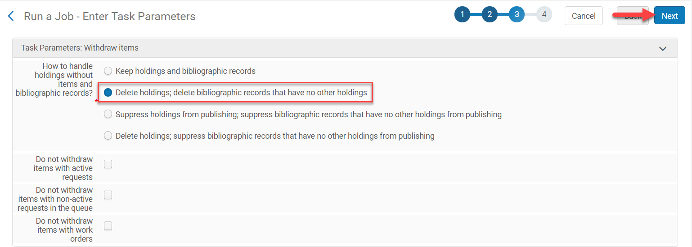
Withdrawing a Set of Items (Batch Withdrawal in Alma)
Click on the “Delete holdings; delete bibliographic records that have no other holdings” radio button
Click Next

Slide 26
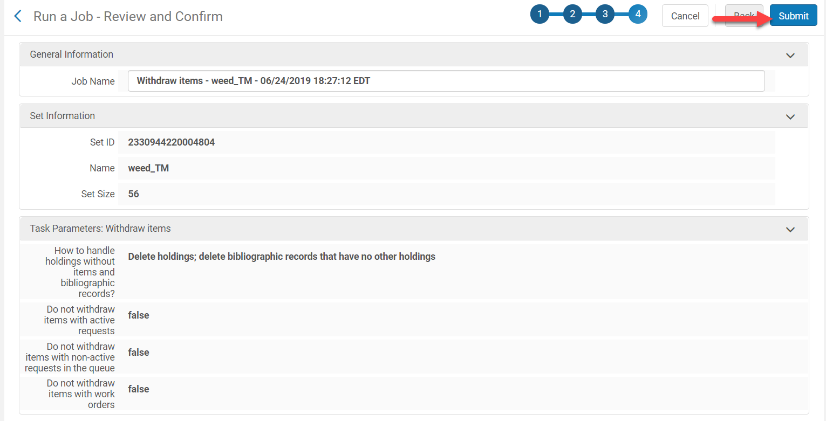
Withdrawing a Set of Items (Batch Withdrawal in Alma)
Review the job and click Submit

Slide 27
Withdrawing a Set of Items (Batch Withdrawal in Alma)
Click Confirm
The job will run

Slide 28
Using Analytics to find materials withdrawn from the permanent collection

Slide 29
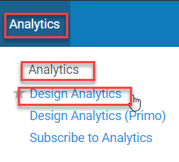
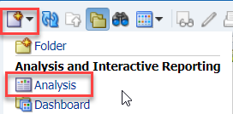
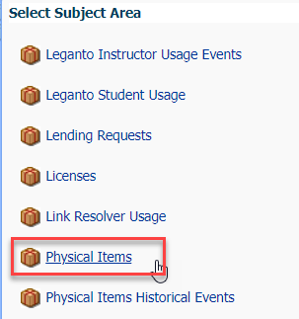
Using Analytics to Find Withdrawn Materials
Go to Analytics>Analytics>Design Analytics
Click on Catalog
Click on the New down arrow
Click on Analysis
Click on the Physical Items subject area

Slide 30
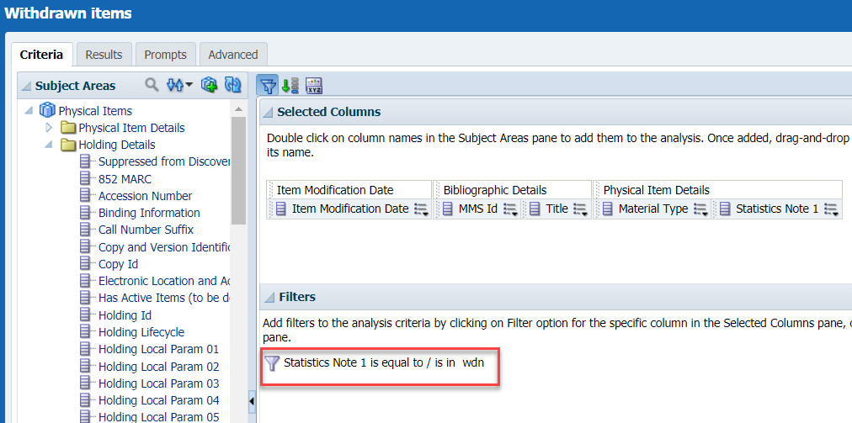
Using Analytics to Find Withdrawn Materials
Double Click on the necessary report criteria
Filter Statistics Note 1 is equal to wdn
Filter other fields to get the desired results
Save the report under the Shared Folder>Institution folder>Reports

Slide 31
Using Analytics to Find Withdrawn Materials
Click on the Results tab to view the report results

Slide 32
How to Unlink a brief Bib record from the NZ and Place it in the IZ

Slide 33
How to Unlink a Brief Bib Record from the NZ and Place it into the IZ
If you accidentally create a brief bib record or a course reserve records in the Network Zone instead of in the Institutional Zone:
Perform a repository search for the title
Click Edit Record to open the record in the MD Editor

Slide 34
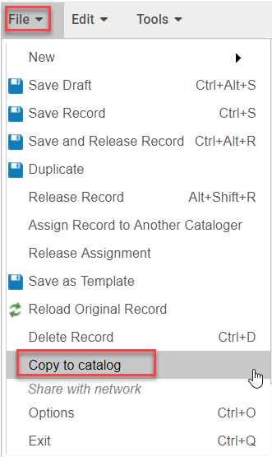
How to Unlink a Brief Bib Record from the NZ and Place it into the IZ
Go to File>Copy to Catalog
The record and any associated inventory is now in the IZ

Slide 35
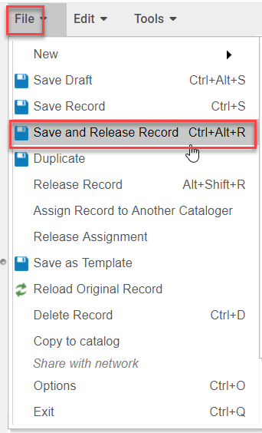
How to Unlink a Brief Bib Record from the NZ and Place it into the IZ
File>Save and Release the record (Ctrl+Alt+R)
Submit the NZ MMS ID and Title of the bib record that needs be deleted from the NZ in the Request to Delete NZ Bib Records form on SLC libguides

