Slide 1
Fulfillment Analytics
Timothy Jackson
SUNY Library Shared Services (SLSS)

Slide 2
Agenda
How to log into Analytics and roles needed
Alternatives to Analytics
Fulfillment related subject areas
How to create, export, and save reports
Viewing shared reports
Questions

Slide 3
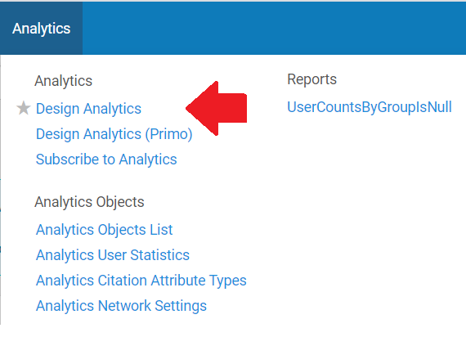
Logging In and Roles Needed
Role needed: Designs Analytics
Logging in to Analytics: Go to Analytics | Design Analytics

Slide 4
Alternatives to Analytics
Active and Expired Hold Shelves
Display lists of items currently on hold
Active Hold shelf: all items on hold including expired holds
Expired Hold shelf: only expired holds
Lists are limited to a particular circulation desk
Lists can be exported to Excel
Role needed: Requests Operator
FAQs:
Active Hold Shelf: https://slcny.libanswers.com/faq/281639
Expired Hold Shelf: https://slcny.libanswers.com/faq/281684

Slide 5
Alternatives to Analytics
Monitor Requests and Item Processes
Shows all active requests and work orders
Can generate lists of items by request date, workflow step, request/process type, pickup location, etc.
Can export lists to Excel
Role needed: Requests Operator or Fulfillment Operator
Ex Libris Documentation:
https://knowledge.exlibrisgroup.com/Alma/Product_Documentation/010Alma_Online_Help_(English)/030Fulfillment/Resource_Requests/020Managing_Requests_and_Work_Orders

Slide 6
Alternatives to Analytics
Create Fines and Fees Report
Can generate lists of fines and fees from the past 7 days
Can limit report to libraries, circulation desks, or transaction type (payment vs. waive)
Can print report or send to specific user via email
Role needed: Fulfillment Administrator or Circulation Desk Manager
Ex Libris Documentation:
https://knowledge.exlibrisgroup.com/Alma/Product_Documentation/010Alma_Online_Help_(English)/030Fulfillment/070Advanced_Tools/090Creating_Fines_and_Fees_Reports

Slide 7
Fulfillment Analytics Subjects
Data available via Analytics divided into Subjects
Fulfillment related subjects:
Course Reserves
Fines and Fees
Fulfillment
Physical Items
Physical Items Historical Events
Requests
Users
There is a great deal of overlap between subjects, but some information is in only one subject area

Slide 8
Course Reserves
Contains information on courses, reading lists, and citation lists
Good for obtaining lists of items placed on reserve
Does not contain usage data, but you can obtain those from the Fulfillment subject area
List of all fields available in Course Reserves:
https://knowledge.exlibrisgroup.com/Alma/Product_Documentation/010Alma_Online_Help_(English)/080Analytics/Alma_Analytics_Subject_Areas/Course_Reserves

Slide 9
Fines and Fees
Contains information on all fines and fees, including loan info, user info, and library staff
Good for assessing fine/fee structures or auditing waives
List of all fields available in Fines and Fees:
https://knowledge.exlibrisgroup.com/Alma/Product_Documentation/010Alma_Online_Help_(English)/080Analytics/Alma_Analytics_Subject_Areas/Fines_and_Fees

Slide 10
Fulfillment
Contains information on all loans, including bib & item info, loan measures, users, and course reserves
Good for obtaining circulation counts and statistics about how long items were on loan
List of all fields available in Fulfillment:
https://knowledge.exlibrisgroup.com/Alma/Product_Documentation/010Alma_Online_Help_(English)/080Analytics/Alma_Analytics_Subject_Areas/Fines_and_Fees

Slide 11
Physical Items
Contains information on all items in your collection regardless of loan history, including bib & item info, PO information, and funds information
Does contain some circulation data but does not contain user info
Good for obtaining reports on number of items in a location or circulation counts by LC classification
List of all fields available in Physical Items:
https://knowledge.exlibrisgroup.com/Alma/Product_Documentation/010Alma_Online_Help_(English)/080Analytics/Alma_Analytics_Subject_Areas/Physical_Items

Slide 12
Physical Items Historical Events
Contains information on item changes, such as transits, temporary location changes, item process status changes
Good for obtaining reports on amount of time needed for particular workflows
List of all fields available in Physical Items Historical Events:
https://knowledge.exlibrisgroup.com/Alma/Product_Documentation/010Alma_Online_Help_(English)/080Analytics/Alma_Analytics_Subject_Areas/Physical_Items_Historical_Events

Slide 13
Requests
Contains information on all requests, including bib info, userinfo, and turnaround time measures
Good for obtaining reports on requests by user group and request turnaround times
Includes Resource Sharing requests, but there are separate Borrowing Requests and Lending Requests subject areas
RS Analytics Session:
https://public.3.basecamp.com/p/WdzRDPGPJFkQCdtdZVjMwRuN
List of all fields available in Requests:
https://knowledge.exlibrisgroup.com/Alma/Product_Documentation/010Alma_Online_Help_(English)/080Analytics/Alma_Analytics_Subject_Areas/Requests

Slide 14
Users
Contains information on all users, including personal info, blocks, and turnaround time measures
Includes your patrons, walk-in borrowers, and library staff
Good for obtaining lists of blocked patrons, walk-in borrowers by home institution, or staff with a specific role
List of all fields available in Requests:
https://knowledge.exlibrisgroup.com/Alma/Product_Documentation/010Alma_Online_Help_(English)/080Analytics/Alma_Analytics_Subject_Areas/Users

Slide 15
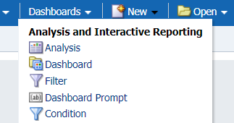
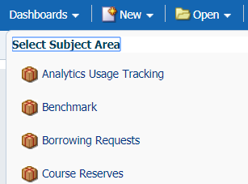
Creating Reports
To create a new report, click the New link and select Analysis from the dropdown
Select a subject area

Slide 16
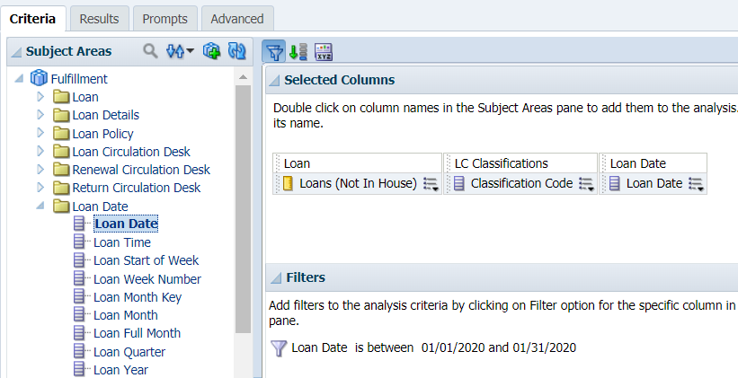
Creating Reports
Add fields and/or measures to report
Create filters if necessary
Click Results to generate report

Slide 17
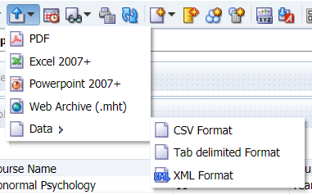
Exporting Reports
Analytics allows you to export report results in a variety of formats
Click the Export button
Select Export format

Slide 18
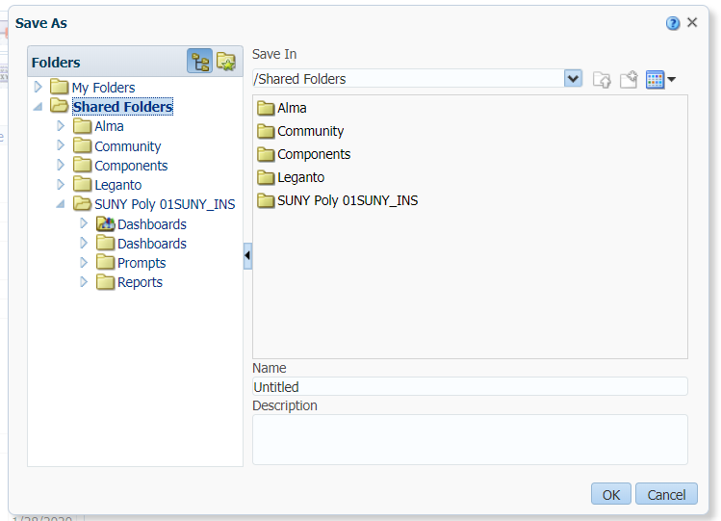
Saving Reports
Click the Save icon to save a report
Reports can be saved to a personal folder or a shared folder

Slide 19
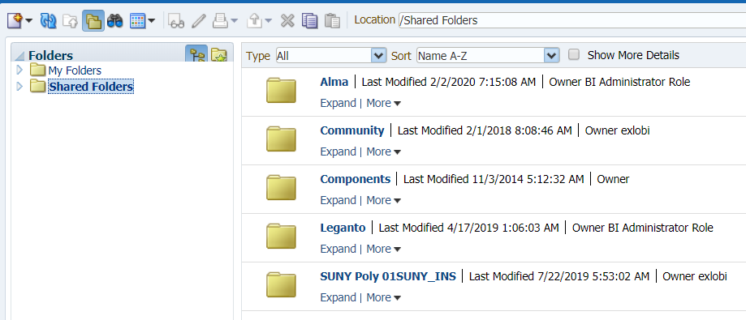
Opening Saved Reports
Click the Catalog link
Navigate to reports or search for reports
You can open reports that have been saved to shared folders at other institutions

Slide 20
Analytics Resources
Out of the box reports
Shared reports created by Ex Libris
Organized by subject areas
/Shared Folders/Alma
Community reports
Shared reports created at other Alma institutions
Organized by Consortia and Institution
/Shared Folder/Community/Reports
SLSS will be creating shared reports in the coming months
Basecamp
Salesforce

