Slide 1
School Board Accountability Update 2019
Add your district logo here
Notes:
Add your district logo here
*Times on each slide are estimates. Many slides with 1 min listed will take less than 1 min to review.
For more information or assistance in using these slides, please contact Melinda Marquez at melinda.marquez@esc13.txed.net

Slide 2
Objectives
Review A-F Accountability System
Review District Ratings
Review Campus Ratings
Next Steps
Notes:
1 min
Say: (read slide)

Slide 3
A-F Accountability
Labels/Grades
A = Exemplary Performance Scaled Score 90-100
B = Recognized Performance Scaled Score 80-89
C = Acceptable Performance Scaled Score 70-79
D = In Need of Improvement Scaled Score 60-69
F = Unacceptable Performance Scaled Score ≤ 59
Notes:
1 min
Say: As we know, letter grades are now used to rate both districts and campuses. It is important to note the descriptions which TEA uses when referring to the letter grades.

Slide 4
Three Domains: Calculating an Overall Accountability Rating
Improvement Required/IR
Domain Letter Grade
Domain Letter Grade
Domain Letter Grade
Best of Achievement OR Progress
70%
30%
=
Overall Letter Grade
Notes:
2 min
Say: Both districts and campuses have received a letter grade for each domain in addition to an overall letter grade for a total of 4 letter grades.
In order to calculate the overall grade, TEA takes the better of the Student Achievement Domain or the School Progress Domain for 70% of the overall grade and Closing the Gaps Domain for 30%.
The term Improvement Required is no longer used.

Slide 5
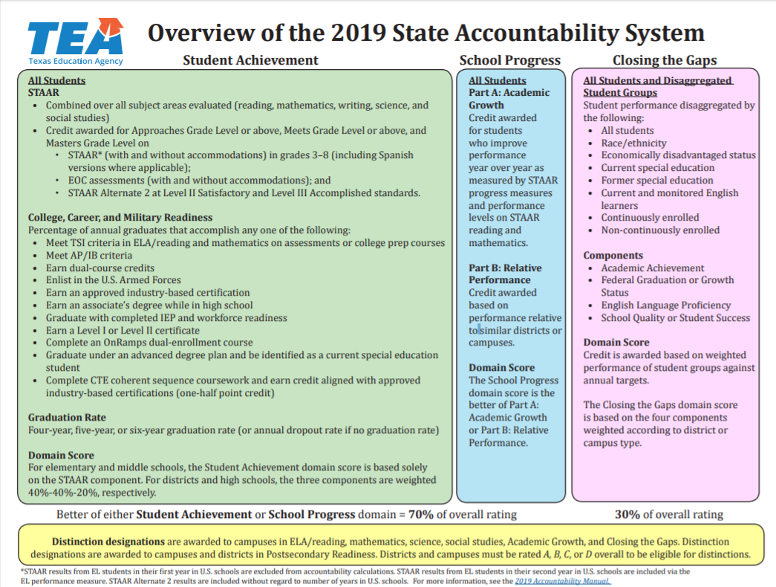
Overview
Notes:
2 min:
TEA has created a one page overall view of the A-F accountability system.
IF YOU WOULD LIKE TO MAKE COPIES OF THIS DOCUMENT IT CAN BE FOUND HERE:
https://tea.texas.gov/sites/default/files/2019%20Overview%201%20page_fnl_accessible.pdf

Slide 6
Student Achievement Domain
Performance
6
Notes:
1 min:
Say: Let’s take a look at the first domain- Student Achievement- which looks at student performance

Slide 7
Student Achievement Domain
Calculating the Score
STAAR
One point is given for each percentage of assessment results that are at or above the following:
Approaches Grade Level or above
Meets Grade Level or above
Masters Grade Level
Percentage of Assessments at Approaches Grade Level or above +
Percentage of Assessments at Meets Grade Level or above +
Percentage of Assessments at Masters Grade Level
Three
7
Notes:
1 min:
Say: To calculate the STAAR portion of the Student Achievement domain, TEA averaged the percentage of students who achieved each of the three performance levels: approaches grade level, meets grade level, and masters grade level.
It’s important to note here, that if a student receives Masters on their assessment, they will be counted 3 times in this equation because they are included in the Approaches grade level or above, the meets grade level or above AND the masters grade level.

Slide 8
Student Achievement Domain
CCMR Indicators for High School
College Ready
Meet criteria of 3 on AP or 4 on IB examinations
Meet TSI criteria (SAT/ACT/TSIA/College Prep course) in reading and mathematics
Complete a course for dual credit (9 hours or more in any subject or 3 hours or more in ELAR/ mathematics)
Earn an associate’s degree
Complete an OnRamps Course and earn college credit
Military Ready
Enlist in the United States Armed Forces
Career Ready
Earn industry-based certification
CTE coherent sequence coursework completion and credit aligned with approved industry-based certifications (one-half point credit)
Graduate with completed IEP and workforce readiness (graduation type code of 04, 05, 54, or 55)
Earn a Level I or Level II certificate
Graduate under an advanced degree plan and be identified as a current special education student
Notes:
3 min: Use the animations to bring in each section one at a time
Say: The college, career and military readiness indicators include several opportunities for graduates to earn points towards accountability. New CCMR Indicators are in red.

Slide 9
Student Achievement Domain
Graduation Rate
Graduation Rate
High school graduation rates include the four-year, five-year, or six-year longitudinal graduation rate (with state exclusions) or annual dropout rate, if the graduation rate is not available.
Example Calculation: Graduation Rate
Graduation Rate | All Students
Class of 2018, 4-year | 90.9%
Class of 2017, 5-year | 91.4%
Class of 2016, 6-year | 90.0%
Graduation Rate Score | 91.4
Notes:
1 min:
Say: The graduation rate component of the Student Achievement domain takes the best of the four-year, five-year, or six-year high school graduation rates.

Slide 10
Add District Name Here
Student Achievement Domain Score
 | Component Score | Scaled Score | Rating
STAAR Performance
CCMR
Graduation Rate
Notes:
2 Min
Using the District 2019 Accountability Ratings Overall Summary Page located in TEAL or enter each component score, scaled score and rating

Slide 11
School Progress Domain: Growth
Notes:
1 min:
Say: Let’s take a look at the second domain- School Progress- which looks at growth

Slide 12
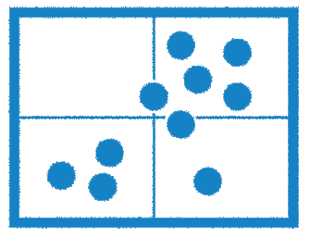
School Progress Domain
Part A: Academic Growth
Part B: Relative Performance
Best of Academic Growth OR Relative Performance
Notes:
1 min
Say: The School Progress domain has two parts: Student Growth and Relative Performance.
The higher scaled score of Part A: Academic Growth or Part B: Relative Performance is used to calculate the School Progress domain rating.

Slide 13
School Progress Domain
Part A: Academic Growth
Part A: Academic Growth
School Progress, Part A: Academic Growth includes all assessments with a STAAR progress measure. Districts and campuses (including high schools) earn credit for results that maintain proficiency or meet growth expectations on STAAR.
Notes:
1 min
Say: Let’s look at Part A of the School Progress Domain.
Part A: Academic Growth looks specifically at Growth. This is done by looking at the STAAR progress measure. Remember, not every test has a STAAR Progress Measure- just those tests with a previous test to compare.

Slide 14
School Progress Domain
Part B: Relative Performance
Part B: Relative Performance—High Schools, K–12, and Districts with CCMR Component
Student Achievement STAAR component* and CCMR component results averaged compared to districts or campuses with similar percentages of economically disadvantaged students
Part B: Relative Performance—High Schools, K–12, and Districts without CCMR Component
Student Achievement STAAR component* results compared to districts or campuses with similar percentages of economically disadvantaged students
Part B: Relative Performance—AEA Districts and Campuses
Alternative education accountability (AEA) districts and campuses are not evaluated on School Progress, Part B due to the small number of districts and campuses used for comparison.
Notes:
*Choose which section applies to your district and delete the others
1 min
Say: (read section)

Slide 15
School Progress Domain
Part B: Relative Performance
Part B: Relative Performance—High Schools, K–12, and Districts with CCMR Component
Student Achievement STAAR component and CCMR component results averaged compared to districts or campuses with similar percentages of economically disadvantaged students as reported in the TSDS PEIMS October snapshot.
Part B: Relative Performance—High Schools, K–12, and Districts without CCMR Component
Student Achievement STAAR component results compared to districts or campuses with similar percentages of economically disadvantaged students
Part B: Relative Performance—AEA Districts and Campuses
Alternative education accountability (AEA) districts and campuses are not evaluated on School Progress, Part B due to the small number of districts and campuses used for comparison.
Notes:
*Choose which section applies to your district and delete the others
1 min
Say: (read section)

Slide 16
Add District Name Here
School Progress Domain Score
 | Component Score | Scaled Score | Rating
Part A: Academic Growth
Part B: Relative Performance
Notes:
2 min
Using the District 2019 Accountability Ratings Overall Summary Page located in TEAL enter each component score, scaled score and rating

Slide 17
Closing the Gaps Domain: Ensuring Educational Equity
Notes:
1 min:
Say: Let’s take a look at the third and final domain- Closing the Gaps- which ensures Educational Equity.

Slide 18
Closing the Gaps Domain: Aligning Accountability Systems
Notes:
1 min:
Say: The Closing the Gaps Domain is closely aligned with the Federal Accountability System- ESSA – The Every Student Succeeds Act

Slide 19
Closing the Gaps Domain
14 Student Groups
All Students
African American
Hispanic
White
American Indian
Asian
Pacific Islander
Two or More Races
Economically Disadvantaged
Current Special Education
Former Special Education
Current and Monitored English Learners
Continuously Enrolled
Non-Continuously Enrolled
Notes:
1 min:
Say: Closing the Gaps domain looks at 14 student groups
(click) All students and the 7 Federal Race/Ethnic groups and
(click) (read 6 groups from slide)

Slide 20
Closing the Gaps Domain
4 Components
Academic Achievement:
STAAR Performance Status at the Meets Grade Level or above standard in English language arts (ELA)/reading and mathematics
Growth or Graduation
Academic Growth Status: The School Progress, Part A domain data in reading and mathematics for elementary and middle schools
Federal Graduation Status: The four-year federal graduation rate (without exclusions) for high schools, K–12s, and districts with graduation rates. If a high school, K–12, or district does not have graduation data, Academic Growth Status is used, if available.
English Language Proficiency
The English Language Proficiency component measures an EL’s progress towards achieving English language proficiency. Current ELs are the only students evaluated in this component.
School Quality or Student Success
STAAR component of the Student Achievement domain for elementary and middle schools
College, Career, and Military Readiness (CCMR) Performance Status component for high schools, K–12s, and districts If a high school, K–12, or district does not have CCMR data, STAAR component is used, if available.
Notes:
2 min: Use animations to bring in 2 components at a time
Say: There are four components to Closing the Gaps.
(click) Academic Achievement, Growth or Graduation-depending on campus type
(click) English language proficiency and School Quality or Student Success- depending on campus type

Slide 21
2018 Alternative Education Accountability
2019 Alternative Education Accountability
AEA charter schools and campuses will be able to earn bonus points which will be added to the overall scaled score.
A maximum of ten bonus points may be applied to an AEA’s overall scaled score. AEA charter schools and campuses may earn up to five points for each of the following two indicators:
Credit for graduation plan type awards AEA charter schools and campuses bonus points for the percentage of graduates who graduate under either a RHSP, DAP, FHSP-E, or FHSP-DLA graduation plan.
Credit for EOC retest assessments awards AEA charter schools and campuses bonus points for the percentage of EOC retest assessments at the Approaches Grade Level standard or above.
Notes:
Delete if not applicable
2 min:
Say: Alternative Education campuses and districts are rated under the Alternative Education Accountability. AEA does not rate campuses under School Progress Part B due to the small number of districts and campuses used for comparison.
Alternative procedures are used for the graduation rate and the annual drop out rate.
Targets and cut points vary from traditional districts.

Slide 22
Add District Name Here
Closing the Gaps Domain Score
 | Component Score | Scaled Score | Rating
Closing the Gaps
Notes:
1 min
Using the District 2019 Accountability Ratings Overall Summary Page located in TEAL to enter each component score, scaled score and rating

Slide 23
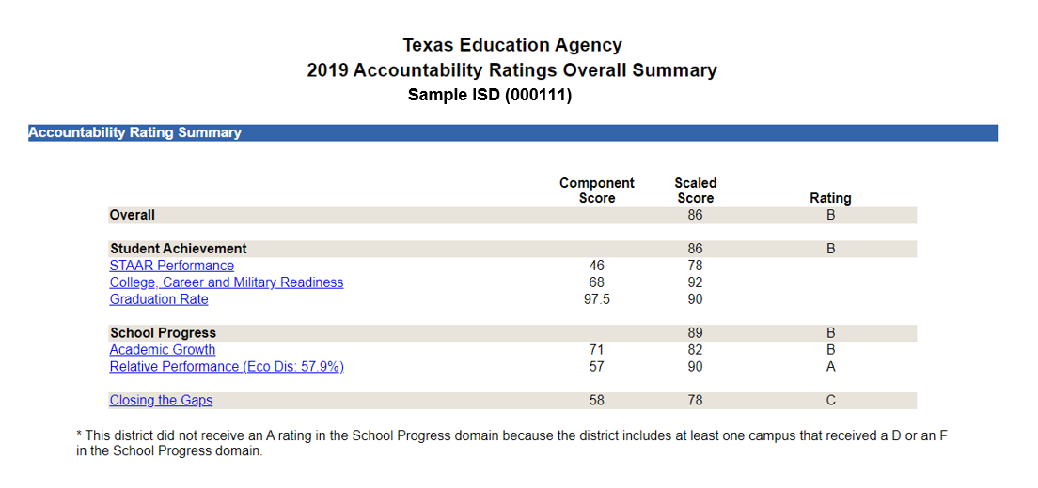
Enter Your District Name Here Overall Summary
Notes:
3 min
Review document
Delete Sample Pic and Insert District 2019 Accountability Ratings Overall Summary Page here.
This page can be found in TEAL or https://rptsvr1.tea.texas.gov/perfreport/account/2019/srch.html?srch=D
**this can be easily done using the snipping tool on your computer

Slide 24
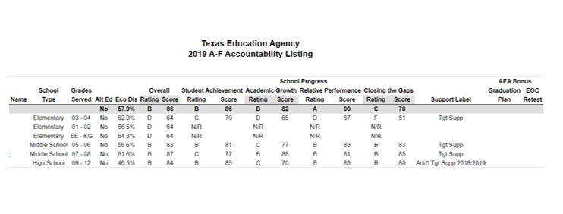
Enter Your District Name Here Campus Summary
Notes:
Campus summary view Option 1
3 min
Review document
Delete Sample Pic and enter Campus Ratings here using your Accountability Reports which can be found in TEAL or https://rptsvr1.tea.texas.gov/perfreport/account/2019/srch.html?srch=D
This sheet may be difficult to interpret- if so, see next slide
**this can be easily done using the snipping tool on your computer

Slide 25
Enter Your District Name Here Campus Summary
Campus Name | Overall |  | Student Achievement |  | School Progress |  |  |  | Closing the Gaps |  | Support Label
 | Rating | Score | Rating | Score | Part A: Rating | Part A: Score | Part B: Rating | Part B: Score | Rating | Score
SAMPLE EL | Met Standard | 68 | Met Standard | 67 | Met Standard | 70 | Impr. Req | 59 | Met Standard | 77 | Add. Target
BEST EL | Met Standard | 68 | NOT RATED |  | NOT RATED |  | NOT RATED |  | NOT RATED
WONDERFUL EL | Met Standard | 68 | NOT RATED |  | NOT RATED |  | NOT RATED |  | NOT RATED
SAMPLE INT | Met Standard | 71 | Met Standard | 73 | Impr. Req | 59 | Met Standard | 69 | Met Standard | 66 | Add. Target
SAMPLE MIDDLE | Met Standard | 91 | Met Standard | 80 | Met Standard | 93 | Met Standard | 82 | Met Standard | 87 | Add. Target
SAMPLE HS | Met Standard | 81 | Met Standard | 84 | Met Standard | 69 | Met Standard | 80 | Met Standard | 73 | Add. Target
Notes:
Campus summary view Option 2
3 min
Review document
Delete information in the sample chart and enter your Campus Ratings using your Campus Summary Accountability Report which can be found in TEAL or https://rptsvr1.tea.texas.gov/perfreport/account/2019/srch.html?srch=D
This chart is easier to read, but takes more time to complete.

Slide 26
A – F Accountability
Distinction Designations
Notes:
If no Distinction Designations are earned, delete this slide
1 min
Say: Let’s take a look at Distinction Designations

Slide 27
Distinction Designations
Distinction Designations are awarded in the following areas:
Academic Achievement in English Language Arts/Reading (campus only)
Academic Achievement in Mathematics (campus only)
Academic Achievement in Science (campus only)
Academic Achievement in Social Students (campus only)
Top 25 percent: Comparative Academic Growth (campus only)
Top 25 percent: Comparative Closing the Gaps (campus only)
Postsecondary Readiness (district and campus)
Notes:
If no Distinction Designations are earned, delete this slide
2 min:
Say: Districts and campuses that have met standard are eligible for Distinction Designations. This chart shows the various distinctions designations that can be awarded.
Distinction designations are awarded for achievement in several areas and are based on performance relative to a group of campuses of similar type, size, grade span, and student demographics.

Slide 28
Add District Name Here
Add DD here
Distinction Designations
Notes:
If no Distinction Designations are earned, delete this slide
1 min
Review distinction designations

Slide 29
Comprehensive and Additional Targeted Support and Improvement
Notes:
If no campuses are labeled Comprehensive or Additional Targeted Support- delete this slide

Slide 30
Comprehensive Support and Improvement
Comprehensive Support
The Closing the Gaps domain scaled score will be used to rank and identify schools for comprehensive support.
The agency will identify at least the lowest five percent of Title I, Part A campuses, based on the CTG scaled score, for comprehensive support.
For 2018, the lowest five percent CTG scaled score cut point was 47. The 2019 the lowest five percent CTG scaled score cut point is 42.
Notes:
If no campuses are labeled Comprehensive - delete this slide
2 min:
Say: (read bullets)

Slide 31
Targeted Support and Improvement
Targeted Support and Improvement
TEA uses the Closing the Gaps domain to identify campuses that have consistently underperforming student groups.
TEA defines a “consistently underperforming” student group as one that does not meet at least three of the same indicator targets for three consecutive years.
Campuses will be identified annually for the first time in 2019 based on 2017, 2018, and 2019 data.
Notes:
If no campuses are labeled Targeted Support - delete this slide
2 min:
Say: (read bullets)

Slide 32
Additional Targeted Support and Improvement
Additional Targeted Support and Improvement Identification
Any campus that is not identified for comprehensive or targeted support and improvement will be identified for additional targeted support if an individual student group’s percentage of evaluated indicators met is at or below the percentage used to identify that campus type for comprehensive support.
Any campus that had a student group that met ZERO indicators was identified as additional targeted support
Notes:
If no campuses are labeled Additional Targeted Support- delete this slide
2 min: Say (read bullets as they come in)
*For more information on how to read the reports for Additional Targeted support, please contact Melinda Marquez at Region 13 at melinda.marquez@esc13.txed.net

Slide 33
Add District Name Here
Comprehensive
and
Additional Targeted Support
Campuses
Notes:
Add Comprehensive and Additional Targeted Support Campuses here
1 min
Review campuses

Slide 34
Add District Name Here
Next Steps
Notes:
Add Next Steps here

