Slide 1

SUNY Library Shared Services Update
April 30, 2020
www.suny.edu

Slide 2
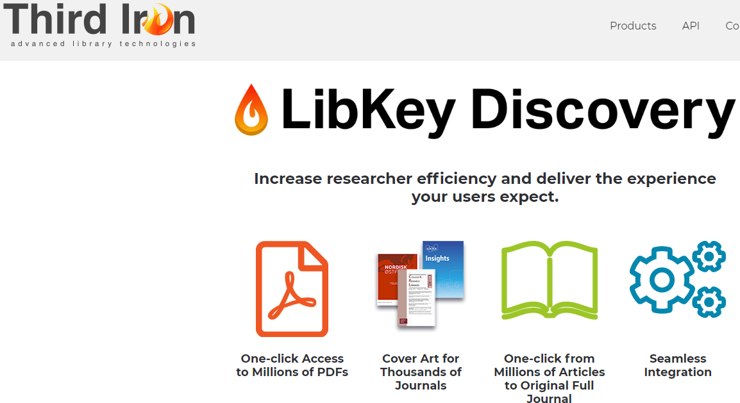
Libkey
All campuses who have expressed interest have been set up.
  SLSS handled Alma/Primo work.
Contract has been bid, and we’re reviewing the process now, and will reach out to campuses about next steps very soon.
It’s ok to go-live with Libkey, even as we’re still working on contract.
www.suny.edu

Slide 3
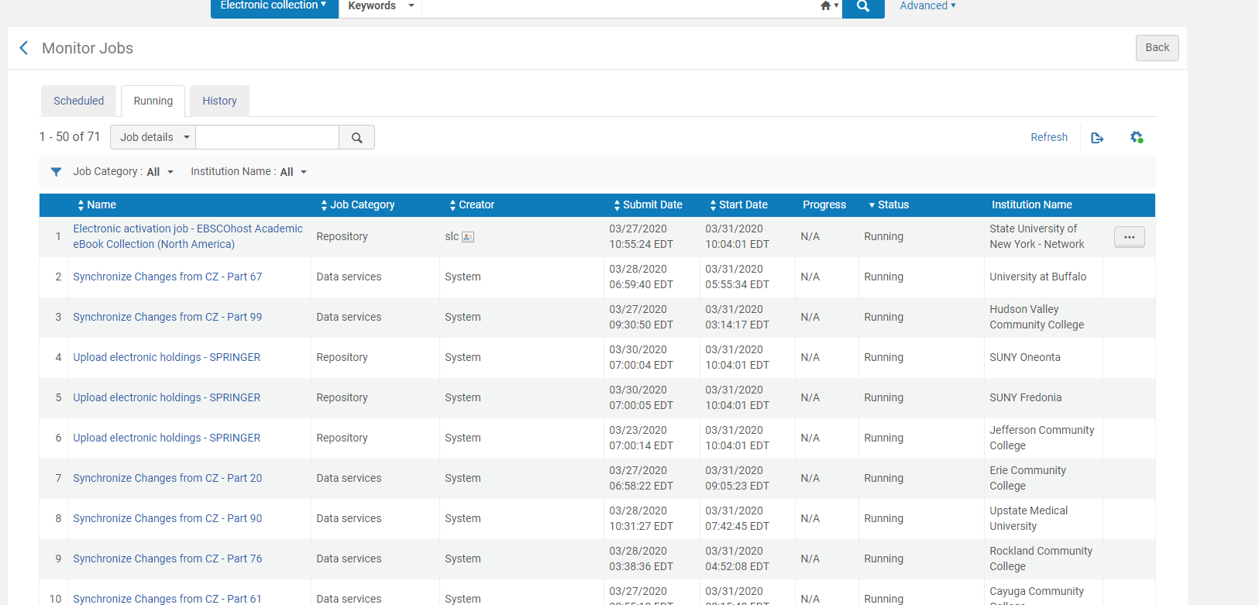
Update on Repository Jobs Issue
  All jobs seem to be back to normal.
  Still analyzing performance on deletion/deactivation jobs.
    If you see any slow deactivation jobs, please let us know.
  Working to get a root cause analysis and thorough report.
  Primo VE indexing, at this point, has been identified as the major cause of the issue.
  Investigating “ghost records” with Primo VE managers, as tangentially related with this.
    March release should have improved this, and we’re continuing to investigate and provide examples.
www.suny.edu

Slide 4
SUNY EIT Accessibility Plan
Campus plans are due June 30
EIT Library Plan open forum tomorrow, 5/1 at noon
Where to Start FAQ
Nazely Kurkjian, Coordinator of Disability, Diversity, & Nontraditional Student Services at SUNY System Administration, will be looking for volunteers to help with checking third-party vendors for accessibility, including library databases and other content
www.suny.edu

Slide 5
SLSS Initiatives
Feedback we’re getting from campuses during virtual visits is that more campuses are emerging from the post-migration period and may be willing to participate in new initiatives.
  Current initiatives are here:
    https://slcny.libguides.com/overview/initiatives
  Past initiatives we’ve analyzed but not moved to a wide rollout are also on this page. If anything we’ve analyzed before is something you wish to champion, please let us know.
  If you have initiatives that you’d like SLSS to consider, please submit them to:
    info@slcny.libanswers.com
www.suny.edu

Slide 6
Support Update: the Highlights from April Meeting
Review of MD Editor rollout planning.
RS:
  Automatic Renewals: determined that functionality desired isn’t available.
About the topic issues
Review NZ activations functionality for firm understanding of expected behavior.
Getting transition plan for PCI to CDI support
Repository Jobs
Discovery Import Profile not being removed—under investigation
www.suny.edu

Slide 7

Please Bring Cases to our Attention and Status Check
  We're doing our best to review cases across the consortium, and to find issues that we need to escalate.
  But, we're not perfect, so if there's a case that needs to attention that we haven't discovered, please let us know by emailing info@slcny.libanswers.com
  Is there anything we could do better to manage the support relationship better with EXL?
www.suny.edu

Slide 8

Discovery & E-Resources
Updates
Michelle Eichelberger
www.suny.edu

Slide 9
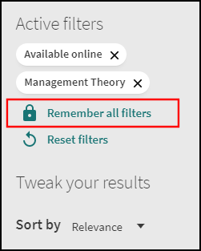
Primo May Release
No new April release due to COVID-19
Facets:
  Will now be able to make all selected facets "sticky" rather than one at a time
  Reset filters will clear all filters, including sticky ones
FRBR: ability to pick which record is preferred, configure by resource type, date, or availability. Dedupe coming in June.
Ability to configure local resource types in the NZ
Ability to add library names to holdings in cases where you have same locations (e.g. Stacks) in more than one library
New configuration options for the Get It display, to control of related holdings display in Primo VE
Can test access of portfolio in CZ before activation
https://knowledge.exlibrisgroup.com/Primo/Release_Notes/002Primo_VE/2020/010Primo_VE_2020_Release_Notes
www.suny.edu

Slide 10

CDI
Ex Libris will activate for us May 24, 2020
Please start testing
Testing check-in May 8 at 1pm, Q&A only (no slides)
If you do nothing, you will not lose any access in Primo but it's good to familiarize yourself with CDI
How will the Central Discovery Index (CDI) work and what do I need to know?
www.suny.edu

Slide 11
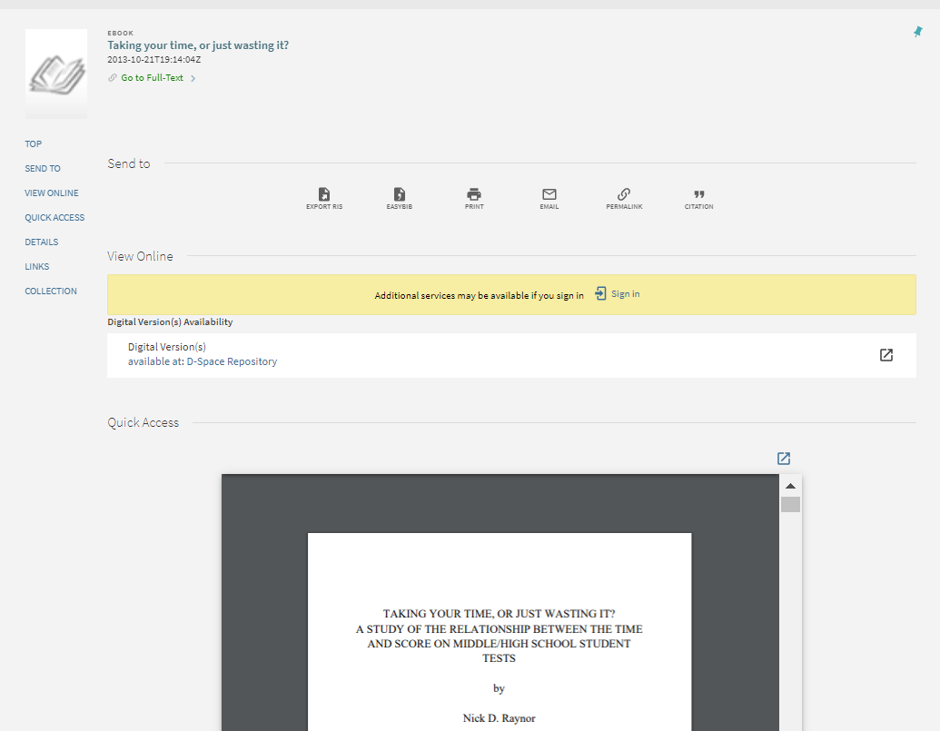
Archives & Collections Import into Alma
New Collections FAQ
Can do interesting things with setting up remote digital repository, importing digital content and putting it into a Collection
New Alma Viewer (March 2020) will let you display pdfs, images, and videos on full record in Primo VE
www.suny.edu

Slide 12
SUNY Shared Collections Updates
Esta Tovstiadi
www.suny.edu

Slide 13
Current & Upcoming Projects
  Academic Video Online (currently trialing)
    Working on a SUNY-wide offer
    Looking at title comparison to Films on Demand content
  STAT!Ref Nursing ebooks renewal
    SLSS negotiates pricing and sends names of interested campuses to vendor
    Vendor invoices campuses directly
    Pricing received for current subscribing campuses; will share soon
    If you are interested in pricing for this deal and haven't already contacted me, please let me know as soon as possible.
  Chronicle of Higher Education Renewal
    Flat renewal, 25% discount for new campuses
    Please indicate interest using this form: https://slcny.libwizard.com/f/sunypricing
www.suny.edu

Slide 14
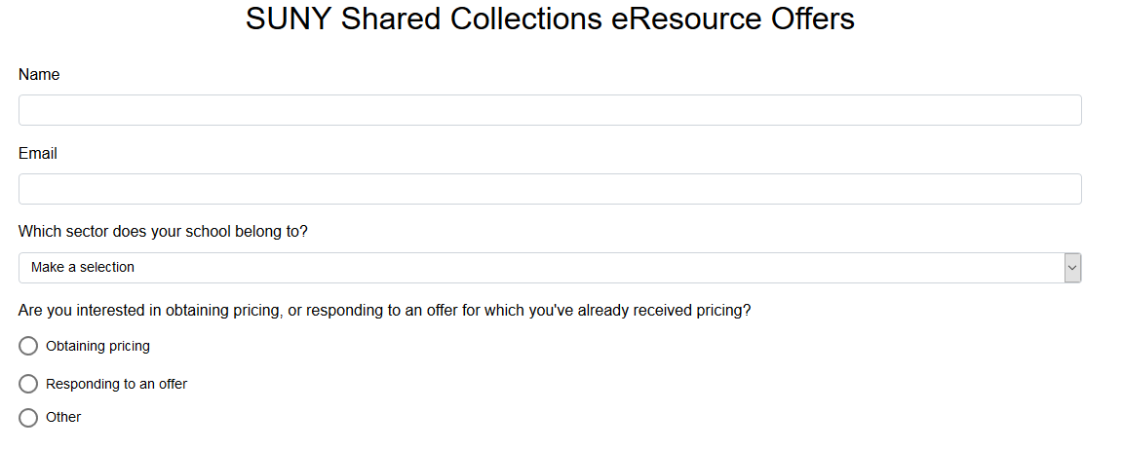
New form for responding to e-resource offers
  https://slcny.libwizard.com/f/sunypricing
  Use this form when responding to SLSS-managed e-resource offers or to indicate interest in obtaining pricing for an upcoming offer
www.suny.edu

Slide 15
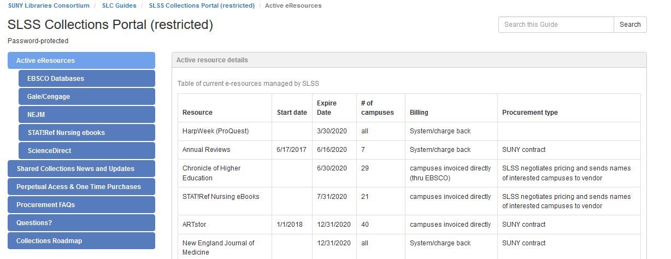
Collections Portal Update
  In development: https://slcny.libguides.com/overview/collections
  Content related to pricing, licensing, offers, etc is password restricted; we will distribute the password through the SLC Director's listserve this afternoon.
www.suny.edu

Slide 16
Resource Sharing Update
Timothy Jackson
www.suny.edu

Slide 17
Alma Resource Sharing Shutdown
Alma Resource Sharing shut down for all SUNY campuses indefinitely
  No timeline for turning physical resource sharing back on at this time
  Please be sure to keep SLSS informed of your plans to reopen
Empire Library Delivery suspended indefinitely
  Will be able to resume services quickly once libraries start to reopen
  We may need to work with ELD on how to best handle backlog of items that need to be shipped
  ELD sending survey about accepting returns from users from other institutions sometime next week
  SUNY temporary policy allows SUNY users to return items to any SUNY library
www.suny.edu

Slide 18
Alma Resource Sharing Renewals
Automated renewals for borrowing requests not possible per Ex Libris
  Please be sure to process requests in Mediated Patron Renewal status
Automating lending renewal responses is possible, but that could cause some problems
  Renewal requests sent to lender without a requested due date will be auto-approved with a new due date of 12/31/1969
  Users given new due date of 16 weeks from day of renewal request, so the result is a huge discrepancy between user due dates and request due dates
  ASRS weighing pros and cons of automating lending renewal responses
www.suny.edu

Slide 19
Article Resource Sharing Updates
Article lending now being tested at Albany, Binghamton, Buffalo, Fredonia, Geneseo, Oswego, Stony Brook, Upstate Medical
Lending workflow is manageable as long as volume is kept low
Alma article borrowing not practical for high volume libraries, but it is an option for non-ILLiad and low volume ILLiad libraries
Reach out to me if you'd like to test Alma article borrowing and/or lending
Goal is to implement article RS at a small number of libraries in May
www.suny.edu

Slide 20
Resource Sharing Outside of SUNY
Testing physical resource sharing with Union College has gone well
Also talking about physical resource sharing with CUNY, Ithaca College, St. John Fisher, Nazareth, Canisius, and Marist
Difficult to say when we'll be able to implement this due to library closures
Having preliminary talks about article resource sharing with Connecticut State Colleges and Universities (CSCU) system
Plan to discuss article resource sharing with previously mentioned institutions as well
www.suny.edu

Slide 21
Fulfillment Unit Configuration Training
Three part course on fulfillment unit configuration
  Monday, May 11 – 1:00pm-3:00pm
  Thursday, May 14 – 1:00pm-3:00pm
  Tuesday, May 19 – 1:00pm-3:00pm
Presenters:
  Jeff Goldstein, University at Albany
  Lisa McLaughlin, University at Buffalo
  Timothy Jackson, SLSS
Participants should have Fulfillment Administrator role
Registration:
  Fee: $100.00
  https://sunycpd.eventsair.com/QuickEventWebsitePortal/cfu-alma/cfu-info
www.suny.edu

Slide 22
Network Zone
Maggie McGee
www.suny.edu

Slide 23

SUNY Local Subject Headings Initiative Update
SUNY Local Subject Heading Initiative to change the LCSH "illegal aliens" to "undocumented immigrants" in Alma/PrimoVE
Two-pronged approach
  Normalization rule upon import
  Display normalization rule
The configuration changes will be applied to all SUNY Alma instances by the SLSS
  Campuses will be notified via Basecamp prior changes will be applied
  ETA of May 2020 to apply the normalization and display normalization rules
www.suny.edu
Notes:
Good attendance and engagement for all sessions. A successful switch to registration-based training, which makes it easier to communicate with and count participants.

Slide 24
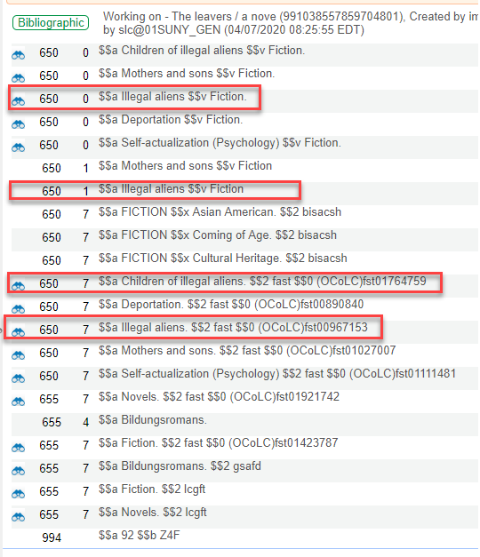
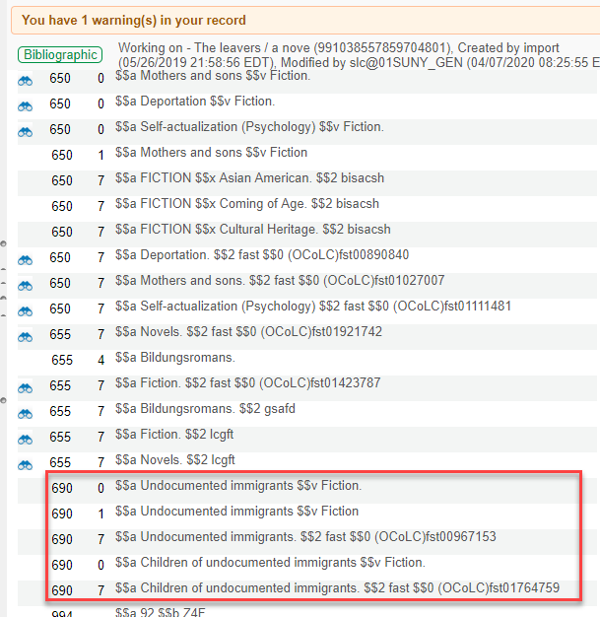
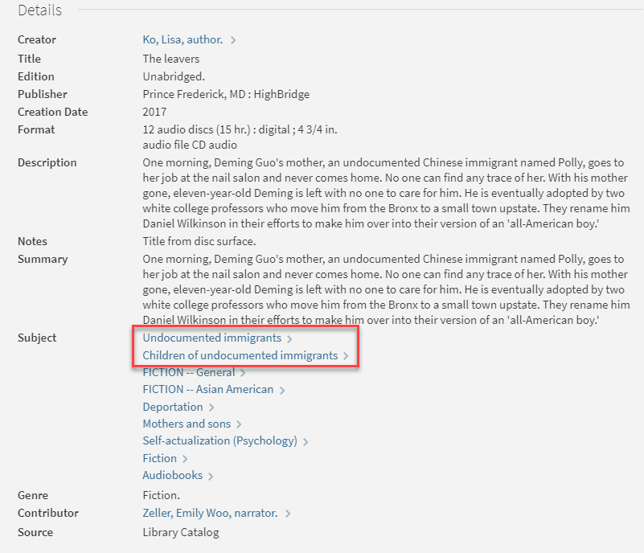
SUNY Local Subject Headings Initiative Update
Original MARC Record
Norm Rule Applied
PrimoVE Display
www.suny.edu
Notes:
Good attendance and engagement for all sessions. A successful switch to registration-based training, which makes it easier to communicate with and count participants.

Slide 25


OCLC Import Profile Updates
April 30, 2020 deadline to move to OCLC's new exchange servers has been currently suspended by OCLC due to COVID-19
  OCLC encourages moving to the new servers as soon as possible
  Once the changes have been made the access to the old server will no longer be available
Instructions are available in the following FAQ:
  http://slcny.libanswers.com/faq/300093
The OCLC exchange server changes will need to be made for any other OCLC services being used in Alma beyond publishing profiles for all campuses
https://help.oclc.org/Librarian_Toolbox/Exchange_files_with_OCLC
www.suny.edu
Notes:
Good attendance and engagement for all sessions. A successful switch to registration-based training, which makes it easier to communicate with and count participants.

Slide 26

Alma May 2020 Release Notes
Acquisitions:
New Order API update:
  11 vendors are enabled to match and activate ebooks to the CZ that originate from OASIS
  Pre-requisite: The relevant CZ electronic collection must be activated in your Institution Zone
    If the collection is not available in the Institution Zone, a standalone electronic resource (portfolio) is created and the order is associated to it, requiring the use of a full MARC update via an Update Inventory import profile for complete descriptive information and access information
List of vendors and more information:
https://knowledge.exlibrisgroup.com/Alma/Product_Documentation/010Alma_Online_Help_(English)/020Acquisitions/020Purchasing/020Creating_PO_Lines/020Real-Time_Acquisitions
www.suny.edu
Notes:
Good attendance and engagement for all sessions. A successful switch to registration-based training, which makes it easier to communicate with and count participants.

Slide 27
Alma May 2020 Release Notes
Resource Management
UTF-8 Special Character Handling
  Ability to configure UTF-8 characters to normalize on save to always save the composed version of special characters
Statistical Notes
  Can now be searched using an advanced repository search for Physical Titles or Physical Items
    Full inventory indexing needs to be run to enable this functionality
New Metadata (MD) Editor in sandboxes
www.suny.edu
Notes:
Good attendance and engagement for all sessions. A successful switch to registration-based training, which makes it easier to communicate with and count participants.

Slide 28
New Metadata (MD) Editor
May 2020 Alma Release introduced the first phase of the new MD Editor in the Sandbox:
  Interested in being considered to help test the New MD Editor? Contact the SLSS via the New MD Editor Testing Interest Form: https://forms.gle/zQywUzhdpVWp9R3v6
Functionality currently unavailable:
Resource Management Training will be schedule for Fall 2020 and it will include the changes to the New MD Editor
New MD Editor Information:
https://knowledge.exlibrisgroup.com/Alma/Product_Documentation/010Alma_Online_Help_(English)/010Getting_Started/050Alma_User_Interface_%E2%80%93_General_Information/045Usability_Improvements
Add Items | Suppress/Unsupress | Copy to Catalog | Share with Network
Merge Records & Combine Inventory | Templates & Rules | Set Management Tags | Finding Matches
www.suny.edu
Notes:
Good attendance and engagement for all sessions. A successful switch to registration-based training, which makes it easier to communicate with and count participants.

Slide 29
New Metadata (MD) Editor
Functionality/Features | Sandbox Release | Production Release | Notes
New MD Editor Layout and core functionality | May 2020 | September 2020 | Push to MD Editor
Address Issues from Customer Feedback | June & July 2020 | July 2020
Contribution to the CZ & Using Catalog Set | July 2020 |  | Expected fix for: Split screen errors when using “Find Matches”
All Record Management Functionality | September 2020 | September 2020 | Expected fix for: Fix Add Local Extensions
Template Management | October 2020 | November 2020 | Expected Fix for: Slow performance issues the MD Editor Slow performance issues using the “Show MD editor” icon
Rule Management | November 2020 | December 2020
Actions menu | February 2021 | TBD | Allows: Right-click actions Field-level actions Validation message in the right pane
New MD Editor as Default | February 2021 | March 2021 | SUNY will move to using the new MD Editor at this time
Improved Merge & Combine |  | Q2/Q3 2021
www.suny.edu
Notes:
Good attendance and engagement for all sessions. A successful switch to registration-based training, which makes it easier to communicate with and count participants.

Slide 30
Training Update
Jennifer Koerber
www.suny.edu

Slide 31
Training Updates
Training Guides
Upcoming Training
Alma Acquisitions guide:
https://slcny.libguides.com/training-acquisitions
Main Training Site:
https://slcny.libguides.com/lsptraining
Fulfillment Online Training Course
May 11, 14, 19 – 1p – 3p
https://sunycpd.eventsair.com/QuickEventWebsitePortal/cfu-alma/cfu-info
Alma Training: Using SLSS Resources to Offer Local Training webinar
May 20, 11a – 12p
https://slcny.libcal.com/event/6683185
Acquisitions Online Course coming in the summer
www.suny.edu

Slide 32
Training Trends from SLSS Virtual Site Visits
Needs: E-Resources; Circulating items like laptops and wireless hotspots via Alma
FAQs and webinar recordings heavily used, guides less universally
Add timestamps to webinar videos or breaking them into segments, depending on the content
Add "why/how do we do this?" sections to guides – not just step-by-step instruction, but the context and benefits to Alma workflows, suggestions for most effective workflows
A space to share campus documentation & training materials, to learn from peers
  Local Campus Docs/Training folder in Basecamp: https://public.3.basecamp.com/p/JPL8a7pseBKYzqv3hpTinzsm
Capturing local knowledge as people leave/retire and sharing it with new hires: "Learning the institution as much as Alma." Perhaps a Top 10 Questions to Ask?
A "1-year Tune-Up" checklist like the Health Checklist – systematically review configurations and look what else you're ready to try now
www.suny.edu

Slide 33


Questions or Discussion?
www.suny.edu

