Slide 1
Resource Management: Batch Processing
Shared Library Services Platform Project
Maggie McGee

Slide 2
Sets
Two types of set:
Itemized set– is a set of individual items that are uploaded from a file or from analytics
Logical set – is a saved search query that is dynamic and it changes to reflect what is in the repository
Sets can be created for:
Resource Management
Bib records
Item records
Holding records
Reading lists
PO Lines
Vendors
Users

Slide 3
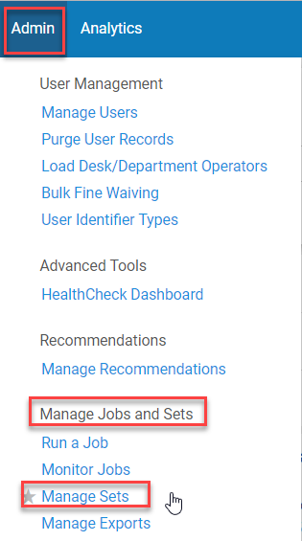
Sets
To view sets once they have been created
Go to Admin>Manage Jobs and Sets>Manage Sets
Manage Sets Screen opens and displays the following three tabs:
My Sets – sets created by user that are both private and public
Public Sets – sets created as public
All sets – all sets

Slide 4
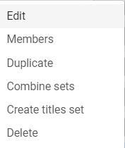
Itemized Sets Row Actions (Ellipses)
What can be done with itemized saved sets from the row actions list (ellipses):
Edit – edit the parameters of the set
Members – displays the results of the set
Duplicate – duplicates the set
Saved to set with prefix of “Copy of”
Combine Sets - create a new set from two sets
Create titles set – creates a titles set (bib) from an itemized set of physical items, electronic portfolios, or digital files
Delete

Slide 5
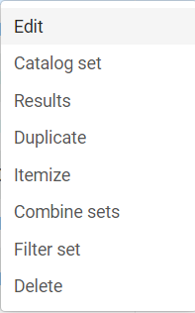
Logical Sets Row Actions (Ellipses)
What can be done with logical saved sets from the row actions list (ellipses):
Edit – edits the set parameters
Catalog set – opens the set in the MD Editor
Limit of 200 records
Results – runs the set and updates the results
Duplicate – copies the set
Saved to set with prefix of “Copy of”
Itemize – changes the set to an itemized set
Combine Sets – create a new set from two sets
Filter Sets – creates a new set based on non-indexed metadata elements
Delete

Slide 6
Creating an Itemized Set
Creating an itemized set
Go to Admin>Manage Jobs and Sets>Manage Sets
Click Add Set
Click Itemized

Slide 7
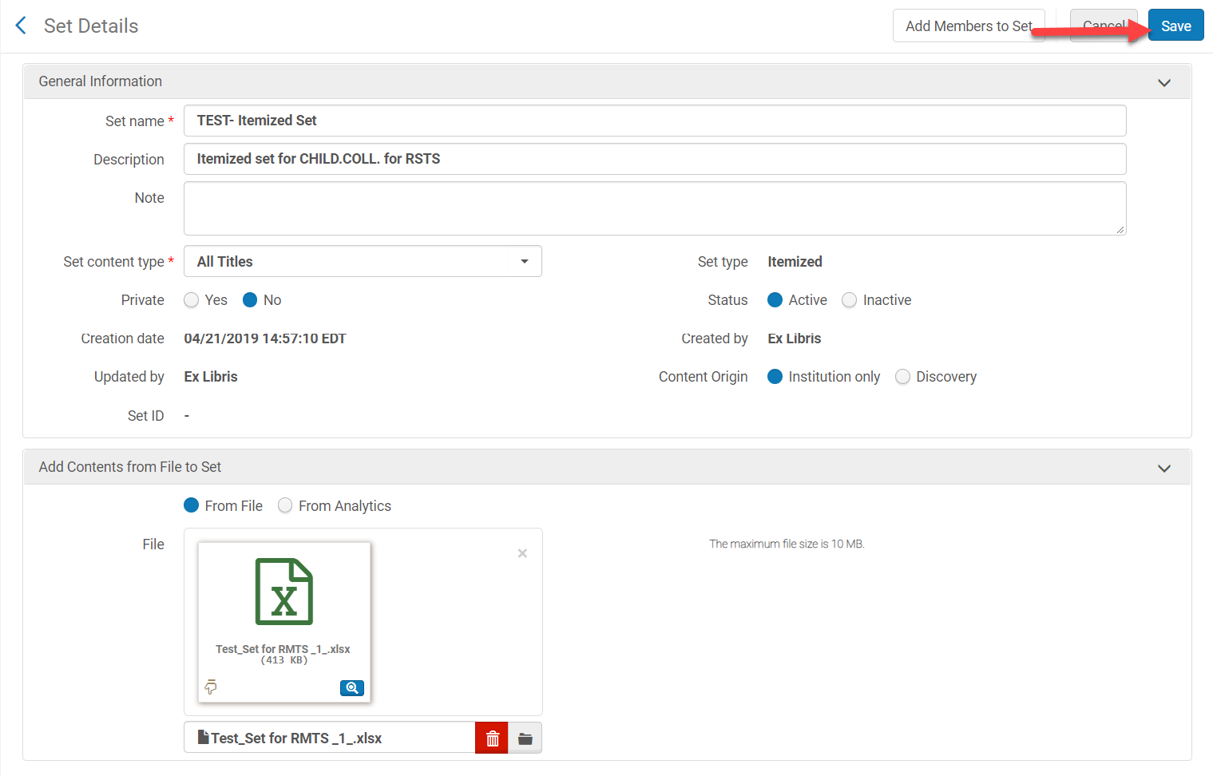
Creating an Itemized Set
Creating an itemized set continued
Set Name: [name the set]
Description: [optional, but helpful]
Private: [No – unless the report should remain private]
Status: Active
Add Contents from a File to Set
Click Save

Slide 8
Creating a Logical Set
Perform a repository search for the set
Use the advance search to refine the results
Click Search
Click Save Query

Slide 9
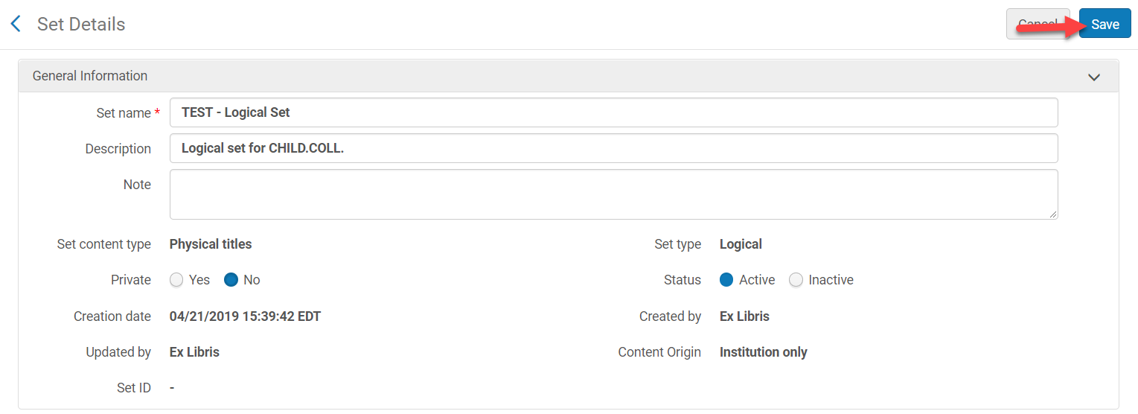
Creating a Logical Set
Set name: [name the set]
Description: [optional, but useful]
Private: [No, unless for private use only]
Status: Active
Click Save

Slide 10
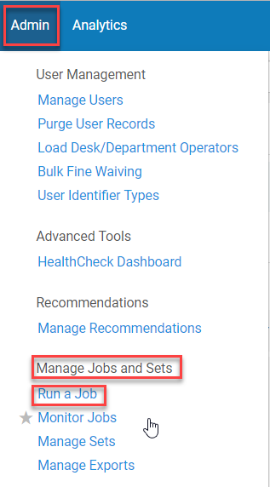
Running Jobs on Sets
Roles required (there are many other roles that can also run jobs) to run a job related to cataloging:
Catalog Administrator or
Catalog Manager
To run a job go to Admin>Manage Jobs and Sets>Run a Job
There are many jobs that can be run on sets
https://knowledge.exlibrisgroup.com/Alma/Product_Documentation/010Alma_Online_Help_(English)/050Administration/070Managing_Jobs/020Running_Manual_Jobs_on_Defined_Sets
BE CAREFUL: many jobs cannot be undone once they have been run

Slide 11
“Withdraw Items” Job Using a Logical Set
Perform a repository search for Physical Items for the process type “Missing” using an advanced search
Click Save Query from the search results screen

Slide 12
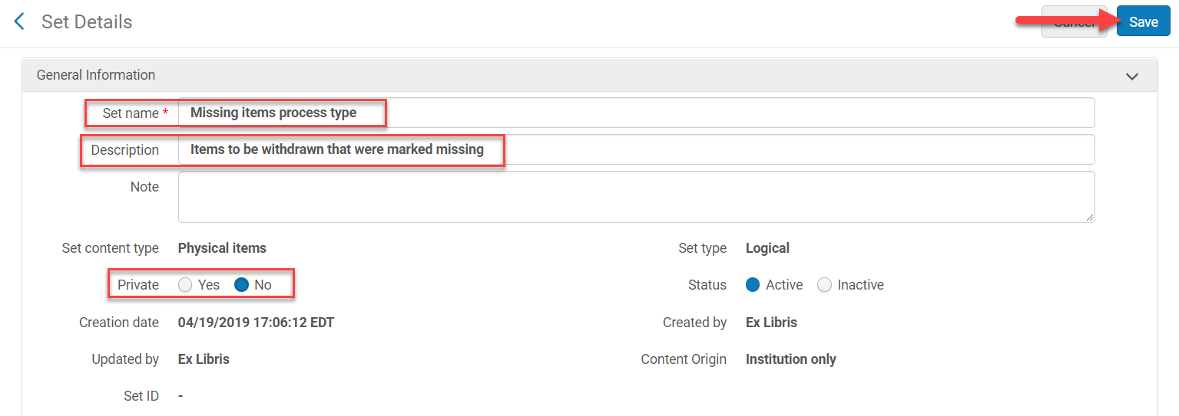
“Withdraw Items” Job Using a Logical Set
The Set Details screen opens
Name: [mandatory – name the set]
Description: [optional, but useful]
Private: [No]
Status: [Active]
Click Save

Slide 13
“Withdraw Items” Job Using a Logical Set
Go to Admin>Manage Jobs and Sets>Run a Job
Search for the job by name or description
Click the radio button next to the job
Click Next

Slide 14
“Withdraw Items” Job Using a Logical Set
Select the “Set”
Click on the radio button next to the set the job will be run on
Click Next

Slide 15
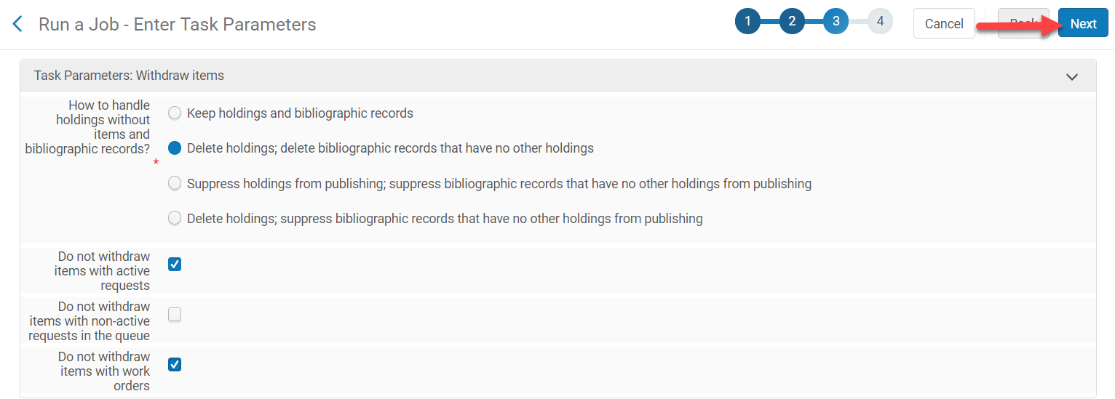
“Withdraw Items” Job Using a Logical Set
Select the parameters for withdrawing the missing items
Click Next

Slide 16
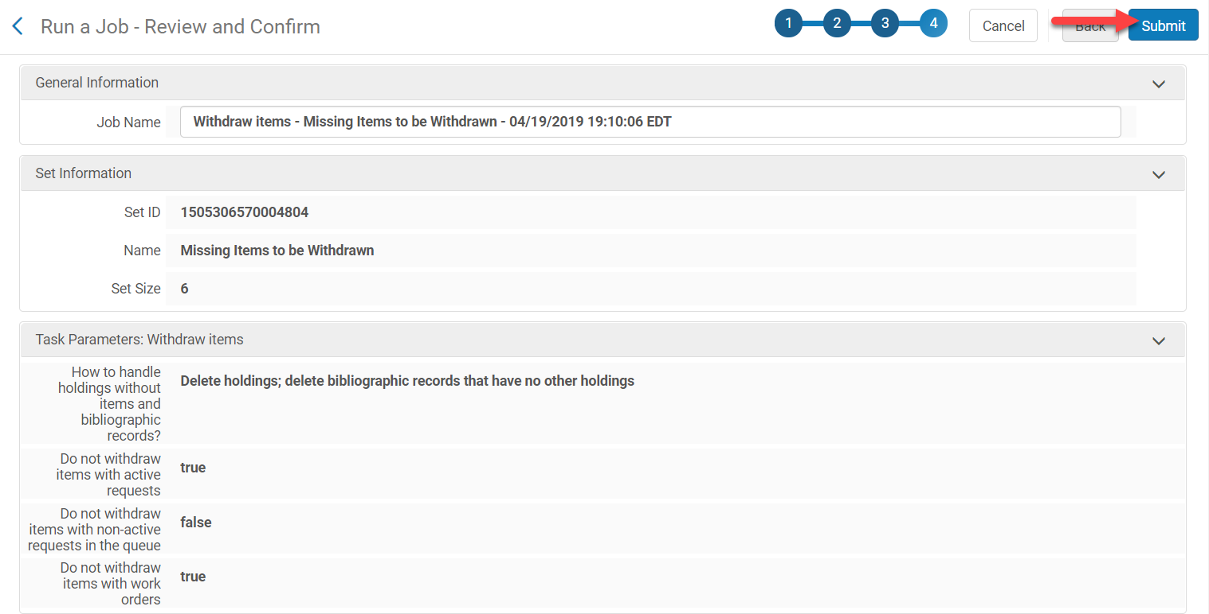
“Withdraw Items” Job Using a Logical Set
Review the details of the job
Click Submit

Slide 17
“Withdraw Items” Job Using a Logical Set
Click Confirm if this is the correct job and outcome
This job cannot be undone
The Monitor Jobs screen opens and shows that the job is running

Slide 18
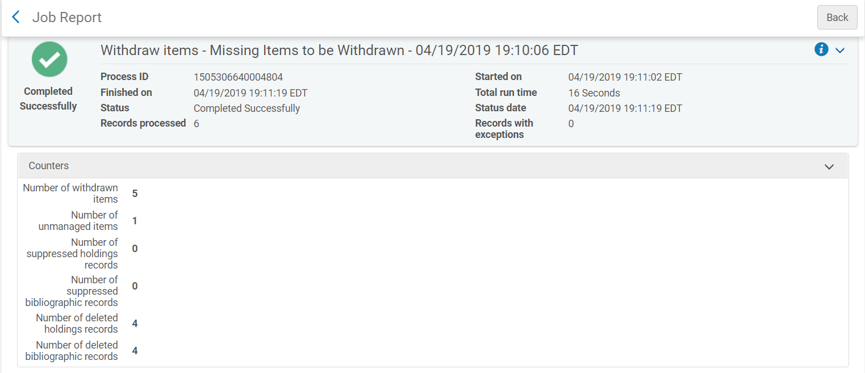
“Withdraw Items” Job Using a Logical Set
Click on the History tab
The completed job displays under the History tab
Click Report from the ellipses to view the results of the job

Slide 19
Normalization Rules
Normalization Rules are used to add, remove or replace MARC information in bibliographic and holdings records
MARC field
MARC subfields
Indicators
A combination of the above
Normalization Rules can be used on a single record or a group of records using a set
It is always a good idea to test a normalization rule on a single record to make sure it works as desired
Export the set to Excel first to use to later verify the changes worked properly
The Cataloging Administrator, Catalog Manager, or Cataloger Role is required to create or edit normalization rules
Three classifications of Normalization Rules:
Private – only you can use and see them
Shared – can been seen by anyone at your institution
Community – created and shared by Alma users worldwide

Slide 20
Normalization Rules
ExLibris Documentation Working with Normalization Rule
https://knowledge.exlibrisgroup.com/Alma/Product_Documentation/010Alma_Online_Help_(English)/040Resource_Management/040Metadata_Management/070Working_with_Normalization_Rules#Record_Elements
ExLibris Documentation and Presentations on Normalization Rules
https://knowledge.exlibrisgroup.com/Alma/Training/Extended_Training/Presentations_and_Documents_-_Rules#Normalization_Rules
ExLibris Examples of Normalization Rules
https://developers.exlibrisgroup.com/blog/alma-normalization-rule-examples/

Slide 21
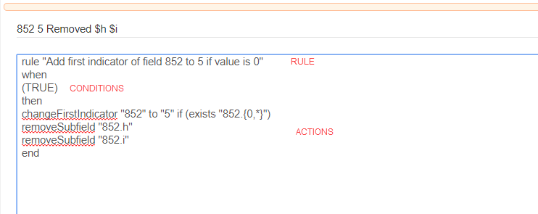
Normalization Rules Syntax
Contains one or more rules
When using more than one rule they must be prioritized if they are performing an action in the same MARC field
Example, Action1, Action2, etc.
Contains a condition
Record must meet these conditions
Contains one or more action
What is to be done

Slide 22
Normalization Rules Process
Create a set
Itemized or
Logical
Create a normalization rule
From a new normalization rule
From an existing normalization rule or
Create a normalization process
Run a normalization job

Slide 23
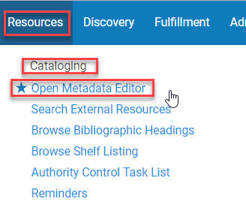
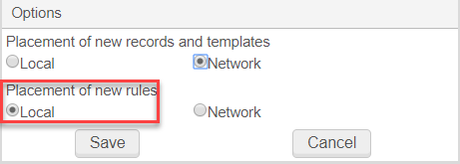
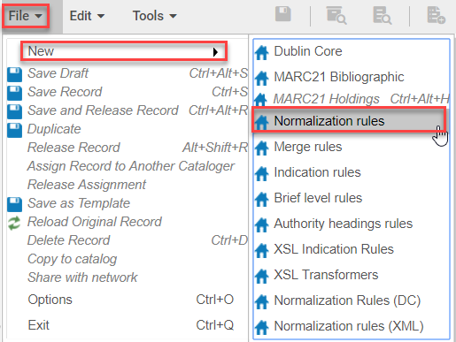
Creating a New Normalization Rule
Open the Metadata Editor
Resources>Cataloging>Open Metadata Editor
Go to Files>Options
Makes sure the Placement of new rules is set to Local, unless you want to share the rule to the network
Go to File>New>Normalization rules

Slide 24
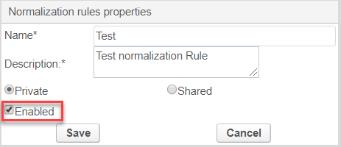
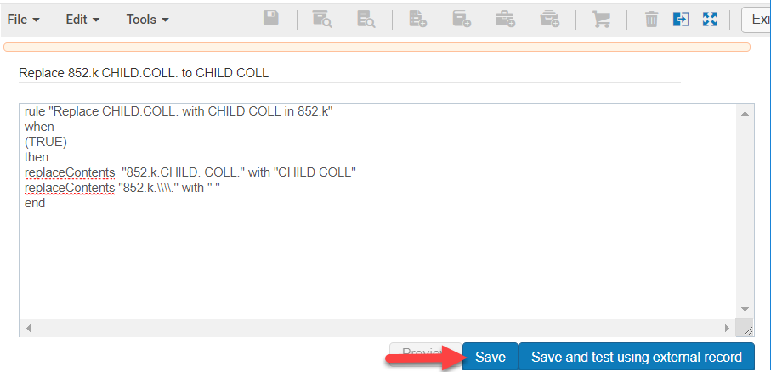
Creating a New Normalization Rule
Name the Normalization rule
Add a description
Click the radio button next to
Private – only seen by creator
Shared - seen by others and allows it to be used in a normalization process
Click in the check box next to Enabled
Click Save
Begin typing the normalization rule in the MD editor
Click Save
Click File>Exit
Test the normalization rule on one record
*It’s easier to create a normalization rule from an existing rule

Slide 25
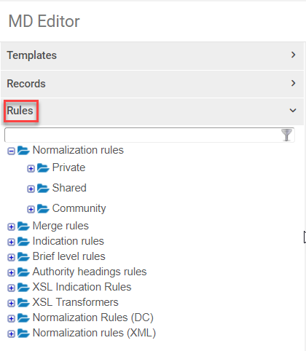
Creating a Normalization Rule From an Existing Rule
Open the Metadata Editor
Resources>Cataloging>Open Metadata Editor
Go to Files>Options
Makes sure the Placement of new rules is set to Local, unless you want to share the rule to the network
Click on the Rules drop-down menu in the left pane of the Metadata Editor
Click on the + next to Normalization rules to expand it

Slide 26
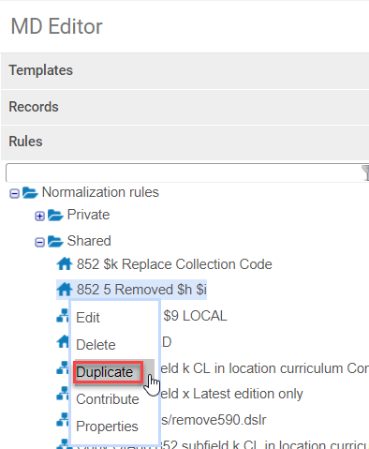
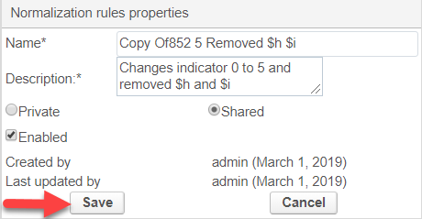
Creating a Normalization Rule From an Existing Rule
Click the + on the folder where you want to copy a normalization rule
Click on the rule and select Duplicate
The Normalization rules properties screen opens
“Copy of” is added as the prefix of the original rule name
Change the name and description as needed
Click Save
The normalization rule opens in the MD Editor
Make the necessary changes
Click Save
Test the normalization rule on one record

Slide 27
Applying a Normalization Rule for One Record/Testing
Open a bib or holdings record in the MD editor
Click on the split screen icon and click into the empty space
Open the normalization rule
Click Preview in the normalization screen

Slide 28
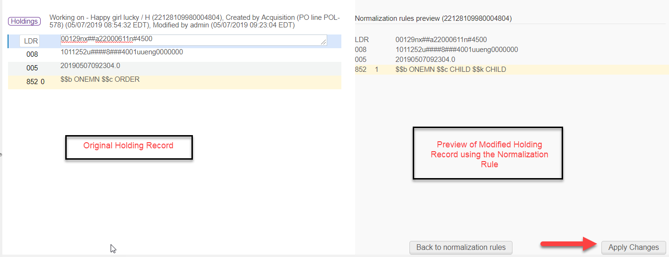
Applying a Normalization Rule for One Record/Testing
Review the changes in the normalization rule screen
Click Apply Changes if the changes are as displayed as expected
If not, click back to normalization rules and modify the rule to apply the correct information

Slide 29
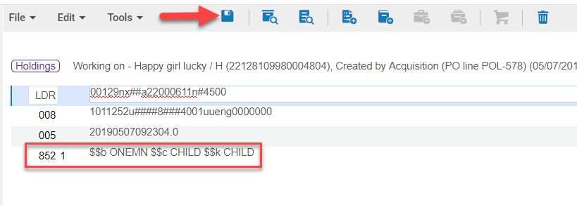
Applying a Normalization Rule for One Record/Testing
The changes have been applied
Click Save (Ctrl+S) or Save and Release Record (Ctrl+Alt+R)

Slide 30
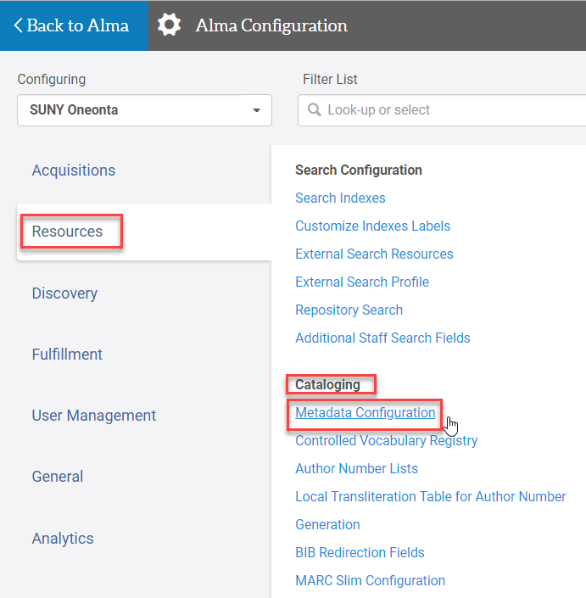
Create a Normalization Process
Required Role: Catalog Administrator
Go to Configuration Menu>Resources>Cataloging>Metadata Configuration
Click on the MARC21 link for the process being created

Slide 31
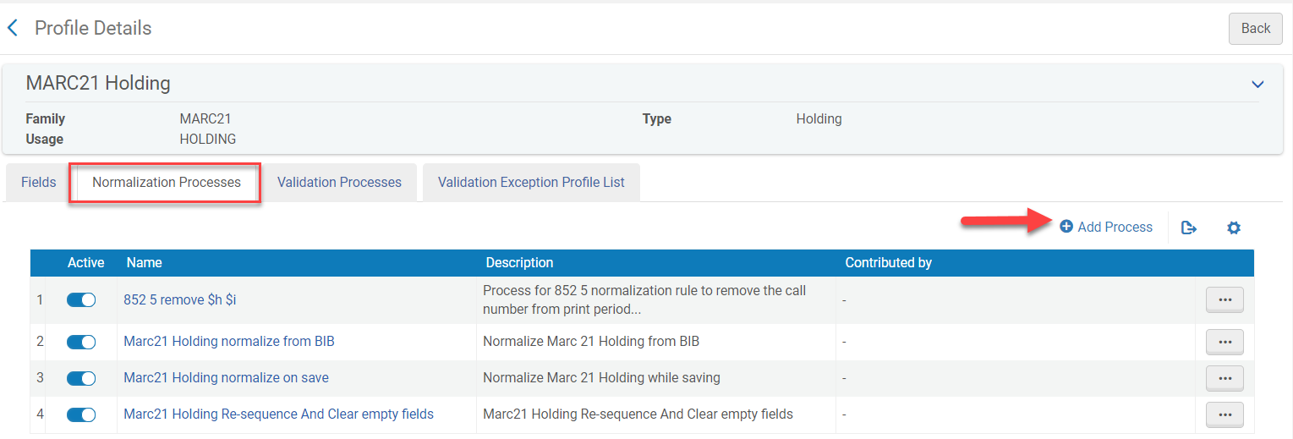
Create a Normalization Process
Click on the Normalization Processes tab
Click Add Process

Slide 32
Create a Normalization Process
Name the normalization process
Add a description
Status: Active [default]
Click Next

Slide 33
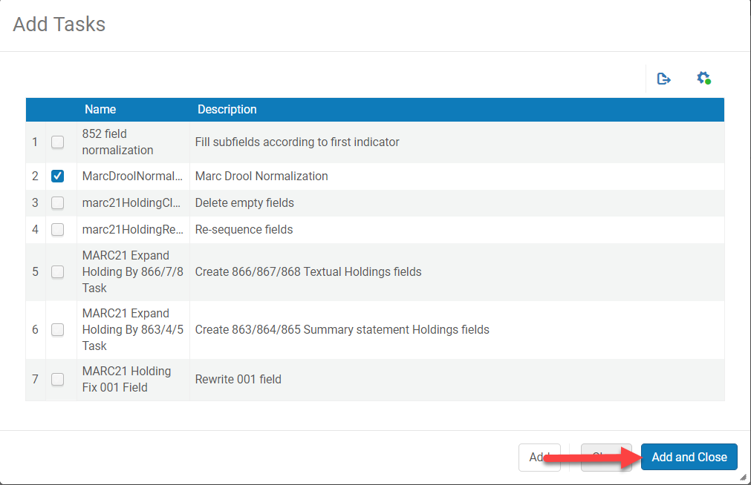
Create a Normalization Process
Click Add Tasks
Click in the check box next to Marc Drool Normalization
Click Add and Close

Slide 34
Create a Normalization Process
Click Next
From the drop-down choose the Drools file key (the normalization rule that was created)
Click Save

Slide 35
Running a Normalization Job on a MARC 21 Holdings Set
Before running a normalization job it is suggested to export the set to excel to review results
Go to Admin>Manage Jobs and Sets>Run a Job
Select the job to either change holdings or bibliographic information
Holdings – uses the job “Change Holdings Information”
Bibliographic – uses Marc21 Bibliographic Normalization
Type the name or description into the search box
Click the radio button next to the job
Click Next

Slide 36
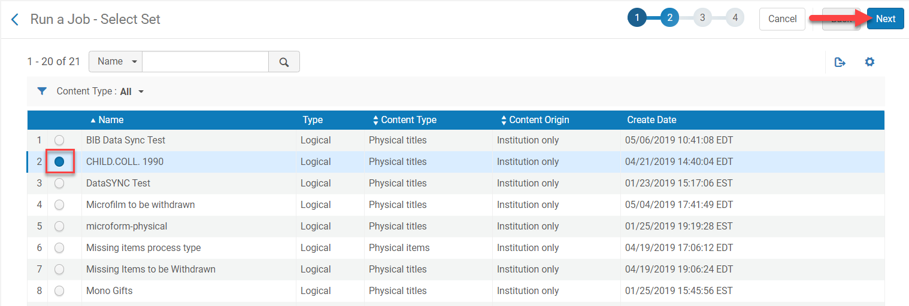
Running a Normalization Job on a MARC 21 Holdings Set
Click the radio button next to the desired set
Click Next

Slide 37
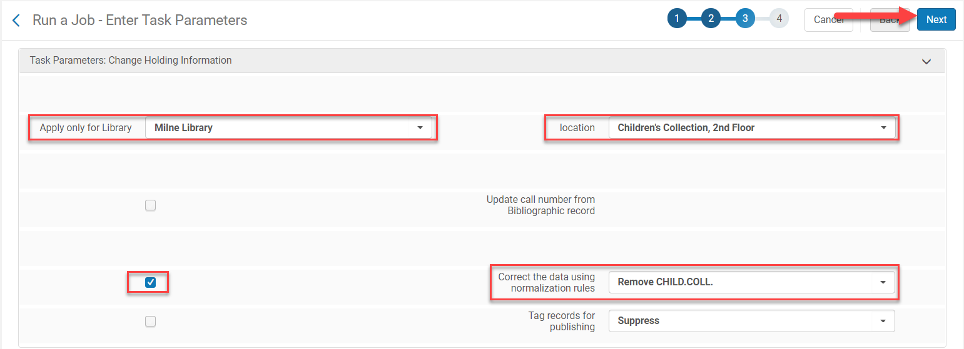
Running a Normalization Job on a MARC 21 Holdings Set
Enter the parameters you want to run against the set
Apply only for Library
Location
Check in the box across from Correct the data using normalization rules
Select the normalization rule from the drop-down menu
Click Next

Slide 38
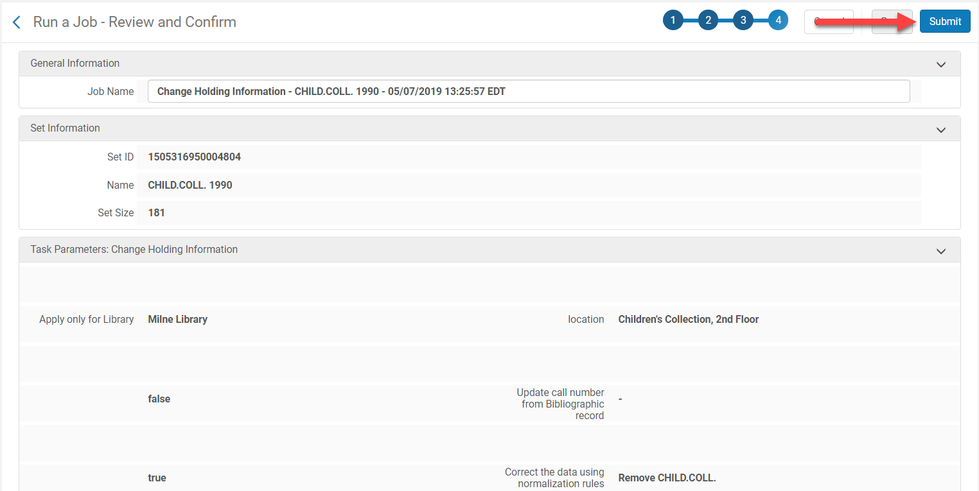
Running a Normalization Job on a MARC 21 Holdings Set
Review and confirm the job
Click Submit

Slide 39
Running a Normalization Job on a MARC 21 Holdings Set
Click Confirm when the confirmation pop-up appears
The job cannot be reversed
The Monitor Jobs screen opens and the job is running

Slide 40
Running a Normalization Job on a MARC 21 Holdings Set
Click on the History tab
Click Report from the ellipses to review the job results

