Slide 1
How to link Institutional Zone (IZ) Bib records to the Network zone (NZ) Post Migration
Shared Library Services Platform Project
Maggie McGee

Slide 2
Why Are Some Migrated IZ Bib Records Not Linked to the NZ?
The bib records were not included in the NZ seed files
The institution’s holdings were not added to OCLC
The institution’s holdings were added to OCLC after the OCLC holdings were pulled to seed the NZ
The bib records do not have OCLC numbers

Slide 3
IZ Bib Records that Should Not Be Linked or Added to the NZ
E-resources
Form 0 in MARC field 008 position 23 or
MARC field 300 $a online resource
Foreign language bib records
MARC field 040 $b is not eng
The record would need to be cataloged as an English language bib records to be able to added to or linked to the NZ

Slide 4
IZ Bib Records that Should Not Be Linked or Added to the NZ
Personal-copy course reserves
Titles borrowed on ILL from outside the SUNY Libraries Consortium
Inventory control of equipment
Host bibliographic records for bound-withs
Suppressed bibliographic records
Proprietary vendor bib records
* MSP-3: ALMA Network Zone (NZ)

Slide 5
Steps to Link Migrated IZ Bib Records to the NZ
Identify IZ migrated bib records that are not linked to the NZ
Create a Physical Titles Set from the repository search results from step 1
Review the set
Run the “Link a set of records to the Network Zone” job on the set of records
Review the job report

Slide 6
Identify IZ migrated bib records that are not linked to the NZ
Shared Library Services Platform Project
Maggie McGee

Slide 7
Identify Migrated IZ Bib Records that Need to be Linked to the NZ
Perform a Physical Titles advanced repository search to see all IZ bib records that are not linked to the NZ
Physical Titles: Is Linked: Equals: No
The results will include all physical titles that are not linked to the NZ
To get more manageable results:
Add other search parameters
Use facets

Slide 8
Identify Migrated IZ Bib Records that Need to be Linked to the NZ
Other System Number: Contains Keywords: (OCoLC)
Is linked: Equals: No
Tag Suppressed (Title): Equals: No
These can also be added as search parameters:
Has Inventory: Equals: Yes or NO
Permanent Physical Location: Equals: [select location(s)]

Slide 9
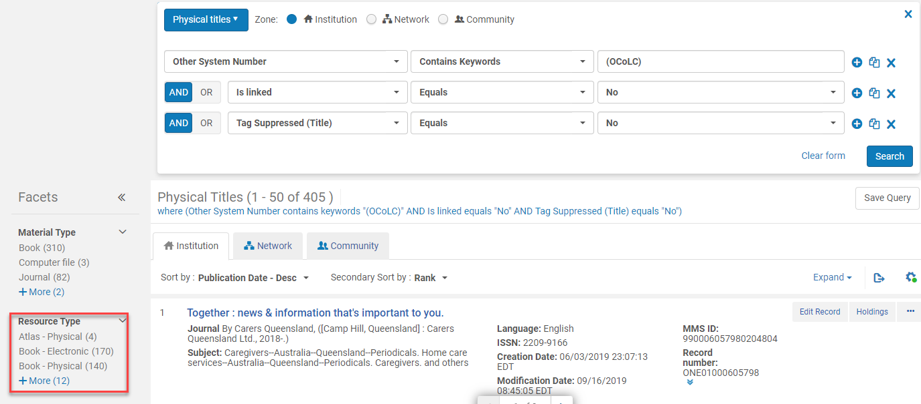
Identify Migrated IZ Bib Records that Need to be Linked to the NZ
Use the facets on the left to limit the search by resource type to eliminate e-resources from the set

Slide 10
Identify Migrated IZ Bib Records that Need to be Linked to the NZ
Perform an advanced repository search to identify IZ bib records without OCLC numbers that are not linked to the NZ.
Other System Number: Not Contains Keywords: (OCoLC)
Tag Suppressed (Title): Equals: No
Is linked: Equals: No
Permanent physical location: Equals: [select location(s)]
* These records will need to have OCLC number added to the IZ bib records before running the “Link a set of records to the Network Zone” job

Slide 11
Identify Migrated IZ Bib Records that Need to be Linked to the NZ
Perform an advanced repository search to identify IZ bib records without inventory that are not linked to the NZ.
Is linked: Equals: No
Has inventory: Equals: No
*These records need to be reviewed for possible withdrawal

Slide 12
Create a Physical Titles Set
Shared Library Services Platform Project
Maggie McGee

Slide 13
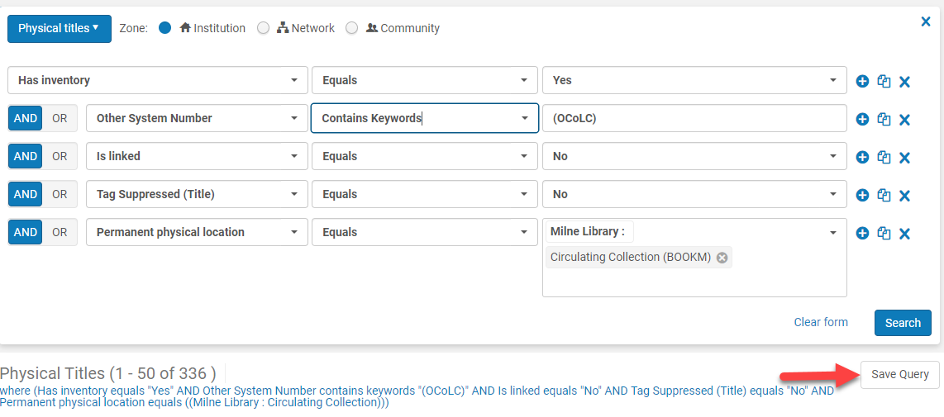
Create a Set of Unlinked IZ Records From a Repository Search
Click Save Query from the advanced repository search

Slide 14
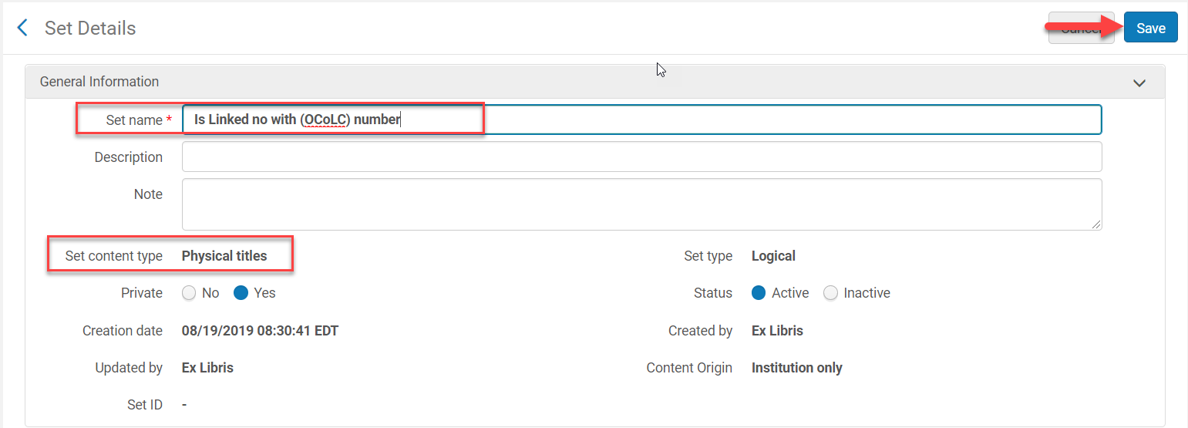
Create a Set of Unlinked IZ Records From a Repository Search
The Set Details Screen opens
Set name: [name the set]
Description: [optional]
Set Content type: Physical Titles
Make Private: No (shared) or Yes (private)
Status: Active
Click Save

Slide 15
Review the Set of records
Shared Library Services Platform Project
Maggie McGee

Slide 16
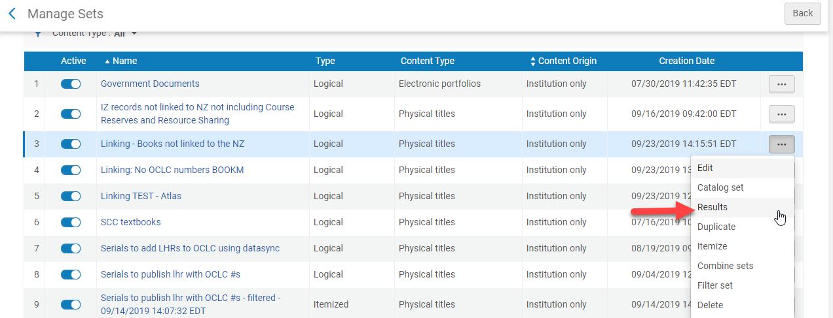
Review the Set of Records
Go to Admin>Manage Jobs and Sets>Manage Sets
Click Results (logical set ) from the ellipses of the set

Slide 17
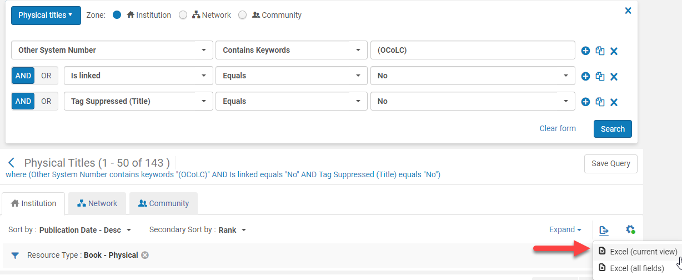
Review the Set of Records
Review the bib records to identify bib records that do not need to be linked to the NZ by:
Exporting the set to Excel or
Refining the query and then exporting the results to excel

Slide 18
Edit the Set of Records*
Edit the results in Excel only if the search results are modified
Delete all fields except the title and 035 field the Record Number columns
Change the Record Number column header to 035 field
* Editing the search results and creating an itemized set is not always necessary

Slide 19
Edit the Set of Records
Create an itemized set for the edited results
Go to Admin>Manage Sets and Job>Manage Sets
Click Add Set
Click on Itemized

Slide 20
Edit Set of Records
Set Detail Screen Opens
Set name: [name set]
Description: [optional]
Private: [Select No, unless you do not want others to see]
Status: Active
Add Content From to Set: From File
Click the File icon to upload the set
Click Save

Slide 21
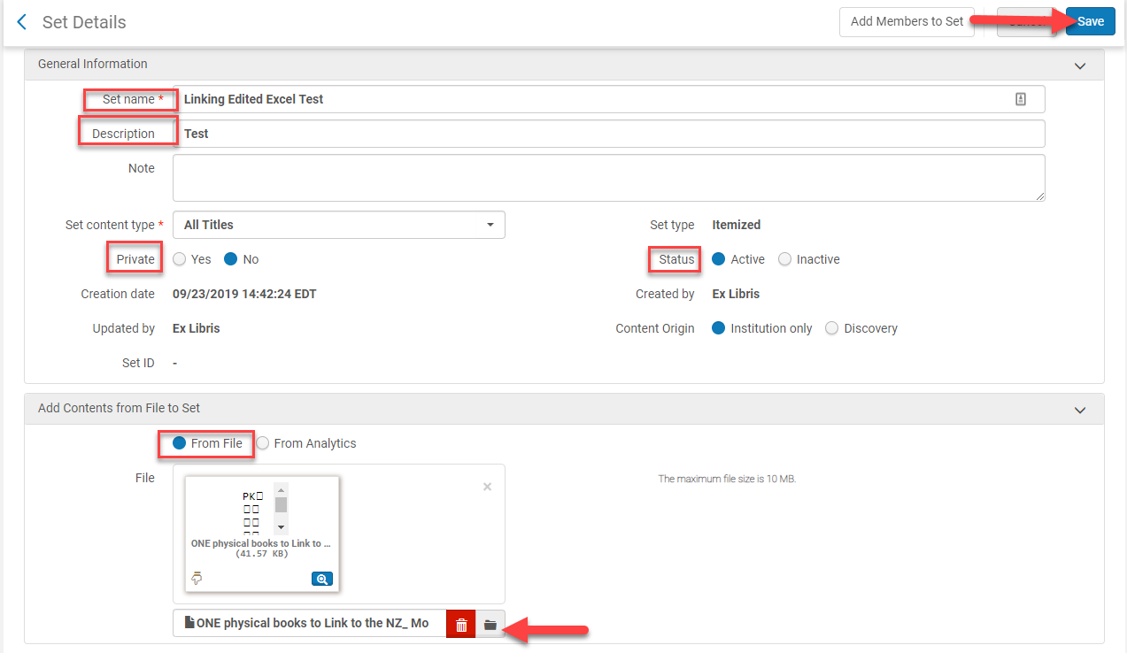
Edit Set of Records

Slide 22
Run the “Link a set of records to the Network Zone” job
Shared Library Services Platform Project
Maggie McGee

Slide 23
Run the “Link a set of records to the Network Zone” job
Go to Admin>Manage Jobs and Sets>Run a Job
Search for the “Link a set of records to the Network Zone” job by name
Click on the radio button next to the job
Click Next

Slide 24
Run the “Link a set of records to the Network Zone” job
Click on the radio button next to the set created to identify IZ records not linked to the NZ
Click Next

Slide 25
Run the “Link a set of records to the Network Zone” job
Serial match method: Unique OCLC Identifier Match Method
Non Serial match method: Unique OCLC Identifier Match Method
Check the Contribute IZ records check box
This adds the bib record to the NZ and links the IZ record if there is no matching bib record in the NZ
Click Next

Slide 26
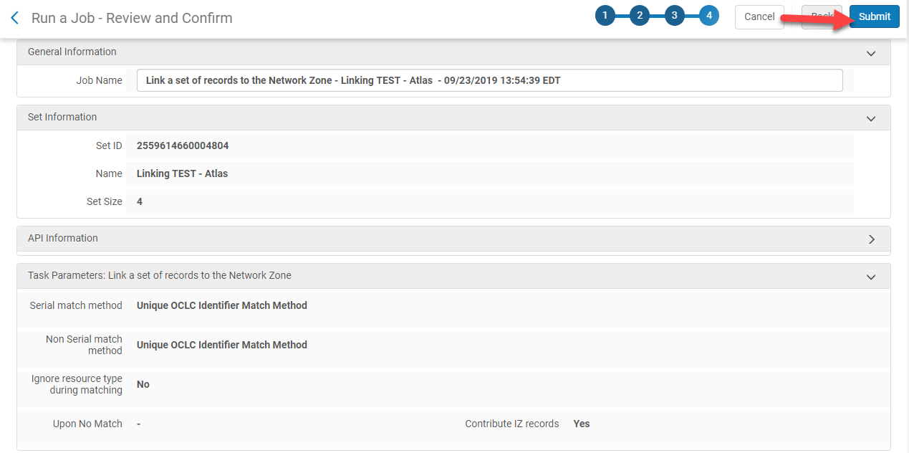
Run the “Link a set of records to the Network Zone” job
Review the job
Click Submit

Slide 27
Run the “Link a set of records to the Network Zone” job
Click Confirm when the pop-up confirmation message appears

Slide 28
Review the job report
Shared Library Services Platform Project
Maggie McGee

Slide 29
Review the Job Report
Go to Admin>Manage Jobs and Set>Manage Jobs
Click on the History tab
Click Report from the ellipses of the job called “Link a set of records to the NZ”

Slide 30
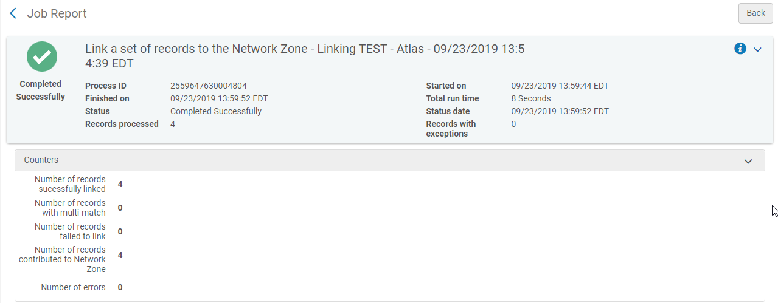
Review the Job Report
Troubleshoot the records that were not linked or contributed to the NZ

