Slide 1
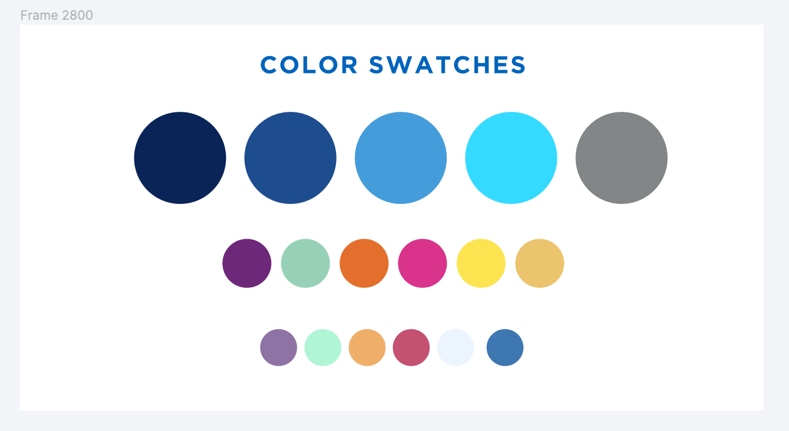
Alma Resource Sharing – Digital Borrowing & Lending Workflows
May 2, 2024

Slide 2
Alma Digital Borrowing and Lending Workflows
Topics to be covered:
Processing borrowing article requests
Filling lending request for digital articles
Filling lending requests for print articles & book chapters

Slide 3
Alma Resource Sharing – Other Training Resources
Alma Resource Sharing Training Guide: https://sunyolis.libguides.com/training-resource-sharing
Digital Borrowing: https://sunyolis.libanswers.com/faq/300919
Digital Lending: https://sunyolis.libanswers.com/faq/294697

Slide 4
Alma Physical Resource Sharing – Roles Needed
Roles Needed to Process Lending Requests:
Circulation Desk Operator - scoped to library & circulation desk
Fulfillment Services operator - scoped to library
Requests Operator - scoped to library & circulation desk

Slide 5
Alma Article Resource Sharing in SUNY
Article resource sharing was not implemented at Alma go live
Nearly all SUNY libraries still has ILLiad, and ILLiad’s article borrowing and lending capabilities were much better
Significant improvements were made to Alma article resource sharing, and the cost of ILLiad became an issue for many SUNY libraries, so we implemented Alma article resource sharing in the spring of 2020
Approximately half of SUNY now borrows and/or lends articles via Alma
Please email info@sunyolis.libanswers.com if your library is interested in Alma article borrowing and lending

Slide 6
Alma Digital Borrowing Workflows
Article borrowing requests can be submitted in the same exact manner as physical borrowing requests
Submitted by users via Primo
Submitted by staff via Alma
Alma assembles a rota and automatically sends requests in the same exact manner as physical borrowing requests with one exception
Alma can be configured to not automatically send requests that exceed the CONTU “Rule of 5”
This has been set up for all SUNY Alma article borrowers

Slide 7
Alma Digital Borrowing Workflows
Article requests that exceed the CONTU “Rule of 5” must be sent manually by staff
Copyright payments must be handled outside of Alma
Report copyright via the Copyright Clearance Center (copyright.com)
Purchase article from publisher or a document delivery supplier like Reprints Desk
Articles obtained outside of Alma can be uploaded and delivered via Alma
Articles are delivered to users via email and download link in their Primo account

Slide 8
Alma Digital Lending Workflows
Vast majority of article requests are for articles from our e-journal subscriptions
Digital articles can often be found directly from the article lending request, but some require additional searching in Primo
If an article from a print journal is requested, the specific volume/issue can be added to the Prick From Shelf list
Articles scanned from print are delivered in the same manner as articles downloaded from e-journals

