Slide 1
Clearing the Air: Navigating Mold Challenges in SUNY Libraries
SUNY Spotlight 2023
Milo Cameron, MVCC

Slide 2
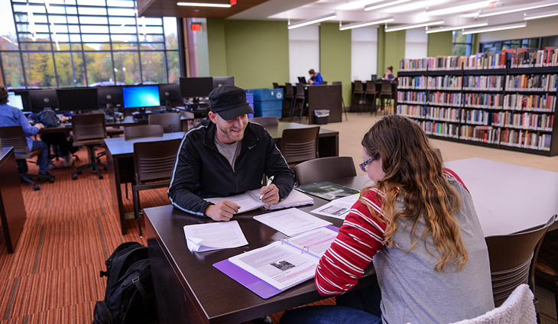
Setting the stage
MVCC’s Rome satellite campus

Slide 3
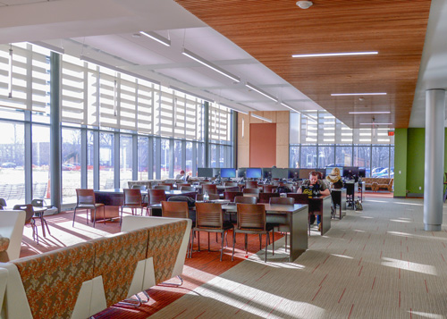
Small space, big changes
Satellite campus of Mohawk Valley Community College
One room, limited collection
Moved to its own wing after campus renovations in 2016
Spearheaded the school’s transition to RFID through grant funding as part of the update
Has a more specialized collection with heavy emphasis on cooking techniques, history, and culture for the culinary program

Slide 4
Act I: mold, conditions, and how we spotted it

Slide 5
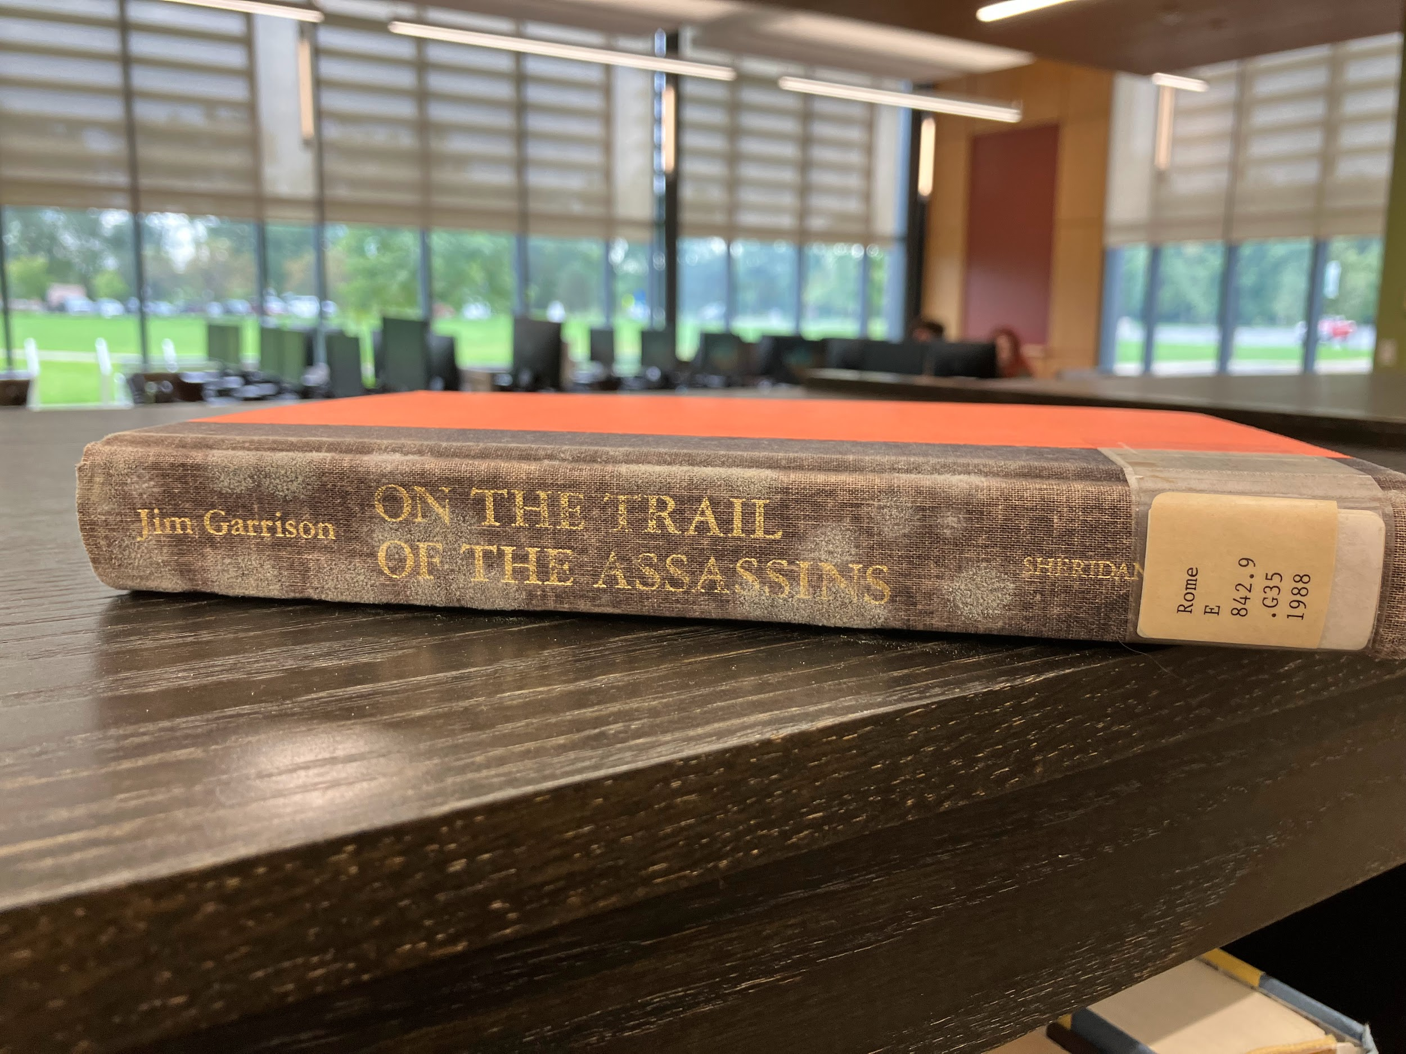
Facilities are everything
During the renovation, the entire collection was stored in a non-air conditioned facility
Although it lay dormant for a while, the mold surfaced when the humidity in the new library rose too high in Fall of 2022.

Slide 6
Seeing spots
In the summer we found one book with signs of mold. We discarded the book and moved on (hubris at its finest).
In October, while doing some routine searching, we found that a full on outbreak had spread to the whole collection.
Gray fuzzy spots on spines and covers
Discoloration and water damage on some books
Can usually be differentiated from general wear by wiping: if it rubs away, then it’s spores and not just damage.
We ended up discarding over 60 books from across the collection.

Slide 7
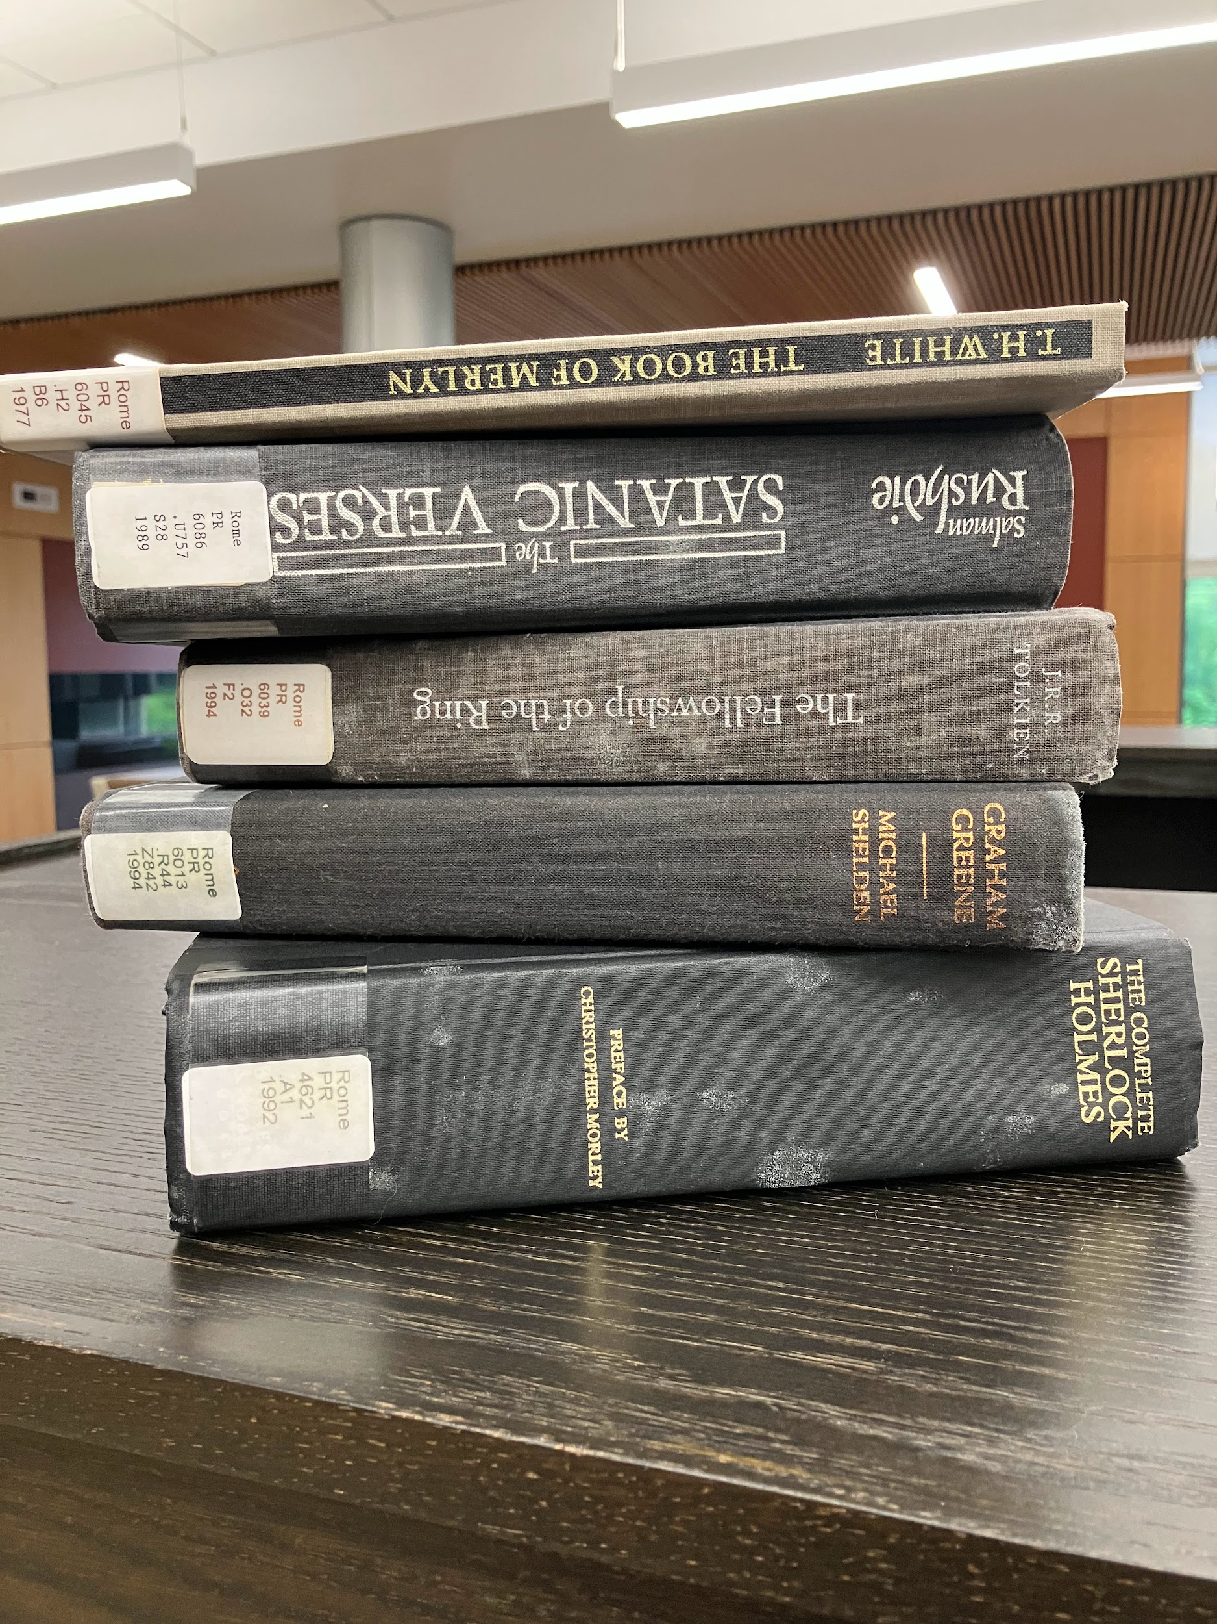
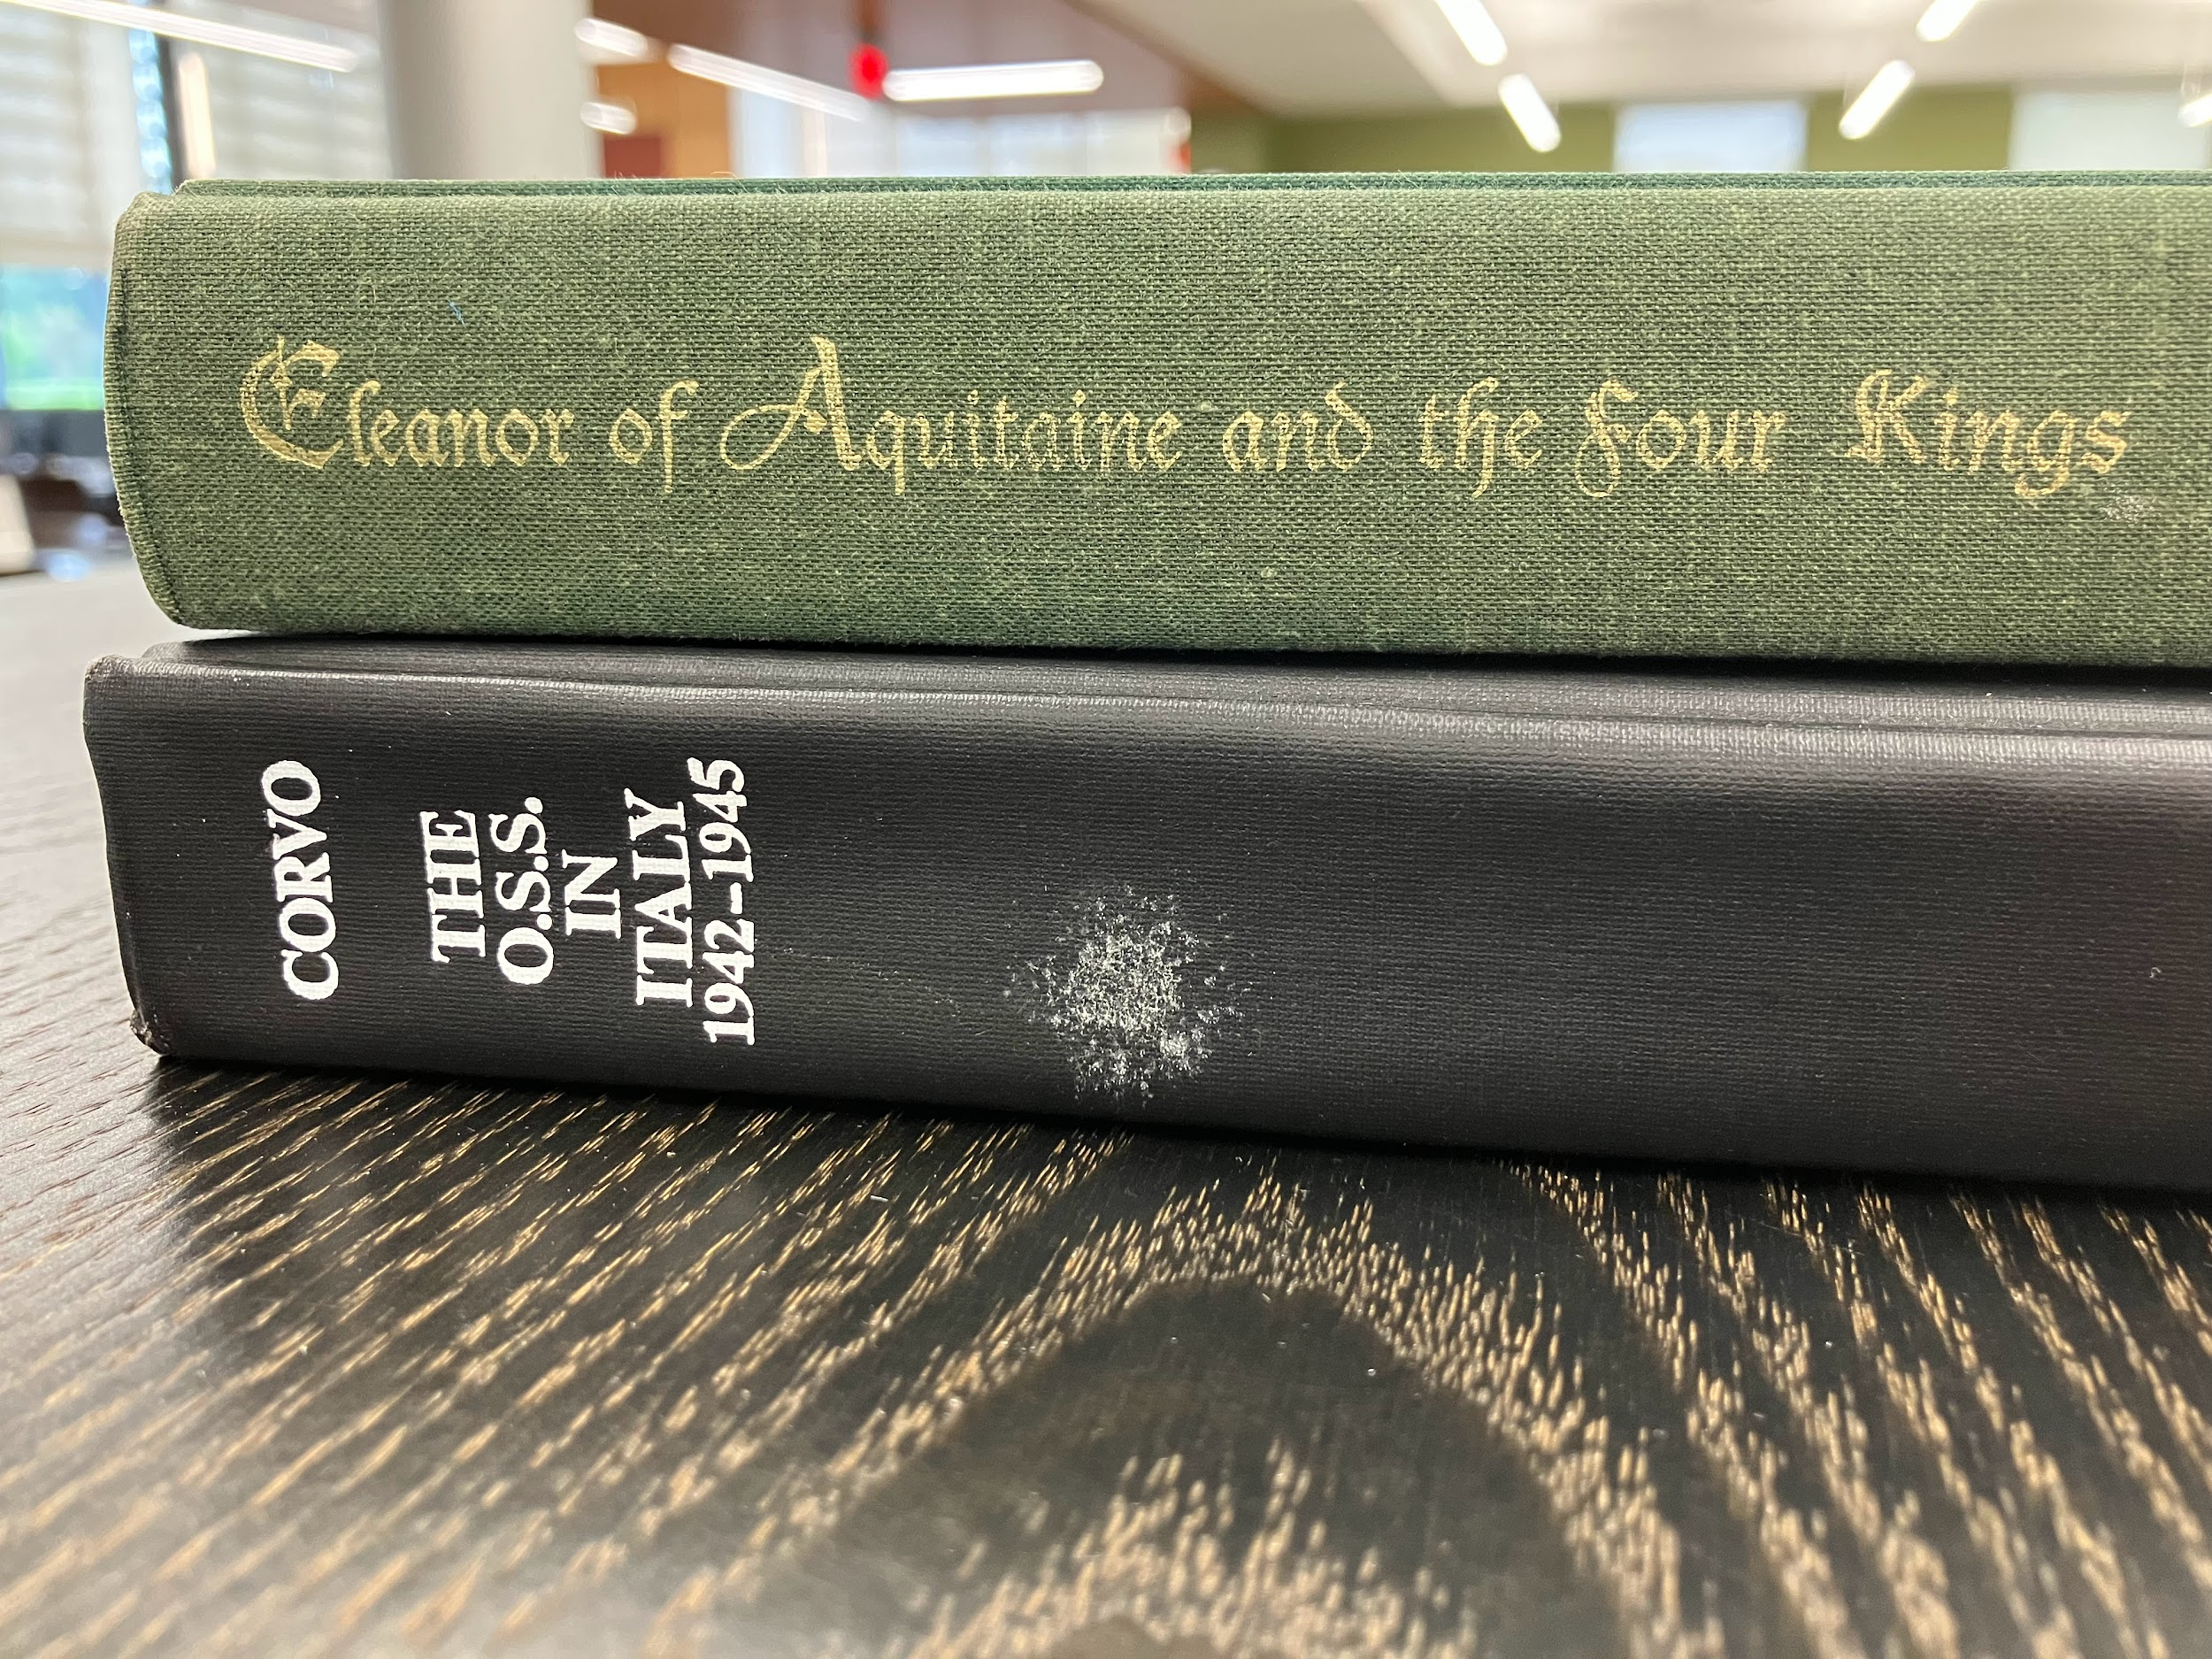

Slide 8
Researching best practices: take it seriously!

Slide 9
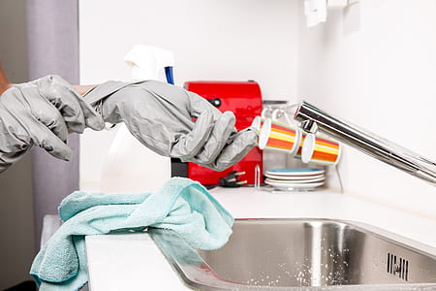
DIY
Based on our available resources and the budget constraints the college faces, we decided to attempt to handle things ourselves in-house.
While we’re by no means professional mold cleaners, we had a uniquely manageable outbreak with the small collection, and a good amount of time to work with the low traffic on that campus.

Slide 10
Ask an Archivist!
We searched for expert advice from the New York State Library, the Northeast Document Conservation Center, ALA, and the New York State Library.
We also took advantage of an “Ask an Archivist” program taking place at the time. They encouraged us to take it VERY seriously.
The archivist actually personally called after emailing to emphasize the gravity of the situation.
All sources encouraged careful personal protection, thorough methodical cleaning, and ongoing monitoring.

Slide 11
How we proceeded: divide and conquer

Slide 12
Equipment + Time + People = Success?
Materials
Purchased a vacuum with a HEPA filter to collect spores and protect patrons using the library while we cleaned.
Received heavy duty alcohol cleaning wipes (not soapy lysol wipes) to disinfect without damaging.
Distributed masks and gloves to anyone working in the stacks.
Procedure
Halt all outgoing interlibrary loan/resource sharing. Clean all books from other libraries before returning to avoid spread.
Vacuum, remove and clean each book, wipe down shelf, then replace dried books for each shelf in the library.

Slide 13
Ongoing maintenance: other duties as assigned

Slide 14
Looking forward
Cleaning took the rest of the year, right up until Christmas.
Waited a few months to ensure no new blooms, then reopened resource sharing and ILL.
Everything that gets transported out of the library is wiped down first to prevent any kind of spread.
Everything that gets returned gets wiped down in case it was checked out while we cleaned.
This will continue for at least the next year in case it turns out to be a seasonal recurrence (it shouldn’t, but you never know), and we will continue to monitor the stacks on both campuses just in case.
Stay tuned to learn how this turned out…

Slide 15
Act II: revenge of the mold

Slide 16
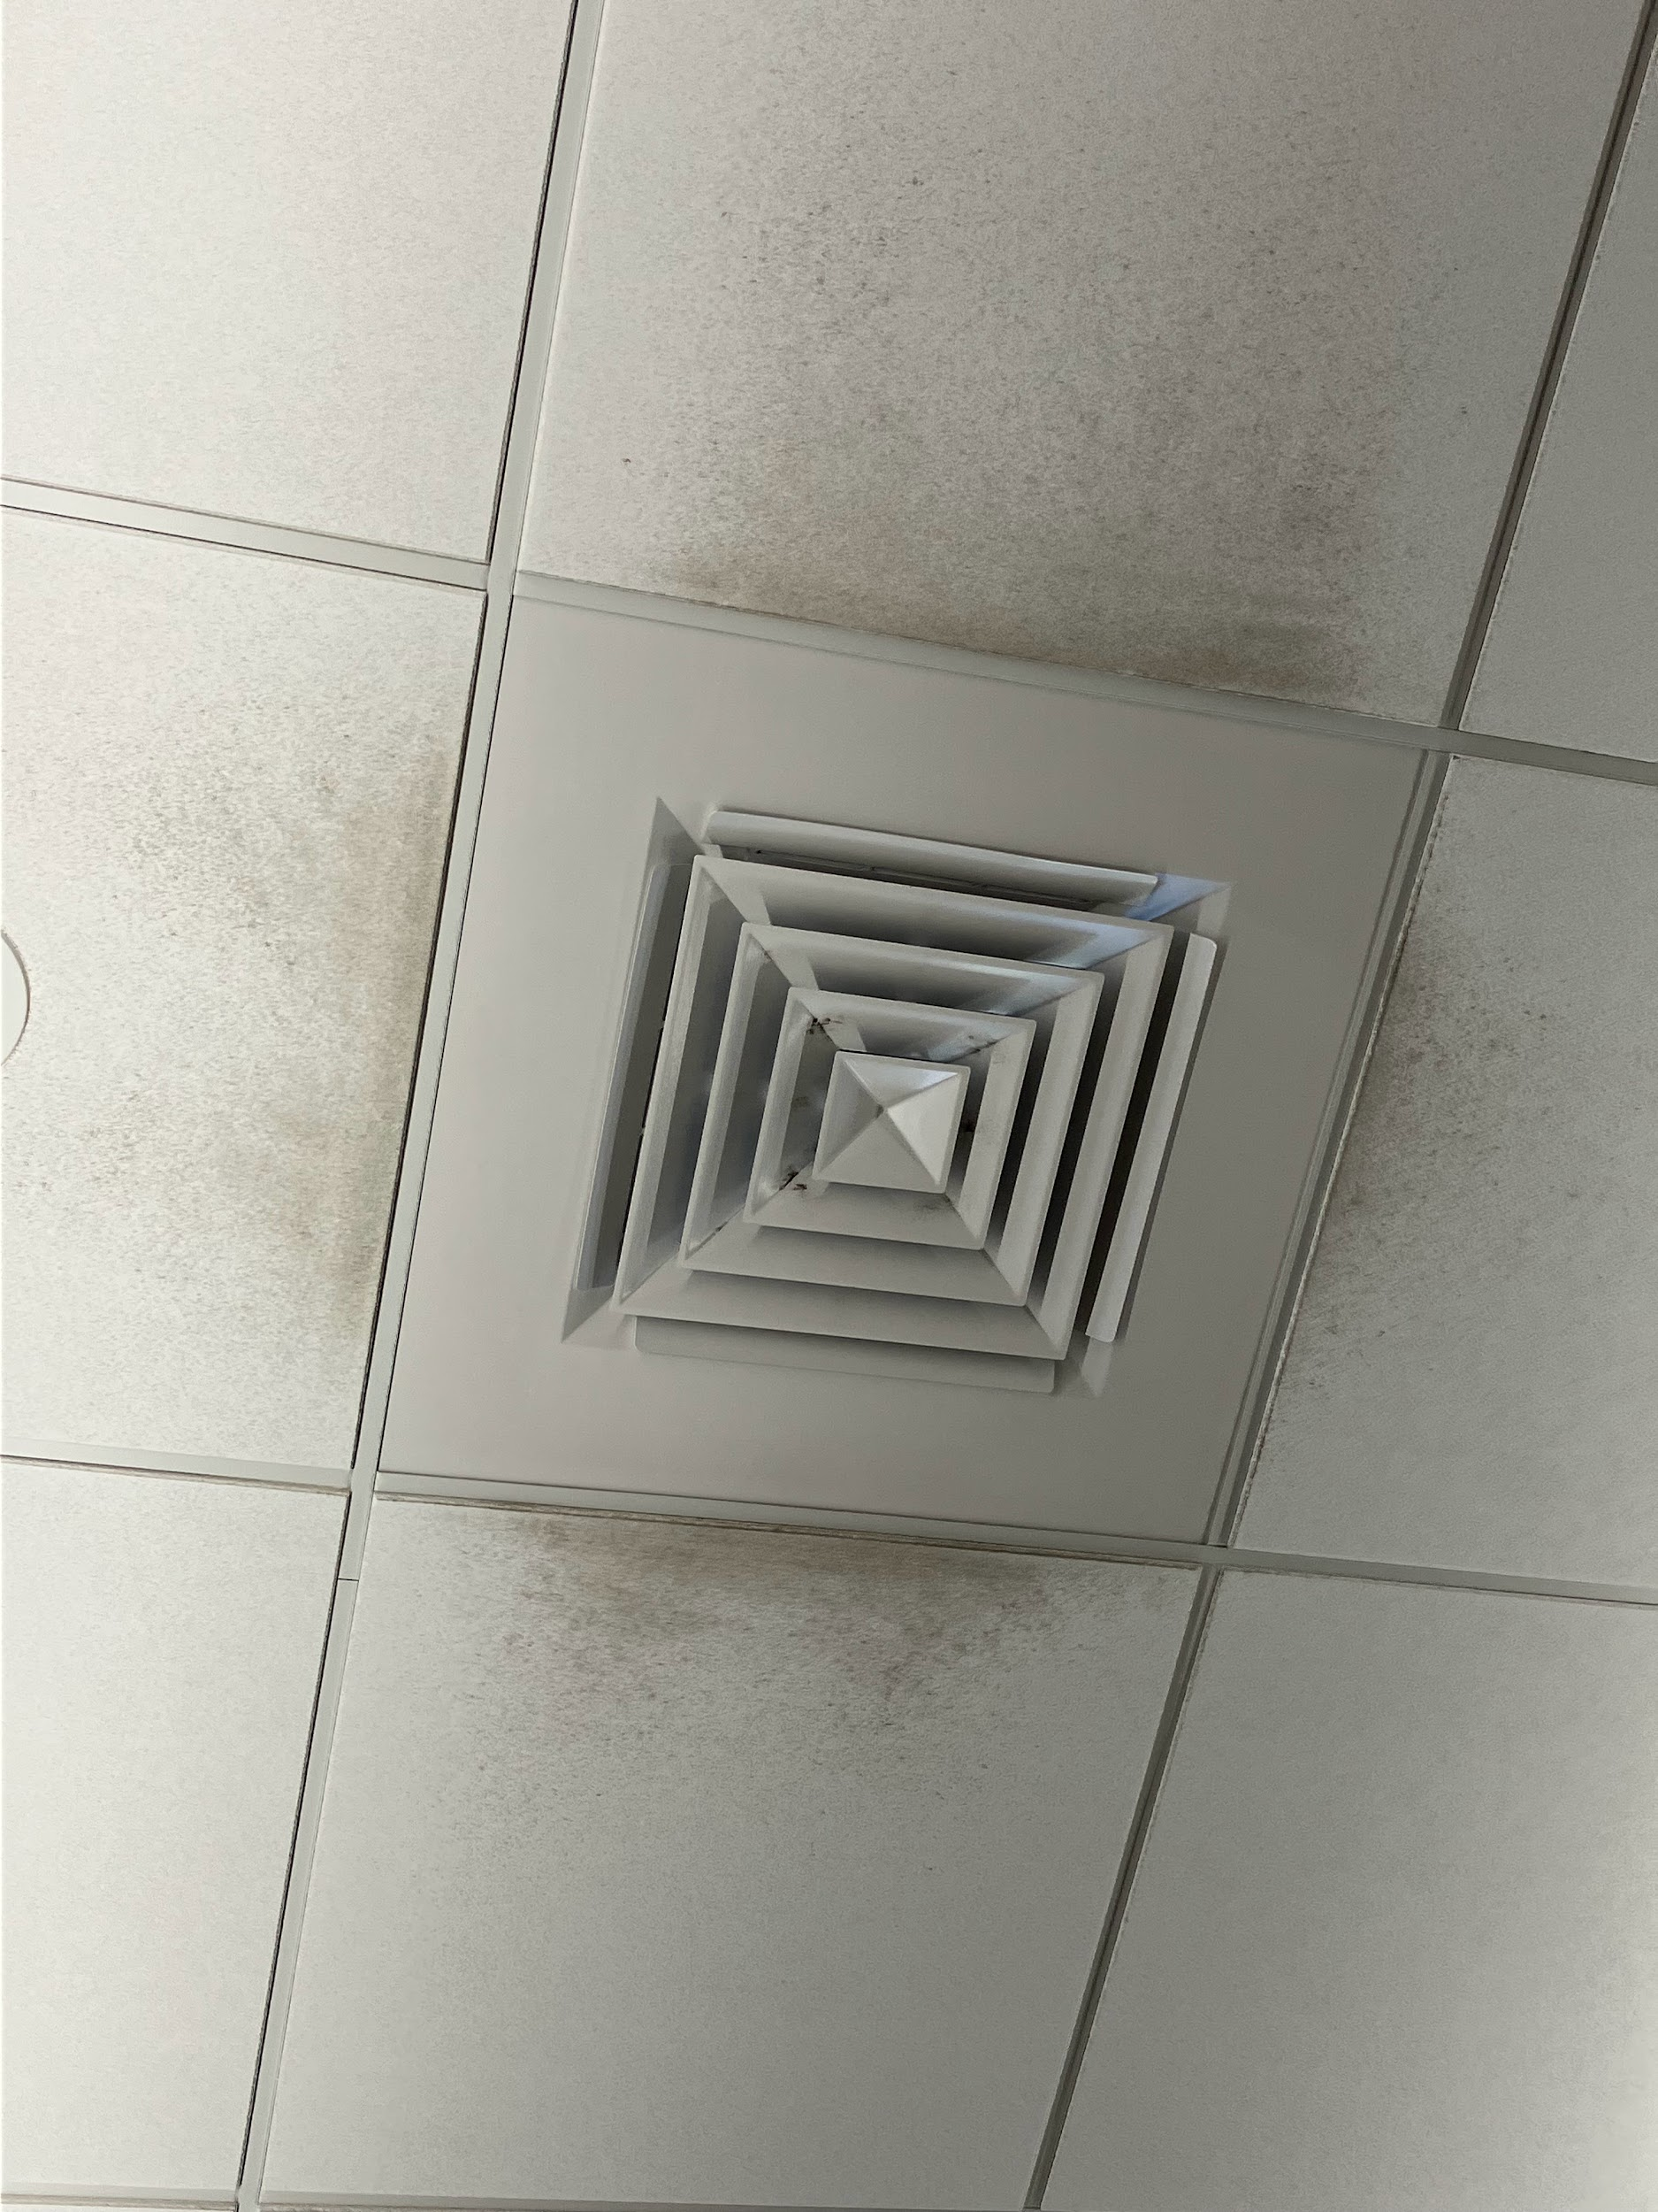
Environmental influence
This summer, AC was shut off throughout the building at night and turned back on during the day to save energy. This resulted in severe condensation which caused papers on desks to go floppy and paperbacks on display to curl.
Mold appeared around the ceiling vents, but the concerns were dismissed as paranoia over dust.

Slide 17
Back with a vengeance
The original outbreak took 60 books out of our collection, and had us clean every single item in the collection over the course of the semester.
This new outbreak has so far cost us over 160 books, with more showing signs of mold growth over time.
Library staff have agreed that we do not have it in us to clean the collection by hand again without support from the college, and Facilities are too short staffed to do it.

Slide 18
The current plan
We have reinstated a no-external-lending policy. No materials are to be sent from the Rome campus to any other campus, college, or interlibrary loan recipient. Students may still borrow items, but they must be cleaned before leaving and after being returned.
The mold issue has been escalated to facilities and top college administration. They have committed to setting up humidity sensors and more closely controlling the HVAC in our wing.
There are talks of getting professional mold treatment companies in to tackle the problem, although none have yet been contacted.

Slide 19
Takeaways
This is the second third time I have experienced a major mold outbreak in my time working in libraries. It can happen to you!
Book mold is no joke, and it spreads easily. Protect your collections and your people with care.
Take potential outbreaks seriously, and immediately take steps to convey the severity of the situation to your upper administration. This is not a small problem you can handle alone.
If you have any experience or advice for people experiencing or worried about a potential book mold outbreak, share your knowledge! It is much easier to convince administrations to respond appropriately when we have examples to back us up.

Slide 20
Thank you!
Milo Cameron,
User Experience Librarian and MVCC Rome campus library coordinator
mcameron@mvcc.edu

