Slide 1
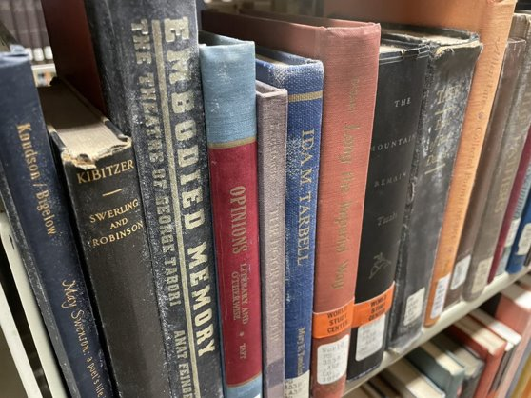
Navigating the Mold Zone: Advocacy, Remediation, and Communication Through a Mold Crisis at SUNY New Paltz
Kristy Lee & Madeline Veitch
Notes:
Kristy Lee (she/her) is the Systems Librarian at STL, and served as Interim Dean from April 2022 to March 2023.
Madeline Veitch (she/her) is the Collection Development and Zine Librarian

Slide 2
AGENDA
Overview of Mold Situation
Closing our Ground Floor – Technical
Closing our Ground Floor – Communication
Collections Access / Collection Development
The Long View
Notes:
Agenda (MV)
Overview of our Mold Situation (MV)
Closing our Ground Floor – Technical (KL)
Closing our Ground Floor – Communication (KL)
Collections access / Collection Development (MV)
The Long View (MV) long view relationships with Facilities / Design and Construction, building will always need to be maintained, so many old buildings housing collections; what is our outlook on collecting, what formats are best for users? Led us to new research.

Slide 3
Moldy TIMELINE
Forever ago - 2020
2020-2021
2022
2023
Sporadic cases of mold found on the library's ground floor
Evidence of past outbreak cleanup efforts
Library shuts down during COVID-19 pandemic.
Library Reopens Fall 2021
January-February: Mold observed on ground floor. Official assessment confirms
Initial vendor visit focused on worst areas
June: Floor closed awaiting work; humidity sensors and dehumidifiers installed
Summer / Fall: Revised scope of work to make more inclusive of full floor
November: 2nd vendor visits
January-May: Waiting for $$ approval from Albany
June: Polygon begins remediation work
July: Additional problems with ground floor investigated (groundwater seepage contributing to moisture on the floor).
Notes:
The Ground floor of STL is a subterranean floor, and has carpet over unsealed concrete, leading to groundwater seepage following periods of rain.
When sensors were placed, it was with the understanding that humidity levels should stay well below 65 to prevent further mold growth. Generally this has been achieved but in the hot humid months the humidity spikes when the air intake brings in outside air, and then it drops down as dehumidifiers remove moisture.

Slide 4
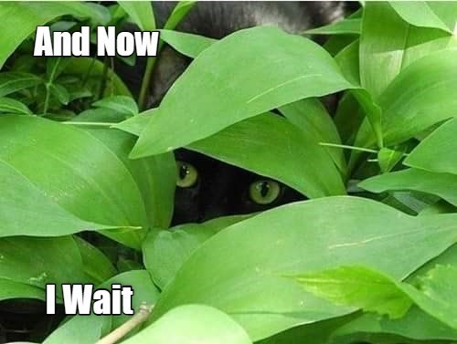
So Where are we now?
Ground floor is still closed, books are labelled "unavailable" in catalog
Polygon is currently cleaning the books offsite
Groundwater seepage is being investigated, and there is ongoing work to improve drainage around the building.
We do not yet have a reopening date for the ground floor
All new books purchased within the M-Z classification are currently shelved on the Main floor of the library, safe from the mold zone.
Notes:
Also, worth mentioning that now there are moisture problems in staff office areas on the Concourse level, so we may have to move offices for 10 people elsewhere in the library.

Slide 5
Closing the Ground floor
Technical & Communication Aspects
Notes:
from the timeline Madeline mentioned, most of the library activities and response to the mold situation started last year 2022 while I was serving as the interim dean of the library, in addition to my systems librarian’s role here in New Paltz. So I will talk more about the technical side of things and Communication.

Slide 6
Steps to route to RS/ILL
identify
Change
Gather
Batch
Define
Existing "Missing" items
All existing missing items to a different temp. location
All Ground Floor items into reports
Change all GF items to Missing status/location
In Primo config to display all Missing as Unavailable & trigger the RS request form
Tech details see this presentation – Redirect Searches to RS Requests
Notes:
For the Technical side of things, before we closed the ground floor, we had to make sure most of the materials can be borrowed/loaned thru SUNY Resource Sharing and ILL. OLIS and system support team are super heroes to our rescue. Tim and Michelle responded to my support ticket immediately and reassured me that we were not the first or only campus that needed to switch our workflow to more resource sharing and ILL to fill the requests for the inaccessible materials.
So basically, we changed about half of our physical items status to unavailable and in Primo the resource sharing ILL form pops up if the user wants to request those items. The tech details is in this presentation (on slide 7) that Tim Jackson and I co-presented at ENUG & ELUNA conferences.

Slide 7
communication
Advocacy – Provost and Administration
Collaborate – Facilities and Env. Health Safety
Channels – FOL, Lib Advisory Bd, Comm. & Marketing, campus Daily Digest whole campus email
Notes:
Communication included advocating to the campus admin, as the interim library dean, I met with the provost (and at that time, our interim provost) every other week, reporting problem also seeking advice to collaborate and work cooperatively with campus Facilities department, Environmental Health and Safety office. Our campus Communication & Marketing dept. created a headline of the library mold remediation in the Daily News Digest, which is an email newsletter send out to the entire campus. Our Friends of the Library (FOL) is an active volunteer group also helped advocating for the remediation thru their channels.

Slide 8
AREAS OF FOCUS
Within the library
Campus community
Ad hoc Mold Remediation Committee representing all areas of operation
Clear plan for the summer and fall 2022 instructional support purchases
Created LibGuide and LibAnswers FAQs
Direct contact with academic departments
Librarians contacted their liaison academic departments
Worked closely with Communication & Marketing to announce the closure ahead of time and throughout the remediation process
Notes:
From our experience, I think communication is especially important within the library and the community we serve. The Mold problem affects all areas of our operation, and I am so grateful for the library staff and librarians that we worked together on this process and still on it.
We had an ad hoc mold remediation committee, had a clear plan to support the instruction needs, we contacted the academic departments such as the History, Art History, The School of Fine Arts and Performing Arts, several others that are directly impacted by this closure.
The Good News – most of the moldy books are cleaned and Polygon (the mold remediation company) is bringing them back sometimes this month. With our fingers crossed, all removed books will be back on the shelves and the ground floor will be re-open soon.
Now I am passing the mic back to Madeline.

Slide 9
Reference / Collection Development Impacts
Chrissy O'Grady and the Research and Education Team created a great LibGuide
Notes:
RET created this helpful libguide to aid patrons in finding an accessible copies of books from the ground floor. Strategies include searching for ebooks we've paid for in the catalog, using Internet archive to find books that can be digitally borrowed, or requesting a copy via SUNY Resources Sharing / ILL.

Slide 10
Reference / Collection Development Impacts
What we thought would happen.
What actually happened.
Notes:
With ground floor books inaccessible, we developed a workflow that would allow us to buy ebook editions of titles from the ground floor that were needed for courses in particular (individual research led to ILL requests). I thought we'd see a real jump in ebook spending, but we really didn't. This may have been because many of the books needed had never been released as ebook editions, so they were either ILL-ed. accessed via Internet Archive or we purchased additional paperback copies to provide access (we did this for books needed for Reserves).

Slide 11
Reference / Collection Development Impacts
Year | Ebook Spending
2020-2021 (pandemic closure) | $35,166 (258 titles)
2021-2022 (open, pre-mold closure) | $14,895 (110 titles)
2022-2023 (mold closure in effect) | $19,644 (169 titles)
Notes:
As you can see, ebook spending was much higher in our pandemic closure year than it was in the first year of our mold closure.

Slide 12
Takeaways / The Long View
Mold cleanup plan = time + coordinated effort
Significant effort directed out of the library to other units that support the cleanup
Structural issues in our buildings are real, and may be the hardest thing to fix
We're going to keep on, no matter what (the library finds a way to library!)

Slide 13
THANK YOU
Kristy Lee
leek@newpaltz.edu
Madeline Veitch
veitchm@newpaltz.edu
Notes:
We started with mold on a book, but we leave with moss on a rock, a hopeful image.

