Slide 1
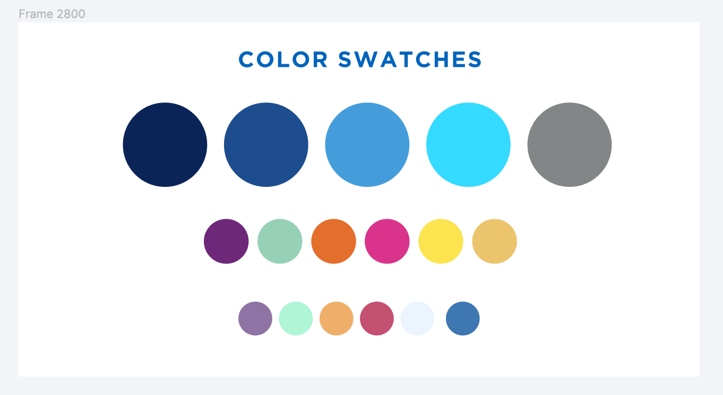
Fulfillment Analytics
October 15, 2024

Slide 2
Alma Analytics Training
Today’s session is part of a series of sessions on Analytics
Sessions have already been held on Analytics basics, Resource Sharing, Physical Collections, and Acquisitions
Recordings of these sessions have been posted to Basecamp
Future Analytics training sessions on eResources and Sharing Reports
Registration information: https://sunyolis.libcal.com/calendar/training
Future sessions will be recorded, and recoding links will be posted to Basecamp

Slide 3
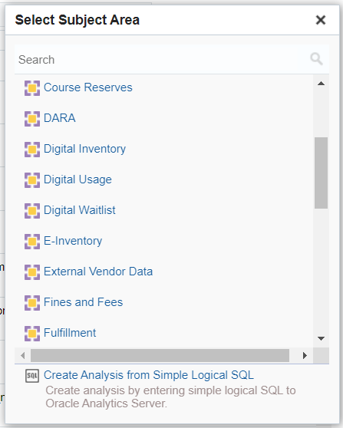
Fulfillment Analytics
Fulfillment Analytics divided into four subject areas
Fulfillment
Requests
Course Reserves
Fines and Fees
Some fulfillment related data also included in Physical Items, Borrowing Requests, and Lending Requests subject areas
See Marcy’s 10/1 session on Physical Collections
See my 9/25 session on Resource Sharing

Slide 4
Fulfillment Subject Area
Contains information about physical items that have a circulation history
Items with no circulation history will not appear in Fulfillment reports
Can be used to get circulation counts, loan lengths, and renewal counts
Circulation data more detailed than what’s provided in Physical Items subject area
Divides loan counts into “In House” vs. “Not In House”
Loans (In House) – item was scanned in without being checked out to a user
Loans (Not In House) – item was checked out to a user

Slide 5
Requests Subject Area
Contains information about various types of requests
Patron Physical Item Requests (holds & borrowing resource sharing)
Ship Physically & Ship Digitally (lending resource sharing)
Patron Digitization Requests
Booking Requests
Transit for Reshelving, Move Temporarily & Restore Item requests
Work Order requests
Can be used to obtain request counts, request processing times, hold shelf times, fill rates, and lists of outstanding requests
Additional information about resource sharing requests available in Borrowing Requests or Lending Request subject areas

Slide 6
Course Reserves Subject Area
Contains information on Courses, Reading Lists, and Citations
Can be used to obtain start lists of courses, reading lists, and citations based on status or date (creation date, modification date, start date, end date, term, year, etc.)
Cannot be used to obtain circulation counts for items on reserve
Can create either a Fulfillment or Physical Items report for items in your reserves location

Slide 7
Fines and Fees Subject Area
Contains information on fine and fees
Overdue Fine
Lost Item Replacement Fee
Custom Fees
Can be used to obtain information about outstanding and paid fines and fees, including fee status, fee date, payment date, and staff who accepted payment

Slide 8
Alma Resource Sharing Analytics
Will be saving reports created during today’s session to the following shared Analytics folder:
/shared/Community/Reports/Consortia/SUNY/Alma Fulfillment
Plan to add additional fulfillment reports to shared folder soon
Feel free to submit requests to info@sunyolis.libanswers.org
Shared reports can be copied to your institution’s Analytics folder
Will only return your institution’s data
Please do not make any changes to reports in shared Analytics folders!

Slide 9
Alma Resource Sharing Analytics
Alma Analytics does not provide data in real time
A snapshot of all of your data is taken every night
Data you’re seeing in Analytics is from previous day
Ex Libris documentation
https://knowledge.exlibrisgroup.com/Alma/Product_Documentation/010Alma_Online_Help_(English)/080Analytics/Alma_Analytics_Subject_Areas

Slide 10
Anonymization
Alma can retain a lot of personally identifying information about fulfillment activities
This personally identifying information can be deleted from both Alma and Analytics by the Anonymization Job
Job can anonymize loans, requests, and fines & fees
Job can be run daily, weekly, or monthly
Libraries can configure the amount of time personally identifying information is retained before it is anonymized
Anonymization FAQ: https://sunyolis.libanswers.com/faq/387409

