Slide 1


Slide 2

Supporting the Healthy Opportunities Pilot
An NC AHEC Statewide Program
Laurel Booth
5/17/2023
2
NC AHEC
Notes:
Hi welcome, LB, PM at MAHEC

Slide 3
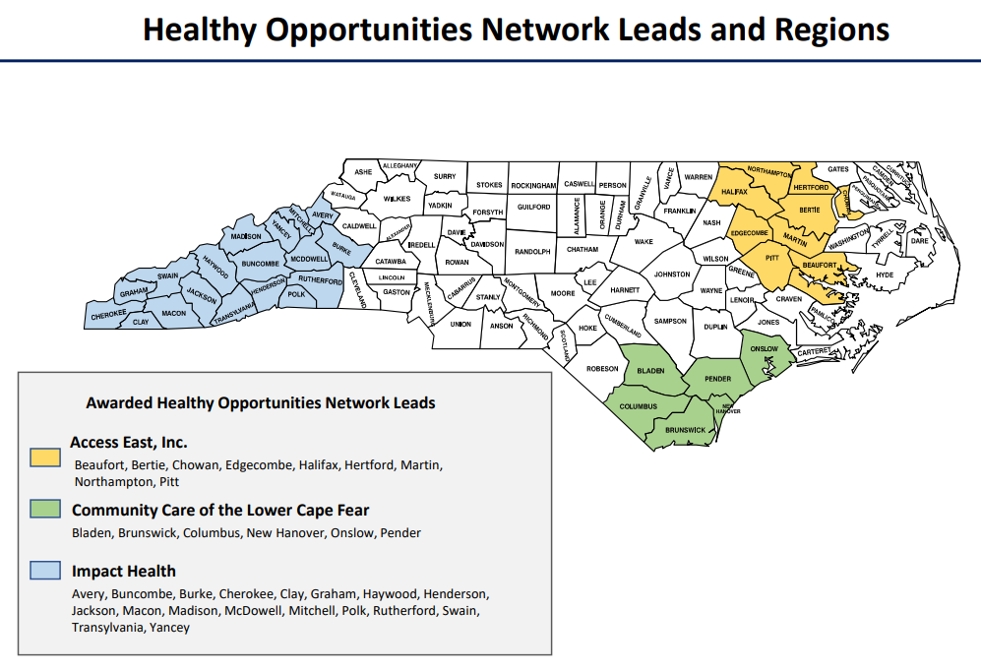
What is the Healthy Opportunities Pilot?
Medicaid Pilot under 1115 waiver
Provides reimbursement for Social Determinants of Health Needs
  29 services currently available – phased implementation
  5 domains: Food, Housing, Transportation, Interpersonal Violence/Toxic Stress, and Cross-Domain
As of 3/31 5,500 Members enrolled
  51,490 services delivered
3
3
NC AHEC

Slide 4

HOP in the field
During a routine doctor’s appointment, an enrollee was identified as having multiple unmet health-related needs. The most pressing was transportation, as he had not had reliable transportation in five years. He lives in a rural county that does not have public transit and his car has needed constant repairs.
Through the Healthy Opportunities Pilots, he was able to have his brakes repaired, which has allowed him to keep medical appointments and reconnect with his community, which is helping with his depression.
In addition to the car repair, he is also receiving a fruit and vegetable prescription and his wood-burning furnace is being repaired just in time for winter. When asked about how the Healthy Opportunities Pilots have impacted him, he shared that “the Healthy Opportunities Pilots have literally changed my life.”
4
4
NC AHEC

Slide 5
NC AHEC Supports the Healthy Opportunities Pilot
Funder: Kate B. Reynolds Charitable Trust
Duration: 2 Years
Training for Pilot Staff
  Care Managers: Screen Medicaid Members to determine eligibility and provide referrals to appropriate Pilot services
  Human Service Organizations: Local CBOs who provide the 29 services and receive reimbursement
Statewide Conference
  August 7th – Hybrid format, with hub sites in each Pilot region
5
5
NC AHEC

Slide 6





Thank you to our fantastic team!
6
6
NC AHEC

Slide 7
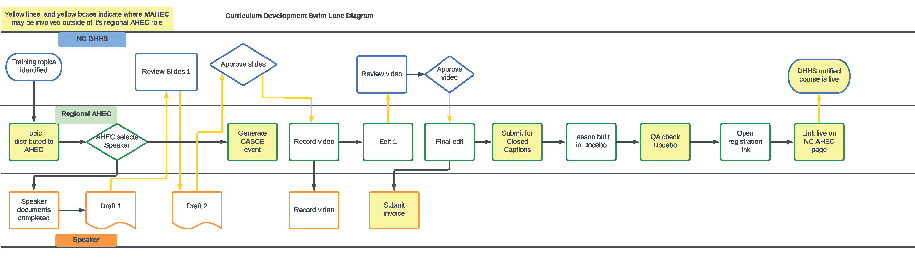
Training Development Process
7
7
NC AHEC

Slide 8

Year 1
11 total trainings released
  10 for Care Managers
  1 for HSOs and other Staff
Almost 5,000 course completions
Over 90% of learners agree or strongly agree information will enhance their practice or daily work & expectations were met
NC AHEC HOP webpage launched to streamline training
Conference planning underway
8
8
NC AHEC

Slide 9
Lessons Learned
Clear and consistent communication essential
  Between AHEC partners & Program Office
  Between Lead AHEC and Customer
Timelines must allow for flexibility
Consistent review and improvement of processes and product
  Among partners and customer
  Incorporating learner feedback
9
9
NC AHEC
Notes:
Communication is important between regional AHECs, scoping the roles on the project to make sure each AHEC can participate based on availability and capacity (different AHECs have multiple projects)
Communication with the program office very important, particularly on learner capacity for statewide projects (much larger volumes) really appreciate Ashley Langley and Lisi’s support
Communication between Lead AHEC and Customer, a strength is relationship built with HOP team at DHHS, getting familiar with the project and them getting familiar with our development process, and exploring options to best meet learner needs.
This may be pilot specific, but it is important to allow for flexibility in timelines, priorities evolve in a pilot setting requiring shifting of trainings – so building in room to anticipate course changes is a good lesson
Consistent review and improvement – supported by communication – feedback how we can improve our development process and intentional time for reflection. Quarterly meetings. One instance of improvement is building content as a template in Absorb create, and a guide to help standardize modules across each AHEC
Review learner feedback – look for content suggestions – see more requests for interaction/case-based work, shorter, some live trainings and new topics

Slide 10

NC AHEC Nursing Clinical Partnership Project
AHEC CPD Office Hours 5/17/2023
Katie Fitzpatrick
944493938by gettyImages Cecilie_Arcurs Royalty Free

Slide 11
Nursing Clinical Partnership Project
Intent
Methods
Support academic-practice partnerships using clinical nurses as clinical faculty.
Train RNs to serve in the dual role of clinical nurse and clinical instructor.
                Increase nursing clinical faculty to expand the capacity to graduate more nurses and
                Provide retention opportunities.
                Create recruitment opportunities.
                Offer professional development.

Slide 12
There is an urgent goal to:
Retain nurses in the profession.
Train and graduate more nurses.
Recruit new nurses to areas of high need.

Slide 13
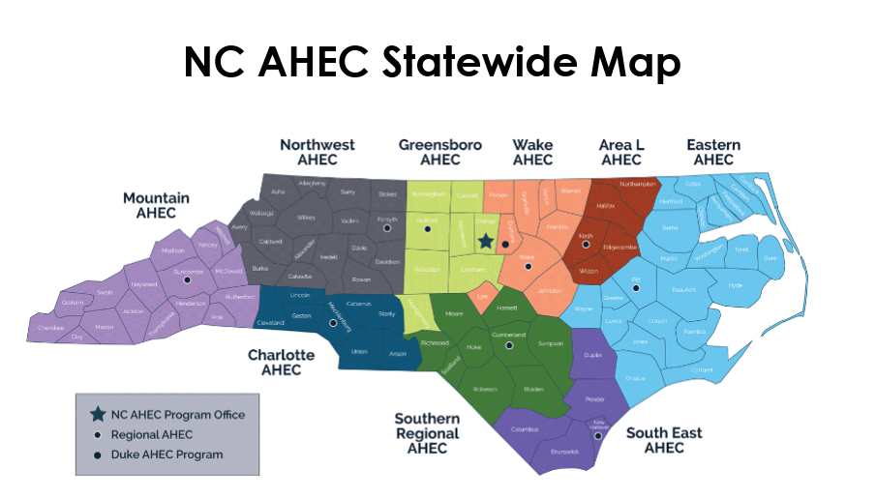

CIP Roadmap
Tested, Proven Model
Eastern AHEC: CEP
NW AHEC: CTA
Partners reported: higher satisfaction, enrollment, recruitment, and retention
Methods

Slide 14
The AHEC Impact
February 2022 Academic Progression Meeting
March 2022 AHEC nurses met to discuss a statewide model.
July 2022 AHEC nurses from every region and PO leaders divided into 3 workstreams: Curriculum, RFP and Live Webinar Planning

Slide 15
The AHEC Impact Cont’d
    August 2022 Curriculum advisory committee
October 2022 First RFP cycle
November 2022 NC BON approval and funding to 16 schools
December 2022 SMEs confirmed and module dev’t started.
March 2023 three Cohorts planned
July 2023 Cohort 1 opens

Slide 16
AHEC Collaboration
              PO leadership, marketing, finance, IT
              Regional AHEC leadership, finance, IT, Marketing
              Regional AHEC nurses, curriculum development, RFP support, managing academic/practice partnerships, CPD planning, and guidance of the project
              External Partners: NCBON, Academic/Practice Partners, DLL

Slide 17
Evaluation
# of CIP partnerships in place
# of CIPs teaching
Knowledge gains and satisfaction of training
SON enrolment and graduation rates
CIP job satisfaction and retention
Student satisfaction
Practice recruitment

Slide 18

What’s next
RFP Cycle 2 for FY24
3 cohorts confirmed for summer and fall 2022
2 more cohorts to be planned for spring and summer 2024
Evaluation
1387152896 by gettyImages Fatcamera/ Royalty Free

Slide 19

Questions and Feedback
127969055 7by gettyImages Olemedia/ Royalty Free

