Slide 1
August-September 2022 OLIS Update
September 19, 2022

Slide 2
GENERAL UPDATES
Shannon Pritting

Slide 3
Staffing Updates
Associate Director of Assessment and Data Analysis begins 9/28: Dr. Catherine Stollar Peters
Will permanently fill NZ Coordinator role in early 2023.
Hoping to post additional staff recruitment by end of 2022 to fill needs in resource management and metadata support.

Slide 4
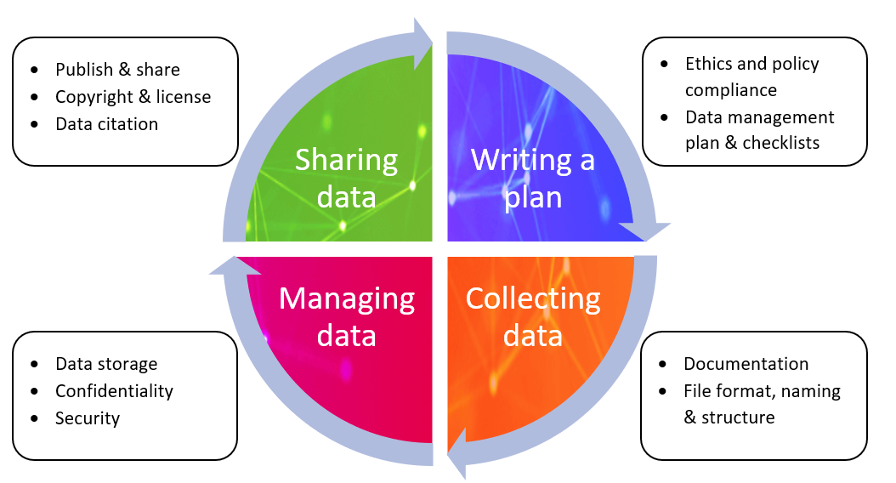
Research Data Management
OLIS is working with a group from SUNY and RF to review how well-prepared campuses are to address new NIH requirements for Research Data Management.
Also reviewing new security requirements, but this is more limited in impact to SUNY.
No plans for any services yet, but investigating the situation.
Will discuss at the July 27th Scholarly Communications Group Meeting:
https://slcny.libcal.com/event/9364654
Also conducting outreach to campuses who currently have active NIH grants.

Slide 5
ConnectNY Discussion
OLIS staff met with the new ConnectNY Executive Director to discuss areas of potential shared interest with this group.
Attending CNY board meeting in fall.
Discussing more Alma-Alma resource sharing.
Reviewing potential other areas where collaboration could be mutually beneficial.

Slide 6
SUNY Press Discussion
Have been meeting with SUNY Press on potential access and OA partnerships.
Will begin connecting OLIS, SUNY Press, and SSCC (or other organization dependent on SLC future) to review potential partnerships.

Slide 7
ORCID
OLIS discussing ORCID membership and project(s) to increase adoption of ORCID with Research Foundation and ORIED.
OLIS will work to partner with librarians if/when campus outreach happens regarding ORCID.
Exploring ORCID membership for SUNY central to utilize Affiliation Manager.

Slide 8
Strategic Plan for OLIS
Will be releasing a draft 3-year Strategic Plan for OLIS soon.
Plan to send to Directors first for input, and then to other groups.
OLIS will use to develop yearly goals and to prioritize requests for services and projects.

Slide 9
Lunch and Learn on Open Access and Research Data Mgmt.
Provost's office requested a presentation/lunch and learn on open access mandates and research data management at request of UFS.
10/25 from 12-12:30
Will share information on access/registration when it's available.
If you'd like to provide input on this presentation, please reach out.

Slide 10
ENGAGEMENT AND PROFESSIONAL DEVELOPMENT UPDATES
Cori Wilhelm

Slide 11
CPD Leadership and Management Certificate
https://sunycpd.eventsair.com/llmcert
First course has started for the fall, still time to register for the remaining eight courses
CPD points can be used to pay (dependent on campus and availability)
Focus on learning and applying methodologies and tools to issues that librarians and staff face regularly.
Advisory board – leaders in different roles around SUNY libraries
Reviewed and provided feedback
Plan to reconvene and review after fall courses have concluded

Slide 12
CPD Leadership and Management Certificate - Courses
Assessing your Leadership Style – course has already begun
Fall courses available for registration:
Universal Design for Libraries
Access and Collection Strategies
Leading High Performance Teams
Winter/Spring courses available for registration:
Introduction to Project Management for Libraries
Change Management in Libraries
Developing Library Partnerships
Library Strategic Planning
Library Assessment

Slide 13
Spotlight on SUNY Libraries
Series of online conversations to focus on the great things that SUNY libraries are doing!
Currently developing Fall schedule…..have a great program or idea for a future Spotlight? Contact Cori at cori.wilhelm@suny.edu

Slide 14
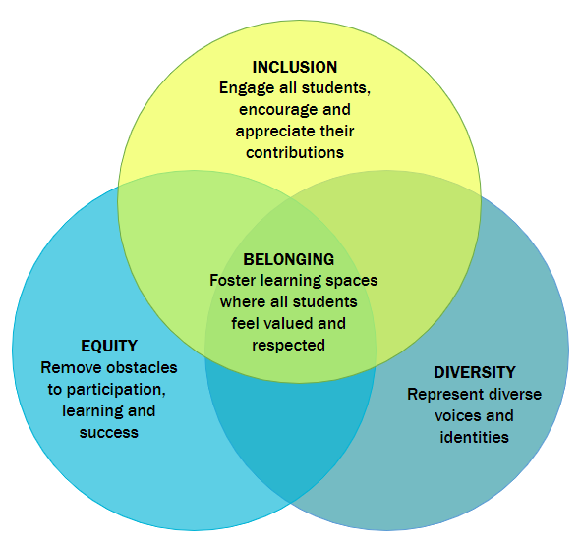
Reminder:
Online Course: Exploration of Belonging for Educators
Using Lumen Circles (separate from faculty-focused Belonging Circle)
Self-paced course intended for librarians and other student support faculty and staff.
Different sign-up process for fall:
https://tinyurl.com/sunybelonging

Slide 15
Library Acquisitions and Retirement Survey (LARS)
SLS is facilitating LARS for the state-operated campuses.
Reporting period is 7/1/2021 - 6/30/22.
Due date is Friday, 8/12/22.
Campuses may submit their own data, or SLS will submit on your behalf.
All campuses have been polled as to preference.
Direct submission link has been sent to campuses to review (no changes from last year).
For questions, please submit ticket to info@slcny.libanswers.com

Slide 16
Library Acquisitions and Retirement Survey (LARS) - Shelf Space Inventory
SLS is facilitating LARS for the state-operated campuses.
In conjunction with this survey is the annual request for shelf space inventory.
Submission link was sent to campuses the week of July 5.
For questions, please submit ticket to info@slcny.libanswers.com

Slide 17
Discovery & Resource Management
Michelle Eichelberger

Slide 18
Aug/Sep Discovery Updates
August Release:
Resource Recommender: Can create a permanent banner at the top of your search results, and create persistent suggestions that don't need to match on a search term
CDI Searching:
Default CDI search setting changed from Search in FT (Yes: Always) to Search in FT (No: Always). Will result in fewer search results, but results may be more targeted. Campuses may choose to switch it back.
Can hide title level ebook results from CDI without losing access to chapter level indexing (done in Search Profiles configuration)
Can choose the types of resources that you want to show from the CDI, thereby excluding those that you don't want (Search Profiles configuration)
Secondary Resource Types: Can add secondary resource types to help with filtering. Note that work needs to be done in both IZ and NZ for NZ-linked bib records. Thanks to Nancy Babb for testing this new feature. No immediate plans to implement any new resource types.
Full August Release Notes

Slide 19
Aug/Sep Resource Management Updates
AVON Premium – United States Package
Live for almost everyone
FAQ about managing purchased titles and local hosted titles: https://slcny.libanswers.com/faq/373957
AVON admin training recording and slides: Alexander Street Admin Portal
Lexis-Nexis Uni Linking:
Global parser for Nexis Uni changed to title level, but Ex Libris created a local workaround for institutions that would like to support article-level linking. Alma: LexisNexis - removal of article-level linking for some collections (see section: “Article-level workaround for Alma/SFX via local override”).
OCLC Data Sync:
Lost data supposed to have been fixed with August release
Finished all sync updates for support contract campuses and those who requested our help
Will be reaching out to rest of campuses to see if you'd like assistance
Training Guides:
Reorganizing and updating. Contact us if you're looking for something and can't find it: info@slcny.libanswers.com.

Slide 20
Shared Collections
Esta Tovstiadi

Slide 21
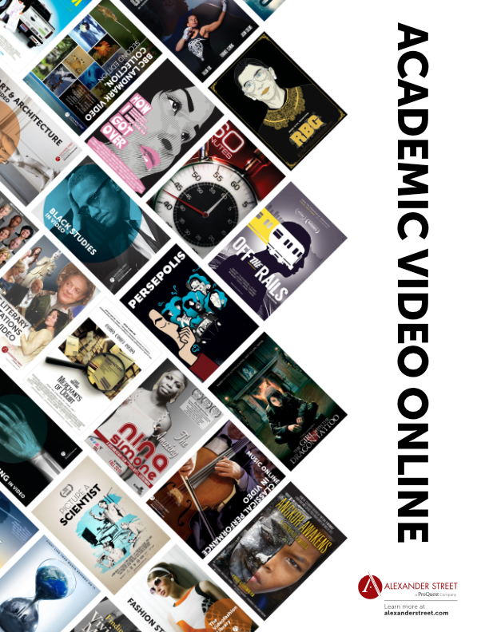
Renewal and Recharge Reminders
AY 2022-2023 OLIS Recharges
Check the ATIS portal for the most up to date information
JSTOR charges have not yet been added
ProQuest and Chronicle charges should be available
If you receive an invoice and were expecting to pay it via recharge, let me know.
Submit a ticket if you have any questions
Renewal information
Artstor contract is in progress
ScienceDirect Package Annual Report presentation: https://slcny.libcal.com/event/9688940
NEJM renewal coming soon

Slide 22
Upcoming Collections Project: Expanding JSTOR Access
Overview:
SUNY and Ithaka have been discussing working towards permanent expansion of access for all SUNY campuses to all JSTOR Journal collections.
Timeline:
We have received a draft proposal from Ithaka and have begun engaging stakeholders, and will be working with a group to review the proposal and recommend next steps.

Slide 23
Upcoming Collections Initiative: Reviewing Cooperative Ebook Collecting
Overview:
SLS would like to build an all-SUNY ebook collecting program.
Timeline:
SLS has had initial conversations with SSCC and director groups from different sectors.
Will begin to scope the program or determine if/how to address this in Fall 2022, at which point SLS will have larger meetings and form a structure for the program.
Director's Listening/Feedback Session, 9/19 at 11 am: https://slcny.libcal.com/event/9609183
Open Listening/Feedback Session, 10/18 at 11 am: https://slcny.libcal.com/event/9688534

Slide 24
Resource Sharing
Timothy Jackson

Slide 25
SUNY Shared Courier Approach
Current Empire Library delivery contract expires in July 2023
Empire State Library Network (ESLN) beginning RFP process for new contract
ESLN plans to award new contract to a vendor by end of March 2023
SUNY has historically managed ELD contract centrally, but there will be no central contract going forward
Campuses will be billed directly by ESLN
Bills likely to come from your 3Rs council (we've asked for clarification on that)
We will not know cost of courier until new contract is awarded

Slide 26
SUNY Shared Courier Transition
We are rethinking long-standing requirement that all campuses must have five-day courier service
Campuses may be allowed to reduce courier service to 3 days per week
Gathering input from campuses with a survey sent to all SUNY resource sharing contacts in early August
Survey responses are due today
SUNY Shared Courier Task Force will meet to discuss responses and reach a decision next week

Slide 27
New Alma RS Request List Interface
August Alma release included a new interface for borrowing and lending RS request lists
New interface is currently opt-in, but it will eventually replace the current interface
You can opt in by clicking the person icon and then clicking the Feature Rollout Configuration link
Opting in does not impact anyone else at your institution
You can easily opt back out if you wish
SLS will conduct training webinar for new interface in October
FAQs will be updated accordingly

Slide 28
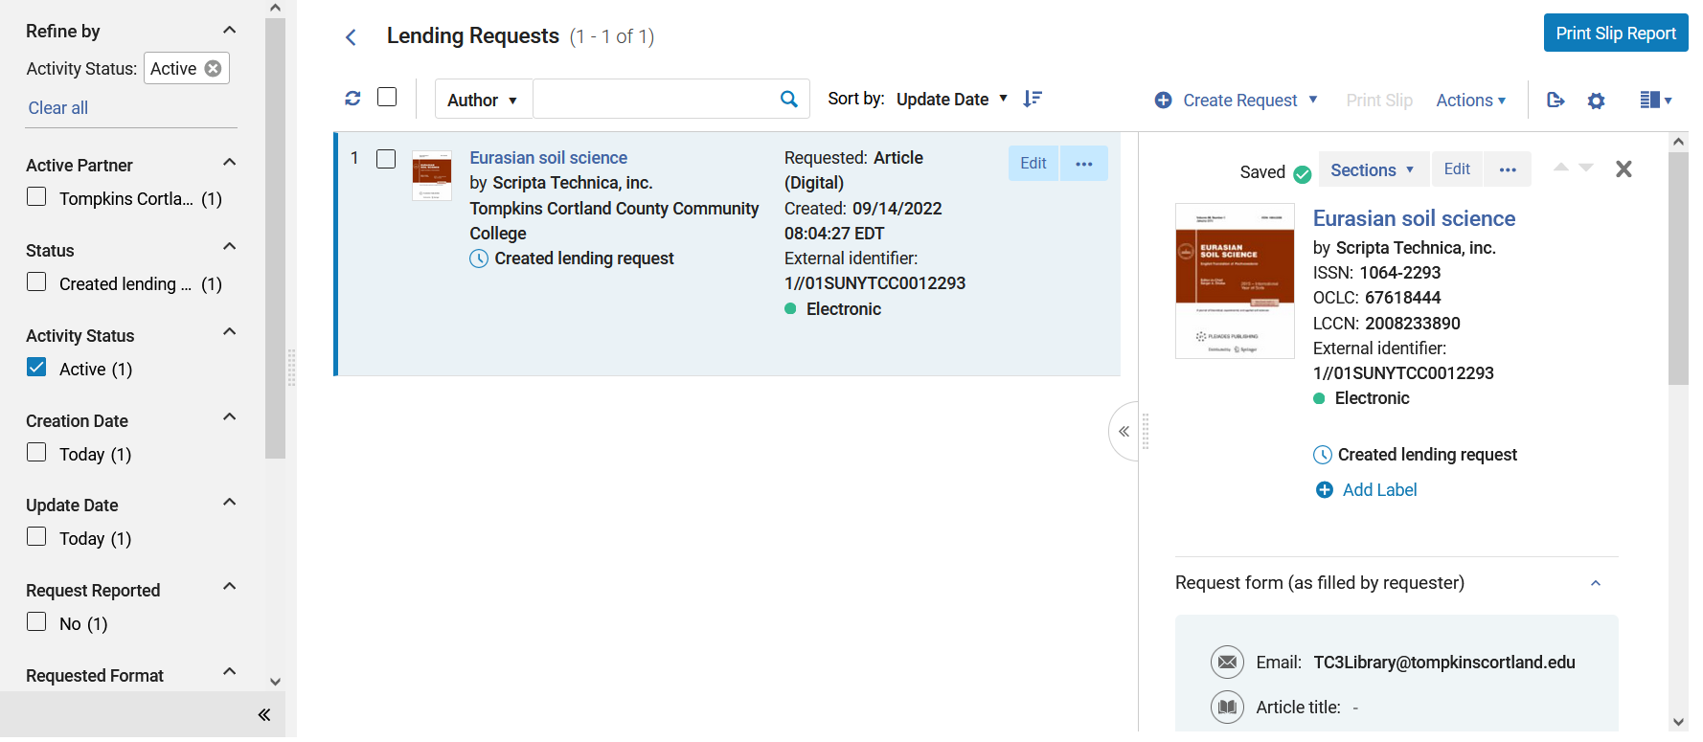
New Alma RS Request List Interface

Slide 29
Other Recent Alma Changes
Alma article RS now capable of checking requests for CONTU rule of 5 compliance
Requests put in review status if they exceed rule of 5
Copyright still needs to be paid outside of Alma
Email info@slcny.libanswers.com if you'd like to implement copyright compliance functionality or Alma article borrowing
Alma RS request form now has book chapter borrowing feature
Already implemented at 10 libraries
Email info@slcny.libanswers.com if you'd like to implement book chapter borrowing feature

Slide 30
Alma Resource Sharing Beyond SUNY
Plan to start borrowing articles from Nazareth College via Alma next month
We've been borrowing books from Nazareth via Alma since Fall 2021
They hope to start borrowing from us via Alma later this semester
Expanding article resource sharing with the Connecticut State Colleges and Universities (CSCU) system
Exploring possibility of physical Alma RS with four libraries CSCU system
All SUNY libraries have been added to Alma's resource sharing directory
Purpose of directory is to help libraries form RS relationships with other Alma libraries by sharing RS partner and policy information
Directory contains several libraries that may be good Alma RS partners for SUNY, so SLS will be reaching out to those libraries later this semester
If a library reaches out to you about Alma RS, please refer them to SLS

Slide 31
Repositories

Slide 32
Content & Usage Analysis (CUA) Module for SOAR and SDR
Content & Usage Analysis (CUA) Module is functioning well, but it is difficult to read the data because so many collections have generic names
Project underway to disambiguate existing collections, to precede all collection names that are not truly unique with the campus names, e.g.: "Master's Projects and Creative Activities" will become "SUNY at Fredonia Master's Projects and Creative Activities"

Slide 33
Removing Duplicate Content from SDR
• In the fall of 2020, several collections were migrated from SDR to SOAR, but these collections were not removed from SDR
• Have been in contact with relevant campuses regarding these collections, and will be deleting the SDR instances on October 1 for those campuses who are ready to do so
• We are also in the process of defining more clearly what types of content will go in SDR and SOAR, and I have been reaching out to campuses regarding SDR content that is suitable for SOAR. If you haven't yet heard from me and would like to discuss options, please feel free to contact us directly or through LibAnswers: yvonne.kester@suny.edu; info@slcny.libanswers.com

Slide 34
Basecamp Community of Practice for Institutional Repository Managers
• Place for repository administrators to post questions, share ideas on content management, workflows, soliciting content
• Place to share announcements regarding SOAR and SDR
• If you would like to join, please send a request to info@slcny.libanswers.com

Slide 35
Scholarly Communications Community Group Meeting
Informal community of practice related to scholarly communications, monthly meetings
Anyone in SUNY Libraries who has elements of scholarly communications work as part of their job duties is welcome to attend.
Zachary Vickery, College Archivist Librarian at SUNY Oswego, will present this month on his work promoting scholarly communications through student research parties and faculty research parties. To register: https://slcny.libcal.com/event/9598365
If you are interested in presenting at a future meeting, please reach out to us! info@slcny.libanswers.com

Slide 36
Accessibility
Michelle Eichelberger and Yvonne Kester

Slide 37
Accessibility and Procurement
VPAT® and VPAT®less Reviews completed in the past 3 months:
American National Biography
ArtStor
Choice Reviews Online
CountryWatch
JoVE
Newsbank
Oxford Handbooks and Reference
Proceedings of the National Academy of Sciences (PNAS)
ProQuest Congressional, Resources for College Libraries, and Ulrichs Web

Slide 38
Accessibility Reviewing in Context of DLE
OLIS met with Mark Greenfield and Toni McCreash, who are SUNY system project managers working on setting up a workflow for accessibility and security reviewing of applications integrated into DLE.
Intent is to align OLIS processes with larger SUNY approach.
We'll update everyone if there are any changes to location/format of reviews.

Slide 39
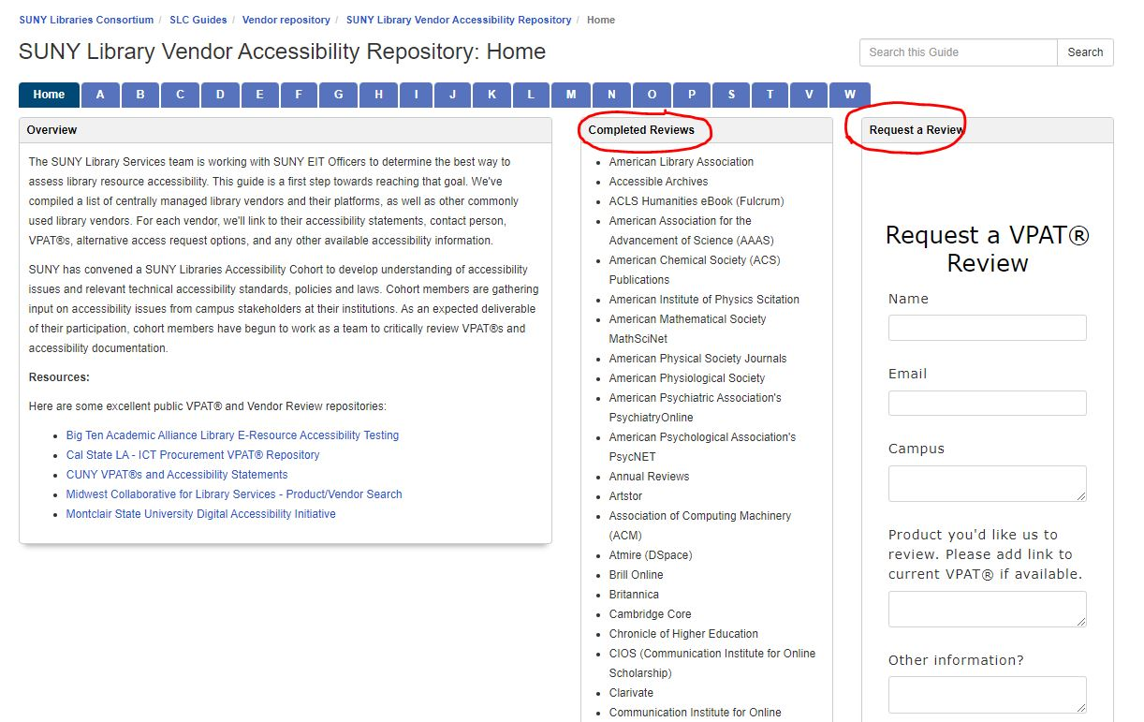
Accessibility and Procurement
For a complete list of reviews, please see the “Completed Reviews” box on the SUNY Library Vendor Accessibility Repository home page.
If you don’t see the vendor platform you need, please feel free to fill out the “Request a Review” form located on the same page. This is a service we offer to all SUNY libraries.

