Slide 1
Unveiling Challenges and Seizing Opportunities in collection and analysis of the NEET-related statistics leading to evidence-informed policymaking
Natalija Ziminiene
Senior expert at ICON-INSTITUTE
Natalija.Ziminiene@icon-institute.de
15 November 2023 | Florence, Italy

Slide 2
Part 1: What is the status quo of currently available NEET statistics?
Introduction to the topic “NEET-related statistics at the EU level “
Definition of the NEET-rate
NEET rate for the EU -27 and separately for the project partner countries
NEET rate by gender, educational attainment level, place of the residence
Plenary discussion around “To what extent can these data be of help to you?
What disaggregation of data does seem essential for you?”
Introduction to the topic “NEET-related statistics at the national level“
Discussion in small groups “Do you know the absolute number of NEETs in your country? Do you know who /which institutions(s) has these data?”

Slide 3
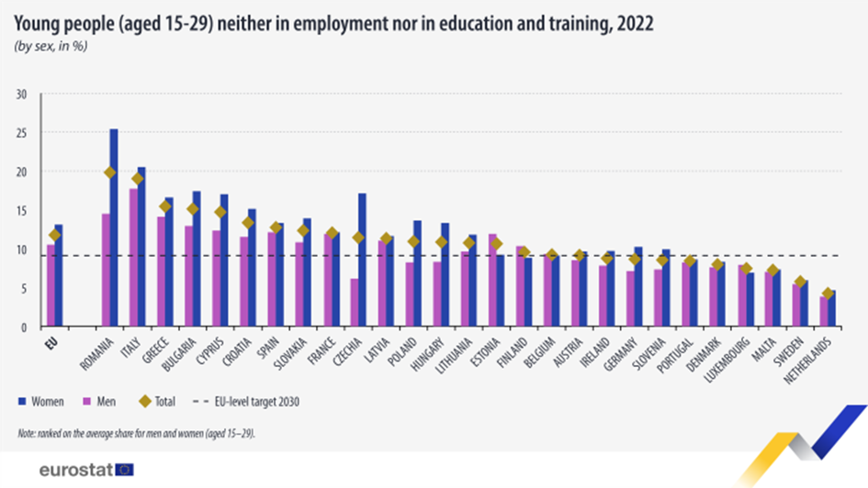
NEET-related statistics at the EU level
Notes:
By 2022, Slovenia, Luxembourg and Malta have already reached the EU-level target for 2030. Lithuania is approaching the target. AtWork4NEETs project is an excellent opportunity for Romania, Italy and Croatia to learn more about which policy measures allow these countries to reach such success.

Slide 4
NEET: changes because of COVID-19 pandemic
Notes:
The COVID-19 pandemic and related economic restrictions have contributed to an increase in the NEETs rate to 13.7% in 2020 (compared to 12.6 % in 2019), as a result of job loss and barriers to education and training for young people.
Worrying levels of mental well-being were reported among young people in the EU, especially when it comes to feelings of loneliness and depression, where young people were suffering the impact of pandemic restrictions and reduction of social interactions more than the older population.
Young people were also experiencing greater job loss and insecurity about their professional and financial futures. The impact of the pandemic on education also damaged young people’s opportunities to accumulate human capital. The suspension of schooling hindered skills formation, while reinforcing inequalities between the most privileged and the most vulnerable.
Positive message: Eurofound’s ‘Living, working and COVID-19’ survey of Europeans’, launched in three rounds in April and July 2020 and in March 2021, showed that young people were grappling with the crisis situation.
More information about how young people were affected by the economic fallout from COVID-19 can be found here:
Publication: Living, working and COVID-19 (Update April 2021): Mental health and trust decline across EU as pandemic enters another year
Blog: Youth in a time of COVID
Event 23 October 2020: Watch the webinar - Being young in the COVID-19 pandemic
Event 25 June 2020: Watch the webinar: How COVID-19 affects Europeans and the EU labour market

Slide 5
NEET by sex, 2022
Notes:
Young women are more likely to neither be in employment nor in education or training than young men.
Figure shows that there is a difference between the sexes in relation to the proportion of young adults who were neither in employment nor in education or training.
In 2022, 13.1 % of young women aged 15–29 in the EU were NEETs, while the corresponding share among young men was 2.6 percentage points lower, at 10.5 %.
There is a range of factors that may explain the gender gap. For example, social conventions or pressures, which tend to place a higher importance on women’s role within the family and on men’s role to provide for the family through work.
Additionally, there is a risk for labour market issues, such as:
employers preferring to hire young men over young women;
young women facing assimilation difficulties when returning to work after childbirth;
young women being more likely to have low-paid jobs or precarious employment etc.

Slide 6
NEET statistics at the EU level - more details
Notes:
Educational attainment level affects the share of NEETs
The Figure on the left shows young NEETs by educational attainment level.
The three different levels of educational attainment are as follows:
less than primary, primary or lower secondary level of education (ISCED 2011 levels 0–2; hereafter referred to as a low educational attainment level or low level of education);
upper secondary or post-secondary non-tertiary education (ISCED 2011 levels 3 and 4; hereafter referred to as a medium educational attainment level or medium level of education);
tertiary education (ISCED 2011 levels 5–8; hereafter referred to as a high educational attainment level or high level of education).
Does it matter where you live?
The Figure on the right demonstrates NEETs by level of urbanisation or in other words, according to their place of residence.
In 2022, the share of young people (aged 15–29) in the EU who were NEETs was lowest in cities (10.9 %) and about the same level in towns and suburbs (12.2 %), and rural areas (12.6 %).

Slide 7
Time for joint and open discussion
?
Q1. To what extent can these data be of help to you?
Q2. What disaggregation of data seems essential for you?
Q3. What other characteristics of NEETs would be important to look at?

Slide 8
Useful information (1)
Link to the Eurostat database, NEET: https://ec.europa.eu/eurostat/databrowser/view/tesem150/default/table?lang=en

Slide 9
Useful information (2)
Link to the Eurostat podcast “STATS in a WRAP”, Season 1, Episode 3: “How has the pandemic affected youth employment in Europe? https://ec.europa.eu/eurostat/databrowser/view/tesem150/default/table?
Released on 21 June 2022 2022 is the ‘European Year of Youth’ and we are going to focus on the world of work for young people and the effects that the COVID pandemic has had and continues to have on it. Anna Emilia Martin from Eurostat and Niall O'Higgins, senior economist from the International Labour Organization, talk with Jonathan Elliott about this topic to figure out how the world has changed for young people aged 15 to 29 in Europe.

Slide 10
NEET statistics at the national level
Which public institutions, or organisations may have complete or partial administrative data on NEETs?
National Statistical Office
Ministry of Education / Youth
Ministry of Social Security and Labour
Public Employment Services (PES)
Police
Local municipalities

Slide 11
Time for the discussion in small groups
?
Please take 10 minutes to discuss the following questions:
Q1. Do you know the absolute number of NEETs in your country?
Q2. Do you know who /which institutions have these data?
Q3. What are the challenges of gathering these data?
Please report on the discussion results, taking 3 minutes per group.

Slide 12
Young people neither in employment nor in education and training (NEET), by sex and age - annual data (thousand persons)
 | 2013 | 2014 | 2015 | 2016 | 2017 | 2018 | 2019 | 2020 | 2021 | 2022
EU- 27 countries (from 2020) | 12.393 | 11.965 | 11.516 | 10.970 | 10.282 | 9.705 | 9.273 | 9.998 | 9.300 | 8.356
Croatia | 173 | 166 | 148 | 142 | 128 | 109 | 97 | 98 | 98 | 85
Italy | 2.416 | 2.415 | 2.344 | 2.208 | 2.182 | 2.108 | 1.991 | 2.084 | 2.032 | 1.670
Lithuania | 79 | 73 | 65 | 56 | 50 | 43 | 49 | 57 | 54 | 44
Luxembourg | 7 | 6 | 8 | 7 | 7 | 9 | 7 | 9 | 10 | 8
Malta | 9 | 10 | 10 | 8 | 8 | 7 | 8 | 9 | 9 | 7
Romania | 906 | 907 | 930 | 860 | 752 | 703 | 662 | 635 | 611 | 597
Slovenia | 39 | 38 | 35 | 30 | 25 | 23 | 23 | 24 | 22 | 25
[lfsi_neet_a__custom_8399241]
Notes:
Indeed, the complete number of NEETs from administrative records /registers is hardly available, but the EU LFS data allows us to approximate it up to a thousand.

Slide 13
Useful information (3)
Link to the Eurostat database, NEETs’ number in thousand: https://ec.europa.eu/eurostat/databrowser/view/lfsi_neet_a__custom_8397557/default/table?lang=en

Slide 14
Part 2: Policy response to the diverse NEET population
Introduction to the topic “Diversity of the NEET population“
Exploring the diversity of NEETs
Why is categorisation needed?
Discussion in small groups “Sharing examples of the two most effective measures/interventions”.
Introduction to the topic “Indicators and evidence-informed policymaking”
Plenary discussion around policies and a mix of policies that should be considered to reduce NEETs.
Notes:
While all NEETs share the common feature of being young people who are not accumulating human capital through either the labour market or education, the various groups within this category have very different characteristics and needs.
This has important consequences for policy responses.
Besides the simplicity of computing offered by the NEET indicator, the main added value of the concept is to increase the understanding of the vulnerabilities of young people in modern societies, and to bring groups such as young mothers or young people with disabilities to the centre of the policy debate rather than have them hidden under the label of ‘inactive’.
Although governments and social partners have rightly set targets to reduce the overall NEET rate, their interventions may fall short unless some attempt is made to understand the subgroups covered by the concept and to meet their specific needs.
Categorisation of NEETs into seven sub-groups helps to better assist policymakers in understanding who the NEETs are and to design adequate support measures to meet a wide variety of needs.

Slide 15
Diversity of the NEET population
TOTAL
12.3 MEUR
Source: Eurofound, 26/11/2021
Notes:
The NEET population is a diverse group of vulnerable and non-vulnerable young people who are not accumulating human capital through the labour market or education, whether voluntarily or involuntarily.
Re-entrants: This category captures those young people who will soon re-enter employment, education or training and will soon begin or resume the accumulation of human capital through formal channels. They are people who have already been hired or enrolled in education or training.
Short-term unemployed: This category is composed of all young people who are unemployed, seeking work and available to start within two weeks, and have been unemployed for less than a year.
A short period of unemployment during the transition from school to work can be considered normal, and the level of vulnerability among people in this category can be expected to be moderate.
Long-term unemployed: This category is composed of all young people who are unemployed, seeking work and available to start within two weeks, and have been unemployed for more than a year.
People in this category are at high risk of disengagement and social exclusion. Long-term disengagement damages young people’s employability, their human capital and their future employment outcomes; in some cases, the damage will last the rest of their lives.
Unavailable due to illness or disability: This category includes all young people who are not seeking employment or are not available to start a job within two weeks due to illness or disability.
This group includes those who need more social support because illness or disability means they cannot do paid work.
Unavailable due to family responsibilities: This group includes those who are not seeking work or are not available to start a new job because they are caring for children or incapacitated adults, or have other less specific family responsibilities.
Young people in this group are a mix of the vulnerable and non-vulnerable; some are not able to participate in the labour market because they cannot afford to pay for care for their child or adult family member, while others voluntarily withdraw from the labour market or education to take up family responsibilities.
Discouraged workers: This group captures all young people who have stopped looking for work because they believe that there are no job opportunities for them.
They are mostly vulnerable young people at high risk of social exclusion who are very likely to experience poor employment outcomes over the course of their working lives and are at high risk of lifelong disengagement.
Other inactive: This group contains all NEETs whose reasons for being NEET do not fall into any of the previous six categories. This group is a statistical residual category, and it is made up of those who did not specify any reason for their NEET status. It is likely to be an extremely heterogeneous mix that includes people at all extremes of the spectrum of vulnerability: the most vulnerable, the hard-to-reach, those at risk of being deeply alienated, the most privileged, and those who are holding out for a specific opportunity or who are following alternative paths, such as careers in the arts, that have little formal presence in the labour market or education.

Slide 16
Operationalisation of the disaggregation of the NEET indicator
Source: Eurostat, EU-LFS
Notes:
Technically, the categorisation is operationalised with the EU-LFS, using the following five variables:
Seeking employment during the previous four weeks (SEEKWORK);
Reasons for not looking for a job – (SEEKREAS);
Availability to start job within two weeks (AVAIBLE);
Reasons for not being available to start a job (AVAIREAS);
Duration of unemployment (SEEKDUR).

Slide 17
Time for the discussion in small groups
?
Please take 10 minutes to select:
two examples of the measures/interventions (preferably the most effective if such is proven) addressed to the two most vulnerable NEET sub-groups.
Please describe briefly these measures in the plenary, taking 3 minutes per group.

Slide 18
Useful information (5)
Link to the PES Knowledge Center, Repository of the PES Practices (2019-2022):
https://ec.europa.eu/social/main.jsp?catId=1206&langId=en
Outreach and activation of NEETs by use of Mobile Teams | 2022 | Romania | 2022
Flexible and creative partnerships for effective outreach strategies and targeted support to young NEETs | 2021 | Belgium | 2021
Youth towards work | 2021 | Finland | 2021
PES Practice: Lithuania – Youth Job Centres | 2018 | Lithuania | 2018
PES Practice: Youth Job Programme | 2015 | Sweden | 2019
Promising PES Practice: Luxembourg Digital Skills Bridge | 2019 | Luxembourg | 2021
Only currently (09.11.2023) open practices were extracted.
Notes:
PES Practices were extracted from the repository using the following key words for a search: 1) NEET, 2) youth, and 3) bridge.

Slide 19
Indicators and evidence-informed policymaking
There is a wide range of factors that may contribute to young people being NEETs.
Some of them are individual-based. Motivation to learn and work has a vital role.
Some factors are influenced by the economic situation in the country and the national employment policy that is interrelated with education policy, social protection system, and tax policy as well as by the level of social partnership and social responsibility of the business community.
The European Pillar of Social Rights sets out 20 key principles and rights essential for fair and well-functioning labour markets and social protection systems.
Notes:
A relatively high proportion of young people in the EU are neither in employment nor in education or training (11,7 % in 2022, the EU-27 average), and policymakers are increasingly concerned by the economic and social consequences of their disengagement.
There is a wide range of factors that may contribute to young people being NEETs, among which:
having a low or medium level of educational attainment;
living in a household with a low level of income;
coming from a family where a parent experienced unemployment;
being raised by a single parent;
living in a rural area;
having been born in a country outside the EU;
or having a disability.
Young people who spend a considerable time as NEETs are often affected by a range of social conditions, such as poverty and social exclusion, insecurity, crime or health problems.
The above-mentioned factors are influenced by the economic situation in the country and the national employment policy that includes education policy, social security and protection, tax policy (supporting population and businesses) that are impacted by the level of social partnership and social responsibility of the business community.
Some employers criticise the lack of basic skills that some young people have when they leave the education system, as well as their under-developed life skills (communication and presentational skills, ability to work in a team, problem-solving skills), or their lack of work experience and knowledge in relation to their chosen profession.
With a surplus of labour, employers may prefer to recruit young people who have completed a tertiary level of education or an apprenticeship. Recent research proves that tertiary graduates, when facing difficulties in finding a job, take jobs for which they were over-qualified in order to get into the labour market.
As a result, young people with few or no qualifications may struggle to enter the labour market and may be excluded of work or increasingly find themselves stuck in a cycle of low-paid jobs with little opportunity for progression.

Slide 20
National policy responses are guided by the European Pillar of Social Rights
Principle 4 of the European Pillar of Social Rights − Active support to employment states that
“Everyone has the right to timely and tailor-made assistance to improve employment or self-employment prospects. This includes the right to receive support for job search, training and re-qualification. Everyone has the right to transfer social protection and training entitlements during professional transitions.
Young people have the right to continued education, apprenticeship, traineeship or a job offer of good standing within 4 months of becoming unemployed or leaving education.
People who are unemployed have the right to personalised, continuous and consistent support. The long-term unemployed have the right to an in-depth individual assessment at the latest at 18 months of unemployment.”
Notes:
An overall commitment to an inclusive high employment rate is made by setting an EU-level target: the overall goal is that at least 78 % of the population in the EU aged 20-64 should be in employment by 2030.
In order to reach this goal, a decrease in the rate of young people neither in employment nor in education or training (NEETs) aged 15-29 to 9% is aimed at, namely by improving their employment prospects.

Slide 21
Improving employment prospects of NEETs
‘Young people have the right to continued education, apprenticeship, traineeship or a job offer of good standing within four months of becoming unemployed or leaving education’.
What is vital for improving employment prospects of NEETs?
Open and flexible education with a wide range of paths from formal general education programmes to flexible learning modules to acquire a profession or qualification.
Affordable childcare facilities and daily centres for elderly people.
Benefit system that, on one side, would protect from being poor (basic things a person needs to live) and ensure fair living conditions in case of unemployment but would not enhance the unemployment trap.
Decent work: fair and equal pay for men and women; healthy, safe and well-adapted work environment.
Notes:
Unemployment trap is a situation when unemployment benefits discourage the unemployed to go to work. People find the opportunity cost of going to work too high when one can simply enjoy the benefits by doing nothing.
In 2022, the unemployment trap stood at 74.3 % in the EU (76.4 % for the euro area). The highest rates were recorded in Lithuania (104.4 %), Belgium (93.4 %) and Luxembourg (91.9 %) and the lowest ones in Poland (60.0 %), Greece (54.1 %) and Romania (50.7 %).

Slide 22
Time for joint and open discussion
?
Q1. How can you/your organisation contribute to improving the employment prospects of NEETs?
Q2. What kinds of constraints, if any, prevent you from being active/successful?

Slide 23
An exemplary set of indicators for monitoring NEETs’ situation and better directing addressed measures
INPUT indicators | PROCESS indicators | OUTPUT /OUTCOME indicators
NEET rate, year n |  | NEET rate, year n+1
Number of short-term unemployed (STU) NEETs needed to acquire a new qualification | A share of STU NEETs involved in short-term training (in 4 months from being unemployed) from the total number of those who needed to gain an additional qualification The reasons for dropping out of training (e.g. by the results of the participants’ survey) | A share of STU NEETs involved in short-term training who accomplished it successfully/ gained a certificate A share of the trained NEET got employment in the next 3 months The reasons for being not employed after the interview with the potential employer (by the employer’s response and by the candidate’s response) A share of the trained and employed former NEETs still in employment after 6 months
Notes:
The monitoring and analysis of indicators may lead to rearrangements of training if its schedule is challenging to follow.
E.g. the training approach does not allow online participation for the theoretical part OR the training curriculum does not reflect modern technology OR training is not motivating enough and a visit to the relevant company /enterprise would be needed to demonstrate a working environment …

Slide 24
Thank you!
www.interregeurope.eu/atWork4NEETs

Slide 25
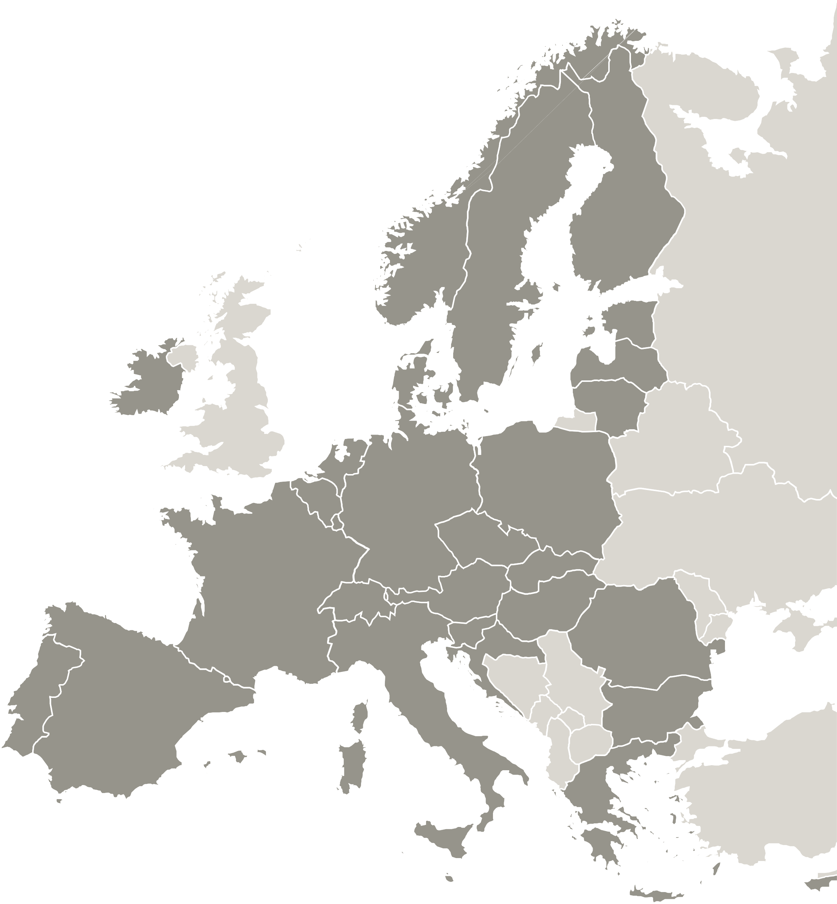
The project atWork4NEETs is implemented in the framework of the Interreg Europe programme and co-financed by the European Union.
www.interregeurope.eu

