Slide 1
Imagining the Future of the Cybersecurity Workforce:
What Would Walt Do?
Jon Brickey, Ph.D.
Mastercard Cybersecurity Evangelist

Slide 2
Challenges
500,000+
Current number of open positions in cybersecurity (Cyberseek.org)
$3 trillion
2017 global impact of cybercrime damages (Europol)
$6 trillion
2021 forecasted global impact of cybercrime damages (Forbes)
$10 billion
Est. global spending on cybersecurity by 2027
Opportunities for the future cybersecurity workforce
Priceless ®

Slide 3
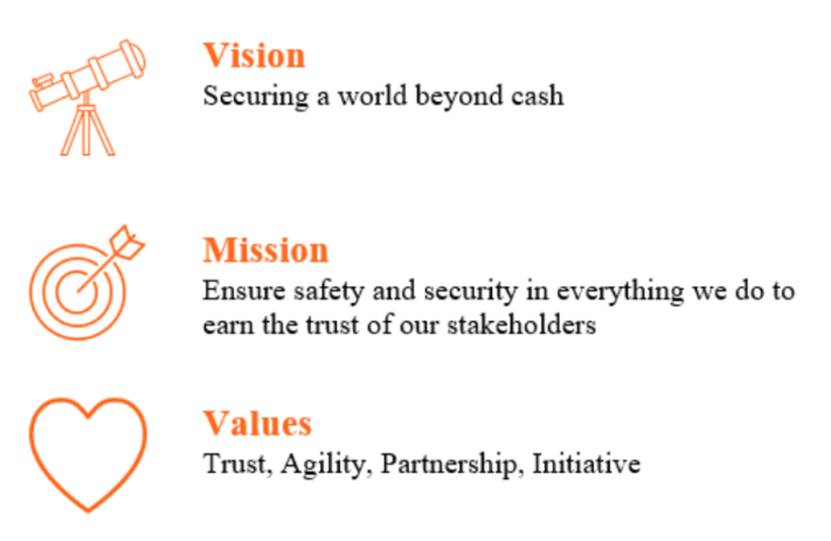
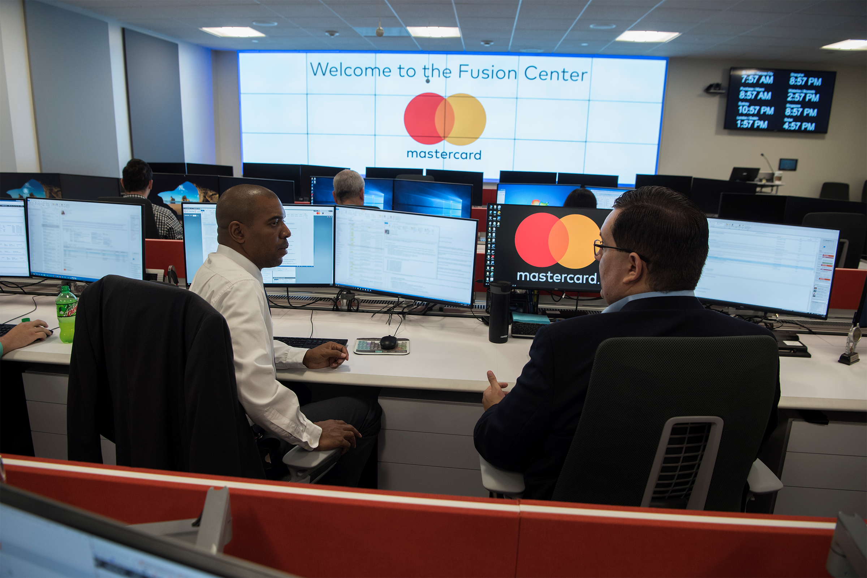
Cybersecurity at Mastercard

Slide 4

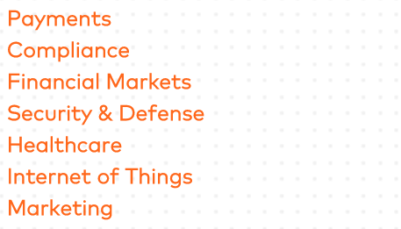

A robust AI platform that works in any industry, with any data source, regardless of type, complexity or volume.

Slide 5

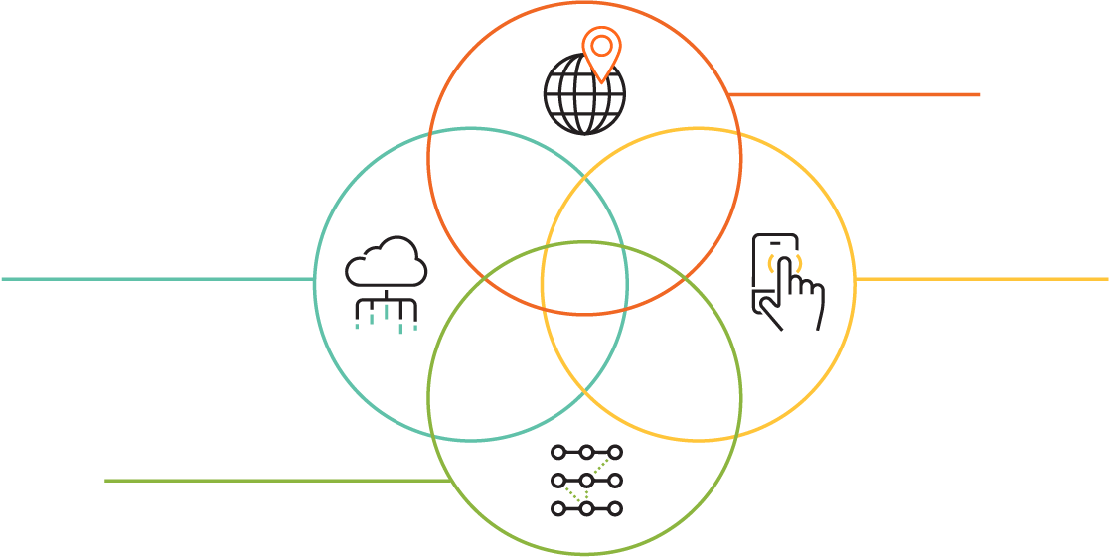
Multi-Layered Approach
Device, Connection, and Location Intelligence
Trust Consortium
Environment Data
Passive Biometrics

Slide 6


Walt Disney Quotes

Slide 7
Walt
Quote #1
“You can design and create, and build the most wonderful place in the world. But it takes people to make the dream a reality.”
7
7

Slide 8
Walt
Quote #2
“It's kind of fun to do the impossible.”
2018 Mastercard Proprietary and Confidential.
8
8

Slide 9

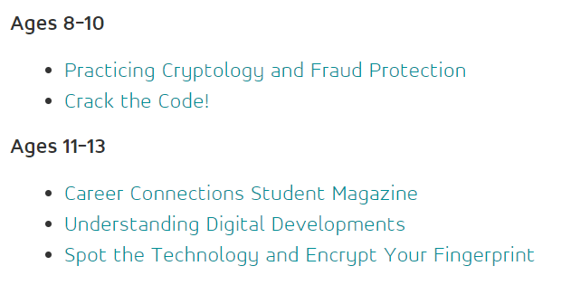
Girls4Tech and Scholastic
Introduces girls to two dynamic STEM careers
and activates their logical, analytical and
perceptive powers with exercises from Girls4Tech
and Scholastic.
Notes:
https://www.mastercard.us/en-us/about-mastercard/corp-responsibility/social-sustainability/corporate-philanthropy-volunteering/girls-4-tech.html
https://youtu.be/8-9PwUx-KZM

Slide 10
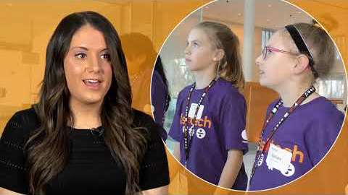

Slide 11
Walt
Quote #3
“When you're curious, you find lots of interesting things to do.”
2018 Mastercard Proprietary and Confidential.
11
11

Slide 12
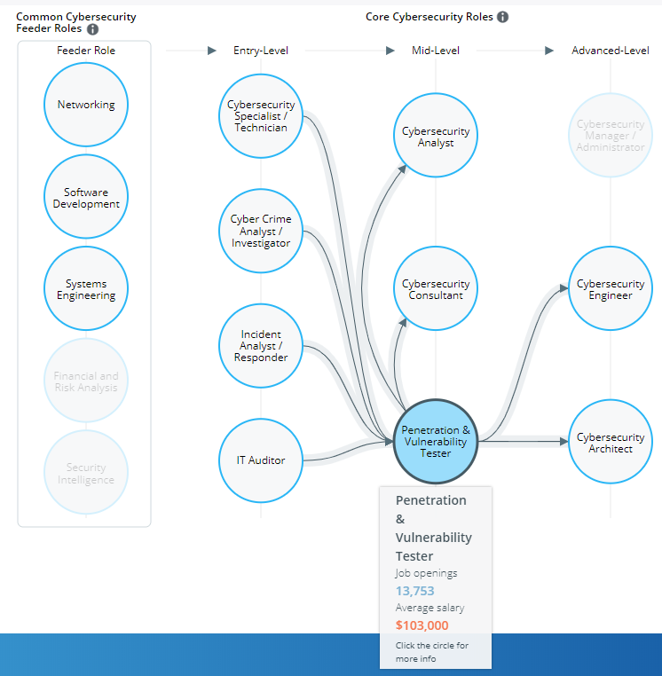
Cybersecurity Career Pathways
Based on the NICE Workforce Framework
52 work roles
Various pathways with on and off ramps
Not everyone is a coder
Source: Cyberseek.org

Slide 13
Walt
Quote #4
“All our dreams can come true, if we have the courage to pursue them.”
2018 Mastercard Proprietary and Confidential.
13
13

Slide 14

In 2019, the number of unfilled cybersecurity jobs in the United States reached
Program Objectives:
500,000
Address immediate cybersecurity talent deficiency faced by the federal government
Provide the private sector with a talent pool of post entry-level experienced cybersecurity technologists
Support efforts to address a related major public policy issue – rising student loan debt projected to reach $1.4 trillion in 2019
Globally, projections suggest a cybersecurity workforce shortage of
1.8 million by 2022
The annual cost of data breaches is expected to rise to
©2018 Mastercard. Proprietary and Confidential.
$2.1 trillion by 2020

Slide 15













OPERATING PARTNER
CORPORATE PARTNERS
PARTICIPATING FEDERAL AGENCIES
Naval Intelligence
National Oceanic and Atmospheric Administration
Additional corporate partners and federal agencies to be added; discussion ongoing

Slide 16
Key Program Components
How it works
Eligibility
Corporate Commitment
The Cyber Talent Initiative is structured around a two year period of service at a participating federal agency, followed by full-time employment with a participating company
Outstanding student loan debt is required in order to be eligible
Candidates must still interview for private sector role following government service
Participating entities will cover outstanding student loan debt up to $75,000
Annual program budget of $500,000 funded proportionally by corporate sponsors.
Pursue cybersecurity-related undergraduate or advanced degree
Two year full-time cybersecurity role at a federal agency
Transition to a cybersecurity position with participating corporate sponsors
Corporate sponsor provides student loan debt relief
www.CyberTalentInitiative.org

Slide 17
Walt
Quote #5
“Times and conditions change so rapidly that we must keep our aim constantly focused on the future.”
2018 Mastercard Proprietary and Confidential.
17
17

Slide 18
Walt
Quote #6
“The way to get started is to quit talking and begin doing.”
2018 Mastercard Proprietary and Confidential.
18
18

Slide 19
To Do
Identify resources & opportunities
Find champions
Develop/adopt programs
  Partner with Gov, Industry, Academia
Share with others
2018 Mastercard Proprietary and Confidential.
19
19

Slide 20

thank you
Notes:
Questions

