Slide 1
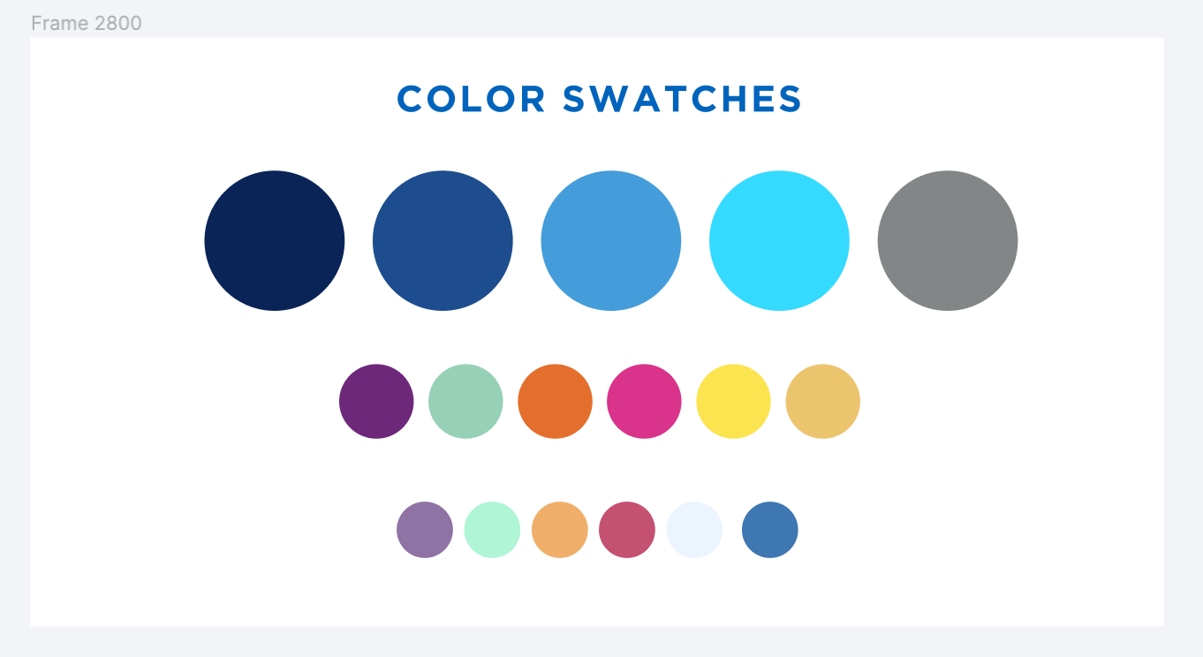
Cleaning Up Named Users
February 25, 2022

Slide 2
Contractual Background
Subscription Metrics

Slide 3
Subscription Metrics
Alma-Primo VE Contract Renewal due in November 2022 (CM 03130)
Listed are subscription metrics:
2,023 Named Users
392K FTE
24.7M Documents Indexed by Primo VE
22.3M Bib Records
250,000 Unique e-Journal Titles
10% growth every five years for collections
Pricing for the next renewal “can be adjusted,” incorporating a 2% increase, upon mutual agreement by both parties, capped at 5%.
SUNY is below subscription metrics in all areas except for named users.
SUNY pricing is based on pricing as a group, not campus pricing provided in contract.
No per user/record escalation metrics included.

Slide 4
Named User Metrics and Cleanup
Initially, SUNY had almost 4,200 Named Users.
We’re now at 2,970 Named Users.
Analysis of non-active users indicates we can likely get close to 2,023 users without asking campuses to change business operations.
Many student workers from past semesters still have roles, making them a named user.
No current plans to place limits on individual campuses.
Initial plan was to focus on campuses with more than 100 named users, but we’ve found that there aren’t enough expired users in these campuses to do this.

Slide 5
What we are/aren’t asking campuses to do.
What we are asking you to do:
Clean up any staff or student accounts for users who no longer need access to Alma.
Review any staff accounts who may have wanted/needed access to Alma in the past, but no longer do.
Review any accounts who haven’t logged into Alma in months.
Do a meaningful analysis of who still needs access to Alma.
Review any generic/test accounts that may no longer be needed.
What we are NOT asking you to do:
Change practices on how you manage user access such as moving from individual student worker accounts to a generic account.
Remove any staff who has a legitimate need to access Alma, but hasn’t in the last few months.

Slide 6
Known Issues for Consideration
SLS Staff Accounts
You’ll see slc and suny-name accounts in your Alma.
Please leave those to SLS for review.
We’ve already removed several hundred accounts, and will remove more if needed.
ExLibris Accounts
You’ll see Exlibris logins.
Please leave those to SLS to review.
We’ll be requesting that EXL remove these from our account, or we’ll delete them and force them to re-create, re-role, and re-scope.
Admin Accounts
This is a local practice question at the discretion of the campus.
SLS/EXL doesn’t use admin generic accounts.
This is how EXL delivered access to migrated environments.

Slide 7
Named User Cleanup Workflow

Slide 8
Named Users Cleanup Workflow
Run the Staff Login Report
Create set of users with no recent logins
Remove named users you want to keep from set
Remove roles from users who no longer need them
Delete users you no longer need

Slide 9
Named Users Cleanup
Removing roles is sufficient to clean up a named user
You don’t have to delete any users
Inactive and expired roles must be removed
Please do not delete or remove roles from Ex Libris or SLS accounts
If you’re unsure about whether you should delete or remove roles from an account, please email info@slcny.libanswers.com

Slide 10
Staff Login Report
Shows staff usage of Alma during the last 90 days
Can retain staff login info for longer period of time by changing staff_login_ip_address_retention setting
Configuration > User Management > General > Other Settings
Lists username and last login date of every named user in your system
Cannot add additional fields to report
Results can be exported to Excel
Need General System Administrator role

Slide 11
Creating a Set of Users
Having a set of named users with no recent logins will make cleaning up named users easier
Set provides information on users beyond just username (full name, user group, etc.)
Can easily access full user records by clicking on user’s name
Can run jobs on user sets
Can be created from Excel file of Staff Login Report
Remove valid users with recent logins from file before creating set
Need User Administrator or User Manager role

Slide 12
Removing Named Users You Need to Keep from the Set
You do not have to clean up every named user that hasn’t logged in to Alma recently
Some named users are legitimate but don’t need to log into Alma frequently
If you can easily tell which named users must be kept when you run the Staff Login Report, it’s easiest to delete them from the Excel file before creating the set
If not, you can use Remove Selected function to remove individual or batches of users from a set

Slide 13
Removing Staff Roles
Can batch remove roles other than Patron from within user record using Select All and Remove Selected functions
Remember to deselect Paton role before clicking Remove All
Users will not be automatically removed from set once their non-patron roles are removed
Must be removed from set manually

Slide 14
Removing Staff Roles
Update/Notify Users job can remove roles from batches of users
Job cannot remove multiple roles at same time
May need to run job multiple times
Job cannot remove following roles:
Circulation Desk Operator, Circulation Desk Operator - Limited, Circulation Desk Manager, Requests Operator, Work Order Operator, Receiving Operator, Receiving Operator Limited, Fulfillment Services Operator
Usefulness is limited

Slide 15
Deleting Named Users You No Longer Need
If a named user is a departmental or test account you no longer need, you should delete the user record
You may want to delete ex-staff
You should not delete ex-student employees
You can manually delete individual users from the user search results page
Purge User job can batch delete users
Users must have purge date in their records
Could potentially be purging other users with purge dates
Not recommended unless you need to delete a large number of users

Slide 16
Documentation & Help
Named User Cleanup FAQ:
https://slcny.libanswers.com/faq/363475
SLS will perform cleanup for campuses
Will need list of users who can be deleted or have their roles removed
Email info@slcny.libanswers.com if you need help or if you want SLS to do cleanup work for your campus
Please keep us posted on your progress if you’re doing this cleanup work yourself

Slide 17
Demo

