Slide 1
Psychological Safety through Diversity Lens in Healthcare Teams
Nelly Burdette, PsyD,
Senior Director, Integrated Behavioral Health, CTC-RI
Director, Population Behavioral Health, Boston Medical Center Health System
October 5, 2023
5/12/2022
Contact: nellyburdette@gmail.com
‹#›
Prepared by Care Transformation Collaborative of RI

Slide 2
Dr. Nelly Burdette has 15 years of experience within integrated behavioral health clinical and leadership roles as a clinical health psychologist. She has created, implemented, led, and shown sustainability of integrated care programs at federally qualified health centers, community mental health centers, and the Veteran’s Administration for pediatric, family medicine and adult populations. In her current roles, Dr. Burdette is the Senior Director of Integrated Behavioral Health for the Care Transformation Collaborative of Rhode Island (CTC-RI), a multi-disciplinary, multi-payor collaborative seeking to transform primary care in the State and is convened by the Office of the Health Insurance Commissioner and EOHHS. In her CTC-RI role for the past 8 years, Dr. Burdette provides IBH leadership for the State, while also creating and publishing the first of its’ kind virtual self-paced training for IBH Practice Facilitators. She is also the Director, Population Behavioral Health at Boston Medical Center Health System, which serves as the central hub for initiatives that drive performance in the Mass Health ACO program by supporting behavioral health strategies both in primary care through content expertise, program design and operations, and translation of data into program actions. Dr. Nelly Burdette received her doctorate degree in Health Psychology from Spalding University and completed her internship at Cherokee Health Systems, focusing on behavioral health services within a primary care safety net population. Her post-doctorate was completed at University of Massachusetts Medical School in Primary Care Psychology.
Dr. Nelly Burdette

Slide 3
Conflict of Interests
Session presenter has no financial relationships with a commercial entity producing healthcare-related products used on or by patients. All relevant financial relationships of those on the session planning committee have been disclosed and, if necessary, mitigated.

Slide 4
Objectives
Describe components of high-functioning teams in healthcare from a diversity perspective
Explore psychological safety from a diversity lens
Learn how an Integrated Care Department in largest FQHC in Rhode Island is approaching psychological safety

Slide 5
How to define a high-functioning team
“Team-based health care is the provision of health services to individuals, families, and/or their communities by at least two health providers who work collaboratively with patients and their caregivers—to the extent preferred by each patient— to accomplish shared goals within and across settings to achieve coordinated, high-quality care.”
Citation: Mitchell et. al (2012)
Notes:
Study of primary care teams suggest 6 team members is optimal size for a team, while greater than 12 are too large.

Slide 6
Values of High-Functioning Healthcare Teams
Honesty: transparency about aims, decisions, uncertainty, and mistakes
Discipline: develop and stick to their standards and protocols even as they seek ways to improve or when inconvenient
Creativity: excited about tackling new or emerging problems and see errors and unanticipated bad outcomes as potential opportunities to learn and improve.
Humility: can rely on each other to help recognize and avert failures, regardless of where they are in the medical hierarchy
Curiosity: dedicated to reflecting upon lessons learned and using those insights for continuous improvement of their own work and the functioning of the team
Citation: Mitchell et. al (2012)

Slide 7
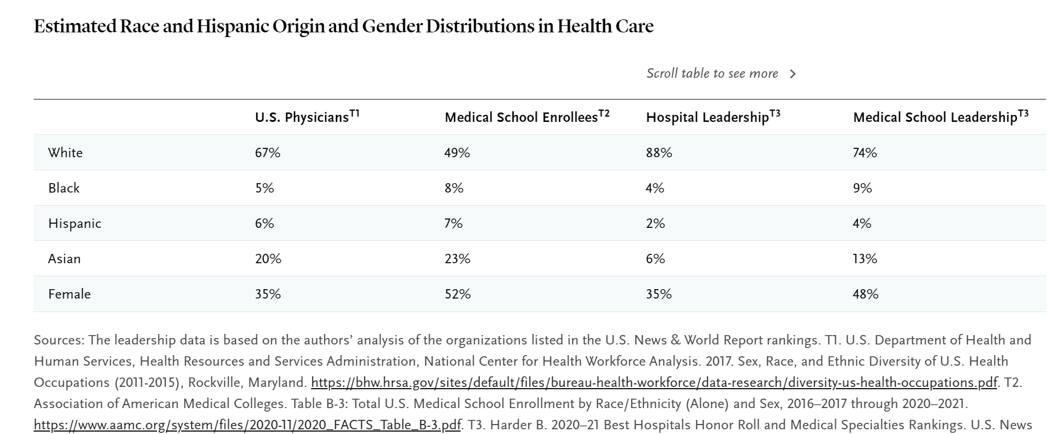
Diversity in Healthcare Teams & Implications
Notes:
This information is a blurry snapshot because the way race and ethnicity are captured varies widely among available sources, but the data on four major racial/ethnic groups (white, Black, Hispanic, and Asian) are robust enough to serve as the basis for discussion. We focus on physicians, but analogous data for researchers, nurses, and other health professionals show similar themes.

Slide 8
At the same meeting, the Council of Representatives adopted two additional resolutions
One delineating APA’s and psychology’s role going forward in dismantling systemic racism in the United States and
the other pledging to work to advance health equity in psychology.
Read full apology and resolutions here:
https://www.apa.org/about/policy/resolution-racism-apology.pdf

Slide 9
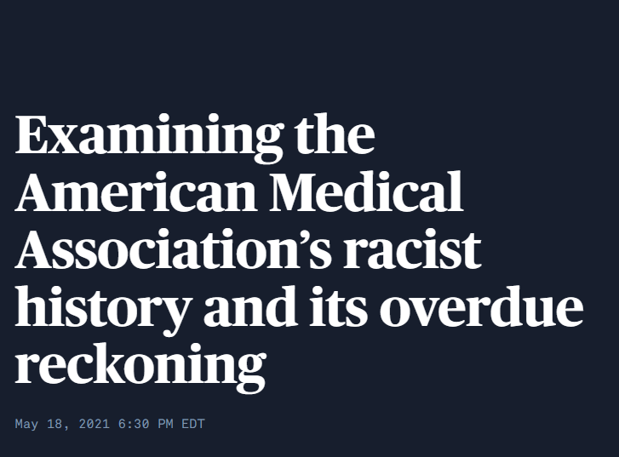
Notes:
-now the AMA is finally beginning to come to terms with racism in its own past.
issued an 83-page report (2021) that found that the organization is "rooted in white patriarchy and affluent supremacy."
ANA issued “racial reckoning statement” (2022) apologizing and accounting for mission and commission related to racism and coinciding with National Commission to Address Racism in Nursing

Slide 10
Acknowledging and addressing systemic racism in healthcare
Creating psychological safety in healthcare teams

Slide 11
What is psychological safety?
Psychological safety is a multi-dimensional, dynamic phenomenon that concerns team members’ perception of whether it is safe to take interpersonal risks at work [1].
“In psychologically-safe environments, people believe that if they make a well-intentioned mistake, others will not think less of them for it, nor will they resent or penalize them for asking for help, information, or feedback. Psychological safety thus fosters the confidence to take interpersonal risks, allowing oneself and one’s colleagues to learn and focus on collective goals and problem prevention rather than on self-protection.”
Citation: Amy Edmondson (2009)
Notes:
Amy Edmondson, Professor of Leadership and Management at the Harvard Business School thought up the term psychological safety in the context of the workplace( See TED talk) 11:26

Slide 12
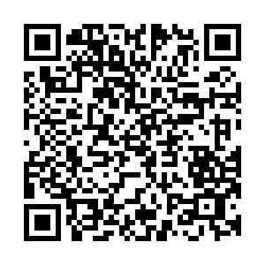
Time for a poll
Individual Safety
Team Respect
Team Learning
https://PollEv.com/mmooney757
Notes:
Either pass out paper copies or use e-polling: https://www.polleverywhere.com/multiple_choice_polls/sZyMSeJwjhIaAbF1tKPuf?preview=true&controls=none
Individual Safety
1. In this team, it is easy to discuss difficult issues and problems.
Strongly Disagree Disagree Neutral Agree Strongly Agree
2. I won't receive retaliation or criticism if I admit to an error or mistake.
Strongly Disagree Disagree Neutral Agree Strongly Agree
3. It is easy to ask a member of this team for help.
Strongly Disagree Disagree Neutral Agree Strongly Agree
4. I feel safe offering new ideas, even if they aren't fully-formed plans.
Strongly Disagree Disagree Neutral Agree Strongly Agree
Team Respect
5. In this team, people are accepted for being different.
Strongly Disagree Disagree Neutral Agree Strongly Agree
6. My teammates welcome my ideas and give them time and attention.
Strongly Disagree Disagree Neutral Agree Strongly Agree
7. Member of this team could easily describe the value of other's contributions.
Strongly Disagree Disagree Neutral Agree Strongly Agree
Team Learning
8. In this team, people talk about mistakes and ways to improve and learn from them
Strongly Disagree Disagree Neutral Agree Strongly Agree
9. We take the time to find new ways to improve our team's work and processes.
Strongly Disagree Disagree Neutral Agree Strongly Agree
10. Members of this team raise concerns they have about team plains or decisions.
Strongly Disagree Disagree Neutral Agree Strongly Agree
11. We try to discover our underlying assumptions and seek counterarguments about issues under discussion.
Strongly Disagree Disagree Neutral Agree Strongly Agree

Slide 13
Notes:
-The job of a leader is not to protect their team from discomfort. It’s to protect them from harm—and to help motivate them to push through the discomfort and harness it for growth.
-In other words, the more you face cognitive friction, the better you get at not taking other people’s pushback and different ideas personally.
https://www.snow.academy/

Slide 14
Which describes your team?
Notes:
Psych Safety = Psych safety is NOT =
-Candor -being nice
-Productive Disagreeement -always agreeing
-Free Exchange of Ideas -personality characteristic (that you have or don’t individually)
-Experienced a group culture -same as trust (although trust is a component)

Slide 15
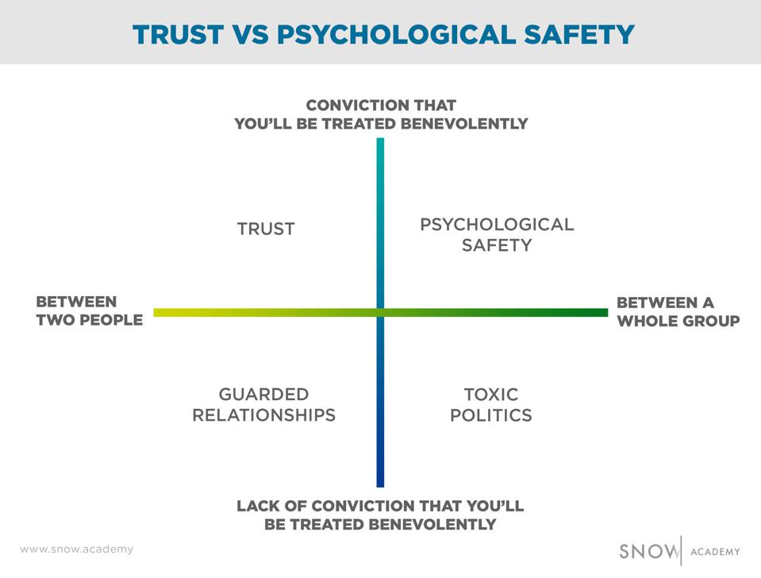
Notes:
-psychological safety is trust among a group, rather than just between two people.
https://www.snow.academy/

Slide 16
Diversity + Psychological Safety
Diversity is not sufficient for high performance…diverse teams tend to underperform, in part because team members avoid interpersonal risks.
2022 research: Test idea of psychological safety as a ‘lubricant’ in diverse teams empirically
Results:
Diversity was positively associated with performance in those teams with high psychological safety
Diversity was even more negatively associated with performance in teams with lower psychological safety
Take-away: It is crucial to nurture psychological safety to get the most out of diversity.
Citation: Bresman & Edmondson 2022
Notes:
-Note: this is not a published study but showed that psych safety is a moderator between diversity and performance

Slide 17
A little about Providence Community Health Centers
80,000 patients
25,000 under the age of 18
70% Medicaid, 10% Uninsured, 10% Medicare
60% Better-served in a language other than English
9 clinics
Most are multi-specialty (Peds, FP, IM, Ob-Gyn)
Several other specialties (Asthma and Allergy, Podiatry, Optometry)
Two large urgent cares embedded in clinics

Slide 18
PCHC & Integrated Behavioral Health Team
Each clinical site has two IBH staff members:
- Led by IBH Clinician (LICSW, LMHC)
- Paired with Behavioral Health Advocate (CHW)
2 Psychiatry Team Members with Behavioral Health Advocates
Travel across all sites
MAT Team
PCP and Nurse Care Manager

Slide 19
Psychological Safety Baseline Results
Roles
Providers and Advocates
Domains
Individual Safety
Team Respect
Team Learning
Notes:
Individual Safety
1. In this team, it is easy to discuss difficult issues and problems.
Strongly Disagree Disagree Neutral Agree Strongly Agree
2. I won't receive retaliation or criticism if I admit to an error or mistake.
Strongly Disagree Disagree Neutral Agree Strongly Agree
3. It is easy to ask a member of this team for help.
Strongly Disagree Disagree Neutral Agree Strongly Agree
4. I feel safe offering new ideas, even if they aren't fully-formed plans.
Strongly Disagree Disagree Neutral Agree Strongly Agree
Team Respect
5. In this team, people are accepted for being different.
Strongly Disagree Disagree Neutral Agree Strongly Agree
6. My teammates welcome my ideas and give them time and attention.
Strongly Disagree Disagree Neutral Agree Strongly Agree
7. Member of this team could easily describe the value of other's contributions.
Strongly Disagree Disagree Neutral Agree Strongly Agree
Team Learning
8. In this team, people talk about mistakes and ways to improve and learn from them
Strongly Disagree Disagree Neutral Agree Strongly Agree
9. We take the time to find new ways to improve our team's work and processes.
Strongly Disagree Disagree Neutral Agree Strongly Agree
10. Members of this team raise concerns they have about team plains or decisions.
Strongly Disagree Disagree Neutral Agree Strongly Agree
11. We try to discover our underlying assumptions and seek counterarguments about issues under discussion.
Strongly Disagree Disagree Neutral Agree Strongly Agree

Slide 20
Next Steps at PCHC
Modeling curiosity
Allowing all voices to be heard
Framing challenges as problem-solving exercises that everyone can join in.
Re-assess psychological safety after interventions
Citation: Bresman & Edmondson 2022
Notes:
-Make more mistakes might be what you see…OR discussing how mistakes occur might make them seem more often due to climate of openness

Slide 21
How do I get from here to there?
Setting the Stage: FRAMING
Frame meetings as information-sharing opportunities: Start with explicit goal of information sharing rather than evaluation/decision-making
Frame differences as a source of value: “Each of us is likely to have different perspectives going into this meeting, and this will help us arrive at a fuller understanding of the issues at stake in this decision (or project).”
Ask these questions: FRAMING
Have I clarified the nature of the work and level of uncertainty?
How often do I refer to these aspects of the work and how well do I assess shared understanding?
Have I spoken of failures in the “right way”…that small failures are the currency of subsequent improvement?
Do I emphasize that it is not possible to get something brand new “right after the first time?”
Citation: Bresman & Edmondson 2022; The Fearless Organization (2019) Edmondson
Notes:
-Leadership needs to drive clear, direct, candid communication as a way to frame one aspect of psychological safety but inviting the participation by those who tend to remain silent is CRITICAL for psych safety.
-How leadership responds when speaking up occurs is the next step

Slide 22
How do I get from here to there?
Ask these questions: INQUIRY
Have I made sure that people know I do not have all the answers?
Have I emphasized that we can always learn more?
How often do I ask good question rather than rhetorical ones?
How often do I ask questions of others, rather than just expressing my opinion?
INQUIRY
When team leaders – and others - practice genuine inquiry that draws out others’ ideas, listening thoughtfully to what they hear in response,
Questions that recognize shared ownership and causality versus those that don’t: What did we (or I) do to put you in a challenging position? Or How can we help?
Citation: Bresman & Edmondson 2022; The Fearless Organization (2019) Edmondson
Notes:
-Leadership needs to drive clear, direct, candid communication as a way to frame one aspect of psychological safety but inviting the participation by those who tend to remain silent is CRITICAL for psych safety.
-How leadership responds when speaking up occurs is the next step

Slide 23
How do I get from here to there for leaders
Citation: Edmondson & Bransby (2023)

Slide 24
How do I get from here to there without making mistakes?

Slide 25
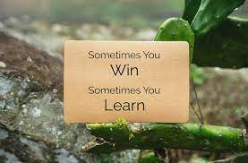
Reframe: How do I learn from my failures and help my team do the same?

Slide 26
How do I know if I made a difference?
Or what does success look like?
Measure psychological safety before and after diversity interventions
Look at engagement rates pre- vs post diversity interventions
Link a measure of psychological safety to quality goals/incentives among healthcare teams

Slide 27
Next Steps:
From theory to practice
Care Transformation Collaborative of Rhode Island
Healthy Happy Teams Initiative
10 Primary Care Practices in RI
2 IBH Practice Facilitators/Content Expert
To learn more: https://public.3.basecamp.com/p/fnW6sYDH6Nr2Uu3k1C9AuGDj
Notes:
-Psych Safety is Mission Critical and much like diversity does not have an endpoint it reaches and then is done

Slide 28
Learn more
https://hbr.org/podcast/2019/01/creating-psychological-safety-in-the-workplace
Notes:
-Psych Safety is Mission Critical and much like diversity does not have an endpoint it reaches and then is done
-

Slide 29
References
Bresman, H., & Edmondson, A. C. (2022). Exploring the Relationship between Team Diversity, Psychological Safety and Team Performance: Evidence from Pharmaceutical Drug Development (No. 22-055). Harvard Business School Working Paper.
Edmondson, Amy C. The Fearless Organization: Creating Psychological Safety in the Workplace for Learning, Innovation, and Growth. Hoboken, NJ: John Wiley & Sons, 2019.
Amy C. Edmondson and Derrick P. Bransby (2023). Psychological Safety Comes of Age: Observed Themes in an Established Literature. Annual Review of Organizational Psychology and Organizational Behavior. 10:1, 55-78.
Edgoose JYC, Quiogue M, Sidhar K. How to Identify, Understand, and Unlearn Implicit Bias in Patient Care. Fam Pract Manag. 2019 Jul/Aug;26(4):29-33. PMID: 31287266.
Edmondson, A., & Roloff, K. (2009). Leveraging diversity through psychological safety. Rotman Magazine, 1(2009), 47-51.
Mitchell, P., Wynia, M., Golden, R., McNellis, B., Okun, S., Webb, C. E., ... & Von Kohorn, I. (2012). Core principles & values of effective team-based health care. NAM Perspectives.
O’Donovan, R., McAuliffe, E. Exploring psychological safety in healthcare teams to inform the development of interventions: combining observational, survey and interview data. BMC Health Serv Res 20, 810 (2020). https://doi.org/10.1186/s12913-020-05646-z
Tavris, C., & Aronson, E. (2007). Mistakes were made (but not by me): Why we justify foolish beliefs, bad decisions, and hurtful acts. Harcourt.

Slide 30
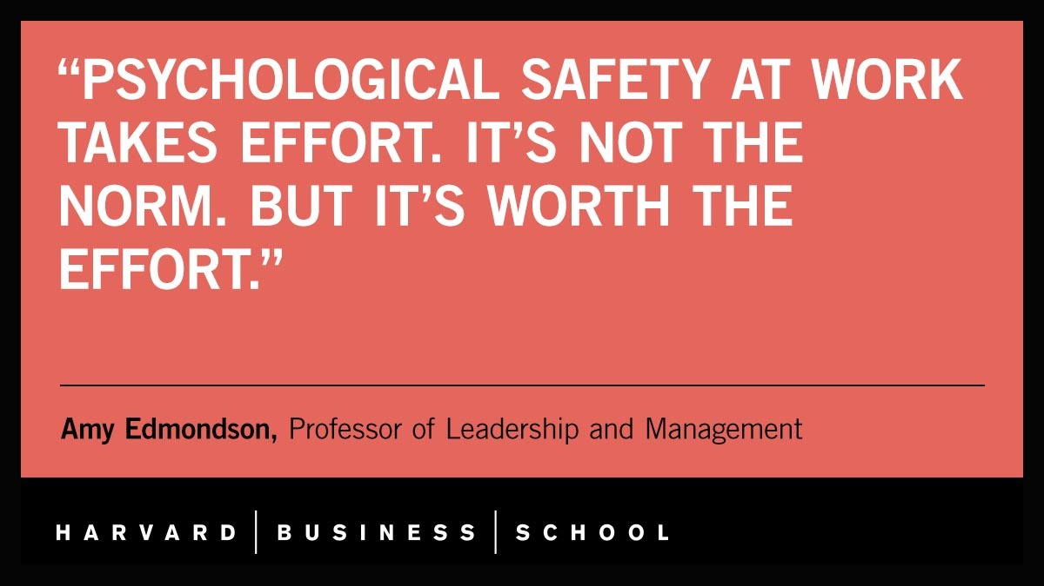
THANK YOU & QUESTIONS

