Slide 1
Fulfillment: Resource sharing Configuration
Shared Library Services Platform Project
Heidi Webb

Slide 2
Some Basics when Searching Documentation
SUNY is using Peer to Peer resource sharing in Alma
currently only for physical items
SUNY is using only a small portion of the Fulfilment Network for walk-in borrowing

Slide 3
Roles Needed
General Systems Administrator
Fulfillment Administrator
Resource Sharing Partners Manager

Slide 4
Roles to Process Resource Sharing Requests
You will need the following roles to process all aspects of resource sharing requests:
Circulation Desk Operator - scoped to library* and circulation desk
Requests Operator - scoped to library* and circulation desk
Fulfillment Services Operator - scoped to library*
Fulfillment Services Manager - scoped to library*
*library - For most SUNY campuses, this should be your main library

Slide 5
Resource Sharing Library
Your main library is likely configured as your resource sharing library.
This was setup for you.
Configuration
At the Institution Level → General → Add a Library or Edit Library Information

Slide 6
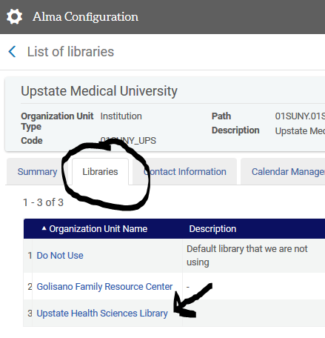
Navigating to Library Settings

Slide 7
Library Information
If checkbox is checked, this is your resource sharing library.
Symbol is defined at the Network Zone level
Pro Tip: It’s not tied to OCLC

Slide 8
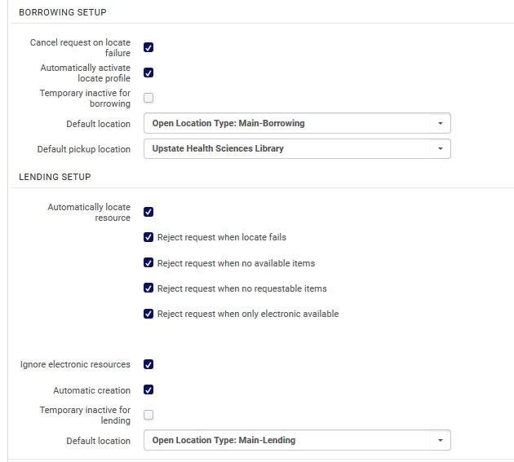
Borrowing and Lending Setup
You can temporarily disable borrowing and lending
We are a consortia, so use sparingly

Slide 9
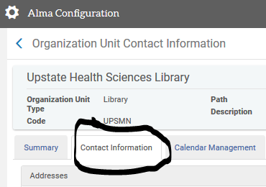
Contact Information
HUB addresses have been pushed down from the NZ for requests.
Email address displaying on requests is from Contact Information tab

Slide 10
Partners
Defined in the Network Zone
These are the libraries you are lending from

Slide 11
Rotas
Defined in the Network Zone
Equivalent to Lending String

Slide 12
Fulfillment Units

Slide 13
An overview of the Fulfillment Units in SUNY
Regular/Circulating Coll.
Institution
All campuses have at least 4 Fulfillment Units at the Institution Level, and then one at the library level.
Institution Level FU governs locations and circulation(loaning)/requesting/booking policies.
Library level FU is for resource sharing and governs the temporary location that your borrowing and lending items go into when they are part of resource sharing activities.
Your set up may be slightly different if you’ve done customization, but this is how at least 50 campuses’ Fulfillment Units are set up.
Closed Stacks
Closed Stacks
Reserves
Reserves
Short Loan
Short Loan
Library
Resource Sharing (XXMNFU)

Slide 14
But, why can’t I just add RS policies to the RS Fulfillment Unit?
That would make sense (and folks have tried).
The RS Fulfillment Unit Rules and policies are only applied to items when they’re in the transitory/temporary status of Resource Sharing.
To determine if they can become Resource Sharing, this needs to be determined by TOUs or Fulfillment Unit Rules in your institutional FU that either allow or deny resource sharing requests.

Slide 15
So, I’m a Lending RS request, how does my Alma know to let me in or not?
What Request Fulfillment Unit Rules Apply?
Incoming RS Request
What location is this in?
FUR Match: Does the TOU assigned allow Physical RS requesting?
RS Allowed in TOU—Request is put in lending queue
Move on to someone else in the rota, buddy, you’re not getting this from here!
If RS Not Allowed—Reject Request—No Staff Intervention Needed
If no Request Rules apply, does the default Request TOU allow Physical RS?

Slide 16
How to create a lending deflection in Alma
FAQ:
https://slcny.libanswers.com/faq/264199
Basic process:
Create a Fulfillment Unit Request Rule that applies a Terms of Use that does not allow Physical Resource Sharing requests.
Add in any parameters that you want to use to include locations, material types, etc.
Institution
Regular/Circulating Coll.
Deflections at Institution Level as these FU/Rules/TOUs applied first.
Closed Stacks
Reserves
Short Loan
Library
Resource Sharing (XXMNFU)

Slide 17
Deflections: Non-requestable Fulfillment Units
Most likely at Institution Level
Good chance Closed and Reserves are already blocked from Resource Sharing
Default TOU for Request Fulfillment Unit Rules should have “Not Requestable for Resource Sharing”
Or one of the rules should include that in a TOU

Slide 18
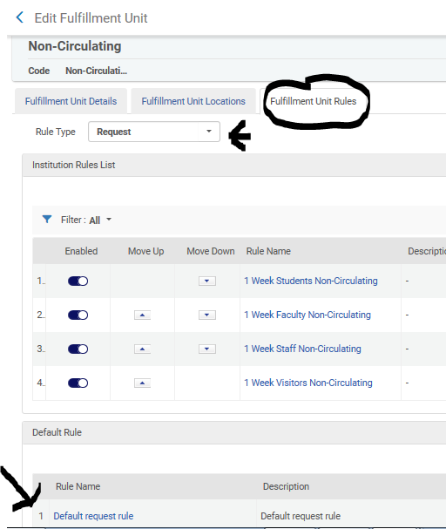
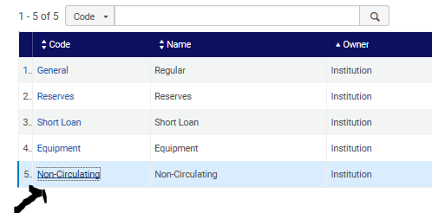
Config → Fulfillment → Fulfillment Units

Slide 19
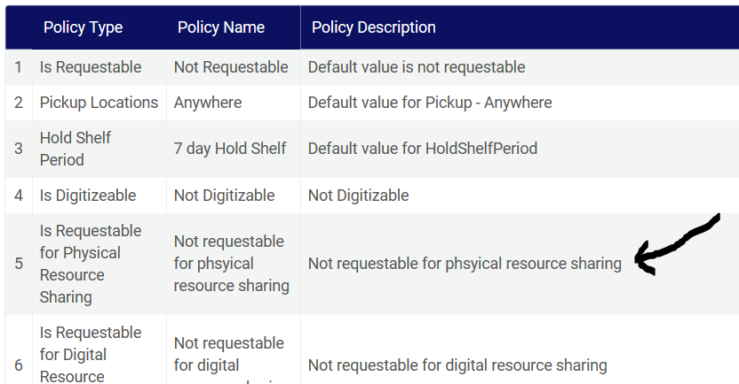
Default TOU
Config → Fulfilment → Terms of Use and Policies

Slide 20
Resource Sharing Fulfillment Unit Configuration

Slide 21
What you can technically change via Resource Sharing Fulfillment Unit Configuration
Length of loan period for regular loans (lending and borrowing).
What locations, material types, etc. are considered short or long loan periods for lending.
The patron types that can use RS.
Pickup location choice, etc.
Renewal and maximum total loan period.

Slide 22
What you can change via Resource Sharing Fulfillment Unit Configuration from a Policy Standpoint.
Length of loan period and renewals, etc. for borrowing resource sharing (this means don’t change the lending loan periods).
Pickup locations.
What patron types can and cannot request items via RS.
Adjust any locations or material types that should be short or long loan.

Slide 23
SUNY Libraries Consortium Network Zone Loan Periods Policy Highlights
https://slcny.libguides.com/ld.php?content_id=40225585
For general circulating collections:
16 weeks for all, with faculty and grads receiving renewals.
For media, and other protected circulating collections:
30 days with one renewal.
Network Zone recalls will not be used unless the item is needed for course reserves.
Campuses are also encouraged to add as many collections to the Network Zone as possible to enable the broadest collection possible for SUNY.

Slide 24
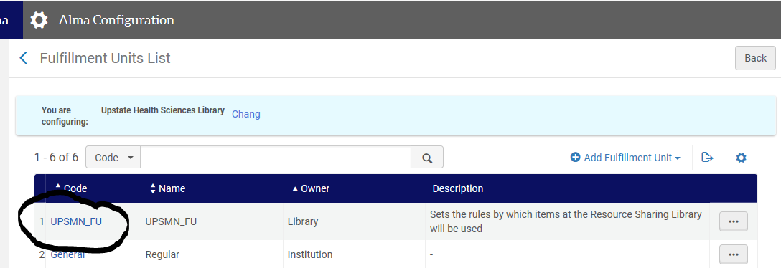
Finding the Resource Sharing Fulfillment Unit
Config → Library Level → Fulfillment → Fulfillment Units

Slide 25
Borrowing: User Groups
Can adjust what user groups can place resource sharing requests

Slide 26
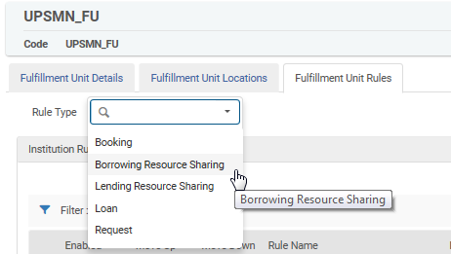
Fulfillment Unit Rules: Rule Type = Borrowing Resource Sharing

Slide 27
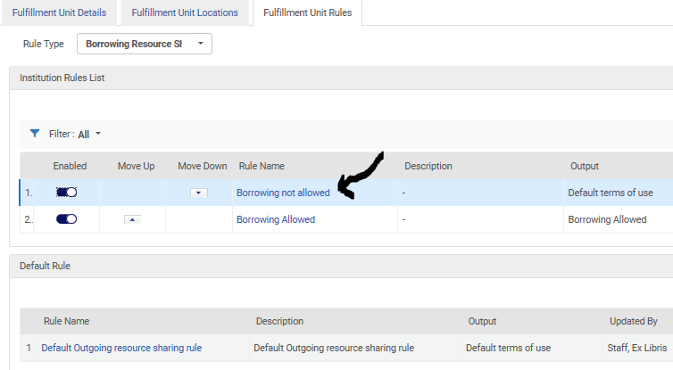
Example: Restrict Which User Groups Can Place Resource Sharing Requests

Slide 28
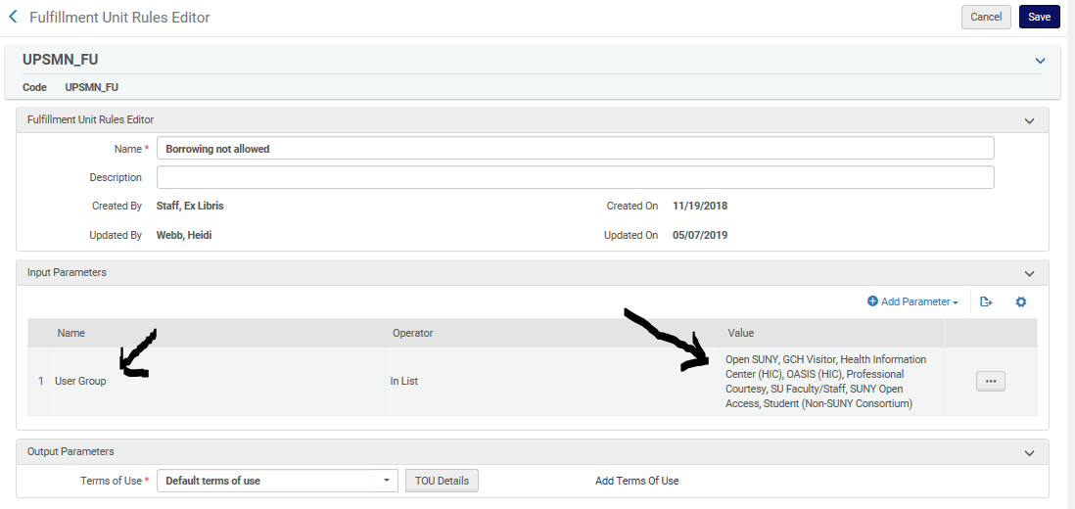
Example: Restrict Which User Groups Can Place Resource Sharing Requests

Slide 29
Borrowing: Local Loan Length
Can adjust the loan length for local users
Example: End of Term

Slide 30
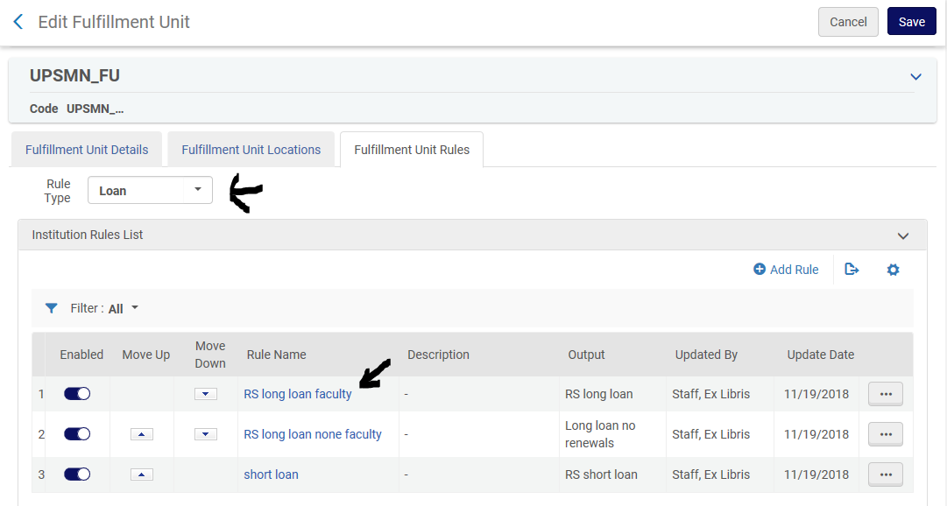
Borrowing: What TOU?

Slide 31
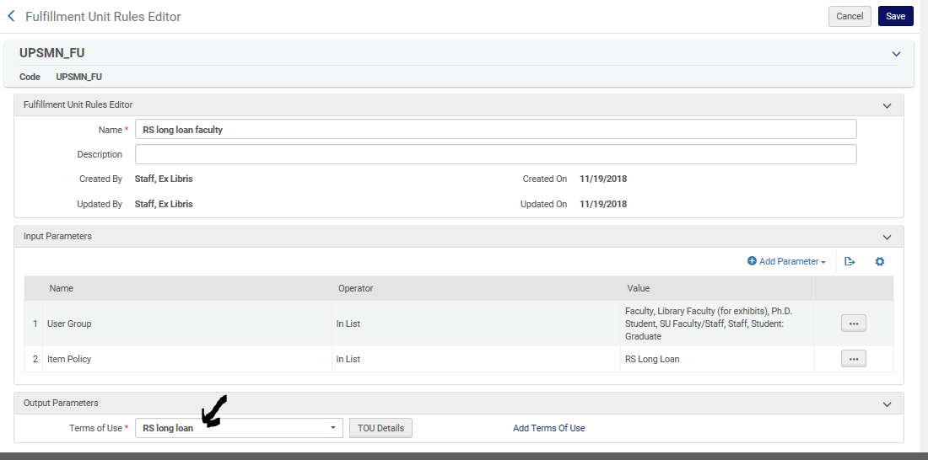
Borrowing: What TOU and what parameters?

Slide 32
What is that Item Policy?
It comes from the lending library and is used to determine long loan versus as shorter material loan based on material type
More on this later

Slide 33
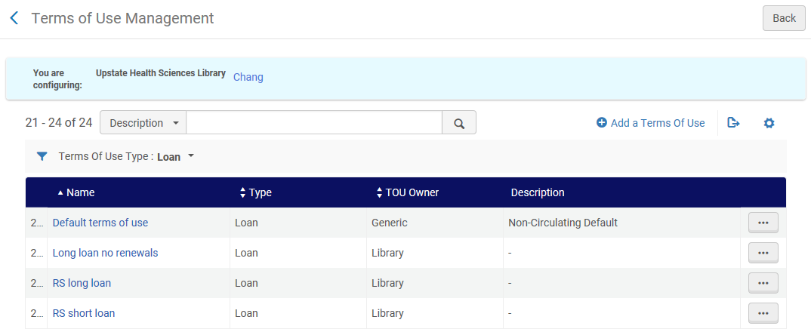
Changing the Borrowing TOU
Config → Library Level → Fulfillment → Terms of Use and Policies

Slide 34
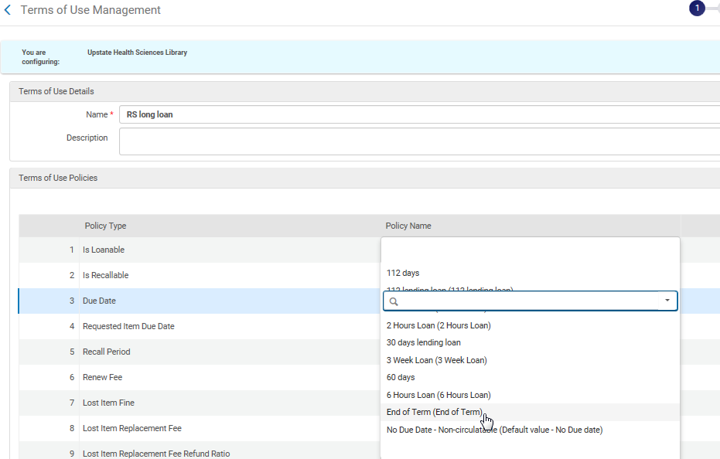
Borrowing TOU Options: Remember End of Term Use Case?

Slide 35
Borrowing Pickup Location Options

Slide 36
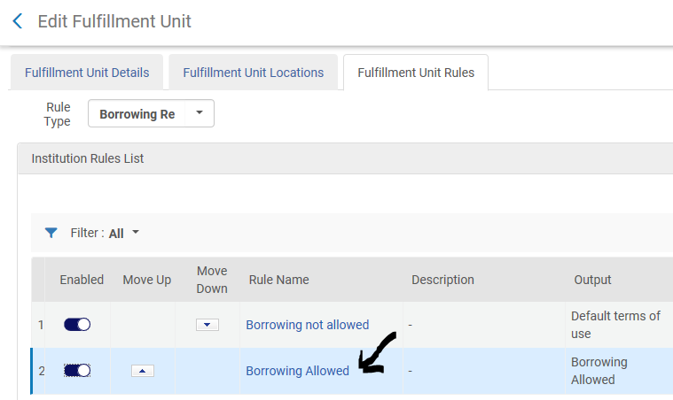
Borrowing: What TOU do you need to change?

Slide 37
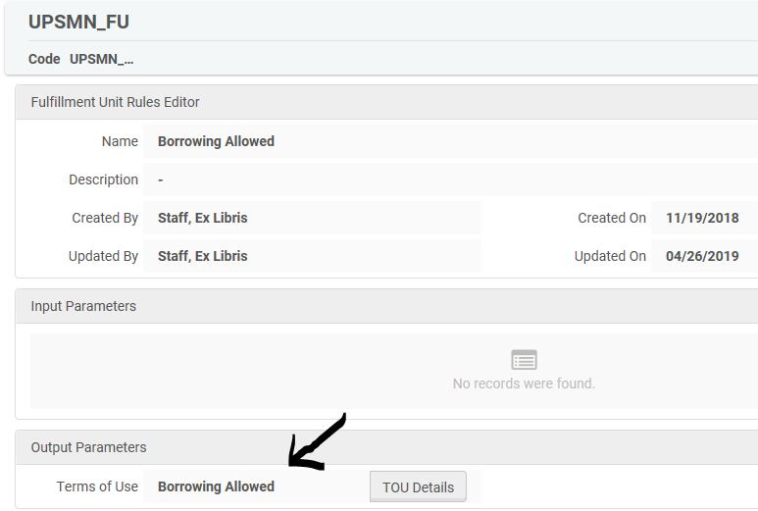
Borrowing: What TOU do you need to change?

Slide 38
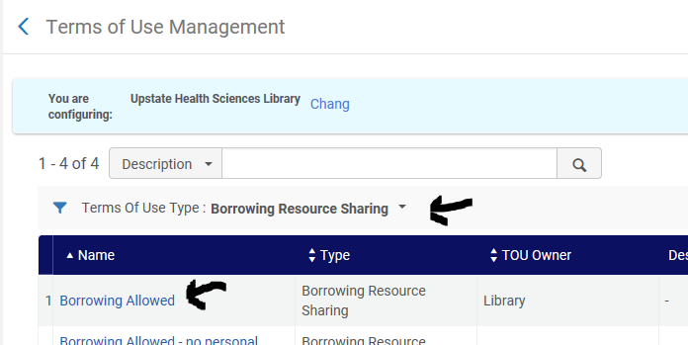
Config → Library Level → Fulfillment → Terms of Use and Policies

Slide 39
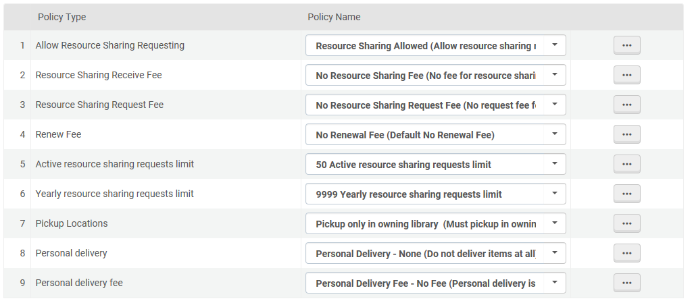
TOU can Designate Pickup Location Options and Request Limits

Slide 40
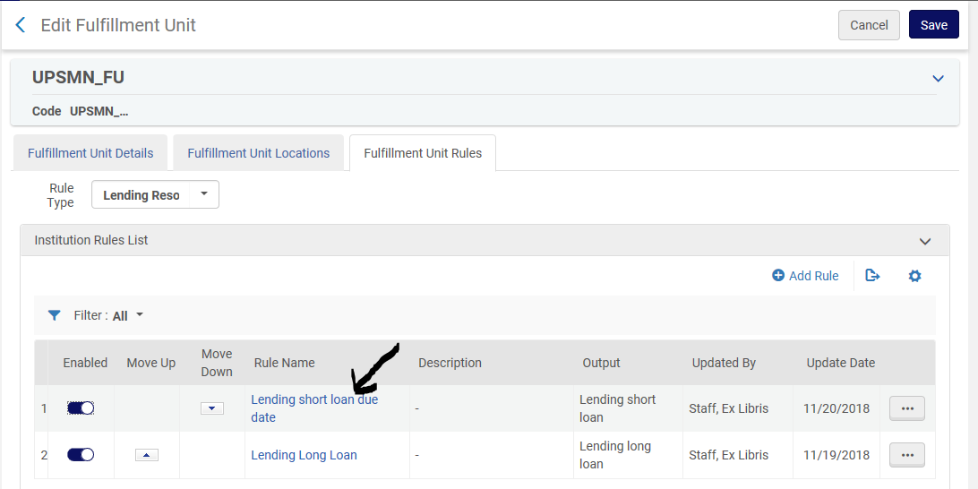
Lending: Short Loan Material Types
Adjust any locations or material types that should be short rather than long loan

Slide 41
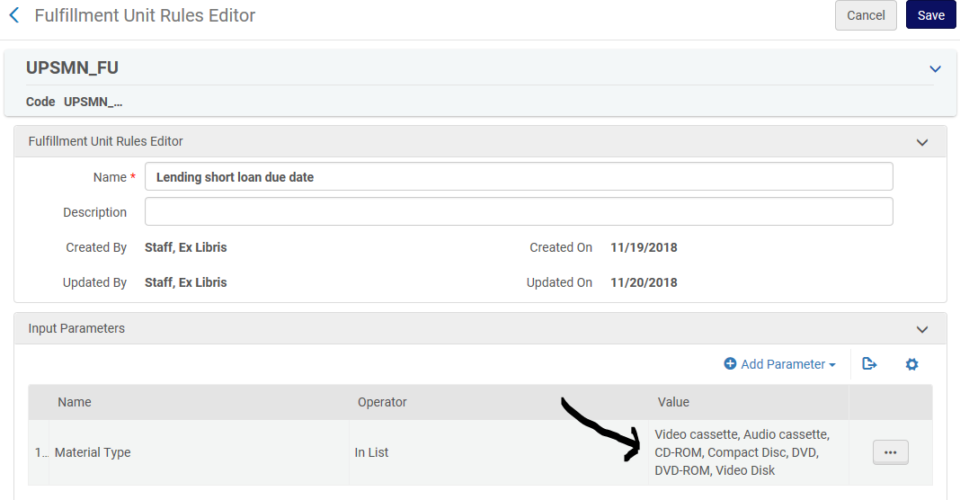
Lending: Short Loan: Media Material Types

Slide 42
Other Workflow Configuration Options

Slide 43
Fulfillment → Other Settings
rs_keep_rejected_request_active
Whether or not to keep rejected requests in the active queue. To remove, “None”
Several others: https://knowledge.exlibrisgroup.com/Alma/Product_Documentation/010Alma_Online_Help_(English)/030Fulfillment/080Configuring_Fulfillment/110General#mapping_table_CustomerParameters_fulfillment

Slide 44
Remember: Jobs do not run until cutover
Jobs like remove expired requests are not running until go-live

Slide 45
Primo Configuration

Slide 46
Roles Needed
Discovery Administrator

Slide 47
Request Link Documentation
Setting up Holds, Alma Resource Sharing and OpenURL links
https://slcny.libanswers.com/faq/261544

Slide 48
Primo Configuration: Alma Resource Sharing Requests

Slide 49
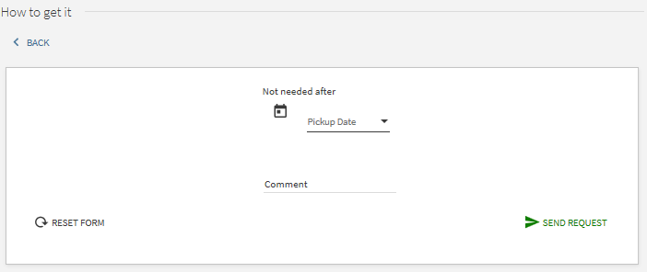
Primo Configuration: Alma Resource Sharing Requests
Request Form Options: Example 1

Slide 50
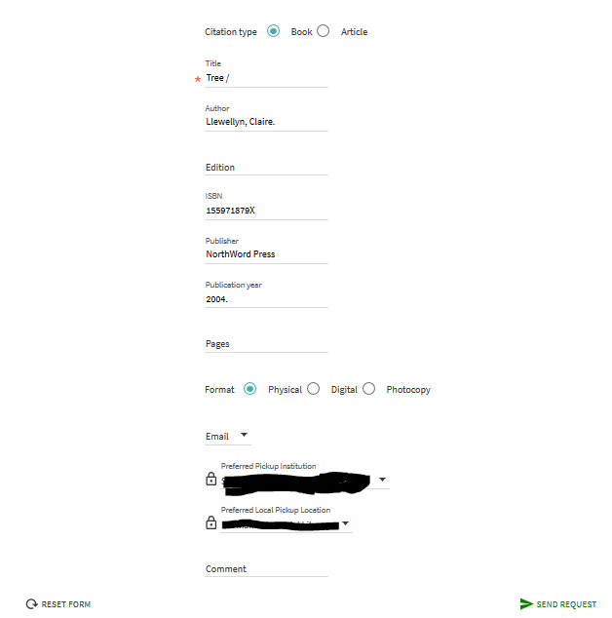
Request Form: Example 2
Do you really need?
Citation Type
Format
Pickup Library
Pickup Location

Slide 51
In Alma: Config → Discovery → Resource Sharing Request
Fields can be mandatory or visible or both

Slide 52
Request Forms: Remember Physical Resource Sharing not Digital/Article
No need to fill out Article options
You can set the Format Default as Physical

Slide 53
Questions?

