Slide 1
Value Based Payment in Pediatrics
Sue Kressly, MD, FAAP
skressly@kresslypediatrics.com
www.linkedin.com/in/susan-kressly

Slide 2
Faculty Disclosure
I have the following financial relationships with the manufacturer(s) of any commercial product(s) and/or provider(s) of commercial services discussed in this CME activity:
ownership shares, Connexin Software
I do not intend to discuss an unapproved/investigative use of a commercial product/device in this presentation.

Slide 3
Learning Objectives
Review Alternative Payment Models and industry trends
Discuss unique pediatric challenges in Value Based Payment models
Introduce Value Improvement and it’s importance in shaping the future of healthcare delivery and payment models

Slide 4
Payment Models
What an ideal Value Based Payment Model for Pediatrics Looks like???
Fee for Service Only
Capitation w/Carve Outs
Risk contract with upside risk only
Fee for Service w/P4P Bonuses
Partial Capitation/
Partial Fee for Service
Full risk contract with both upside and downside risk
With or without P4P and/or carve outs

Slide 5
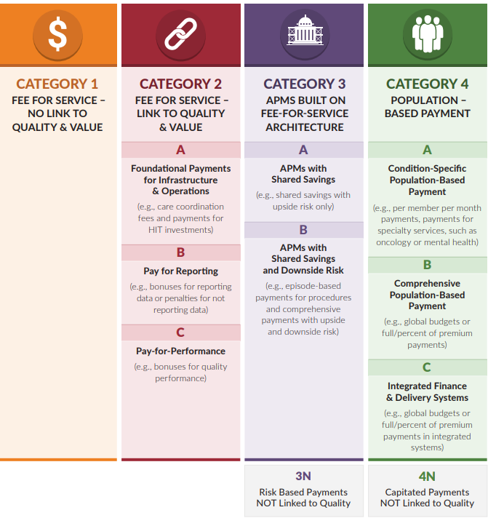
APM Framework
Healthcare Payment Learning and Action Network: http://hcp-lan.org/workproducts/apm-framework-onepager.pdf

Slide 6
Market Penetration for APMs
Categories Key:
4: Population Based Payments
3B: APM w/downside risk
3A: APM w/shared savings
1&2: FFS + Quality/P4P
https://hcp-lan.org/workproducts/apm-infographic-2022.pdf

Slide 7
CMS Strategic Direction
Measurement Goals:
All Medicare fee-for-service beneficiaries will be in a care relationship with accountability for quality and total cost of care by 2030.
The vast majority of Medicaid beneficiaries will be in a care relationship with accountability for quality and total cost of care by 2030.
https://innovation.cms.gov/strategic-direction

Slide 8
Current Pediatric Problem w/APMs

Slide 9
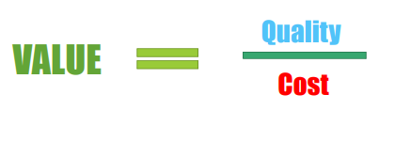
The Value Equation
VALUE
Outcomes (+ Patient Experience)
Cost (+ Inputs)

Slide 10
The Pediatric Outcomes Problem
Difficulty to measure “whole child” outcomes
Long time frame to demonstrate improved outcomes
Pediatric outcomes very dependent on Social Drivers of Health of caregivers
Chronic underinvestment in other avenue’s of children’s well-being
Determining who should be accountable
Unlike Medicare, children change insurance plans/types frequently
Pediatric care is a “team” sport
Inadequate risk adjustment schema

Slide 11
The Pediatric Cost Problem
Limited avoidable spending through improved care and care coordination
Significant amount of spending comes from a small population
Premature infants
Catastrophic illnesses/injuries
Congenital conditions
“Wrong pockets” problem as children age
Comparatively “small problem” (budget dust for payers, not worth designing pediatric systems for the ROI)

Slide 12
Where Do We Start?
Determine what part of total cost of care is in the control of the PCP
Increase involvement in specialty care/contribution to total cost of care (incentives currently not aligned)
Attribution models designed for the way pediatric patients access care
Risk Adjustment Models that Work for Pediatrics
Pediatric Quality Measures that reflect OUTCOMES
Moving from Quality Improvement to Value Improvement

Slide 13
Total Cost of Care and the PCP
ALL Preventive care costs should be subtracted from total cost of care
Well visits
Screenings and evaluations according to Bright Futures
Immunizations
Attribute only the costs that PCP has control over
Medications written by the PCP team (not specialists)
Treatment in the PCP office
Should reward complex care in the medical home including mental health and taking care of children and youth with special healthcare needs (can be done by carving out or appropriate risk adjustment)
Reward efforts to increase access (such as parity for Telehealth care and incentives for extended hours)
Avoidable Emergency Department costs must NOT depend on ED coding (croup)
Give data to empower improvement efforts (including day, time of day and conditions)
Carve out high cost patients
Collaboration between payer/practice for early identification of patients > 2 deviations from expected spend

Slide 14
Specialty Contributions
Specialists need to be included in
Education about total cost of care
Incentives
Discussions about shared care/care coordination w/PCPs
Need aligned incentives with entire delivery ecosystem
Identify unnecessary specialty referrals and support the capacity of the medical home
Identify value improvement opportunities

Slide 15
Attribution Models
Consider how often pediatric patients change insurance coverage
Anchor in preventive care services (most recent well visit)
Need transparent and collaborative panel/roster reconciliation
Shared payer/PCP responsibility for those patients who are hardest to engage (with EXTRA resourcing)

Slide 16
Risk Adjustment Models
Need new methodology for the pediatric population (Medicare models do NOT work)
Must include SDoH of the caregivers
Place to start?
Patient conditions: ICD 10 diagnoses that are unique to pediatrics
Environment conditions: neighborhood risk adjustment models as a proxy for SDoH
Parental/caregiver health and SDoH condition considerations

Slide 17
Pediatric Quality Outcome Measures
How do we define healthy outcomes instead of absence or control of a chronic condition?
School readiness/on-time graduation rates? Only partly influenced by health investments
Move away from “doing tasks” to achieving “optimal health”

Slide 18
Moving from Quality to Value Improvement

Slide 19
Value Improvement
Considers the value of all care you deliver from the viewpoint of:
The patient/family
The ordering pediatric clinician
The payer
Incorporates
Clinical best practice guidelines
Patient out of pocket costs
Indirect practice costs
Total cost of care

Slide 20
When to Refer
When the presenting problem is not within the expertise of any provider within the practice
When the patient is not responding to the usual courses of treatment as expected
When there is a high index of suspicion for a serious condition or illness
When the family demands, and you have attempted to set appropriate expectations

Slide 21
When Not to Refer
When you don’t have time in the schedule
When you don’t like taking care of patients with a particular condition, but you have the experience
When it’s easier then taking the time to address the concerns

Slide 22
When You Order a Test that You Really Don’t Think is Needed..
You add practice work
You have to place an order
Make sure the patient gets the test done
Process the results
Communicate the results to families
Run the risk of dealing with borderline or mildly abnormal labs that have no clinical implications
You add inconvenience and potentially expense to the family
They may have to miss school/work to go to the lab
They worry about something being seriously wrong
You may have to interrupt work to connect with them
They may need additional testing to deal with mild abnormalities
You reinforce that ordering lots of tests is the best way to make a diagnosis

Slide 23
When You Refer to a Specialist
You add practice work
Processing the referral (including getting pre-approval sometimes)
Your practice team should do the work of closing the referral loop to make sure the patient went
Your practice team may have to call the specialist to coordinate an appropriate appointment
You have to process the referral response including reconciling the data
The patient/family
Likely has to miss work/school
There is additional expense to the family (often more expensive cost-sharing)
There may be additional testing with additional expense and inconvenience
There may be additional anxiety with families worried about something serious
You set the expectation that you do not have expertise and families may bypass you entirely in the future

Slide 24
The Specialist
Often tests because of family expectations of “doing something”
May see a PA/NP because of lack of specialty availability
May cause access issues when your patients really need a specialist due to backlog/volume
Often schedule follow-up with patients by matter of routine
May refer to a second specialist without your knowledge

Slide 25
Common Conditions that often do NOT need Testing
Fatigue
Headaches
Abdominal Pain
Sleep Issues
Anxiety
Palpitations
Minor Head Trauma
Back pain

Slide 26
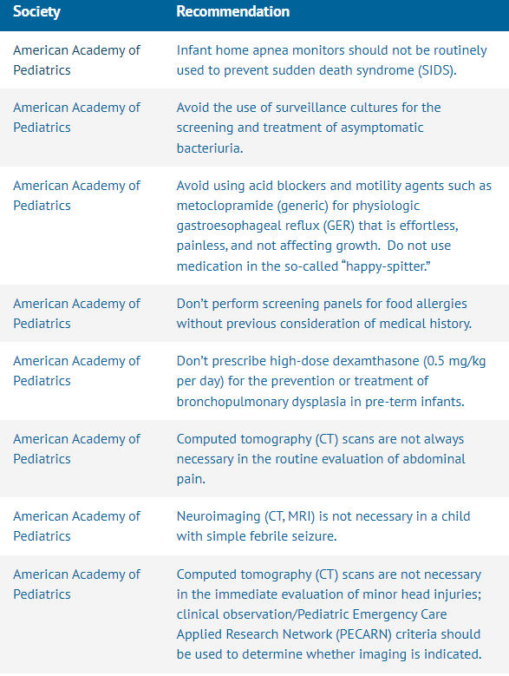
Choosing Wisely

Slide 27
US Healthcare Expenditure
Very high per capita expense
Worse life expectancies

Slide 28
Implications of Overspending/Overuse
Goldman, et al, JAMA Internal Medicine 2018
Berwick and Hackbirth, JAMA 2012
Schroeder, JAMA Pediatrics, 2013

Slide 29
How Much Impact Can I Have?
20-30% of wasted spending is related to low-value clinical decisions
Need to prepare for the future where clinicians understand value and lead systemic changes
Practices that already are on this journey will have more leverage in the future

Slide 30
Value Matrix

Slide 31
Culture of Value
Principles:
Build will to change
Create infrastructure to support value improvement
Expose physicians to value-based payment models
Demonstrate commitment to shared goals

Slide 32
Resources
Value-Based Payment as a Tool To Address Excess US Health Spending (Health Affairs, Dec 1, 2022) https://www.healthaffairs.org/do/10.1377/hpb20221014.526546/
Beckett MK, Martino SC, Agniel D, Mathews M, Hudson Scholle S, James C, Wilson-Frederick S, Orr N, Darabidian B, Elliott MN. Distinguishing neighborhood and individual social risk factors in health care. Health Serv Res. 2022 Jun;57(3):458-471. doi: 10.1111/1475-6773.13884. Epub 2021 Oct 20. PMID: 34596232; PMCID: PMC9108057.
https://www.aap.org/en/practice-management/practice-financing/value-based-and-other-alternative-payment-models/

Slide 33
Resources
Healthcare Value Resources
Table of Contents
1 Cost Data - Resources for understanding what things cost in healthcare
2 Cost and Outcomes Data - Big picture data sources about the costs of healthcare
3 Educational Resources and Curricula on High-Value Care
4 Journal Sections on High-Value Care
5 National Organizations Focused on High-Value Care
6 Value Improvement Project Resources
7 Other resources to measure harm and non-cost resourc use
8 References and Articles on High-Value Care and Value Improvement
9 Textbooks and Books on High-Value Care, Overuse, and Waste in Healthcare

Slide 34
Ideas for Improving Value: Care Team
Stop ordering unnecessary diagnostic tests:
Abdominal flat plate for constipation
Vitamin D levels
Fatigue labs with normal exam
Rapid strep/throat culture for kids with low suspicion (cough, runny nose, no significant pharyngeal erythema/exudate)
Xrays for back pain
CXR for bronchiolitis
Stop ordering unnecessary prescription medications
Meds for uncomplicated infant GER
Antibiotics for asthma exacerbation in child with low index of suspicion for bacterial PN
Antibiotics for recurrent OM

Slide 35
Ideas for Improving Value: Care Team
Improve communication with patients
Set a protocol for throat cultures: only call positives, post negative results on the portal
Beef up your website so your staff can refer patients to articles/common treatment protocols so your staff can refer patients there and get them off the phone quickly
Make sure you confirm pharmacy while the patient is in front of you or on the phone (to avoid call backs)
When you do a sick and a well together, TELL the family there will be patient responsibility and why
Improve communications with your care team
Use a practice AM (and PM?) huddle to let staff know where they can stick in extra patients if the need arises without having to interrupt you
Use practice huddle or some consistent way to anticipate needs of patients being seen that day or next day (get old records, imms, ED report, etc)
Be clear and consistent about how much time patients need for appropriate scheduling and who/when to refer to ED or Urgent Care (protocols help!)
Empower your care team to treat patients the way that you want YOUR family to be treated and then BACK THEM UP!

Slide 36
Ideas for Improving Value: Patients & Families
Give patients a standard school/camp form at every well visit (whether they ask or not)
Eliminate unnecessary rechecks (additional burden for families)
STANDARDIZE treatment protocols: so expectations are consistent no matter who the patient sees
Utilize formularies when prescribing meds (avoids pharmacy call backs and reduces out of pocket expenses)
Provide protocols for common issues for families in their preferred language:
Constipation
Reflux
Asthma
WELL VISITS: what to expect!
Implement self-scheduling

