Slide 1
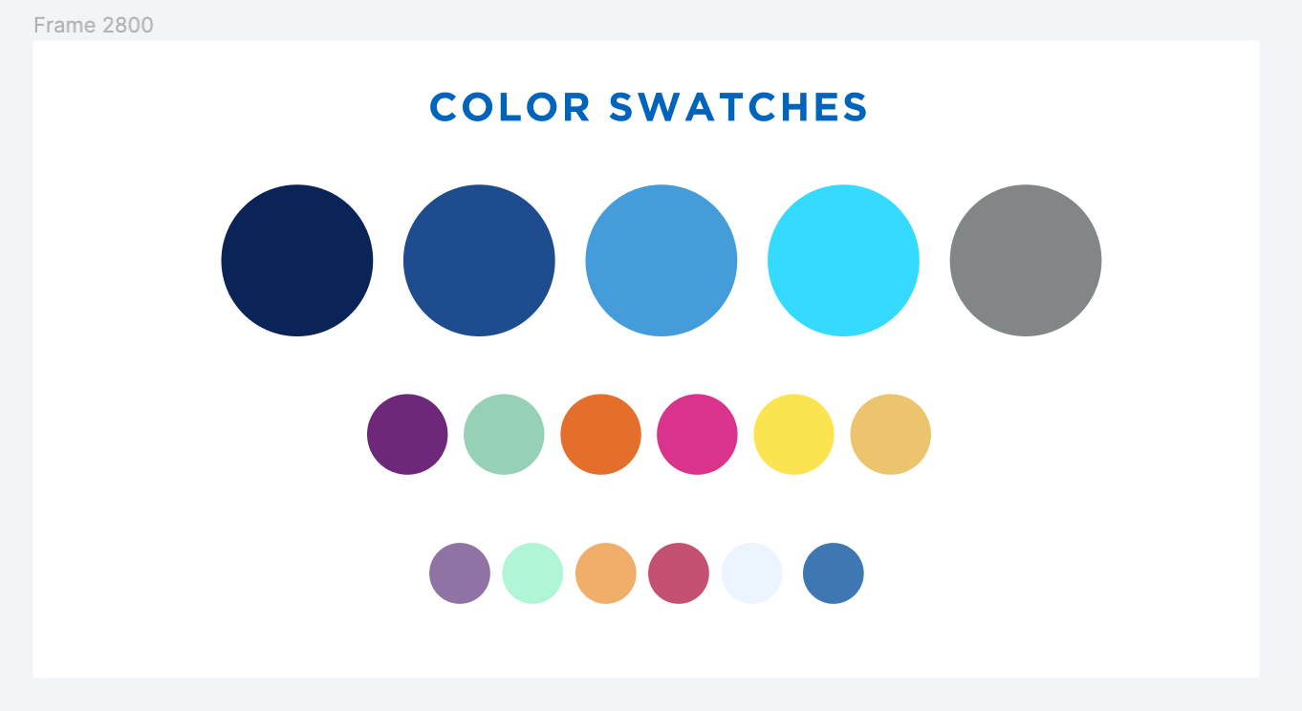
Alma Analytics: Sharing Reports
Justin Dise, University at Buffalo
Michelle Eichelberger, SUNY OLIS
October 24, 2024

Slide 2
Overview
Creating Objects
Pinning Objects
Widgets
Scheduling Reports
Embedding in Webpages
Agenda
Notes:
Michelle

Slide 3
Overview
Alma Analytics is powerful, but it can be a challenge to easily share data with stakeholders.
Analytics can be shared and displayed in five types of Analytics Objects in Alma:
Widgets - boxes on the Alma home page
Reports - individual reports that can be run as needed, accessed from the Analytics menu
Dashboards - dashboards of reports that are accessed from the Analytics menu
Scheduled Reports - individual reports that run on a schedule, results are emailed to subscribers (both Alma users and non-users)
Scheduled Dashboards - dashboards that run on a schedule and are sent to subscribers (both Alma users and non-users)

Slide 4
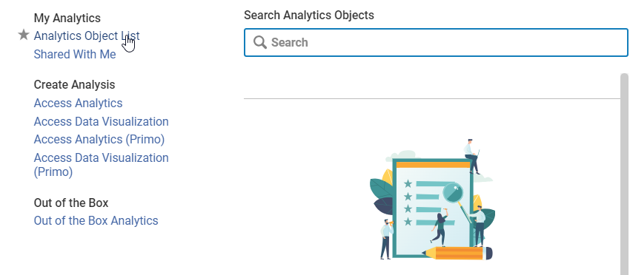
Analytics Objects
Note: Analytics reports/dashboards that are meant to be shared must be placed/copied to the Campus/Institution Shared Folder or subfolders in Analytics before creating the Analytics Objects in Alma.
In the Alma left menu bar, go to Analytics > My Analytics > Analytics Objects List

Slide 5
Analytics Objects, cont.
Under Actions, choose: Add New Alma Analytics Object:
Add General Information: Analytic Folder, Report Name, Display Name and Click Save

Slide 6
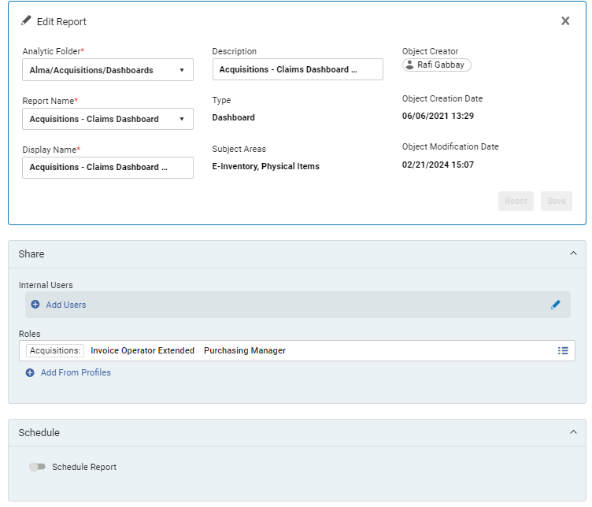
Analytics Objects, cont.
The Object Page appears, where you can edit the analytics object

Slide 7
Pinning Objects
Go to Analytics > My Analytics > Analytics Objects List
Click on the three dots next to the report that you want to pin and choose Pin to Analytics Menu:
Once you pin it, you'll see the indication "Pinned to Menu" in the object entry:

Slide 8
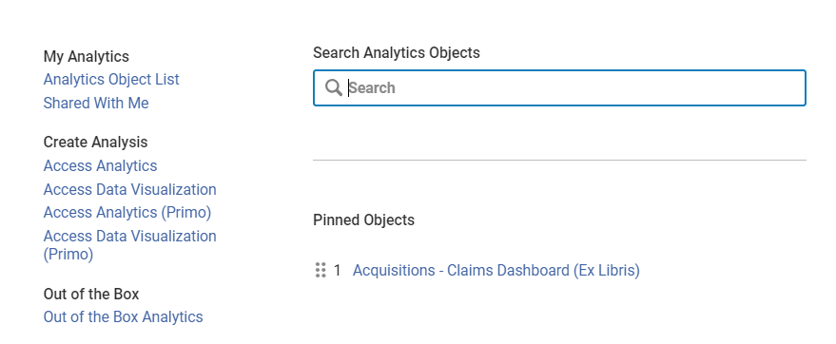
Pinning Objects, cont.
The object will now show on the bottom right side of your Analytics Menu:

Slide 9
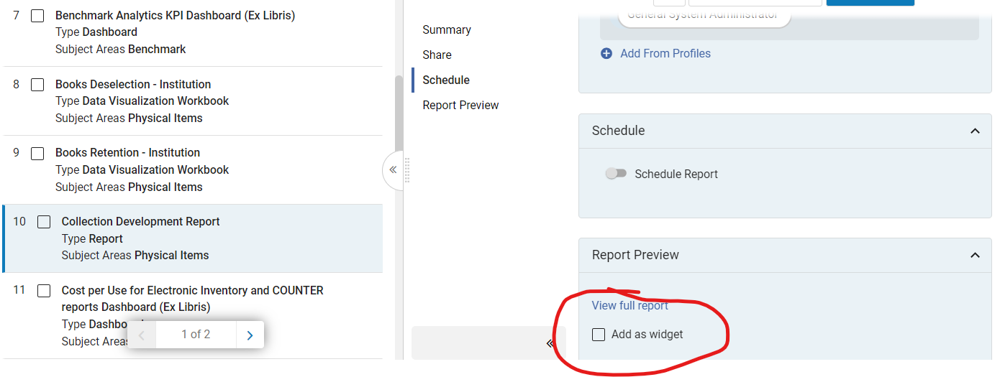
Widgets
Choose "Add as a widget" in the Report Preview section:

Slide 10
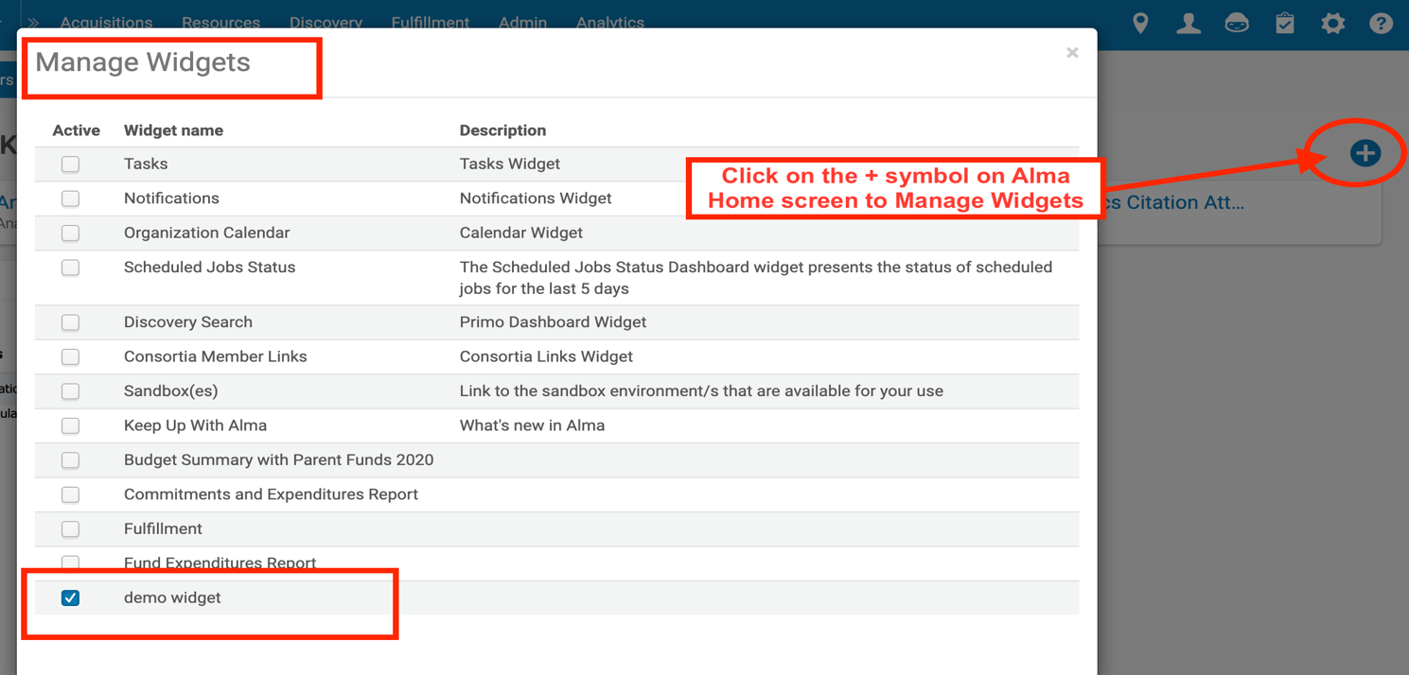
Widgets, cont.
Once the widget has been created, you'll see an indication in the Object list:
Go back to Alma Home screen, click on the + symbol to manage widgets, click to select the widget created. You do have to share the report with a role/person before add widget will work.

Slide 11
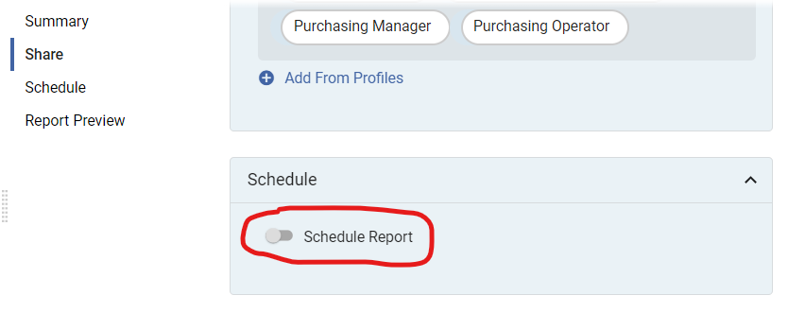
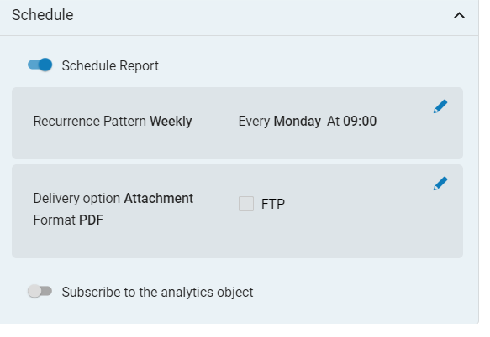
Schedule Report
In the side panel, click on Schedule Report:
Choose your schedule and decide if you'd like to subscribe to the analytics object:

Slide 12
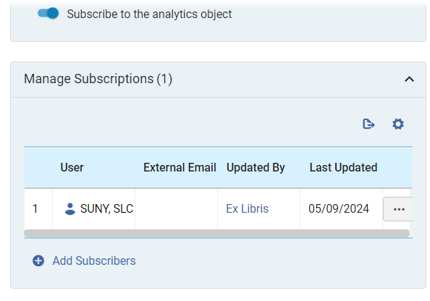
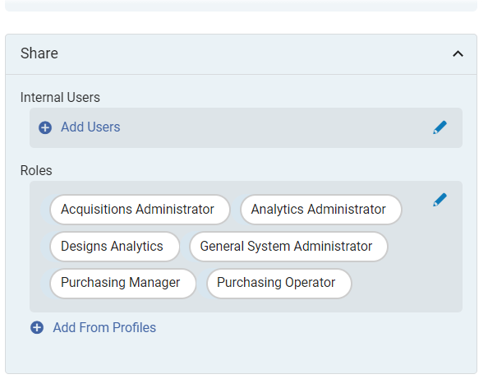
Subscribe to Report
If you choose to subscribe to the object, add subscribers in the Manage Subscriptions area:
You may also share the object with users who have the roles that you assign in the Share area:

Slide 13
Embedding Reports in Web Pages
Overview
Analytics API
Shared Reports
DataTables Code
Notes:
Michelle

Slide 14
Overview
Create your report in Analytics and save it to a shared folder – preferably your institution shared folder
Copy the path of the report, which you can find after path= in the URL for the report
Create an Analytics API key in the Developer Network (Make sure your account is affiliated with your campus – reach out to SLS if you need help)
Test the call: https://api-na.hosted.exlibrisgroup.com/almaws/v1/analytics/reports?apikey=<YOUR_KEY>&path=<PATH_PARAMETER>
Update the code parameters and paste into webpage/libguide
Documentation from Developer’s Network: Embedding Alma Analytics Reports in Web Pages
Notes:
Michelle

Slide 15
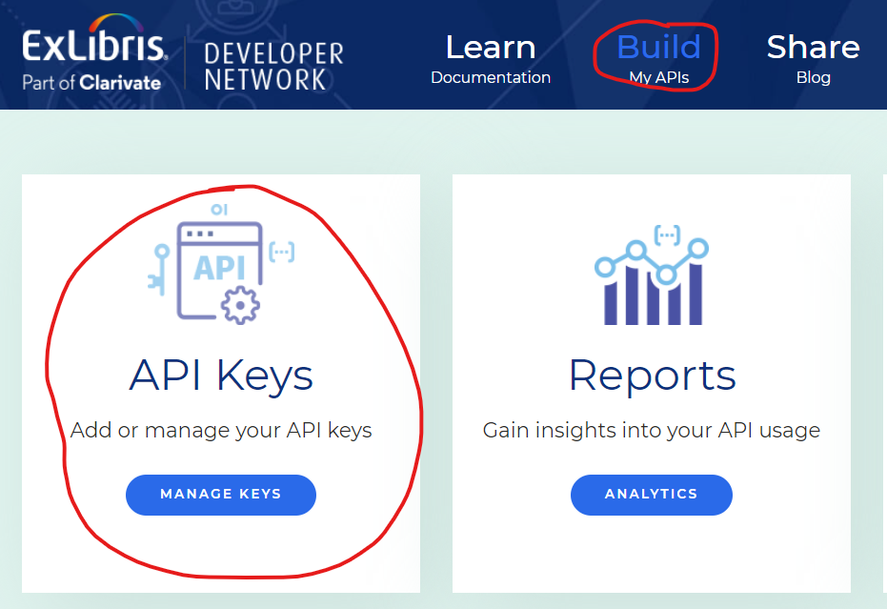
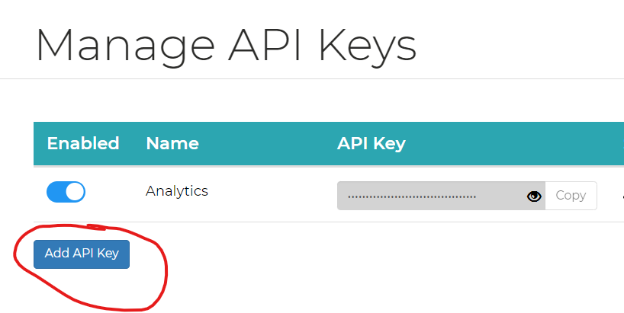
API Setup
Notes:
Michelle

Slide 16
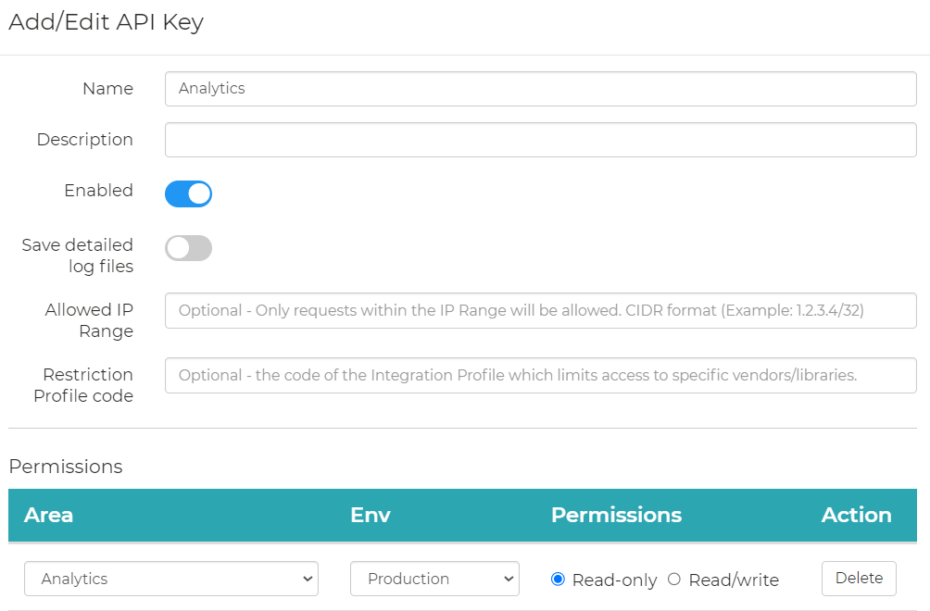
API Setup, Continued
Notes:
Michelle

Slide 17
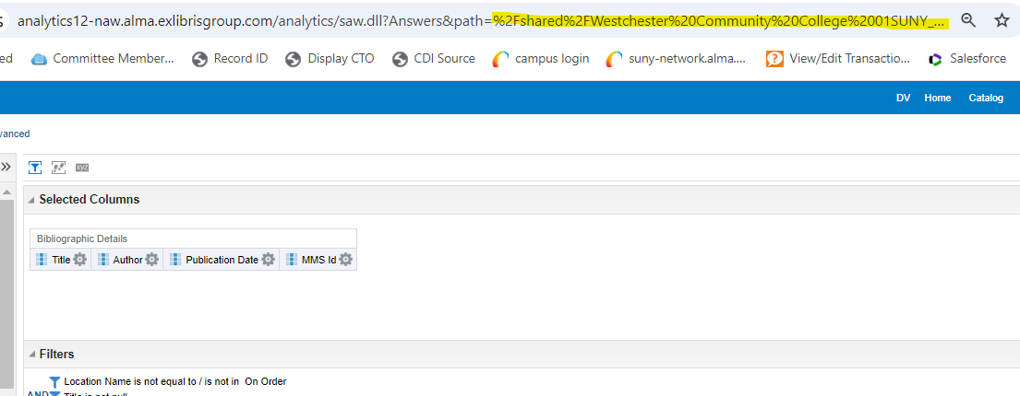
Shared Reports
Make sure to save your report under Shared Folders, your campus location
To find the path to the report, edit the report and copy everything after path= in the URL:
Notes:
Michelle

Slide 18
Embedding Analytics Reports in Webpages
The Challenge: How to take the XML output from the Alma Analytics API and create a usable HTML table out of it?
The Solution: “Simple” client-side (browser) code that can be copied and pasted into a webpage or LibGuide.
Notes:
Michelle

Slide 19
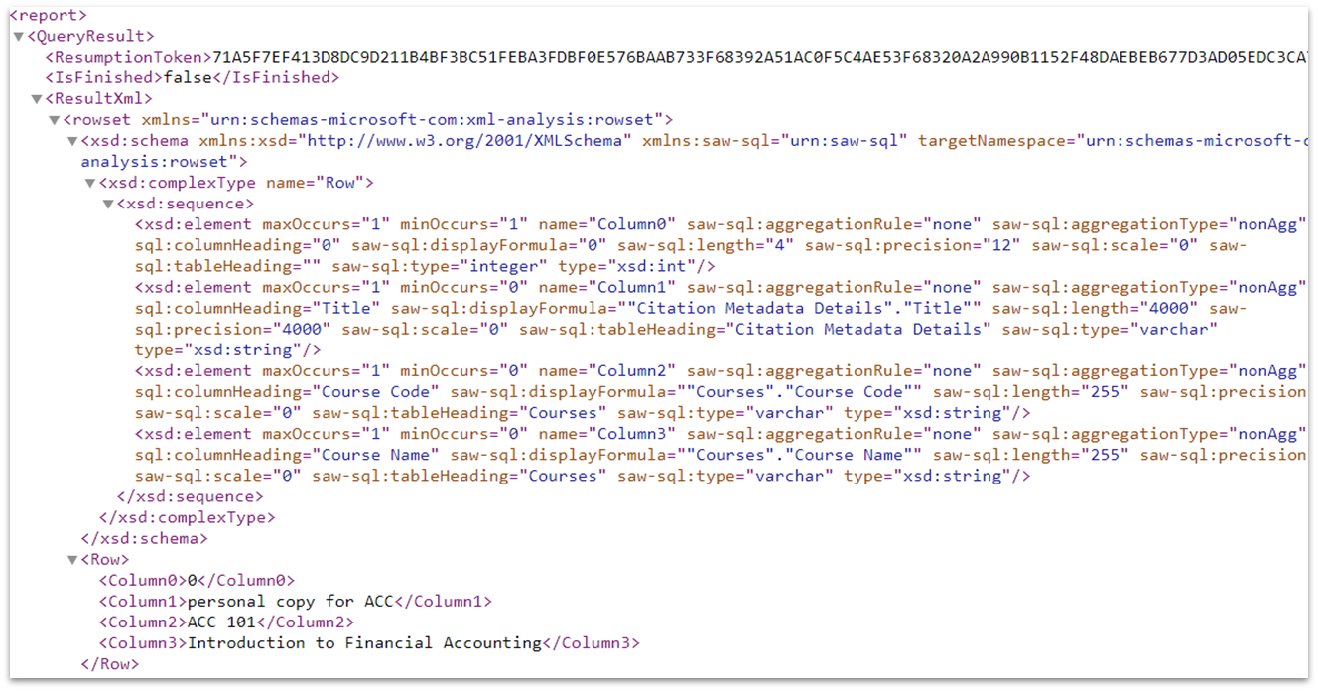
Looking at the XML Data
Notes:
Michelle

Slide 20
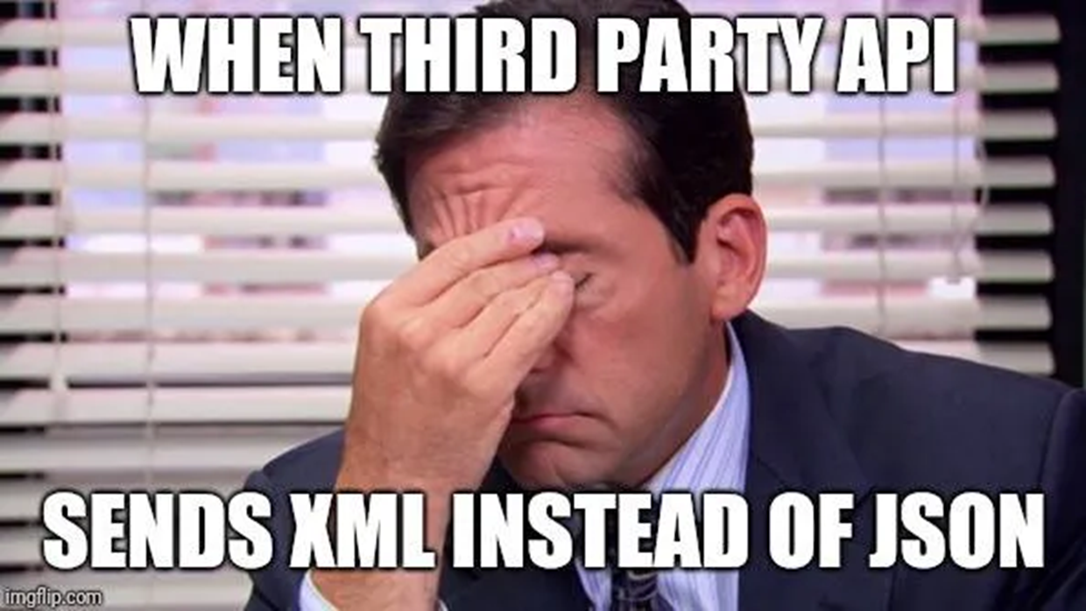
Notes:
Michelle

Slide 21
Code Overview
Use JavaScript to fetch and parse the XML data
Build an HTML table using the data
Use DataTables to add functionality to the HTML table (pagination, sortable columns, search box)
Notes:
Michelle

Slide 22
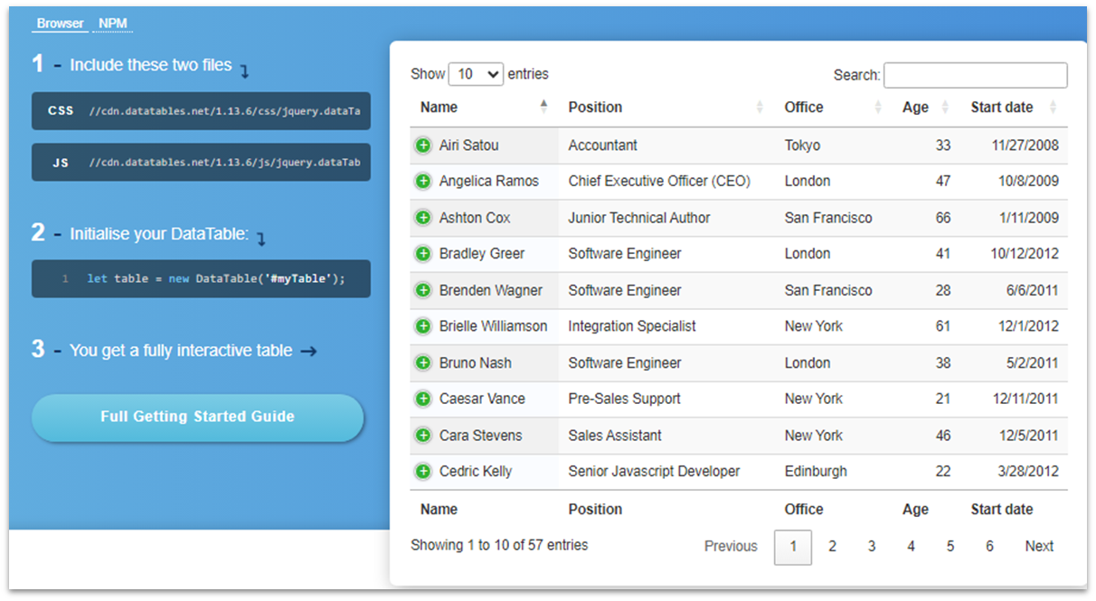
DataTables
An open source tool using the jQuery Javascript library
https://datatables.net/
Supports many data sources
HTML table
Javascript arrays/objects
JSON
Server-side processing
Notes:
Michelle

Slide 23
Using the Code
Code and instructions available on GitHub:
https://github.com/jrdise/alma-analytics-datatables
Notes:
Michelle

