Slide 1
Acquisitions Analytics Part II
June 30, 2021
Michelle Eichelberger
& SLS Staff
www.suny.edu

Slide 2
Plan for Today
Review Analytics Training Guides for ACQ
Discuss Out of the Box reports
Using Reports for data clean-up – Best Practices for ACQ
Live Demo
Questions
www.suny.edu

Slide 3
Training Guides
General Analytics (SUNY): https://slcny.libguides.com/training-analytics - Provides overview of how to create reports, tips & tricks, etc.
General Analytics Training (Ex Libris): https://knowledge.exlibrisgroup.com/Alma/Training/Analytics - good overview of analytics, videos as well as documentation
Alma: Analytics LibGuide (Ex Libris): https://exlibris.libguides.com/alma/analytics
Out of the Box Reports, Modify Canned Report: Acquisitions
www.suny.edu

Slide 4
Analytics Subject Areas
Subject areas relevant to Acquisitions:
Cost Usage
E-Inventory
Funds Expenditure
Licenses
Physical Items
Titles
www.suny.edu

Slide 5
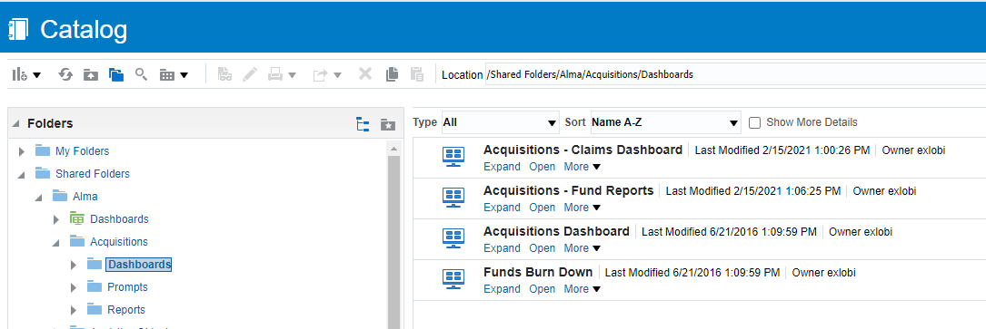
Out of the Box Reports
Analytics->Design Analytics->Catalog->Shared Folders->Alma->Acquisitions
www.suny.edu

Slide 6
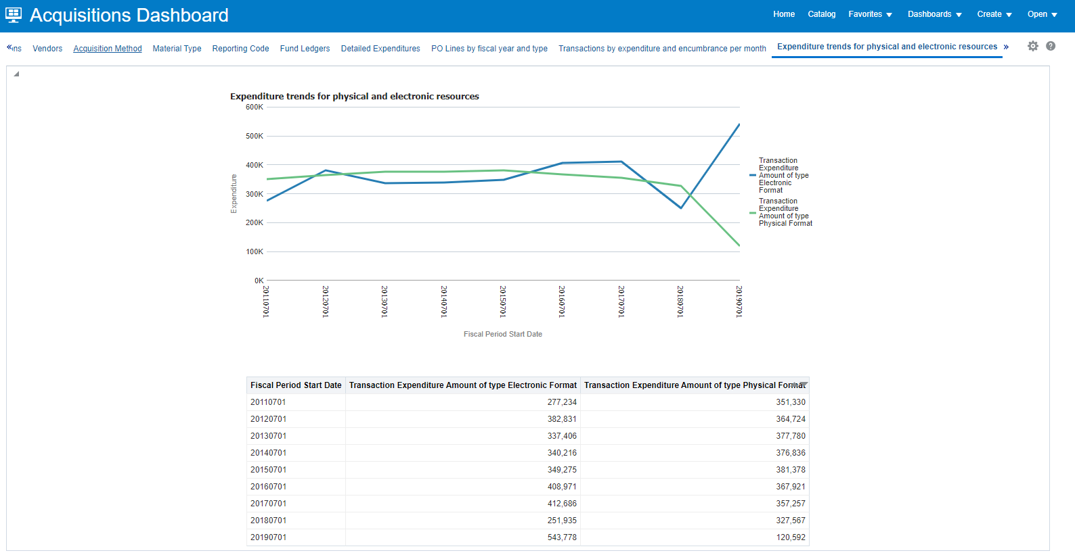
Out of the Box Reports
Benefit of many Alma users: reports that you’d like may already exist
Dashboards will populate with your own data
Can copy reports to your own environment to modify
Please don’t copy dashboard itself
www.suny.edu

Slide 7
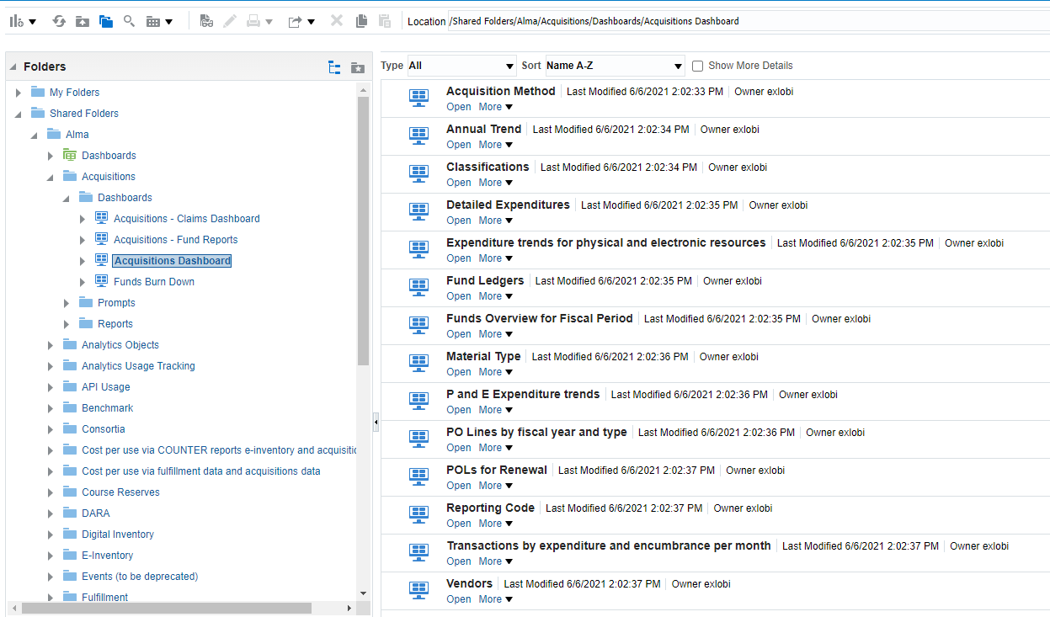
Out of the Box Reports
www.suny.edu

Slide 8
Using Reports for Data Clean-up/ACQ Best Practices
Running the reports can show you entries that may have been misidentified, e.g. electronic content noted as print, subscription content identified as one-time, etc.
In testing IPEDS and LARS in campuses, SLS staff found several areas where updating campus practices would make reports work more smoothly:
Adding list price for Technical Acquisitions
Following MSP-50 Guidelines for Deletions/Withdrawals by using wdn in Statistics note 1 for withdrawals
Managing gifts by using Gift Acquisitions Method and/or Gift vendor
Reporting codes can also be used alone or in conjunction with Gift Acquisitions Method and Gift vendor
Move towards full acquisitions by adding incremental acquisitions workflows
www.suny.edu

Slide 9
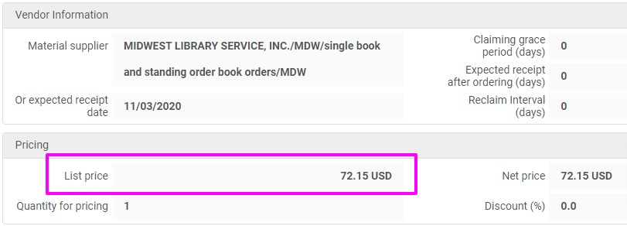
ACQ Best Practices: Technical Acquisitions
Add list price: Best practice is to input the amount paid on the invoice and not the order price for the most accurate reporting
Next steps in moving towards full acquisitions is to decide if creating invoices in Alma is right for your institution
www.suny.edu

Slide 10
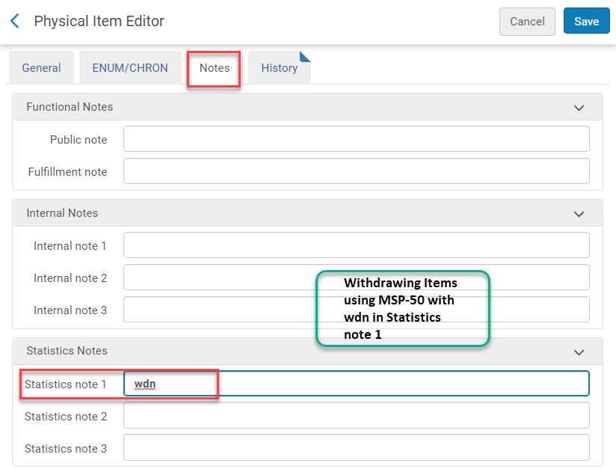
ACQ Best Practices: Deletions and Withdrawals
Follow MSP-50 Guidelines for Deletions or Withdrawals:
wdn is added to Statistics note 1 in the item record prior to withdrawing the item in Alma
Individually added
Added to a set via a job
wdn clearly identifies items being weeded from the library collection
Analytics reports can easily access wdn in Statistics note 1 after the item is no longer in Alma. Total number of withdrawn items is often required in annual reports
Libguide: https://slcny.libguides.com/c.php?g=986218&p=7266252
www.suny.edu

Slide 11
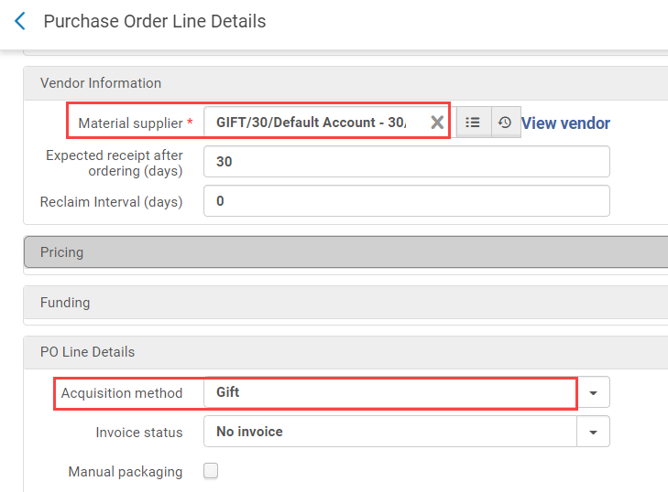
ACQ Best Practices: Gifts
Managing gifts: use gift Acquisition Method and/or Gift Vendor – Reporting codes are an alternative
Gift Acquisitions Method:
Use in conjunction with Gift vendor
Does not require funds or a list price
Allows analytics and repository searches to easily identify items added to Alma as Gifts
Can continue to add gift notes in MARC records
Gift Vendor:
Can be used with Gift or Technical Acquisitions Method
Allows Analytics and repository searches to easily identify items added by the Gift vendor
Can continue to add gift notes in MARC records
Reporting Codes:
Can be used in lieu of or in conjunction with Gift Acquisitions Method and/or Gift vendor
Allows Analytics and repository searches to easily identify items added by Gift vendor
www.suny.edu

Slide 12
ACQ Best Practices: Amp up your ACQ
Incrementally amp up your acquisitions:
Add vendors (helps with SUSHI/usage data too)
Add Ledgers and Funds
Could set up one general fund
Create POLs
Manually
Import Profiles
Implement New Order APIs
Create invoices
Manually
Implement EDI invoicing
The more data you put into Alma, the more you can get out via Analytics
www.suny.edu

Slide 13
Live Demo
www.suny.edu

Slide 14
Questions?
www.suny.edu

