Slide 1
Shared Library Services Platform Project Update
July 12, 2019
Shannon Pritting, Tim Jackson, Maggie McGee
SUNY Shared Library Services

Slide 2
Review of Cutover and Go-Live
No major unanticipated delays in go-live for campuses.
Some migration issues at specific campuses, but no widespread major issues beyond Primo indexing lags.
High match rate in NZ for everyone overall.
Some misunderstandings of when the environments/config. were copied (see Basecamp post).
Clean-up will be needed for e-resources for many.

Slide 3
Final Alma Health Checklist
This final Alma Health Checklist will be reviewed in much greater detail by ExLibris than others.
Will be used to determine readiness for moving to support.
Released today (7/12), and Due on 7/31.
Checking with ExLibris to see if any further forms are due.

Slide 4
Banner-Alma Integration Update
SUNY will support Alma integration when you have an XML file to test.
We’re happy to set up a meeting with you if desired; we’ve done this with several campuses.
Or, we can work with you via e-mail.
Please reach out to us before testing SIS synchronization in your live Alma environment.
Recommend testing with small file of test patrons if you haven’t completed SIS in your test load environment.
For every campus we’ve worked with thus far, we’ve found something that needs to be adjusted.
23 campuses have SIS integration working.

Slide 5
Network Zone Nightly OCLC Jobs
The "new" files from OCLC started being run manually in Alma on Sunday, July 7, 2019
Each file is being reviewed in MarcEdit prior to being imported into Alma
Reports are being reviewed in Alma after each job is run to see how many records have been imported, merged, and not imported
"New" files have been run through June 29, 2019
981 new bib records have been added to the NZ to date
916 merged bib records in the NZ
321 records not imported into Alma
"Updated" files from OCLC will start to be run manually in Alma once the "new" files are up-to-date and automatically uploaded into Alma via the ftp

Slide 6
Network Zone Nightly OCLC Jobs
Excel files are being created for each campus that has "new" holdings in OCLC. These "new" holdings in OCLC triggered the "new" bib record to be exported into Alma
Campuses "new" holdings are not linked to the NZ
Campuses should review the bib records to make sure that they have the holdings and if they want the bib records linked to the NZ
Campuses can use the Excel file to create an itemized set in Alma and run a job to link the bib records to the NZ

Slide 7
Publishing Profiles Next Steps
After the baseline has been run in Alma the publishing profile job will be set to incremental
Incremental only publishes updated bib records with a flag set to "Publish Bib"
Changed (updated), deleted, or new are the triggers that set the record to be published to OCLC
All bib records have been set to "Publish Bib" during the migration process
Brief bib records created in the MD Editor are automatically set to "Publish Bib"
After the first incremental file is sent to OCLC, the file will physically be reviewed by someone at OCLC
This process can take several weeks to be completed
Holdings in OCLC will not be updated during this period
Holdings will automatically be updated each time the job runs after the initial file has been reviewed and accepted

Slide 8
Publishing Profiles Next Steps
Publishing profiles require a few extra steps to ensure that each campus publishes the holdings they intend to publish to OCLC:
"Limit Added Records to WorldCat Staging = Yes” under "Bibliographic Record Information" in the datasync collection
Exclude online resources from the "Excluded Information" under "Bibliographic Record Information” in the datasync collection
Create a set for bib records that should not be published to OCLC and run a job to unflag these records from publishing

Slide 9
Publishing Profiles Next Steps
What does "Limit Added Records to WorldCat Staging = Yes” do?
It acts as a safety net to prevent bib records without an OCLC number (035) from publishing to OCLC
It places bib records without OCLC numbers into a staging area to be reviewed by the campus
Example, brief bibs in the IZ on NZ
The campus will then be responsible for reviewing the file and determining if these records should be published to OCLC or not
What will excluding online resources do?
It will prevent bib records with "online resources" in MARC field 300 from being published to OCLC

Slide 10
Publishing Profiles Next Steps
What does unflagging bib records from being published to OCLC do?
Unflagging a set of records will prevent these bib records from being published to OCLC when changes have been made to the bib record
Records can be unflagged in a set and a job can be run to perform this action
Most efficient way to handle unflagging a large group of records
Records can also be unflagged manually from the MD Editor

Slide 11
Publishing Profiles for Campuses SUNY Set-Up
SUNY will contact OCLC to make the following changes to the datasync collections:
Change "Limit Added Records to WorldCat Staging" from "No" to "Yes"
Add online resources to the "Excluded Information"
SUNY will create a set for electronic records and run a job to unflag these records
This will ensure these e-resources will not be published to OCLC
SUNY will run the baseline and then incremental will be set to run
SUNY will review the initial Worldshare files that are created to make sure records being published are as expected

Slide 12
Resource Sharing Update
16 libraries have gone live with lending, and an additional 7 libraries will go live next week
Remaining libraries are scheduled to go live between July 22 and August 5
Please be sure to respond to lending practice session questionnaires!
As of July 10, 50 resource sharing requests have been received by borrowing libraries, and another 46 requests were en route
Filled requests had an average turnaround time of 5.2 days
Fill rate is only 30%, but that should improve as more libraries start lending

Slide 13
Regional Rotas
Prior to this week, a single rota was being used for all of SUNY
We are now using three regional rotas based on ELD hub membership
East: Albany, Newburgh, and Syracuse hubs
West: Binghamton, Rochester, and Buffalo hubs
NYC: NYC hub
Trying to strike a balance between turnaround time and load levelling concerns
Will revisit if this isn't working well

Slide 14
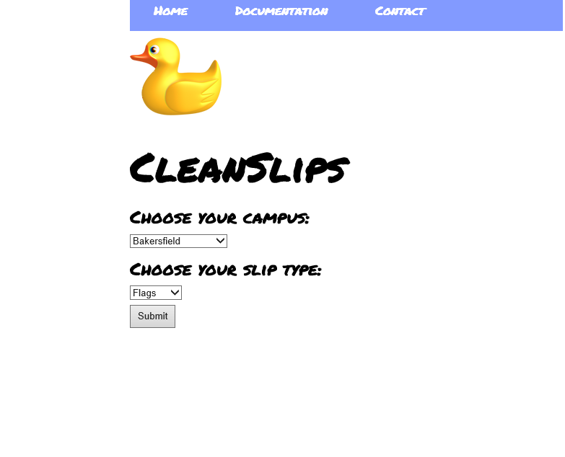
CleanSlips
Program developed by Cal State system to make printing RS lending requests easier
Users can upload Alma's Print Slip Report and then print either stickers or flags
Working with IDS Project to modify Cal State's code for use by the SUNY system
Hoping to roll this out later this summer
Cal State’s Site is at:
https://slips.calstate.edu/

Slide 15
Primo Speed and Responsiveness
SUNY is continuing to meet with ExLibris administration about this.
This remains a high priority for us to work with them.
Some improvements in speed seem to have come as result of going live.
ExLibris released a speed enhancement as we were going live, which has led to a decrease in response times.
If you are having Primo VE speed issues, please submit a salesforce case and email us the case # at slc_lsp@suny.edu
If your users have complained about speed, please note that in your case.
Please provide specifics (screencasts are great) of where/how Primo VE is slow.

Slide 16
Primo Indexing
ExLibris indicates publishing lag due to indexing jobs “catching up.”
Have begun jobs to reindex all of SUNY, which should complete over the weekend.
After Monday, July 15th, if you see any publishing lags, please begin submitting Salesforce cases, and email the case # to: slc_lsp@suny.edu so that we can track and escalate this issue.

Slide 17
Training and Documentation Consultant
SUNY has contracted for a consultant to work with us for 1 year to develop structured training materials and plans, and to review and enhance current documentation.
This consultant has led the training and documentation efforts for a major Alma/Primo transition from Aleph, so is familiar with how Alma works, as well as the challenges of our migration.
Primary work of consultant is not to lead training, but to assist with creation of content, materials, and structure.
Contract begins on August 15th

Slide 18
Preparation for Consultant
SUNY will be releasing a couple of short training surveys in the next month to provide us with some information to begin engaging with the consultant.
Surveys will be focusing on:
Areas where training material is needed most, and will have the most benefit across SUNY.
Desired structure and content for training program/materials and documentation.

Slide 19
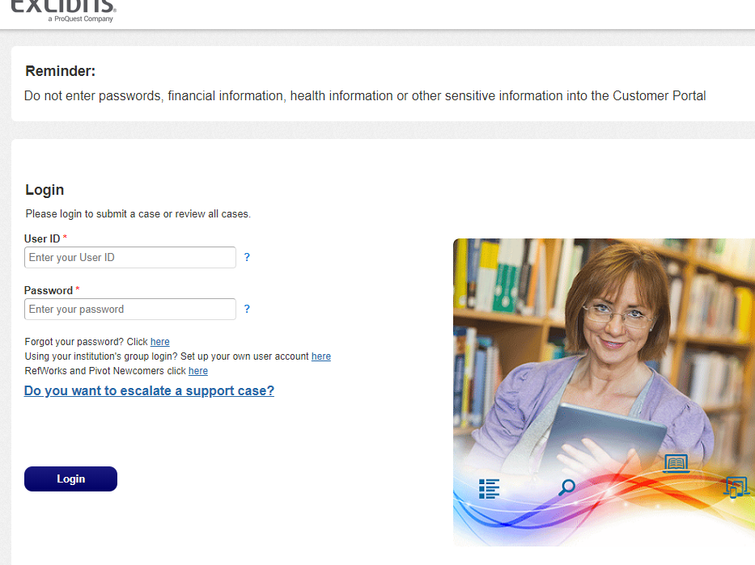
Transition to Support
ExLibris will be respond via Basecamp and will refer to Salesforce as needed.
Estimated switch to support is end of August.
SUNY will provide direct support and individual assistance until mid-August.
After mid-August, SUNY Library Shared Services (SLSS) Staff will focus will be on:
Supporting Network Zone and Shared Infrastructure
Will provide extended services to campuses who enter into support agreement with us.
Campuses agreeing to extended services will go to SLSS for tier 1 support and assistance, and SLSS will
Direct support for campuses not working with SLSS on extended support will go ExLibris support via Salesforce for tier 1 and tier 2 support.
Campuses without Extended Support will manage their interactions with ExLibris themselves without direct assistance from SLSS.
SLSS staff will monitor and review cases related to NZ issues or maintenance, but will not be involved with individual cases, except for extended support campuses.
SLSS will review support trends with ExLibris management.

Slide 20
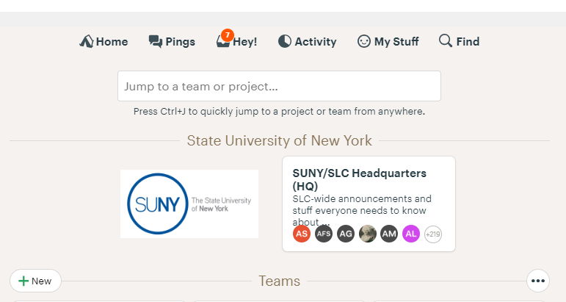
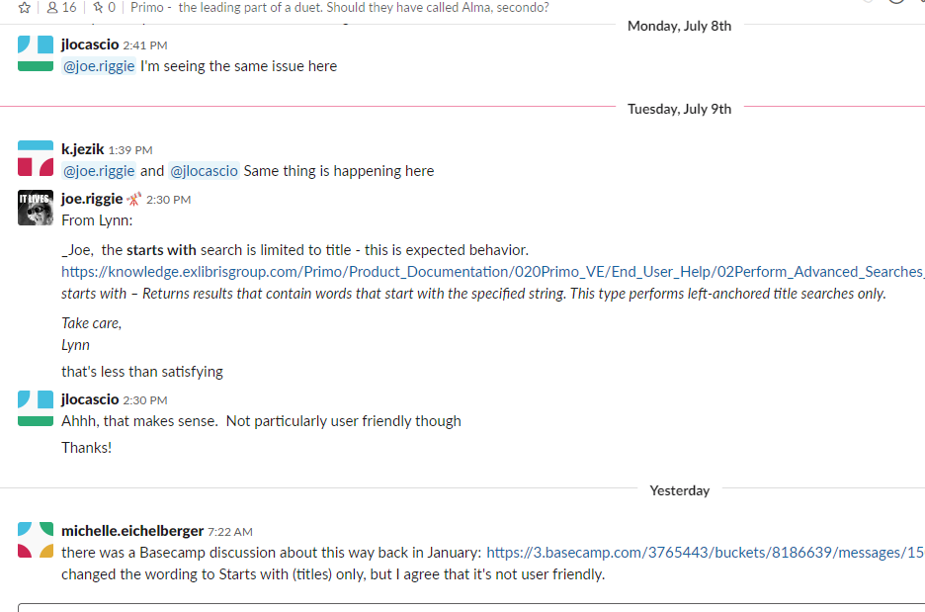
Will there be channels for peer to peer assistance?
No specific platform/channel has been designated as a space for peer to peer assistance.
SLC will drive the decision on what platform/channel is used and will need to administer.
The SUNY basecamp will be available, but unclear whether this will be the space for peer to peer sharing/assistance going forward.
SUNY will not provide direct assistance via Basecamp or other platform/channels after end of August.
Primo/Alma Slack Channels have also been created by SUNYLA.
https://sunyla-tdg.slack.com/

Slide 21
What Extended Services Are Available and When?
SLSS is prepared to offer Extended Services now, and charges can go through campus recharge.
Extended Services:
Analytics Services
Resource Sharing Management
Training, Metadata, and Workflow Services
Physical Cataloging Services
Comprehensive Management of Library Services Platform
Comprehensive Management of Library Technology and Workflows
Service Level Agreements, and Participating Institution Agreement going through final approval at SUNY System.
SLSS is ready to begin working with campuses to get agreements going with campuses for extended services now. Campuses working with us to get agreements in place will be supported moving forward while we finalize agreements.
For details, costs, and to sign up, please email Shannon (shannon.pritting@suny.edu)

Slide 22
Who Will be Providing Extended Support?
Three Staff funded via surplus from Alma/Primo contract dedicated to system wide initiatives and supporting the shared environment.
Additional staff hired to support new extended services. Two staff with Alma/Primo experience beginning in fall to provide support to initial campuses.
More staff will be hired as campuses agree to contracts with SUNY Library Shared Services.

Slide 23
I’m a campus who does not have an extended service agreement with SLSS, where do I go for help after August?
Campuses without a service agreement with SUNY should go directly to ExLibris via Salesforce case. Questions should not go directly to SUNY staff or to the SUNY libanswers or future ticketing system.
If campus is unhappy with answer from ExL support, they should escalate the issue through Salesforce.
SUNY will monitor support performance and cases on a macro level, and will not get directly involved in specific cases unless it involves Network Zone or shared infrastructure issues.
Only Network Zone related issues should go to SUNY libanswers.

Slide 24
Questions?

