Slide 1

Shared LSP Project Update
September 27th, 2019
www.suny.edu

Slide 2
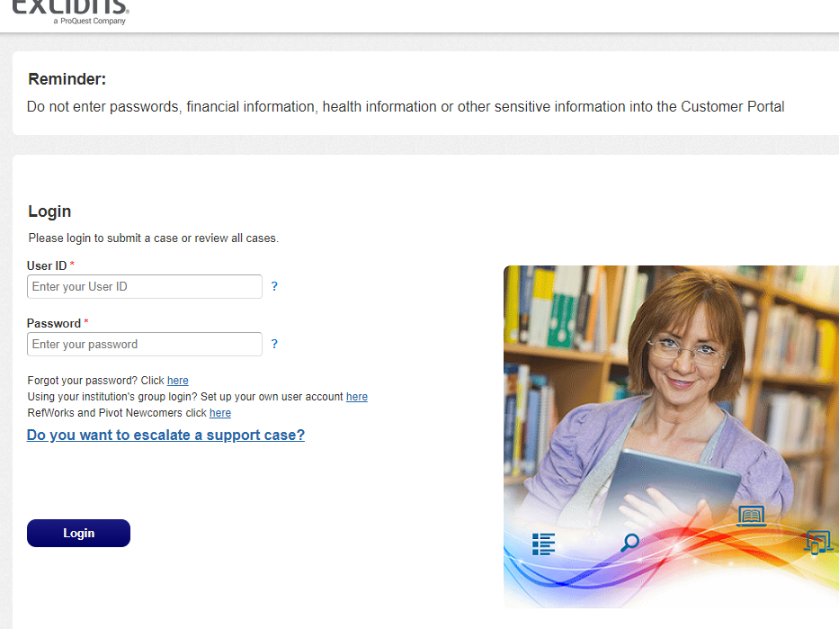
We’re In Support!
Ex Libris support is now the primary contact for campuses.
SUNY will be reviewing Salesforce (SF) cases as a group (but not necessarily looking at every single case).
Check out the Switch to Support Meeting for more information on ExL processes:
  https://public.3.basecamp.com/p/W1znT4MUjiMVxzmQgeiqzG8K
www.suny.edu

Slide 3

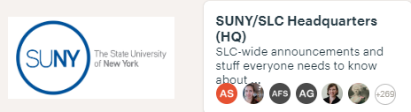

How do I get Support and Information?
Submit a Salesforce case to Ex Libris Support
Direct Support
Post a question for your peers to review
Training, Documentation, and Ongoing Learning Opportunities
SSLS staff will provide training sessions and create documentation based on review of SF cases and Basecamp.
www.suny.edu

Slide 4
Recommendation to Publish Salesforce Cases
LSP Advisory Board recommends changing account settings to publish your cases.
Benefits are that others who have SF Ex Libris accounts can see and is easier to find similar cases.
SSLS FAQ: Should I turn on publishing for Salesforce cases, and if so, how do I do that?
www.suny.edu

Slide 5
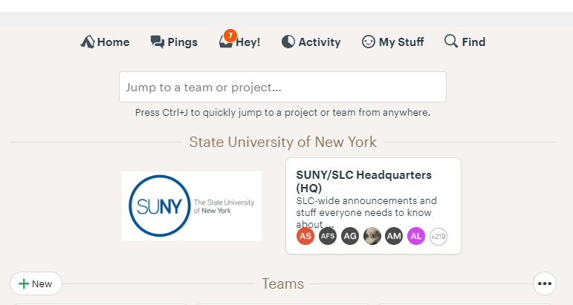
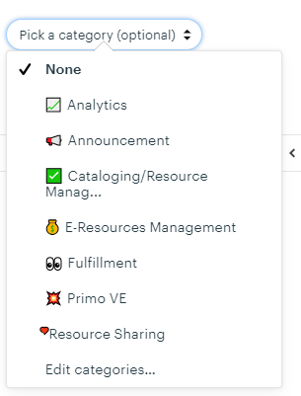
Peer to Peer Platform
SUNY/SLC HQ will be used as Peer to Peer Platform until a longer-term decision is made about what platform would work best.
If you’re not already there, please add yourself:
  https://3.basecamp.com/3649838/join/3oUqZrsjbeqZ
Categories have been added for functional areas.
SUNY Staff won’t be engaging as with the ExL basecamp.
  Unless it’s NZ config. related.
www.suny.edu

Slide 6
The Future of Institutional Leads
Although we’re done with implementation, we’ll continue with institutional leads and the communication channels associated with this concept.
SSLS will be reaching out soon to ensure that your listed institutional lead is still accurate:
  https://slcny.libguides.com/overview/institutional_leads
We expect that the amount of information/activities will be less, but it is crucial that we have someone who can act as a primary point of contact for the LSP at your institution.
www.suny.edu

Slide 7
Shared LSP Baseline Services
Require no extended financial commitment.
Covered under Alma/Primo costs plus SUNY Provost subsidy for 2 years.
Vendor relationship management
Support and maintenance for shared infrastructure like NZ, Resource Sharing, etc.
Communication and information about upcoming changes in LSP.
Updates, webinars, and regular training offerings.
Development of FAQs, training materials, best practice documents.
Engagement with Working Groups and Task Forces.
www.suny.edu

Slide 8
SUNY Library Shared Services Extended Support
Contact us at LibAnswers (info@slcny.libanswers.com) if you are interested in extended support.
Will send Service Level Agreement, Options, and Participating Institution Agreement.
Number of Campuses Currently Participating/In Negotiations:
  6 campuses in Training, Metadata, and Workflow Consulting Agreements.
  1 campus entering into Physical Cataloging agreement
  3 campuses entering into Managed Alma/Primo VE agreements
  2 campuses considering agreements to have SSLS manage Resource Sharing
www.suny.edu

Slide 9
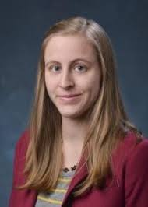
New SUNY Shared Library Services Staff
Esta Tovstiadi joined the SUNY Shared Library Services staff in early September.
She’s currently helping libraries with Primo, E-Resources, and other things Alma.
Want to know who’s on the team?
https://slcny.libguides.com/overview
www.suny.edu

Slide 10
Upcoming New Additions to SUNY Shared Library Services Staff
Two more staff joining SUNY Shared Library Services Staff to help with Extended Support.
  Half-Time Release Time Staff beginning very soon.
  Full-Time Dedicated SSLSS Staff under contract to begin in ~two months.
Both are in SUNY and have been active in the implementation, so will be able to begin contributing quickly.
www.suny.edu

Slide 11
Relationship Management: Primo VE
9/18 Primo VE Meeting with Ex Libris
Regular meetings established to push to improve Primo VE speed and accuracy
Ex Libris delivered first month of search performance metrics.
Performance is improving.
Reviewing day to day and more granular performance to get to 2.2 sec for 50% of searches and 4.5 sec for 95% of searches.
Reviewed indexing issues discovered: agreed to escalate any newfound problems.
Open URL performance metrics coming soon.
www.suny.edu

Slide 12
Vendor Relationship Management
Worked with Ex Libris staff to escalate ongoing problems identified by SSLS and campus staff:
Resolved automatic walk-in user creation when viewing other campus records in Primo
  Engaged with campuses or fixed cleanup of user records.
Escalated cases related to deleting large collections of eBooks in Alma, missing database services in Primo, z39.50 searching, etc.
Continued to lobby for better communication about possible fixes for outstanding issues like disappearing facets
www.suny.edu

Slide 13

Resource Sharing Update
Timothy Jackson
www.suny.edu

Slide 14

Resource Sharing Update – Request Volumes
Borrowing Request Volume by Month:
  July: 1,398
  August: 3,369
  September (to date): 3,658
Active Request Volume by Rota:
Rota | Borrowing Volume | Lending Volume
East | 700 | 1,155
West | 1,987 | 1,439
NYC | 95 | 188
www.suny.edu

Slide 15
Resource Sharing Update – Turnaround Times
Average Turnaround time for August & September : 4.4 days
Average Turnaround Time by Rotas:
Will continue to monitor turnaround times
Send East requests to NYC before West? Merge East and West rotas for upstate institutions?
 | East | West | NYC | Overall
East | 4.6 | 5.1 | 4.8 | 4.8
West | 4.2 | 4.0 | 5.3 | 4.1
NYC | 6.9 | 9.2 | 4.1 | 4.4
www.suny.edu

Slide 16
Resource Sharing Update – Fill Rates
Fill Rates by Month:
  July: 38%
  August: 50%
  September 53%
Reviewing unfilled requests to determine why fill rate is low
  Most unfilled requests genuinely cannot be filled within SUNY
    Requests coming from WorldCat records with no SUNY holdings, requests for items with very few holdings in SUNY, textbook requests
  Submitting cases to Ex Libris about unfilled requests I cannot explain
  Already found one issue:
    extraneous info tacked on to author when submitting request from Primo
    Temporary fix already in place, permanent fix available in December release
www.suny.edu

Slide 17
Resource Sharing Update – Misc.
Working with Ex Libris and Atlas Systems on testing a new method of exporting unfilled RS reqeusts from Alma to ILLiad
  New method uses APIs instead of email, so hopefully no more =09 issues
  Thanks to Albany, Buffalo, and Upstate Medical for their help
Training sessions on configuring RS lending deflections
  Small groups, hands on
  5 sessions between October 3 & 9
  Sign-up information available very soon
www.suny.edu

Slide 18
LSP Change Management
September Release:
New printing functionality:
  Tested in sandbox
  Created FAQs: How does the new Quick Print function work? and How do I configure the new Printout Queue function, and how does it work?
  Alma Print Queue and Quick Printing Webinar
New SAML on-the-fly user creation: testing with Empire
New Discovery boosting functionality: updated FAQ, posted in Basecamp
www.suny.edu

Slide 19
Webinars and Presentations
Receiving Serials in Alma Maggie Magee. (2019/09/03)
Alma/Primo Link Resolver Michelle Eichelberger. (2019/09/12)
Resource Sharing Q&A Tim Jackson (2019/08/22)
Relinking Bib Records Maggie McGee (2019/07/30)
Post-Go-Live E-Resource To-Dos Michelle Eichelberger (2019/07/23)
Publishing Profiles: Creating Sets and Unflagging Bib Records Maggie McGee (2019/07/19)
Publishing Profiles: Next Steps Maggie McGee (2019/07/16)
Deleting IZ Records and Unlinking Bib Records from the NZ Maggie McGee (2019/07/03)
www.suny.edu

Slide 20

FAQs, Training Materials & Documentation
Starting Thursday, October 3rd, the former weekly Ex Libris Q&A meeting will become Café Alma Open Mic Thursdays!
Are you looking to sharpen your skills in Alma and Primo?
Are you hyped-up on lattes and need an outlet to share your love for Ex Libris?
Do you just want a place to lurk and learn once a week?
Whatever the reason, you belong at Café Alma!
Café Alma is a collaborative, peer-driven learning opportunity for SUNY Alma and Primo users. The Café is open (via Zoom) nearly every Thursday from noon until 1 pm EST. The hour will be divided into two activities: Open Mic and Q&A.
Visit Café Alma online for sign up info, session links, presenter and host guidelines, and other details.
www.suny.edu

Slide 21
FAQs, Training Materials & Documentation
New FAQs (09/2019):
How long should things like activating e-collections, making changes to the Primo VE interface, indexing, etc. take to fully show up in the system so we can know when to test? Michelle Eichelberger
Can I modify the citation function in Primo VE? Michelle Eichelberger
How does the email function work in Primo VE and what do I do if it isn't working? Michelle Eichelberger
How do I renew an item? Jennifer Koerber
Can local MARC fields be searched in an Alma repository search? Margaret McGee
How do I delete a bib record that has no inventory and is no longer held by my institution in the NZ, but shows the bib record is still linked to the NZ? Margaret McGee
Where can advanced analytics training and information be found? Wendi Ackerman
Why didn't the brief bib record get updated after I added the OCLC#, saved the record, and exported the record from OCLC to the NZ? Margaret McGee
How to display the total number of rows in an analytics report Wendi Ackerman
Can the session time-out be increased for fulfillment/Circulation functions? Margaret McGee
Should I turn on publishing for Salesforce cases, and if so, how do I do that? Michelle Eichelberger
How do I suppress item records for serials that are generated from prediction patterns that have not been received? Margaret McGee
www.suny.edu

Slide 22
FAQs, Training Materials & Documentation
New FAQs (09/2019) cont.:
Is there a job to restore item records that were deleted in Alma? Margaret McGee
I "Deleted" a PO Line during creation and the bib record is now linked to the NZ. How do I remove the record from the IZ and unlink it from the NZ? Margaret McGee
How to I create an NZ brief bib record for Ordering purposes? Margaret McGee
How can I delete a POL template? Margaret McGee
How do I change the default location for new POLs? Margaret McGee
Is there a way to print the results from browse shelf list in the Alma MD Editor? Margaret McGee
Do you need to activate the corresponding PCI collection for your Alma collection in order to get article level indexing to work? Michelle Eichelberger
How does the new Quick Print function work? Tim Jackson
How can you change a technical-migration process type to missing? Margaret McGee
How do I remove the missing item status? Margaret McGee
How do I change/mark an item record as missing? Margaret McGee
What's the best way to print a list of results from Primo VE? Michelle Eichelberger
www.suny.edu

Slide 23
Training Update
Jennifer Koerber
www.suny.edu

Slide 24
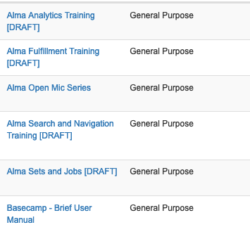
Training Materials in LibGuides
Training LibGuide for each functional area contains:
  Static text to introduce the topic
  Lists of FAQs to explain step-by-step processes
  Links to Ex Libris documentation
  Links to training videos stored in Basecamp
  Links to local campus training materials stored in Basecamp
www.suny.edu

Slide 25
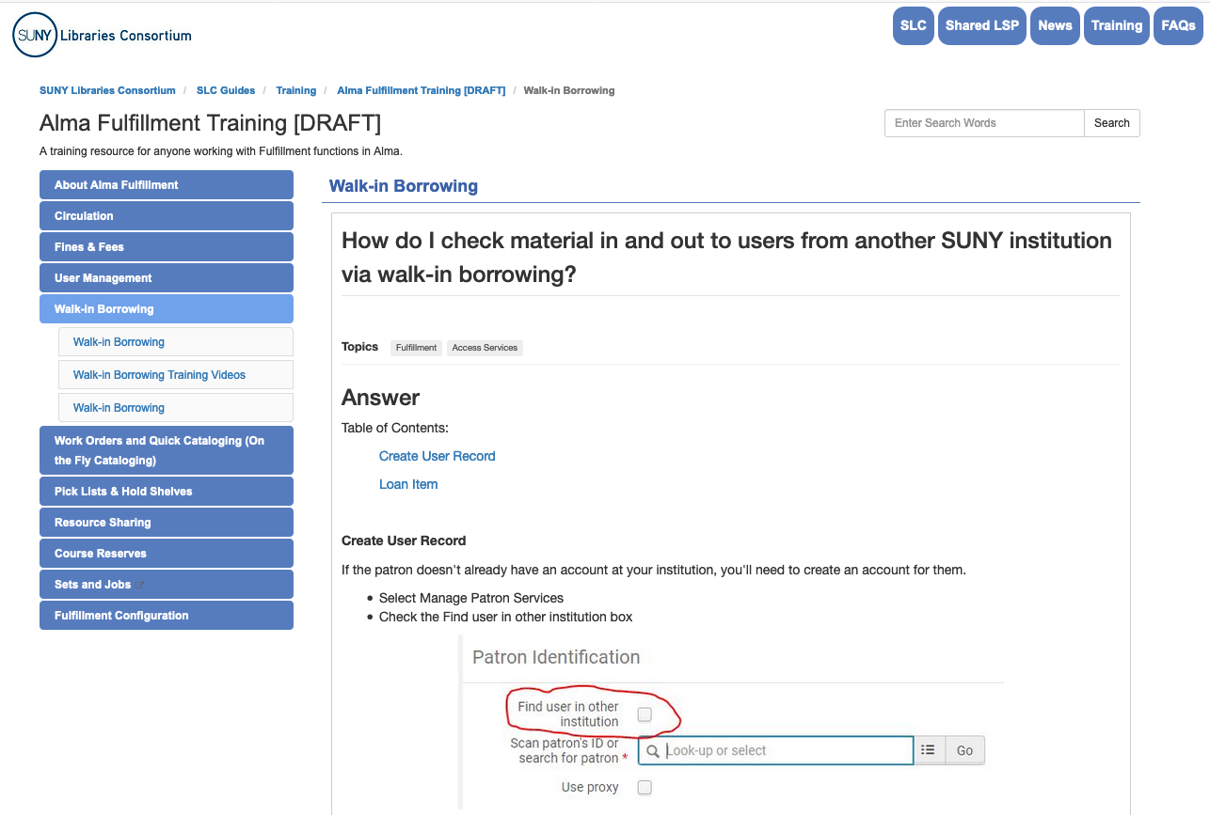
Fulfillment Training Guide - Final Draft
https://slcny.libguides.com/training-fulfillment
www.suny.edu
Notes:
Not findable via search or the guide list yet – just via that URL.

Slide 26
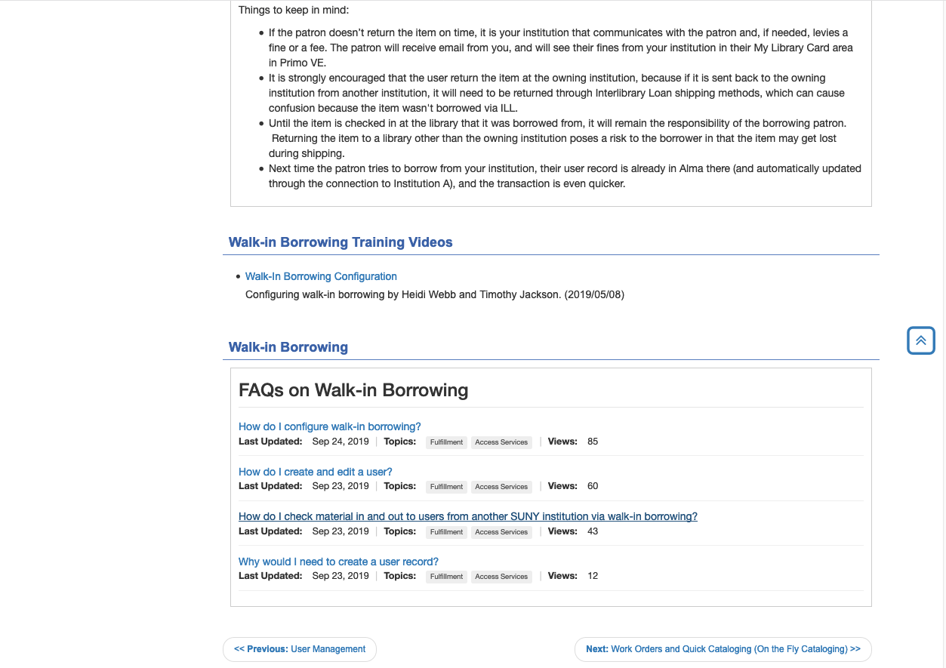
Fulfillment Training Guide - Final Draft
www.suny.edu

Slide 27
Upcoming Webinars and In-Person Training
Webinars
  Resource Sharing Training on Deflections
  Submitting a Good Support Ticket, October 9, 11a – 12noon
  http://slcny.libwizard.com/supporttickettraining
  Creating Sets and Running Jobs, October 10, 9:30a – 10:30a
  http://slcny.libwizard.com/setsjobstrainings
In-Person
  Analytics full-day training, November 6&7, Syracuse and Orange/Middletown
  More to come!
www.suny.edu

Slide 28
Goals for the Next Year
Create training guides for each of the functional areas and any special topics as needed
Roll out task-oriented webinar and in-person trainings, as indicated by the training surveys
Increase opportunities for peer learning through:
  Basecamp discussion threads
  The Alma Open Mic series
  Local campus documentation and training materials uploaded to Basecamp
Get feedback and iterate each of these as needed
www.suny.edu

Slide 29
What Else is the SSLS Working On?
6 Premium Sandboxes Delivered. Reviewing these to determine how SUNY sandboxes can best be utilized.
Providing Regular Presentations: https://slcny.libguides.com/overview/presentations/ssls_training
Upcoming webinar on Primo VE expected behavior
Working with campuses/SICAS to finalize SIS loading and Gail is providing individual training sessions on SIS loading.
Reviewing Primo VE Analytics options and best practices
Review of all Basecamp content and migrating to SUNY-specific areas.
Development of process, best practices, and workflow for harvesting ETD collections.
Development of process for Suppression from Dedup/FRBR for Special Collections or similar content.
www.suny.edu

Slide 30
Engagement with Working Groups and Task Forces.
Representation:
  Access Services & Resource Sharing: Tim
  Acquisitions & Electronic Resources Management: Michelle
  Analytics: Gail
  Discovery: Michelle
  Metadata Standards & Policy: Maggie
  LSP Advisory Board: Shannon
Recent Activity:
  Collaborated to create Central Discovery Index (CDI) Task Force
  Brought concerns about Resource Sharing stats to Discovery to review SUNY Catalog inclusion in Everything Search
  Initiated discussions with Analytics WG re: in-person and web-based training
www.suny.edu

Slide 31
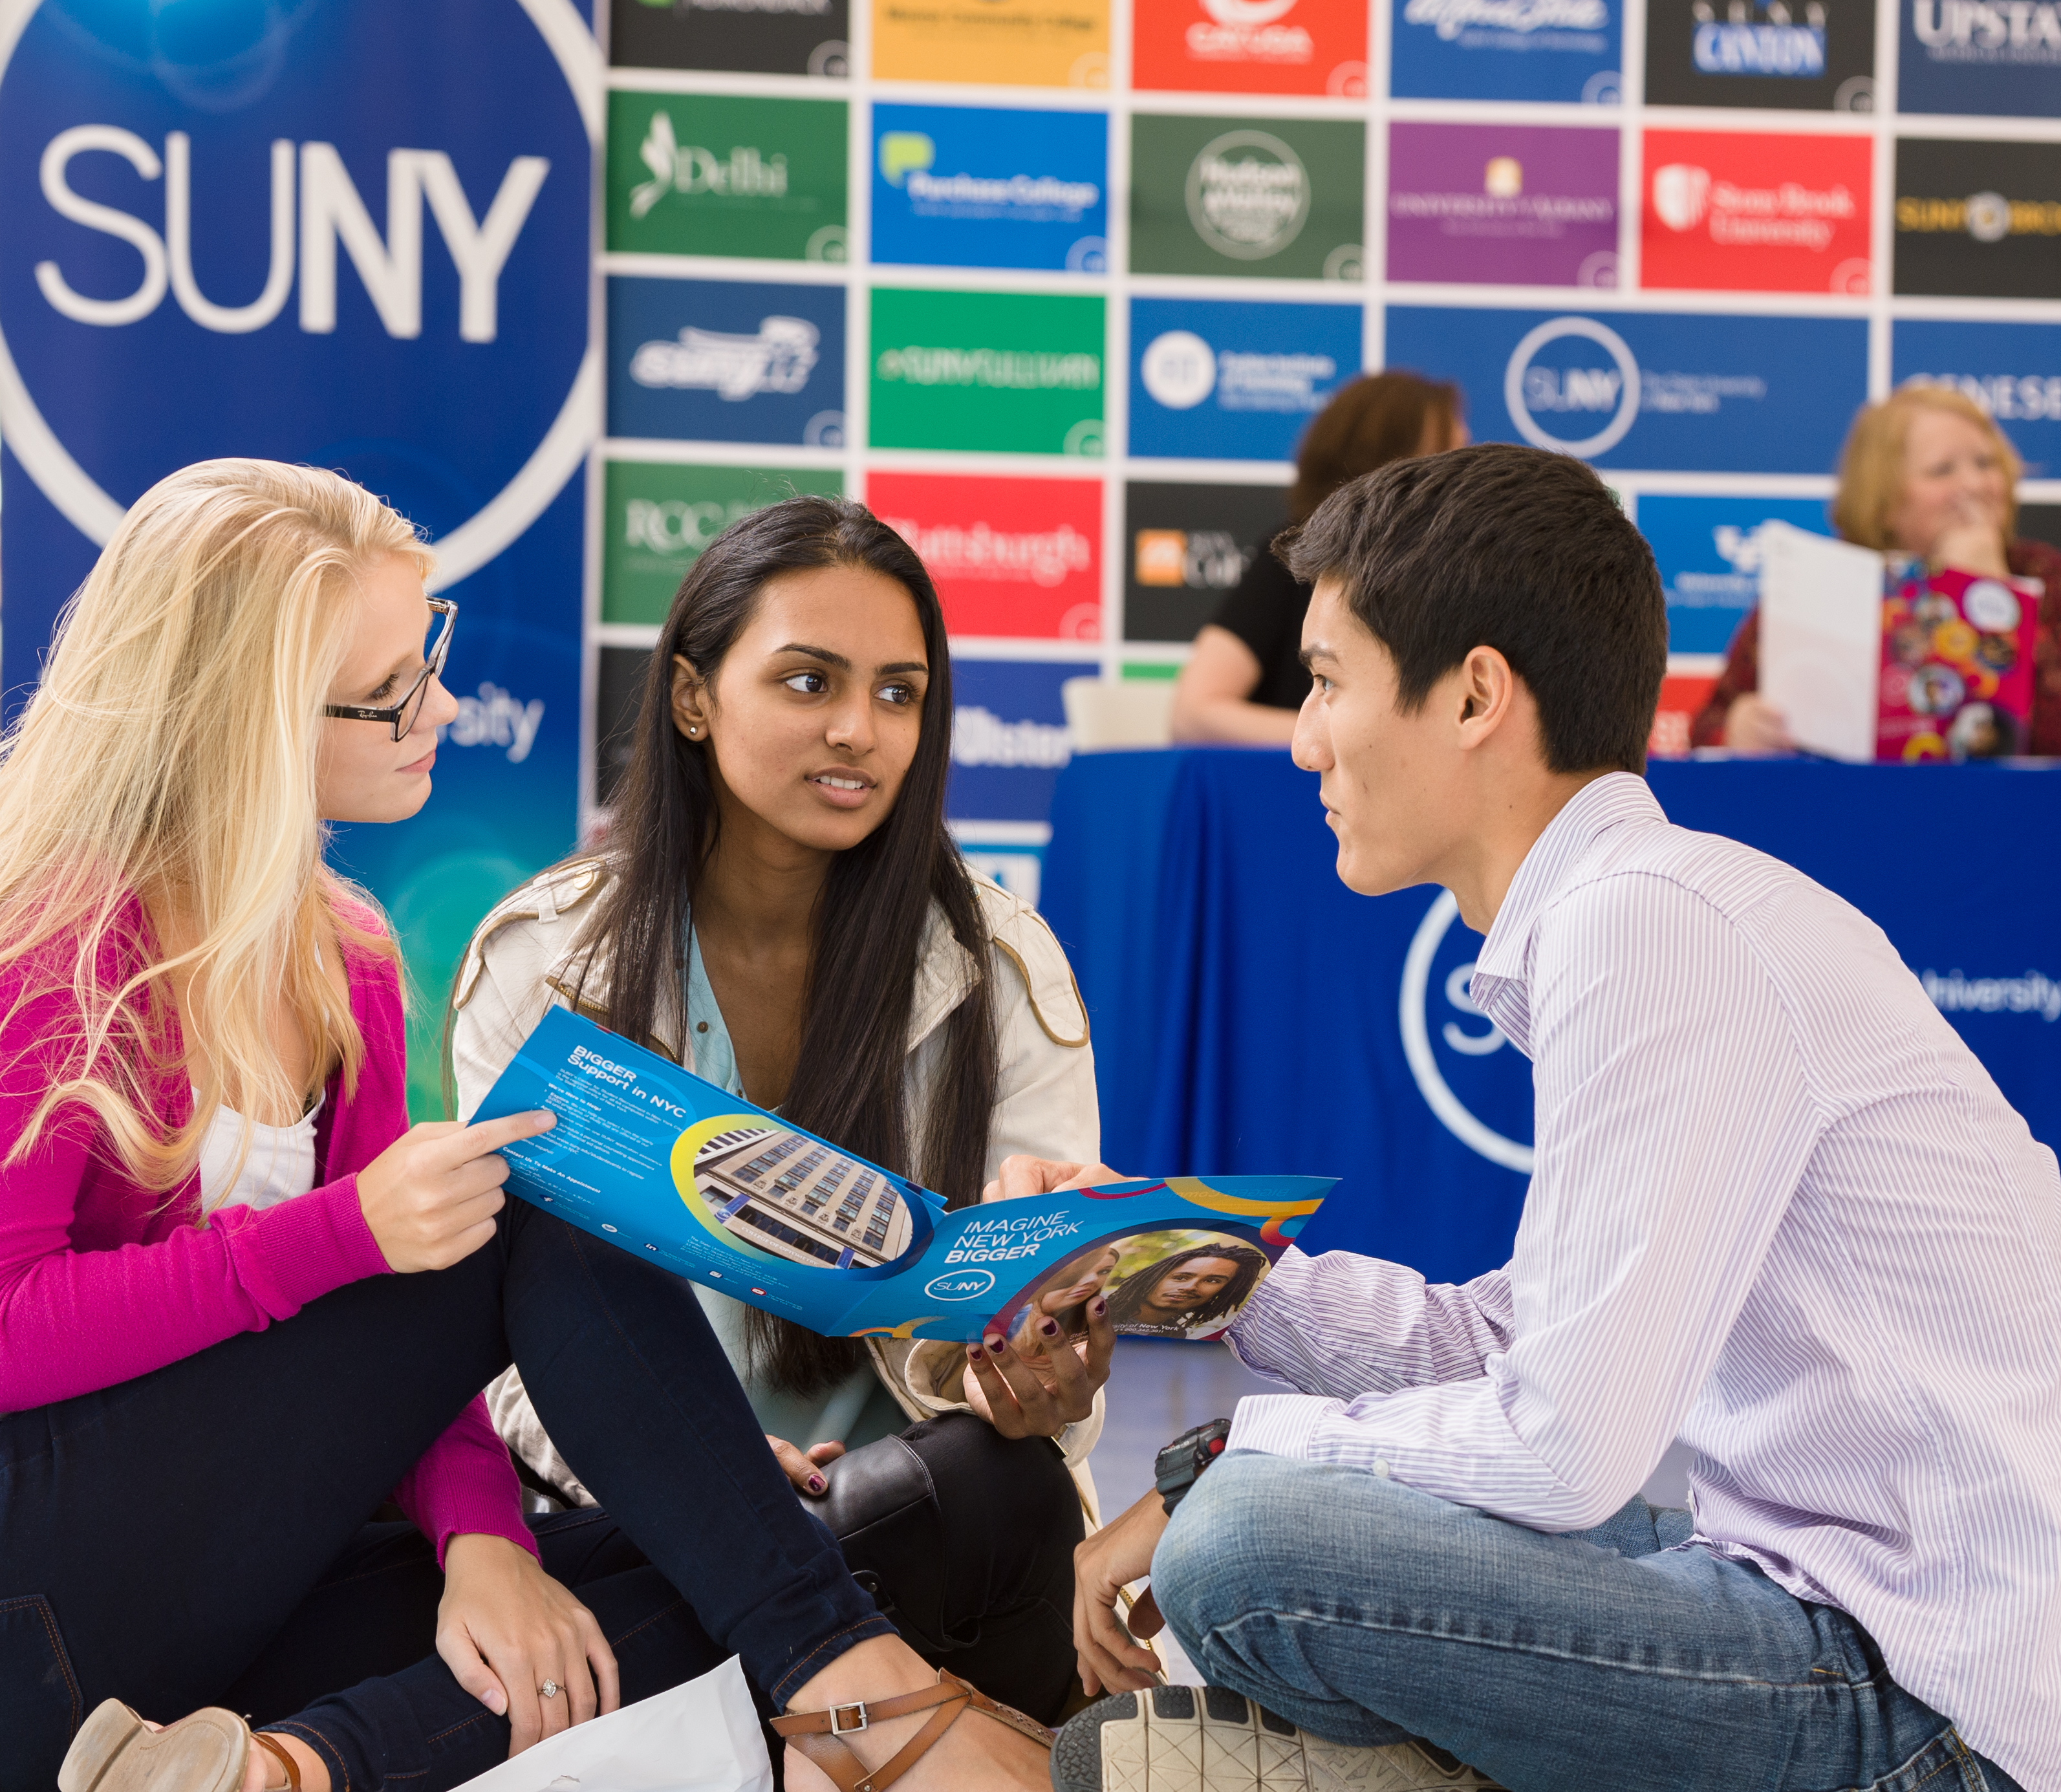

Questions or Discussion?
www.suny.edu

