Slide 1

George Mason District
Roundtable
March 14, 2024

Slide 2

Pledge

Slide 3
Agenda
Welcome and Pledge
Questions about Read-ahead
Award(s)
General Announcements
Council Announcements
Program Announcements
Joint Session: Recruiting – Joint Cub/Troop Event
Cracker Barrel/Networking (Optional; NLT 9pm)
Next Meeting: April 11, 2024 (DCOH 7:00pm, RT 8pm)

Slide 4
Welcome
New to Roundtable?
Please introduce yourself!

Slide 5
Questions/Clarification about Read-ahead?

Slide 6
Award(s)

Slide 7
Council Update - Alignment
Organizational Alignment Committee Recommendations
  Goal - Align with High School boundaries and provide optimal service to units by balancing professional workload.
  Draft Plan (give us your comments)
    This plan is membership driven. The council membership has dropped 33% since 2017. The plan is an attempt to align council resources in a way to drive new membership at a rate far above past goals of 3% per year.
    The plan calls for renaming most districts. The districts will choose their own names.
    Individuals are not tied to any particular district. They can choose where to volunteer regardless of where they reside.
    Units affected will have their charter renewal process through their new district and be served by the District Executive in the new district. They may choose to participate in activities such as Roundtable in a different district if that better serves their needs.
    The plan, if adopted, will likely be implemented this spring so that all elements can be in place for a robust fall recruitment season and in time for the program launch in the districts.

Slide 8
Council Update – Misc.
Jamboree-on-the-Water – Just as there is a Jamboree-on-the-Air/Jamboree-on-the-Internet, this year scouts are invited to plan an activity on the water in the second weekend in July. More information and a web site will be coming out soon. [Flyer]
Member Renewals - Beginning March 1, 2024, all members renew using the new “Yearly Membership” process. Renewals open two months before your expiration date. You can find your pending renewal by clicking on the “My Applications” tab found above and then click “My Renewals”. Check with your unit before you renew, some units are choosing to process the renewal for the members.
AOL Transfers to Troops – Paper is fine. However, online will probably be faster. If the transfer is done online, some units are seeing duplicates. Just mark them as “Duplicate” in the comments and transfer them to the District. This will stop the reminders that your Key 3 will receive.
Flyers from the Elementary Schools – The Scout Executive and the NCAC President met with Dr. Michelle Reid, Fairfax County School Superintendent this week. She is willing to support flyer distribution across all the elementary schools. More details will follow.

Slide 9
Council Update - Aquatics Committee
Paddle Craft Safety – Still water (Camp Snyder) & Moving Water (Ryan’s Lock)
  May 18-18: https://scoutingevent.com/082-82687
  Jun 1-2: https://scoutingevent.com/082-82688
  Aug 24-25: https://scoutingevent.com/082-82689 - Opens June 2nd
  Sept 7-8: https://scoutingevent.com/082-82690 - Opens June 28th
Pre-Camp Swim Tests – Camp Snyder
  June 1: https://scoutingevent.com/082-82691
  June 2: https://scoutingevent.com/082-82692
  Partial MB Completion Day – First weekend in Oct?

Slide 10
General Announcements

Slide 11

Big Rock - Recruiting-Joint Cub/Troop Event

Slide 12

Current 2024 George Mason Calendar
April 11, 2024 – District Court of Honor (7pm)
April 13, 2024 – GMD Pinewood Derby, St James, Falls Church, VA
May 3-5, 2024 – Spring Camporee, 4H
May 27, 2024 – Memorial Day Flags In, Falls Church, VA
May 29, 2024 – Elks Youth Recognition Dinner for 2023 Eagle Scouts

Slide 13
STEM
03/23/24 – Maryland Science Center Camp-In, Baltimore, MD
05/04/24 – 19th Annual NCAC Orienteering Meet, Prince William Forrest
07/08/24 – 07/12/24 – STEM Summer Workshop, Alexandria, VA
08/05/24 – 08/09/24 – STEM Summer Workshop, Alexandria, VA
Ancient Earth: Birth of the Sky (on PBS) - link
Anytime – DC STEM Trek- Showcases 24 government agencies, private organizations and monuments related to the tenets upon which STEM is based. Two hikes - 10.57 miles, or 4.75 miles
Ancient Earth: Birth of the Sky (on PBS) - link
Anytime – DC STEM Trek- Showcases 24 government agencies, private organizations and monuments related to the tenets upon which STEM is based. Two hikes - 10.57 miles, or 4.75 miles

Slide 14
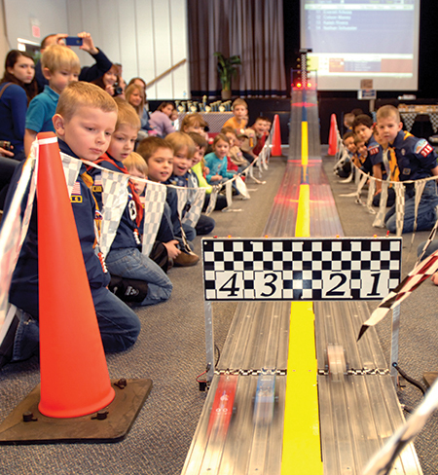
2024 George Mason Pinewood Derby
Race Day is April 13, 2024
All Packs wanting to participate in the 2024 Pinewood Derby MUST hold their Pack Pinewood Derby by April 5, 2024.
One unit winner from each age bracket (Lions, Tigers, Wolves, etc.) regardless of gender.
Pack winners must register (and pay) on Council website. $15.00 per entry. No money collected at door on day of race. Must register by 04/06/24.
Register at: https://scoutingevent.com/082-82698
Race will be held at St James Catholic Church, Falls Church, VA.
For questions, contact Pat Berney.

Slide 15

District Court of Honor
To recognize adults who served/are serving at the unit level.
Two awards:
  Unit Commissioner’s Unit Scouter Award – 1 per unit
  Unit Appreciation Award – Maximum 8 per unit.
Please provide a sentence or two describing the individual’s service.
Submit Unit Commissioner’s Unit Scouter Award to Unit Commissioner.
Unit Appreciate Award to gm.adultrecognition@gmail.com
Must have all submissions by no later than March 22, 2024.
Will confer awards at District COH/April Roundtable.

Slide 16

Elks Youth
Recognition Dinner
For youth that earned Eagle in 2023 (i.e. their Eagle Board of Review was held in the 2023 calendar year) and their Scoutmasters.
Thursday, May 29, 2024
Elks Lodge - 2188, 8421 Arlington Blvd., Fairfax, VA.
Will need unit leader help in contacting Scouts and obtaining an RSVP.
Scoutmaster are invited at no cost to them.

Slide 17

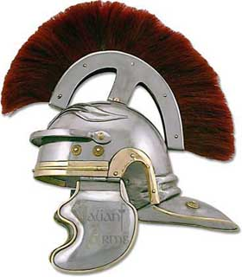
George Mason District Roundtable
MARCH 7, 2024
GREEKS VERSUS ROMANS
SPRING CAMPOREE

Slide 18
A Game with a Purpose
Practice and Apply Scout Skills
Fulfill Rank Requirements
Learn and Appreciate Ancient History and Culture
Exercise Creativity and Ingenuity

Slide 19
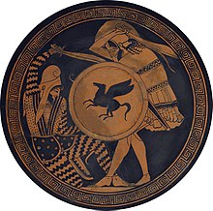
The Details
When: May 3-5, 2024
Where: 4-H Camp, 600 4H Center Drive, Front Royal, VA 22630
Cost:
  Scouts: $
  Adults: $
  Staff:
Program: I’m glad you asked…

Slide 20
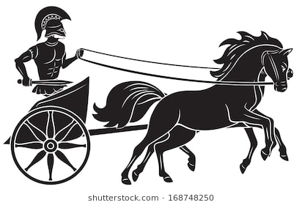
The Chariot Race
Like a Klondike Derby, Patrols will build and race Chariots, pulled by Scouts.

Slide 21
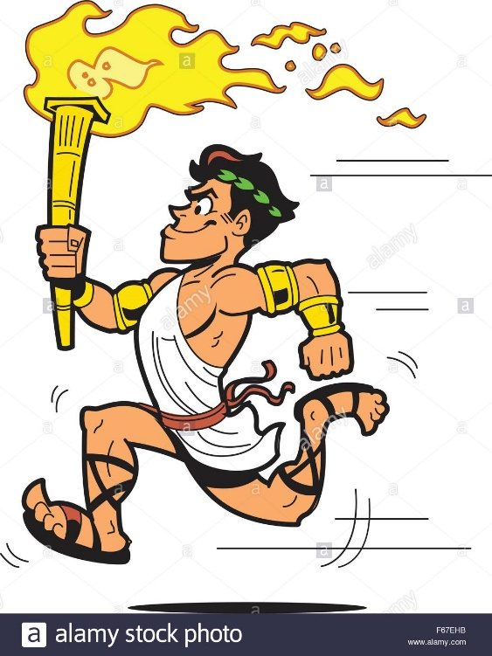
Olympic Running
A one-mile run for either the “before” or “after” section of Tenderfoot requirement 6a.

Slide 22
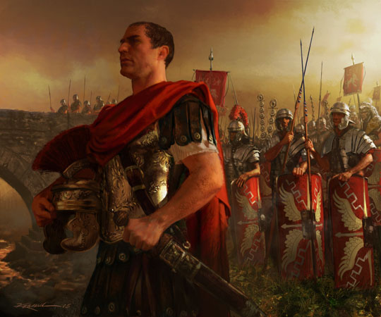
Crossing the Rhine
Use lashings to build a bridge to carry Caesar’s troops to Rome (First Class Requirement 3b, 3c, 3d).

Slide 23
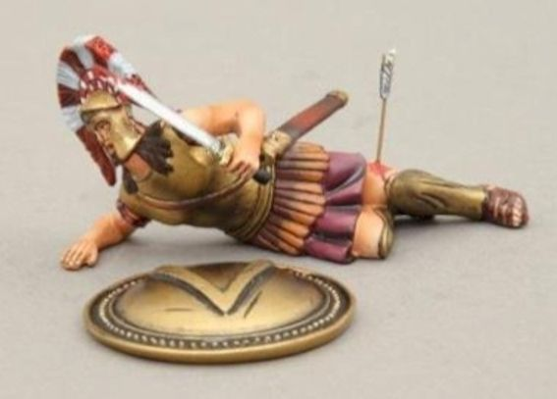
Hoplite Down!
Triage, deliver first aid, and transport a wounded Greek soldier (Second Class, 6a, 6b; First Class, 7a, 7b)

Slide 24
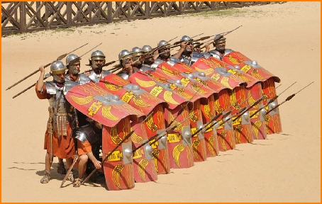

Shield Wall Drills
Learn how Greek and Roman soldiers used teamwork to protect themselves and defeat their enemies.

Slide 25
Culture Competition
Decorate your campsite in Greek or Roman fashion!
Perform themed skits at the Campfire!
Experiment with Greek or Roman camp dishes!

Slide 26
What Do We Need From You?
Make cardboard shields to bring (instructions provided)
Build a chariot

Slide 27
Time for Cracker Barrel
Minutes and slides available on the GMD web site (District Resources, Roundtable). Password is “GMDRT”
Next meeting – April 11, 2024, at Thoreau MS
  District Court of Honor – 7pm
  Roundtable – 8pm

Slide 28
Backup Slides

Slide 29


Merit Badges
The online Merit Badge Counselor registration works for all Scouters who do not already hold another District position.
New Merit Badge Counselors must complete online merit badge counselor training, in addition to YPT. Be sure the counselor uses his/her legal name – no nicknames.
Merit Badge Counselors, or the unit Dean/Leader, also need to scan and send Margee the Merit Badge application form listing the badges the counselor is applying to teach and providing a justification of his/her qualifications.
Youth Protection Training is the essential first step. Don’t hit “send” on the application without it!
Contact Margee if you have questions at GM.MB.Dean@hotmail.com.
Did you know:
The National Council does not limit the number of merit badges a youth may earn from one counselor, though a unit leader is permitted to do so, as long as the same limit applies to all Scouts in the unit. Ideally, Scouts should work with a variety of adults. (GTA 7.0.0.3)
Partial Merit Badges have no expiration except the Scout’s 18th birthday. (GTA 7.0.3.3)
Due to the BSA policies related to Youth Protection and two-deep leadership, a merit badge counselor must have another adult present during all merit badge counseling sessions. However, the parent or legal guardian of the Scout may serve as the second adult. This parent or legal guardian does not have to be a registered leader.
If the requirements for a merit badge differ between the merit badge pamphlet and the current edition of Scouts BSA Requirements, the requirements in the Scouts BSA Requirements book supersede all others.

Slide 30

Training (https://www.ncacbsa.org/george-mason/training/)
Cub Scout Den Leader Specific (C42)
  Available on-line (125 min)
  03/02/24 - Alexandria, VA
  04/06/24 - Alexandria, VA
  05/04/24 - Alexandria, VA
  05/04/24 - Herndon, VA
  06/01/24 - Alexandria, VA
Basic Adult Leader Outdoor Orientation (BALOO;C32) -
  03/16/24 - 03/17/24 - Haymarket, VA
  05/04/24 - 05/05/24 - Gaithersburg, MD
  05/10/24 - 05/11/24 - Fredericksburg, VA
Scoutmaster Position Specific Training(S24)
  Available on-line (192 min)
  03/02/24 - Alexandria, VA
  04/06/24 - Alexandria, VA
  05/06/24 - Alexandria, VA
  05/04/24 - Herndon, VA
  06/01/24 - Alexandria, VA
Introduction to Outdoor Leadership Skills (IOLS; S11)
  04/19/24 - Stafford, VA
  05/04/24 - 05/05/24 - Gaithersburg, VA
  05/10/24 - 05/11/24 - Fredericksburg, VA
Climbing Level 1 Instructor
April 20-21 at Great Falls Park, 7:30 AM to 5:00 PM. Logistics memo
April 27-28 at Carderock Rec Area, 8:00 AM to 5:00 PM. Logistics memo
June 15-16 at Great Falls Park, 7:30 AM to 5:00 PM. Logistics memo
Sept 7-8 at Great Falls Park, 7:30 AM to 5:00 PM. Logistics memo
Sept 21-22 at Sugarloaf Mountain, 8:15 AM to 5:00 PM. Logistics memo
Mental Health First Aid
https://www.fairfaxcounty.gov/hscode/ereg/Registration.aspx?groupID=47
NYLT https://www.ncacbsa.org/national-youth-leadership-training/
24.2: 06/16/24-06/21/24
24.3: 06/23/24-06/28/24
24.4: 07/28/24-08/02/24
24.5: 07/28/24-08/02/24
Registration is open. Some seats are still available. There may be a wait list.
Wilderness First Aid (N02) https://scoutingevent.com/082-WFASpring2024
03/23/24 – 03/24/24 – Camp Snyder
04/27/24 – 04/28/24 – Camp Snyder
Wood Badge (A90) https://www.ncacbsa.org/wood-badge/
04/12/24 – 04/14/24 & 05/04/24 – 05/05/24
10/14/24 – 10/15/24

Slide 31

GM High
Adventure
Members of the High Adventure Committee are available to assist units in planning and training for their upcoming high adventure trips – Contact Brian Heath for more information
Important notes for this month
  Registration for BSA’s high adventure bases - https://www.scouting.org/outdooradventures/open4adventure/
    2024 treks – Most BSA High Adventure bases still have availability
    2025 treks – Registration for all high adventure bases are now open
  2024 National High Adventure Base Scholarships
    SUMMIT: Submit by 3/31/24. Go here for the application.
    The deadlines for all other bases have already passed.
NCAC-Organized High Adventure Trips - 2024
  Lenhok’sin – James River Canoeing Trek - July 7-13, 2024
    Crew of 6-12 - $475 per participant – 5 slots remaining
    Registration: https://scoutingevent.com/082-75664
    For more information, e-mail highadventure@ncacbsa.org
  Joshua Tree with Climbing Committee - Winter Break 2024/25 (Tentative)
  Wind River Range, WY: 06/22 to 06/30/24 – Registration is Full
  All NCAC-sponsored trips for Philmont, Northern Tier & Sea Base are already full
NCAC-Organized High Adventure Trips - 2025
  Sawtooth Mountain Trip 06/21 to 06/29 2025
    Registration begins June 1, 2024 - $1,165 per person – Ask for details
High Adventure Preparation Training - Open to all NCAC Scouts & adults that are participating in HA trips in the next few years
  Philmont 2024 Sessions: IIIa – 03/24/24 (virtual); IIIb – 04/06/24 (in-person)
  Philmont Advisor Hikes: Sun 3/17/24, 8:00am – Catoctin Mt Park, Thurmont, MD
  Northern Tier: Sat, 04/06/24 (in-person); Sat, 04/20/24 (virtual)
Mar 2024
Notes:
Sea Base Trip on Jul 29-Aug 3, 2024 - FULL

Slide 32
GM High
Adventure
Other Training
  Back Country Outdoor Leadership Skills
    Maryland session, Spring 2024: 03/02/24 (classroom), 04/27-28 (overnight), https://scoutingevent.com/082-79025-191979
    Virginia session, Fall 2024: 9/21/2024 (classroom), 10/19-20 (overnight)
  Paddle Craft Safety Training Sessions (2024): May 18-19, June 1-2, August 24-25, September 7-8
National High Adventure Base Quick Links
  Philmont: https://www.philmontscoutranch.org/register/
  Northern Tier: https://www.ntier.org/provisional-scout-connections/
  Sea Base: https://www.bsaseabase.org/scouts/scout-connections/
  Summit: https://www.summitbsa.org/registration/scoutconnections/
Other High Adventure Bases
  Adirondack High Adventure Area: https://public.3.basecamp.com/p/hLgsVbk7Suju6cuDzQQJaEn4
  Maine High Adventure Area: https://www.mainehighadventure.org/
  Montana Outdoor High Adventure Base: https://montanabsa.org/camps/high-adventure/
Other useful links for high adventure information and opportunities
  NCAC High Adventure website - https://www.ncacbsa.org/high-adventure/
  List of units with available slots in their upcoming high adventure trips - https://public.3.basecamp.com/p/xWpkdrKHKAA9pCzwmHMNdbWb
Mar 2024 (cont.)

Slide 33
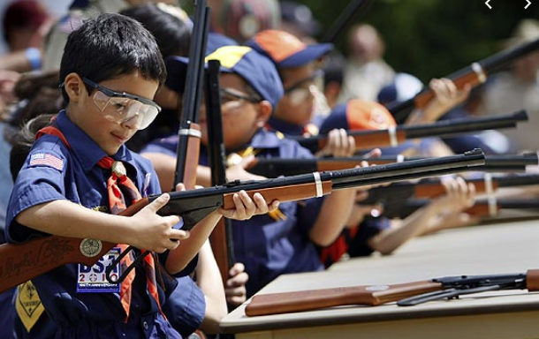
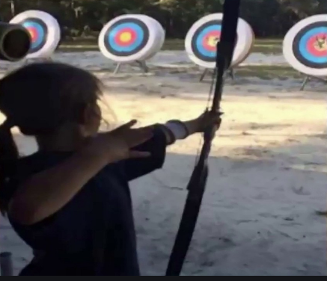
Shooting Sports
Requests for Shooting Events – Lead Time!
  50+ scouts - 6mos
  Less than 50 scouts - 3mos
Shooting on private land:
  Requirements
  Permissions/protocols
Shooting Sports web page
Shooting Sports Instructor Classes:
  Rifle/Shotgun - 04/27/24, 07/20/24, 08/24/24
  Archery – 04/06/24 & 05/04/24

Slide 34
Order of the Arrow
  Brian Fleck is Chapter Advisor.
  2024 Dues can be paid online: https://wipit470.org/dues.html
  The Amangamek-Wipit Lodge will be sending a contingent to the one-and-only National Order of the Arrow Conference (NOAC) next summer and we want you to join us! Registration is now open! Follow the directions below to register for the one and only 2024 National Order of the Arrow Conference (NOAC) at the University of Colorado at Boulder. Here are the steps to register for this once-in-a-lifetime opportunity!
Step 1: Click the registration link here!
Step 2: Fill out all information for the registration form.
Step 3: Congrats! You have reserved your spot for the 2024 NOAC! Look out for other emails in regard to both national registration AND further payments you may need to make! Can’t wait to see you there!!
If you have any questions regarding the National Order of the Arrow Conference email noac2024@wipit470.org
  Registrations open online https://wipit470.org/index.html under “Events”

Slide 35
OA – Lodge Master
Instructions for setting up a Troop in Lodge Master for upcoming O/A elections. They should have their election dates confirmed prior to setting this up.
  Log into Lodge Master (https://lodgemaster.oa-bsa.org/)
  Select “Inductions”
  Select “Visit & Election Management” (right side of the screen)
  Filter on “George Mason”
  Find your Troop and select “Edit”
  Scroll to the bottom of the page and enter your eligible Scouts information.
  Please include e-mail addresses for both the Scout and Parent. If no Scout e-mail is available, add the parents.
  Please add phone numbers.
  SAVE
You should be back at the 2024 Inductions page. If you are not, go back and repeat steps 1-4. At the top in the red banner, click on “Reports”
Print 2 copies of the Unit Election Report. The Election Team will sign both and give one to you at the conclusion of the election.
Print 1 copy of the Candidate Information Form. This is for the Election Team to use to verify the election results.
Click on the Unit Election Ballots and print that as many times as you need for all the Scouts in the Troop.

