Slide 1
ERM Overview
Objectives for today’s presentation:
Provide a broad overview of where our e-resources reside
Show how PCI and Alma components interconnect
Suggest helpful documentation (Basecamp, SUNY LibGuides, Ex Libris)
Recommend authorization roles for performing ERM activities in Alma
Demonstrate possible workflows for some common ERM tasks in Alma
Description and arrangement of portfolios and collection; selective packages
Linking to community zone and what that process entails (what CZ linking does)
Activate full-text services and select packages
Create & manage collections
Import profiles

Slide 2
ERM Life Cycle & Alma
Working Definition of an ERM:
“Tools for managing the license agreements, related administrative information, and internal processes associated with collections of licensed electronic resources”
- Ellen Duranceau, Against the Grain, June 2005
E-resource Lifecycle:
Selection
Trials
Acquisition process
Implementation
Administration
Maintenance
Evaluation/Renewal
Electronic Resources Conceptual Background available @ https://knowledge.exlibrisgroup.com/Alma/Training/Alma_Essentials/Alma_Essentials_-_English/E_Resource_Management/06_Electronic_Resources_Conceptual_Background_(15_min)

Slide 3
Where does our data reside?
Sources – Aleph, ERM systems (in a few cases), miscellaneous localities
Alma
Manages print, electronic, & digital holdings; Publishes to Primo; Defines services available per user per record
Primo
Front end interface for Discovery and Delivery as well as Alma Link Resolver services
** Consider impact on workflow as we walk through demonstration

Slide 4
Primo: What is it?
Primo – Front end interface for Discovery and Delivery as well as Alma Link Resolver services
Primo Central Index (PCI) is a centralized Primo index that encompasses hundreds of millions of records of global or regional significance that are harvested from primary and secondary publishers and aggregators. The full text in PCI is indexed and used for discovery, not for delivery. The number of resources and records added to PCI grows continually.
Product/ database lists available @ https://knowledge.exlibrisgroup.com/Primo/Content_Corner/Product_Documentation/Primo_Central_Indexing
ExLibris documentation @ https://knowledge.exlibrisgroup.com/Primo

Slide 5
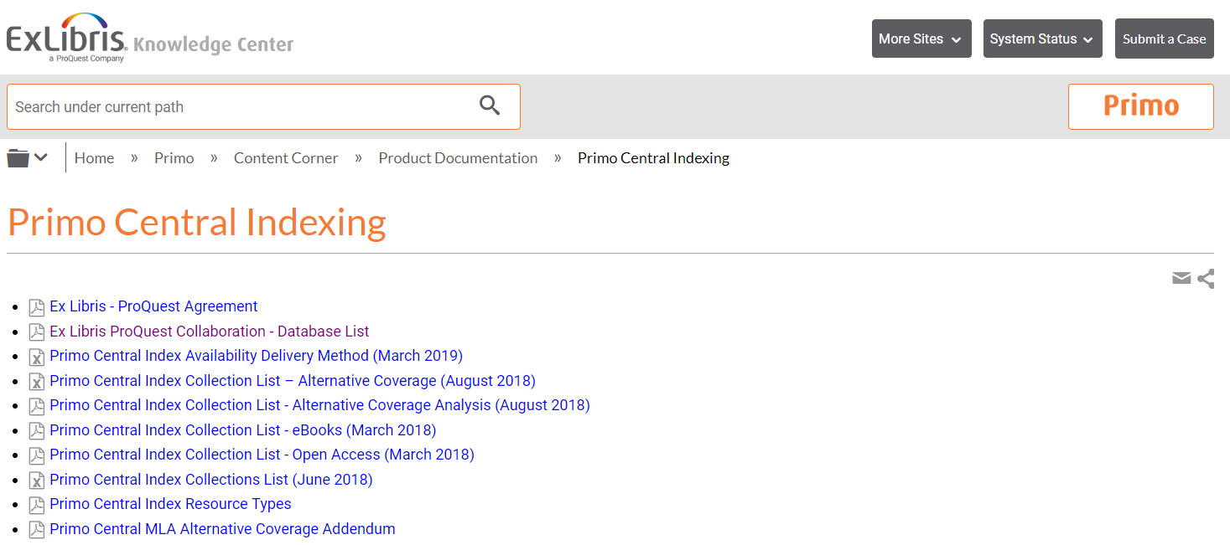
Primo: What’s in it
See https://knowledge.exlibrisgroup.com/Primo/Content_Corner/Product_Documentation/Primo_Central_Indexing

Slide 6
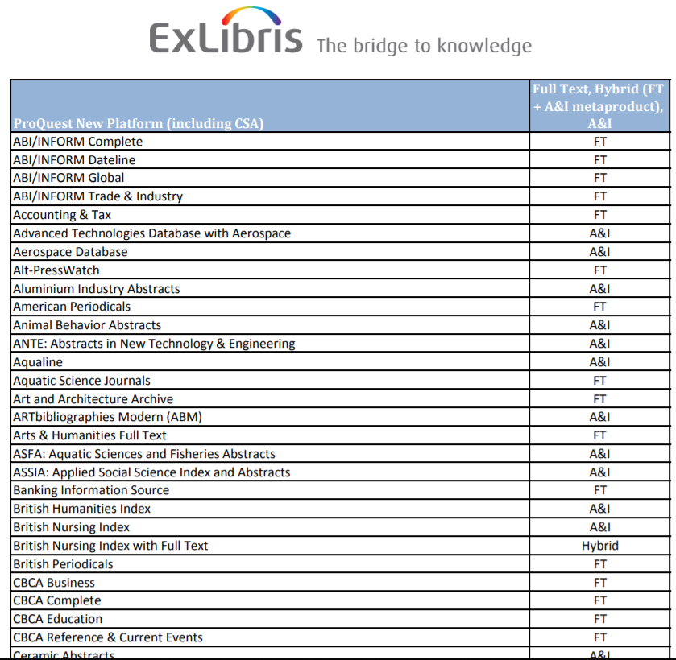
E.g. PCI Database List

Slide 7
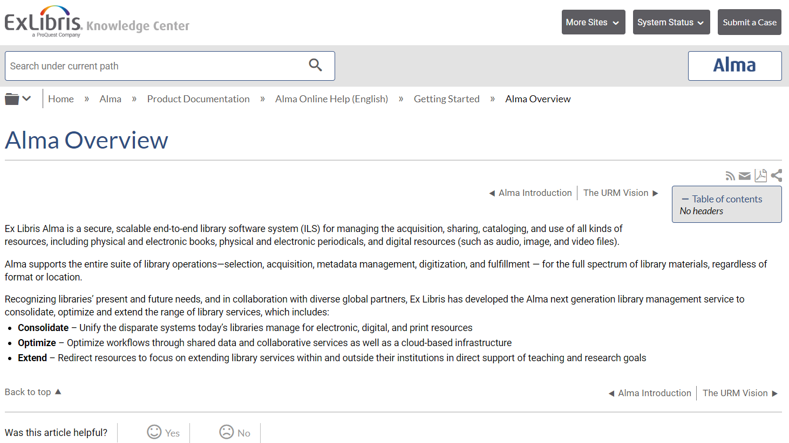
Alma: What is it?
See https://knowledge.exlibrisgroup.com/Alma/Product_Documentation/010Alma_Online_Help_(English)/010Getting_Started/010Alma_Introduction/010Alma_Overview

Slide 8
Alma: What’s in it
Alma
- Manages print, electronic, & digital holdings; Publishes to Primo; Defines services available per user per record
Central Knowledge Base (CKB)
- Describes vendor offerings for electronic resources and is maintained by Ex Libris. By integrating the CKB into the data services environment (the Community Zone), Alma allows libraries to eliminate the need to manually synchronize records for electronic resources into the local catalog. When a complete or partial package is activated in the CKB, the individual titles in that package are immediately available in the library’s inventory.
Breakdown by zone:
- Records for what we own in Institutional Zone (IZ), i.e. Inventory
Community Zone (CZ) - Records for electronic access, including e-books, e-journals, and packages
* Use CZ records to create links for online access
- Network Zone (NZ) - Records for all materials owned by campuses included in the SUNY scope

Slide 9
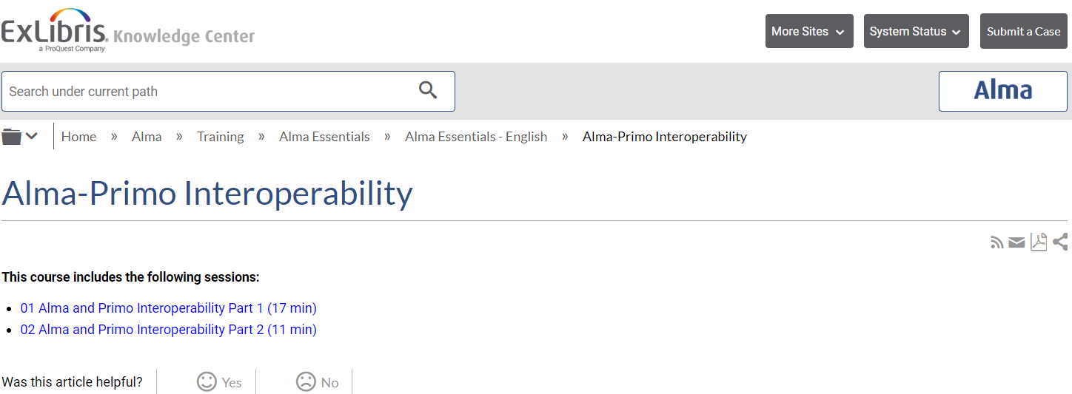
Alma & Primo: How do they interact
See https://knowledge.exlibrisgroup.com/Alma/Training/Alma_Essentials/Alma_Essentials_-_English/H_Alma-Primo_Interoperability
Notes:
Might require an additional step to activate in Primo

Slide 10
SLC Training Guide @ https://slcny.libguides.com/training?b=g&d=a&group_id=16376

Slide 11
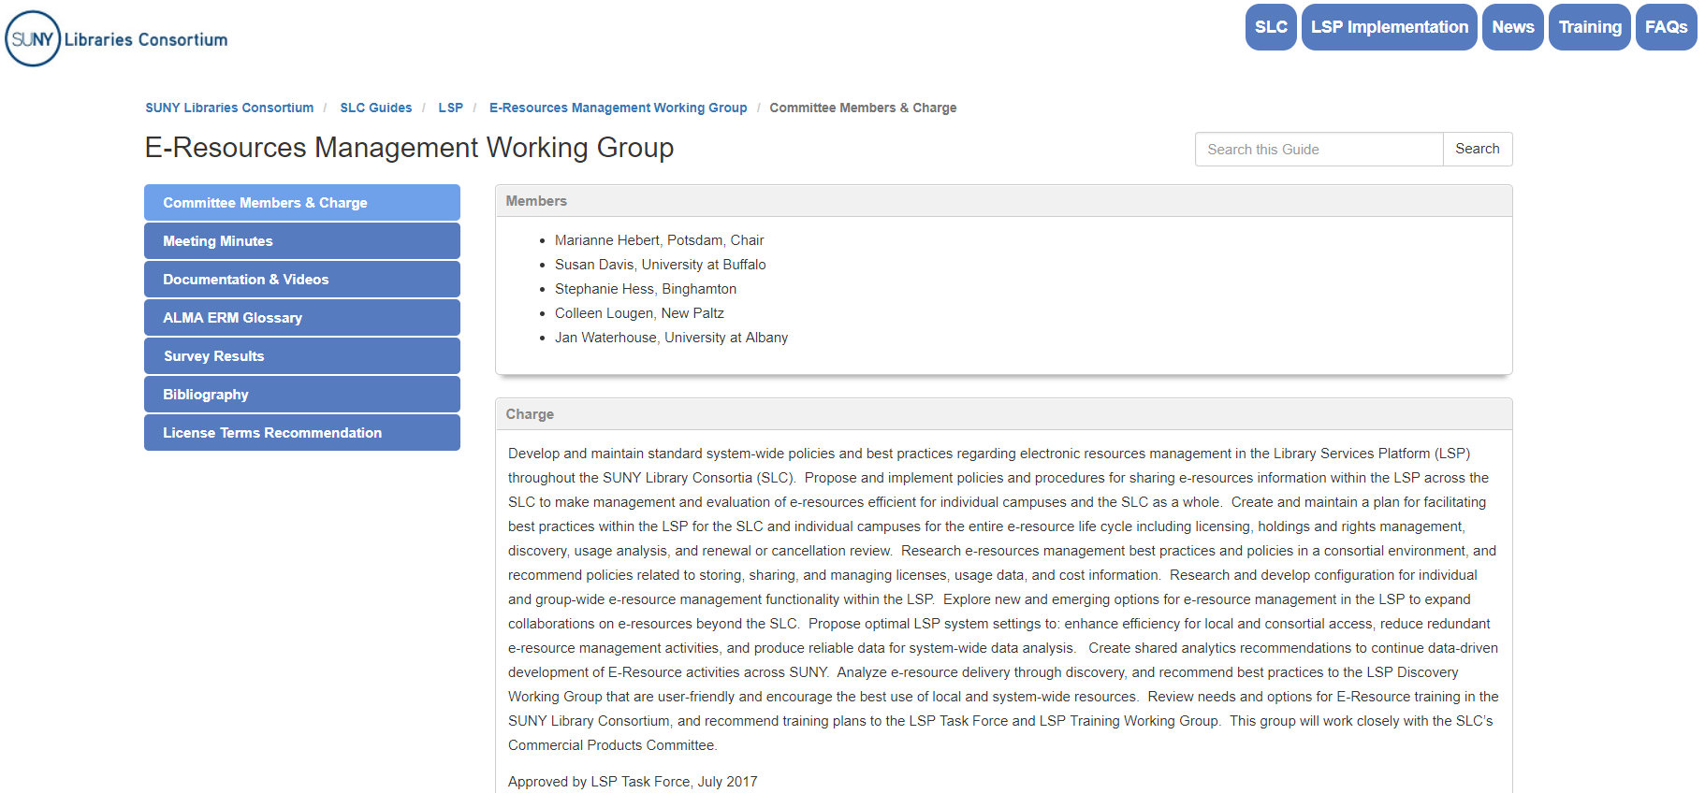
ERM Working Group LibGuide @ https://slcny.libguides.com/eresourceswg

Slide 12
Authorization Roles needed for ERM in Alma
A role profile is a collection of roles, grouped according to job function
Role profiles make it easy to add a commonly select list of roles to a user when adding a new user by assigning the user a job category or user group
You configure role profiles on the Profiles List page:
Configuration Menu > User Management > Roles and Registration > Profiles
To configure role profiles, you must have one of the following roles:
User Administrator or General System Administrator
Notes:
Highly recommend reviewing David Schuster’s excellent ENUG 2018 presentation “Primo and Alma Working Together for Access” ; He goes into greater detail re: the technical details of activating resources in the PCI

Slide 13
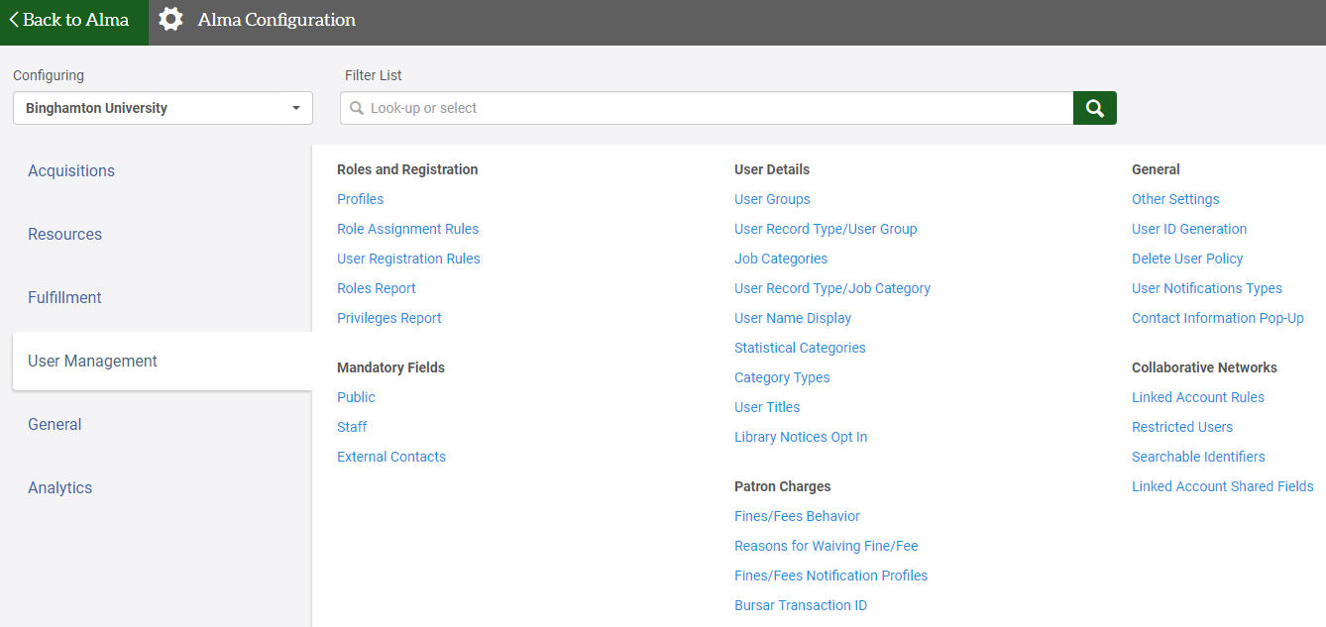
Configuring Roles in Alma
Notes:
Highly recommend reviewing David Schuster’s excellent ENUG 2018 presentation “Primo and Alma Working Together for Access” ; He goes into greater detail re: the technical details of activating resources in the PCI

Slide 14
Authorization Roles needed for ERM in Alma

Slide 15
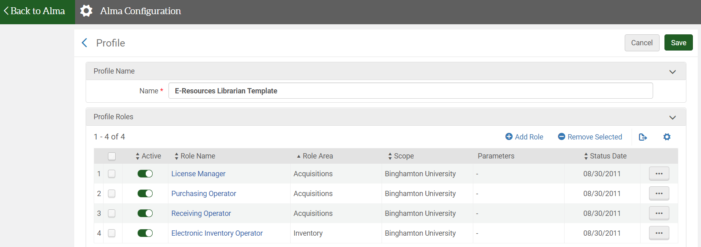
Authorization Roles: Templates

Slide 16
Authorization Roles: Reports
Notes:
Highly recommend reviewing David Schuster’s excellent ENUG 2018 presentation “Primo and Alma Working Together for Access” ; He goes into greater detail re: the technical details of activating resources in the PCI

Slide 17
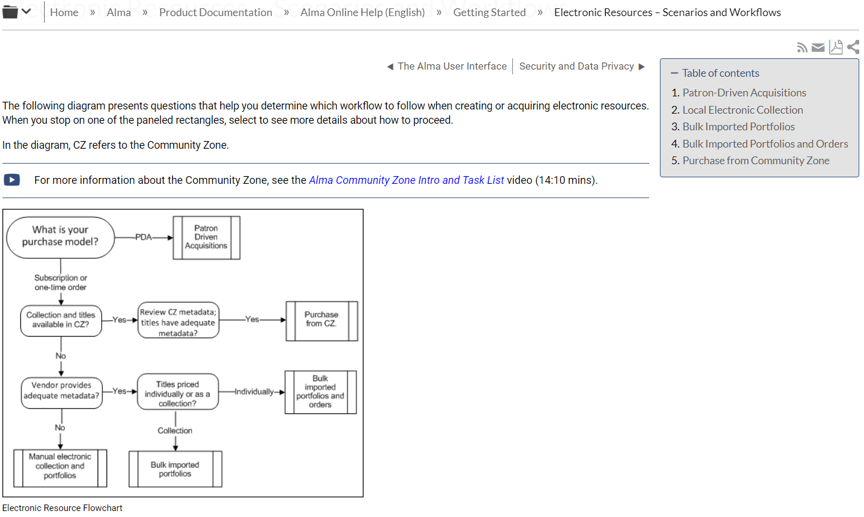
Workflows: Ex Libris documentation
See https://knowledge.exlibrisgroup.com/Alma/Product_Documentation/010Alma_Online_Help_(English)/010Getting_Started/060Electronic_Resources_%E2%80%93_Scenarios_and_Workflows

Slide 18
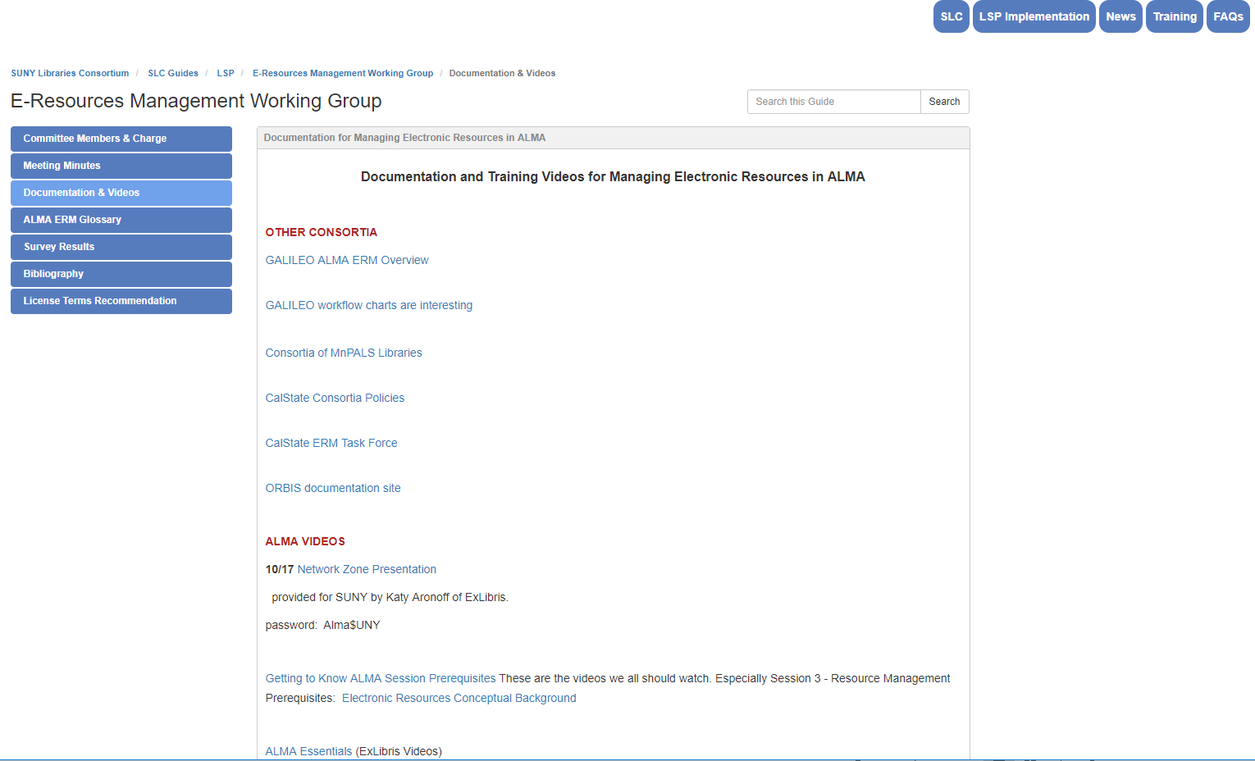
Workflows: ERM Working Group Documentation
See https://slcny.libguides.com/c.php?g=777084&p=5709582

Slide 19
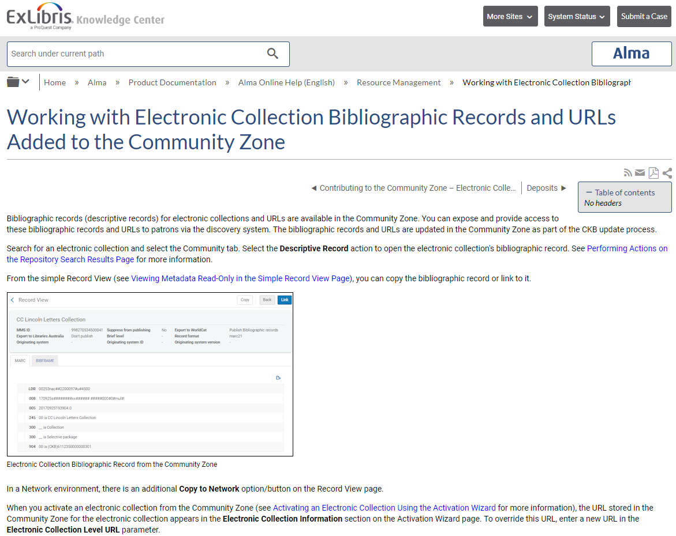
See https://knowledge.exlibrisgroup.com/Alma/Product_Documentation/010Alma_Online_Help_(English)/040Resource_Management/050Inventory/100Working_with_Electronic_Collection_Bibliographic_Records_and_URLs_Added_to_the_Community_Zone See https://knowledge.exlibrisgroup.com/Alma/Product_Documentation/010Alma_Online_Help_(English)/040Resource_Management/050Inventory/020Managing_Electronic_Resources#Activating_an_Electronic_Collection_Using_the_Activation_Wizard
Working with Electronic Collection Bibliographic Records and URLs Added to the Community Zone
Notes:
Highly recommend reviewing David Schuster’s excellent ENUG 2018 presentation “Primo and Alma Working Together for Access” ; He goes into greater detail re: the technical details of activating resources in the PCI

Slide 20
Activate full-text services for aggregator package
See ExLibris Documentation for Activation Workflows @ https://knowledge.exlibrisgroup.com/Alma/Training/Alma_Essentials/Alma_Essentials_-_English/D_Acquisitions/03_Activation_Workflows
Notes:
Highly recommend reviewing David Schuster’s excellent ENUG 2018 presentation “Primo and Alma Working Together for Access” ; He goes into greater detail re: the technical details of activating resources in the PCI

Slide 21
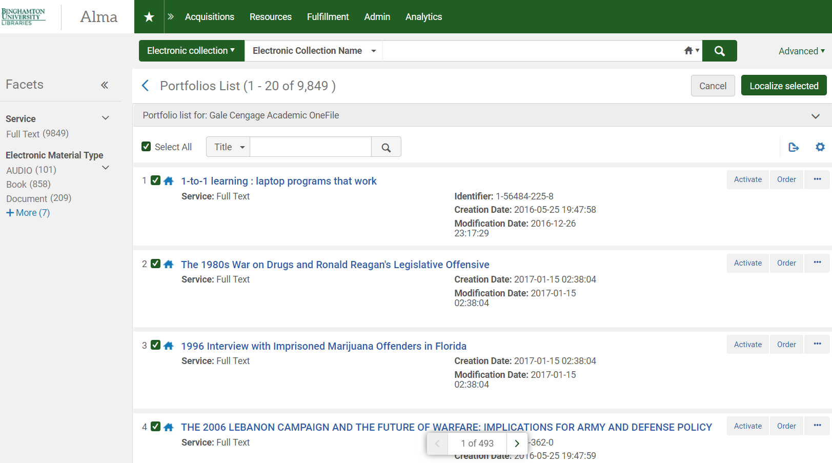
Portfolios in an aggregator package
Notes:
Highly recommend reviewing David Schuster’s excellent ENUG 2018 presentation “Primo and Alma Working Together for Access” ; He goes into greater detail re: the technical details of activating resources in the PCI

Slide 22
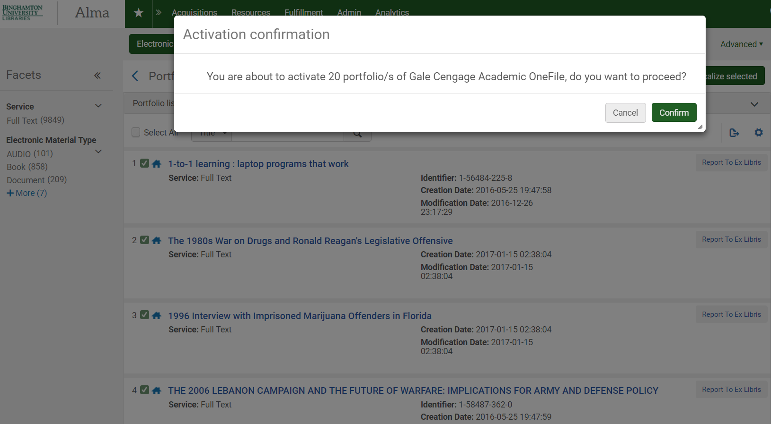
Activate Confirmation
See ExLibris Documentation for Activation Workflows @ https://knowledgeexlibrisgroup.com/Alma/Training/Alma_Essentials/Alma_Essentials_-_English/D_Acquisitions/03_Activation_Workflows
Notes:
Highly recommend reviewing David Schuster’s excellent ENUG 2018 presentation “Primo and Alma Working Together for Access” ; He goes into greater detail re: the technical details of activating resources in the PCI

Slide 23
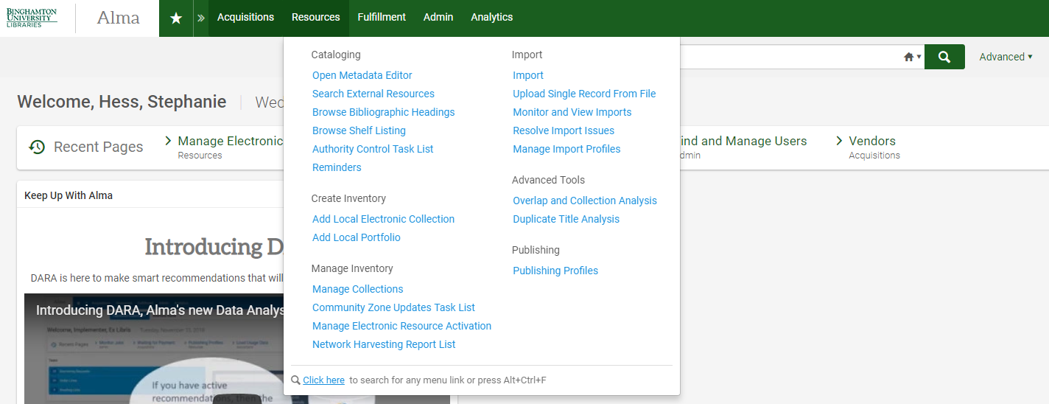
Workflows: Create and Manage Inventory
Notes:
Highly recommend reviewing David Schuster’s excellent ENUG 2018 presentation “Primo and Alma Working Together for Access” ; He goes into greater detail re: the technical details of activating resources in the PCI

Slide 24
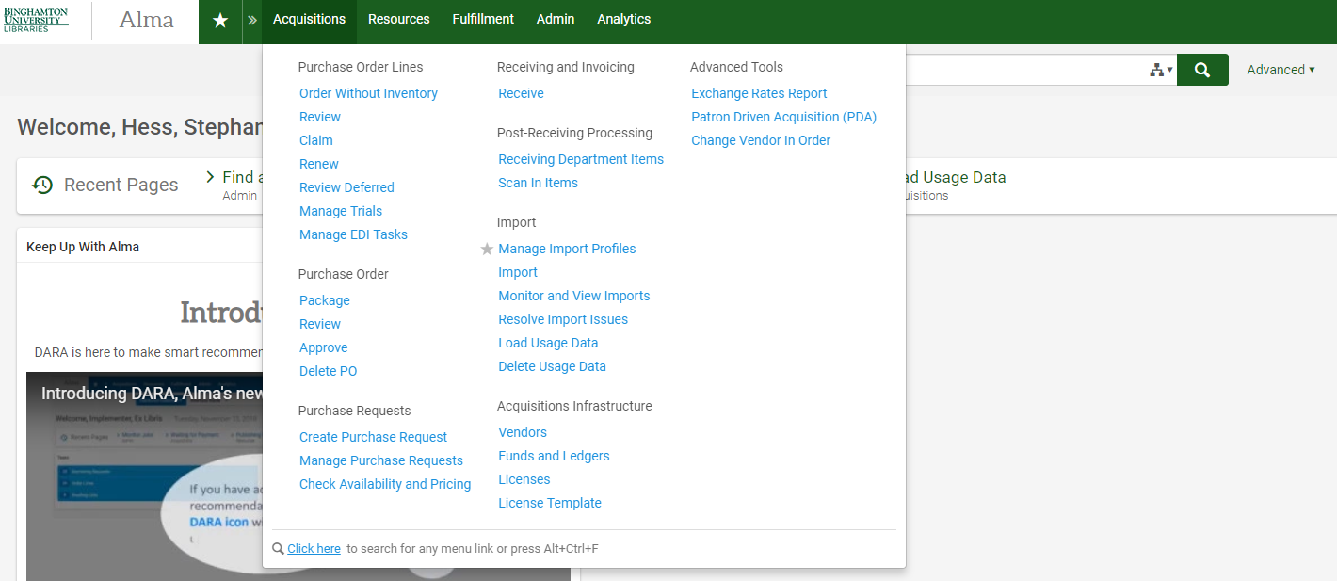
Workflows: Import profiles
Notes:
Highly recommend reviewing David Schuster’s excellent ENUG 2018 presentation “Primo and Alma Working Together for Access” ; He goes into greater detail re: the technical details of activating resources in the PCI

