Slide 1
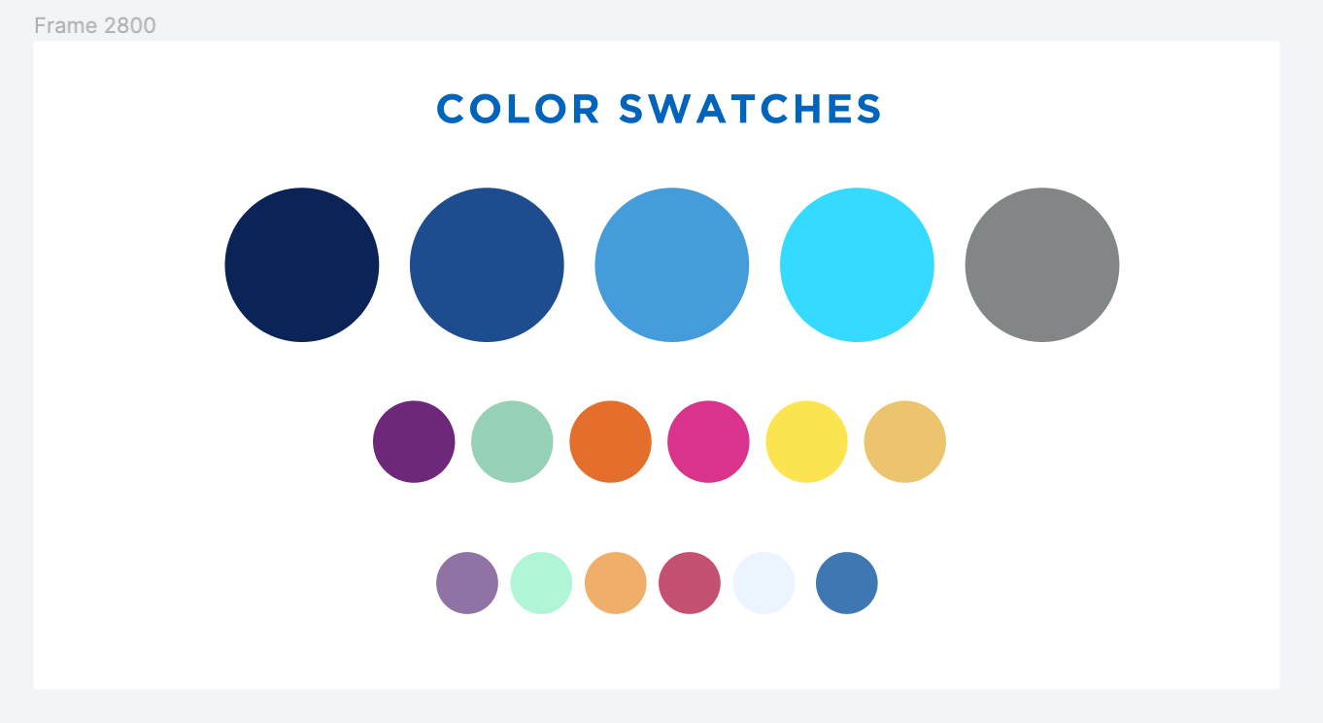
Update for OCLC/Alma Data Sync
June 15, 2022
Maureen Clements and Michelle Eichelberger

Slide 2
What's happening?
Additions and deletions of OCLC records in Alma have been regularly sent to OCLC from campuses, but don't always arrive, even though the publishing job in Alma says that it succeeded.
The Problem

Slide 3
How did we discover this problem?
In early April, we received a campus report of titles deleted in Alma not showing as deleted in OCLC.
Troubleshooting:
Checked OCLC S/FTP settings
Checked OCLC Data Sync publishing profile settings
Checked Alma job history to look for failures
Checked Worldshare to see if files had arrived from Alma

Slide 4
What we found
Comparison of successful jobs in Alma with files received in Worldshare demonstrated that there were missing files.
"Completed Successfully" indication in Alma didn't always mean that a file showed up in Worldshare.

Slide 5
FTP Delivery
FTP, the delivery mechanism for these files, is notoriously unstable, but if the job fails early enough in the process, the entire job fails, and the content is resent the next time the job runs.
If you look at job events for successful jobs, you'll often see FTP Connection Fail errors, but that doesn't mean that the job wasn't successful. It will keep trying to connect and is usually successful (eventually).

Slide 6
Poor Success Indication
With the intermittent failures that we identified by comparing files sent by Alma with files received by OCLC, the failure comes too late in the job process to be identified as a true failure, and the job is marked as "completed successfully."
The problem with this is that the content will NOT be resent, because Alma thinks the job ran successfully.
Both Ex Libris and OCLC stated that this is a known issue, and has been reported by institutions outside of SUNY.
On the bright side, Ex Libris can see these late failures happening on their end and is working to better identify them as failed jobs.

Slide 7
Missing Data Challenges
How do you tell which jobs really failed?
No current indication in Alma
Files in OCLC are only kept for a limited length of time, so comparison of jobs in Alma with received files in Worldshare isn't comprehensive
Timing of when file was sent from Alma and when it arrives at OCLC doesn't always match up. There can be a lag.
How do you tell what was in the file that never arrived?
Alma job reports number of records processed, but not which ones
Deleted bibs only send once, and if that fails, they're gone from Alma
Alma may be including electronic content bibs that you don't really own in OCLC

Slide 8
Next Steps

Slide 9
Vendor Management
SLS will continue to advocate for improvements to the publishing job.
Have met and will continue to meet with development teams at both OCLC and Ex Libris
We are communicating our findings to other consortia
Will use SUNY LSP and Discovery Headquarters HQ to communicate status updates to SUNY Libraries

Slide 10
Data Sync Reality Check
OCLC
Alma
The job will not be fixed in the near future.
SUNY Library holdings are out of sync in Alma and OCLC and will continue to be only somewhat in sync until the job is fixed.

Slide 11
Data Sync Workflow
Find deleted titles
Batch delete in Connexion*
Run Full publishing from Alma
*Running deletes first ensures that if your campus has deleted a title and then added it back in, the delete will not override the re-added title.

Slide 12
Data Sync Workflow Responsibility
SLS will run the initial data sync workflow to catch missing changes since go-live:
Will run first pass for any SUNY campus who opts in via https://slcny.libwizard.com/f/data_sync_opt-in
Will run first pass and continuing quarterly or bi-annual data sync for campuses who have support contracts
SLS has created a training FAQ (https://slcny.libanswers.com/faq/369093) for campuses who wish to do this work themselves for the first pass or for ongoing maintenance.
We plan to finish first pass for supported and opt-in campuses by the end of summer.

Slide 13
Initial Results
Rate of Failure has varied widely for the first three campuses who have been resynched.
This could be related to daily vs. weekly OCLC publishing, with weekly publishing seeing a much higher rate of failure. Or could be related to the frequency of weeding, times of the week when the servers are more busy than others, etc.
We'll post our findings in the SUNY LSP and Discovery Headquarters HQ Basecamp if we find any reportable data.

Slide 14
Questions?

