Slide 1
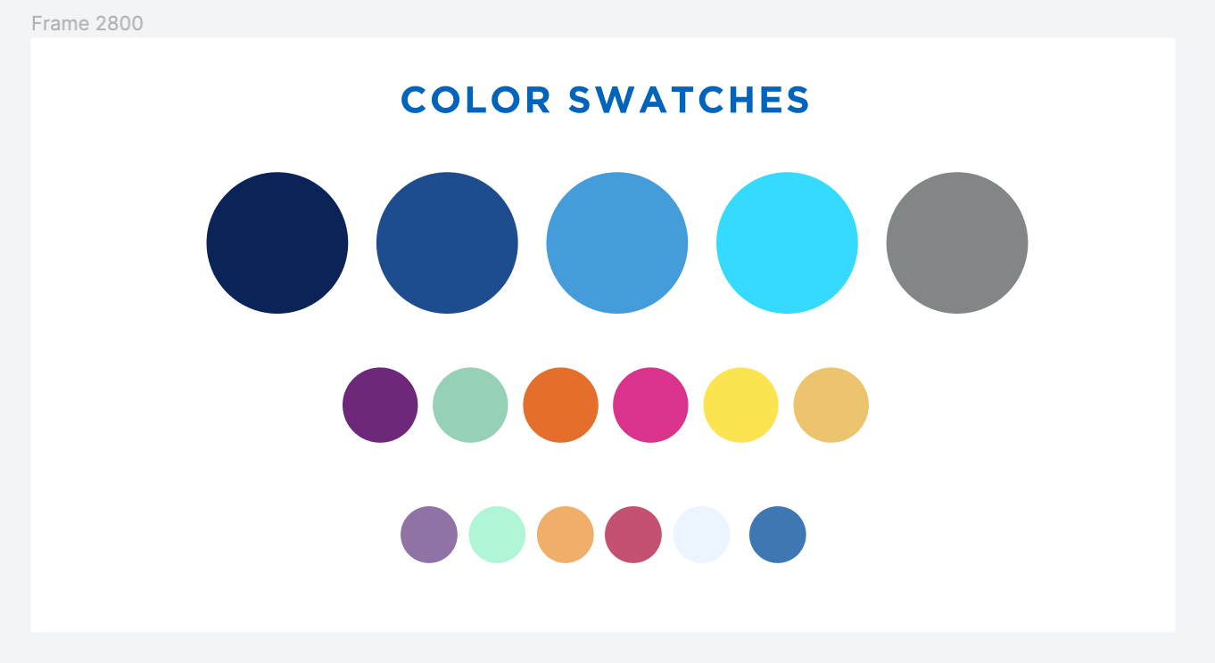
Using Local Collections and GES for Custom Linking in Primo VE
Michelle Eichelberger, SUNY OLIS
Nancy Babb, University at Buffalo, State University of New York
SUNY OLIS Webinar, September 28, 2023

Slide 2
What is Custom Linking?
Set up in Alma
Lets you add Primo links for content that isn’t available in the Community Zone, or for content that doesn’t work the way you’d like it to work
Allows you to pull metadata out of bib record or CDI search record and send it somewhere else, either to fill out a form, or do a search on another platform
Built with two pieces of information: a search URL (could be internal in Primo or external like Google) and a Primo data field to use in the search
Opportunities are endless

Slide 3
Use Case for Custom Linking
Newspaper Records in the Central Discovery Index (CDI):
ISSNs match on search records from multiple editions, not just the edition indexed by library’s provider. Titles often change between late edition and next day’s edition, leading to linking failures
Also match on search records from blogs, other content that might not be included on some vendor platforms, but not all, and maybe not in your library’s provider database.
Site License newspaper packages aren’t set up to use dynamic linking. If there is a collection in the CZ, it’s probably just a direct link to the website.
Nancy will be providing additional examples.

Slide 4
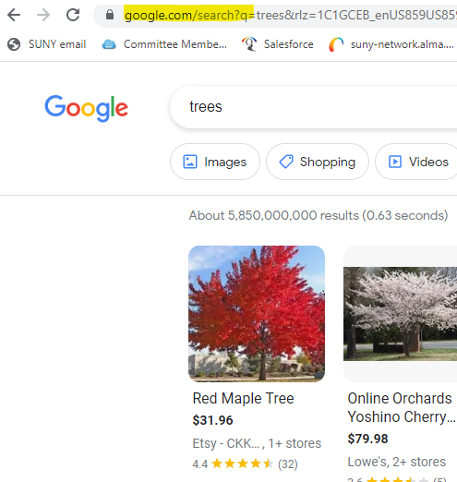
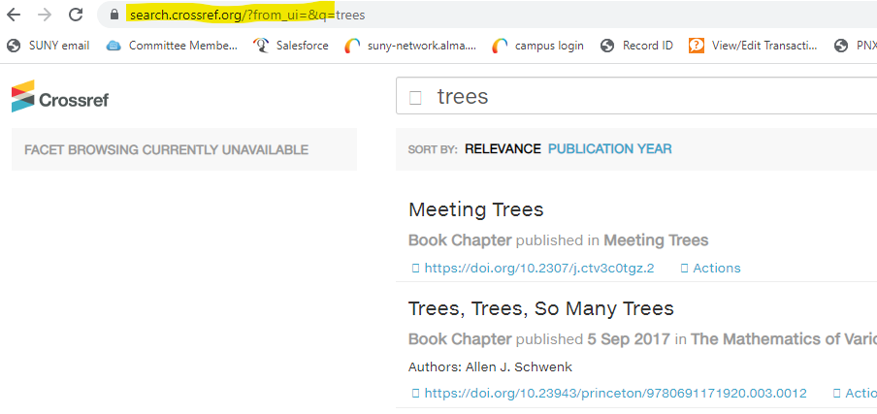
Creating a Search String: External Search
Step 1:
Perform a search in the site where you’re trying to link, and figure out the search structure.
Examples: https://www.google.com/search?q=trees or https://www.nytimes.com/search?query=trees

Slide 5
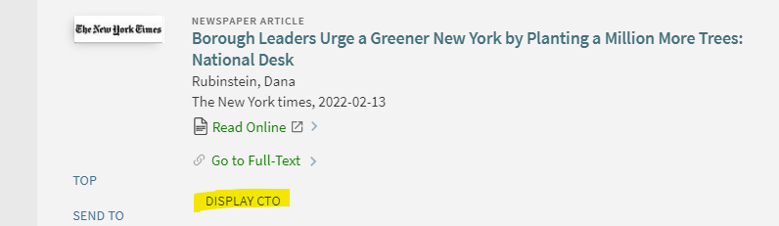
Creating a Search String: Select metadata
Step 2:
Perform a search in Primo and add &displayCTO=true to end of URL to figure out what fields you want to pull from the search records:
https://suny-esc.primo.exlibrisgroup.com/discovery/fulldisplay?docid=cdi_proquest_newspapers_2628025643&context=PC&vid=01SUNY_ESC:01SUNY_ESC&lang=en&search_scope=MyInst_and_CI&adaptor=Primo%20Central&tab=Everything&query=any,contains,trees%20new%20york%20times&facet=rtype,include,newspaper_articles&facet=jtitle,include,The%20New%20York%20Times&offset=0&displayCTO=true

Slide 6
Creating a Search String: Create link
Step 3:
Combine the search URL with the field(s) you want to use for the search: For example, if you wanted to create a link that searches the New York Times website by article title, the link would look like: https://www.nytimes.com/search?query={rft.atitle}
Best practice is to err on the side of simplicity: Justin Dise did testing with the New York Times and found that adding date or author could inadvertently remove relevant search results.
SLS FAQ: How can I create custom linking for resources like the New York Times Academic Pass, which isn't included in the Community Zone?

Slide 7
Collection vs General Electronic Service
General Electronic Service (GES):
Set up in Config>Fulfillment>Discovery Interface Display Logic
Applied by genre, ISSN, title or other field in metadata - need to add one at a time
Could display in View It, Get It, or How to Get It
Easy to control whether patron needs to login to see link, can affiliate by user group
Collection:
Link appears in Get It with other full-text links
Tied to portfolio bib record, which can allow greater control over where it appears
If you’d like to apply link to a large number of portfolios, can use portfolio loader to add them in bulk
Can use display order to put at top of list of full-text links
Both:
Can add public note
Can be used with display order to hide or display based on criteria

Slide 8
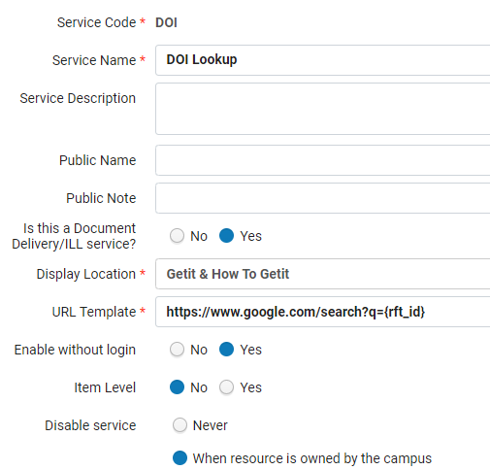
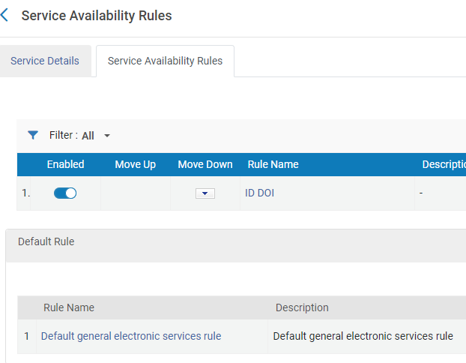
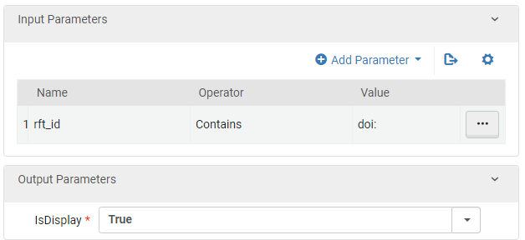
Setting up the GES
GES:
Config>Fulfillment>Discovery Interface Display Logic
Link format would be something like: https://www.google.com/search?q={rft_id} and you could choose to only display it if the item is not owned by the campus (e.g. if you get no full-text links for an incoming link resolver link)
Use Service Availability Rules for more granular filtering, like rft_id Contains doi:

Slide 9
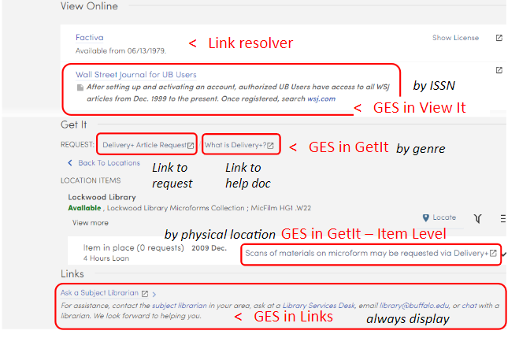
Setting up the GES, continued
GES Notes/Caveats:
Rules with multiple criteria: AND = single rule with multiple criteria; OR = multiple rules with separate criteria in each
Public notes & HTML are supported in View It & Links – but not GetIt
Links area is most flexible location, but is it easy to overlook?
For article-level actions, records may need to exist in CDI
There are limitations to what attributes can be used in GES OpenURL strings - it may be necessary to combine multiple GES and multiple display logic rules (ex: GES for an electronic collection)
Availability calculation (i.e. records included in filtered results; title-level coverage display in results & brief records) depend on Alma collection activation – GES alone isn’t sufficient

Slide 10
Setting up a Collection
Collection:
Create Local Collection
Edit Service, linking tab add dynamic URL
Add specific titles on Portfolios tab, Add Local Portfolio (reuse CZ bib record)
Add Public Note if it’s a subscription-based collection or has other access requirements

Slide 11
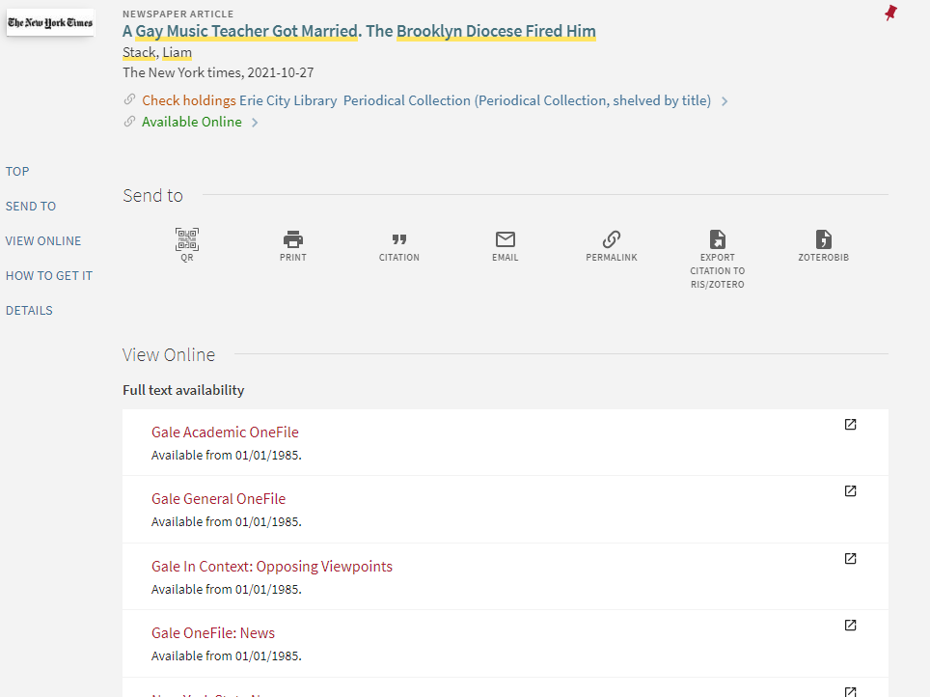
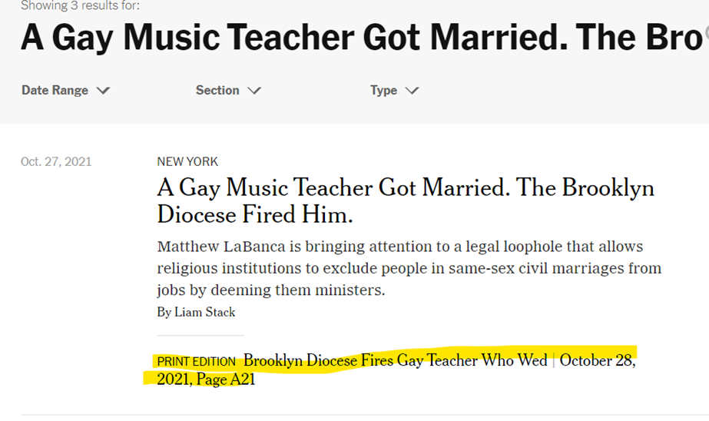
Example: New York Times Site License
Print Edition title is different from Late Edition title and both match as available search records for The New York Times in Primo. Gale linking will fail for Late Edition title.

Slide 12
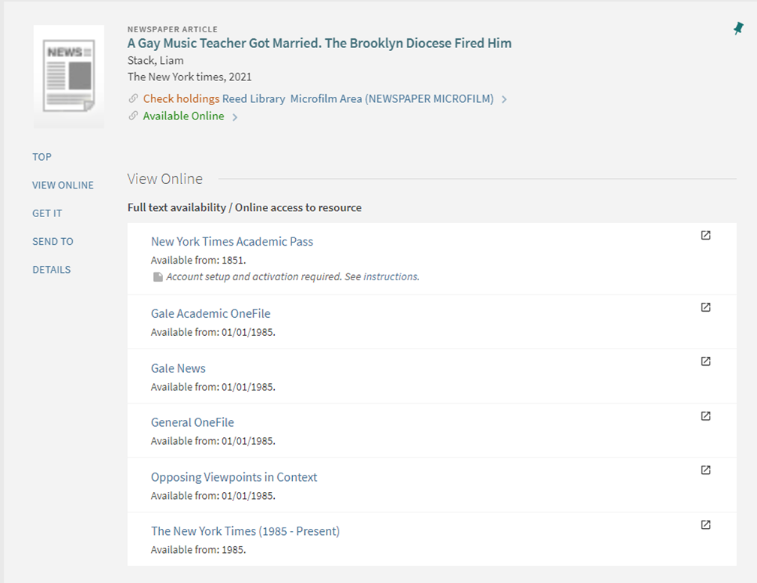
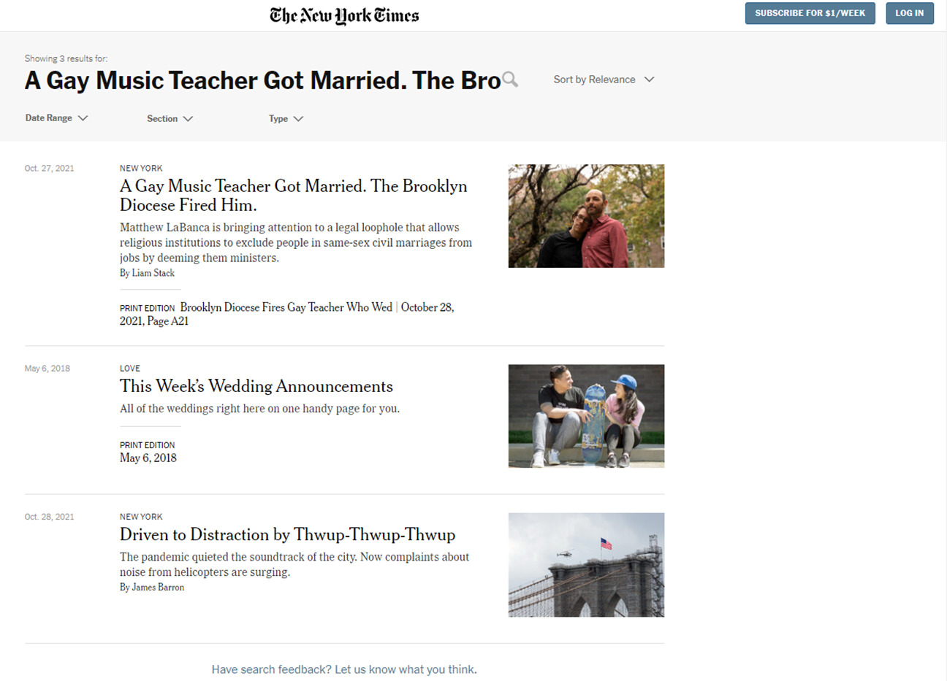
Examples: New York Times Site License

Slide 13
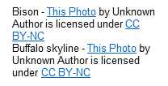
Problem? Fix it!
Custom GES use at University at Buffalo, SUNY
Our Use Cases
Supplementing or enhancing outgoing links from CDI records;
Improving Primo VE services pages (incoming OpenURL responses);
Contextual point-of-problem help & documentation
Our Caveats
GES are perfect for some actions – such as links to ILLiad forms – but in other cases they’re qualified successes that serve best as temporary quick fixes while more robust solutions are developed;
Outgoing links are great to add, but they can’t be used to calculate availability display in Results nor Brief Record;
Article-level action both outgoing & incoming requires that the records already exist in CDI;
Alternatives include: local collections; custom js; Resource Recommenders

Slide 14
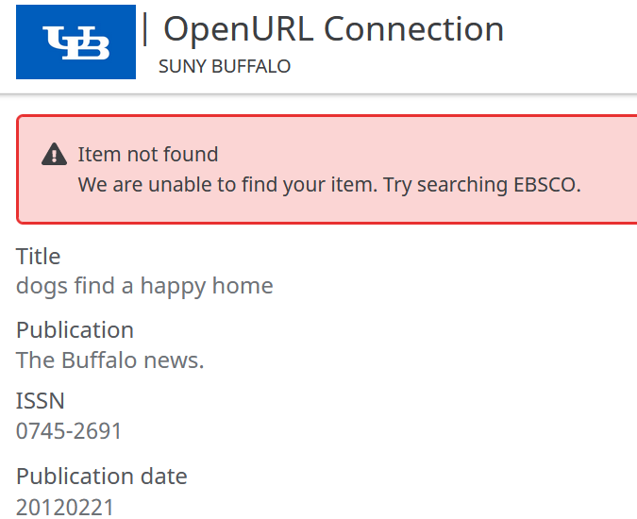
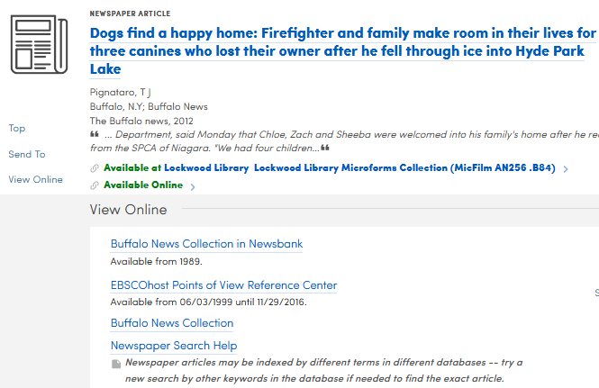
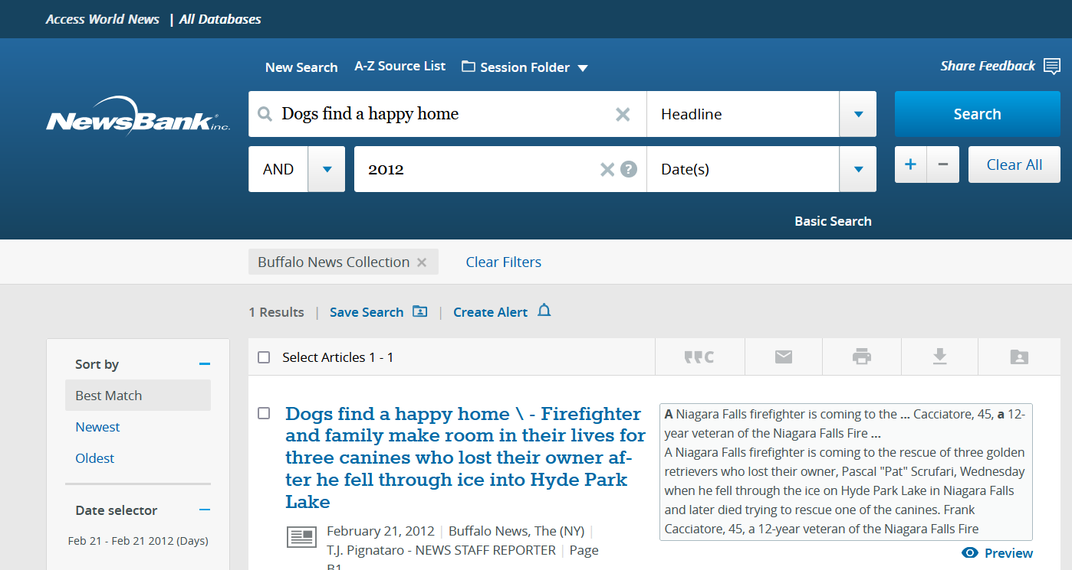
Problem: Content indexed in CDI for other collections but local link / collection not available in or appropriate for CZ
Fix it! GES for title or collection using ISSN and OpenURL search string
< Local Collection
< Link resolver
< GES
< GES
Supplementing/Enhancing outgoing links - example 1

Slide 15
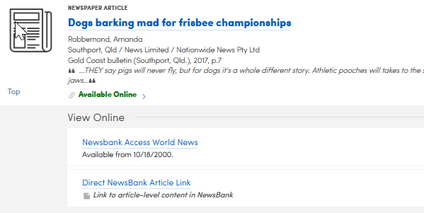
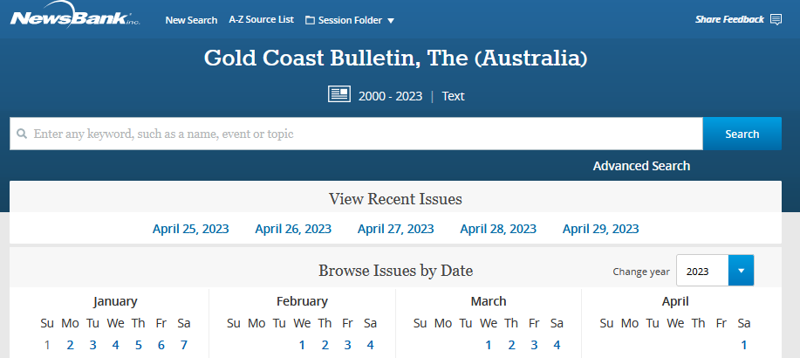
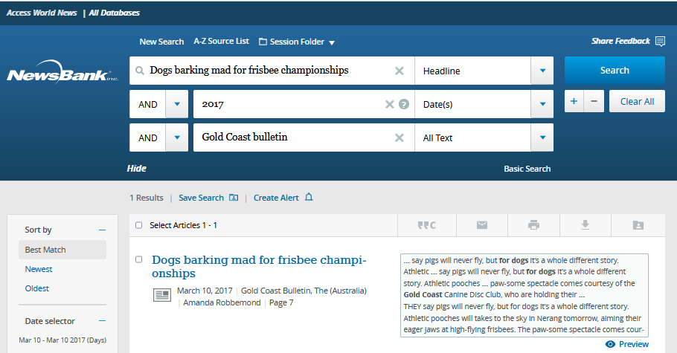
Problem: Link resolver links to title only, not individual articles
Fix it! GES using OpenURL string for articles within a particular electronic collection, using genre/resource type and OpenURL search string; discovery display logic to hide/display for collection (see filters in CTO)
< Link resolver
< GES
GES for Newsbank Article Linking - https://knowledge.exlibrisgroup.com/Alma/Knowledge_Articles/GES_for_Newsbank_Article_Linking
Supplementing/Enhancing outgoing links - example 2

Slide 16
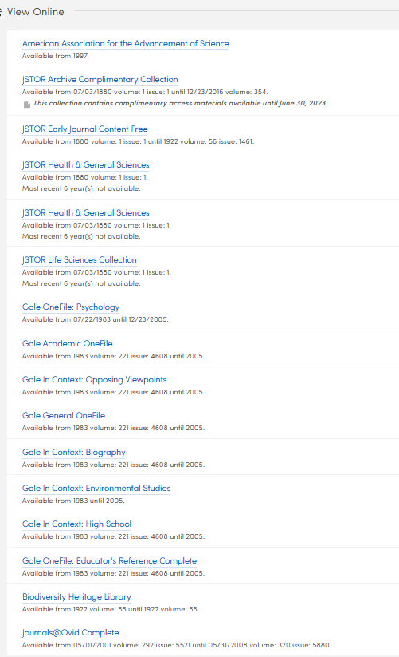
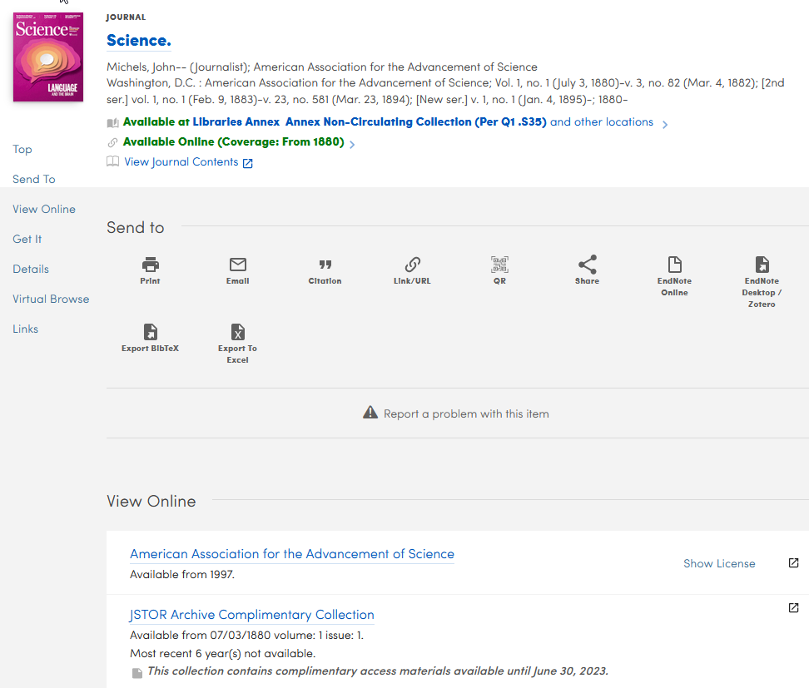
Why we consolidate by Interface
AAAS
JSTOR (5)
Gale (8)
BHL
Ovid

Slide 17
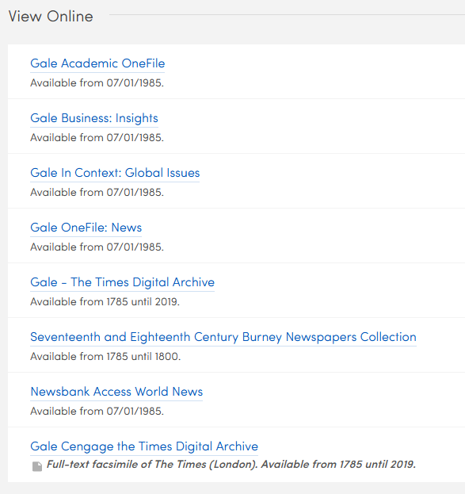
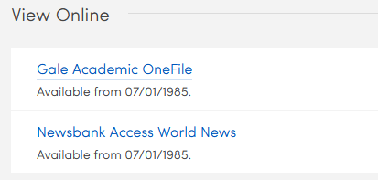
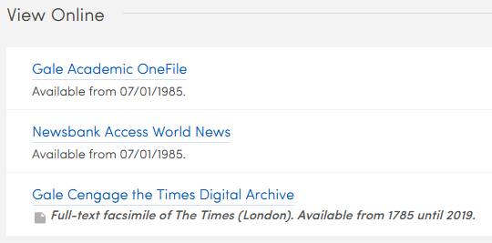
Problem: Consolidating links by interface suppresses display of specialized collections in favor of otherwise most desirable link - how to exclude collections from consolidation?
Fix it! multiple GES using OpenURL string for titles & articles within a particular electronic collection
What can you do about
too much or not enough
Times ?
Too few
Too many
Link resolver >
Just right?
Link resolver >
GES >
Supplementing/Enhancing outgoing links - example 3

Slide 18
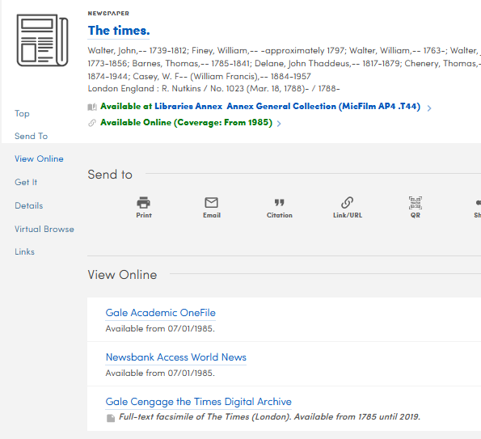
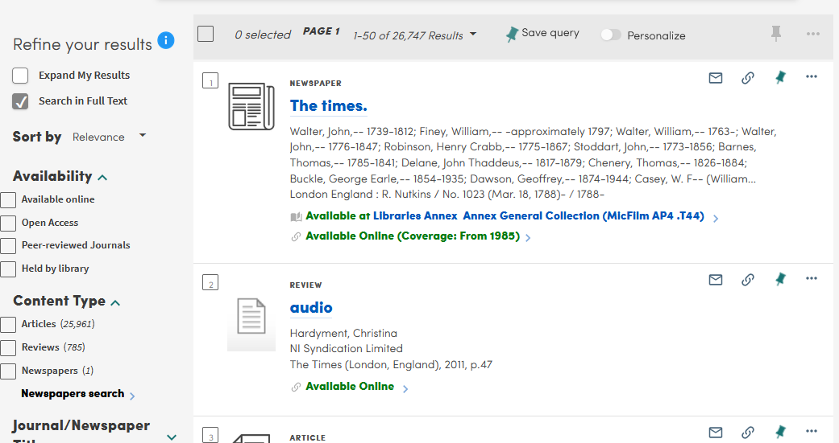
Hooray but also Alas
The GES link will display within years included in defined criteria (1785-2019), so it’s fine for article-level coverage –
but the GES dates of coverage are not displayed in the results list/brief display.
Results/Brief Display Availability = From 1985
Link resolver = From 1985
Link resolver = From 1985
GES = 1785-2019
Supplementing/Enhancing outgoing links - caveat

Slide 19
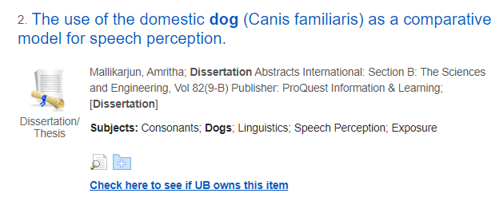
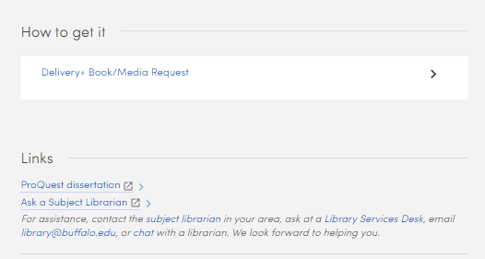
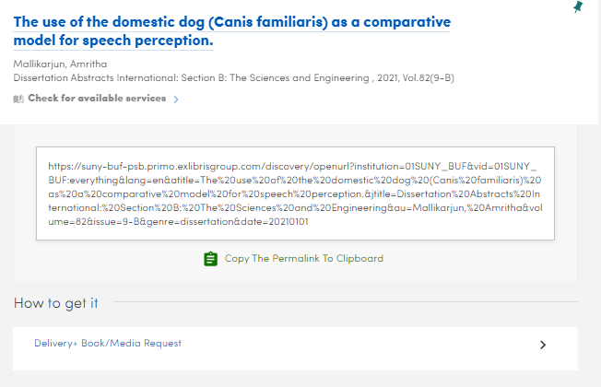
Problem: Incoming OpenURL searches do not trigger links for content in database-type collections
Fix it! GES using any available metadata element to trigger link in How to Get It – ex: genre/format “dissertation” for ProQuest Dissertation collections
With default shared GES from Community = link; good, but may be easy to miss
APA PsycInfo
University at Buffalo revised GES = How to Get It + instructional note
Without GES =
No online services
Hat tip and huzzah to Justin Dise, University at Buffalo!
Improving Primo services pages (incoming OpenURL responses) - example 1

Slide 20
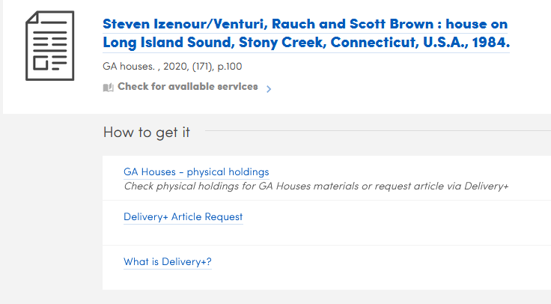
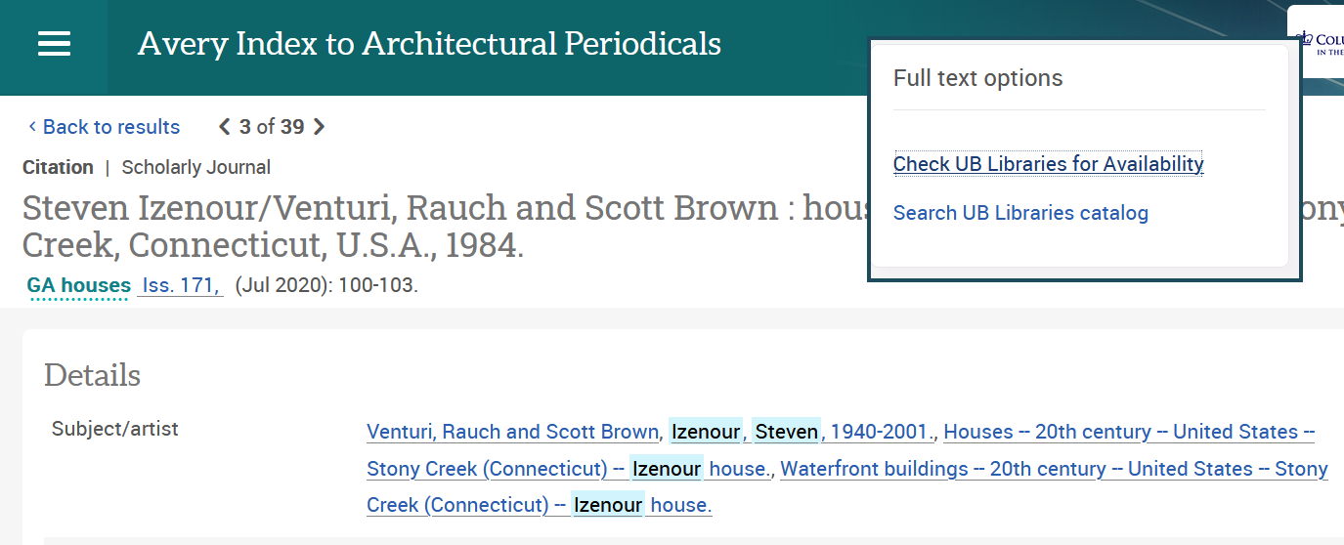
Problem: Incoming OpenURL searches can’t apply physical-only journal holdings if there’s no ISSN, so users may miss materials
Fix it! GES for selective journals by other unique identifier to add public note and link to record for print holdings - applies to both Primo services page (incoming OpenURL) & CDI records that appear in expanded search results
GES >
No online holdings nor fulfillment for article, but GES alerts to the existence of journal physical holdings
Improving Primo services pages (incoming OpenURL responses) - example 2

Slide 21
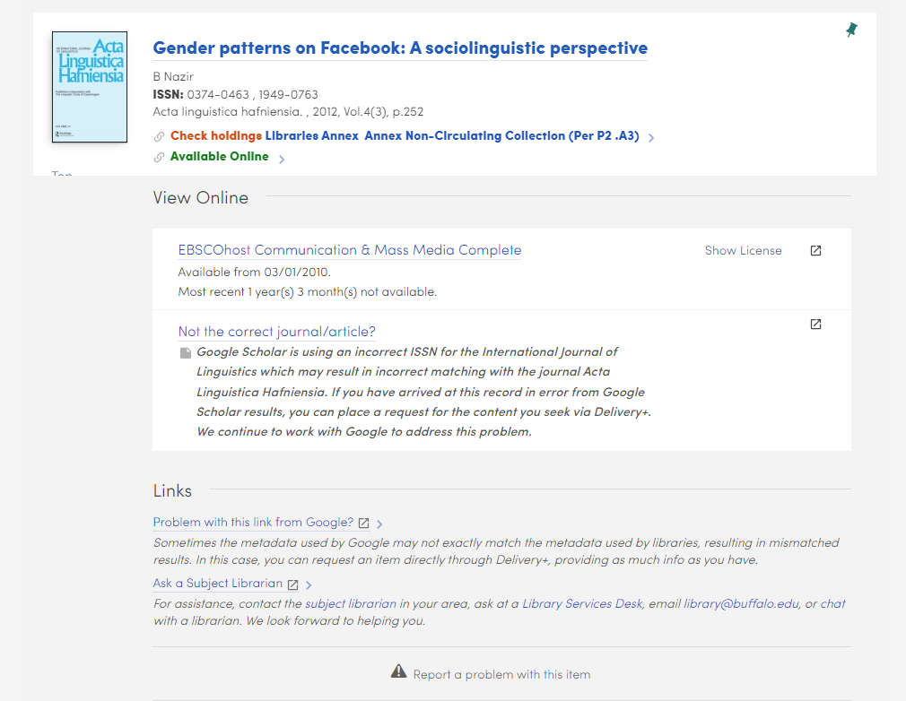
Problem: Other incoming OpenURL/Primo services page problems
Fix it! GES for referring site (ex: rfr_id=google, rfr_id contains PubMed) to add user explanation and assistance via note and link; can be combined with additional attributes (ex: ISSN) for greater specificity
https://suny-buf-psb.primo.exlibrisgroup.com/discovery/openurl?institution=01SUNY_BUF&vid=01SUNY_BUF:everything&volume=4&date=2012&aulast=Nazir&issue=3&issn=0374-0463&spage=252&auinit=B&title=International%20journal%20of%20linguistics&atitle=Gender%20patterns%20on%20Facebook:%20A%20sociolinguistic%20perspective&sid=google
Google Scholar has an incorrect ISSN for journal resulting in bad metadata/link in Primo services page – GES guides user to place a request for desired content
GES >
GES >
Improving Primo services pages (incoming OpenURL responses) - example 3

Slide 22
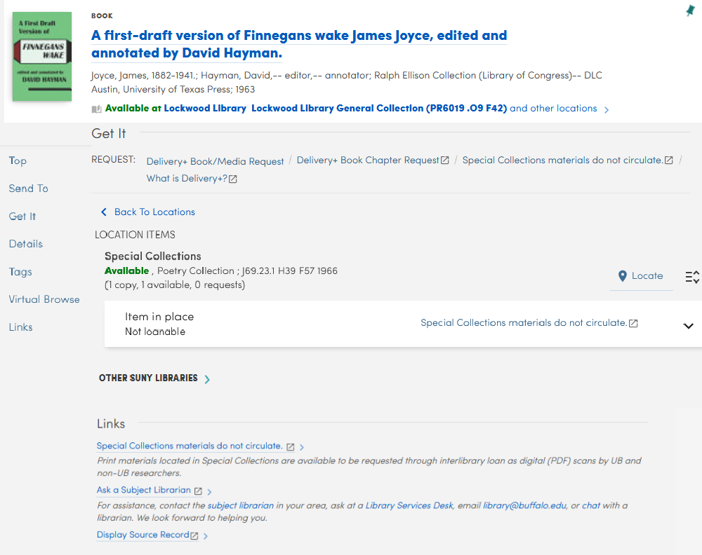
Problem: Users are often not familiar with special use policies and other rules related to specific libraries, locations, or collections, resulting in disappointing visits or requests if materials are restricted.
Fix it! GES for Library/Location ideally within GetIt title or item area, alerting users to policies with links to more information.
> Rule = location
> Rule = library OR location
Alas, currently only the labels and not the public notes are displayed in GetIt GES (open case 06485222) ; Notes are displayed in ViewIt and Links. So – display in both GetIt & Links?
Contextual documentation & communication - example 1

Slide 23
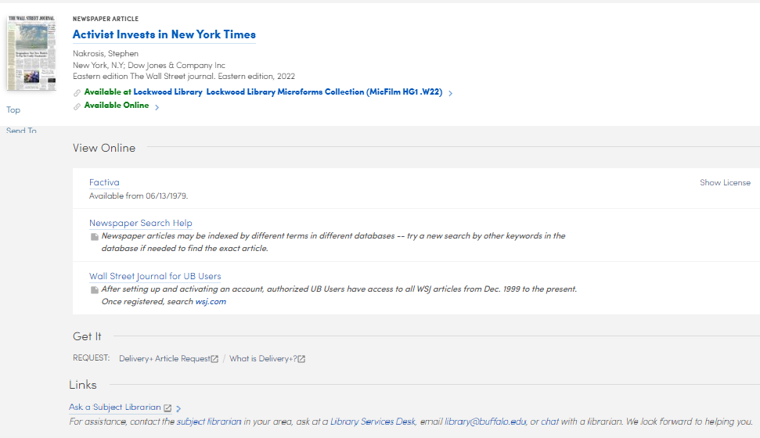
Problem: Some types of searches or materials may have known quirks in Primo VE, which can be alleviated with contextual help at the point of challenge. These “help” GES can be useful to end users and those who work with them.
Fix it! GES for resource type/genre within ViewIt with quick tips & link to more in-depth help documentation.
Other custom GES in this record are custom link to Wall Street Journal (by ISSN) & general help info for all records.
Link resolver >
GES >
GES >
GES >
Contextual documentation & communication - example 2

Slide 24
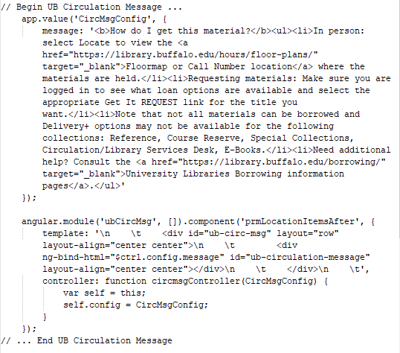
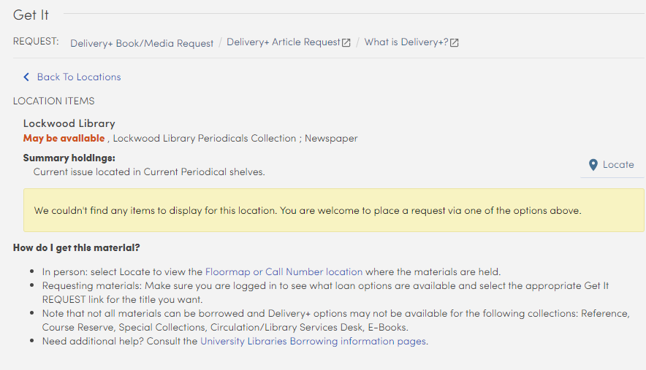
Alternative: custom js message or file include Use to add note/link to part of the Primo VE record independent of a unique identifier
This example adds a note within the custom.js file to display at prmLocationItemsAfter. It will display only with the item display and disappears with “Back to Locations.”
Alternative example 1 - custom js message or file include

Slide 25
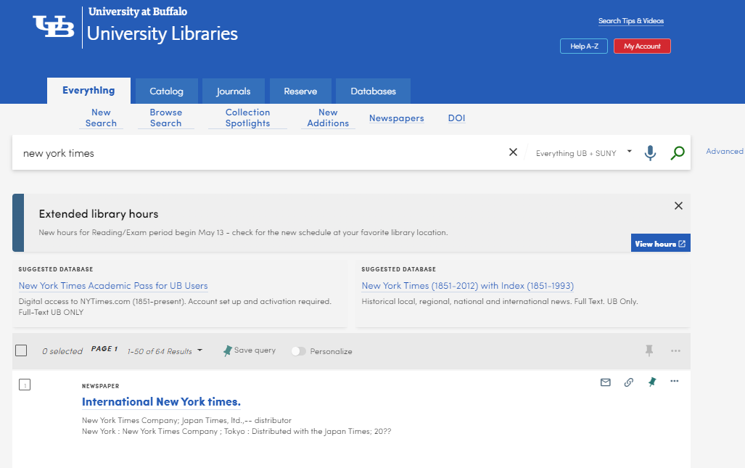
Alternative: Resource Recommender
Use to alert users to system problems or provide more prominent links to search-specific help.
Use full banner or individual entry.
Display always or on keyword match.
Custom CSS for Resource Recommender Banner by Justin Dise, available at https://primoviews.org/css-snippets/css-revised-resource-recommender-banner/
Alternative example 2 - Resource Recommender banner

Slide 26
Contact
Links
Michelle Eichelberger
Discovery and E-Resources Program Manager
SUNY Library Services
email: michelle.eichelberger@suny.edu
https://slcny.libguides.com/sls
Nancy Babb
Discovery Services Librarian
UB Libraries, University at Buffalo, SUNY
email: babb@buffalo.edu
https://library.buffalo.edu/
SUNY Primo VE instances: https://slcny.libguides.com/discoverywg/suny_primo_urls
UB Primo VE: https://library.buffalo.edu/
UB Sandbox: https://suny-buf-psb.primo.exlibrisgroup.com/discovery/search?vid=01SUNY_BUF:everything

