Slide 1
Behavioral Health Apps for Youth
Liz Cantor, PhD & Sarah Hagin, PhD
October 5, 2023

Slide 2
Presenters
Liz Cantor, PhD
Pediatric IBH Practice Facilitator & Consultant, CTC-RI
Sarah Hagin, PhD
Director, Feeding Program, Hasbro Children's Hospital

Slide 3
CTC-RI Conflict of Interest Statement
If CME credits are offered, all relevant financial relationships of those on the session planning committee have been disclosed and, if necessary, mitigated.
The AAFP has reviewed ‘Advancing Comprehensive Primary Care Through Improving Care Delivery Design and Community Health,’ and deemed it acceptable for AAFP credit. Term of approval is from 03/18/2022 to 03/18/2023. Physicians should claim only the credit commensurate with the extent of their participation in the activity. NPs and RNs can also receive credit through AAFP’s partnership with the American Nurses Credentialing Center (ANCC) and the American Academy of Nurse Practitioners Certification Board (AANPCB).

Slide 4
Objectives
Increase knowledge and utilization of BH Apps in pediatric patients with MH conditions
Learn how to evaluate BH Apps for efficacy
Identify at least one BH APP to recommend to patients and families.

Slide 5
Objectives
1. Increase knowledge and utilization of BH Apps in pediatric patients with MH conditions
2. Learn how to evaluate BH Apps for efficacy
3. Identify at least one BH APP to recommend to patients and families.

Slide 6
Today’s Outline
Defining terms: Apps vs. Digital Therapeutics
State of the field
How many (quality) apps are out there?
Are there models or frameworks to evaluate them?
What’s important to teens?
Do they work?
Digital BH Interventions in pediatric primary care
Case examples/App recommendations
(References and Resources at the end of the slide deck)
Notes:
Disclaimer! We are not experts in this field, but were invited to present on this topic and provide some guidance to our pediatric community
What we found: it IS overwhelming, things are changing all the time, and there are no perfect solutions or one-size-fits-all solutions
So, today we wanted to give you an overview of the field, some tools for finding and evaluating apps, AND provide some suggestions based on the current app availability
Hold questions for the end -

Slide 7
Defining terms
Digital mental health = all digital solutions and tools
Apps, digital tools that are adjuncts to treatment, virtual care AND the use of the information/technology to support health; aka digital interventions
APPlications = a type of software that allows you to perform specific tasks on a mobile/desktop device – examples:
BH Apps: Calm, Sanvello, Headspace
Digital Therapeutics – next slide

Slide 8
Digital Therapeutics
Definition of Digital Therapeutics from the Digital Therapeutic Alliance:
Digital therapeutics (DTx) deliver evidence-based therapeutic interventions that are driven by high quality software programs to prevent, manage, or treat a medical disorder or disease. They are used independently or in concert with medications, devices, or other therapies to optimize patient care and health outcomes.
Core Principles include (there are others):
Prevent, manage, or treat a medical disorder or disease
Be reviewed by regulatory bodies
Publish trial results in peer-reviewed journals
“Software as a medical device”
For more information: https://dtxalliance.org/aboutdtx
Notes:
Regulators use the term: “Software as a medical device” ; e.g. Daylight (anxiety) and Sleepio (tx for insomnia and other sleep pxs) – more widely available in the UK – the NHS covers the cost of these for everyone in Scotland
(E.g. Sleepio – treats insomnia disorder in adults –$450/year)
DTXs provide an exciting opportunity for extending the reach of evid based therapeutic interventions to more people - almost everyone has access to a mobile device –I’ll say a bit more about this in a few minutes

Slide 9
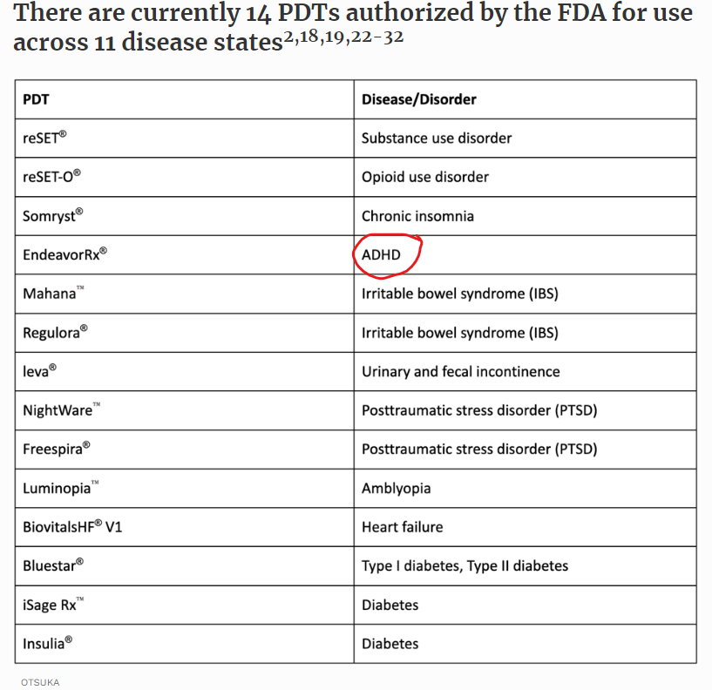
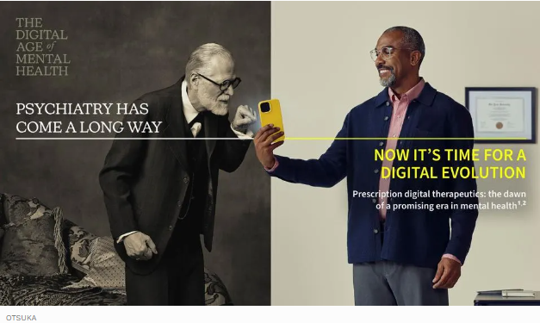
Some digital therapeutics
require a prescription
Forbes June 26, 2023
Notes:
DTs may or may not require a prescription – If they require a Rx, they are FDA approved
Note: only one for kids and MH is EndeavorRX

Slide 10
Example of a Prescription Digital Therapeutic EndeavorRx
Target: ADHD (ages 8-12)
FDA-authorized “prescription video game” – not available w/o Rx
Targets cognitive processes that are involved in attention
Algorithm personalizes the intervention – adjusting difficulty and speed based on perf
Multiple studies, over 600 children, 4 week intervention: results -> improved sxs, improved perf on attn msrs*
Instructions provided
Should be part of a therapeutic program: clinician-directed tx, medication, educational interventions, etc.
$99/month
website: hcpendeavorrx.com
* Kollins, S.H. et al. 2021
Notes:
English only

Slide 12
SparkRx by Limbix (recently bought by Big Health)
Target: Adolescent Depression (ages 13-22)
5 week program, moving up levels
Expectation – using SparkRx in between provider visits – adjunctive
Follow up visit scheduled when SparkRx completed
Provider registers, gets a code -> patient
Provider can see progress
NOT approved by FDA yet, but offered for free during pandemic per FDA
One published clinical trial*
Not meant as a treatment w/o supervision by a provider
Not for emergencies/crisis/suicidality
English only, requires 5th grade reading level
Could be a great choice for pts with an IBH team
* https://classic.clinicaltrials.gov/ct2/show/NCT04524598
Notes:
This one does NOT need a prescription but it’s supposed to be used under supervision of a provider and provider sees and monitors progress
Free during pandemic – FDA Enforcement Policy – to expand options for treatment – working towards FDA approval
Pediatric provider can be the provider? Tried to get clarification on this but unable to get confirmation or update on cost
English only
WE LIKE THIS ONE – have to have a provider code to access it

Slide 13
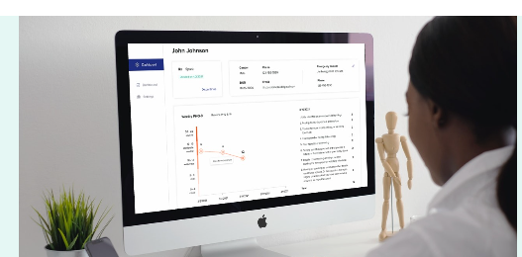
You can request a demo at https://www.sparkrx.com/
Offered for free during the pandemic
Providers can monitor sxs/progress
Notes:
Not sure of current cost
Note: we will provide a reference on digital tools for youth on substance use – not covered by us today

Slide 14
Digital therapeutics - one last word
DTxs hold promise for expanded access to MH care
Almost everyone has access to a smartphone
BUT, a major barrier: not usually covered by insurance (in the US)
Which means patients can’t afford it…
…and developers cannot sustain their companies…some are declaring bankruptcy
Notes:
NOTE: Heather Stringer article, APA: There is a major hurdle blocking widespread access which is that it is not usually covered by health insurance in the US. The costs for the software alone are often out of reach for many patients.
Which means… it’s also not sustainable for the companies that create the products – some are already declaring bankruptcy
Important for health equity- to make these available to folks who could benefit from them but can’t afford them

Slide 15
BH Apps - State of the field
How many (quality) BH Apps are out there?
Models for evaluation and where to find App info
FASTER (AHRQ)
APA evaluation model/MindAPPS.org
Onemindpsyberguide
Research
What do young people want in an App?
Meta-analysis for efficacy
Notes:
There is no regulatory body with a standardized review system – we’re on our own
Who is working on this – what does the research tell us?

Slide 16
How many (quality) BH Apps are out there?
There are between 10,000-20,000 MH Apps (overall, adult + youth)
Most don’t have any empirical evidence to back up their claims
They are not FDA approved
The field is changing all the time
One study: 2021 Systematic evaluation of apps for children and adolescents
Looked at: Dep, anx, or PTSD apps; search revealed 3806 apps
Only 15 Apps fulfilled their criteria for quality for:
Engagement
Functionality
Aesthetics
Information quality (inc evidence base)
Domhardt et al. 2021
Notes:
1st question – how many apps are out there?

Slide 17
Overall, quality “mediocre” and widespread absence of rigorous studies
“future high quality research is urgently needed”
(This list is already out of date…)
Notes:
NOTE THE LIST IS ALREADY OUT OF DATE – literature is always behind
FearShrinker – gone
Braineka – LatinAmerica – no longer available on iOS – they have a website
Conclusions This study systematically evaluated the quality of MHA for anxiety, depression and PTSD in youth. The results revealed a moderate overall app quality and point to a significant lack of empirically-informed intervention development, as well as an absence of rigorous studies to investigate the efficacy of apps that are currently offered in major marketplaces. Hence, future high quality research is urgently needed, to advance and evaluate MHA, all contributing to the augmentation and evidence-based utilization of digital health interventions. Furthermore, non-profit provisions of scientifically-based information on essential aspects of apps are urgently required to enable informed and balanced treatment choices for patients, caregivers and stakeholders in mental health.
*MARS (Mobile Application Rating Scale, 19 items, scored 1-5)
Engagement
Functionality
Aesthetics
Information quality (inc evidence base)
Not just in USA

Slide 18
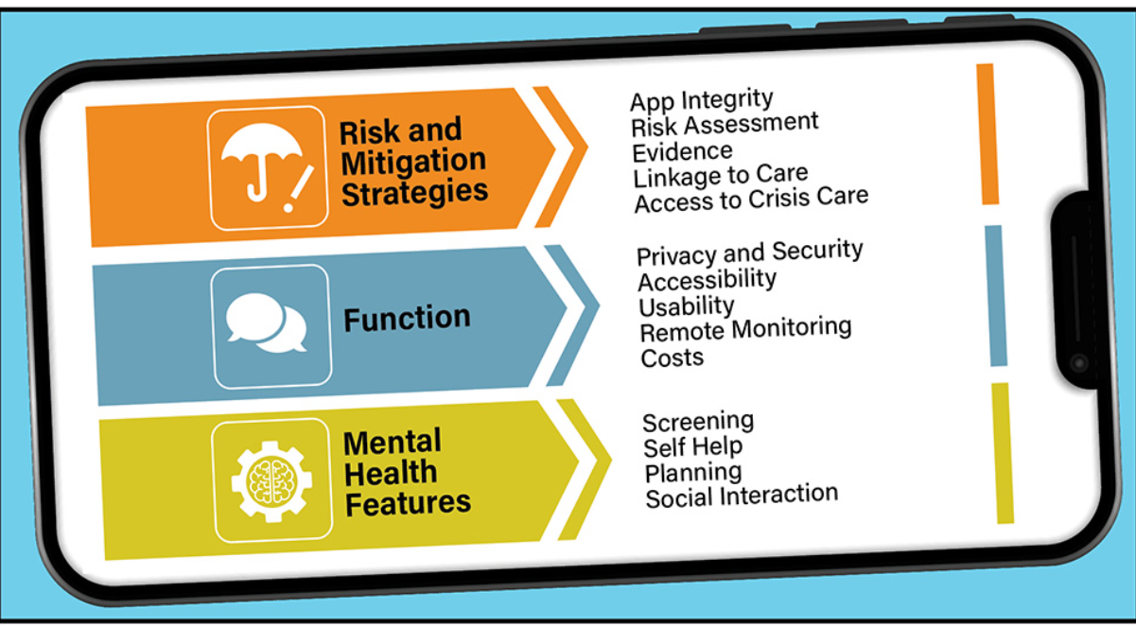
Models for Evaluation
AHRQ’s Academy for Integrating BH & PC
Framework to Assist Stakeholders in Technology Evaluation for Recovery (FASTER) to Mental Health and Wellness
FASTER may be used to help appraise and select mental health mobile apps
https://integrationacademy.ahrq.gov/products/topic-briefs/behavioral-health-apps
Notes:
2 Qs: how do I evaluate them, and how do I know what the options are?
I’m presenting 3 options - all have frameworks that they offer, educational material, and ways of finding out about what apps exist;
Model: 1. assess the risk/safety, 2. technical functionality, and 3. mental health features of apps.
Their website provides a nice overview of the field, how Apps can be helpful in primary care, things to think about (Not pedi specific)
Section 1. Risks and Mitigation Strategies, assesses the integrity and risk profile of the app; Section 2. Function, focuses on descriptive aspects related to accessibility, costs, organizational credibility, evidence and clinical foundation, privacy/security, usability, functions for remote monitoring of the user, access to crisis services, and artificial intelligence (AI); and Section 3. Mental Health App Features, focuses on specific mental health app features, such as journaling and mood tracking.
Conclusion. FASTER may be used to help appraise and select mental health mobile apps. Future application, testing, and refinements may be required to determine the framework’s suitability and reliability across multiple mental health conditions, as well as to account for the rapidly expanding applications of AI, gamification, and other new technology approaches.

Slide 19
From AHRQ BH App databases
https://integrationacademy.ahrq.gov/products/topic-briefs/behavioral-health-apps
Notes:
List of data bases for apps, also for DTxs

Slide 20
Models for evaluation American Psychiatric Association - App Evaluation Model
“The purpose of the evaluation is to give the psychiatrist and the patient sufficient information from which to make an informed decision that they deem correct for their situation.”
The Model
Start with lower levels, if ok, then move up
Level 1 = Background
Level 2 = Privacy and Safety
Level 3 = Clinical foundation/evidence base
Level 4 = Ease of use – hard to evaluate bec of individual diffs among pts – more subjective
Level 5 = Data/Clinical Integration
3 videos show how to use the framework
They don’t endorse any apps in particular
https://www.psychiatry.org/psychiatrists/practice/mental-health-apps
Notes:
2nd Model

Slide 21
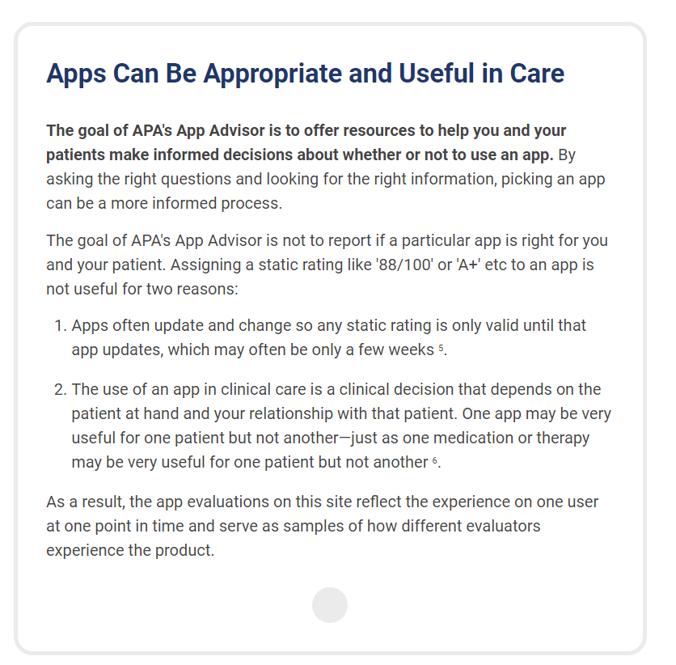
American Psychiatric Association
Notes:
They include cautions – things to think about
Really intended for psychiatry/patient to use together.
Note Right slide #1 item

Slide 22
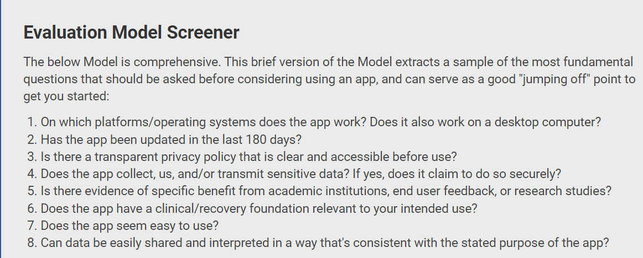
American Psychiatric Association
MINDapps.org: Using the APA model in an interactive data base
600 Apps to choose from
Slide coming up

Slide 23
MindApps.org
Notes:
MINDapps.org
Note filters on left: Free, Spanish, Mood
Also note the search function on the top
Downside: cannot filter by age group
Mention Virtual Hope Box – Sarah will do one slide on this

Slide 24
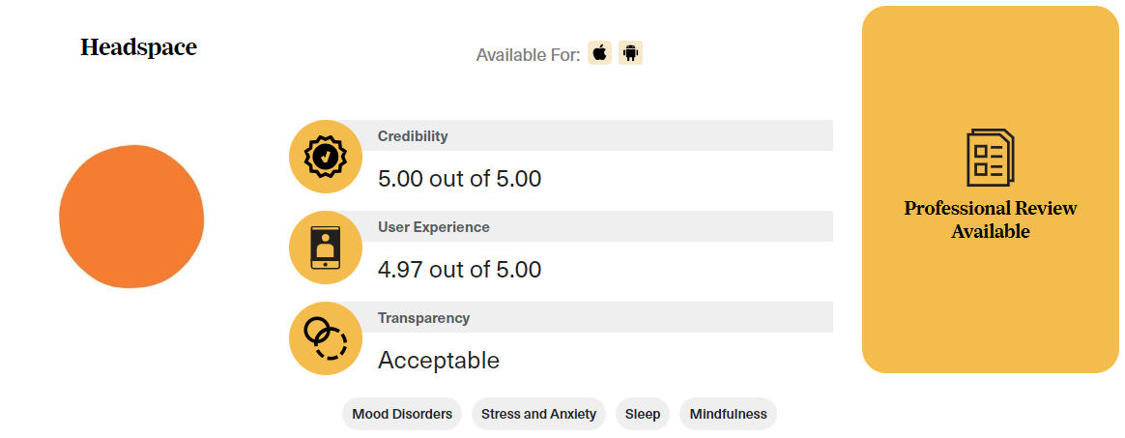
Models for evaluation One Mind Psyber Guide
Help me find an App https://onemindpsyberguide.org/apps/
Choose condition (e.g. Stress and anxiety)
Filter by: Platform (e.g. iOS), Audience (e.g. Adolescents), Cost (e.g. Free)
Apps rated by
Credibility
User Experience
Transparency
Notes:
3rd MODEL: look at credibility, user experience, and privacy
Professional Review will include pros/cons and detailed review by a professional
This is a living guide –
Filter by audience:
Includes Currently Unavailable Apps: - show picture
Say more about transparency – what that means – transparent AND whether policy is ok

Slide 25
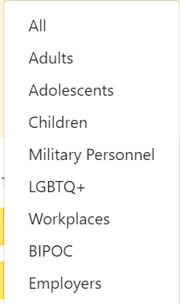
Filter by audience: Note there is no filter for language, and you cannot pick two (e.g. BIPOC Adolescents)
Notes:
It’s not perfect

Slide 26
Also includes Currently Unavailable apps (there are dozens…)

Slide 27
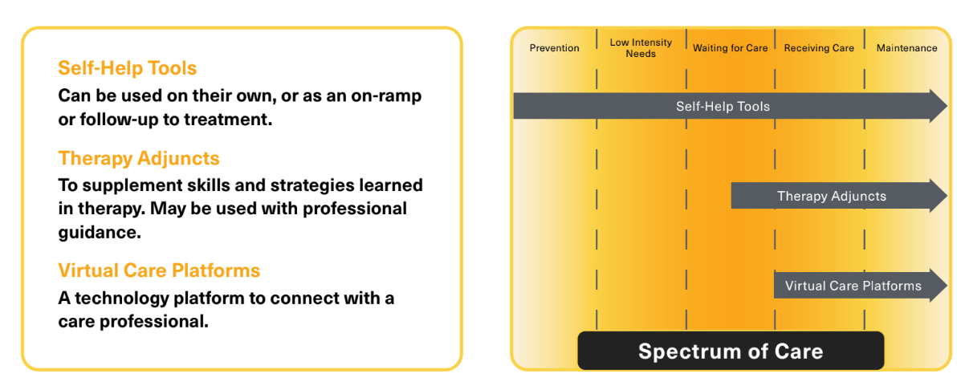
Teen App Guide (from One Mind Psyber Guide, in references, 2022)
Reviews of 19 selected digital tools
Provide insights from interviews with teens, professionals, developers
Provide practical resources to teens, families, providers, to support selection of a tool
Notes:
Not a living document, but just made in 2022

Slide 28
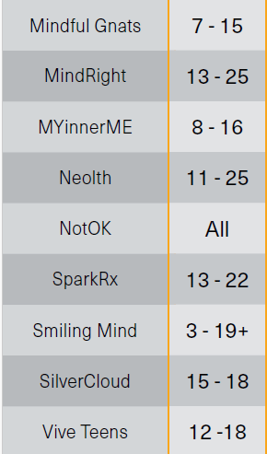
19 Apps they review
Notes:
Note that they list Platforms – not all apps are available on each platform – e.g. Mindful Gnats is available through Google Play but not through the Apple App Store.
Examples of how the field changes all the time – need to regularly review apps

Slide 29
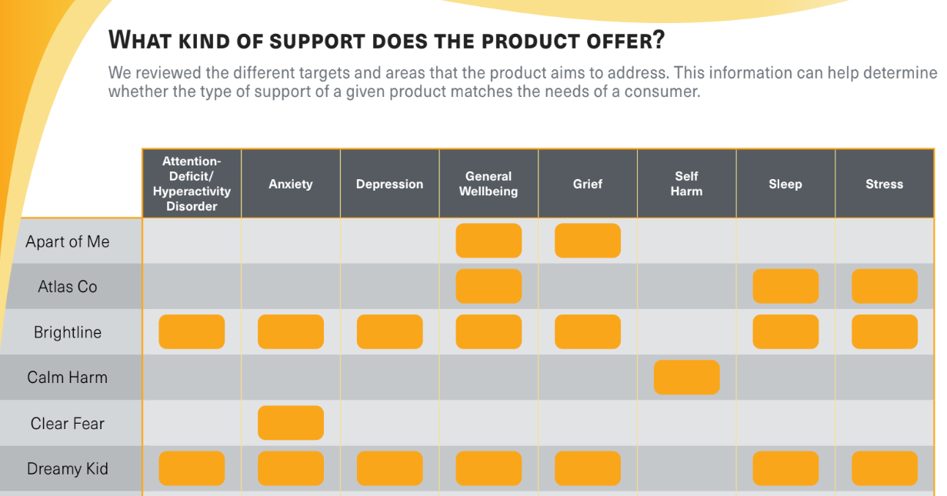
Notes:
Example of a table in the guide –
Apart of Me= Grief
Atlas CO – not on IOS
Brightline: general MH app
Calm Harm – 99cents
Clear Fear = anxiety
Dreamy Kid = Meditation app

Slide 30
What criteria are young people using…
Do users and developers/experts have the same priorities?
Studies interviewing teens – what are their priorities?
Accessibility
FREE (inc. bec then parents don’t have to know)
Accessibility to all groups/genders and knowing others are going through the same thing
Privacy and Security is critical (no sign up)
Is sensitive information safe
Teens worry about stigma – who’s going to know/see what they’re doing
Does it work as advertised?
No bugs, easy to navigate
Is the intervention going to lead to promised results – i.e., evidence base
(Kabacińska K. et al. , d'Halluin A. et al.)
Notes:
Need for more MH App user guides and evaluation tools for teens
Impt to teens: no sign up, ability to conceal it on the device for added privacy – this isn’t part of APA model
Important to talk to teens about what matters to them –
APA identifies Data Integration towards therapeutic goal – impt to professionals, not to teens – obv still need this but have to understand that priorities are different

Slide 31
Are BH APPs effective for youth?
2018 Meta-analysis Grist et al. (UK) - CBT interventions yielded a medium effect size (n=17, g=0.66 [95% CI 0.42–0.90] p<0.001).
34 studies incl 3113 children and adolescents, ages 6-18
Results from CBT-based apps:
Equally effective for depression/anxiety; but more effective for more severe sxs
Equally effective across ages
More effective than no tx (waitlist controls)
NOT more effective than face to face tx
Parent supported interventions were more effective
More effective for subjects who continued other tx during the study (e.g. meds)
Notes:
Effectiveness? YES for CBT based interventions – other interventions not as effective as CBT based (e.g. cognitive and attention bias modification)
Now, to Sarah to talk about how to apply some of these ideas pediatrics

Slide 32
Digital BH interventions in primary care
When:
Preventative
Targeted
Waitlist
Why:
Some evidence of effective adjunct; some evidence supportive as stand-alone
Expand capacity; remove implementation barriers
Remove engagement barriers; increased convenience
What to consider:
Potential limitations – access to technology, cost, cultural/linguistical appropriateness
Ability & Interest
Motivation, mild symptoms
“active ingredient” aligned with MH condition
Alignment with therapeutic goals
https://integrationacademy.ahrq.gov/products/topic-briefs/behavioral-health-apps
Notes:
Prevention – counting steps for physical activity.
https://integrationacademy.ahrq.gov/products/topic-briefs/behavioral-health-apps
Effective adjunct; some are effective as stand alone
Remove implementation barriers – address barriers to treatment (transportation, time, shortages) – however, it is important to consider limitations related to access to technology, cost, and cultural/linguistic appropriateness
Remove engagement barriers; Increased convenience – self-administered, availability in the moment,
Common factor interventions -

Slide 33
Digital BH interventions in primary care
How:
Introduce BH intervention in office. Don’t rely on digital tool education alone.
Ideal: you have engaged with it yourself
Ideal: demonstrate tool with patient/parent present
Review/develop specific goal for using the tool and measurement strategy
Relate it to specific problem pt wants to address; tailor discussion of use to pt’s needs
Plan for evaluating how its going
Acknowledge and address barriers
Normalize fluctuations in utilization; support sustained engagement
Ease of use, privacy
Fits into daily lifestyle
Follow-up
https://integrationacademy.ahrq.gov/products/topic-briefs/behavioral-health-apps https://www.apa.org/monitor/2020/04/career-using-apps
https://www.psychiatrictimes.com/view/integrating-mental-health-apps-into-care-with-your-patients-what-you-need-to-know
Notes:
APPs that say they use CBT but may not actually
https://www.apa.org/monitor/2020/04/career-using-apps
demonstrate tool with patient/parent present – solve problems before starting, establish do-able goals (mediation 3x/wk for 5 mins)
https://integrationacademy.ahrq.gov/products/topic-briefs/behavioral-health-apps
https://www.psychiatrictimes.com/view/integrating-mental-health-apps-into-care-with-your-patients-what-you-need-to-know
There is evidence of a steep decline in stand alone app engagement soon after its downloaded
Not surprisingly, there is emerging evidence that positive outcomes are associated with consistent engagement.

Slide 34
Talking to teens about apps they are using
Ask about use of digital health apps
What are they using them for
Are they helping/how do they know
Ask about privacy
Do you have to create an account/log in
Review pros/cons of using peer based and/or data collecting apps
Ideal: provide references to finding apps for digital BH interventions that have been vetted
Think of it like asking about supplement use
Notes:
Social connectedness within app

Slide 35
Example – Young Child, prevention
Well visit – 3 yo, healthy, parent expressing worries about plan for transition to pre-k, child presents as more inhibited/shy (observed and parent reported)
Provide education re socio-emotional development at this age
Introduce written and/or digital tools that can support positive SED (including parent role in supporting child)
Sesame Street BH APP – Breath, Think, Do
Notes:
What’s a BI to get the family started? Add
Not an intervention – just prevention

Slide 36
Breathe, Think, Do
Ages 2-5yo
Languages: English and Spanish
5 modules
Frustration with putting shoes on
Nervous/sad separating from parent for school
Disappointed/sad block tower not staying up
Anxious about dark at bedtime
Impatient waiting for turn on playground
Skills focused on
Identifying, labeling and communicating feelings
Belly breathing (pausing emotions)
Problem solving
Choosing action to support emotion regulation
Parent training!
Ideally parents are doing this with the children
https://apps.apple.com/ca/app/breathe-think-do-with-sesame/id721853597
Notes:
Add Ages 2-5
Emphasize parent/child doing it together
Modules are short

Slide 37
Breathe, Think, Do

Slide 38
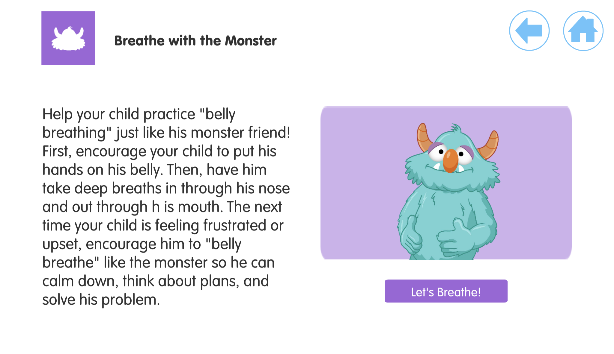

Slide 39
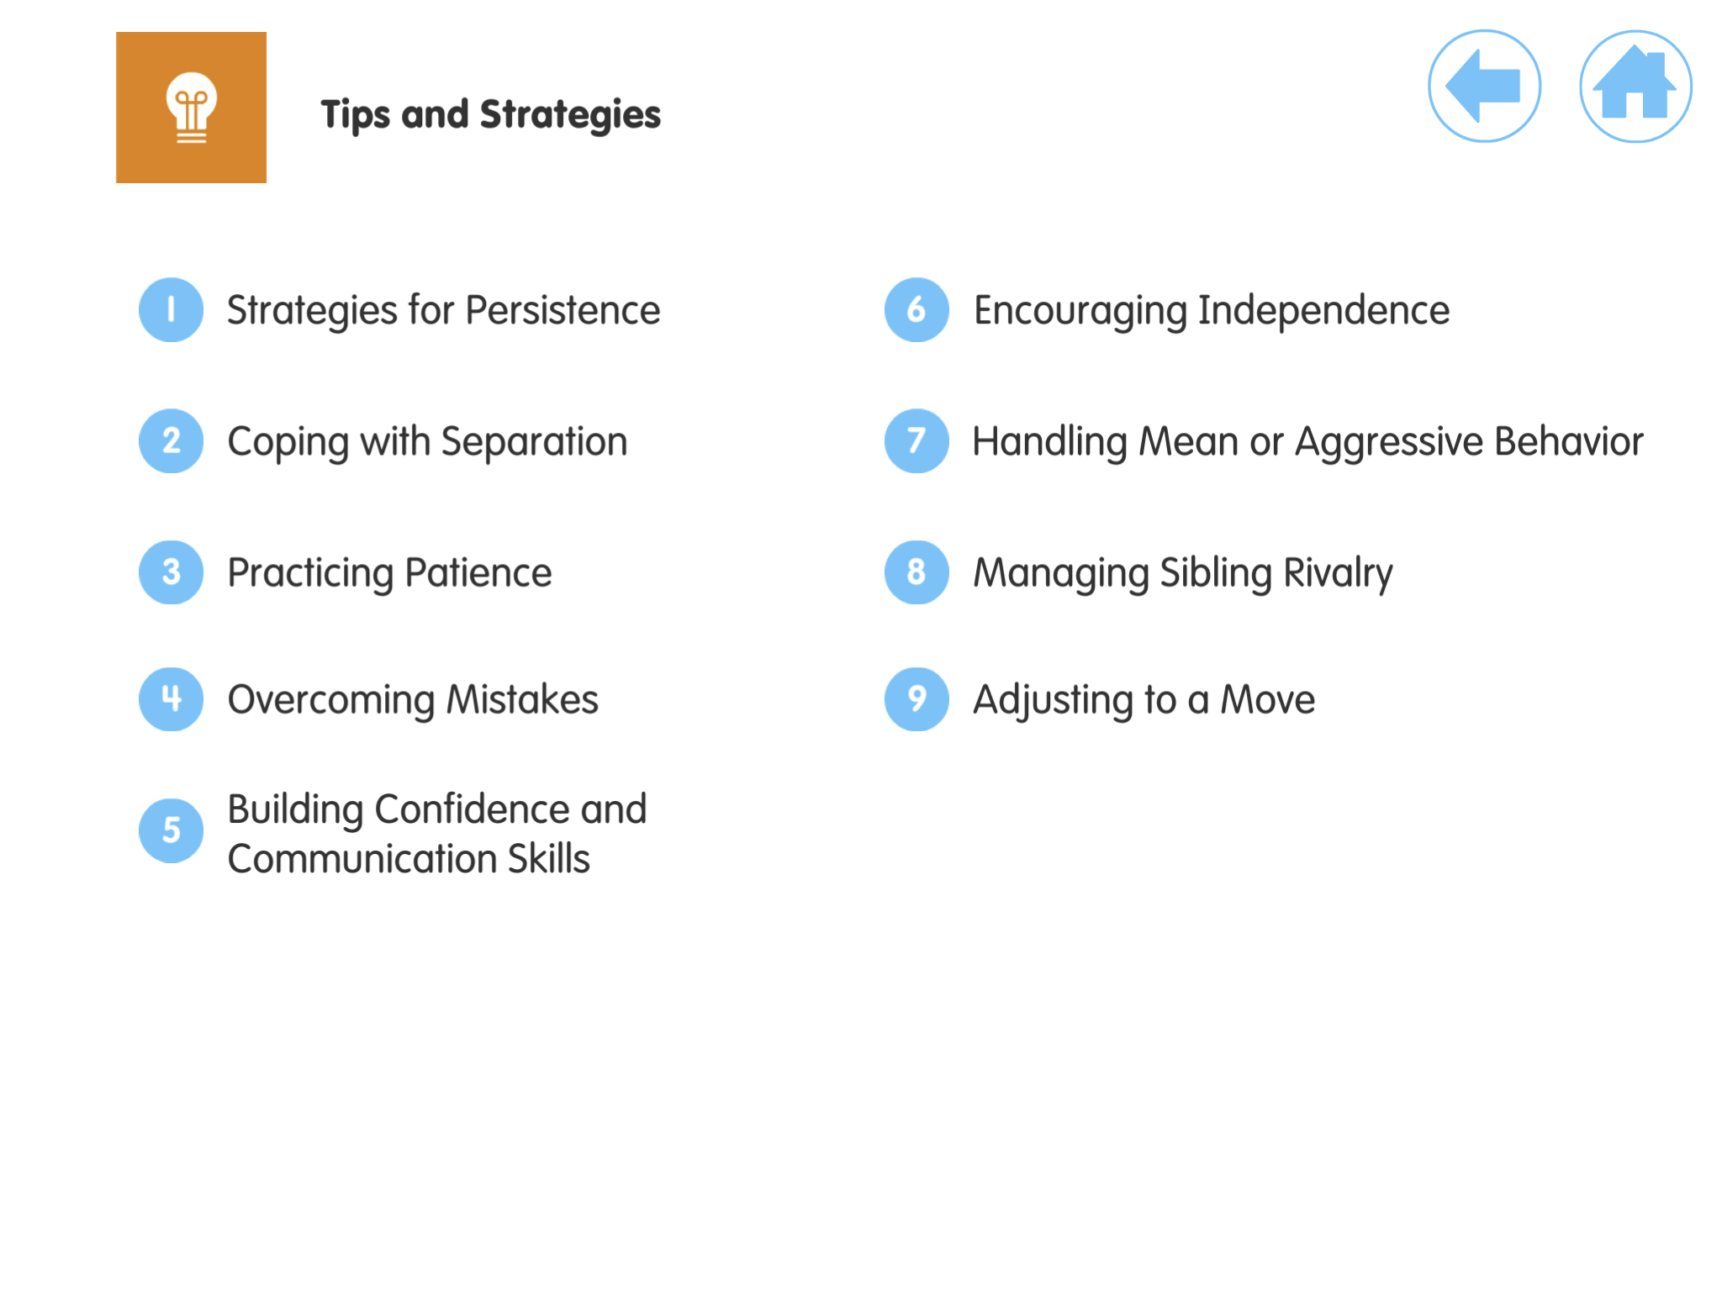

Slide 41
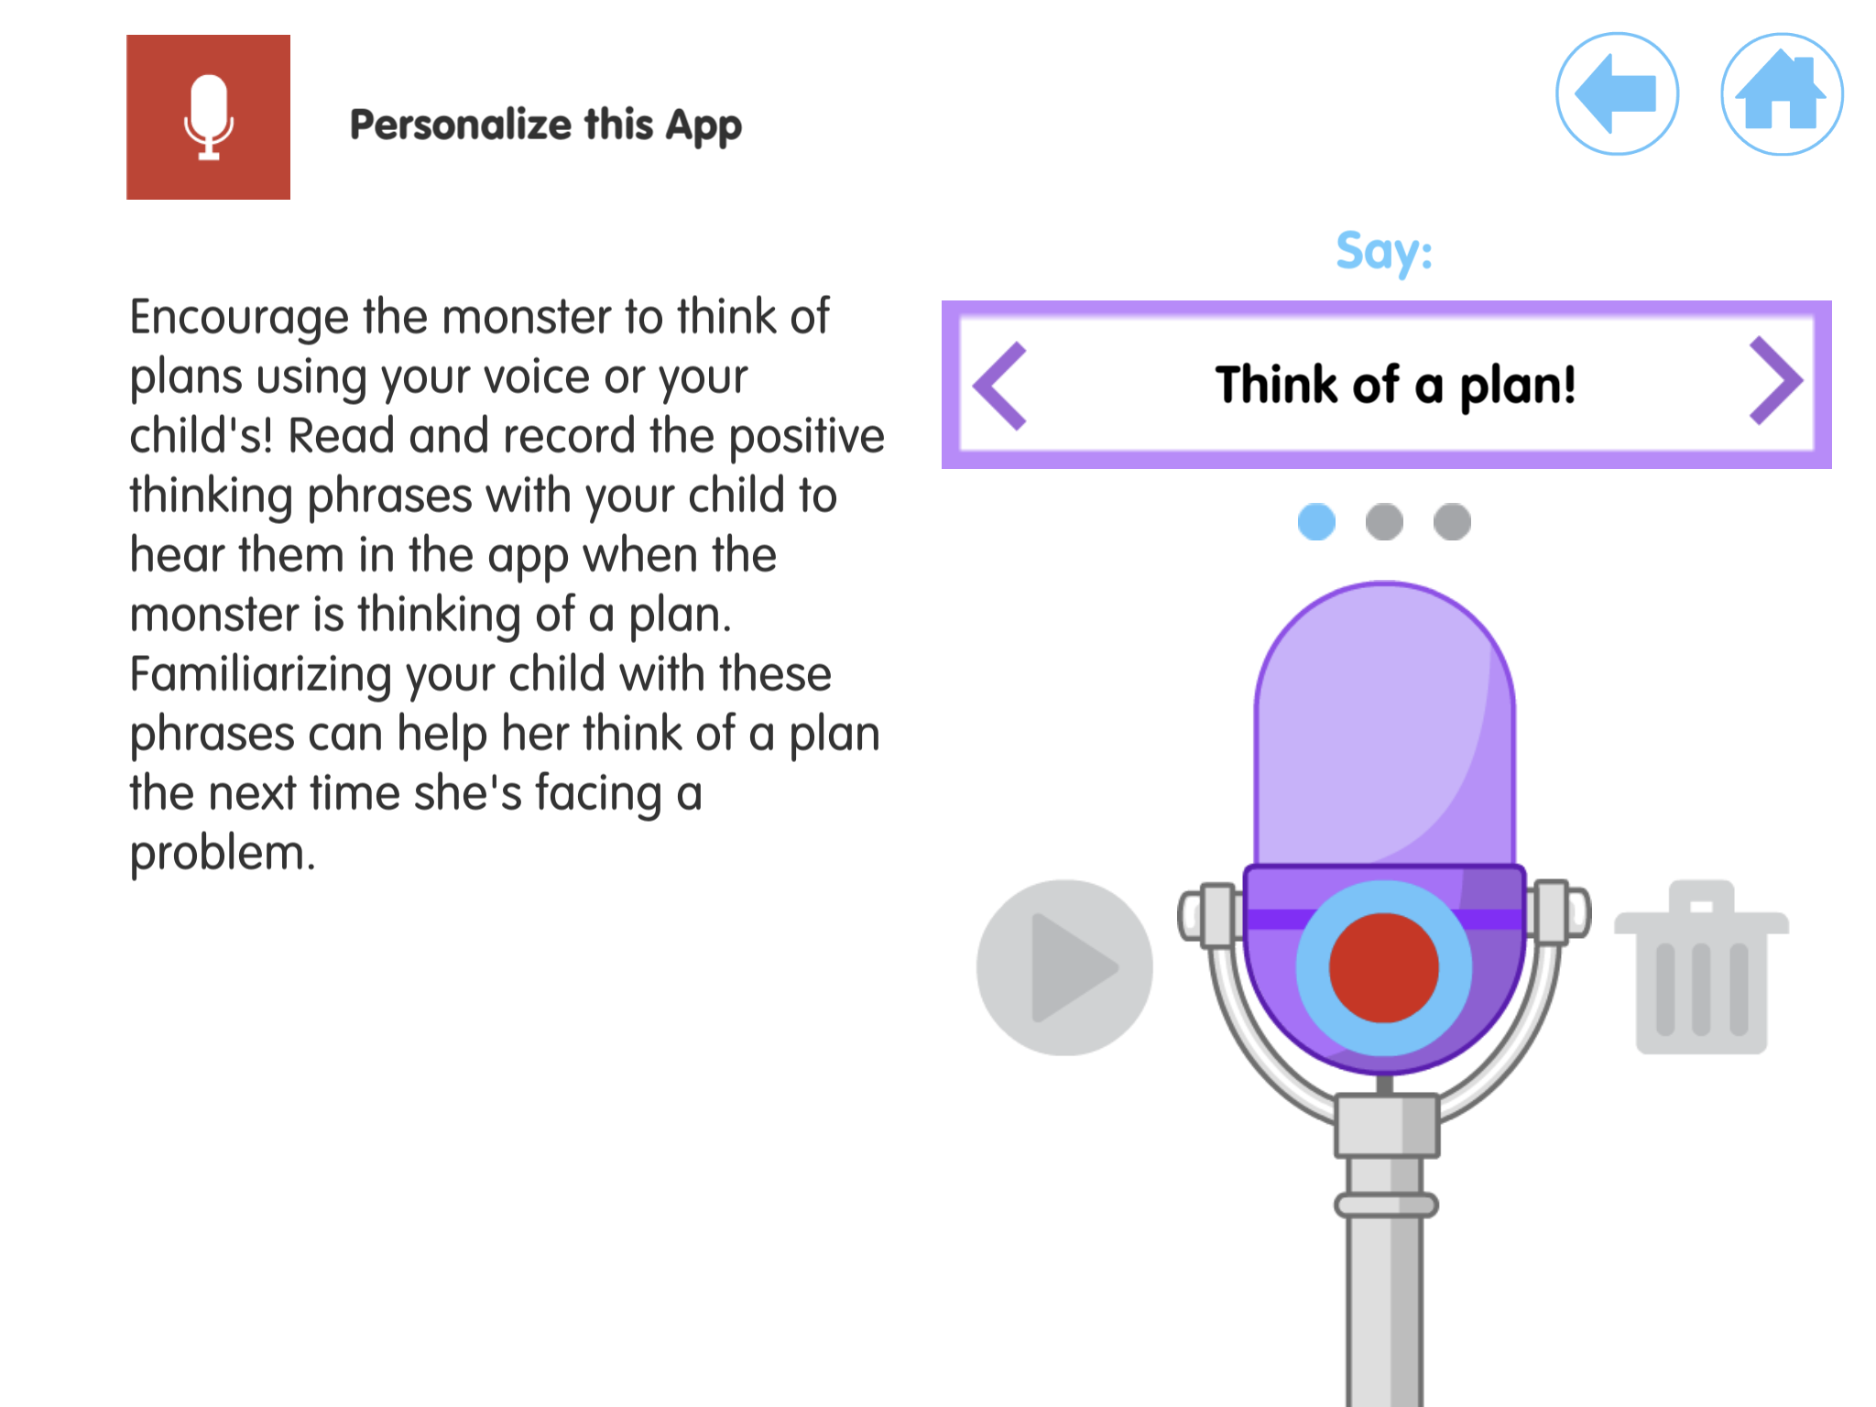

Slide 42
Example, school aged child, targeted
Sick visit, 9yo belly aches, missing school. Child acknowledging anxiety about new school and parent acknowledging not knowing how to respond.
Provide education about and normalize anxiety symptoms and avoidance responses
Review stress response and benefits of activating rest/digest response
Review caregiver responses that inadvertently reinforce avoidance
Errors of kindness, natural parenting responses
Introduce written and/or digital tools that can support parent developing supportive responses and help child manage anxiety symptoms.
For child: Smiling Mind
For parent: Project EMPOWER
Notes:
Add relaxation APPs in resources and mention them here –
Mention BI for anxiety in references

Slide 43
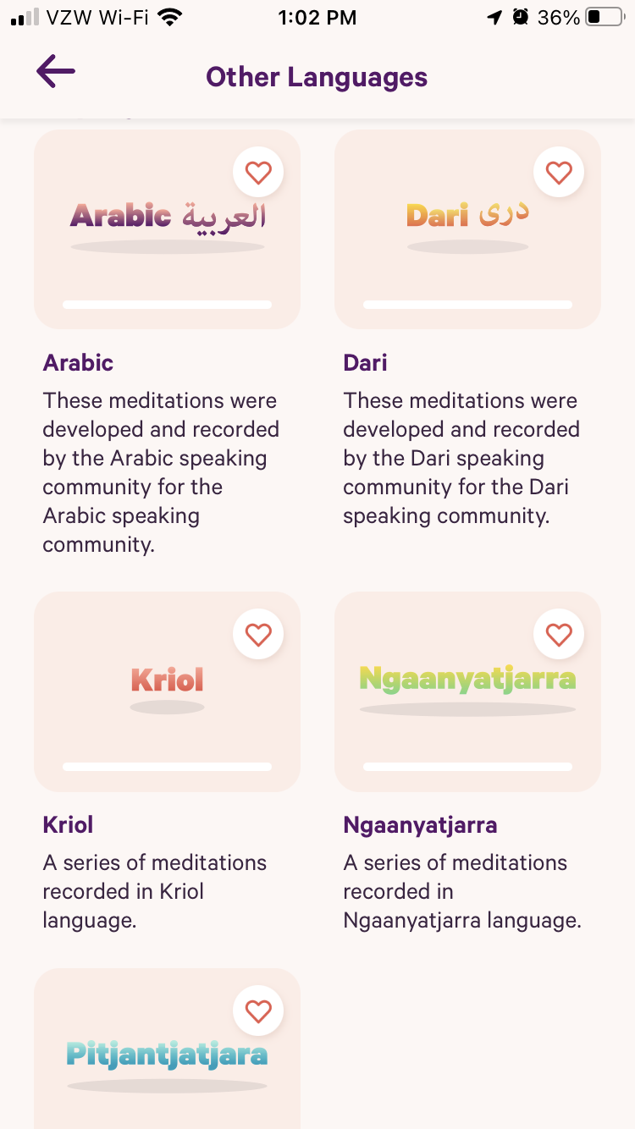
Smiling Mind
Age: 7 and up
New early childhood programs
Opening page – quick intervention
5 Mindful Breaths
Different programs by age, location, activity
Variety of mediation/mindfulness activities
Settings: reminders, wellbeing check-in
Have to sign-in
BEST if you teach diaphragmatic breathing in office
Languages: English, Arabic
Australian Indigenous Languages
https://www.smilingmind.com.au/smiling-mind-app
Notes:
Sign-in = potential for data collection. Website provides details re their privacy policy and what they are collecting (de-identified) – but important to inform family about.

Slide 44
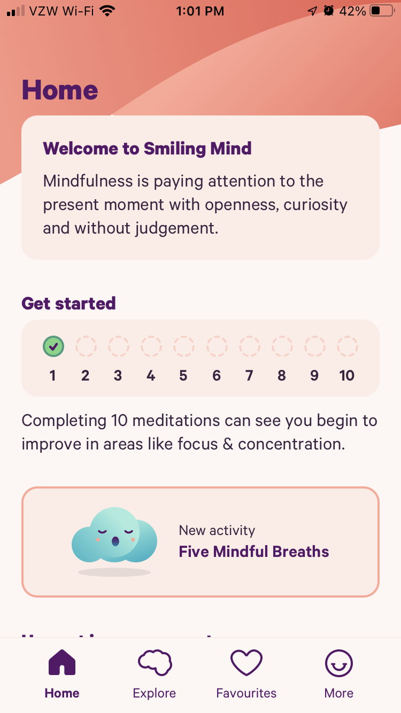
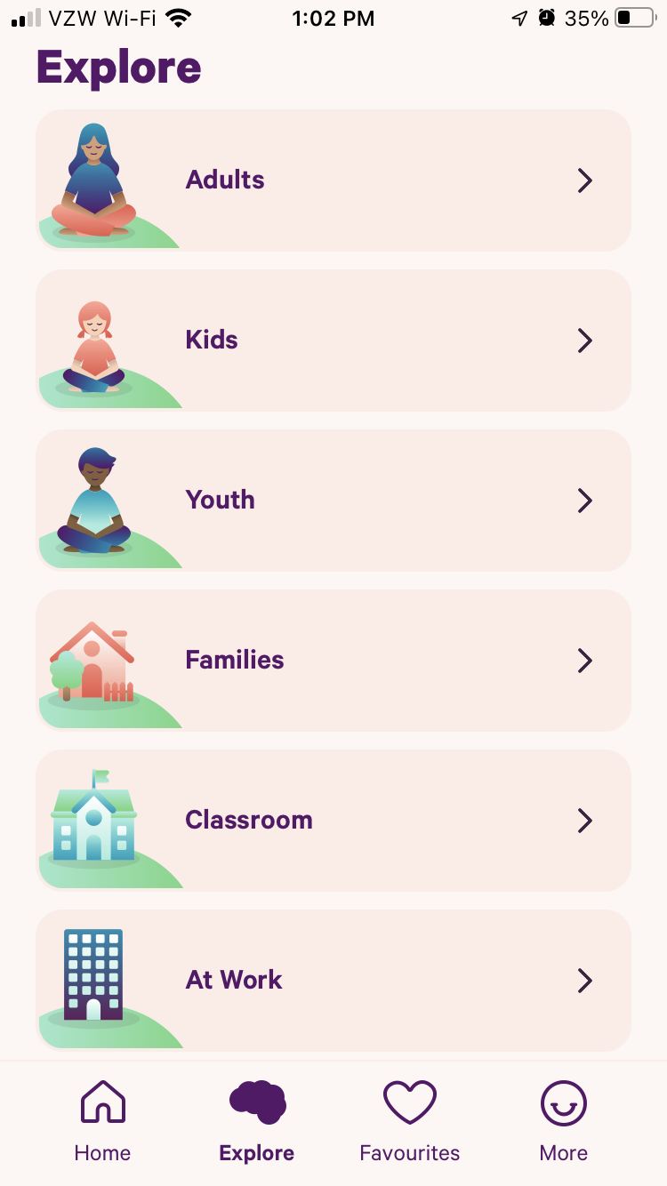
Smiling Mind

Slide 45
Smiling Mind

Slide 46
Project EMPOWER
Free, evidenced based “1-session online program for parents, teaching skills to build bravery and reduce anxiety in children and pre-teens”
Anonymous – surveys are optional
Languages: English, Spanish, Creole
Time: ~20 mins
Easy to understand psychoeducation re the avoidance response
Interactive/feedback on understanding of concepts
Examples (with choices)
Videos
Step-by-step plan based on child’s specific symptoms
Problem-solves potential barriers
Resources at the end
Web-based links
Worksheets
The anxiety cycle
Behavioral Approach Plan
Talking to your child about being brave
https://www.schleiderlab.org/empower.html
Notes:
Open Source
online platform, not an APP
Mention why you are not recommending APPs for the school age kids – importance of parents’ role
Have other brief interventions available – one for teens, others in progress

Slide 47
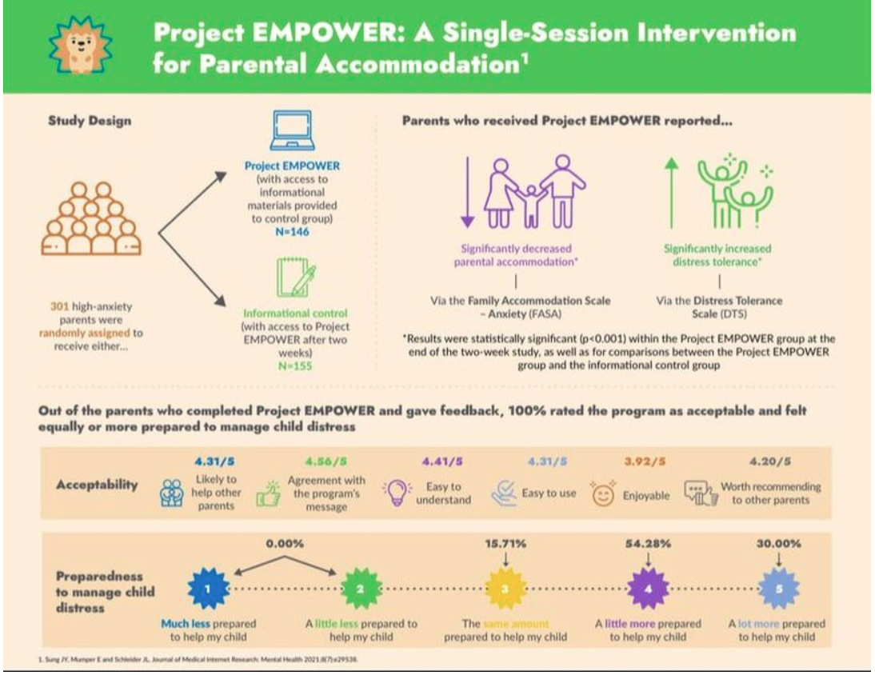

Slide 48
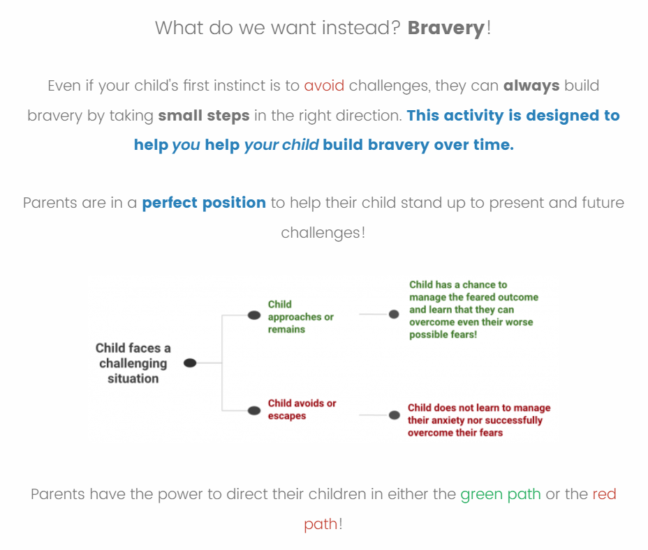

Slide 49
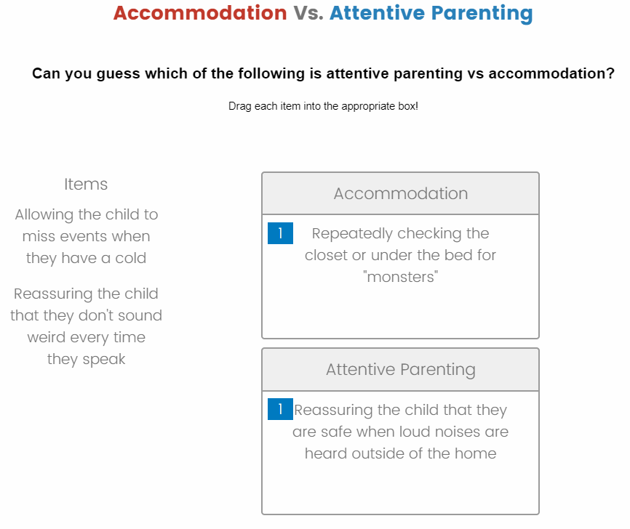

Slide 50
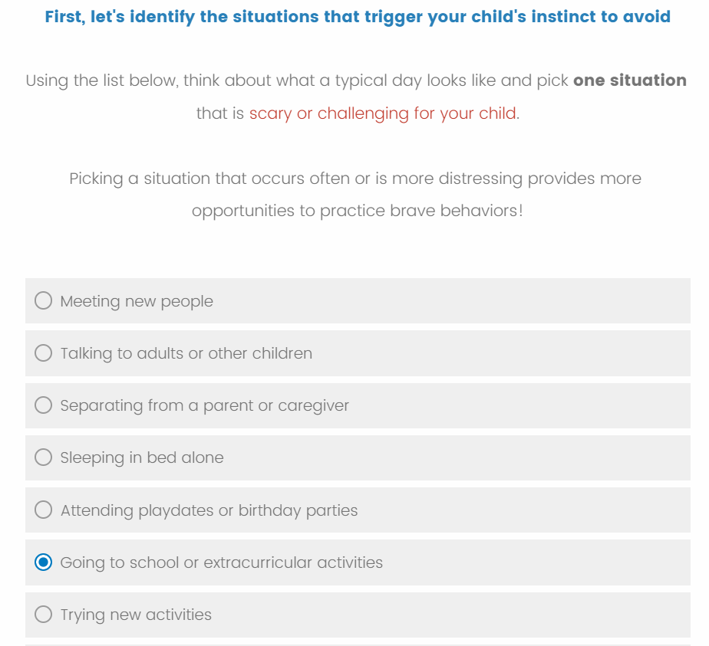

Slide 51
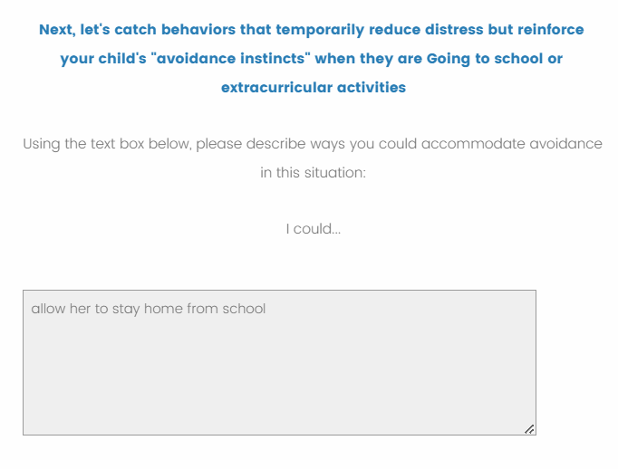
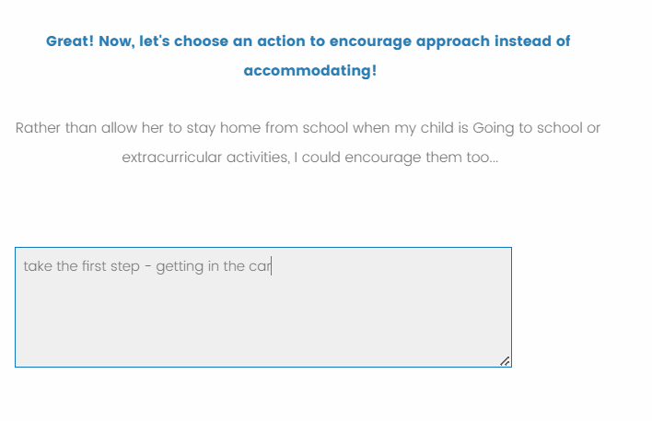

Slide 52
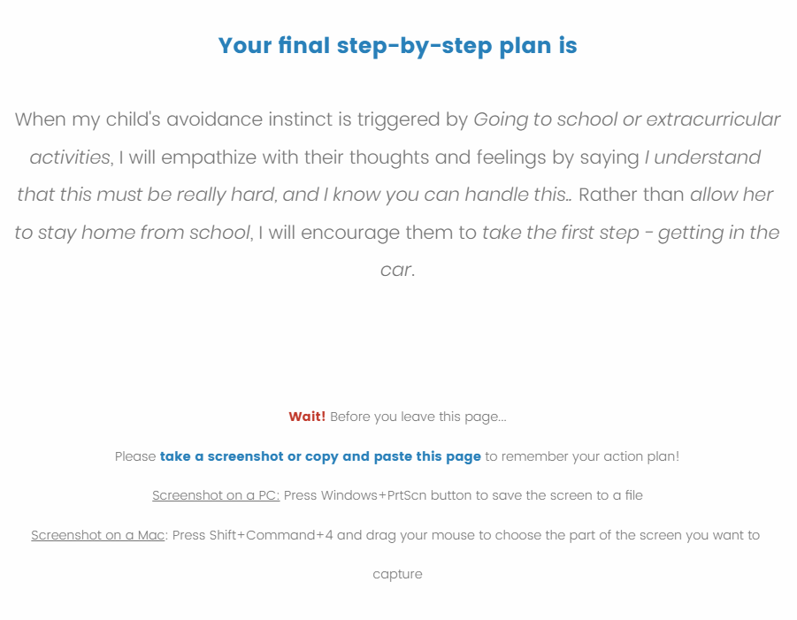

Slide 53
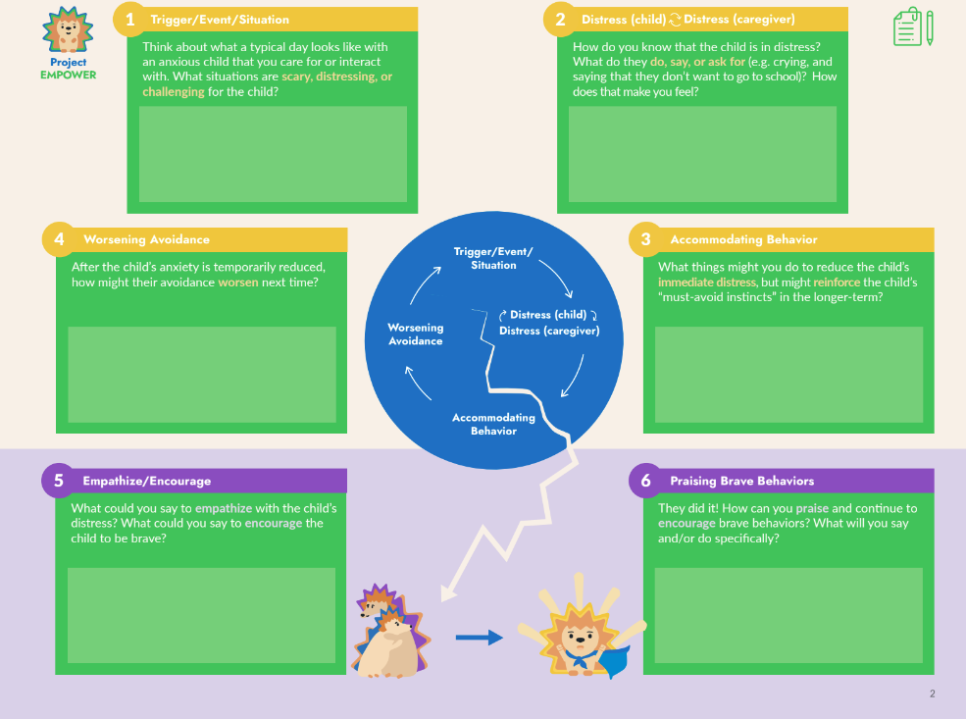

Slide 54
Example, teen, waitlist
Psychopharm med check, 14yo newly diagnosed with depression, started on SSRI, on waitlist to see community BH provider
In context of check-in re symptoms, Pt shares ongoing anhedonia, increased withdrawal/isolation
Provide education on behavioral activation
Introduce written and/or digital tools that can support engagement in behavioral activation interventions
MOVE MOOD
Notes:
Sarah – will review apps on guide and make a slide of resources/recommendations
Mention BA – what it is, why it’s useful
Age range?
Add screen shot of ages on APP store

Slide 55
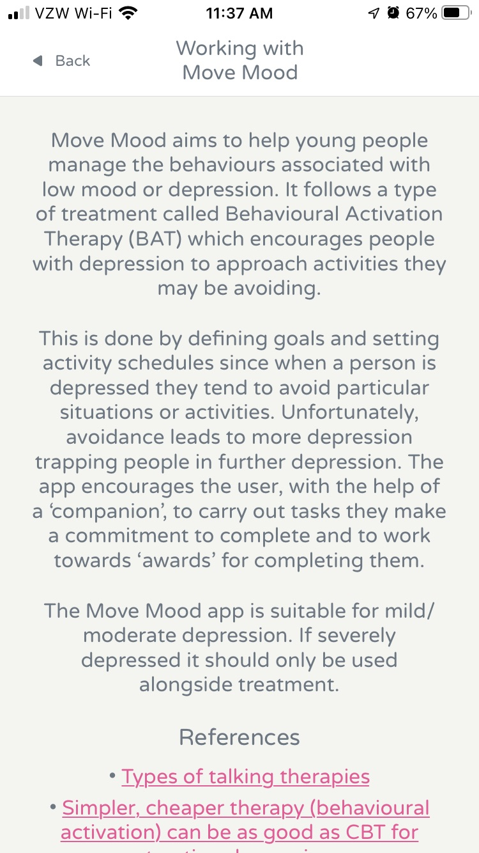
MOVE MOOD
https://www.movemood.co.uk/
Ages: 13 +
A little younger with help from adult
Best for mild/mod depression
Language: English
Create tasks
Routine, necessary, enjoyable
Starts with identification of values
what do you want to work on
Examples/options
Create your own
Scheduling tasks – daily, weekly, monthly, custom
Feedback supports insight into how activity impacts mood
Rate mood after task (compared to when scheduled)
Did the task help lift your mood?
Did you carry out the task at the time you set for yourself?
Was it easier or harder than you expected?
Notes:
2nd Teen example? Maybe self-injury?

Slide 56
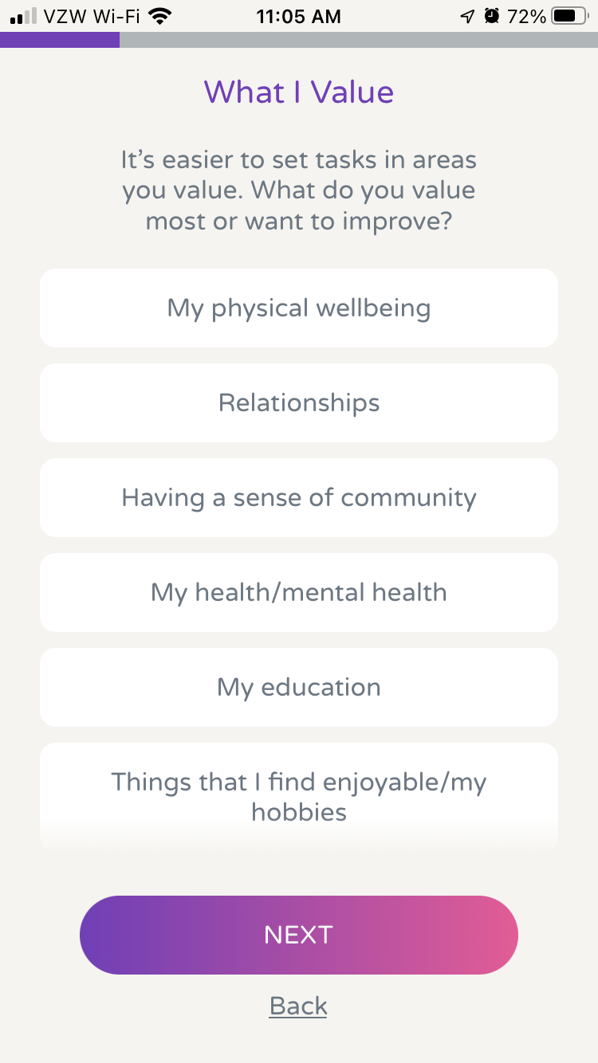
Move Mood

Slide 57
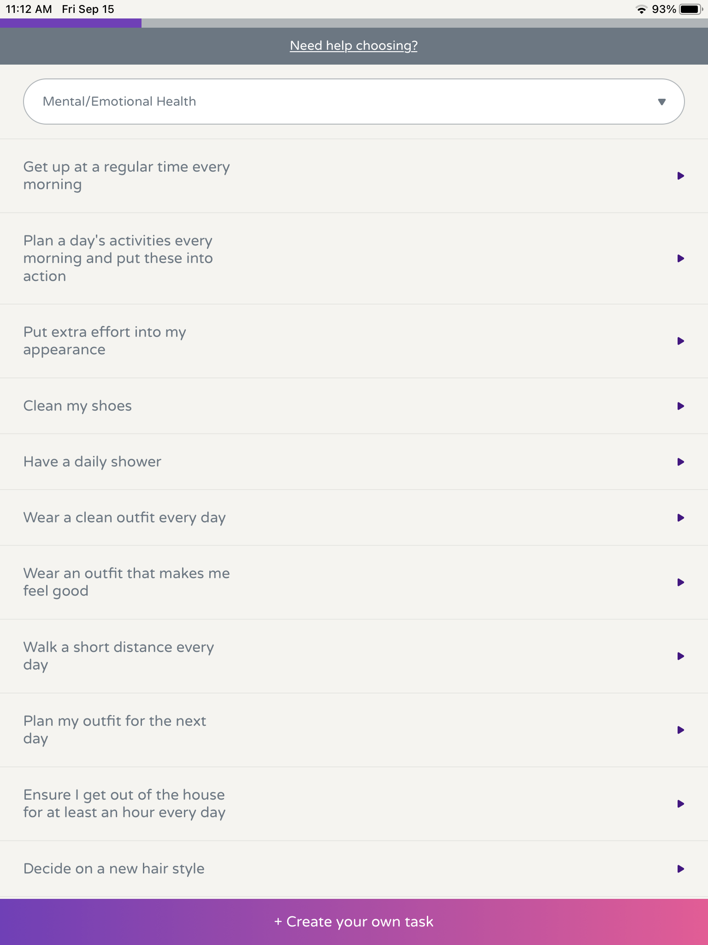
Mood Move

Slide 58
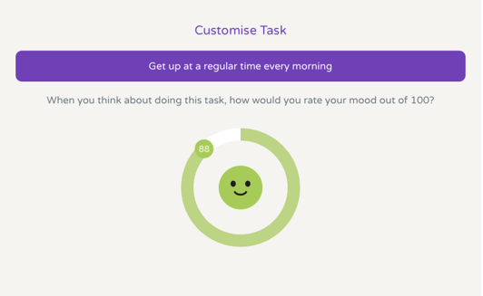
Move Mood

Slide 59
Mood Move

Slide 60
Virtual Hope Box
Pros:
-easy to use
-multiple language options?
-free
-Does NOT collect data
Cons:
-Need BH guidance to effectively use coping tools
-sign-in required (can use touch ID)
-designed for adults so best for teens
https://apps.apple.com/us/app/virtual-hope-box/id825099621
Notes:
Remind me – happy photo/music
Distract me: sudoku, photo puzzle, word search, mahjong solitaire
Relax me: diaphragmatic breathing, muscle relaxation, guided meditation (beach, forest)
Coping tools: coping cards (need therapist) and activity tracker (not as robust as Mood Move)

Slide 61
K’Bro
For kids aged 12+
Pros
-video game interface
-identifying/tracking feelings
-problem-solving/communication skills
-gratitude
-peers support groups (MS vs HS)
Cons
-tracks data
-anonymous peers support is big component
-older kids may find the interface too young for them
-no research
https://kbro.io/

Slide 62
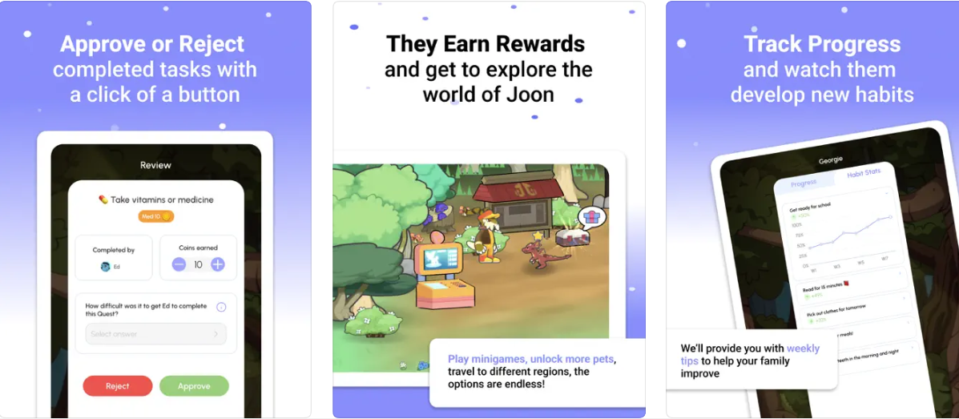
Joon
For ages 6-12yo
Pros:
-free
-helps kids complete daily routines
-parent-child interactions
-reward focused
Cons:
-some data collected
-in-app purchase required to access all features
-works “best” if child has own device
www.joonapp.io
Notes:
Tasks=quests; Reward is taking care of digital pet and play the video game
Earn coins to take care of pet and unlock different parts of the video game
“best”- with regard to fostering independence with daily routines

Slide 63
Resources
BH apps data bases:
Onemindpsyberguide.org
MindAPPs.org
AHRQ: https://integrationacademy.ahrq.gov/products/topic-briefs/behavioral-health-apps
BLOG: Psychologist and professor Jacqueline Nesi (Brown U) shares the latest research on technology and the people who use it, plus practical tips for living and parenting in the digital age. https://technosapiens.substack.com/
APA quarterly column reviewing BH apps: https://www.apaservices.org/practice/business/technology/tech-column
Other online tools:
Suicide Safe Mobile App is free for providers to download and there is no subscription plan available. Suicide Safe also includes free access to a electronic version of the SAFE-T card and access to order a hard copy of the SAFE-T card from SAMHSA’s website: https://store.samhsa.gov/product/suicide-safe - webpage has video
Notes:
(include links to digital BH tools referenced above and any additional tools and/or links to lists of recommended tools)

Slide 64
References
Agarwal S, Jalan M, Wilcox HC, Sharma R, Hill R, Pantalone E, Thrul J, Rainey JC, Robinson KA. Evaluation of Mental Health Mobile Applications. Technical Brief 41. (Prepared by the Johns Hopkins University Evidence-based Practice Center under Contract No. 75Q80120D00003.) AHRQ Publication No. 22-EHC016. Rockville, MD: Agency for Healthcare Research and Quality; May 2022. DOI: https://doi.org/10.23970/AHRQEPCTB41. Posted final reports are located on the Effective Health Care Program search page.
d'Halluin A, Costa M, Morgiève M, Sebbane D. Attitudes of Children, Adolescents, and Their Parents Toward Digital Health Interventions: Scoping Review. J Med Internet Res. 2023 May 2;25:e43102. doi: 10.2196/43102. PMID: 37129931; PMCID: PMC10189627.
Digital Therapeutics Alliance: https://dtxalliance.org/
Domhardt M, Messner EM, Eder AS, Engler S, Sander LB, Baumeister H, Terhorst Y. Mobile-based interventions for common mental disorders in youth: a systematic evaluation of pediatric health apps. Child Adolesc Psychiatry Ment Health. 2021 Sep 13;15(1):49. doi: 10.1186/s13034-021-00401-6. PMID: 34517896; PMCID: PMC8438844.

Slide 65
References cont’d
Grist, R., Croker, A., Denne, M. et al. Technology Delivered Interventions for Depression and Anxiety in Children and Adolescents: A Systematic Review and Meta-analysis. Clin Child Fam Psychol Rev 22, 147–171 (2019). https://doi.org/10.1007/s10567-018-0271-8
Jessy E. Williams, Jessica Pykett, Mental health monitoring apps for depression and anxiety in children and young people: A scoping review and critical ecological analysis, Social Science & Medicine, Volume 297, 2022, 114802, ISSN 0277-9536, https://doi.org/10.1016/j.socscimed.2022.114802.
Kabacińska K, McLeod K, MacKenzie A, Vu K, Cianfrone M, Tugwell A, Robillard JM. What criteria are young people using to select mobile mental health applications? A nominal group study. Digit Health. 2022 May 29;8:20552076221102775. doi: 10.1177/20552076221102775. PMID: 35663239; PMCID: PMC9158405.
Kollins, S.H., Childress, A., Heusser, A.C. et al. Effectiveness of a digital therapeutic as adjunct to treatment with medication in pediatric ADHD. npj Digit. Med. 4, 58 (2021). https://doi.org/10.1038/s41746-021-00429-0

Slide 66
References cont’d
Liverpool S, Mota CP, Sales CMD, Čuš A, Carletto S, Hancheva C, Sousa S, Cerón SC, Moreno-Peral P, Pietrabissa G, Moltrecht B, Ulberg R, Ferreira N, Edbrooke-Childs J. Engaging Children and Young People in Digital Mental Health Interventions: Systematic Review of Modes of Delivery, Facilitators, and Barriers. J Med Internet Res. 2020 Jun 23;22(6):e16317. doi: 10.2196/16317. PMID: 32442160; PMCID: PMC7381028.
Monarque, M., Sabetti, J. & Ferrari, M. Digital interventions for substance use disorders in young people: rapid review. Subst Abuse Treat Prev Policy 18, 13 (2023). https://doi.org/10.1186/s13011-023-00518-1
One Mind Psyber Guide Teen App Guide 2022: https://drive.google.com/file/d/1RDeiVpFF9VN6OXYbbAIrtNhdVJX0dPpz/view
Stringer, H. (2023, July 13). Making digital interventions accessible and affordable. Monitor on Psychology, 54(6). https://www.apa.org/monitor/2023/09/making-digital-interventions-affordable
Prescription Digital Therapeutics For Mental Health: What It Means For Doctors And Their Patients (Forbes Article)

