Slide 1

George Mason District
DCOH/Roundtable
May 9, 2024

Slide 2

Pledge

Slide 3
Agenda
Welcome and Pledge
Questions about Read-ahead
Award(s)
Council Announcements
General Announcements
Program Announcements
Big Rock – Planning for next year of Roundtables
Cracker Barrel/Networking (Optional; NLT 9pm)
Next Meeting: June 13, 2024 (Program Launch/Silent Auction 7pm)

Slide 4
Welcome
New to Roundtable?
Please introduce yourself!

Slide 5
Questions/Clarification about Read-ahead?

Slide 6
District and other Award(s)

Slide 7

Council Announcements
Brand changing to
Outdoor Programs 2025 Strategic Initiative
May 1 – New fees went into effect; no $25 joining fee
May 21 – Council-Wide Roundtable (Virtual)
June 1 – New Cub Program
June 13 – Program Launch (7pm)
July – Dec – Renewal notices, via email, to registered Adults/Youth

Slide 8
General Announcements

Slide 9

Current 2024 George Mason Calendar
May 27, 2024 – Memorial Day Flags In, Falls Church, VA
May 29, 2024 – Elks Youth Recognition Dinner for 2023 Eagle Scouts
Sept 28, 2024 – Life to Eagle Seminar, St James, Falls Church, VA
Oct 18-20, 2024 – Fall Camporee, Camp Rock Enon, Gore, VA

Slide 10
STEM
07/08/24 – 07/12/24 – STEM Summer Workshop, Alexandria, VA
08/05/24 – 08/09/24 – STEM Summer Workshop, Alexandria, VA
Ancient Earth: Birth of the Sky (on PBS) - link
Anytime – DC STEM Trek- Showcases 24 government agencies, private organizations and monuments related to the tenets upon which STEM is based. Two hikes - 10.57 miles, or 4.75 miles
Ancient Earth: Birth of the Sky (on PBS) - link
Anytime – DC STEM Trek- Showcases 24 government agencies, private organizations and monuments related to the tenets upon which STEM is based. Two hikes - 10.57 miles, or 4.75 miles

Slide 11

Elks Youth
Recognition Dinner
For youth that earned Eagle in 2023 (i.e. their Eagle Board of Review was held in the 2023 calendar year) and their Scoutmasters.
Wednesday, May 29, 2024
Elks Lodge - 2188, 8421 Arlington Blvd., Fairfax, VA.
Will need unit leader help in contacting Scouts and obtaining an RSVP.
Scoutmaster are invited at no cost to them.

Slide 12

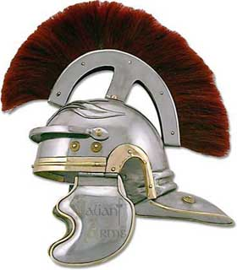
GREEKS VERSUS ROMANS
SPRING CAMPOREE

Slide 13
Alignment Update

Slide 14
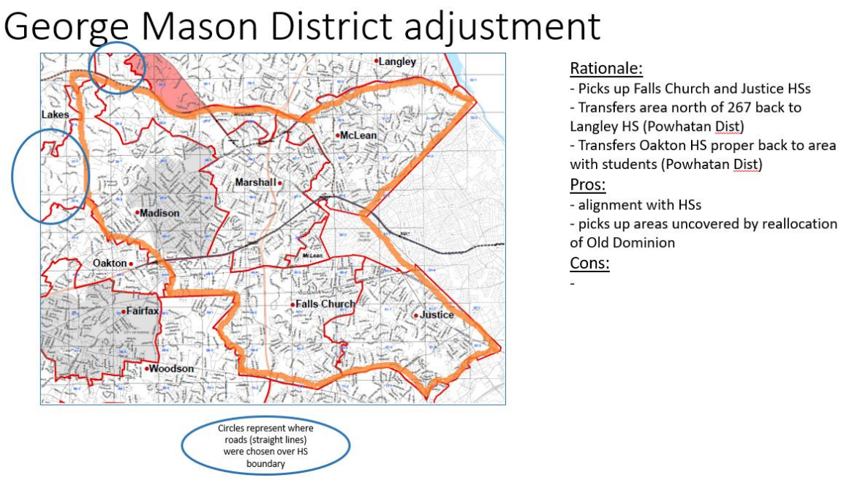

Slide 15
Units Impacted
GMD
  Packs – 0187, 0882, 1513 (to Powhatan)
  Troops – 0187, 0918, 1113, 1887, 1888 (to Powhatan)
Old Dominion District
  Packs – 0855, 1845, 1962 (to GMD)
  Troops – 0875, 1845 (to GMD)
Chain Bridge District
  Still under review

Slide 16
District Name Change
The Organizational Alignment Committee’s district alignment recommendations will propose these naming guidelines:
  Districts composed of more or less than one county should be named after a prominent geographical feature.
  Districts whose boundaries have been significantly redrawn should be renamed [10 districts listed].
  NCAC will approve final name submission.
Our Guidelines:
  We encourage you to get suggestions from your Scouts, parents, Committee members and uniformed leaders.
  The District Committee will review all submissions and develop a short list of names.
  A short list will be provided, via survey, for a vote of all registered adults. One week will be given for this vote.
  To assist in locating a prominent geographical feature, we have added the new District boundary map.
  A survey will be released, within a day or two, to allow you to submit your recommendation(s).

Slide 17

Big Rock – Roundtable Format and Topics

Slide 18
Roundtable Topics Covered
Success stories – fund raising, recruitment, volunteers, cub program
Unique opportunities for scouts, recruiting, fund raising, and training
Outdoor/Camping activities and great sites/unique HA activities
Youth Mental Health and courses available
Local organizations that have activities/programs/opportunities for scouts
Discussions related to transition from Cubs to Scouts BSA
Discussions related to issues as scouts age through the program
Recruiting, membership and how to reach non-traditional youth
How to better publicize activities
STEM opportunities
Backpacking, paddle, climbing and biking locations; program support
Make the Calendar items a pre-read or handout.
De-emphasize information transmission and focus on comradery
Panels on specific topics – clearly identify if Cubs, Scouts or family scouting
Move Scout Expo to a community location for exposure – e.g., Vienna Community Center on Saturday
Roundtable topics planned out for whole year – announce the schedule, type (e.g., panel)
Share best practices
Be more interactive

Slide 19
Not yet Complete or Covered
Share best practices
Be more interactive
Effective communication and team building
Eagle Scout project opportunities
fund raising alternatives
Cub camping places and getting approval
Get more people involved with themes – e.g., advancement coordinator night
In-unit youth training – we are all rebuilding after the pandemic
Developing Leadership/leadership stories
Kids development
Local experts in topics pertinent to scouting program (e.g., Conservation)
Adventures/inspiring service projects
Specific options to expand the scouting experience beyond NCAC
Programming that is not currently part of the unit planning
Periodic social event in lieu of standard meeting - Foster more networking

Slide 20
Time for Cracker Barrel
Minutes and slides available on the GMD web site (District Resources, Roundtable). Password is “GMDRT”
Next meeting – June 13, 2024, at Thoreau MS
  Program Launch/Silent Auction (7pm)
  Roundtable (8pm)

Slide 21
Backup Slides

Slide 22


Merit Badges
The online Merit Badge Counselor registration.
New Merit Badge Counselors must complete online merit badge counselor training, in addition to YPT. Be sure the counselor uses his/her legal name – no nicknames.
Merit Badge Counselors, or the unit Dean/Leader, also need to scan and send Margee the Merit Badge application form listing the badges the counselor is applying to teach and providing a justification of his/her qualifications.
Youth Protection Training is the essential first step. Don’t hit “send” on the application without it!
Contact Margee if you have questions at GM.MB.Dean@hotmail.com.
Did you know:
The National Council does not limit the number of merit badges a youth may earn from one counselor, though a unit leader is permitted to do so, as long as the same limit applies to all Scouts in the unit. Ideally, Scouts should work with a variety of adults. (GTA 7.0.0.3)
Partial Merit Badges have no expiration except the Scout’s 18th birthday. (GTA 7.0.3.3)
Due to the BSA policies related to Youth Protection and two-deep leadership, a merit badge counselor must have another adult present during all merit badge counseling sessions. However, the parent or legal guardian of the Scout may serve as the second adult. This parent or legal guardian does not have to be a registered leader.
If the requirements for a merit badge differ between the merit badge pamphlet and the current edition of Scouts BSA Requirements, the requirements in the Scouts BSA Requirements book supersede all others.

Slide 23

Training (https://www.ncacbsa.org/george-mason/training/)
Cub Scout Den Leader Specific (C42)
  Available on-line (125 min)
  06/01/24 - Alexandria, VA
Basic Adult Leader Outdoor Orientation (BALOO;C32) -
  05/10/24 - 05/11/24 - Fredericksburg, VA
Scoutmaster Position Specific Training(S24)
  Available on-line (192 min)
  06/01/24 - Alexandria, VA
Introduction to Outdoor Leadership Skills (IOLS; S11)
  05/10/24 - 05/11/24 - Fredericksburg, VA
Climbing Level 1 Instructor
June 15-16 at Great Falls Park, 7:30 AM to 5:00 PM. Logistics memo
Sept 7-8 at Great Falls Park, 7:30 AM to 5:00 PM. Logistics memo
Sept 21-22 at Sugarloaf Mountain, 8:15 AM to 5:00 PM. Logistics memo
Mental Health First Aid
https://www.fairfaxcounty.gov/hscode/ereg/Registration.aspx?groupID=47
NYLT https://www.ncacbsa.org/national-youth-leadership-training/
24.2: 06/16/24-06/21/24
24.3: 06/23/24-06/28/24
24.4: 07/28/24-08/02/24
24.5: 07/28/24-08/02/24
Registration is open. Some seats are still available. There may be a wait list.
Wood Badge (A90) https://www.ncacbsa.org/wood-badge/
09/13/24 – 09/15/24

Slide 24

GM High
Adventure
GM High Adventure / Brian H
Members of the High Adventure Committee are available to assist units in planning and training for their upcoming high adventure trips – Contact Brian Heath for more information
Important notes for this month
  Registration for BSA’s high adventure bases - https://www.scouting.org/outdooradventures/open4adventure/
    2024 treks – Most BSA High Adventure bases still have availability
    2025 treks – Registration for all high adventure bases are now open
2024 NCAC-Organized High Adventure Trips
  Lenhok’sin – James River Canoeing Trek - July 7-13, 2024
    Crew of 6-12 - $475 per participant – 6 slots remaining
    Registration: https://scoutingevent.com/082-75664
    For more information, e-mail highadventure@ncacbsa.org
  Lenhok’sin Provo Backpacking Trip June 23-29, https://scoutingevent.com/082-83116
    3 spaces available for Scouts or adults
  11-12 year old Scout High Adventure Experience - Sept 28-29 Prince William Forest
  Joshua Tree with Climbing Committee - Winter Break 2024/25 (Gathering interest)
  Wind River Range, WY Backpacking Trip: 06/22 to 06/30/24 – Registration is Full
  All NCAC-sponsored trips for Philmont, Northern Tier & Sea Base are already full
2025 NCAC-Organized High Adventure Trips
  Sawtooth Mountain, ID Trip - 06/21 to 06/29/2025
    Registration begins June 1, 2024 - $1,385 per person – Ask for details
High Adventure Preparation Training
  All sessions for this year are finished
May 2024
Notes:
Sea Base Trip on Jul 29-Aug 3, 2024 - FULL

Slide 25
GM High
Adventure
Other Training
  Back Country Outdoor Leadership Skills - Virginia session
    Fall 2024: 9/21/2024 (classroom), 10/19-20 (overnight)
  Paddle Craft Safety Training: May 18-19, June 1-2, Aug 24-25, Sept 7-8
National High Adventure Base Quick Links
  Philmont: https://www.philmontscoutranch.org/register/
  Northern Tier: https://www.ntier.org/provisional-scout-connections/
  Sea Base: https://www.bsaseabase.org/scouts/scout-connections/
  Summit: https://www.summitbsa.org/registration/scoutconnections/
Other High Adventure Bases
  Adirondack High Adventure Area: https://public.3.basecamp.com/p/hLgsVbk7Suju6cuDzQQJaEn4
  Maine High Adventure Area: https://www.mainehighadventure.org/
  Montana Outdoor High Adventure Base: https://montanabsa.org/camps/high-adventure/
Other useful links for high adventure information and opportunities
  NCAC High Adventure website - https://www.ncacbsa.org/high-adventure/
  List of units with available slots in their upcoming high adventure trips - https://public.3.basecamp.com/p/xWpkdrKHKAA9pCzwmHMNdbWb
May 2024 (cont.)

Slide 26
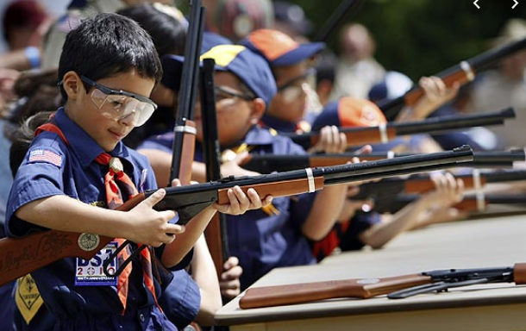
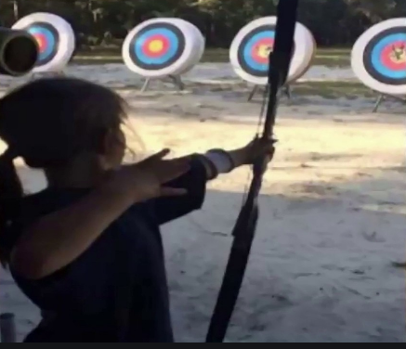
Shooting Sports
Requests for Shooting Events – Lead Time!
  50+ scouts - 6mos
  Less than 50 scouts - 3mos
Shooting on private land:
  Requirements
  Permissions/protocols
Shooting Sports web page
Shooting Sports Instructor Classes:
  Rifle/Shotgun - 07/20/24, 08/24/24

Slide 27
Order of the Arrow
  Brian Fleck is Chapter Advisor.
  2024 Dues can be paid online: https://wipit470.org/dues.html
  Registrations open online https://wipit470.org/index.html under “Events”

