Slide 1
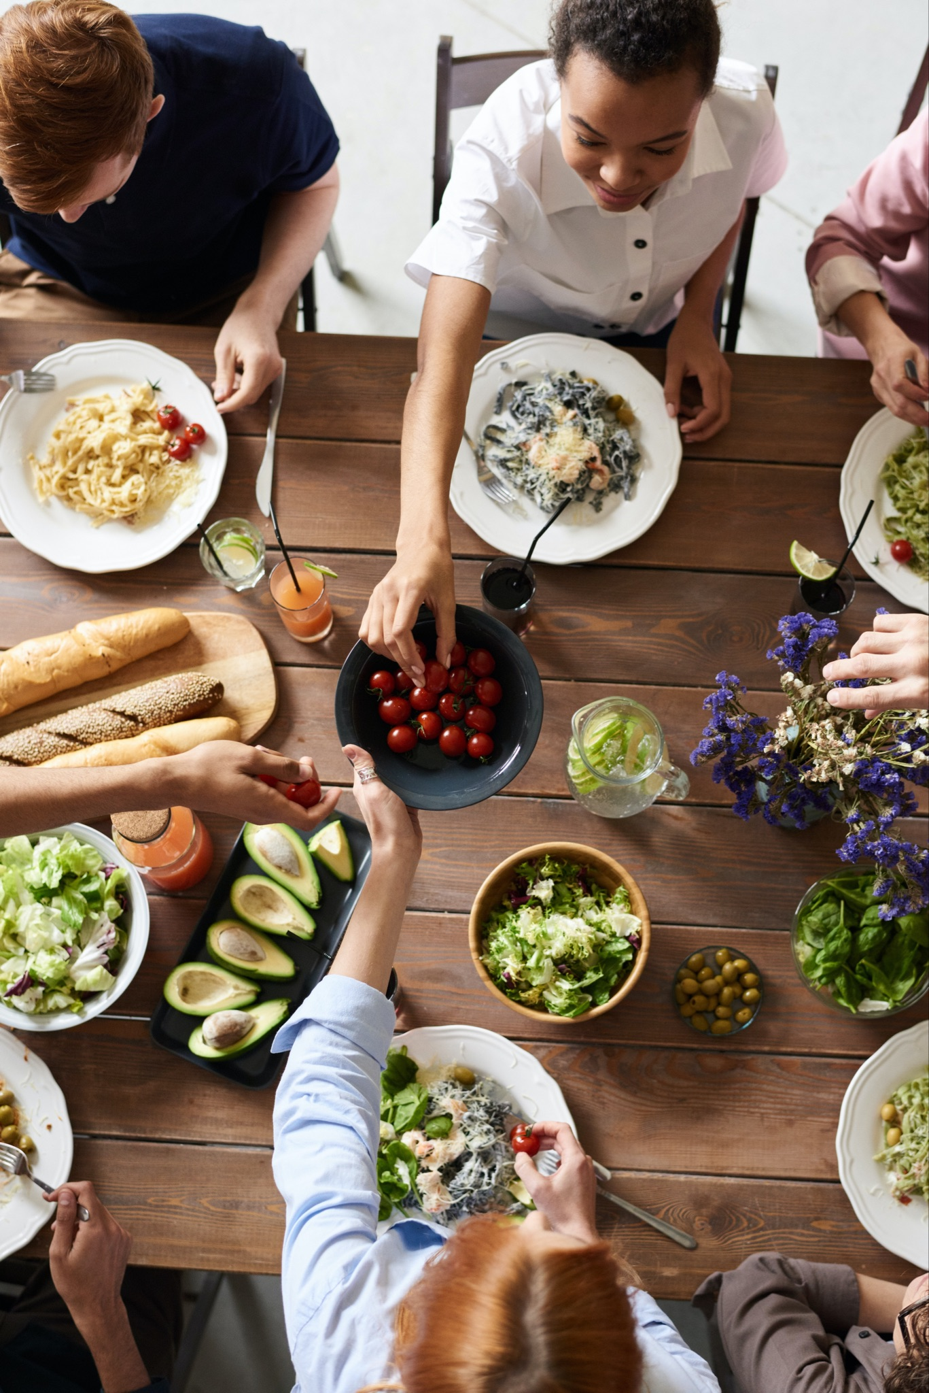
Better Together
Family Café:
Creating Memories
at Mealtime
Notes:
Trainer Note: Introduce yourself and welcome participants to the cafe.

Slide 2
Let's get ready!
Rename yourself if your screen does NOT say your name.
Move the mouse over your picture until you see 3 little dots in the top right corner.
Click on the dots and then click on “Rename” and type your first and last name.
Please be actively engaged during our time together
Participating in the chat box, discussing topics, contributing to the conversation
1
4
2
Type the following information in the chat box:
First and last name
Tell us the name of the ECE Program your child attends
5
Please stay muted unless you have a question or comment.
Please turn on your video at this time.
If two of you are watching together, we must be able to see both of you throughout the training.
If you get kicked off during the training due to a technology issue, please log back in using the same link in your confirmation email.
3
6
Notes:
Trainer Note: Omit this slide if you are hosting the cafe in person.

Slide 3
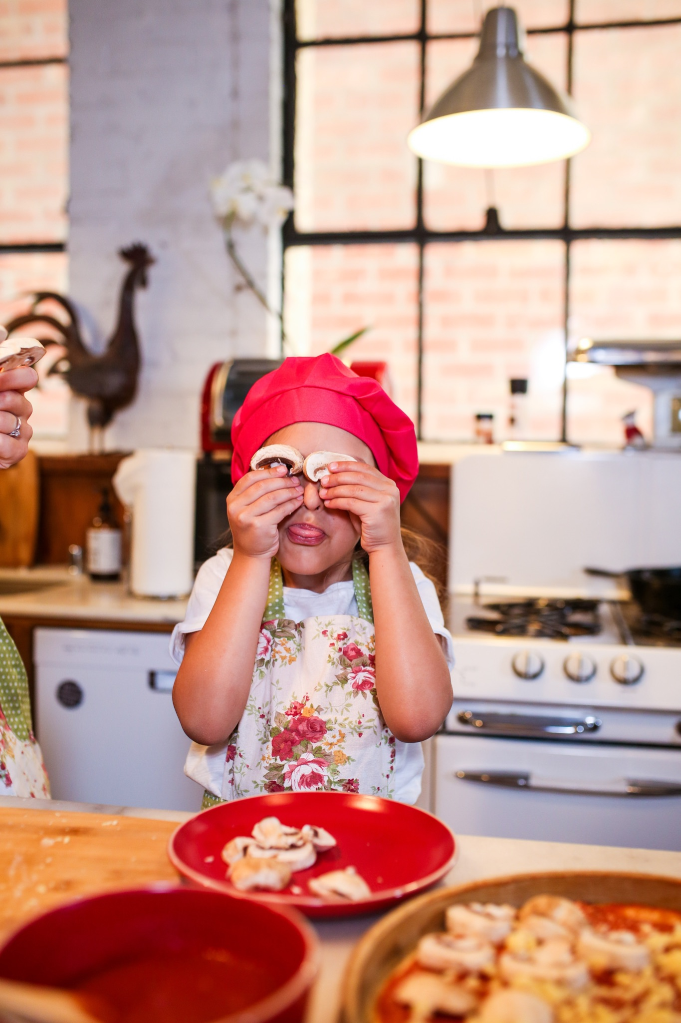
Welcome!
Think about your best day over the last week.
What happened that made it the best?
Notes:
Think about your best day over the last week. What happened that made it the best?
Trainer Note: Share your own response to start the conversation.
Thank you all for sharing! This is a great way to start mealtime conversation at the table! Ask “What was the highlight of your day?” or “What was a moment that made you smile today?”
Now, let’s find out more about what we will discuss during this session.

Slide 4
Objectives
To understand how the Four Building Blocks of HOPE (Healthy Outcomes from Positive Experiences) support the development of the child and family
To explore the various elements of family style dining
To discuss strategies to make mealtime an opportunity for building positive relationships with families through conversations and nurturing interactions
Notes:
Objectives for this Cafe:
To understand how the Four Building Blocks of HOPE (Healthy Outcomes from Positive Experiences) support the development of the child and family
To discuss the various elements of family style dining
To discuss strategies to make mealtime an opportunity for building positive relationships with families through conversations and nurturing interactions
We will start by discussing the Building Blocks of HOPE.

Slide 5
The Four Building Blocks of HOPE
Sege and Browne. Responding to ACEs with HOPE: Health Outcomes from Positive Experiences. Academic Pediatrics 2017; 17:S79-S85
Notes:
Just as ACEs (Adverse Childhood Experiences) are organized into categories or domains, we see that PCEs (positive childhood experiences) can be organized into the Four Building Blocks. HOPE (Healthy Outcomes from Positive Experiences) centers around key Positive Childhood Experiences (PCEs) that buffer against the negative lifelong health effects caused by Adverse Childhood Experiences. These Building Blocks are essential for healthy development - even in the absence of ACES.
Research shows that positive experiences promote children’s long-term health and well-being. They allow children to form strong relationships and meaningful connections, cultivate positive self-image and self-worth, provide a sense of belonging, and build skills to cope with stress in healthy ways.
Now we will look deeper into each of the Four Building Blocks: Relationships, Environment, Engagement, and Emotional Growth
Background Information:
Information about HOPE & the Mission- Spreading-HOPE_FINAL_2.2.2021.pdf (positiveexperience.org)

Slide 6
The Four Building Blocks of HOPE: Relationships
Sege and Browne. Responding to ACEs with HOPE: Health Outcomes from Positive Experiences. Academic Pediatrics 2017; 17:S79-S85
Notes:
Being in nurturing, supportive relationships are critical for children to develop into healthy, resilient adults.
Having key foundational relationships: parents/caregivers who respond to a child’s needs and have warm, responsive interactions.
Having adults outside of the family that take a genuine interest in a child and support their growth and development.
Having healthy, close, and positive relationships with peers.
Trainer Note:
Below is more information regarding this HOPE Building Block. It provides more relatable context. However, if you have already covered the HOPE Building Blocks with the group you are working with in a previous session, please use your discretion in reviewing the information.
For child care providers: Individuals that recall having these types of relationships during childhood experience significantly lower rates of depression and poor mental and physical health during adulthood. When working with families, especially vulnerable families affected by trauma, it is important to ask about the types of positive relationships a parent may recall from their childhood. This information can then be celebrated and used to help create opportunities for their children to experience the types of relationships encompassed by this Building Block of HOPE.
For parents/families: Individuals that recall having these types of relationships during childhood experience significantly lower rates of depression and poor mental and physical health during adulthood. We encourage you to think about these types of positive relationships from your own childhood. Reflecting on this yourself can then be used to help create opportunities for your own children to experience these types of relationships encompassed by this Building Block of HOPE.
Trainer Note: Ask for response-As you think about the positive relationships in your life - what characteristics have they had?
Maybe the relationships have been trusting, nurturing, supporting, etc.
The next Building Block we will discuss is Environment.

Slide 7
The Four Building Blocks of HOPE: Environment
Sege and Browne. Responding to ACEs with HOPE: Health Outcomes from Positive Experiences. Academic Pediatrics 2017; 17:S79-S85
Notes:
Children who live, learn, and play in safe and stable environments are less likely to experience poor mental and physical health as adults. So what do we mean by safe and stable environments?
A safe, stable environment, secure in meeting a child’s basic needs, including adequate food, shelter, and healthcare.
A school or home where children feel emotionally safe
A stable school environment where children feel valued and receive high-quality education.
A community environment to play and interact with other children safely.
Trainer Note:
Below is more information regarding this HOPE Building Block. It provides more relatable context. However, if you have already covered the HOPE Building Blocks with the group you are working with in a previous session, please use your discretion in reviewing the information.
For providers: It is crucial to ask caregivers about the types of environments their children are experiencing. Celebrate the positive and work with families to help ensure their child has the opportunity to live, learn and play in safe and nurturing environments.
For parents/families: It’s important to think about the type of environment your children are experiencing. Celebrate the positive and work to ensure your child has the opportunity to live, learn, and play in safe and nurturing environments.
Think about your child's environment - what positive things does your child experience in their environments?
Do they have friends in their neighborhood they like to play with? Do you have a garden where they can enjoy learning outside?
Now let’s talk about the Engagement Building Block.

Slide 8
The Four Building Blocks of HOPE: Engagement
Sege and Browne. Responding to ACEs with HOPE: Health Outcomes from Positive Experiences. Academic Pediatrics 2017; 17:S79-S85
Notes:
Children need opportunities for social engagement and to develop a sense of connectedness. Developing a connection to and sense of belonging in a community, as well as a sense that you matter to your community, describes the essence of the third of the Four Building Blocks of HOPE. What are some examples of social and community engagement?
Being involved in projects, peer-mentoring, or community service through one’s school or religious organization.
Partaking in family cultural traditions.
Participating in organized music, art, or sports.
Trainer Note:
Below is more information regarding this HOPE Building Block. It provides more relatable context. However, if you have already covered the HOPE Building Blocks with the group you are working with in a previous session, please use your discretion in reviewing the information.
Children need to feel connected to their communities, loved, and appreciated. Having this type of engagement (involvement in social institutions and environments, awareness of cultural customs and traditions, and a cultivated “sense of mattering” and belonging) helps children develop into secure and resilient adults.
Have any of you experienced positive benefits or had good experiences being part of a community group or friend group that you would be comfortable sharing?
Trainer Note: Add a personal story or experience here if participants don’t feel comfortable sharing.
Now let’s move on to discuss the last Building Block- Emotional Growth.

Slide 9
The Four Building Blocks of HOPE: Emotional Growth
Sege and Browne. Responding to ACEs with HOPE: Health Outcomes from Positive Experiences. Academic Pediatrics 2017; 17:S79-S85
Notes:
The final Building Block of HOPE Emotional Growth: through playing and interacting with peers for self-awareness and self-regulation.
Children need opportunities for social and emotional development. What do we mean by social and emotional development?
Developing a sense of emotional and behavioral self-regulation
Having the ability to respond to challenges in a productive manner
Developing key socially and culturally appropriate communication and interpersonal skills
Children need to have ample opportunity to develop their sense of social and self-awareness, learn how to self-regulate emotions and behaviors, and acquire skills needed to respond functionally and productively to challenges.
Trainer Note: (emphasize this point)- Opportunities to develop these skills arise during child-centered play. Children need the support of adults to name and understand make meaning of their emotions. Whether a child needs help developing these skills or they naturally pick up on them, these skills are critical for children to be able to become resilient, emotionally healthy adults.
Trainer note:
Examples of what play and social emotional development looks like-
Play pretend with baby dolls with your child. This helps develop empathy as young as 18 months. Narrating what you’re doing by responding to the baby “crying” and naming their feelings. “Oh the baby must be sad”. Then give the doll to your child and encourage them to do the same.
Playing dress up and imitating housework activities to help them develop a sense of independence.
Practice taking turns. Grab a race car, and give a car to the child. Use cues such as “my turn, your turn, I love the way you’re being patient as you are waiting for your turn”. You can practice this skill with an infant by playing games such as peek a boo and cooing back and forth.

Slide 10
Why HOPE?
Positive experiences help children grow into resilient, healthy adults, and they can help lessen the effects of adversity.
HOPE aims to evolve our understanding and support
of these key experiences.
Notes:
By promoting the HOPE Building Blocks, we aim to support resiliency for our families. We want to encourage positive experiences and the Building Blocks to help children grow into resilient, healthy adults, and to help lessen the effects of adversity.

Slide 11
Partner Activity
How do you define a successful family mealtime?
Notes:
Ten minute activity: Four minutes in groups or breakout rooms, six minutes to debrief upon return
Trainer Note:
Pose question to participants: How do you define a successful family mealtime?
Send participants to groups or breakout rooms in groups of two-three. Allow four minutes total, approximately two minutes for each partner to share.
Debrief: We invite anyone to share your own thoughts or share something from your partner, whatever you are most comfortable with.
Trainer note:
If no one speaks up during debrief, trainer can share example first.
Relate experiences to how sharing a family meal is supporting the HOPE Building Blocks. For example: Typically when we are sharing a meal with others, although it looks different in every household, we are deepening our relationship with our family and friends.
Thank you all for participating in our partner activity! We appreciate you sharing with others about what a successful family meal looks like for you and your family. The reason we like to discuss this, is because it’s important to acknowledge that a “successful” family meal is unique to each individual family.

Slide 12
What do we mean by Family Style Dining?
There’s no right way to have a family meal.
It’s what works for you & your family.
Notes:
What do we mean by Family Style Dining?
There’s no right way to have a family meal, which we discussed briefly in our partner activity. It’s what works best for YOU and your family.
Here are some ideas to consider in making a family meal part of your routine:
Scheduling family meal time can be challenging. Let’s focus on the times you are able to make it happen! Maybe it's a holiday or a Sunday dinner. It may be sharing breakfast together or an afternoon snack. Whatever time you DO have this time together, it’s special, make the most of it.
You can plan your family mealtime around your needs and preferences. There is no one way to do it. It doesn’t have to be once a week. What works for you and your family?
The beauty of a family meal is the connection between healthy food and love. (This is supporting Relationship Building Block.)
Let’s discuss the elements of Family Style Dining.

Slide 13
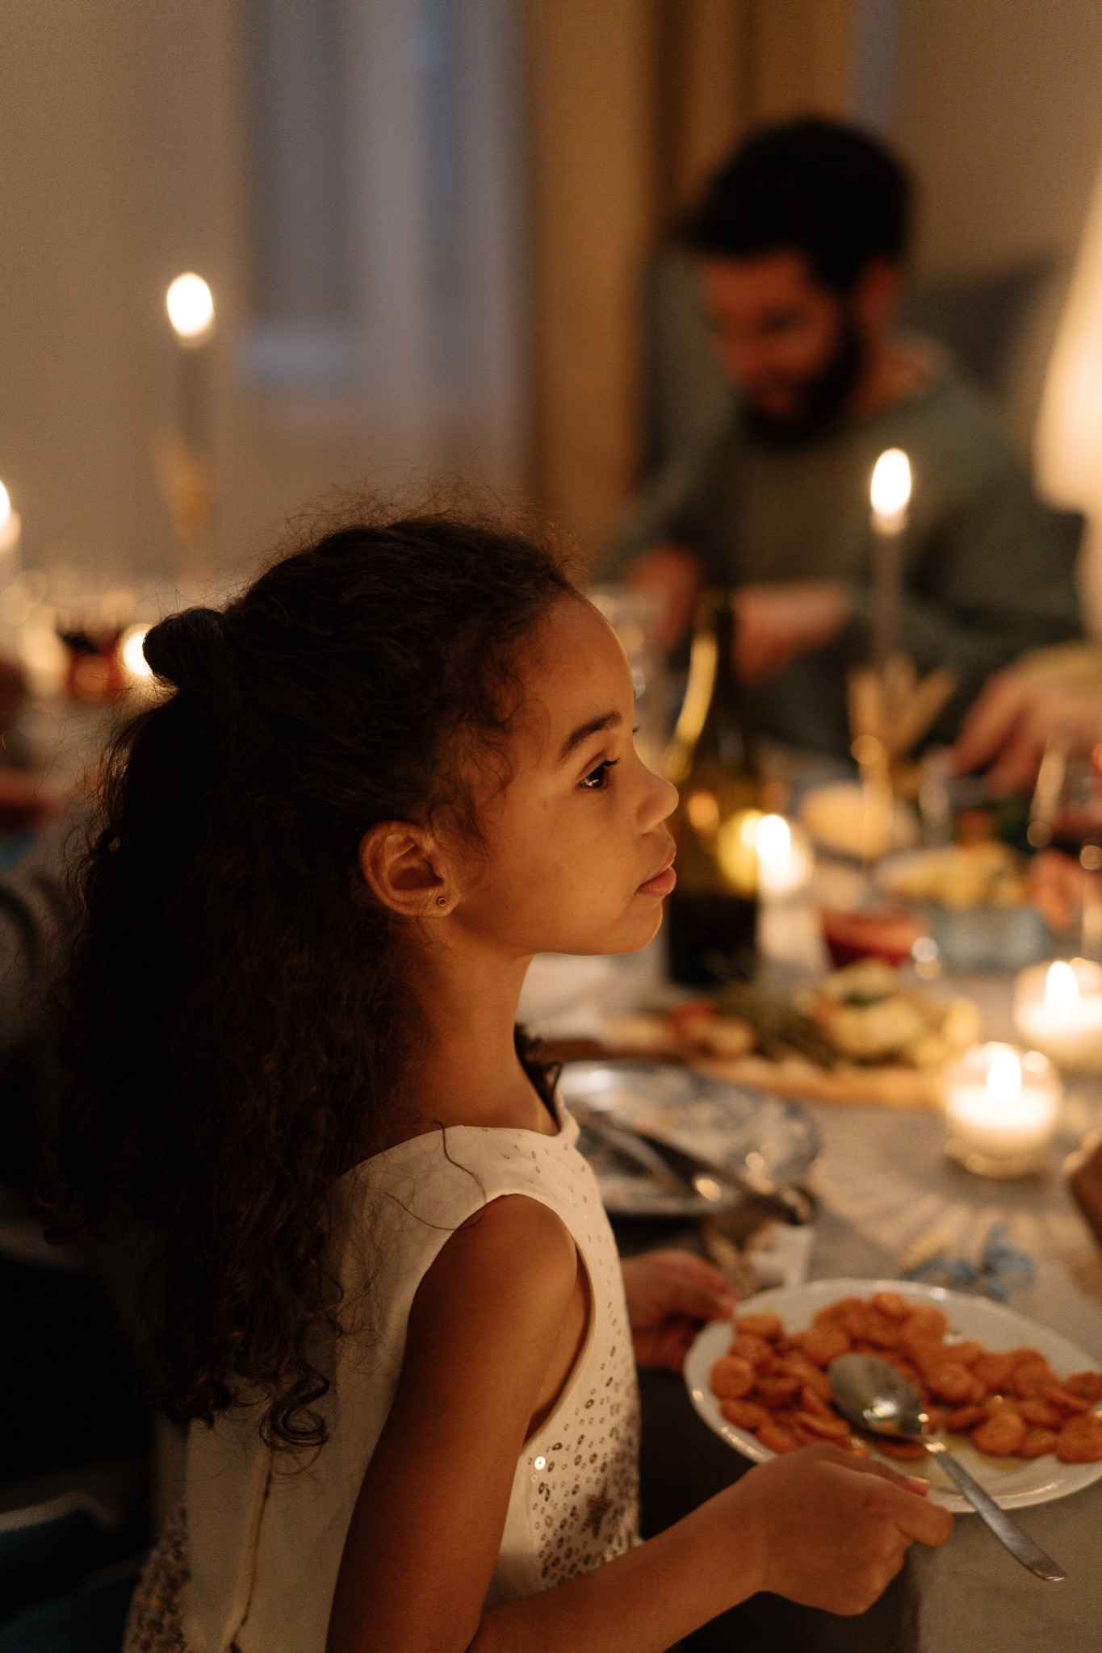
Elements of Family Style Dining
Foods & beverages placed on the table
Encourage children to serve themselves
Find ways for children to be involved
Engage in conversation during mealtime
Notes:
If eating together as a family is new to you, here are some great ideas to adopt as part of a mealtime routine. Start small by introducing one element at a time.
Ideally, we want to have foods and beverages placed on the table and encourage children to serve themselves.
Provide opportunities for children to practice serving themselves before introducing during mealtime. Provide small balls or other objects to practice serving food(tongs, little pom poms, muffin pans, etc.). Child-size utensils are great to use to practice. Give opportunities for children to practice pouring liquids from small pitchers to a child-size cup. We recommend not using actual food items for practice so we are not contributing to food waste. When you are ready to implement this at the table, you can start with simple tasks- perhaps passing rolls or scooping vegetables. You can add items as people get more comfortable, with pouring drinks being last.
If you are concerned with children putting too much on their plates, put a small amount on the table for serving.
Find ways for children to be involved in the planning or preparation of the meal. This teaches important life skills. While perhaps it is more time consuming initially, eventually this will be helpful to you in your planning.
Children can help set and clear the table.
They can set out placemats, utensils, napkins, condiments, etc.
Have things within reach for children to be able to help.
Allow children to help with unloading the groceries, help washing the produce, have small cutting boards and child-friendly knives to cut up produce such as strawberries, bananas, mushrooms, etc. An easy place to start is letting children tear lettuce.
Involving children in the mealtime process is adding to the Engagement Building Block.
Engage in conversation during meal time. This is the most important element of sharing a family meal together. We will talk more about the importance of conversation next as we discuss mealtime habits.

Slide 14
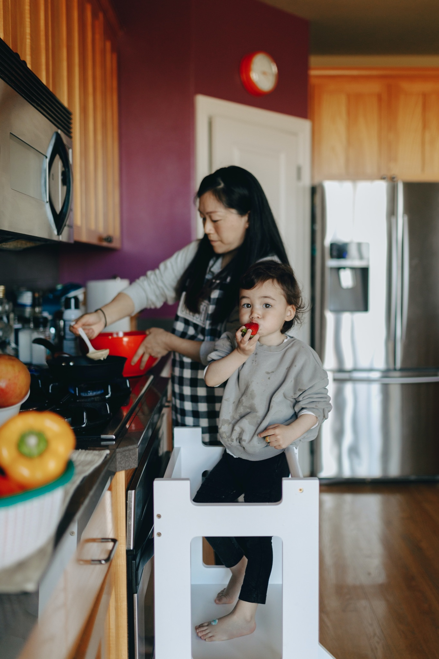
Mealtime Habits
Remember their eating preferences
Model trying new foods
Focus on family at the table
Share in conversation
Notes:
As we think about sharing a meal with our family, we want to make the most of that quality time together. Here are a few habits to help make that time special.
Remember their eating preferences:
Trainer Note: This is carryover information from the Child Nutrition Cafe. If you have already conducted the Child Nutrition Cafe with this group, use trainer discretion to recap information.
Children can have their own food and eating preferences! They may refuse or be reluctant to try fruits, vegetables, other new foods, or foods prepared in new ways. You don’t want food to go to waste, so you serve foods you know children will like and eat with minimal fuss. We often call these children “picky eaters,” but aversions to certain foods, tastes, and textures are a normal part of child development. There are solutions to help children become more willing to explore new foods. Important note: We should not label children as picky eaters (some children will inadvertently try to live up to this label), but continue to encourage them to try new and unfamiliar foods.
Model trying new foods. Give details when you describe the food, how it tastes, and why you like it! Tell your family stories about the first time you tried something and how you didn't like it, but like it now. Trying foods again helps our taste buds learn to like different things.
Focus on the family at the table. Put the phones away. Turn the tablets and TVs off. This is a great time to engage with your family to foster the Relationship Building Block by sharing a meal with our family.
Share in conversation. “Research on strong family relationships consistently has shown that good family communication is one of the cornerstones of a healthy family life.” (source:https://www.ndsu.edu/agriculture/extension/publications/family-meal-times-issue-5-improving-family-communication-family-meals)
Conversation is the quickest way to reconnect. Bond by telling stories from your day. Talk about the food on your plate. If conversations are a struggle for your family, or you aren’t sure how to get the conversation started, occasionally bring up a conversation starter and give the whole family a chance to talk and share. This creates a positive experience for each person at the table. Try to avoid using this time to talk about any negative experiences (behavior choices they may have had at school that day or things you know they are struggling with). Use this time to focus on the positive and connect with each other. Save difficult conversations for after school or after the meal. We want children to WANT to come to the table, and want them to feel safe there.
Speaking of conversation, let’s set the stage for our cafe conversations we are about to have!

Slide 15
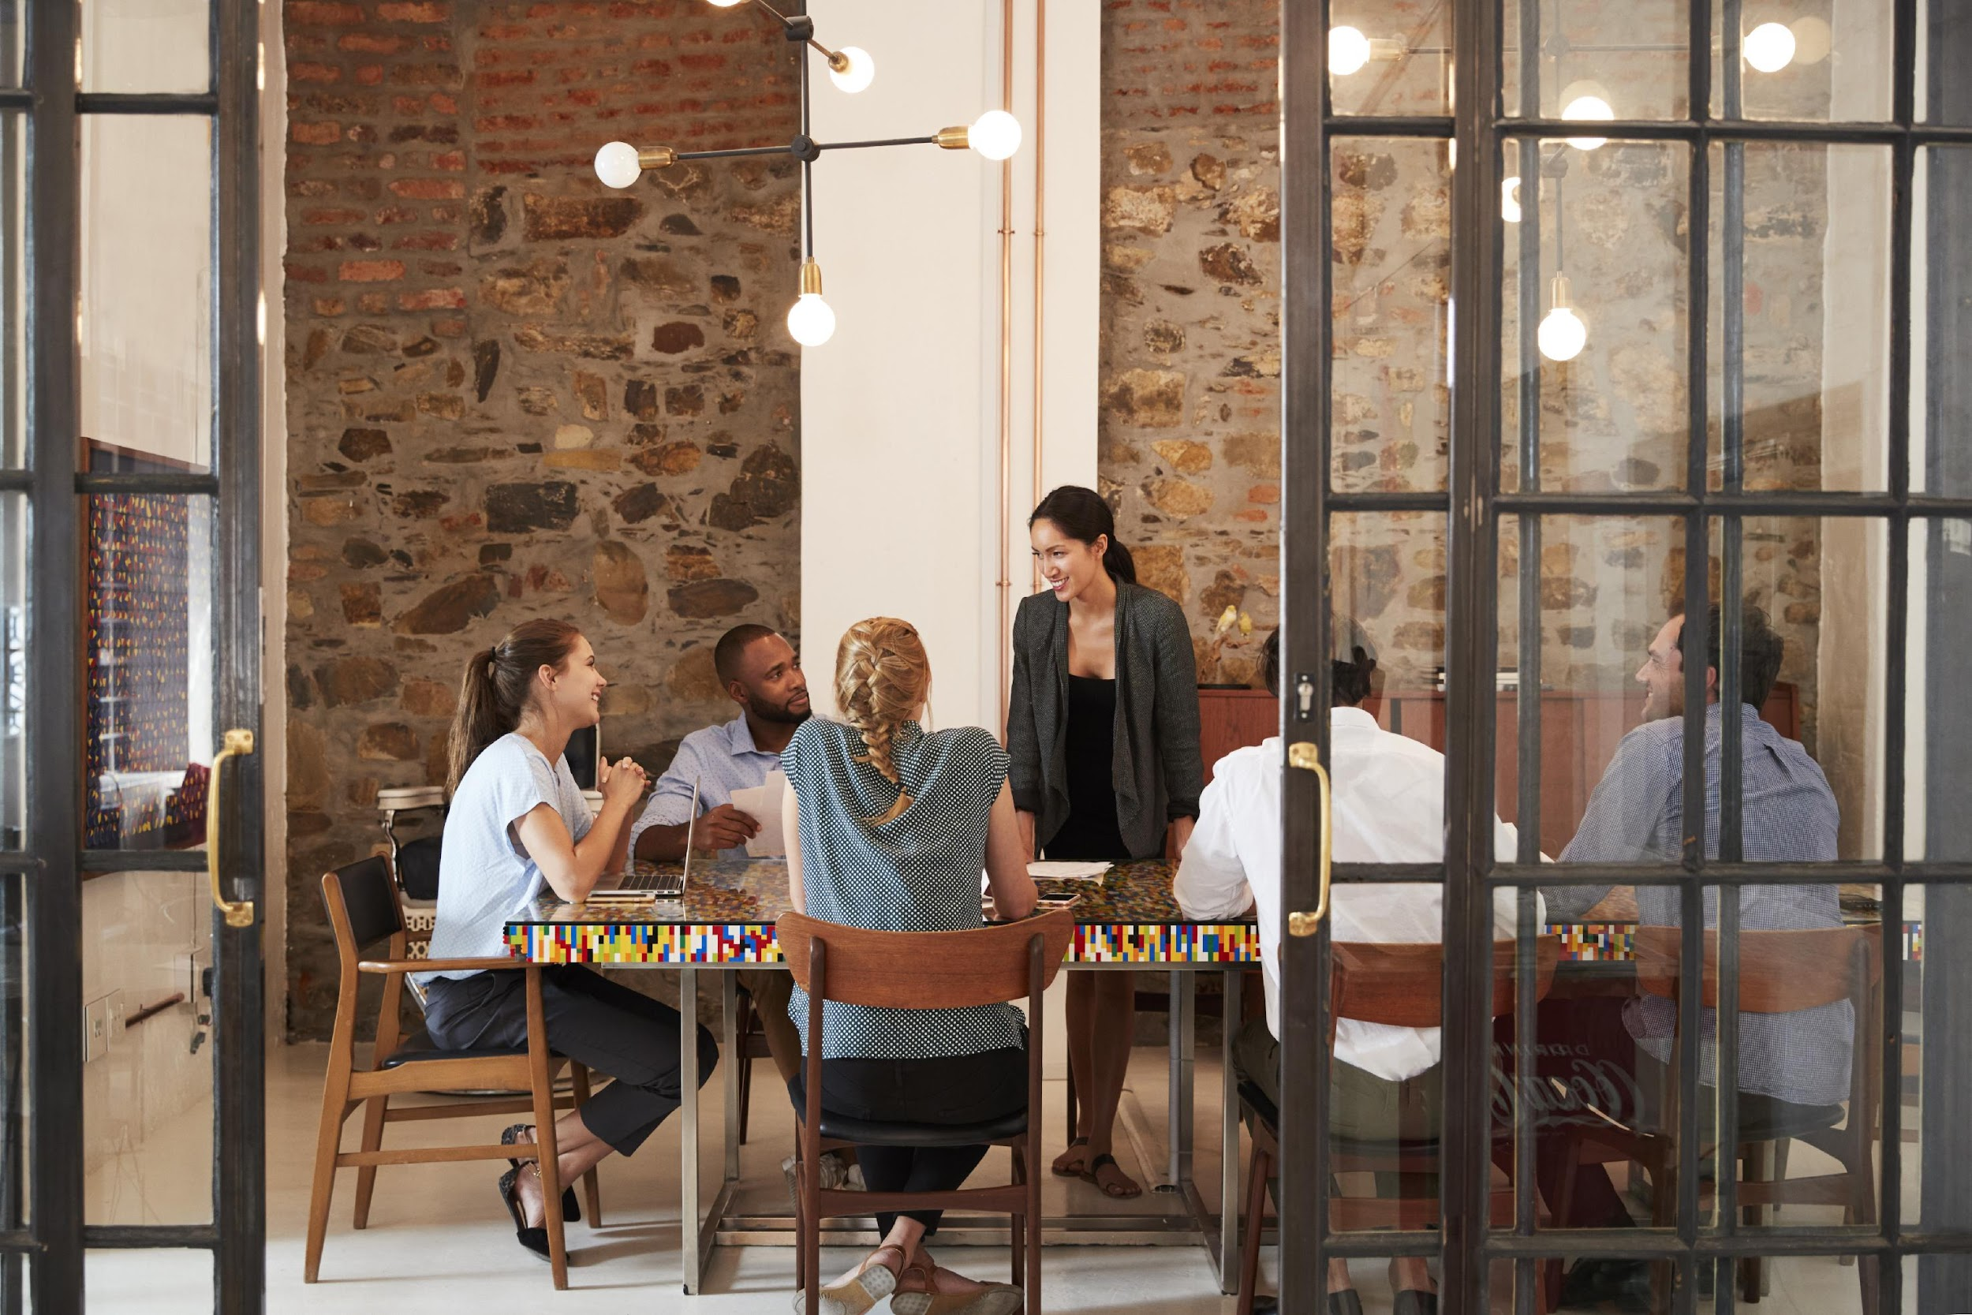
Creating an Emotionally Safe Environment
Active listening
Judgement free zone/safe place
Confidentiality
All responses welcome!
Notes:
Before we move into the discussion, we want to make sure we are setting a space for a positive environment and experience for all who are participating today. This will help set the stage for our conversations.
Active listening- truly listening to everyone sharing and being present
Judgement free zone/safe place- This is a judgement free zone in order to help create a safe place.
Confidentiality-What happens in the café, stays in the café!
All responses welcome! We encourage everyone to be open in sharing their thoughts and experiences. That's what makes a cafe so special!
Any questions? Alright, let’s dive into the Cafe questions.

Slide 16
Cafe Questions
Creating Memories at Mealtime
Notes:
Trainer Note: Based on the number of participants, divide into groups of up to five people. Breakout rooms will be used for each of the cafe questions. Small group discussions should last for eight-ten minutes.
If the Cafe is in person, refer to the Better Together Family Cafe Toolkit for facilitation instructions.
At this time, give a brief explanation of how the cafe portion works to the participants.
Sample Script (This will vary based on several factors: in person/virtual, large group/small group, etc):
We are about to move into the cafe questions. During this time, you will have about eight minutes with your group to discuss the each question. This is an opportunity to connect and collaborate with each other. After each cafe question, we will come back together to debrief our discussion with the whole group.

Slide 17
What is something that your family does or has done in the past that creates a positive mealtime experience?
#1
Notes:
Question 1: What is something that your family does or has done in the past that creates a positive mealtime experience? Examples: the food offered, introducing new foods, encouraging mealtime practices, etc.

Slide 18
#2
What are some positive conversation starters you have used or would like to try during mealtime with your family?
Notes:
Question 2: What are some positive conversation starters you have used before or would like to try during mealtime with your family?
Our Icebreaker question for this cafe was one example of a conversation starter for your family. “Think about your best day over the last week. What made that so?” Some other ideas may include: what is something that made you smile today? what is one way you helped another person today? what has been the happiest day of your life so far (and why)?
Trainer Note: In the materials, The Family Dinner Project conversation starters are linked. It is a great resource to mention when debriefing this question.

Slide 19
What are some creative ways you could include your children in the mealtime planning and experience?
#3
Notes:
Question 3: What are some creative ways you could include your children in the mealtime planning and experience?
We mentioned ways to involve children in mealtime planning and experience. Did you hear any that interests you or are their other ways?

Slide 20
Reflection
How do you feel after listening to the responses from the other participants?
How did you feel sharing your own thoughts and experiences?
What is one thing you will take away from today?
Notes:
Trainer Note: It is important to ask each reflection question individually and allow wait time for responses.

Slide 21
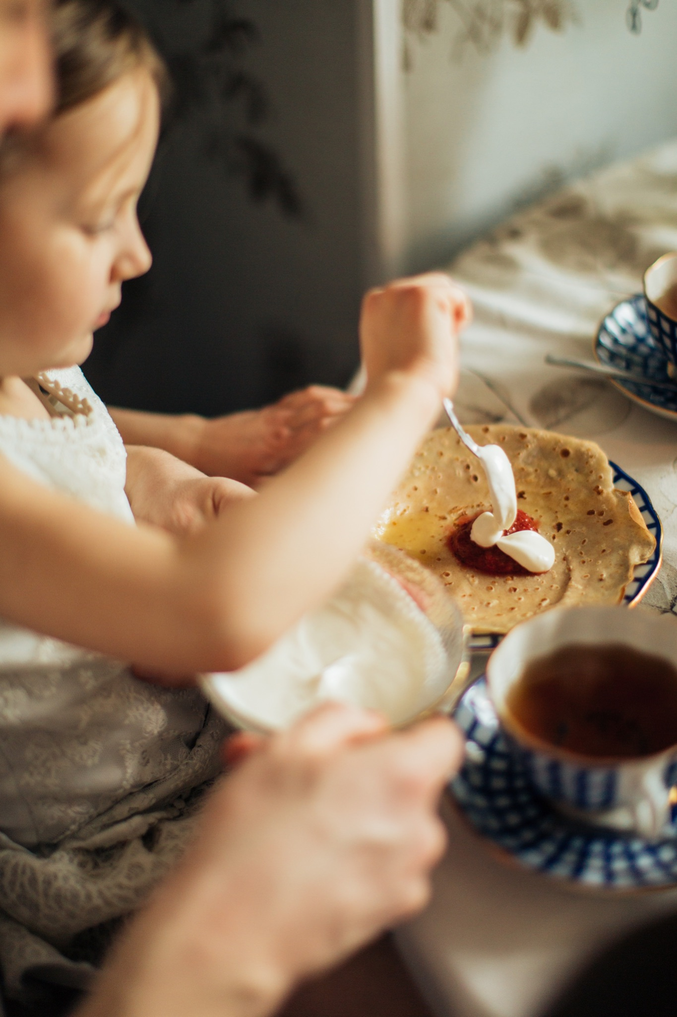
Note to Self
What is one goal you can set to help create a more positive mealtime experience for your family?
Notes:
The purpose of the note to self is to leave you with an action plan in creating a positive experience for your family. We really encourage you to take the time to complete your Note to Self.
What is one goal you can set to help create a more positive mealtime experience for your family?
Trainer Notes:
Some examples to share may be:
-Eating as a family supports Relationship & Emotional Growth Building Blocks
-Engaging children in the meal preparation supports Relationship & Environment Building Blocks
-Getting children involved in serving the meal or cleaning up the meal supports the Engagement Building Block

Slide 22
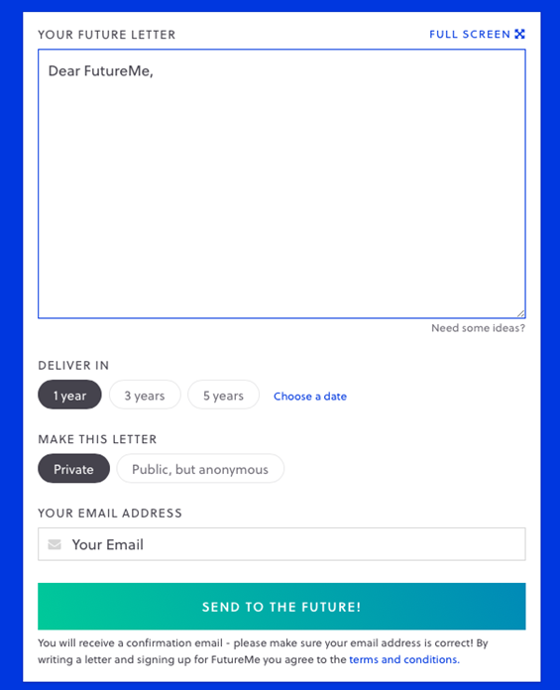
Futureme.org
Type response after reflecting on the
“Note to Self”
Click ‘Choose a Date”
Enter the date two weeks from today
Make this letter private
Type in your email address
Click “Send to the Future!”
Notes:
Trainer Note: Only use this slide if you are hosting the cafe virtually. If you are hosting in person, please refer to the Better Together Family Cafe Toolkit for more details.
Futureme.org is a website we suggest using for the Note to Self. Type in your response, click “Choose a Date” and enter the date two weeks from today. Keep the letter private. Type in your email address. Click “Send to the Future!” On your selected date, your note to self will arrive in your email to serve as a reminder of the positive experience you wanted to create for your family.
Background Information:
https://www.futureme.org is a website participants can use, especially virtually, to send the note to self. The link and information should be included in the follow up email if the cafe is done virtually.

Slide 23
Questions?
Notes:
Trainer Note: This slide can be used to discuss any questions, evaluations, next steps, etc.

Slide 24
THANK YOU!
Notes:
Type your notes

