Slide 1
Self-Care in Disaster Times & Beyond: Organizational Wellness
Notes:
Self-care for responders rests both within individual approaches to wellness, as well as organizational wellness culture. During and after a disaster, emergency or crisis event, it becomes critical to lead by example in order to reduce stress for your team(s).
For this reason, it's helpful for leaders to take time to care for themselves before/while supporting their staff and organization. In the spirit of role modelling, consider taking some time to explore the personal wellness information and exercises in the slides to follow, along with the team and organization-specific information and activities. We also encourage leaders to use the Self-care Toolkit Workbook their own self-awareness and to guide team and organizational self-care planning, for disaster times and beyond. Engagement with the materials can also offer perspective about what may fit or benefit from adaptation or additional strategies, to best meet your team/organizational wellness needs in times of disaster and emergency.

Slide 2
Learning Objectives
Recognize role of self-care within the context of disaster and emergency response and recovery.
Know how/when to engage self-care strategies for myself.
Understand my warning signs/red flags for stress.
Know when to seek help from others.
Reflect on and develop a self-care plan.
Understand systemic barriers, points of advocacy, and action.
Understand leadership role in modelling and supporting self-care culture and practice for their team/organization.

Slide 3
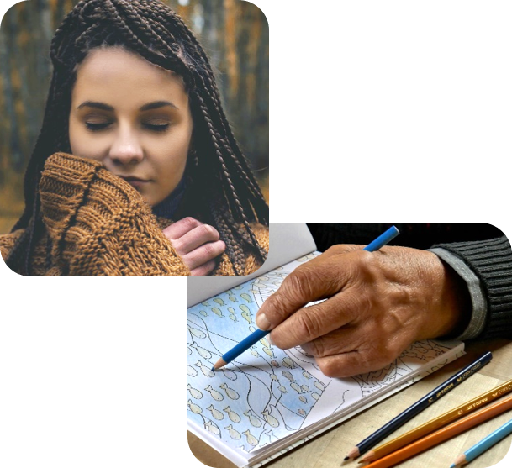
Self-care Opening Practice
Before continuing, we encourage you to take a few minutes to orient yourself towards self-care and wellness.
Choose one of the activities below or use one of your own.
Mindfully enjoy a moment with a warm cup of tea or coffee.
Breathing exercise (e.g., box breathing, HeartMath®)
Guided meditation or mindful reflection
Prayer, smudge, or other spiritual practice
Stretching, yoga, or short walk
Calming music
Drawing, coloring, or doodling
Notes:
We encourage you to take a moment to orient yourself toward self-care and wellness by taking time out to practice before diving into the following content. There will be opportunity for personal reflection and/or team discussion along the way as you progress through the information in the toolkit. Feel free to use the accompanying workbook to supplement your reflections and activities along the way.
If you're practicing self-care with your peers or your team, you may wish to choose one activity as group, or your can invite each person to choose an individual self-care activity, within a set time frame (5-10 minutes). If you decide to practice as a group or team, consider individual (diverse) preferences and needs regarding the type of self-care activity (e.g., physical, mental, emotional, spiritual).

Slide 4
The Story of Self-Care in Alberta Disaster Response & Recovery
Emerged from:
Southern Alberta floods
Recognized need for more focus on responder self-care
AHS Partnered with:
Dr. Patricia Watson
Interviews with affected AHS & community staff and leaders across Alberta
Slave Lake fire
Southern Alberta floods
Regional Municipality of Wood Buffalo / Horse River Wild Fire
Notes:
Context for the Self-care Project and Toolkit:
Following many of the disasters that have happened in Alberta between 2011- 2017 there was an increased recognition that staff supporting the recovery were impacted. They were taking on additional work, while still trying to balance their day to day life and regular workload.
After the fires in Slave Lake in 2011, an external review highlighted how staff and volunteers providing emergency response were experiencing a high amount of stress and burnout. Many individuals were dually impacted, particularly those that were both the ‘helpers’ and residents of the area.
AHS Mental Health Promotion and Illness Prevention (MHPIP) team consulted with Dr. Patricia Watson, the Senior Education Specialist for the National Center for PTSD, and Assistant Professor in the Department of Psychiatry at Dartmouth Medical School Clinical Psychologist focusing on educational training for post-disaster, military, and first responder settings 1. The MHPIP team interviewed (18+) individuals who supported the response and recovery with the FMM fires, the Southern Alberta floods, and the Slave Lake fire to understand recurring themes with self-care & disaster response/recovery work & to develop this workshop.
In the interviews and pilot workshops, many organizations, teams and leaders recognized the need for self-care but acknowledged the difficulty setting aside time for comprehensive, sustainable staff self-care/wellness planning beyond periodic activities or debriefs (with particular difficulty finding time for a longer workshop dedicated to self-care/wellness during stressful post-disaster/recovery times). As such, this toolkit was born.
It has evolved even further as self-care project materials were incorporated into the development of the Psychological First Aid (PFA) for Pandemic webinar, given the widespread and enduring impacts of the COVID-19 pandemic. As self care has been identified as an area of growing interest/need, 30 minutes of interactive self-care discussion has been incorporated in the 2 hour PFA webinars. As the pandemic has progressed, requests have increased for resources to support individual self-care and team wellness in the ever-changing and uncertain events of the pandemic. We hope that you will find the resources and information herein helpful and supportive of your individual, team and organizational self-care journey, as you support your communities and teams through the this response and recovery work.

Slide 5
Notes:
Individual reflection and/or Team discussion questions:
What do you think of when you hear self-care?
Does this term resonate?
Do you use other words?
Examples of self-care concepts: Wellness, Well-being, Positive mental health, Why do we often acknowledge its importance, but have trouble doing it?
Reflect on or discuss our attitudes and perspectives toward the concept of Self-care. For example, it means spending lots of money, it’s grand gestures vs it’s small things (e.g., selfish, self-indulgent) . At no point are we ever “done” knowing how to best take care of ourselves. Our needs change and evolve.
Analogy: just because we eat a big meal one day, we would never expect that would mean we’ve eaten enough for the next week or month; the need to eat continues, just like our needs for rest, fun, purpose, will always be there and always need tending.
Things to consider:
Interviews with and feedback from AHS and community responders and leaders indicated that self-care was both lacking AND a priority for many first responders/frontline staff and managers and that those impacted were playing dual roles.
Within teams and organizations, differing perspectives and values about self-care and personal or team wellness may impact approaches to self-care (and should influence how we approach development of organizational wellness strategies and leadership approaches in disaster times and beyond.
Examples: Working long hours, no time to deal with own personal emotional reactions to disaster or pandemic impacts, balancing work and family.
Story
When we were starting to put this workshop together, we realized that some people really liked the term ‘self-care’ and others had a strong, negative reaction to it. We decided to do a little ‘poll’ of the people we interviewed, our own office mates, and our families. We asked people if they personally use the word/phrase ‘self-care’. What do you think our results were?
To our surprise, nearly everyone said they do NOT use the term for themselves. We had interesting discussions of how people do talk about this concept in a way that makes sense and feels right to them.

Slide 6
Psychosocial Preparedness
Disaster and emergency response work carries potential impacts for your well-being; self-care will be a natural need.
We become a better responder for our family and community when we pay attention to our own self-care.
Recognizing your signs of stress and making self-care a part of your regular routines, individually, in your teams, and your organizations can help to sustain you in your response work.
Notes:
“A successful primary prevention program requires that we know at least one modifiable risk factor and have a way to modify it.” McDowell, I., & University of Ottawa. (2015).

Slide 7
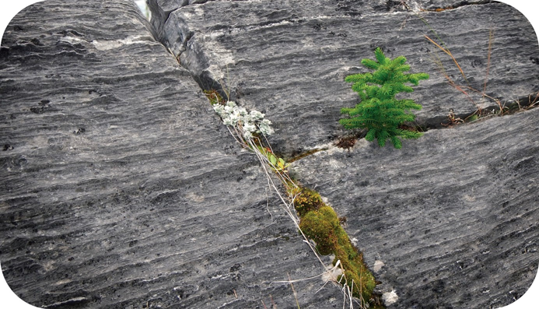
Self-Care is Key to Resilience
“If you’re able to have self-care as part of the makeup, then when disaster hits, you’re not taken to threshold right away.”

Slide 8
Impacts of Supporting Disaster Response & Recovery
Notes:
Although there are risks associated with disaster work, which we will address shortly, it’s important to acknowledge that there are positive features of this type of work
Question for Reflection/Discussion:
From your experience/observations, what are the potential positives of being involved with emergency/disaster response and recovery work?

Slide 9
Positives of Response & Recovery Work
Disaster/Emergency response can lead to:
A sense of strength, confidence, connectedness, contribution, meaning, and respect for human resilience.
Serving others may be:
Rewarding, satisfying, and may build a wealth of personal skills such as coping skills and problem-solving.
It may invite us to reflect on what's important in our lives.
Notes:
Some individuals look at disaster work as satisfying; they feel as though they are making a contribution that is meaningful and rewarding.
Although there's stress involved, not everyone will experience the same level. Despite what some might think, job turnover and loss of support workers is low.
Going through a disaster, or being a support person to those impacted reminds, you what its important in life. It can be life-altering in terms perspective.
Pandemic Considerations: A Pandemic impacts everyone, which can serve as a unifying factor, can foster empathy and connection, and can motivate us to make changes, individually/together.

Slide 10
Challenges of Response & Recovery Work
Severity and rarity of the event.
Duration of the event (e.g., as per a pandemic)
Staff may be affected themselves.
A heightened sense of responsibility and putting own needs aside.
Self-imposed time pressure to react—an internal need to hurry.
Long hours for an extended period.
Getting too involved emotionally with affected individuals.
Intra-agency or interpersonal conflicts.
Notes:
These challenges are based on research about the stressful features of Disaster Response and Recovery Work, including responding to a pandemic.
Reminder: not everyone is going to respond the same way. Everyone will deal in their own way.
Key factors:
The severity and rarity of the event. For example:
Disaster might have happened in past; staff may able to apply ways they’ve dealt with similar situations. There may also be emotional/psychological triggers when another event occurs.
Staff may be affected themselves (as per the pandemic). Consider: In what ways are the staff personally impacted?
A heightened sense of responsibility and high standards. For example:
Someone that is in a management or supervisory role might feel that they are responsible for taking care of others. Or they might be the type of person that puts other’s before themselves, neglecting their own needs. Their family and normal activities may be set aside; spending long hours providing disaster response can lead to both personal and professional conflicts (especially if tending to factors such as family job loss and homeschooling responsibilities for children, as per during COVID-19 Pandemic).
Intra-agency or interpersonal conflicts. (e.g., Stress of disaster may stir pre-existing disagreements between staff/management from different agencies about community service priorities. COVID-19 pandemic has at times brought to the surface differences in beliefs and values related to public health, science, leadership and perception of individual vs. collective rights).
Ongoing uncertainty, risks, micro-losses, and anticipated losses amid a pandemic–everyone is impacted, helper/responder and client/community member alike, which can add stress to the responder role.
Reflective/Discussion questions:
What examples of disaster and/or responder stress have you seen or experienced in your roles?
What did your organization do to support its people?

Slide 11
Human Performance and Stress
Adapted from: Center on the Developing Child at Harvard University. (2017) ; Diamond, D. M., et al. (2007) ; Swank, R.L., & Marchand. W.E. (1946) ; Watkins. A. (1997).
Notes:
(Workbook page 2)
Stress is a natural reaction to a range of experiences in our daily lives. Positive stress motivates us and helps us rise to challenges, helps us learn, problem solve and grow. However, in times of disaster/emergency, when demands increase, often for more prolonged periods, if we push our performance and internal resources beyond the period of maximum efficiency, we begin to experience high stress, and can shift to auto-pilot, at which point we may experience overconfidence (a phase during which errors in judgment, work performance and boundaries begin to show up).
Once we move past the limits of tolerable stress, we become hyper-reactive, fatigued and dysregulated, showing signs/symptoms of toxic stress and possible mental health problems. If we continue to push ourselves to perform beyond this point, we put ourselves at risk for further problems, and possibly illness. In fact, research has shown that if people are supported to step away from their responder role and ensure proper self-care before the period of overconfidence, they are likely to be better equipped to sustain self-efficacy and wellness during their recovery and response work. In short, some level of stress is expected during disaster response and recovery work, but it can become hazardous to our health and helping roles if we push ourselves too far, particularly if we have also been personally impacted by the event.
Adapted from:
Center on the Developing Child at Harvard University. (2017). Toxic Stress. Retrieved from https://developingchild.harvard.edu/science/key-concepts/toxic-stress/print/
Diamond, D. M., Campbell, A. M., Park, C. R., Halonen, J., & Zoladz, P. R. (2007). The temporal dynamics model of emotional memory processing: a synthesis on the neurobiological basis of stress-induced amnesia, flashbulb and traumatic memories, and the Yerkes-Dodson law. Neural plasticity, 2007, 60803.
Swank, R.L., & Marchand. W.E. (1946). Combat neuroses: development of combat exhaustion. Archives of Neurology and Psychology, 55, 236-247.
Watkins. A. (1997). Mind-Body Medicine: A Clinician's Guide to Psychoneuroimmunology.

Slide 12
Long-term Response & Recovery Stress
Sometimes the effects of the stress are masked.
Staff stress may go unnoticed until well after (or into) the event.
Staff will often not realize the impact until they:
develop a medical problem.
take time off and then realize the contrast between stress levels before and after their time off.
Due to stressful impacts for the organization as a whole, senior leadership may not receive or have opportunity to seek feedback until the problems are more serious.
Notes:
There are some long-term factors unique to response and recovery work that put responders at higher risk for potential stress reactions, including:
Staff stress may go unnoticed until well after the event or in the In the case of a pandemic, it could be several months before it’s noticed due to it being masked, or until it's too late and it becomes a medical issue, resulting in absenteeism and perhaps requiring a leave from work.
There may be resource, time, and communication barriers along with the simple fact that these stressful events often impact an entire organization that result in leadership being unaware of the nature and severity of problems. This speaks to the value of building in consistent, transparent communication channels, trust, and rapport prior to major events, to enhance communication and mitigate these risks.

Slide 13
Long-term Response & Recovery Stress
Burnout: Gradual wearing down; emotional & physical exhaustion due to external work and personal stressors (including limited work & personal supports, high workload demands, and limited resources).
Sadness, apathy, cynicism, feeling discouraged, irritability
Compassion Stress/Fatigue: Stress and wearing effects of helping or wanting to help impacted individuals (effects of the difficult and intensive work/needs therein).
Helplessness, frustration, self-isolation, physiological & emotional exhaustion
Notes:
Reflective/discussion question:
What signs do you associate with burnout?
Burnout Symptoms:
Exhaustion due to work demands, low energy, inefficiency, and hopelessness
Feeling apathetic or callous toward clients, co-workers, leadership/the organization can be function detaching ourselves from others and work or family
Feeling incapable to fulfill job responsibilities, worrying about not getting work done, and isolating oneself from colleagues
Contributing Factors for Burnout:
High work demands, lower level of autonomy (e.g., schedule inflexibility, highly detailed reporting and supervisory monitoring), insufficient resources and support (workplace/organizational factors)
A lack of family support or conflict between work and family domains
Perfectionism and self-doubt can add to these effects
Compassion Stress/Fatigue can happen to any caregiver who has direct or indirect contact with trauma survivors and individuals with intensive emotional and physical care needs.
It can be a result of knowing about a trauma experienced by clients and/or a loved one and may have sudden onset
“Disaster Fatigue” can set in, as stated by a community leader working in disaster recovery, “At some point, you just can’t hear one more story about the [disaster].” followed by feelings of guilt, “You feel like a jerk, but you just don’t want to hear it anymore!”.
COVID (Pandemic) Fatigue: People begin to loosen adherence to public health measures. In some cases, people are actively resisting these measures amid the enduring and ever-uncertain nature of the pandemic. They move towards expressing frustration and trying to regain a sense of control.

Slide 14
Long-term Response & Recovery Stress
Secondary/Vicarious Traumatic Stress: Cumulative stress reactions over time due to supporting multiple trauma survivors.
avoidance/detachment or over-involvement, and may include PTSD-like symptoms
Post-Traumatic Stress Disorder (PTSD):
intrusive symptoms (e.g., nightmares, flashbacks)
hyper arousal
numbing
anxiety and/or depression
Notes:
Secondary/Vicarious trauma: Cognitive, emotional, social, and behavioral changes that may occur while working with traumatized individuals. Responders’ views about self and others may be called into question - particularly, views of trust, safety, control, and esteem. The responder’s symptoms and behaviour may begin to parallel the experiences of people they are helping.
Five Types of Most Common Vicarious Stress Reactions*:
Intrusive Preoccupation
Strong emotional reactions, disillusionment, changes in beliefs/ values
Avoidance / Detachment
“Numbing out,” difficulty with concentration and memory
Over-involvement
Difficulty maintaining appropriate boundaries, Strong urge to protect/”do for” and become the caretaker
Professional Alienation
Lack of support, fear of being viewed as inept, difficulty disclosing the emotional impact and “burdening” others with the realities of work
Professional Satisfaction
Heightened sense of meaning and reason for being (which may lend to over-involvement)
*Wilson, J. P., & Thomas, R. B. (2004). Empathy in the treatment of trauma and PTSD.

Slide 15
Post-Traumatic Stress Disorder (PTSD) in Disaster Workers
Contributing factors for post-traumatic stress symptoms in disaster workers:
Pre-disaster factors
Experience/training
Income
Life events/health
Job satisfaction
Economic downturn
Post-disaster factors
Impact on life
Peri-disaster factors:
Peri-disaster factors
Exposure
Poor leadership
Lack of inter-agency cooperation
Unclear expectations
Perceptions & experience of safety
Injury
Social factors
Coping strategies
Notes:
Important Note: Often time we may be mislabeling acute stress (normal/expected acute stress reactions, including heightened mental, physical, emotional, and spiritual reactions as a result of recent exposure to an emergency or disaster) as PTSD.
An example of pre-disaster factors: Fort McMurray experienced an economic downturn prior to the 2016 wildfire, COVID-19, and 2020 flood (cumulative disaster experiences).
Stress reactions are normal and to be expected in adverse events. Although, there might be an assumption that PTSD is quite high in disaster workers, the rates vary from as low as 5% up to 40%, depending on factors before, during, and after a disaster (as per above)

Slide 16
Wave the Red Flag
Notes:
Activity (Workbook page 5)
Individual reflection or team discussion
Take a few minutes, close your eyes, and reflect on recent stressors (you may wish to write them down), answering the following questions for yourself (Questions are show on the next slide).
What have been your red flags about your own stress levels, that cue your self-care needs?
How did you become aware of your physical, mental, emotional, spiritual, or behavioural warning signs of stress?
Did you notice when this was happening for you; did someone else notice and express care/concern?
Are you able to identify any of your yellow flags? (earlier signs of increasing stress and self-care needs)?

Slide 17
Wave the Red Flag
What have been your red flags for your own stress levels & self-care needs?
How did you become aware of your physical, mental, emotional, spiritual or behavioural warning signs of stress?
Did you notice when this was happening for you; did someone else notice and express care/concern?
Are you able to identify your yellow flags? (earlier signs of increasing stress and self-care needs)
Notes:
(Workbook page 5)
For self-reflection or group, peer, team or organizational discussion.

Slide 18
Self-Care Red Flags
Change in eating habits or weight
Loss of interest
Guilt
Taking lots of time off
Drinking, smoking, or vaping more
Conflict in relationships
Changes in sleep
Don’t give self a break
Isolating self
Feeling very busy or hurried
Physical changes
Memory or attention problems
Notes:
Take note of any parallels/differences in your own list(s)
Key message:
Know your own signs of burnout and stress (e.g., I get tired. Then I sleep more); Ideally, tune in often and early to catch your “yellow flags”
People who were interviewed shared about their own impacts of burnout, when self-care was limited (read quotes below):
“You would see people taking lots of time off, they would talk about drinking more, conflict in relationships – all the things we hear about. Eventually they changed attitude but for a long time it was about withdrawing.”
“Many were doing their job going through the motions, there was no ‘care’ anymore. And how do you talk about that? It’s hard.”
“Some people didn’t give themselves a break and did get sick, like serious physical ailments. I can’t for sure say it ties into it but [the disaster stress] triggers what’s already in your body.”
“Planning for relaunch (during COVID-19 pandemic) felt like just another push with no real answers or end in sight…you just lose your energy for it” (re: attempting to support students in post-secondary settings).
Story
It’s knowing when I’m not managing, or things are taking me longer, I’m not thinking as clear. There are cues for me to know. When my memory is going. When I have 4 to-do lists. I get less frustrated when things don’t get done in the timeframe I want. I see that as self-care. Being productive, I need to see evidence that I have done something. I can go home and garden for 4 hours. I did that and I feel better. My self-care isn’t always resting. Sometimes it’s organizing or being productive.
Story
I was struck by how similar the staff reactions were in both Slave Lake and Ft. McMurray. I think this shows we’re dealing with a normal response. Anger and out of control feelings around anger is normal. We just need to find a way to manage that.
Story- Stress in Leaders
You are tending to a broad area of care for others, so it requires your energy and long hours.
From role capacity, it’s not easy on leadership. It was over a year later before we took the time back. It was like a collapsing, not just physically but emotionally, mentally. We are our worst enemies holding a high bar. Our resiliency never returned to the same but our attendance is 99%. People don’t take sick days unless extremely ill. The sheer commitment to this place and the people.

Slide 19
Awareness: Stress Continuum Model
Adapted from: Government of Canada, National Defense & the Armed Forces Canadian. (2008). Road to Mental Readiness-Mental Health Continuum Model and The Big 4.
Watson, P., Nash, W., Westphal, R., & Litz, B. (2012). Combat Operational Stress First Aid Manual.
Notes:
19
Stress Continuum Model (Workbook page 6)
This table has been adapted from the Road to Mental Readiness-Mental Health Continuum Model and The Big 4 (Government of Canada, National Defense & the Canadian Armed Forces., 2008) and the Combat Operational Stress First Aid Manual (Watson, P., Nash, W., Westphal, R., & Litz, B., 2012).
It was originally developed in 2008 by the Canadian National Defense & the Armed Forces to use as a visual tool for assessing an individual's stress responses.
Stress responses lie along a spectrum of severity and type. Four stages: Ready (Green), Reacting (Yellow), Injured (Orange) and Ill (Red). It's important to note that 100% of people will react when faced with stressful stimuli. However, the way in which they respond will depend on how prepared they are for the stressor event and how they, as individuals, interpret it, along with environmental factors such as structural (i.e., work) and social supports.
There’s often stigma associated with reacting to stress. As such, people may try to hide stress reactions from supervisors to avoid medical or psychological intervention.
It’s usually not possible to keep these behaviors hidden from family members, colleagues and friends for long. When you recognize that someone is in trouble, it's important to help them get connected with the appropriate level of help as soon as possible; doing so may help prevent their reaction from progressing into the Red Zone. It's important to get them connected to treatment as soon as possible if they are in the Red Zone.
Take a moment to notice what resonates for you across these zones.
Self-care needs and practices will change across these zones; in particular, as we progress towards Red, it can become increasingly difficult to practice self-care, especially if we haven’t been including it as part of our daily living.
Adapted from: Government of Canada, National Defense & the Canadian Armed Forces. (2008). Road to Mental Readiness-Mental Health Continuum Model and The Big 4.
Nash, W. P., Westphal, R. J., Watson, P. J., & Litz, B. T. (2012). Combat and Operational Stress First Aid Manual.

Slide 20
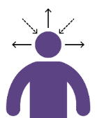
Self-Awareness
Notes:
Self-Reflection or Group Discussion Exercise (Workbook page 6)
Refer back to the Stress Continuum as marker points for the questions on the next slide. Think about your own Red flags and Self-care needs and strengths, across the Stress Continuum zones as you reflect on the questions to follow.

Slide 21
Self-Awareness Activity
Self-reflection questions:
What are your usual ‘go-to’ self-care strategies or activities?
When do they work best?
What does self-care look like for you when you’ve been in different Stress Continuum zones?
What do you do when your self-care strategies don’t seem to be working the way you need or want them to?
Notes:
Self-Reflection or Team discussion Exercise (Workbook page 6)
Take a moment to reflect on (and write down) your answers to these questions.
The more awareness that we have, the greater our ability to identify and handle stress. Its helpful to be able to understand how our self care needs might change as we move along the stress continuum and take appropriate action to mediate stress reactions. More consistent practice and regular reflection makes it easier to cope when stressful situations arise.
Pandemic Considerations: Because a pandemic may have multiple impacts and longer/repetitive response and recovery cycles, it may be helpful to discuss what strategies may require adjustments (or enhancement) amid this sort of ongoing disaster (e.g., consider impacts of any changes in social distancing/public health measures and ongoing effects of uncertainty and fears).
Note For Team discussion: Invite people to share what they learned as they reflected on these questions, if they like (with no obligation to share, of course).

Slide 22
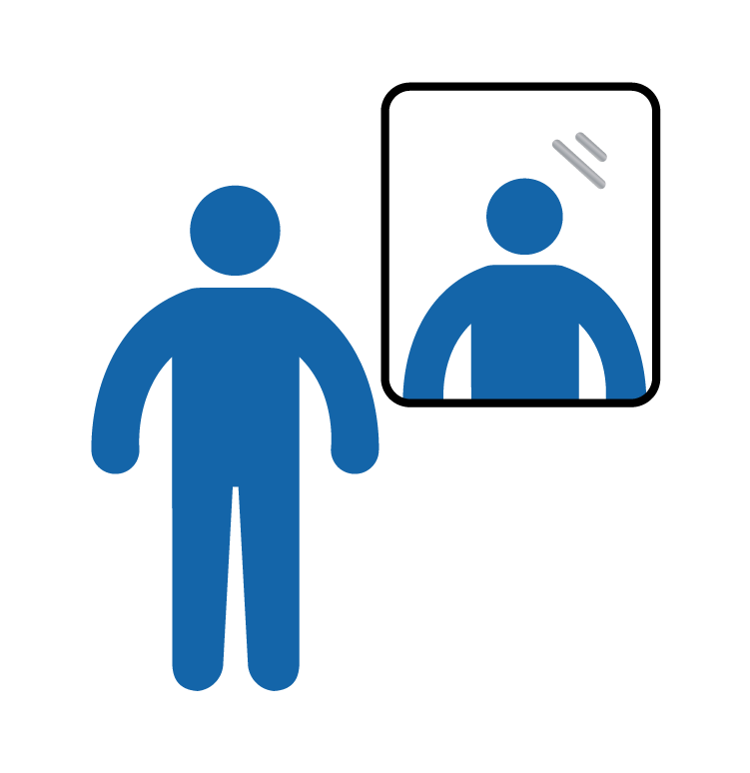
Tuning Into Ourselves
Self-awareness is our starting point for self-care.
We may do this on our own, or with support from our team, organization and/or personal supports
Strategies may include:
Measurement tools (e.g., self-assessment scales)
Personal & Organizational Checklists
Using technology (e.g., apps, calendar reminders)
Routine check-ins
Accepting help & support from others
Notes:
Self-Reflection/Discussion questions (Workbook page 7)
Why is it important to pay attention to ourselves?
Does your workplace currently have any strategies they use to support self-reflection and awareness?
What are your strategies to tune into yourself?
For leaders: Measurement/self-assessment tools work best and will be better received when used for voluntary self-awareness vs. employee monitoring purposes, in tandem with other self-awareness and self-care strategies. Consider that engaging, team-generated, voluntary opportunities for self-awareness are likely to have greater uptake than prescriptive strategies.
Examples of Self-Assessment tools include:
Professional Quality of Life (ProQuol) by Dr. Beth Hudnall Stamm
Website: proqol.org/uploads/ProQOL_5_English_Self-Score.pdf
Self-compassion scale by Dr. Kristin Neff
Website: self-compassion.org/test-how-self-compassionate-you-are/
Links can also be found on page 13 in the workbook

Slide 23
Before Responding to a Disaster
Questions to ask yourself:
What’s going on in my personal life right now?
Do I have personal or family commitments that would be affected if I was redeployed?
How is my current physical, emotional, mental, and spiritual well-being?
Notes:
A self-check in is taking time to survey your physical, mental, emotional, and spiritual health, your personal life and activities for current strengths and risks when responding in a high stress work environment.
it's important to take time to check in with yourself before, during and after disaster/emergency response work (e.g., evacuation reception centre work, ongoing changes in workload, deployment and service delivery during pandemic, during increased recovery service demands).
We often don’t take the time to understand how this type of work affects us emotionally. Part of being an effective provider to post-disaster/traumatic event situations is to know/anticipate personal risk factors that may create challenges for you.
Before volunteering as a responder in/after a traumatic event/disaster, ask yourself these simple questions to start a personal self care plan:
Consider your comfort level with the various situations you may experience while engaged in response/recovery work.
What is your personal situation like at the moment?
Are you ready to help?
Can you take time off to provide support?
What is your family’s ability to cope with you working in a disaster/emergency setting and your absence.
Are there life stresses or family commitments that need attention?
Assess your physical, mental, emotional and spiritual health.
What is your whole health like right now (as per the 4 domains above)?
How can you stay healthy during all phases of the disaster? (especially if it’s prolonged, like in cases of a pandemic)
It’s okay to pass on this work if the timing isn’t right for you.
Note: Consider your own situation or team circumstance with this statement, as it may be appropriate to volunteers and in some larger service centers, but perhaps less so for first responders who are mandated to provide these services and whose absence could significantly impact their work team, particularly for smaller and/or remote service centers with limited staff pool and services. it's helpful to acknowledge these factors if they apply to you/your team.

Slide 24
Self Check-in
Ahead
How has checking in with yourself been helpful to you?
What makes it difficult to do?
Notes:
Self-Reflection or Team Discussion
Note: These questions can be useful in smaller peer/team breakout groups as well. Allow for a minimum of 10 minutes for small group discussion.
A self-check in involves consciously taking time to examine your personal life and activities to assess current strengths and challenges for responding in a high stress work environment.
Sometimes we don’t pause to understand how this type of work affects us emotionally, especially when we are in the crisis pace of response work.
Part of being an effective responder is to understand and anticipate personal and environmental risk factors that may create challenges for you, as well as knowing your individual strengths, capacities and support networks that will allow you to sustain in your response role.

Slide 25
Don’t Forget:

Slide 26
What Works?
Personal
Self-awareness-knowing your personal warning signs of stress.
Having diverse strategies that work for you as an individual.
Being flexible with the learning curve & demands of disaster response & recovery work.
Structuring self-care into your personal routine.
Organizational
Avoiding a one-size-fits all approach.
Build adaptable strategies from within, with staff input.
Modeling self-care individually and structurally at a leadership level.
Check-in, Check-in, Check-in! At all levels of the organization.
Notes:
We learned from the responder interviews that both self-care and organizational strategies that start with awareness and preventative approach are important for reducing stress
Example:
Being flexible about response and recovery work because of the steep learning curve. This is especially true in a pandemic due to multiple impacts, and the changing response and safety measures. Remember to be flexible with yourself and your own needs.
Having MANY personal strategies and supports that you can use, even for people who are ‘good at’ self-care, as new disaster experiences may bring new stressors and challenges.
Be kind to yourself. Know that it’s okay to not be okay or to not know what to do all the time. Be open to seeking and accepting support.
Organizational:
Commitment to sustainable processes, structure and resources–self-care culture has longer term impact than stand-alone, one-off wellness activities and initiatives.
Based on frontline responder feedback, the number one most requested and noticeable element is genuine, supportive, consistent check-in processes. This was echoed from staff across all disaster recovery and response work from Slave Lake fire in 2011 to the 2019 wildfires and during the pandemic.

Slide 27
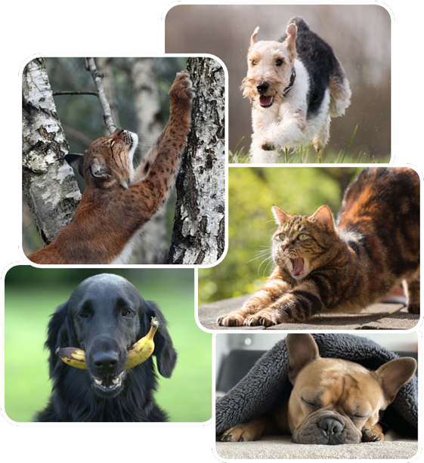
Physical Strategies
Strategies important to our overall health and well-being, which can contribute to reduced stress reactions:
Controlled breathing.
Daily physical activity.
Healthy eating.
Sleep management.
Time outside.
Simple activities like stretching or yoga.
Notes:
The following empirically researched strategies contribute to overall health and well-being, which can calm and contribute to reduced stress reactions:
Controlled breathing:
Slower, systematic, controlled breathing with a focus on expanding the belly, increases ventilation to the lungs. Reduces stress and decreases hypertensive symptoms.
What types of controlled breathing have you used before? (e.g., belly breathing; box breathing, breath counts (5 in, 5 out), yoga and meditation breathing exercises)
Daily physical activity or exercise:
Can improve both your physical and mental health. Benefits: increases energy, relieves stress, and increases positive social interactions with others.
Healthy eating:
Make every effort to increase healthy habits such as eating breakfast, taking lunch breaks away from your workstation, eat more slowly and mindfully, prepare or buy nutritious food options.
Sleep management:
Vital to good physical and mental health. Adequate sleep improves concentration, focus, mood and stress tolerance.

Slide 28
Cognitive Strategies
Increase:
Positive emotion-focused strategies:
Humour—watch a funny video.
Acceptance.
Reinterpreting the event in a positive light (positive self-talk).
Taking time out for yourself each day.
Gratitude practice (for work and home).
Mindfulness practices.
Notes:
The literature on burnout and secondary stress highlights that these cognitive strategies should be increased in order to improve well-being related to work stress tolerance and management.
Review a few and consider your own examples.

Slide 29
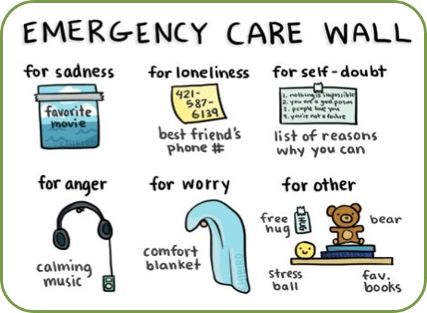
Cognitive Strategies
Problem-focused coping strategies:
Planning ahead.
Maintaining work balance with family and leisure activities.
Maintaining professional identity, values, and boundaries.
Seeking out additional training.
Positive and gratitude oriented self-talk.
Notes:
(Workbook page 9)
As per previous slide, research highlights that these problem focused strategies should be increased in order to improve well-being related to work stress and to prevent burnout or lessen the impact of secondary stress

Slide 30
Social Connections
Seek out contact with and foster a network of family, friends, and colleagues who understand and support you, even if distant.
Be open to different types of support from different people (it might come to you from people & places you hadn’t expected).
Help others.
Maintain routine in daily life and social activities.
Have a trusted person who can watch for and notice changes in you.
Notes:
During interviews with AHS and community staff who had been involved in response and recovery work across Alberta, it was evident that social connections within the workplace and personal life were important for self-care during disaster response/recovery.
Individual examples:
“I had a group of girlfriends who used to go for dinner once a week. You don’t realize how much that supports you each week.”
“For my own self-care, made sure I was surrounded by supportive individuals. Those who experienced the same thing as well as those who didn’t experience any of it - friends and family outside the community. That was a place to disclose where I wasn’t going to offend anyone.”
“Regular self care was trying to maintain normalcy as much as possible, like coaching skating when that started again. Maintain normalcy and re-connect with people.”
Team/Leadership examples:
“Since the disaster, the whole staff in that department was able to have a team-building day a healthy potluck, photo scavenger hunt, and it was SO good for the morale of this team.”
“I think with the staff we got very real with each other. there's no point in hiding the emotion. When you’re hearing sad stories, sitting there with a stone face is not helpful. Some real human moments are critical for leaders. They need to create space for those moments of relating and listening to stories.”

Slide 31
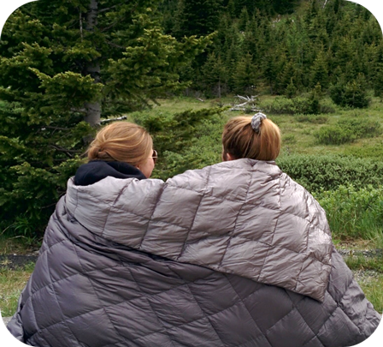
Social Strategies
Make time for personal social support.
Utilize coworker support.
Access mentors.
Seek your own therapy.
Notes:
The following social strategies have been shown in the research to support overall health and well-being, and reduced stress reactions:
Family support has been related to less emotional exhaustion at work, and social support is related to a sense of efficacy. Our support people help us see ourselves as capable and remind us that we can persevere, especially with support.
Utilize coworker support. Valuable support can come from those who understand and live through what you have experienced.
Linking with supportive, competent mentors is associated with lower levels of burnout, and higher levels of knowledge, growth, and satisfaction.
Cognitive-behavioral therapy can have positive effects for burnout.

Slide 32
Healthy Work Boundaries
Know your:
Role
Goals
Resources
Limits
Ensure that you:
Share your own experience appropriately (to connect & empathize, rather than to redirect focus to your experience).
Seek and accept peer support—also offer care and support to others.
Notes:
It’s important for a disaster responder to maintain healthy boundaries when supporting impacted individuals affected by disasters. These boundaries include knowing when it’s the right time for you to provide support, and knowing what your own limitations are (e.g., if you're sick, have family responsibilities, or are experiencing your own disaster impacts that affect your ability to offer support others). This awareness is equally important for leaders.
Self-awareness, can be carried into your professional life, particularly by setting healthy work boundaries. For example:
In every interaction with those you support (in non-therapeutic roles), clarify your role. They might not understand that you’re there to support them, rather than to “diagnose” and “treat” them.
Clarify your role, your available resources, and criteria and process for referrals with your supervisor before making contact with individuals you’re supporting prior to promising outcomes.
Know your goals going in and think with an end state in mind. Keep your goals simple and don’t feel like you have to “fix” the person’s challenges or longstanding problems. For leaders, know that challenges experienced by staff responders, particularly those who are also impacted by the disaster/pandemic may reflect longer standing issues that require additional organizational supports and/or external referrals beyond the scope of your capacity and role.
Refrain from sharing so much of your own story that your contact becomes as much or more about you than the person you’re supporting. Keep the focus on the person and on discussing their needs and priorities. Appropriate personal sharing can be helpful if it builds rapport and trust. Be thoughtful and purposeful about what and how much to share. Sharing too much of your own experience may become overwhelming or invalidating to the person you're helping, potentially adding to their stress.
Maintain confidentiality by talking only to your supervisor or those who need to know about what you discussed with the person you’re supporting (e.g., avoid sharing details with friends, family, volunteer settings, media, on your own social media).
Consideration for leaders: How do you role model and support your team in managing healthy work boundaries, both within your teams as well as in response to external/community needs and requests?

Slide 33
Self-Care Barriers
Levels of exhaustion & stress in post-disaster life and work.
Considering self-care a luxury or indulgent.
Lack of awareness about self-care needs.
Being hard on self (e.g., “I shouldn’t need a break.”).
Denial (e.g., "I'm fine.”, “I don’t need it.”).
Western-European culture/value of over-work.
High workload demands; limited resources (e.g., staffing, funding, isolation).
Notes:
These themes were gathered from interviews with responders around barriers to self-care in response and recovery work.
Pandemic Considerations: The non-linear, ever-shifting nature of a pandemic can invite impatience, frustration, disappointment, and discouragement which may lend to self-care barriers. Repeated ups and downs in hope, anxiety, uncertainty, and setbacks as the pandemic progresses. Redeployments, shifting to working from home (perhaps while attempting to support kids’ virtual education) job disruption or losses, and job/role uncertainty can increase these feelings.
Reflection/Discussion question:
What prevents you from engaging in self-care, both in the moment and over time?
Quotes
“Once the hospital was up and running again there was a change in the narrative, which was ‘we are back to business’ and people weren’t actually back to business. There was a need organizationally to be seen to be back to normal and back in control. So in some ways there wasn’t a lot of appetite to hear about the distress of staff.”
“Once you get off your routine, it’s hard to get back on when the stress is there. How do you keep it going no matter what? Despite the changes that happen. That is the most challenging.”
“Some of the expectations were over the top for some of the leadership. We need to be more humane in our expectations. You can’t be everything to everyone, and people weren’t listening to what was happening at ground zero. The layers above me were frustrating - fending off those expectations.”
“Stress makes people hunker in but we need relationships and communication at that time. How do you keep building relationships and communicating when stress is high? We need to figure that out. Building trust. Hard to build relationships under stress .”
“I’d like never again to be told right after a disaster that it’s going to be 10 years until recovery. Because it’s not 10 years of that first year. The first year was about recovery and hope. The anger intensified in staff and the community in the 2nd year. The 3rd year was better but even 5 years out, we’re not recovered. Everything hits our now raw nerves.”

Slide 34
Unhelpful Approaches to Stress Management
Reduce
Avoidance techniques:
Hyper-focus on helping others to avoid own stress
Ignoring in hopes that the situation will go away
Misuse of substances or medication
Keeping stress to oneself
Negative emotion-focused strategies:
Denial
Repetitive Venting
Substance misuse
Withdrawal/numbing through use of internet/electronics
Notes:
Reflection/Discussion Question:
When do these self-care strategies become a problem?
When are you escaping or avoiding?
Example: People joke about having an “extra” glass of wine, or going out for a beer with friends – what would let us know when this potential social activity shifts toward becoming more harmful than helpful?
Consider when normal, healthy needs for alone time may begin to shift toward self-isolation and/or avoidance. (Keeping in mind your usual preference for introversion or extroversion).
Literature on burnout and secondary stress highlights that these stress management strategies (on this slide) should be reduced in order to improve well-being related to work stress.

Slide 35
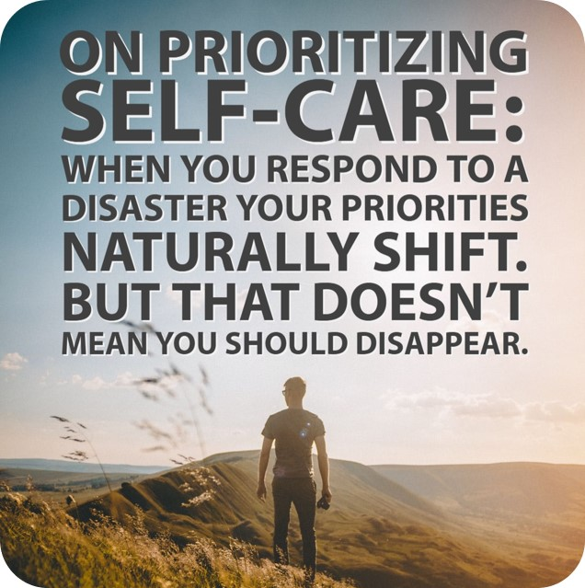

Slide 36
Self-Care in Action
Thinking back to the Red Flags activity:
What flags can I use to cue me to take action?
What is the minimum thing I can do for my self care today?
What resources (e.g., social, practical) are needed to make my self-care strategies part of my regular routine?
What will I need to do after a disaster to ensure some form of these actions remains?
Notes:
Reflection/Discussion (Workbook page 11)
Note for question 2 on slide: Our self-care minimum may change from day-to-day, depending on resources, energy, workload, supports etc. For example: one day your minimum my be walking during your lunch break, the next it might be taking 5 minutes to drink/enjoy your morning coffee/tea. The trick is to tune into yourself and commit to a minimum (which you can build to a maximum depending on where you’re at) each day.
Take time to plan more broadly for self-care routines in achievable, smaller steps (in the moment strategies, day-to-day plans), especially during stressful times. It can be helpful to seek and accept support with this planning and action. You can figure it out and practice together.

Slide 37
Self-Care in Action
Making little changes in routines/daily tasks.
Regular physical activity.
Doing simple activities like yoga or stretching.
Having creative activities or hobbies.
Giving time to yourself every day so you don’t get sick or overly stressed by:
Taking a walk.
Doing some deep breathing.
Spending time with pets.
Watching a funny video.
Notes:
Consider that everyone can have a role to play in building and advocating for a healthy workplace and self-care culture, from showing appreciation and gratitude, validating your peers’ efforts, successes and challenges, eating/sharing healthy snacks, engaging in positive check ins (along with sharing concerns and debriefing challenges) and by modeling your own self-care along the way.
Suggestions from Alberta responders on reaching out to social supports: Access support from peers and supervisors who understand responder work. However, also try to access social support from people who are not immersed in disaster response work in order to give yourself a break from the disaster conversations.
Quotes
“It should be worked into your routines so you can always be topping up your gas tank, a little recharge on your battery.”
“It should involve simple, small changes, like choice of food because it’s a daily need, choices of TV shows, Facebook posts, choices about the people I want to be around, the things I do every day. Am I sitting outside every day? Am I benefitting from that? How long am I watching TV? These are things that are a given, and I take note of how I can make little changes to those.”
“Those that are really good at [self-care] are the ones who are physically active, have a regular routine, or who more likely go for a walk or a run or go to the gym after their shift. The active ones come back to work active and chatty and want to tell people about their experiences.”
“Having an activity that doesn’t require a gym or a team or any of those kind of things. Something you can do alone, such as yoga or stretching. And it’s always built into your day, and you have to do it.”
“When people looked out the windows, some people found it distressing. So we got window paints and people got to paint on the windows. Clients did that and staff did that as a way to depict their experience, or think about something. When people first came back we got big sheets of plywood and put chalk on them for people to write more hopeful resilient type words or pictures, so we did some things like that. For some people that seemed to be quite helpful for their self-care.”

Slide 39
Leaders, Teams, & Organizations

Slide 40
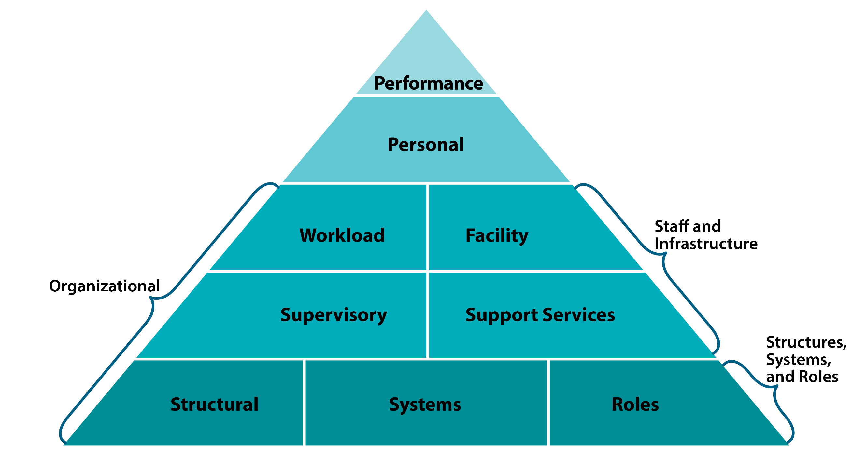
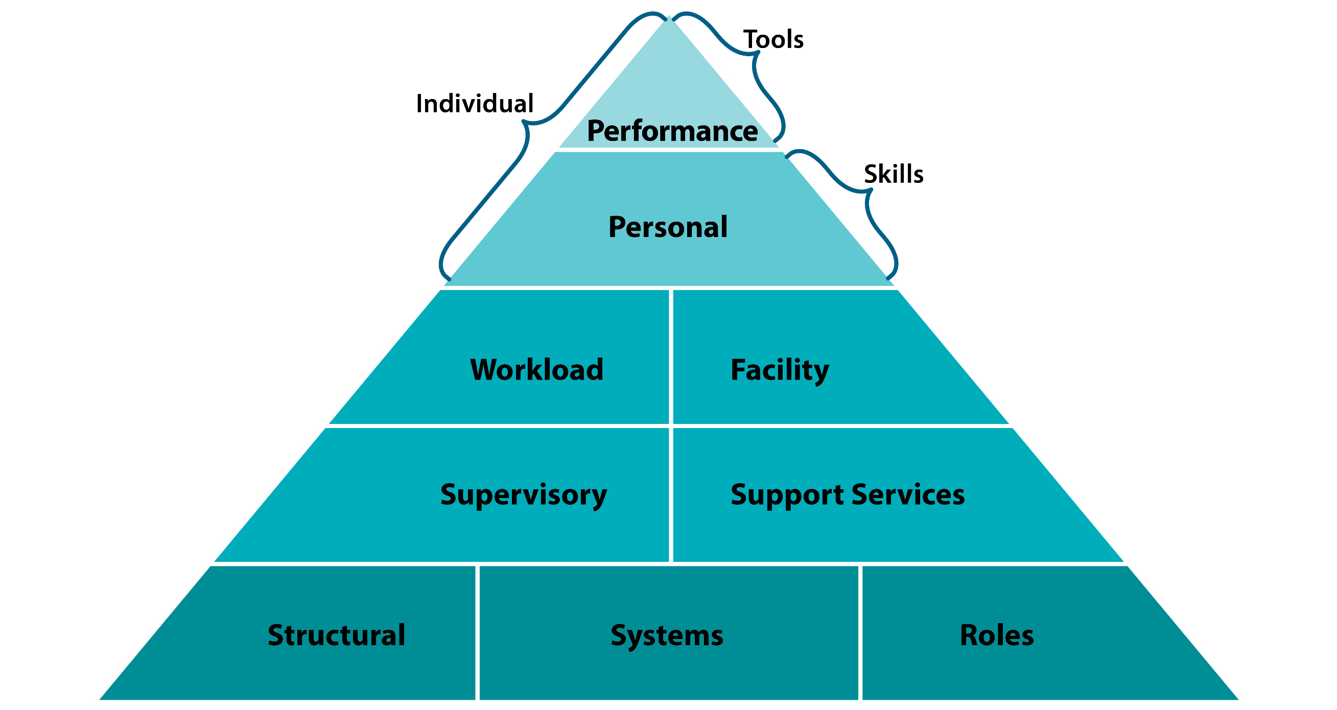
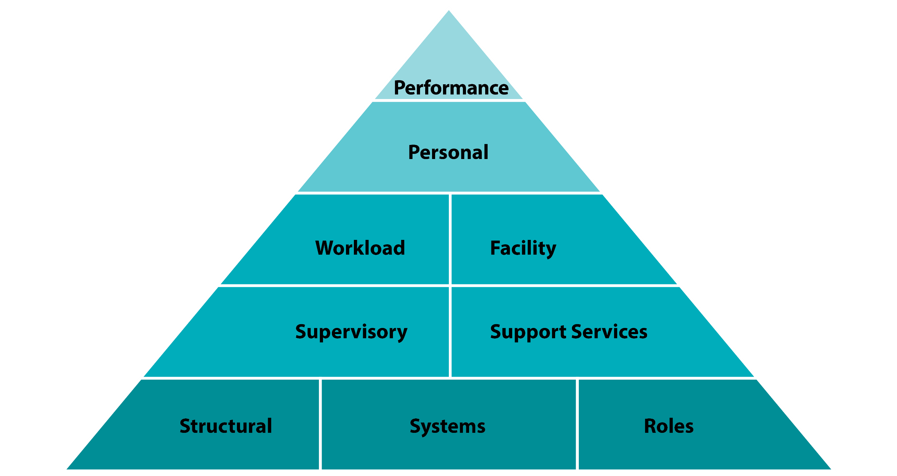
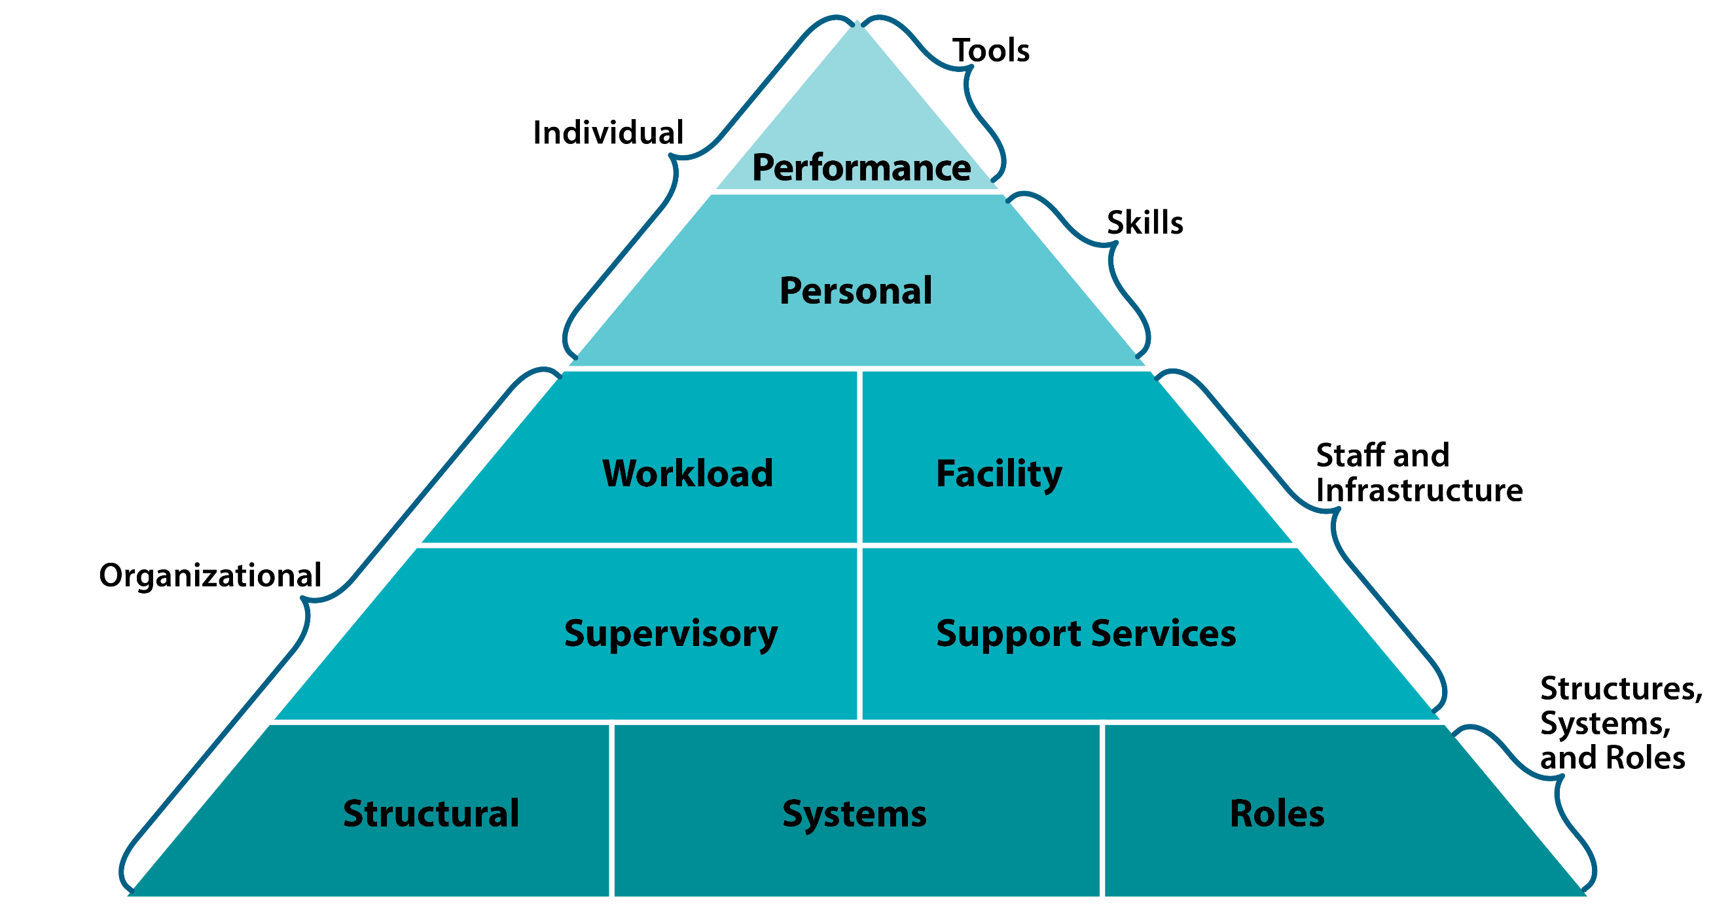
Organizational Approach to Disaster Self-Care Capacity
Adapted from Potter and Brough, 2004 and Management Sciences for Health, 2012
Notes:
NOTE: This is an animated slide (If using this as part of a presentation)
Organizational Approach to Disaster Self-Care Capacity
Based on Potter and Brough’s Systemic capacity building: hierarchy of needs, the Disaster Psychosocial Capacity Building Pyramid is a model of the interconnected individual and institutional factors involved in psychosocial capacity. It provides an integrated framework for understanding and addressing responder well-being in particular, the relationship between individual and organizational (institutional) factors.
While self-care training, strategies and tools most often focus on individual wellness efforts, activities and supports research suggests that it’s the bottom half of the triangle that can have the greatest impact on staff well-being. ln fact, literature suggests that “situational and organizational factors play a bigger role in burnout than do individual ones” (Maslach, 2003), with disaster-specific literature further noting that strategies addressing both individual and institutional factors affecting responders are indicated (Quevillon et al., 2016). This includes leadership approaches to role modelling and actively promoting & fostering workplace wellness and self-care culture through policy, procedures, physical spaces, workload structures, and supports.
Key Points
The Disaster Psychosocial Capacity Building Pyramid:
Demonstrates the interconnection of multiple individual and institutional factors involved in psychosocial capacity and responder well-being.
Is helpful in challenging the perception that the responsibility for self-care falls solely on individuals.
Can create awareness of these factors as an important part of peer support and effective leadership.
The organizational factors that contribute to capacity building in organizations include:
Workload expectations
Facility factors (e.g., space, room, safety, access to basic needs)
Supervisory relationships and support (e.g., trust, psychological safety, availability)
Support services, including administrative help and wellness supports
Structural aspects of jobs (management, supervision and reporting structures)
System procedures and policies (e.g., leave, schedule flexibility)
Role factors of a person’s job, what is expected from them given their role (e.g., scope, flexibility, limits)

Slide 41
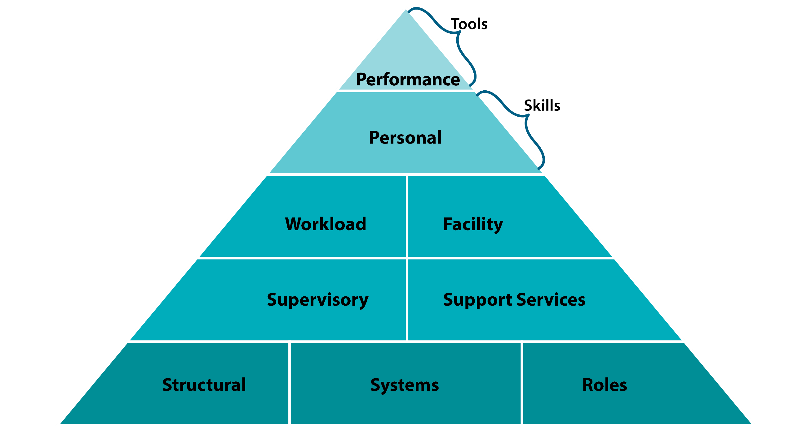
Individual
Tools / Equipment (that influence performance)
Access to bike/pool etc. for physical activity when deployed
Cell phone to contact family/friends/supports
Access to safety equipment/PPE
Personal Skills
Positive coping strategies (e.g., exercise, breathing)
Self-awareness (e.g., own needs, limits, emotions)
Ability to reach out, increase connection
Adapted from Potter and Brough, 2004 and Management Sciences for Health, 2012
Notes:
NOTE: this is an animated slide
For reflection or team discussion, consider:
What things are working well at each level, what things have been impacted (if previous disaster/emergency experience) or what could be impacted, and where are the barriers?
Self-care Project Interviewees/ participants provided the following as factors that both support and impede self-care and organizational care during disasters:
Tools/equipment
Access to bike, pool, or other means for physical activity when deployed.
Cell phone access (and/or permissions to use it) to contact social supports, especially for long distance redeployment or social distancing due to pandemic.
Access to normal foods/dietary needs when redeployed, especially when deployed to smaller centers (e.g., cultural and health considerations).
Access to PPE and clear public health protocols (and/or updated info about it) during pandemic, including in environments that may not serve on the frontline, but have higher volume of staff on site.
Personal Skills
Positive coping strategies (proactive vs avoidant)
Embracing complexity
Self-awareness (e.g., own needs, limits, emotions)
Ability to reduce isolation, increase connection

Slide 42
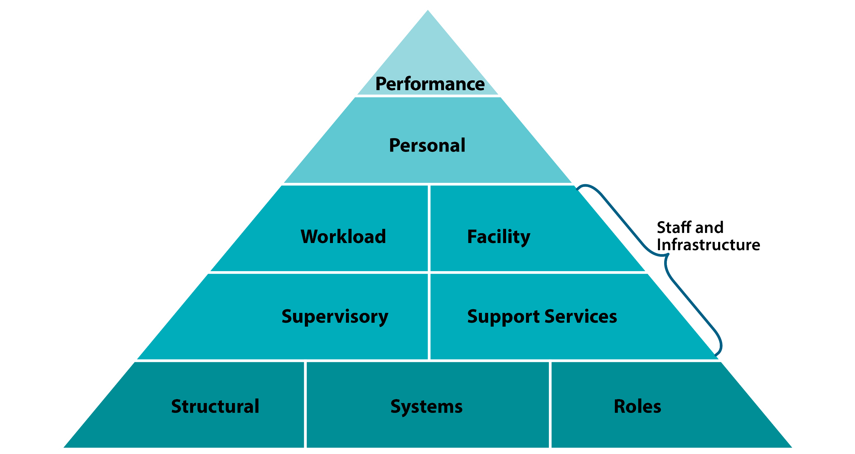
Organizational: Staff and Infrastructure
Workforce / workload
Available advance preparatory training
Length of shifts and deployment
Clear role expectations
Qualitative weight of workload
Facilities
May be away from your usual facilities (e.g., favourite places, recreation, fitness, dog park)
Some facilities may be damaged or unavailable (e.g., trails)
Supervisory
Level of supervisor support (high / low)
Trust / psychological safety
Physical location / consistent access
Built-in role to facilitate & build team cohesion
Support services
Admin support
Technical supports
Adapted from Potter and Brough, 2004 and Management Sciences for Health, 2012
Notes:
NOTE: this is an animated slide
Interview examples, continued:
Workforce/workload
Available advance preparatory training
Length of shifts and deployment
Clarity of role expectations, public health/safety measures within the staff role/setting (as per pandemic)
Qualitative weight of individual workload and team workload distribution (what do the tasks and responsibilities look like? How much physical and mental energy and time do they require?)
Shift to unfamiliar work environments/tasks (e.g. redeployed from school-based service role to COVID assessment centers).
Pandemic considerations: additional/potential strain of increased public health measures such as vigilance on cleaning tasks and PPE can limit access to normal/basic self-care (e.g., continuous masking can interfere with basic hydration; sanitizing measures disrupt workflow, caseload management, plus mental labour of constant vigilance; online fatigue (virtual meetings).
Supervisory
Level of supervisor availability and support (high vs. low)
Trust / psychological safety (without it, all other leader-led strategies will be ineffective): Can staff show and share vulnerability freely and expect a supportive response (e.g., free of concern for repercussions or potentially invalidating impacts of receiving no response, or a response that lacks empathy or relevance)?
Physical location of/consistent access to a competent supervisor
Built-in role to facilitate team synergy, build cohesiveness
Facilities
May be away from your usual facilities if redeployed (e.g. favorite places – recreation, fitness, dog park; Pandemic work from home challenges – changes/limitation in tech set up, access to equipment, confidentiality, etc.)
Some facilities may be damaged, restricted (as per pandemic) or unavailable (i.e., consider air quality/environmental safety factors as well - e.g. trails)
Support services
Admin support – frees frontline staff to focus on increased needs of patients, clients, community and related increase in workload.
Technical supports (e.g., Satellite phone for remote deployments, proper Wi-Fi, software, hardware etc. as per the shift to working remotely for staff who may not have previously done so during a pandemic)
Note that most of these factors apply to building and maintaining a healthy, positive work environment, regardless of the work at hand (disaster, emergency, or not)

Slide 43
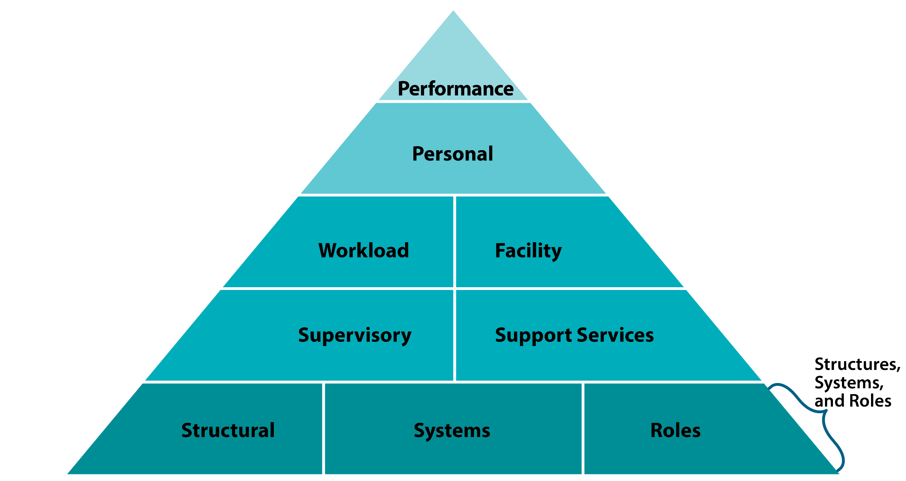
Organizational: Structure, Systems, and Roles
Systems
Wellness strategies and ongoing activities
Union agreements (e.g., scheduling)
Roles
Who / what groups have a role or responsibility for overseeing or supporting well-being in disasters?
Structural
Interagency coordination / cooperation or conflict
Adapted from Potter and Brough, 2004 and Management Sciences for Health, 2012
Notes:
NOTE: this is an animated slide
Structural
Interagency coordination / cooperation (e.g., organizational partnerships, committees etc. that guide work and services)
Systems
Wellness strategies and ongoing activities
Union or contract agreements and internal team planning and adaptations (e.g., scheduling)
Policies (e.g., time worked, overtime, flexible work hours
Roles
Who / what groups have a role or responsibility for overseeing or supporting well-being in your organization? For example, designated wellness champions, wellness/social committees, wellness activity facilitator during meetings, paid wellness positions. Are they formal or informal?

Slide 44
Organizational Self-Care Barriers
Themes:
Level of buy-in from leadership.
Leadership and/or funders not understanding recovery process (timing and duration).
Lack of modeling and structuring breaks/time-off.
Working with colleagues who are experiencing burn out.
Turnover in staff and leadership.
Structure of facility―physical spaces.
Pressure to produce and/or serve (e.g., corporate culture).
Inflexible policies that can impede response & recovery work.
Notes:
These are themes and quotes from the AHS and community-based interviews regarding the organizational barriers to well-being in response and recovery work.
Note: When the demands on leaders increase due to response and recovery work, leader self-care and role modelling can suffer. Consider the potential impacts of “doing as I say, not as I do” for your own wellness as a leader, as well as for your team. Our actions are often the loudest messages we transmit. For example: Words = “Everyone needs to be sure to take their scheduled breaks” ; Actions = Rapidly eating a substandard lunch while furiously typing at your computer. Actions may very well supersede the words in determining the permissions assumed by staff here, despite the leader’s good intentions. Further, disaster leadership literature suggests that we would do well to evaluate and adapt policies and rules that might get in the way of sustainable disaster response work (e.g., rules/expectations around meeting interruptions or rescheduling, kids at work (e.g., working remotely during the pandemic!), cell phone use during shifts, etc.
Quote
“We met a lot and talked a lot about self-care. But post-fact, there was no official way to check-in with some of those people who had traumatic experiences. It was expected that managers would .”
“There were 400-500 people looking for services on any given day. So just the set up in those environments, there wasn’t a place you could go [for quiet / self-care]. There was a place for lunch but it was in the midst of the noise.”
“Everybody talks about self-care in theory. I would love to see more practical support. in figuring out how it looks day to day. And why can’t there be chunks of time for people to re-group, rather than a thing on the weekend that you do, or instead of the forced 5 sessions a day?”
“I would like to see self-care put into the plan itself. For example, that there has to be a de-mobilization plan, that you do a bit of a debrief for people that should consider how they are getting home, especially if they live far away. And it should consider what were the circumstances of the time they were there and what does that mean for self-care? We had people who were gone Wednesday through Sunday and then come to work on Monday morning. We should at least give people a day off in between .”

Slide 45
What Works Organizationally? What we heard from Albertans
A number of attitudes, barriers, and facilitators were identified, including:
Things go well on teams taking care of themselves prior to disasters/major events.
Identifying & addressing gaps in formal supports from the organization.
Avoiding one-size-fits all approaches.
Buy-in & support from leadership.
Embedding self-care into personal life and work life.
Maintaining structures/space for self-care during response and recovery (e.g., breaks, quiet space, resources).
Notes:
What Works Organizationally
Through analysis of the interviews and workshop feedback, a number of attitudes, barriers, and facilitators were identified, including:
Take care of teams prior to disaster: Things go well on teams when they take care of themselves and one another prior to disasters
People self-regulate. I would send out schedules and people would self-select when to go in. People weren’t trying to martyr themselves.
People are going to want to work. How we support them is important. I think we’ve learned from each disaster how to do things differently/ better. If you’re resilient before, you’re likely to bounce back.
Years of relationship building factored into the way meetings are run when people have emotional reactions and then are supported by the group. We can be more rested, more creative when at the table, and able to be effective in recovery work.
Identify gaps in formal supports from the organization
Avoid one-size-fits all approaches
Role for leaders:
Buy-in from leadership, from individual action/management to scheduling and policies (including role modelling, validation of stress, allowing time, respecting needs of the personally impacted, actively promoting self-care, checking in and being available, monitoring basic needs). It’s effective when leaders are flexible in disaster times, which can sometimes feel contrary to our desire to be able to institute greater control amid the pressures, uncertainties and chaos of disaster and pandemic impacts. Ultimately flexibility, with ethical, reasonable parameters can lend to greater adaptability and ease in managing teams in the long run.
Embed self-care into personal life and especially work life through: Meetings, conversations, schedules, reporting, team composition (wellness champions), processes pre and post deployment, dedicated wellness time, funding/resources).
Quote
There needs to be a large variety of things that people can draw on for self-care, which includes all the “small” things that may not even be perceived as related to self-care (e.g., going out for dinner regularly with one’s girlfriends).
Self-care needs to be “built in,” which applied in the individual context as well as the team-level / organizational-level:
Built-in to routines
Built-in to teams (roles, processes, conversations, meetings, etc.)
Designated spaces

Slide 46
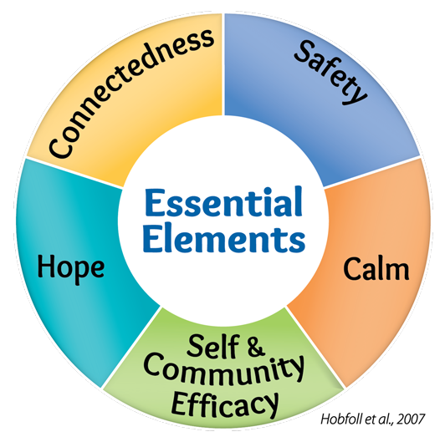
Notes:
There are five essential elements of immediate and mid-term intervention that have been revealed to support better recovery from stress in many adverse situations (across international disaster/emergency contexts). They’re a result of exhaustive literature reviews and an international panel of experts. (Hobfoll et al, 2007). They further represent 5 needs for staff and leaders that are essential to effective self-care amid disaster and emergency response and recovery, for responders, leaders, and organizations.
Promoting a physical and psychological sense of safety can decrease biological stress reactions (i.e., fight, flight or freeze) and can help with thoughts that get in the way of recovery, like beliefs that the world is dangerous or exaggerated sense of future risk.
Promoting calm can ease difficult emotions (e.g., anxiety, fear, sadness, grief) and reactions that get in the way of mood, sleep, decision-making, attention, and concentration. Ultimately, promoting individual and team calm supports us to do better in our work with the people we serve, as well as in our personal lives.
Self-efficacy is a belief that you can successfully do what needs to be done and can handle challenging times. Similarly, community efficacy is the belief that your community can help its members thrive and can take care of them during adversity. Demonstrating and instilling a sense of efficacy allows individuals and communities (include work environments and teams) to feel in control and able to move forward through disaster response and recovery, with greater hope and resilience. Consider your own team/workplace community and how you derive meaning, purpose and efficacy in your work.
Promoting connectedness is based on research evidence that greater social support is related to better well-being and recovery after trauma and can reduce feelings of loneliness and worthlessness. Connectedness can help people engage with others, which can lead to early detection of mental health risks and quicker referral to specialized services if needed (e.g., peer support).
Helping people maintain hope. People who experience more positive recovery after disasters are those who stay optimistic and feel confident that things will work out as best as can be expected.
These elements can provide helpful categories on which to focus when crafting and enhancing self-care and wellness actions and culture in your teams and organizations.

Slide 47
Safety in Action
Supportive leadership: helpful feedback, recognizing staff efforts, clear, consistent, accurate & timely communication, available, accessible, competent supervision.
Psychologically safe environment: demonstrate concern for staff needs, allow staff to share challenges, vulnerabilities and collaboratively problem solve.
Collaborative work schedule planning with staff (where possible); provide guidance regarding work roles/boundaries.
Notes:
There were core themes/approaches for both supportive and unsupportive leadership that either contributed to or detracted from a sense of psychological (and at times, physical) safety.
Example from staff, who voluntarily redeployed following wildfire impacts on a more remote Alberta community: They were driving to redeployment destination (to which they’d never traveled before) through difficult and constantly changing (smoky) highway conditions, where cell service was sporadic, without clear information about a supervisory contact and without a check-in process. Lack of organization, support, and communication resulted in anxiety and stress which contributed to their decision that they would likely not volunteer to be deployed again for future disasters.
Note: These sorts of considerations, while straightforward, are hard to think of at times of emergency and crisis (given acute stress and fast-paced, changing demands). We’re more likely to mobilize safety considerations quickly, appropriately, and smoothly if planning and protocols are established well before they become necessary. Post-disaster learning conversations can assist to address this for future disasters.

Slide 48
Calm in Action
Wellness speakers.
Journaling, art, or music groups or activities.
Mindfulness activities―individual or group reflection.
Newsletter articles on resilience.
Hire dedicated staff to help patients/ staff navigate recovery supports.
Offer physical activity series during lunch or after work (e.g., yoga, cardio classes, running group).
“You can ask your team, you don’t have to know the exact answers as a manager.”
Notes:
Organizational examples of how calm strategies can be incorporated into work may include individual and/or group activities; create organizationally sanctioned opportunities for individual as well as group time for calming activities, information and resources.

Slide 49
Efficacy in Action
Collaborative, coordinated, community-centred (and led) approach (building capacity together).
Offer people practical ideas when they are struggling to think of their own.
Use lessons learned from previous local disasters & emergencies.
Hearing other people’s stories reinforces strengths/hope.
Hire skilled people to support staff self-care & wellness.
Flexible, thoughtful scheduling―attention to workload burden / relief.
Notes:
Examples of Efficacy in Action from Alberta organizations:
In the first year after a disaster, people are vulnerable and don’t have the capacity at that time. They aren’t at a point to go look for things. We made it simple to bring to them, such as thought stopping, identify your stress, pick a self-care strategy prompts etc.
Putting people in someone else’s hands can help, “Here are some nice ideas you can do.” If someone told you to go home and make a great meal for your family, if someone gave you a recipe it would be so much easier. A sense of efficacy can come from both giving and receiving help/support and kindness.
“I realized burnout would happen. I came up with a huge list of activities and ideas that I proposed to the managers and directors. We came up with activities. We were asking for financial support and also time, my own and the staff. Luckily we had one director who said yes – this is what we need and we are going to support it in every way. The ideas were successful.”
Use lessons learned from previous local disasters:
[A leader from a previous disaster] said in hindsight she would have been purposeful and strategic in how to support her staff. It was her biggest piece of advice. It’s not just going to happen because you do nice things.
Hearing other people’s stories is helpful:
“It was helpful to hear how other people managed, their struggles. Having more of those opportunities would be good. You feel isolated. And it wasn’t like I could go and talk to my peers. I didn’t have any peers dealing with the same things or if they did they were impacted so my trials paled in comparison to dealing with insurance and dealing with rebuilding houses. I couldn’t talk to my staff. So it was really powerful to be in a room at a pre-conference event where there were people who had been in a leadership role or in a response role in an event, to hear some of their experiences. (e.g., Gathering, sharing and consultation opportunities beyond our work teams/organizations).”
Importance of approach taken (psychosocial, outreach, community-based, coordinated):
“Previously it was ‘come to us if you have a concern.’ After that, I pushed for outreach: Unit meetings, huddle, telehealth, team building, sending people to community events, door to door. We have to reach out and provide ways to be present and help people cope. Intentionally get in there because they’re not going to come to us. As an organization, we have an obligation to get to them and find out how they’re doing. (Note: Here intentional outreach is vital both for the people we serve, and with our teams/staff. Attend to staff’s potential sense of risk in revealing vulnerability by giving space/permission to be vulnerable and receive support via intentional, repeated, genuine and consistent outreach, processes and spaces to share their challenges and successes (toward building team efficacy). Some staff may access support, some may opt out – take their lead).”
Hire skilled people to support staff self-care:
“The staff support person is critical. They need the ability to develop evidence-informed strategies, and the ability to work with and through the teams rather than being prescriptive. Requires leadership skills and building team relationships. Caring without knowing how to help or being an expert telling people what to do doesn’t work.”
Scheduling / workload burden / relief:
“It made a difference when we got a schedule when people were going (for redeployment) and how long. That decreased the stress. Having time scheduled and knowing I didn’t have to be there at certain times helped.”
“What helped was that managers weren’t deployed. They could stay and keep things going and take on my workload burden that I was abandoning. We made sure people were left back home and ensured that work was covered because those demands didn’t go away. (i.e., Take away message – I can handle this because I have support/back up).”
Have designated physical spaces that support staff:
“It’s important to have a place to go to have breaks. People have to live and stay right there, so they can use the gym off shift if it’s on site. An eating area with a lounge, and comfortable chairs also helps.”
During a pandemic – creative, active, intentional efforts to build in breaks, team points of connection/meeting etc. via online platforms (and/or periodic outdoor, physically distant meet ups). Overcoming these obstacles together builds a sense of efficacy.

Slide 50
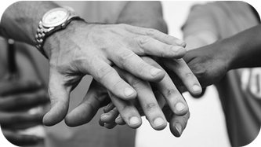
Connect in Action
Staff/team-building days or activities.
Open communication with co-workers & staff.
Staff check-ins, down-time and support.
Humour.
Improve physical & virtual workspaces.
Encourage staff to check in with friends & family.
Cultural ceremonies.
Notes:
Connect Actions: Organizational
This slide provides examples of effective social strategies shared by Alberta organizations based on their self-care efforts and experiences in disaster/emergency response work
For organizations working within cultural models of practice, ceremony may also be a way to connect (e.g., prayer and faith tradition observances for workplaces where employees share common faith values/practices; smudge, sweat lodge, prayer, sharing and healing circles for Indigenous organizations).

Slide 51
Hope in Action
Spiritual care program (e.g., lunch drop-in meditation, prayer or ceremony time).
Newsletter with positive messaging, updates from the town, community activities, opportunities for story telling, personal recovery activity tip sheets.
Help people feel valued and recognize/leverage their strengths―going the extra distance, asking what is meaningful to staff.
Notes:
Consider meeting time, message boards or meditation for sharing/cultivating gratitude, appreciation, accomplishments, goals and steps forward.

Slide 52
WHO Inter-Agency Standing Committee (IASC) Guidelines for Protection of Staff in Disaster Settings
Have a concrete plan to protect and promote staff well-being for the specific disaster.
Prepare staff for their jobs and the specific disaster/emergency context.
Facilitate a healthy working environment.
Address potential work-related stressors.
Notes:
General Guidelines for Protecting Staff in Disaster Settings:
The World Health Organization Inter-Agency Standing Committee (IASC) guidelines enable humanitarian actors, including government agencies, to plan, establish and coordinate multi-sectoral responses to protect and improve people’s mental health and psychosocial well-being amid an emergency or disaster.
The IASC guidelines were developed by consensus from a number of subject matter experts and include guidance specific to caring for staff in disaster settings.
The guidelines include the following recommendations which could be incorporated into your self-efficacy planning:
Make a Concrete plan to protect and promote staff well-being for the specific disaster context
Prepare staff for their jobs and for the emergency context, including training on:
A spectrum of stress identification (both self-awareness and peer support)
Stress management techniques
Existing organizational policy and resources for psychosocial support to staff.
Facilitate a healthy working environment via:
R&R opportunities
Addressing unhealthy behaviours & practices in a supportive manner
Defining working hours and monitoring overtime (towards mitigating potential burnout) – best supported when modeled by leaders as much as possible.
Facilitating communication between staff and supports
Address potential work-related stressors:
Evaluate safety/security in the work environment and other potential sources of stress on daily basis
Regular staff or team meetings and briefings – both for “business” and social connection/team building
Ensure supervision
Build team trust/rapport and actively work to reduce team conflict
Sufficient supplies
Ensure appropriate logistical back-up and supply lines of necessary materials
Ensure that members of senior management visit teams regularly –build ongoing lines of communication/engagement

Slide 53
Organizational Success Story
“The improvements are huge in our staff. They were initially exhausted, calling in sick frequently, eating junk at work, giving junk to others at work, didn’t want to come in to work, and the coffee pot was always going. Now we have water dispensers, staff taking walks on their breaks, challenging each other on the stairs now. They are bringing in healthy snacks for each other now. …We are now doing team care once a week. … It’s really neat to see everyone taking part in it. It has impacted our staff definitely.” AHS AMH North Zone Staff

Slide 54
Take Away
Supervisors, leaders, and frontline disaster and emergency response staff all benefit from individual self-awareness and self-care practice.
Leaders and organizations can shape, co-create, and innovate self-care culture.
Employee participation supports sustainable wellness culture.
Notes:
Disaster psychosocial preparedness, response and recovery work is both demanding and rewarding; wellness and self-care practices support resilience which is key to sustaining in the important work that you do. From individual awareness and action, to team building and organizational planning, there's a spectrum of approaches to developing effective, meaningful, organizational self-care practice and culture. We hope you can draw from this information and the tools provided to craft an individual and organizational approach that resonates for you and your team(s).

Slide 56
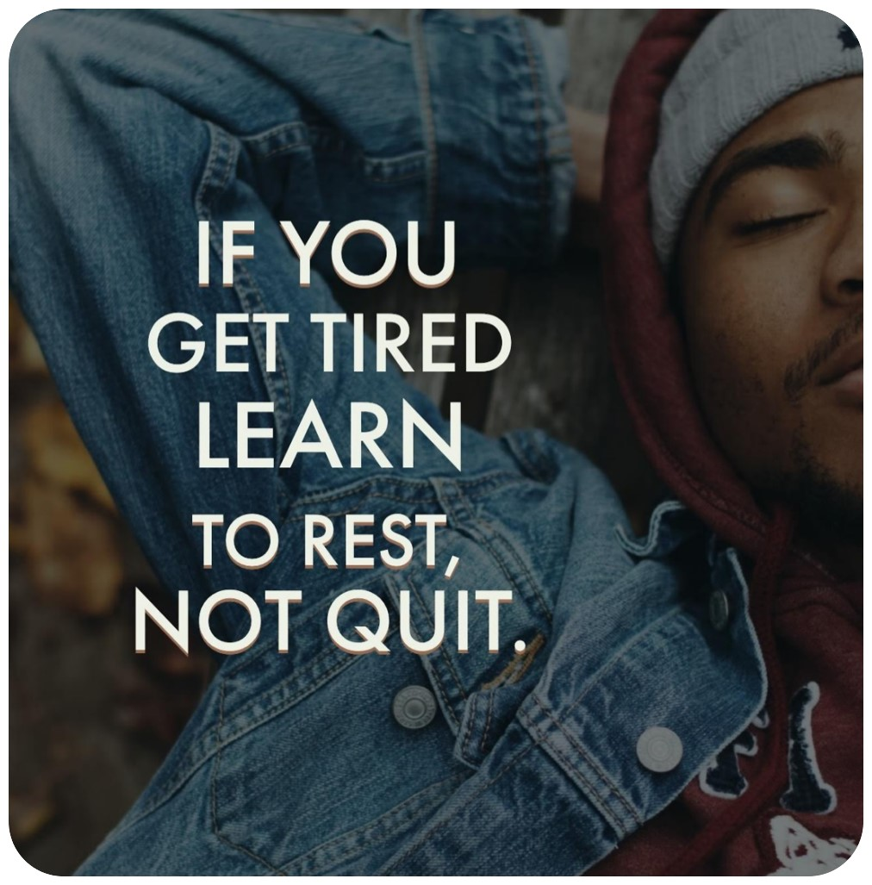
Your opinion matters.
To tell us what you think of this resource, go to:
https://survey.albertahealthservices.ca/selfcare
Notes:
May you go gently into the important response and recovery work that you do, with new information, tools and resources to take care of yourself so that you're ready to help others.

Slide 57
Optional Activities
Notes:
The activities and discussion questions to follow are intended to support either peer-to-peer team self-care and wellness discussions and planning or to assist leaders with team and organizational self-care planning and action. Go forth, experiment with these activities and maybe even venture out with your own team questions, games (e.g., self-care Jeopardy, Trivia, charades), and creative activities to build team trust, connection, communication and awareness for improved wellness.
Tips for Group/Team Activities:
Before pursuing team/group activities, give a brief introduction about confidentiality and safety in the group. Consider any power differentials and/or psychological safety when doing these activities in mixed groups (i.e., frontline staff and supervisors/leaders), as it can affect answers/participation. Pre-existing internal conflicts or mandatory participation may also affect engagement and outcomes.
For leaders: Your humility and openness is key. Consider whether it may be more effective to have team peers complete some activities/discussion separate from supervisors/leaders; have leaders complete as a separate group. Separating team and leadership group activities first, then joining to review/amalgamate themes (without identifying participants’ specific input) can bridge common ground, highlight differences and build rapport and trust.

Slide 58
Calamity Island
You're being deployed in small groups to the tiny, remote island of Calamity to help with a disaster.
During your deployment all your basic needs will be met (e.g., food, clothing, shelter, bedding).
Before being deployed, your group will need to make a self-care plan to use while on the island.
Using the strategy cards provided, choose only 3 self-care strategies (not survival strategies) to take with you.
Feel free to adapt the activity to suit any upcoming or anticipated situations (e.g., what would long-term deployment look like during a pandemic, self-care needs for online or socially distant deployments versus face-to-face deployments).
Notes:
Calamity Island (See the Toolkit guide for Card cut outs.)
The purpose of this activity is to invite team engagement in self-care discussion, increase self-awareness of both individual and peer needs, and to offer team leaders opportunity to assess needs and next steps for planning through experiential activity.
To demonstrate that there are multiple effective self-care strategies and that everyone is different; self-awareness is a key first step. For teams, this activity may help to highlight and identify diversity of needs as well as common ground or themes for building team self-care and wellness strategies together. It can also illuminate team members’ similarities and differences in priorities and decision making related to wellness and self-care, assisting in better understanding and supporting one another.
You will need
10 self-care cards each per small group (3-4 participants). Cards can be found in the toolkit.
Instructions
Break into small groups of 3-4 people
Hand out 10 random self-care cards to each group
Read out the activity instructions below or use the side from the Organizational PowerPoint (adapt as needed).
You’re all being deployed for 1 month in small groups/teams to help with a disaster that has occurred on Calamity Island, a small, remote island. During your deployment, all of your basic needs will be met (e.g., food, shelter, bedding, PPE). Prior to leaving your team needs to make an advance plan for your self-care. To assist you with the planning each group will be given 10 strategies to choose from. As a team, you will be allowed to take only 3 self-care strategies (not survival strategies) with you to the island to use while you’re deployed. Your team will have 10 minutes to decide on the strategies.
Note: You can adapt the cards and activity description to suit any upcoming or anticipated situations (e.g., long-term deployment during a pandemic, self-care needs for online or socially distant deployments).

Slide 59
Calamity Island
What 3 strategies did your group choose and why?
Were there strategies that everyone agreed upon easily?
Which ones?
Were there strategies that no one wanted?
Which ones?
How did your group decide on the final strategies?
How did you handle any differences in opinion about what did and didn’t work?
What were the parallels in this process and the top 3 choices in your own self-care practices?
Notes:
If participants are from the same organization/team, invite discussion about any common ground, or new learning about diverse wellness needs which emerged during the exercise and how it might apply in team/organizational wellness planning going forward.
Discussion Tip: It can be helpful to discuss with the group how the same self-care strategies may look very different based on the unique needs of each person (e.g., introverted vs. extroverted, creative vs. task-focused, scheduled vs. spontaneous, audio, visual, or kinesthetic needs).

Slide 60
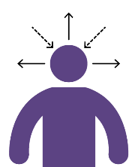
Self-Awareness in Teams & Organizations
Different kinds of strategies can be drawn upon by different people at different times. Examples of self-care strategies within organizations may include:
Formal Tools
Checklists/Procedures for Organizations
Team check-ins
Technology
Social supports
Notes:
Tip: Take into account the individual self-care strategies that were already discussed and the potential, viable self-care strategies that would fit for them and their work teams/organizations.
Time: 10-20 minutes (10 minutes for small group discussions, 10 mins for whole group discussion).
Break into smaller groups
Assign each group one of the self-care strategies listed below:
Formal tools (Pro-Quol and Self-compassion scales, workbook page #).
Checklists/Procedures for organizations (workbook page) (e.g., Providing EFAP info, team debrief process, wellness messages, peer support options, how to help co-workers , flex time policies/flexible schedule for self-care/health appts)
Team check ins. (e.g., shift debrief/temperature checks at the beginning and end of shifts)
Using technology (e.g., fit bit, self-care app, phone reminders, breathing apps, HeartMath®)
Social supports (e.g., accessing support from people in our lives: spouse/partner, friends, colleagues, boss, team activities, peer-to-peer PFA training)
Have one person from each group write down key points from their group discussion.
If some groups are struggling for answers, provide examples (e.g., if assigned the Checklists/Procedures for organization offer examples such as team debrief process, wellness messages, peer support options, how to help co-workers).
Have one person share their groups answers with larger group.

Slide 61
Self-Awareness
What does self-care look like within your organization?
What are some key points from the strategy your group was assigned that might be helpful.
When do they work best?
What would this look like if these strategies were provided or accessed more intentionally?
Notes:
Whole group debrief – Post each group’s flip chart paper and discuss their reflections
Highlight the different types of options
Note that different kinds of strategies can be drawn upon by different people at different times – need to select what’s best for the context, the individual, and the group.

Slide 62
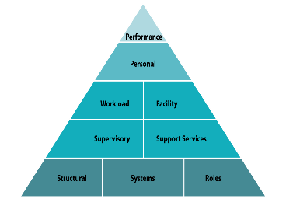
Building Team & Organizational Capacity
This activity is to help us:
assess and provide input about individual, team, and systemic strengths and challenges to self-care (particularly during disasters).
create awareness and find potential opportunities for positive change based on individual, team, leader, and organizational points of influence.
Notes:
Time: 10-15 min
Activity Instructions:
Break into small groups of 3-5 people
Display the pyramid (on the next slide) and/or provide handouts of it to each group.
Assign each group a section of the pyramid (i.e., Tools, Skills, Staff & Infrastructure, Structures/Systems and Roles)
Ask each group to answer the questions on the next slide for their section or assign a question(s) to each group

Slide 63
Adapted from Potter and Brough, 2004 and Management Sciences for Health, 2012
Notes:
You may also wish to assign each group certain questions (see below or display the questions found on the next slide)
In what area(s) of the pyramid do you experience/maintain supports to self-care?
In what area(s) do you experience barriers to self-care?
What are the effects of these supports and barriers on self-care capacity & wellness in your team and organization?
How do you influence them (as an individual, in your work role)?
In what areas of the pyramid could you have most influence to make change?
What are some first steps to self-care change with your team?

Slide 64
From an individual, team, and organizational perspective:
In what area(s) of the pyramid do you experience/maintain supports to self-care?
In what area(s) do you experience barriers to self-care?
What are the effects of these supports and barriers on self-care capacity & wellness in your team and organization?
How do you influence them (as an individual, in your work role)?
In what areas of the pyramid could you have most influence to make change?
What are some first steps to self-care change with your team?
Notes:
Slide questions for follow up to pyramid activities.
Note: For the question about influence – invite people to consider their strengths in terms of influencing Self-care culture and action, regardless of their role in their organization (e.g., A team agreement to avoid talking about media coverage of a disaster/pandemic during break times, with a commitment to focus on a positive activity or topic; supervisors/leaders adapting scheduling for greater flexibility; efforts to build self-care into agency policy (e.g., psychosocial trainings).
Considerations for leaders:
Would this activity be helpful to do with your team?
What is your team’s interest and readiness for implementing these sorts of activities/ideas? (What is your interest and readiness as a leader?)
Of the supports/barriers that you recognized - which ones do you have the most influence over? Does your team feel like they have input and influence as well? (Why or why not?)
Which supports or barriers would you like to have more influence over?

Slide 65
Moving Forward: Team & Organizational Planning
Notes:
Time: 10-20 mins (5-10 mins for small group discussion, 10 mins for large group discussion)
Break into smaller groups
Assign each group 1 to 2 of the discussion questions from the next 2 slides
Have one person from each group write down key points from their group discussion.
Have one person share their groups answers with larger group.
Optional: Ask each person to do this activity on their own (give them 10 min) and then invite participants to volunteer and share some of their answers to the whole group for further discussion or have people add their answers to flipchart paper with the respective questions, posted around the room (or in a shared document) with discussion thereafter. See next slides for questions:

Slide 66
Team & Organizational Planning
What self-care changes, if implemented, would have the greatest impact for you and your staff?
What are the most likely obstacles to implementing any change?
What are the most important resources needed to implement these changes?
What practical first steps would you take over the next month or two?
What practical first steps would you take at the time of the next disaster?

Slide 67
Team & Organizational Planning
What can you as a team and organization agree to focus on for the next 2-6 months? What will be the main sub-objectives?
What are the other aspects of your work will you need to maintain while you’re incorporating new practices?
What will be a time/place/structure for reviewing the progress of the plan?
Notes:
Additional Considerations:
What can you as a team and organization agree to focus on for the next 2-6 months? What will be the main sub-objectives? For example: getting a routine in place, figuring out ways to build habits and structures.
What are the other aspects of work will you need to maintain while you’re incorporating new practices? For example: To still meet expected levels of care (e.g., numbers served, access times, workload deliverables), giving attention to existing goals.
What will be a time/place/structure for reviewing the progress of the plan? For example: weekly 10 minute review, monthly 10 minute review, quarterly review, during team meetings.

