Slide 1
Roundtable
Patuxent District
October 12, 2023

Slide 2
Agenda: October 2023
Opening
“Announcements”
Roundtable Commissioner’s Minute
Safety Moment: “Poisonous Plants”
Breakout:
  Cub Scouts:
  Scouts BSA: Cycling

Slide 3
Welcome
Pledge of Allegiance
  "I pledge allegiance to the Flag of the United States of America, and to the Republic for which it stands, one Nation under God, indivisible, with liberty and justice for all."
Scout Oath
  On my honor I will do my best to do my duty to God and my country and to obey the Scout Law; to help other people at all times; to keep myself physically strong, mentally awake, and morally straight.

Slide 4
Introductions and Announcements
Webmaster’s Minutes: Edward Weeks
District Activity Update: Lenny Wertz
District Commissioner: Carolyn Miller
District’s Director/Executive: Lawson Lipford-Cruz
District Committee Chair: Steward Benson

Slide 5
Safety Moment: “Poisonous Plants”
Urushiol, an oil in poison ivy, poison oak, and poison sumac that is the principal cause of the rash.
Up to 85 percent of us are considered “allergic” and a few are seriously allergic.
As with many things, avoidance is the best action.
Take a careful look where you camp or picnic.
Point out the plants to those who are not familiar with them.
Don’t use wood with hairy vines attached in campfires.
Smoke from these plants can spread the oil and even create rashes in airways and the eyes.

Slide 6
Safety Moment: “Poisonous Plants
You have a limited time to wash off the urushiol before it affects you
Use soap and water or a specially designed product (like Zanfel®, Ivy Wash®, or Tecnu®)
If you’re not successful in removing the urushiol, a rash can develop wherever you’ve come in contact with it.
The rash isn’t contagious.
Both hydrocortisone cream and calamine lotion work well to reduce the itching, as does cool water or even a swim.
Antihistamine creams or lotions are not recommended, but oral antihistamines (like Benadryl®) may help ease itchiness.
Scouts and Scouters should seek medical attention if the rash covers more than 10 percent of the body, if signs of an infection appear, or if the rash gets into the eyes.

Slide 7
Breakout Sessions
Cub Scouts
Scouts BSA

Slide 8
Scouts BSA Leaders
Breakout Session: Cycling

Slide 9
Scouts BSA
Breakout Session
Greetings to first timers
Upcoming Training:
Discussion: Cycling

Slide 10
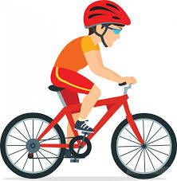
Cycling:
Related Advancement and Awards
Tenderfoot requirements 1b
Second Class requirements 1a and 3a
First Class requirements 1a and 10
Cycling merit badge
Personal Fitness merit badge
50-Miler Award

Slide 11
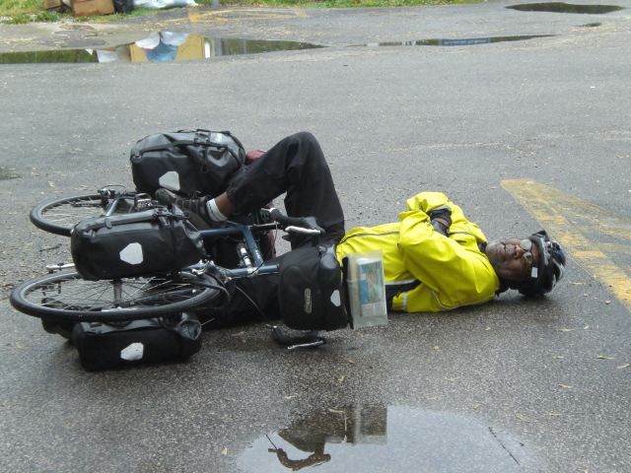
Cycling Safety
Bicycling Safety Training
Any bicycle fall is potentially life threatening even without speed, because the head is likely to strike a hard surface with enough force to cause a concussion, if not a skull fracture.
Always wear a helmet when biking.
Defensive riding practice and cycling rules of the road.

Slide 12

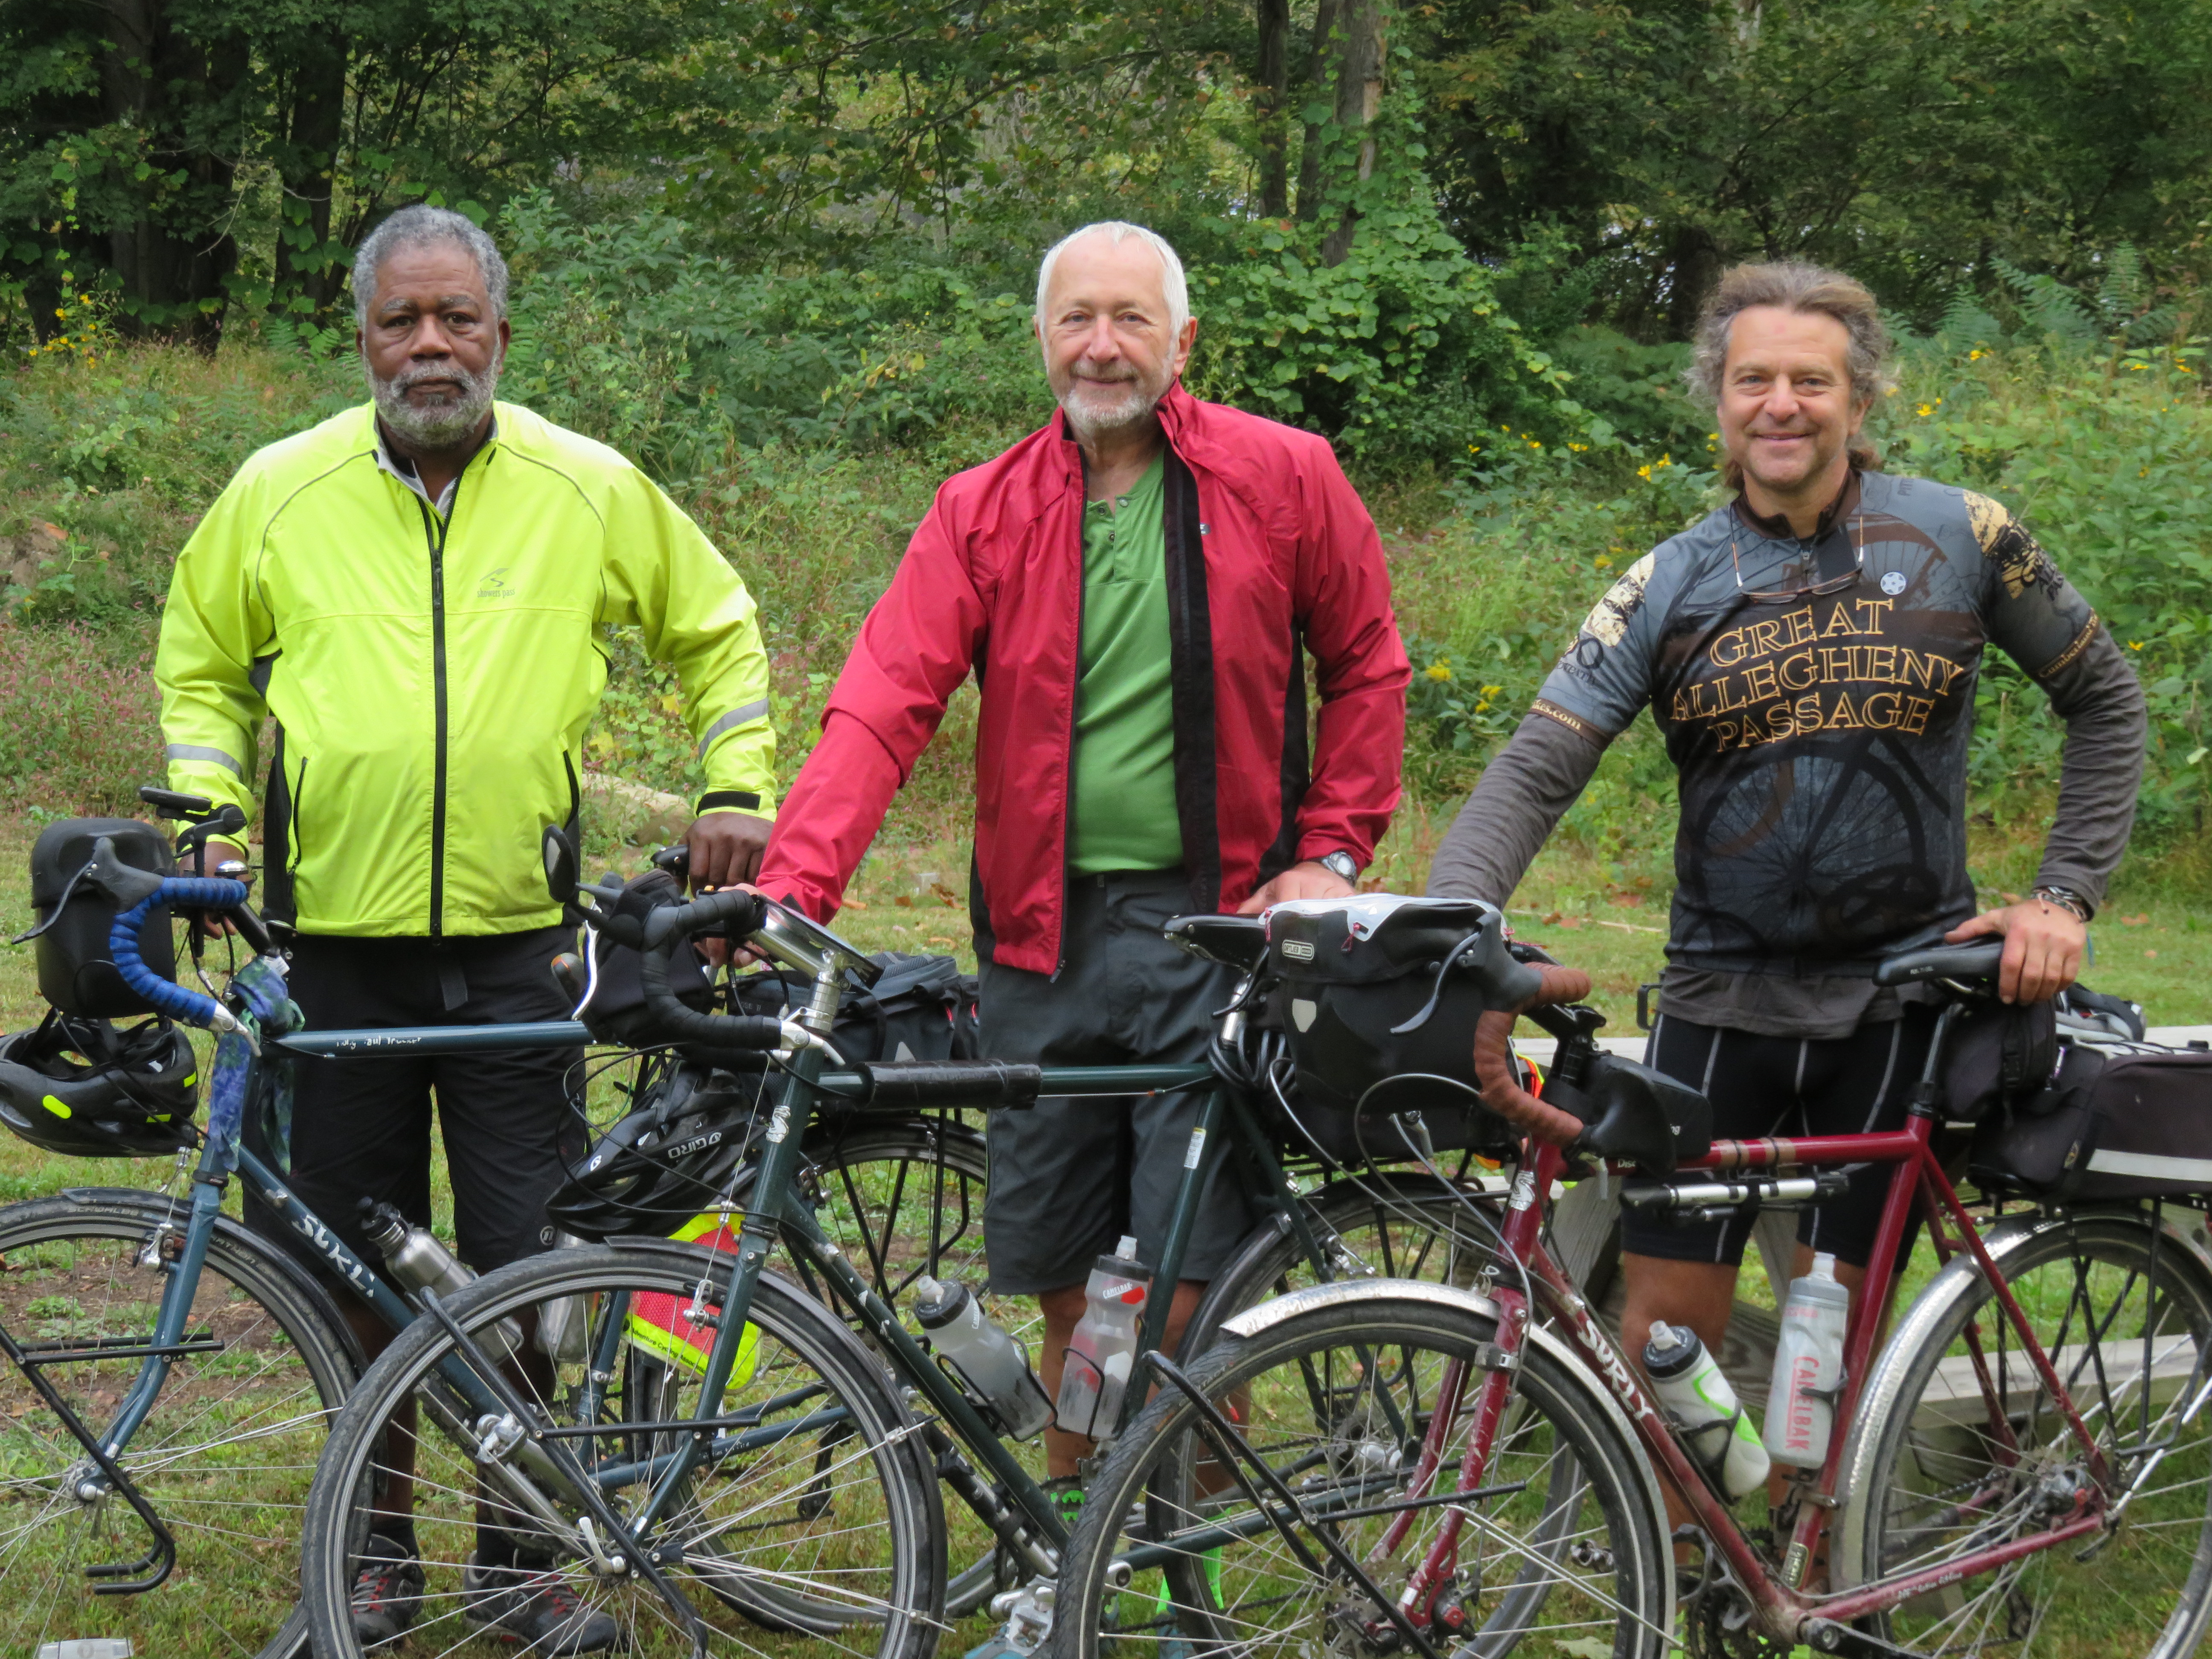
Types of Bikes

Slide 13
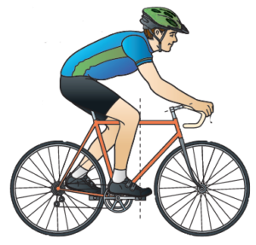
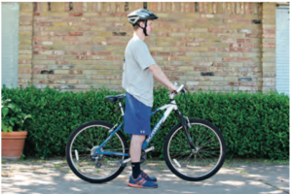
Good Fit

Slide 14
Cycling: Bicycle Basics
Learn how to change tires and tubes.
Lean how to adjust brakes, seat, and stem tube.
Learn skills for short-distance street riding.
Discuss cycling safety and traffic rules, and introduce these topics:
  Bike and helmets
  Bike training and types and parts
  Bike clothing

Slide 15
Cycling: Route Planning
Discuss safe cycling route criteria and streets to avoid.
Brainstorm most common dangers for city cyclists.
Demonstrate signals for turns and stopping.
Discuss other defensive riding techniques.
Introduce bicycle route maps.
Demonstrate websites for bike riders.
Demonstrate online route map creation.

Slide 16
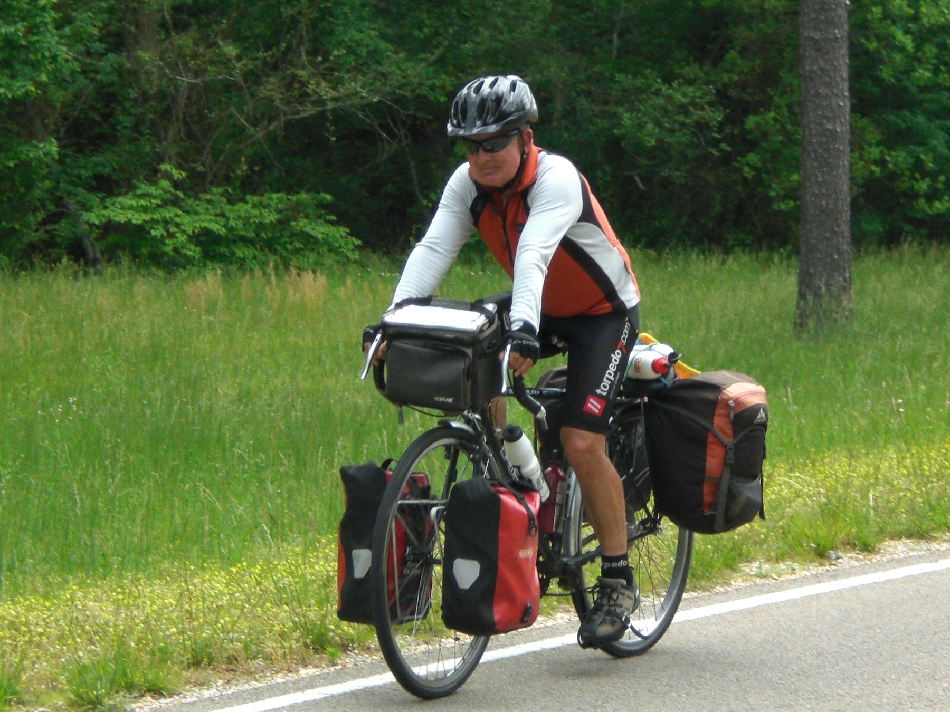
Cycling:
Gear carrying options for bikepacking
Bikepackers carry the same gear as backpackers plus spare bike tools and tubes. Fortunately, you have more places to carry it on a bike.
Unlike backpacking, you don’t want to carry a lot of weight on your back. Instead, most of the weight should be placed low as possible on your bike. This improves bike handling and your riding comfort.

