Slide 1
Roundtable
Prince George’s District
September 12, 2024

Slide 2
Agenda: September 2024
Opening
Hot Topics: “Preparing for the Renewal Process.”
Introductions and Announcements
Safety Moment: In Case of an Emergency
Roundtable Commissioner’s Minute
Breakout:
  Cub Scouts:
  Scouts BSA:

Slide 3
Welcome
Pledge of Allegiance
  "I pledge allegiance to the Flag of the United States of America, and to the Republic for which it stands, one Nation under God, indivisible, with liberty and justice for all."
Scout Oath
  On. my honor I will do my best to do my duty to God and my country and to obey the Scout Law; to help other people at all times; to keep myself physically strong, mentally awake, and morally straight

Slide 4
Hot Topic: “Preparing for the Renewal Process”
The renewal process for units and members has been separated.
Are you ready for renewal this year.
  Members Renewal
  Unit Renewal

Slide 5
Unit Renewal
Units should renew in the 60 days before their charter expire.
Task
  YPT is current for all adult leaders.
  Unit has the required number of leaders.
  Ensure the adult applicate is complete to include SSN
  Youth meet the age/grade requirements.

Slide 6
Preparing for the Renewal Process
Training will be provided.

Slide 7
Scouting America
The Boy Scouts of America has announced that it will rebrand to “Scouting America”, reflecting the organization’s ongoing commitment to welcome every youth and family in America to experience the benefits of Scouting.
The change will go into effect on February 8, 2025, the organization’s 115th anniversary.

Slide 8
Introduction and Announcements
Webmaster’s Minutes: Edward Weeks
District Activity Update: Lenny Wertz
District Commissioner: Amanda Housewright
District’s Director/Executive: Daryl Branson, Lawson Lipford-Cruz
District Committee Chair: Steward Benson

Slide 9
Safety Moment: In case of an Emergency
The BSA has multiple safety programs within the BSA to keep our Scouts and Scouters safe.
Lets look at other ideas that can enhance that ability and be passed on to our friends, families and people outside of Scouting.
In case of an emergency app.

Slide 10
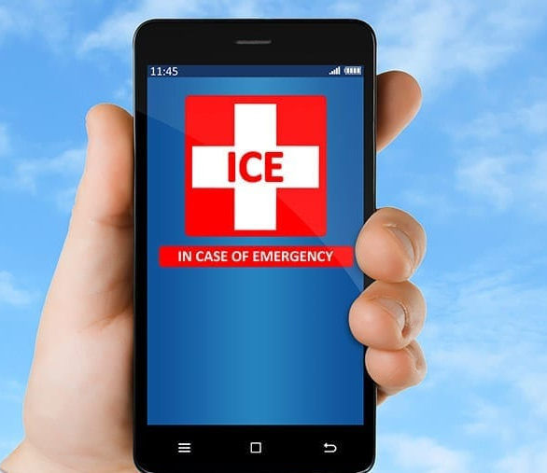
Safety Moment: In Case of an Emergency

Slide 11
Safety Moment: In Case of an Emergency
In your phone contacts, designate two or three individuals as “In Case of Emergency (ICE)” contacts.
Open your contacts, select the person you want to identify as an emergency contact, and simply type ICE in front of their name.
Use your phone’s screen saver to identify emergency contacts. The ability to add text to your screen saver is part of the Android system.

Slide 12
Safety Moment: In case of an Emergency
It takes some creativity with an iPhone as the text has to be added to the photo you are using before you set it as your locked screen.
Other apps that can be downloaded to provide emergency information are iMed Alert, MyID, and Ice: In Case of an Emergency

Slide 13
Scouts BSA Leaders
Breakout Session: Awards

Slide 14
Scouts BSA
Breakout Session
Greetings to first timers
Awards

Slide 15
Scout Awards
50 Miler
National Honor Patrol
Stem Nova Award
Scouts BSA World Conservation Award

Slide 16
The 50-Miler Program
Chartered unit participation is most desirable; however, provisional Scouting units are eligible.
This award does not apply if any other BSA award is available for a trip. The Scouts BSA, Sea Scout, or Venturing unit or provisional group must follow these rules for a 50-Miler trip:
Select a suitable trail or waterway.
Two-deep leadership must be in effect at all times. Adult leadership should utilize and follow the Guide to Safe Scouting.
Groups shall complete the 50 miles / 5 day trip by sailboat, canoe, on foot, by horse, or by bicycle.

Slide 17
Stem Nova Award
Categories
  Science
  Technology
  Engineering
  Math

Slide 18
National Honor Patrol Award
Have a patrol name, flag and yell
Hold two patrol meetings each month
Take part in one patrol/troop activity
Complete two Good Turns or service project
Help two patrol members advance in rank
75 percent of member in full
Attend at least three patrol leader council meetings
Have eight members in the patrol or an increase in patrol membership.

Slide 19
BSA World Conservation Award
Earn the following merit badges
  Environmental Science or Sustainability
  Soil and Water Conservation or Fish and Wildlife Management
  Citizenship in the World
Participate in a conservation project totaling a least three hours that addresses a conservation need common to more than one country.

