Slide 1
Roundtable
Prince George’s District
November 14, 2024
George Martin, Roundtable Commission
301 509-5633 (m)

Slide 2
Scouts BSA
Agenda: November 14, 2024
Opening
Hot Topic: “Leader Succession Planning”
Introductions and Announcements
Membership Moment: “Talking to Friends About Scouting”
Scouts BSA Breakout: “Cycling”
Roundtable Commissioner’s Minute

Slide 3
Welcome
Pledge of Allegiance
  "I pledge allegiance to the Flag of the United States of America, and to the Republic for which it stands, one Nation under God, indivisible, with liberty and justice for all."
Scout Oath
  On. my honor I will do my best to do my duty to God and my country and to obey the Scout Law; to help other people at all times; to keep myself physically strong, mentally awake, and morally straight

Slide 4
Hot Topic: “Leader Succession Planning”
It is important to have a leader succession plan in place.
Succession planning is an ongoing process
You need to regularly identifying potential new leaders.
Help them learn and grow to be experienced leaders themselves.
A succession plan can create a culture of volunteering within your unit and will improve overall unit success.

Slide 5
Hot Topic: “Leader Succession Planning”
Some ideas to help you with your succession planning.
Identify roles to be filled
Know who is available
Determine the skills of your potential new leaders
Ask for help
Get the commitment
Train the leader
Say thank you

Slide 6
Introduction and Announcements
Webmaster’s Minutes: Edward Weeks
District Activity Update: Lenny Wertz
District Commissioner: Amanda Housewright
District’s Director/Executive: Daryl Branson, Lawson Lipford-Cruz
District Committee Chair: Steward Benson

Slide 7
Membership Moment: “Talking to Friends About Scouting”
Personal Touch
Highlight the Adventures
Stress the Sense of Belonging
Make it inviting
Share the Excitement

Slide 8
Scouts BSA Leaders
Breakout Session: Cycling

Slide 9
Scouts BSA
Breakout Session: “Cycling”
Related Advancement
  • Tenderfoot requirements 1b
  • Second Class requirements 1a and 3a
  • First Class requirements 1a and 10
  • Cycling merit badge
  • Personal Fitness merit badge
  • 50-Miler Award

Slide 10
Bicycle Touring

Slide 11
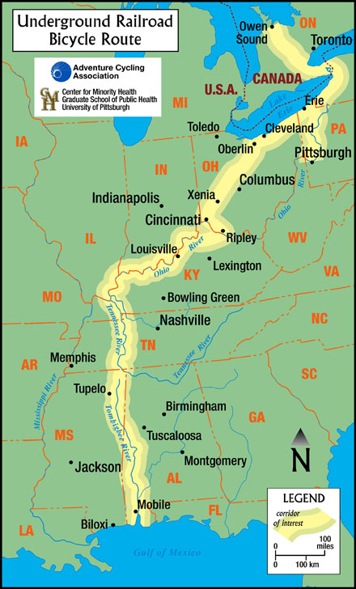
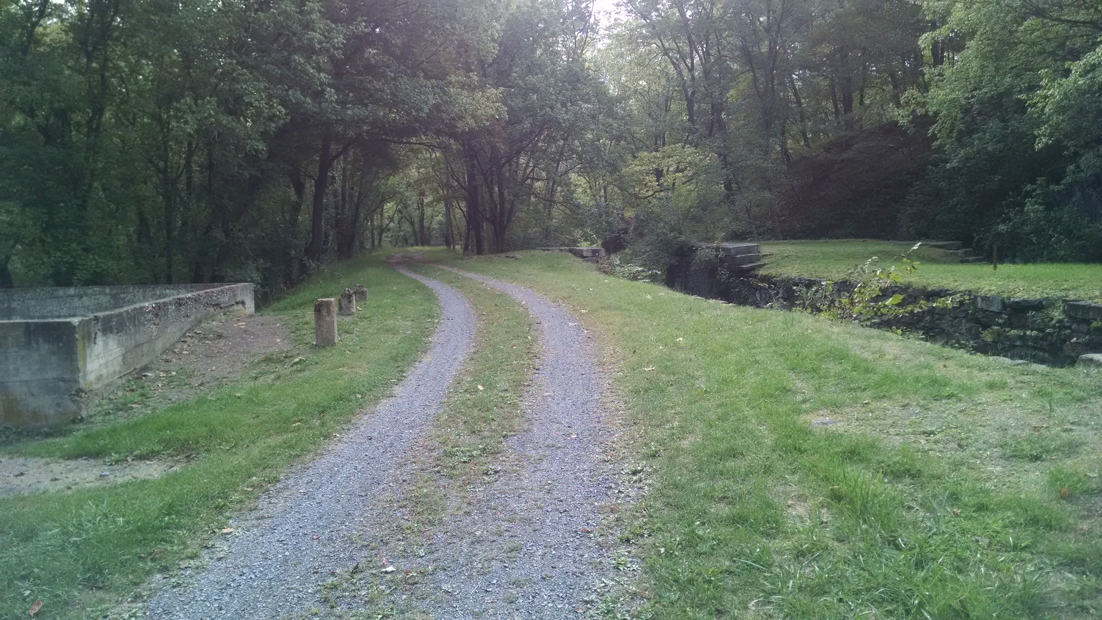
Bicycle Touring

Slide 12
Bike Ride Cue Sheet
Anacostia_Park_to_Lake_Artemesia_Lake.pdf

Slide 13
Bicycle Basic
Learn how to change tires and tubes.
Learn how to adjust brakes, seat, and stem tube.
Learn skills for short-distance street riding.
Discuss cycling safety, traffic rules, and introduce these topics:
— Bike types and parts
— Bike clothing and helmets
— Bike training and nutritional needs.

Slide 14
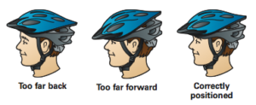
How to wear a helmet
Accordingly, an essential part of cycling gear is a good quality and well-fitted helmet. It is essential to understand the risk involved from head injury and the absolute necessity of wearing a helmet when biking.

Slide 15
Questions or comments
Any ideas for future Roundtable topics?
  Topic
  What would be a good month for the topic?
  Who has expertise in the topic?
Please contact me at georgeoh46@gmail.com

