Slide 1

LARS Overview: 2021 Process and Moving Forward
June 3, 2021
www.suny.edu

Slide 2
Our goals for LARS Now and Going forward
If your campus has the data and would like SLS to pull the data, we’ll pull it from Alma without your input after this year.
If you prefer to continue to gather and report this data, we’ll help with the Alma report if desired to make it easier.
Analysis of what was being gathered via LARS process and ensure we’re getting what is needed, but not gathering data that’s not necessary.

Slide 3
Why is SUNY gathering this data?
Data is gathered for SUNY Controller’s office for auditing purposes.
SUNY Controller’s office prepares the University-wide audited financial statements and campus IPEDS Finance Survey on behalf of the campuses.
For the financial statements SUNY is required to put purchased library materials as a “Capital Asset” in our financial statements versus being reported as an expense.
SUNY needs data on what was purchased (not subscriptions) to know what was spent on permanent collections; and then what collection's items were retired.

Slide 4
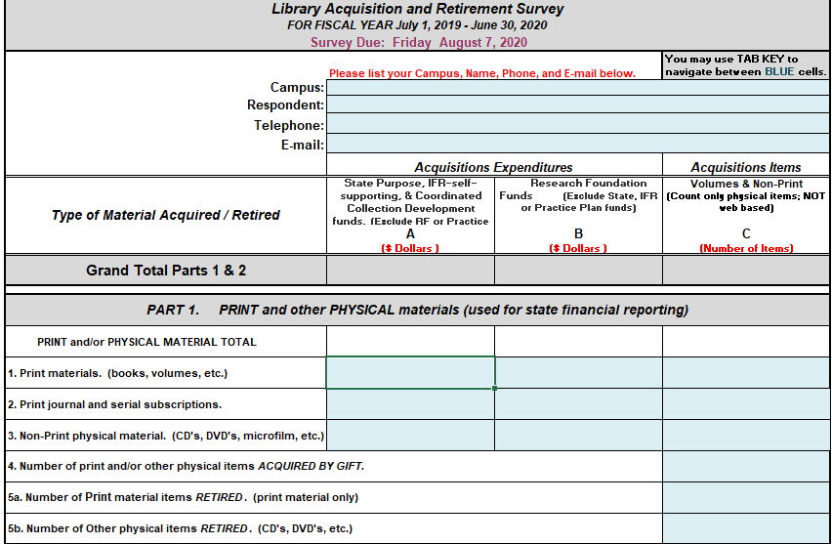
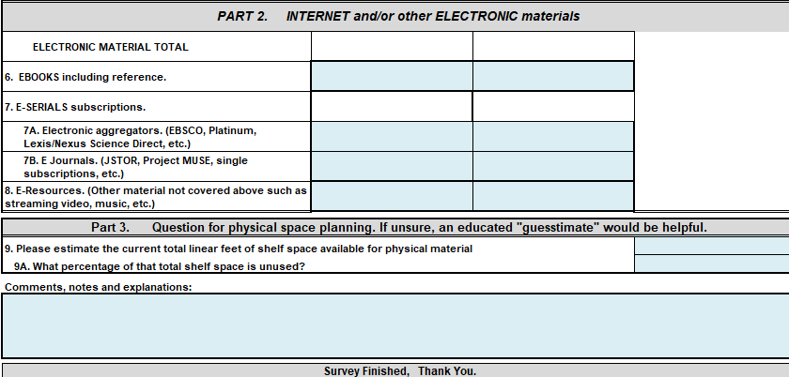
Previous Process

Slide 5
Previous Data Gathered
Print material spend
Print journal and serial subscription spend
Non-print physical material spend
Number of print/physical Gifts
Number of Print materials Retired
Number of Other Physical items Retired
Ebook spend
E-serials subscription spend
  Journals
  Aggregators
Estimate current total linear feet of shelf space for physical materials
What percentage of that total space is unused?
Asked for both amounts/counts and spending for all sections on right.

Slide 6
Data Gathering Going Forward
LARS Questions
Print material spend
Print journal and serial subscription spend
Non-print physical material spend
Number of print/physical Gifts
  Books
  Journals
  CDs, DVDs, etc.
Retired Physical Items
  Books, journals, and AV (CD, DVD, etc) separately gathered
Electronic Content One-Time Purchases
  Ebooks, journal archives, backfiles or permanent purchases
Following Questions on Separate Shelf Space Inventory:
  Estimate current total linear feet of shelf space for physical materials
  What percentage of that total space is unused?

Slide 7
Why was SUNY gathering subscription data?
For several years, IPEDs did not gather this data, so SUNY gathered for program office’s needs.
Since IPEDs now requires this data, and this is publicly accessible, there is no longer a need to gather this information.

Slide 8
Why Separate Shelf Space and LARS?
We hesitated having a second form, but think this data is easier to get from Access Services staff, different from those who would know the LARS type data.
  For LARS, many campuses will just have their data pulled from Alma by SLS.
We’ll review how things go this year, though.

Slide 9
What we have been doing to prepare for this year
SLS has created a LARS dashboard to use as a starting point for pulling the LARS data.
IR provided us with historical data of what campuses provided for LARS in past.
Running historical reports from dashboard in Alma analytics to verify data, and that the numbers we get are similar enough to previous LARS data.

Slide 10
Campuses we don’t have ability to pull LARS data
Some libraries are not using Alma acquisitions (at least 8).
  Not questioning this decision. We understand the decisions and that this is often creating another separate system in addition to your campus financial system.
For non-acquisitions libraries, SLS will:
  Work with you to set up the dashboard to pull as much of the data as possible.
  Provide a streamlined online form for you to submit data.
  If you’re interested in implementing acquisitions, we will help with that and establish a timeline.
Notes:
Non-acq --> Alfred State – Canton - Empire – ESF [set up, no entries] - Maritime [set up, not using] - Morrisville [no 2020/21 entries] - OPT [no 2020/21 entries] - Poly

Slide 11
Creation of Webforms for Providing LARS and Shelf Space
LARS
  https://slcny.libwizard.com/f/SUNYLARS
Shelf Space
  https://slcny.libwizard.com/f/SUNY-shelf-space

Slide 12

Demo Time
Maggie will walk through demo of LARS dashboard.

Slide 13
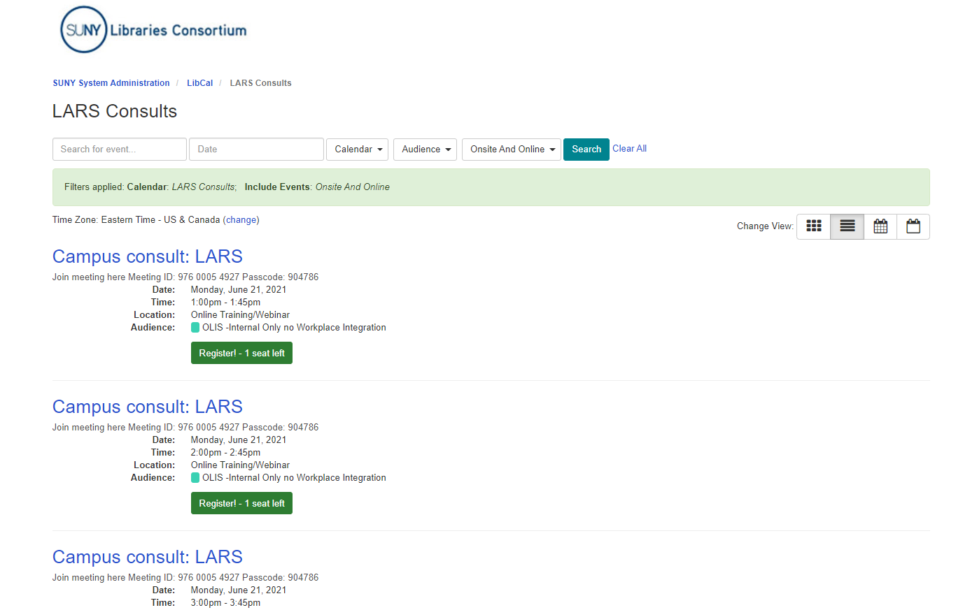
Setting up Appointments
LARS sign up calendar:
  https://slcny.libcal.com/calendar/LARS
  Dates are mid-June to mid-July.
45-minute consults with SLS staff to verify your data for pulling on your behalf or getting you as close to data needed to submit on your own.
If days/times don’t work for you, just send us a ticket with available times, and we’ll do our best.

Slide 14
Issues we’ll likely discuss with reports/dashboards
POL types
  Are you willing to modify POL types going forward?
    E.g. memberships, database subscriptions, access fees, service subscriptions (e.g. OCLC and ILLIad, etc.); print-online combos
General report
  Are you willing to adjust your practices?
  Can we come to agreement on a customized report that is manageable?
Process for Withdrawn Items
  Are you using MSP-50? If not, what is your process for withdrawing items?
Gifts
  What is the process you’re using for gifts? A vendor “Gift” or POL type Gift?

Slide 15
Timelines
August 6th
  Deadline for submissions
Late June
  Scheduled LARS sessions
Late June-July
  Shelf-Space form released

Slide 16
Explanation and workflow for process this year
Campus Meeting
Review of LARS dashboard and library data
SLS will pull data when FY is complete
Agreement on future process
SLS pulls data for campuses in future years
Campus Notifies SLS that it will independently submit its data or vice versa
Campus will pull data and submit via form
Campus submits data using form in future years
Optional Meeting to review any relevant LARS data gathering in Alma

Slide 17
What do I need to do now?
Decide if you would like SLS to pull your data or submit on your own going forward.
Sign up for a consult session (either way).
Let your access services staff know about the shelf space form that will be coming soon.
Let SLS know if there are questions.
Review: “Issues we’ll likely discuss with reports/dashboards” slide

Slide 18


Questions or Discussion?
www.suny.edu

