Slide 1
Reaping Resources for Recommenders
Working with LibGuides, MarcEdit, and Other Simple Tools
SUNY– November 15, 2022
Nancy Babb
Discovery Services Librarian

Slide 2
The promise:
The challenge:
Resource Recommenders must be updated manually – either though individual entry or batch import.
We maintain around 450 research guides and more than 600 active databases – how can we streamline and in any way automate the process of creating and updating Resource Recommenders for these materials?
If we can’t at least semi-automate, it won’t be tenable.
Resource Recommenders provide the opportunity to highlight and draw users to additional library resources when they search in Primo VE. The Recommenders can help guide users to other databases, services, and help, and can be customized for local needs.

Slide 3
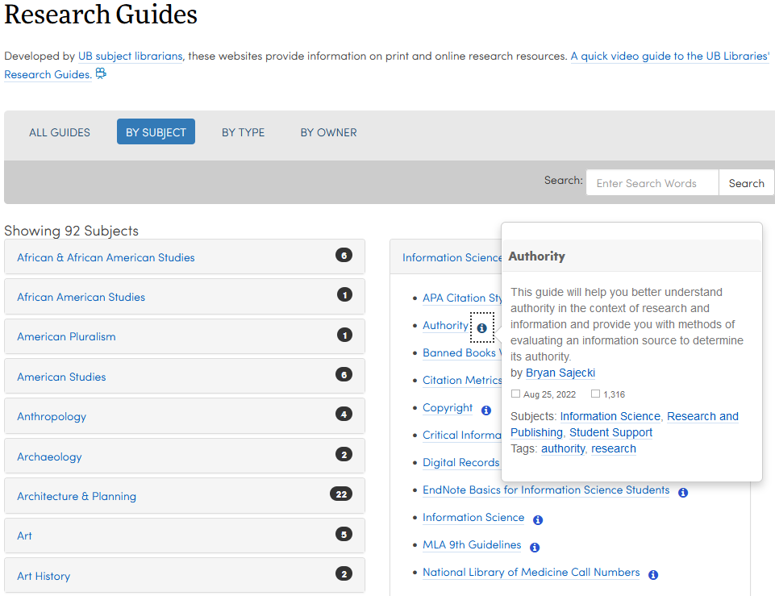
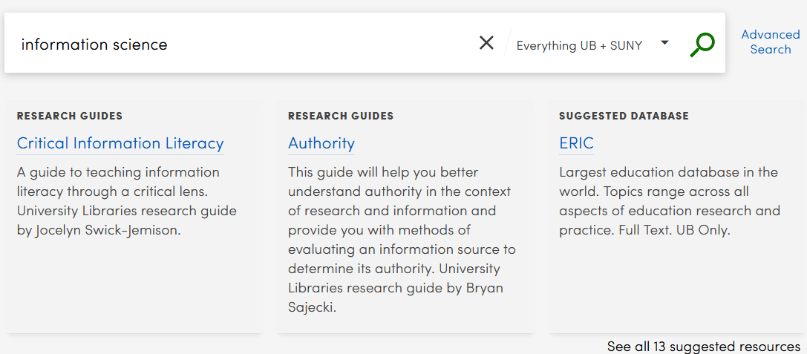
How can we get from there:
?
To here:

Slide 4
Source: LibGuides
Edit, refine: Excel
Import: Alma
Harvest, edit, export: MarcEdit
Maintenance: Notepad++
Output: Primo VE

Slide 5
Step 1. Harvesting the data from LibGuides
Step 2. Editing in MarcEdit
Step 3. Export Tab Delimited Records
Step 4. Import to and final editing in Excel
Step 5. Import Excel file to Alma
Step 6. Test display and functionality in Primo VE

Slide 6
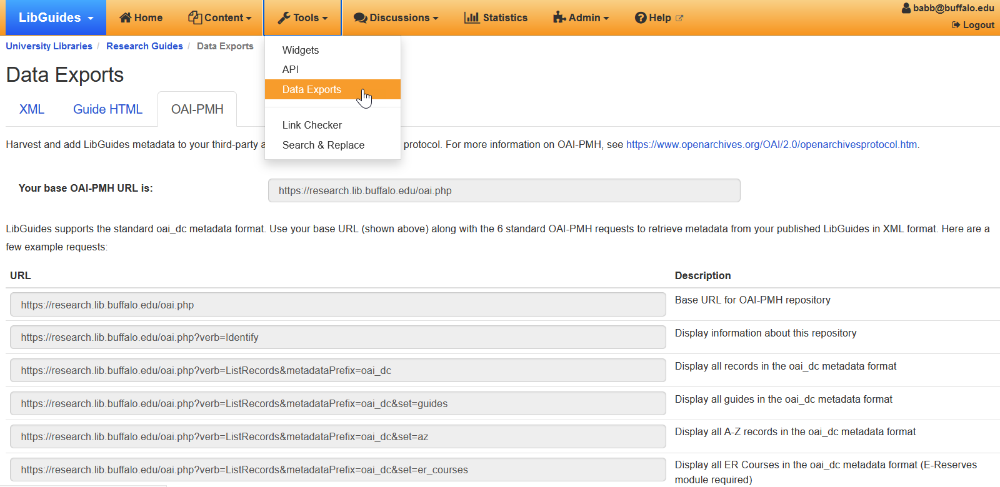
What you need to know from LibGuides

Slide 7
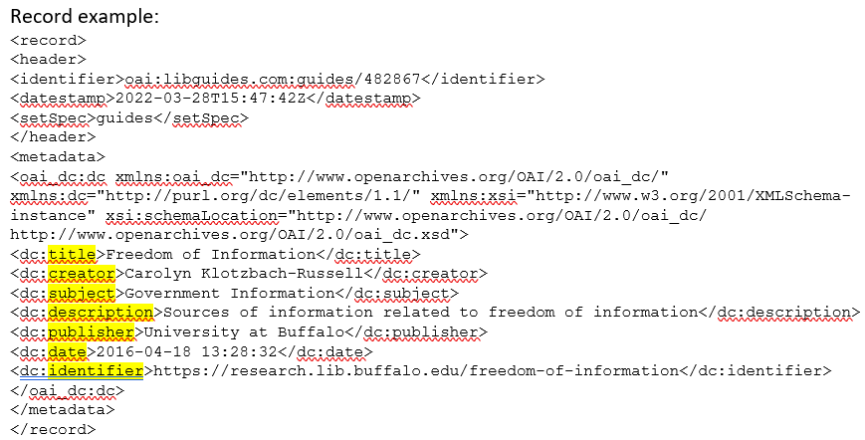
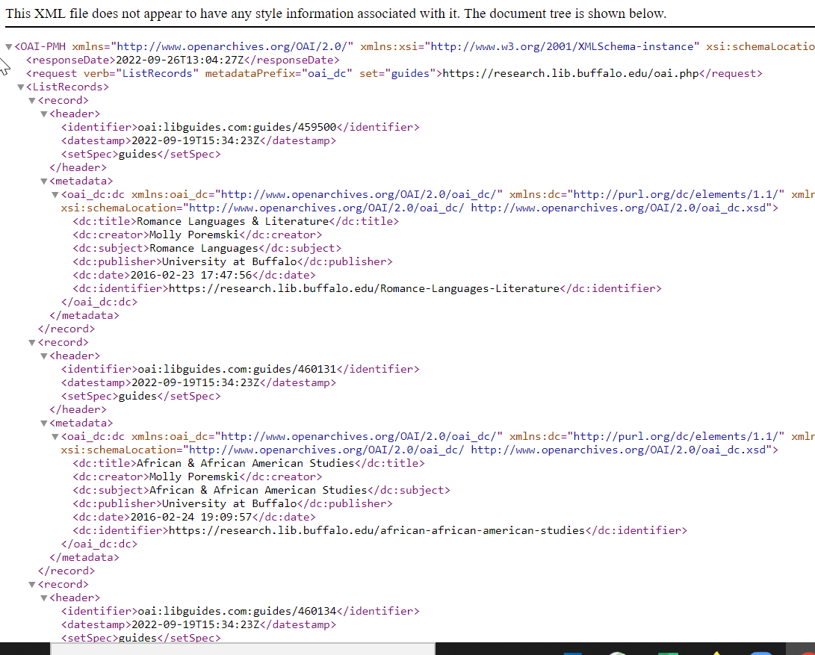
A peek at the OAI-PMH data = ListRecords
Example: https://research.lib.buffalo.edu/oai.php?verb=ListRecords&metadataPrefix=oai_dc&set=guides
These are the fields available for harvest.

Slide 8
Harvest = base URL + set name
ex: https://research.lib.buffalo.edu/oai.php + guides = Research Guides
https://research.lib.buffalo.edu/oai.php + az = Databases
Only published guides and unhidden entries are available for harvest.

Slide 9
Step 1. Harvesting the data from LibGuides
LibGuides makes the data from Guides, A-Z Database List, and E-Reserve Courses available for export in OAI-PMH (Open Access Initiative Protocol for Metadata Harvesting), allowing published LibGuides content to be harvested by supported third-party apps, such as library catalogs, institutional repositories, or discovery layers, supporting the standard oai_dc metadata format,
MarcEdit is a well-supported free program that can harvest OAI-PMH,
MarcEdit can be used to harvest LibGuides in oai_dc format.

Slide 10
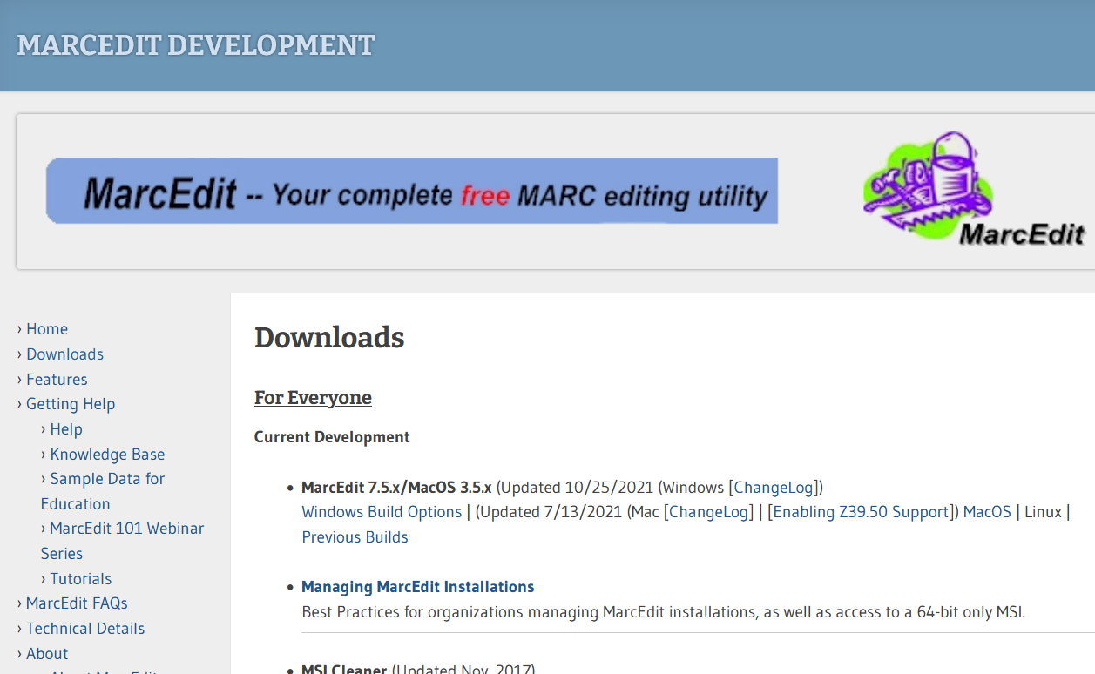
3 Crucial MarcEdit Tools
https://marcedit.reeset.net/downloads
“In 1999, MarcEdit started out as a simple MARC=>plain text translation utility. Today, MarcEdit has become one of the more complete metadata edit suites available to librarians.”
Harvest OAI Records
MarcEditor
Export Tab Delimited Records

Slide 11
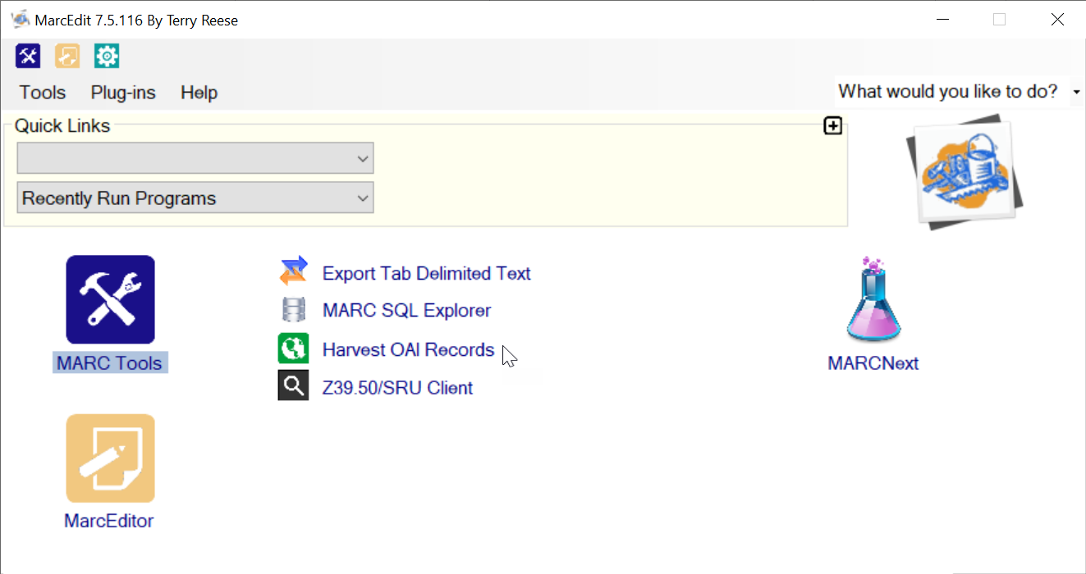
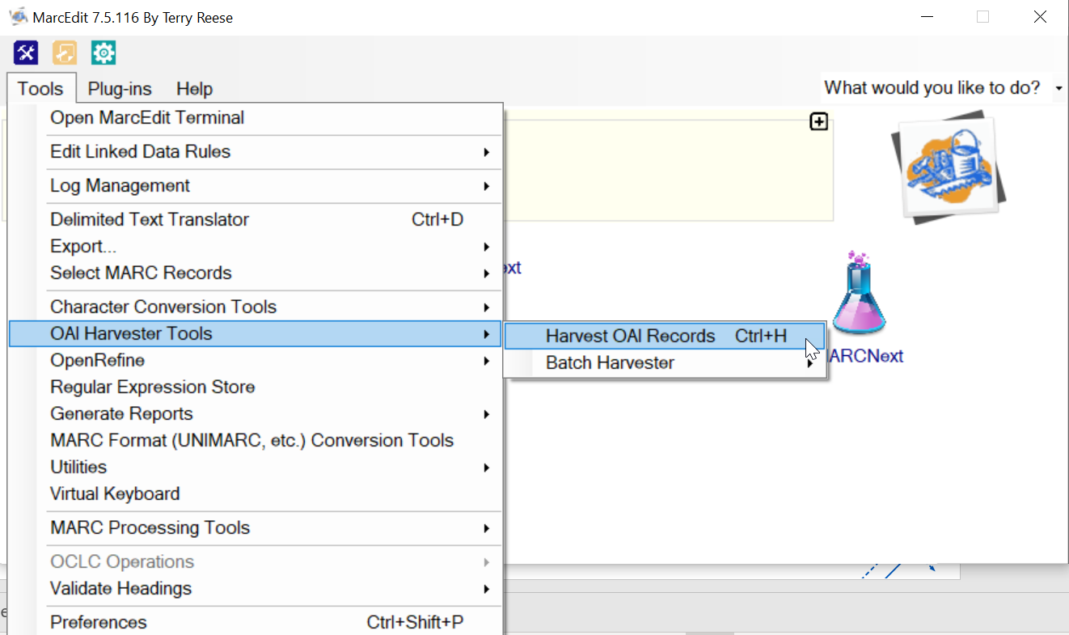
What you need to know in MarcEdit:
Different routes to same place

Slide 12
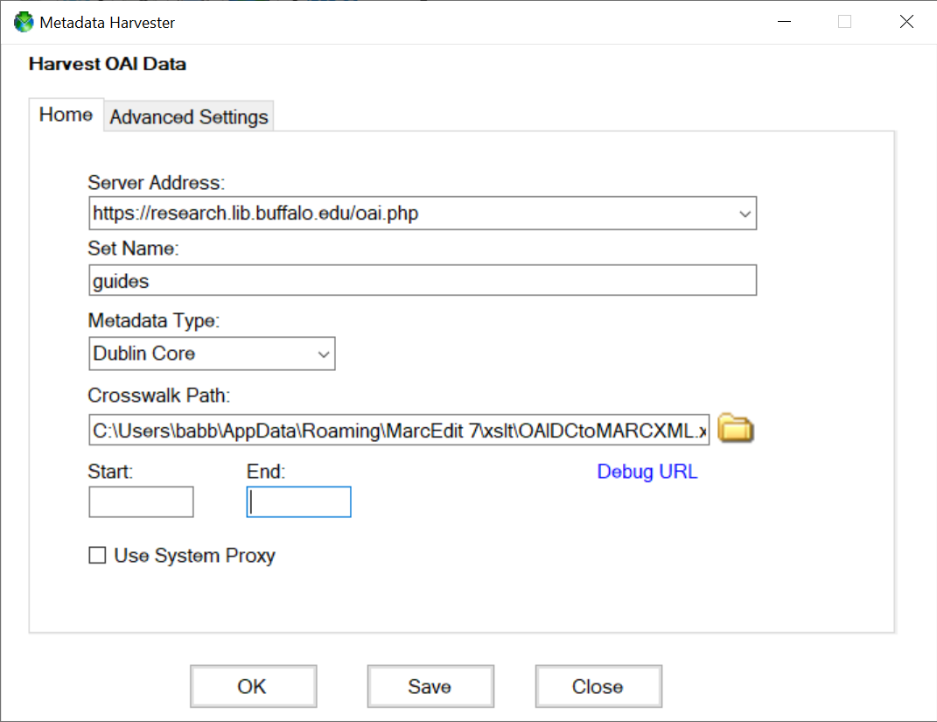
Research Guides example:
Server Address = base URL:
https://research.lib.buffalo.edu/oai.php
Set Name:
guides
MarcEdit supports other Metadata Types, but since LibGuides use oai-dc, I use Dublin Core.
Once the Metadata Type is selected, the Crosswalk Path should be automatically supplied.
(Optional) Start and/or End dates can be specified in format YYYY-MM-DD.

Slide 13
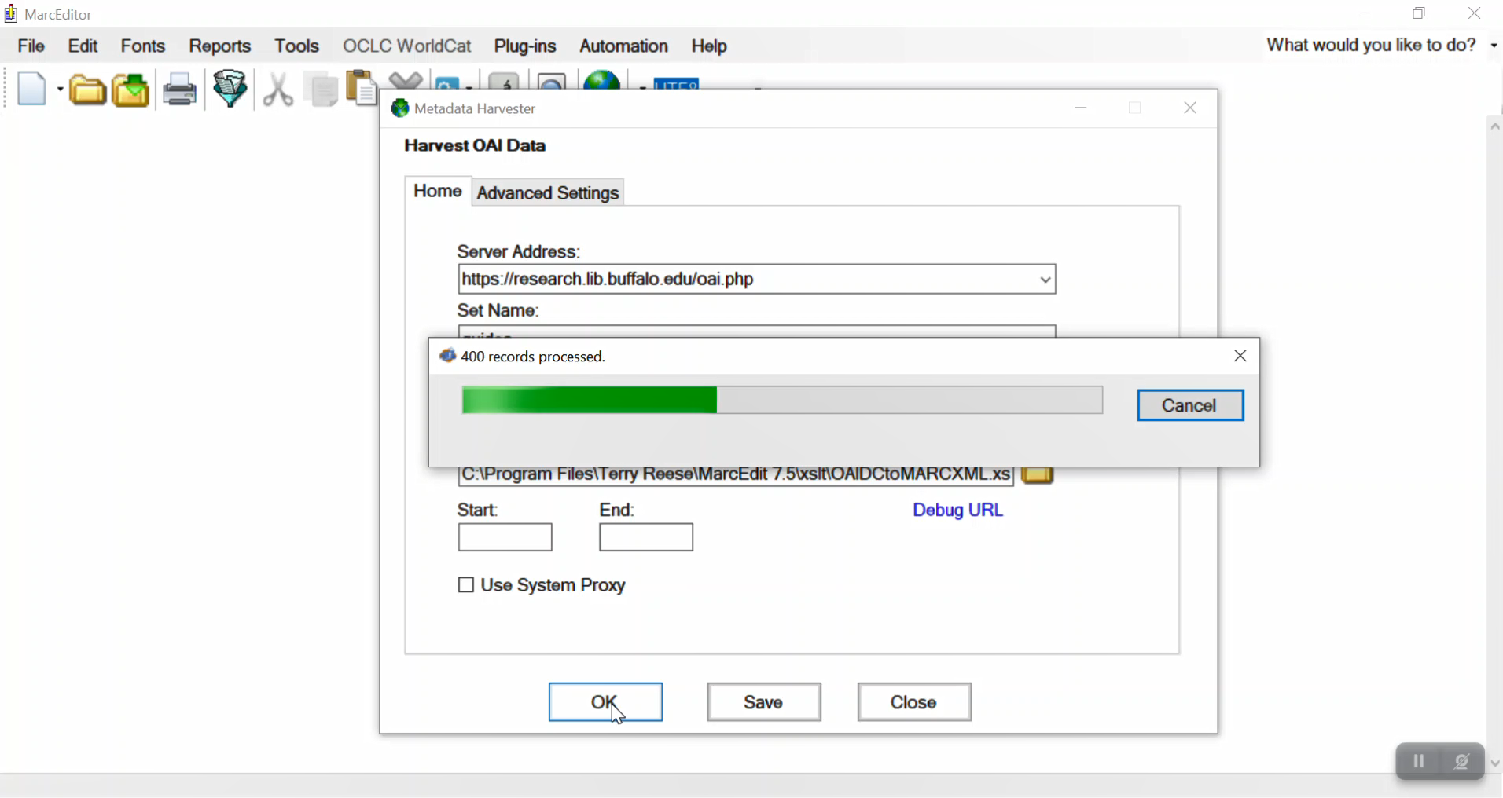
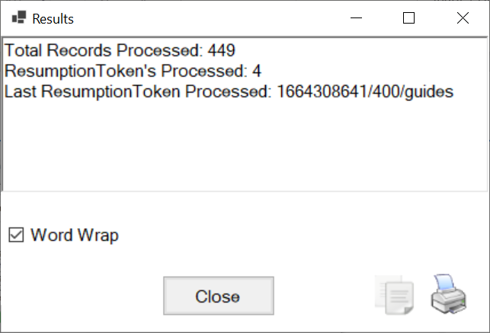

Slide 14
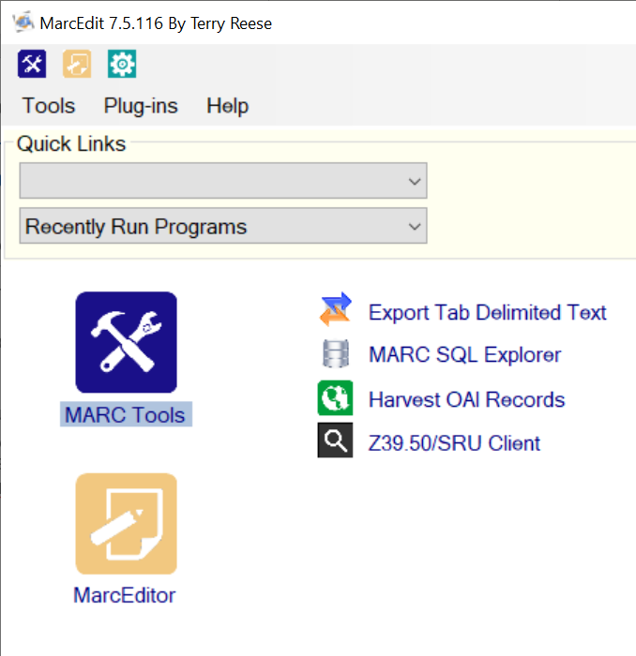
Introduction to MarcEdit files
When you harvest the file, it is opened in MarcEditor – where you can save and make changes.
By default, harvested files are saved as .mrk files – a human-readable MarcEdit-specific version of .mrc (MARC) records. If you’d like to work with MARC records for import into Alma or other uses, you can save .mrk as .mrc – but for Resource Recommender purposes this is not necessary.
When MarcEdit is installed, the default setting is to associate .mrk and .mrc files with MarcEdit, so you should be able to open any .mrk file by double-clicking on it. Alternately, you can open MarcEditor and then open the file.
The first thing I usually do is save two copies of the file, one to work with and one to save. The saved file is a backup in case anything goes awry, and it can also be used as an archive to save time in reviewing for updates in the future. I find it helpful to use standard naming, such as guides_[date].mrk and guides_[date]_BU.mrk, so it’s easy to differentiate.

Slide 15
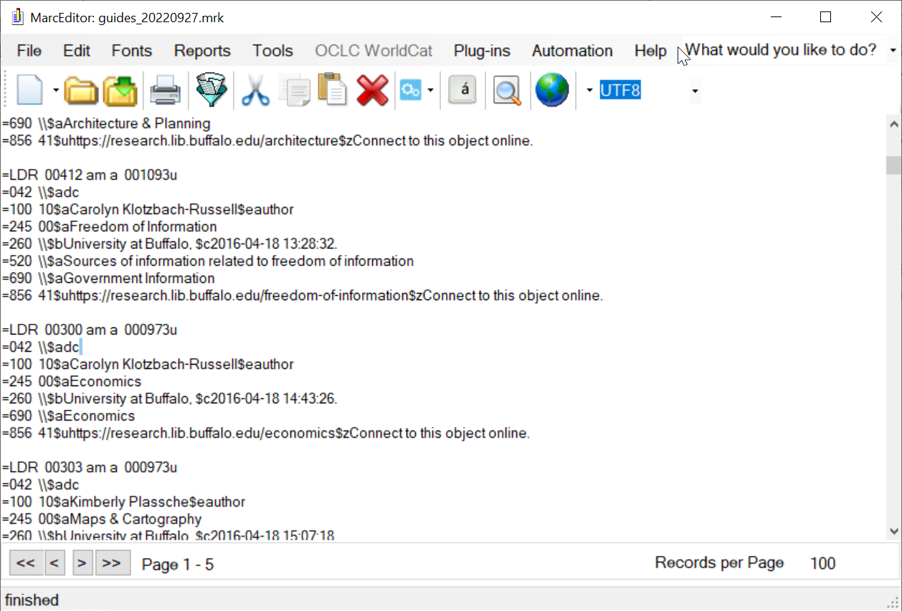
The harvested .mrk file and
single record example

Slide 16
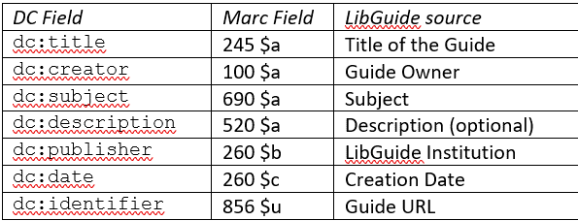
OAI-PMH source record:
.mrk record:
=LDR 00412 am a 001093u
=042 \\$adc
=100 10$aCarolyn Klotzbach-Russell$eauthor
=245 00$aFreedom of Information
=260 \\$bUniversity at Buffalo, $c2016-04-18 13:28:32.
=520 \\$aSources of information related to freedom of information
=690 \\$aGovernment Information
=856 41$uhttps://research.lib.buffalo.edu/freedom-of-information$zConnect to this object online.

Slide 17
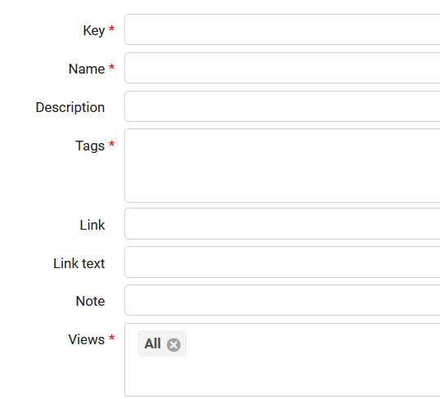
So what does this have to do with Resource Recommenders?
Template for Resource Recommender:
LIBRARY_GUIDE
We can already see how easily some fields will map into the Resource Recommender template – we can use MarcEditor and Excel to add, improve, and enhance.

Slide 18
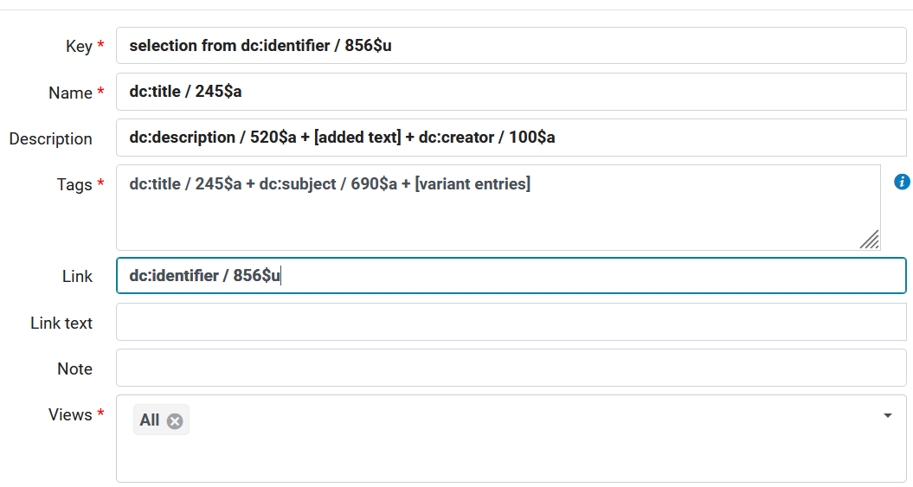
Mapping .mrk fields to LIBRARY_GUIDE fields
edited in:
Your local needs can and will vary - these are some examples
MarcEdit
MarcEdit
MarcEdit
MarcEdit + Excel
MarcEdit
Note: The “key” field is the unique entry name in Alma – I find it helpful to use the friendly file name from LibGuides. The “key” also determines the display order when multiple entries are retrieved in Primo VE, so modify the key value to change the sort order.

Slide 19
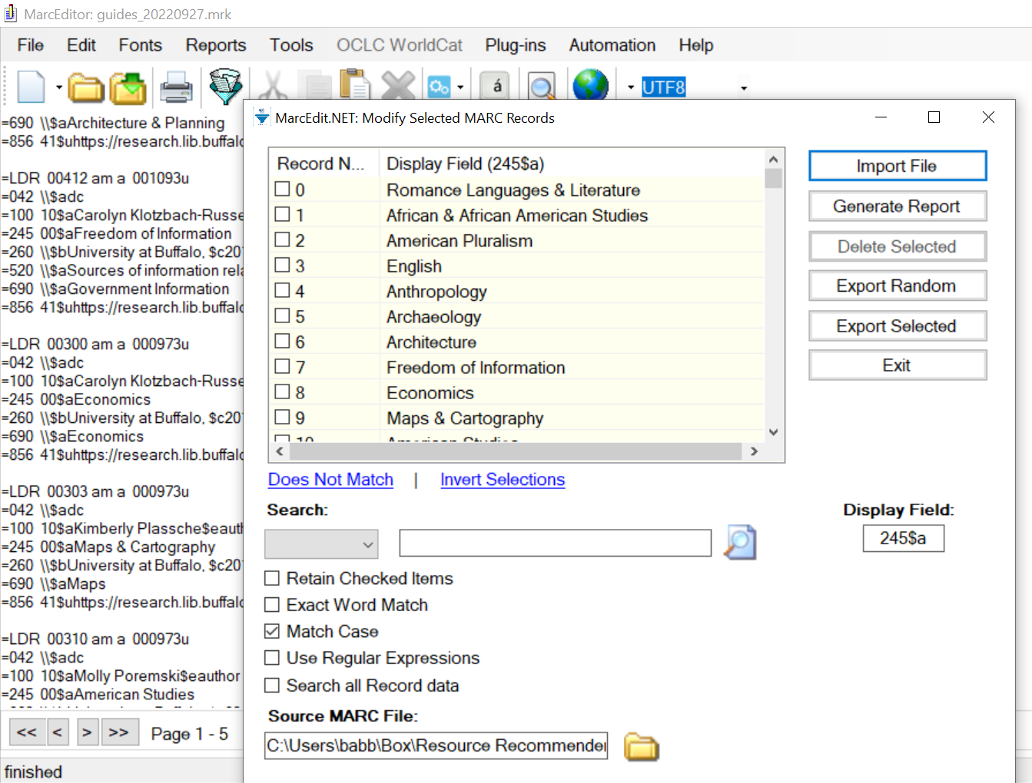
Step 2. Editing in MarcEdit
Start with some quick data checks & initial cleanup:
Reports > Field Counts – shows how many records, which fields, and how many; this should match your expectations
Tools > Mnemonic Formatting Tools:
Remove Blank Lines
Remove Empty Fields/Subfields
Two ways to look at field values:
For a quick view: CTRL-F for any fields or values, ex: CTRL-F > Find All: =245 will display a list of all 245 fields, i.e. dc:title, i.e. anticipated source for Resource Recommender Name
To look more closely and isolate any needed revisions: File > Select Records for Edit – enter Field number (and Subfield if desired) then Import File, ex: Display Field 245$a
Sort and search within fields; select records and export for selective editing – especially helpful if you know a problem field!

Slide 20
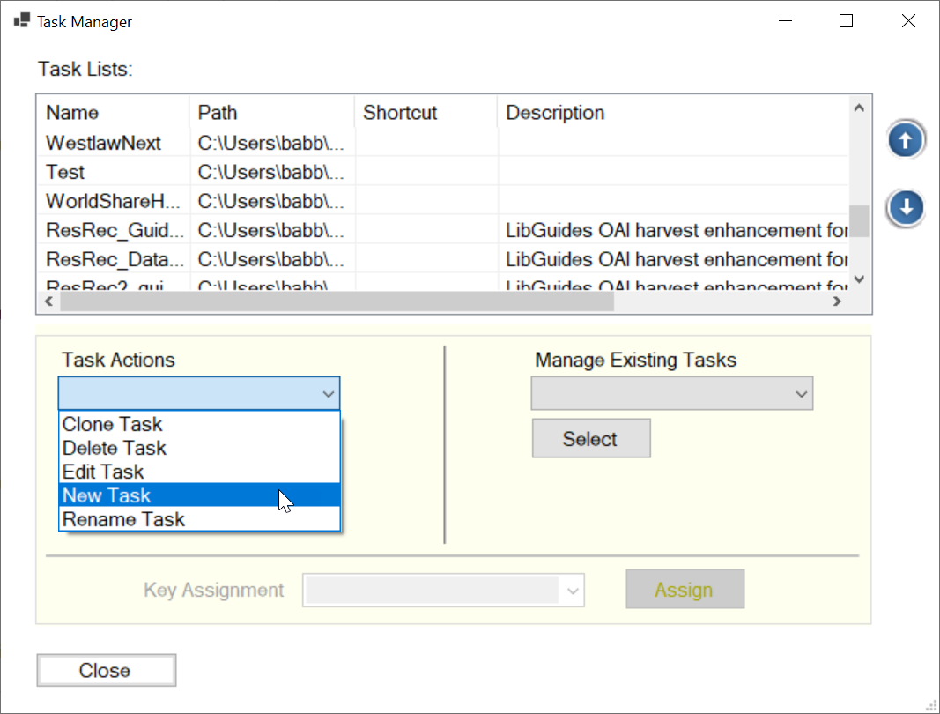
Now the good part –Tasks & Task Lists
Determine what you want/need
What task will accomplish this?
Create a Task List and you can click and go!
Tools > Manage Tasks to create new or edit existing
Tools > Assigned Tasks > Currently Available Tasks to select and run

Slide 21
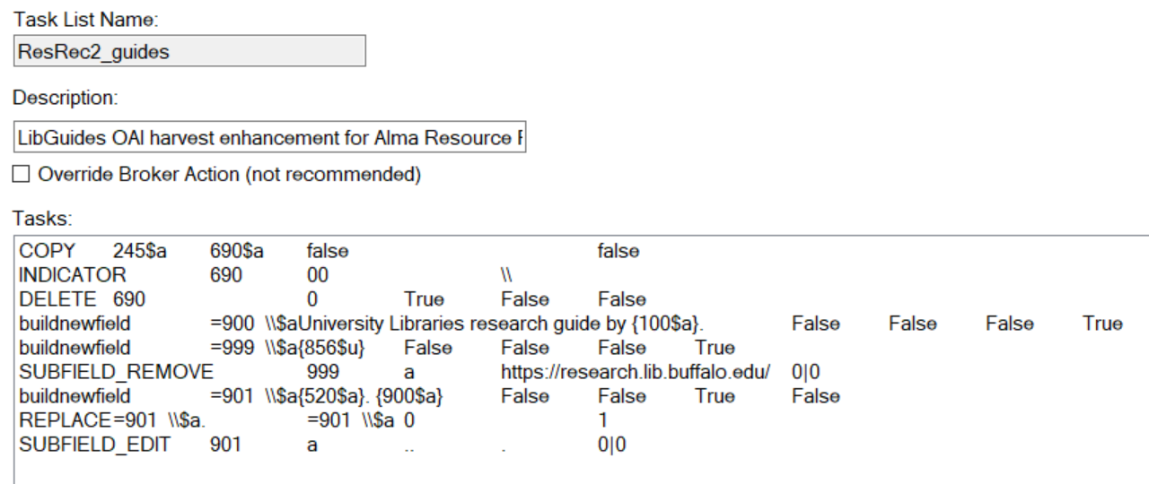
Example Task List for Resource Recommender: LIBRARY_GUIDE

Slide 22
Example Task List for Resource Recommender: LIBRARY_GUIDE, explained
Task Name: ResRec2_guides
Task Description: LibGuides OAI harvest enhancement for Alma Resource Recommender
Task Override: False
COPY245$a690$afalsefalse
Copy 245$a to 690$a – this adds the title value as a subject. We will use the 690$a values as tags and want to include the name of the guide as a tag.
INDICATOR69000\\
Replace the default indicator values 00 for field 690 with values \\ (blanks)
DELETE6900TrueFalseFalse
Remove any duplicate 690 values
buildnewfield=900 \\$aUniversity Libraries research guide by {100$a}.FalseFalseFalseTrue
Build a new field 900\\$a with value: University Libraries research guide by [value in 100$a] – this creates a note to identify both the University Libraries and librarian for each guide.

Slide 23
Example Task List for Resource Recommender: LIBRARY_GUIDE, continued
buildnewfield=999 \\$a{856$u}FalseFalseFalseTrue
Build a new field 999$a to hold only the value from 856$u – this creates a field with only the URL, no note.
SUBFIELD_REMOVE999ahttps://research.lib.buffalo.edu/0|0
In the new field 999$a remove the domain from the LibGuide URL – we use the remaining descriptive filename as key.
buildnewfield=901 \\$a{520$a}. {900$a}FalseFalseTrueFalse
Build a new field 901$a combining the values in 520$a and 900$a – this creates the revised description field which adds ownership/authorship statement. If there is no 520$a, the 900$a value alone is then the description.
REPLACE=901 \\$a. =901 \\$a01
Get rid of any initial “. “ (period space) in field 901$a (this is a simple find/replace of the code)
SUBFIELD_EDIT901a...0|0
If .. (two periods) exist in field 901$a, replace with . (single period)
The False, True, 0, and 1 statements refer to settings such as whether case is matched, values removed or replaced, etc. The Task Editor is a field editor, so you select the options; you don’t have to know these codes!

Slide 24
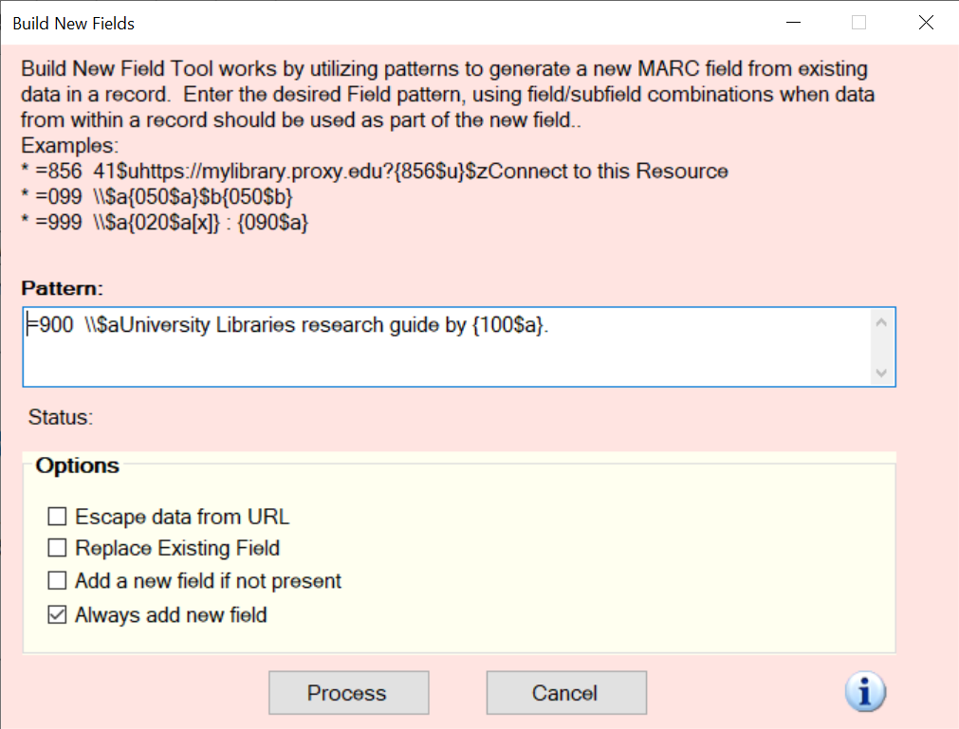
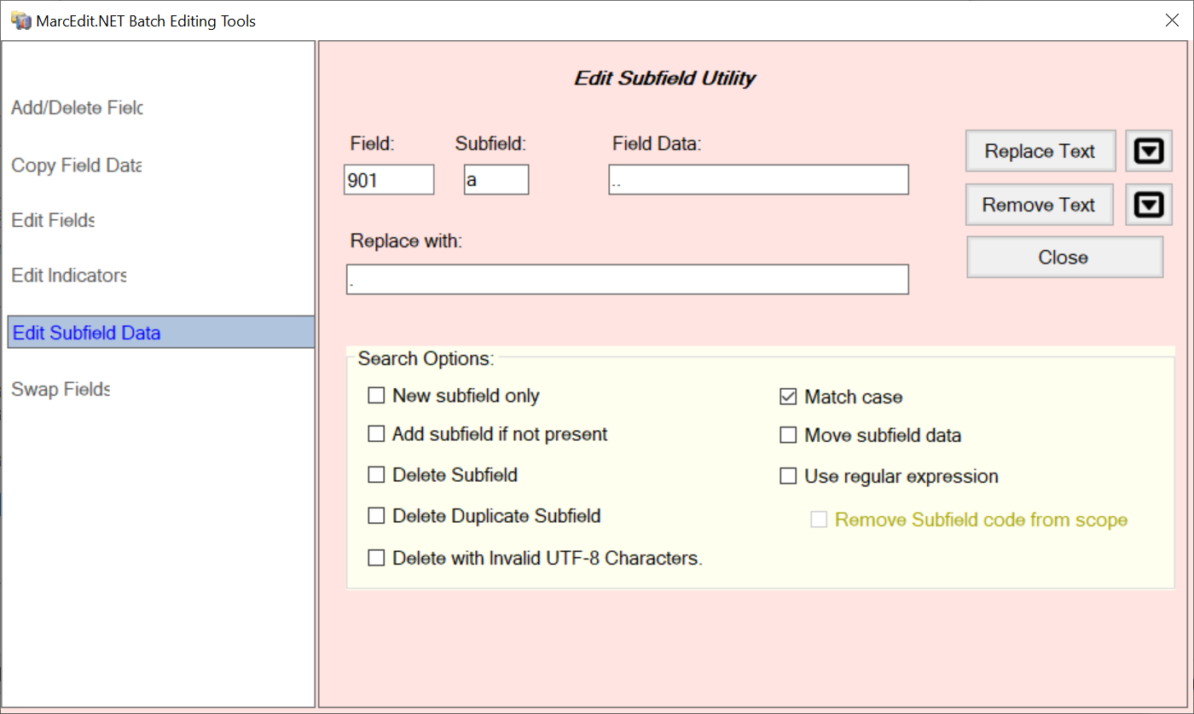
Task field editor interface examples
Not as scary as they might look in the list!

Slide 25
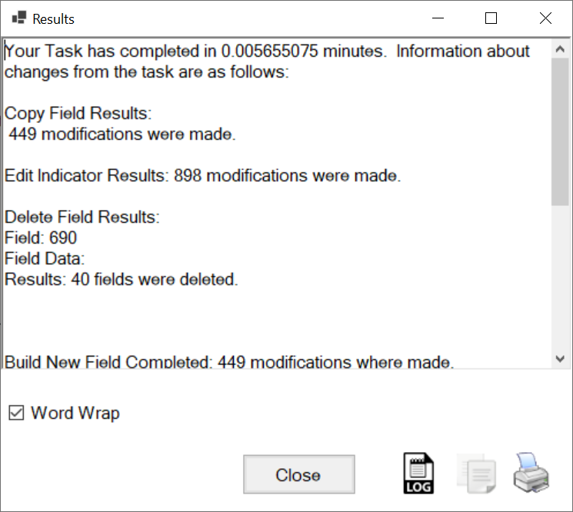
After running the task, the Results are reported in a pop-up window; you can save or print for reference if desired.
The Task Results report may be helpful for troubleshooting when you get unexpected results, although it may be a little intense for general perusal if you have a lot of complex tasks and/or records (don’t worry about it, unless you want to).

Slide 26
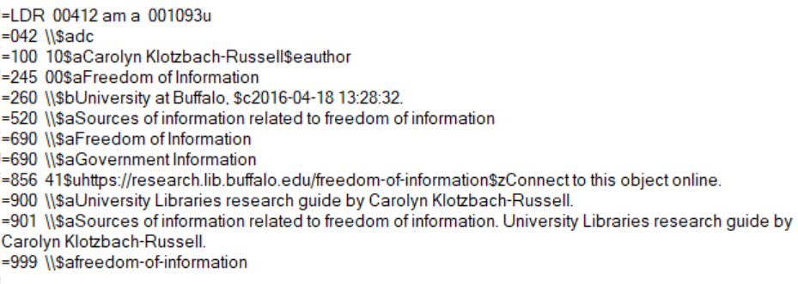
After running the task, the record is transformed to:
999 $a value
245 $a value
901 $a value
690 $a values – multiple occurrences
856 $u value
Which will populate the Resource Recommender as --

Slide 27
By the way…
We’re exploring harvesting and transforming records from LibGuides to populate Resource Recommenders, but records can be harvested from various sources and edited and exported in different formats for a variety of purposes.
For example, we could save the LibGuide records as MARC and import them into Alma, to provide record and not just recommender discovery and access in Primo VE.
Import profiles can also be used to bring records into Alma and/or Primo VE.
We use Discovery Import Profiles in Alma to harvest LibGuides guides and A-Z database entries as records in Primo VE – unlike the Resource Recommenders, this process is fully automated and is updated daily.
We like Resource Recommenders in addition to records because (1) they give added prominence to local resources and (2) we can add lots of alternative search tags.

Slide 28
And now, Excel! Why?
Excel files can be imported into Alma for the Resource Recommenders
It gives us a final opportunity to refine the data before importing
And now, Excel! How?
Use MarcEdit to Export Tab Delimited Records from .mrk source
Import the resulting .txt file into Excel

Slide 29
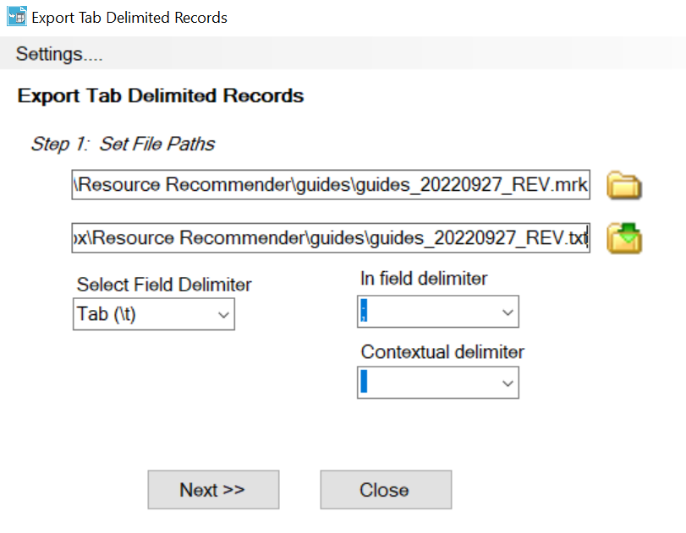
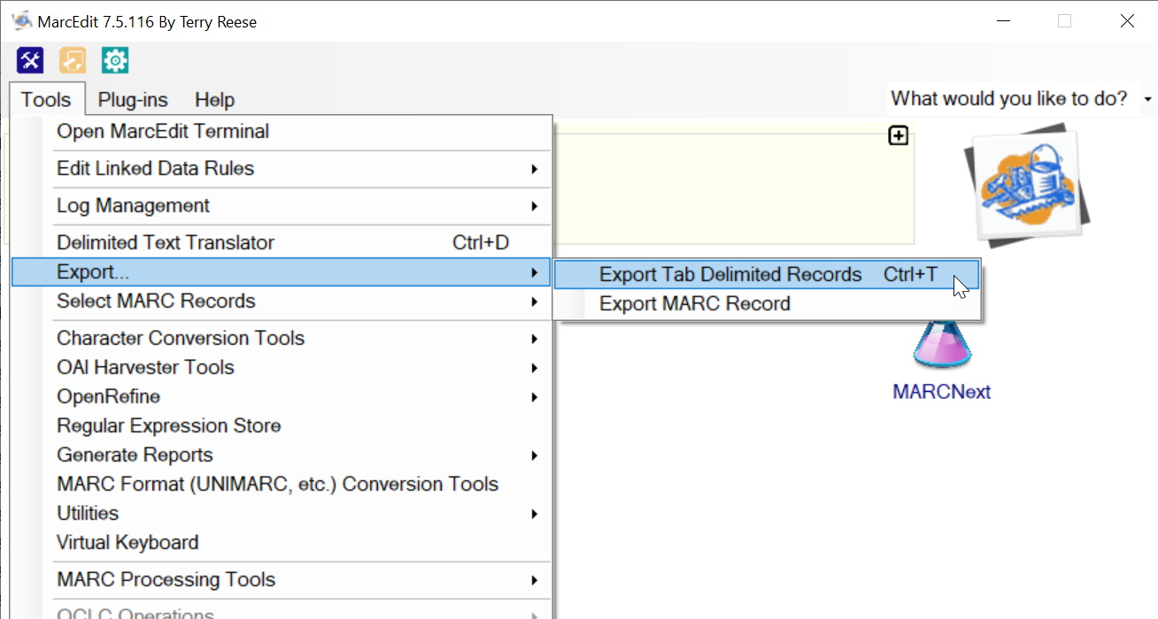
Step 3. Export Tab Delimited Records
Use semi-colon ; as field delimiter – this is separator in tag field
Select your .mrk file as source – you’ll need to specify “MARC Text Files (*.mrk)” to find them
Then enter a .txt file name as destination
– I just copy/paste the full .mrk path and change extension to .txt
And next…

Slide 30
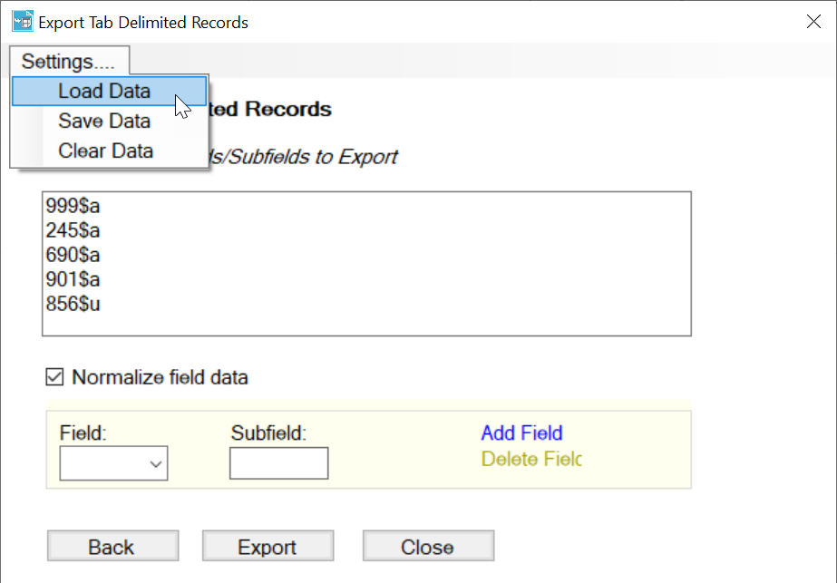
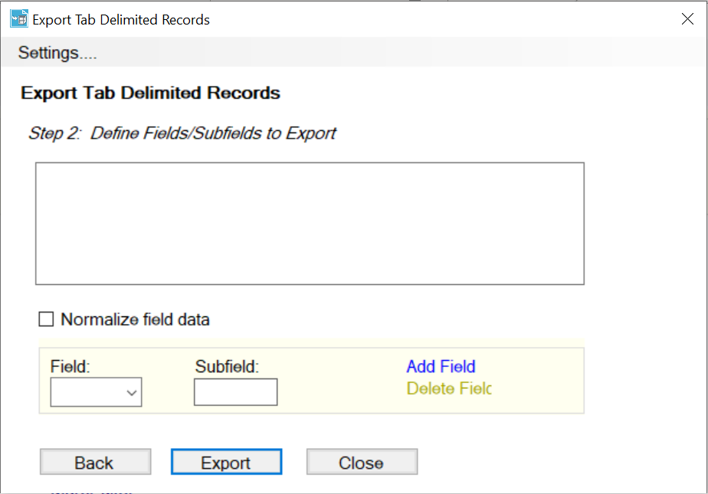
Export Tab Delimited Records, continued
You can add fields and subfields individually or better yet after you Add Fields once you can “Save Data” to create an export file that can be loaded to use every time. The settings shown here will use the field and subfield labels (ex: 999$a) as field names for the values. Multiple field occurrences will be combined into a single field.
Check “Normalize field data” and then Export.

Slide 31
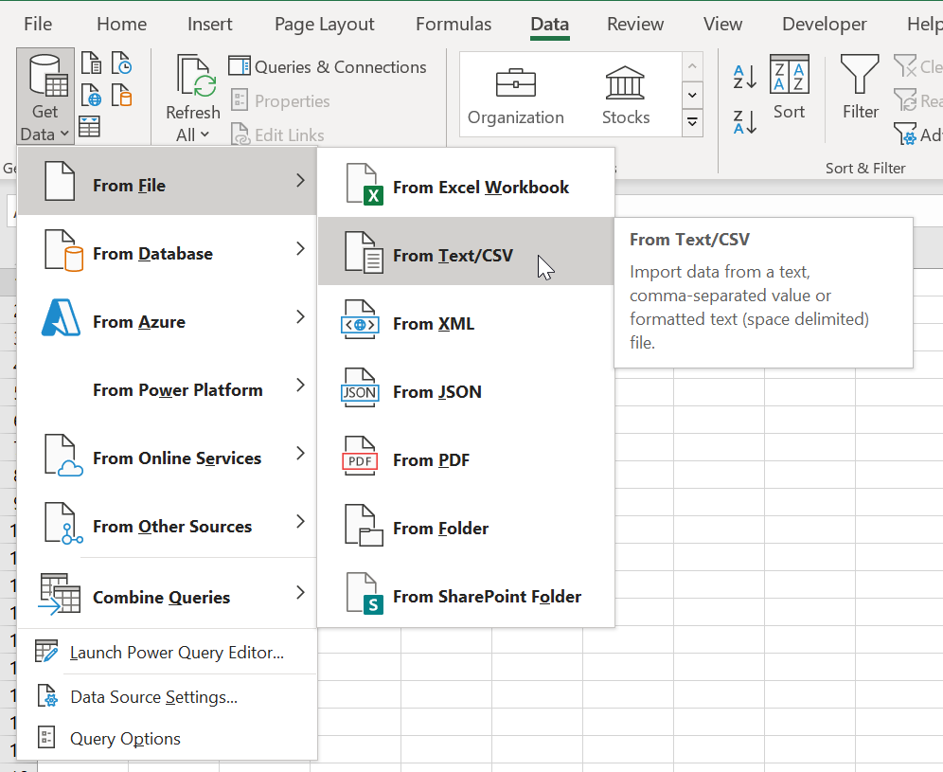
Step 4. Import to and final editing in Excel
Once the Delimited Text Record file has been created, open a new sheet in Excel and import the .txt file.
And NOW …

Slide 32
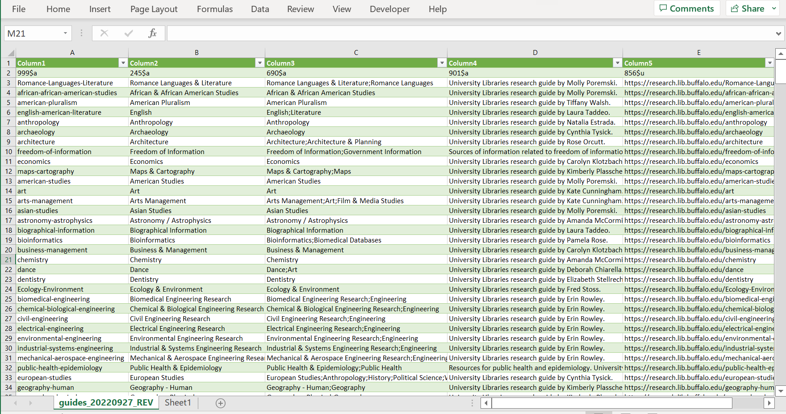
Voila!
Save this imported file as Excel and edit away!
The Excel file will be uploaded and imported to Alma Resource Recommender.

Slide 33
At this point, the Excel file contains almost everything needed to populate the Resource Recommender.
To do:
Change the column labels to match the appropriate Resource Recommender fields.
Add any additional fields needed to complete the Resource Recommender template -- only the required fields need to contain data, but additional fields need to be included in the file for upload.
Review the records for any errors or oddities.
Make any desired final edits, such as adding additional tags.

Slide 34
Resource Recommender Fields
Specific fields vary by Resource Recommender type. See “Resource Recommender for Primo VE: Importing Recommendations” for full description. https://knowledge.exlibrisgroup.com/Primo/Product_Documentation/020Primo_VE/Primo_VE_(English)/120Other_Configurations/010Resource_Recommender_for_Primo_VE#Importing_Recommendations
Tip: a great way to make sure you have all the fields and are using the exact field names needed is to download an existing Resource Recommender file from Alma.
If you don’t already have one, you can add a single entry and leave it inactive.
You can then copy the column headers from the downloaded file into your new file-in-progress – just be sure your data is in the correct columns.
The columns need to be in the specified order.

Slide 35
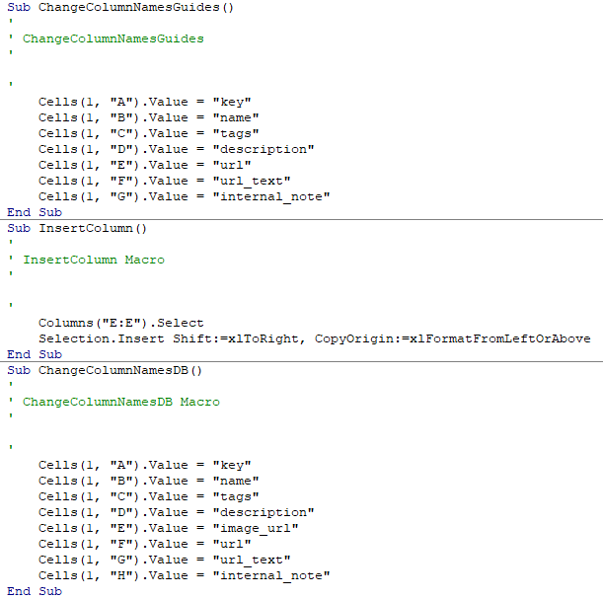
Using Excel Macros to Adjust Columns & Field Names
I’ve just started to use macros to adjust the columns for Resource Recommender – if you save a macro in your Personal Macro Workbook (PERSONAL.XLSB), you’ll be able to use it in any spreadsheet.
For Guides, I only need to change the column names (ex: Cells(1, "A").Value = "key" changes the header Column 1 to key), adding 2 extra columns at the end. I don’t need to add the columns separately; it’s sufficient to name them.
For AZ Databases, I need to insert a column to the right of the 5th column to accommodate the image_url field before the url field (I did this by selecting Column E:E and inserting to the right) and then changing and adding column headers.
Your exact needs may vary depending on your fields.
These macros make sure I have the appropriate number of fields, in the appropriate order, with appropriate headers, overwriting the Column 1, Column 2, etc. headers brought in from the delimited text file import. I still need to manually delete the 1st row to get rid of the MARC-oriented headers (this could also be accomplished via a macro).
Notes:
Sub ChangeColumnNamesGuides()
'
' ChangeColumnNamesGuides
'
'
Cells(1, "A").Value = "key"
Cells(1, "B").Value = "name"
Cells(1, "C").Value = "tags"
Cells(1, "D").Value = "description"
Cells(1, "E").Value = "url"
Cells(1, "F").Value = "url_text"
Cells(1, "G").Value = "internal_note"
End Sub
Sub InsertColumn()
'
' InsertColumn Macro
'
'
Columns("E:E").Select
Selection.Insert Shift:=xlToRight, CopyOrigin:=xlFormatFromLeftOrAbove
End Sub
Sub ChangeColumnNamesDB()
'
' ChangeColumnNamesDB Macro
'
'
Cells(1, "A").Value = "key"
Cells(1, "B").Value = "name"
Cells(1, "C").Value = "tags"
Cells(1, "D").Value = "description"
Cells(1, "E").Value = "image_url"
Cells(1, "F").Value = "url"
Cells(1, "G").Value = "url_text"
Cells(1, "H").Value = "internal_note"
End Sub

Slide 36
Example mapping for Resource Recommender Fields - YMMV
Resource Recommender fields | Needed for import? | MARC field equivalent in Excel file | To do:
active | no |  | ignore unless wanted
key | yes | Column1 999$a | rename column
name | yes | Column2 245$a | rename column
tags | yes | Column3 690$a | rename column
description | yes | Column4 901$a | rename column
url | yes | Column5 856$u | rename column
url_text | yes |  | add column; leave blank or fill in
always_display | no |  | ignore unless wanted
internal_note | yes |  | add column; leave blank or fill in
views | no |  | ignore unless wanted

Slide 37
Considerations for final edits
I find that typically the editing done in MarcEdit is sufficient for the key, name, description, and url fields. Excel is where I like to double-check for any data errors or oddities. Sometimes I find incorrect characters or diacritics, and certain diacritics and scripts won’t import correctly in Resource Recommender. (Note: if you encounter a consistent problem with particular characters, report to Ex Libris for help!)
Excel is also where I find it easiest to focus on the tags. Resource Recommender in Primo VE does not have the smart search enhancements available in Primo BO, so it’s necessary to add variant entries for spelling and spacing. Searching for Hein Online, for example, will not trigger HeinOnline unless you have explicitly added both versions as tags – and “Hein Online” would also need to be added if you expect a user might search with quotes.
Primo Analytics Zero Result Searches reports are a great source for common misspellings that can be added to the tags – JSTORE is a popular search for JSTOR, for example.
Other helpful Excel edits: adjusting key names to change sort order and any special requests (ex: a guide owner may request that a Subject used in LibGuides be removed from the Resource Recommender tags).
You may find it easier to do more editing in MarcEdit or in Excel, or prefer to automate more in MarcEdit with Tasks or in Excel with Macros. Whatever works!

Slide 38
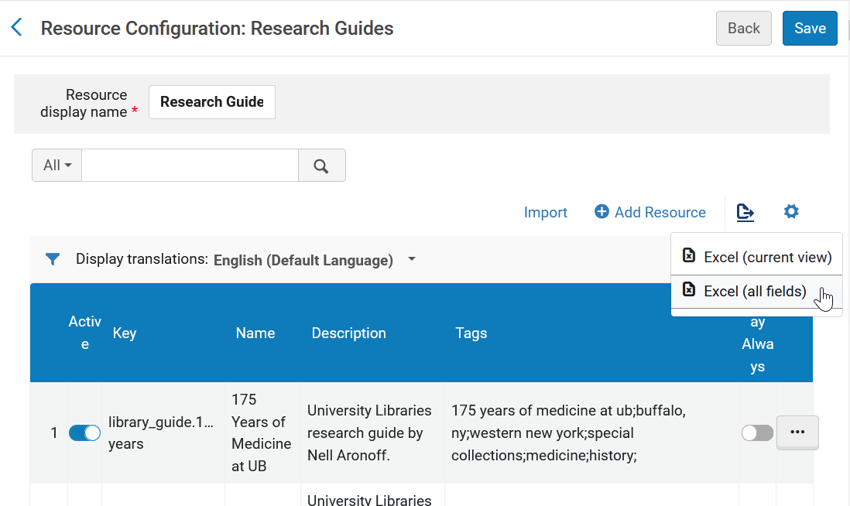
Step 5. Import Excel file to Alma
But first!
If you have an existing Resource Recommender, download a copy. Having this backup will be a great help if there is a problem with the import or you find anything amiss in the Primo display.
If needed, you can use the backup to revert to the previous version of your Resource Recommender; the “key” value is the only one you’ll need to amend. Alma prepends the resource recommender type to the key you assign, so you’ll need to delete that before re-uploading the downloaded file (ex: library_guide.freedom-of-information vs freedom-of-information).
Configuration > Discovery > Other >
Resource Recommender Configuration
Edit > Export List > Excel (all fields)

Slide 39
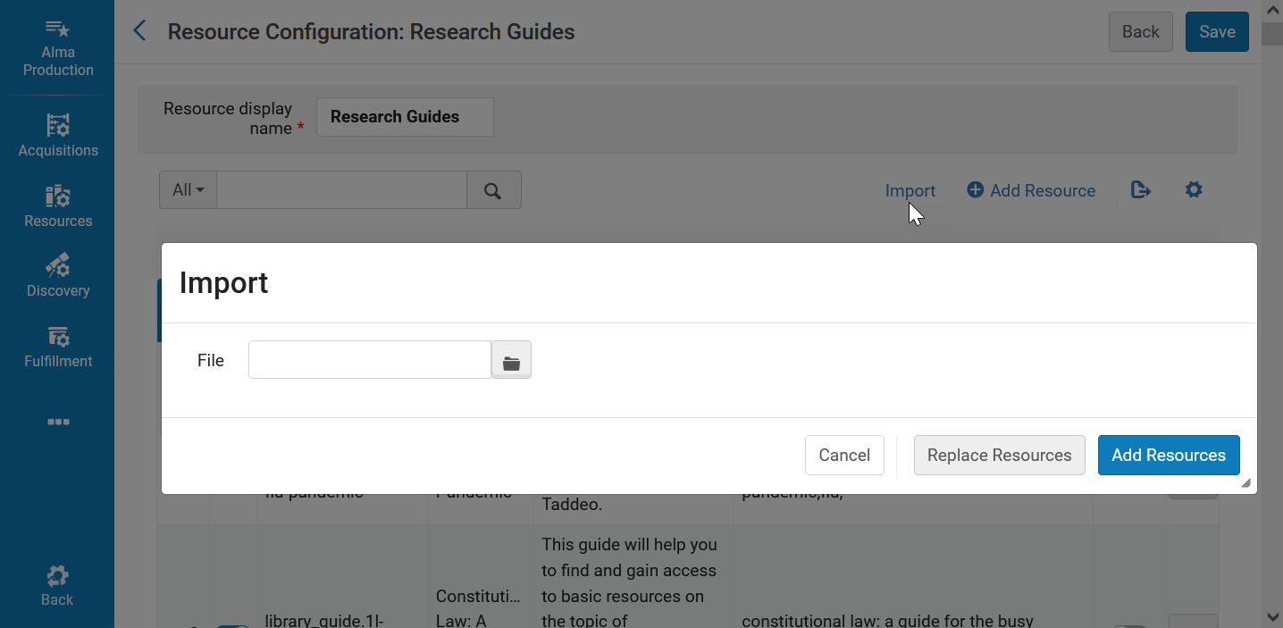
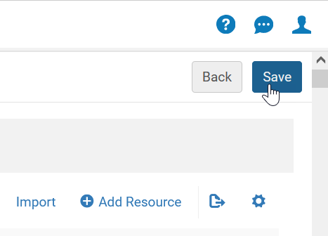
From Excel to Alma: importing the harvested & edited records into the Resource Recommender
Configuration > Discovery > Other > Resource Recommender Configuration > Edit > Import
Select the Excel file to upload and opt to Replace Resources (i.e. all existing entries will be replaced) or Add Resources to the existing entries. You’ll get an error if there are any problems, and if all is well you’ll just see the records. Be sure to Save to complete the process.

Slide 40
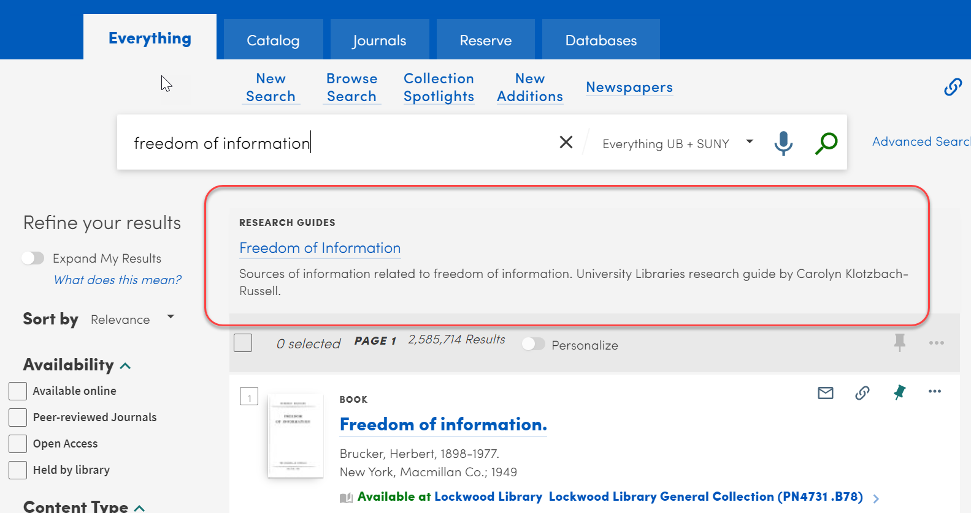
Step 6. Test display and functionality in Primo VE

Slide 41
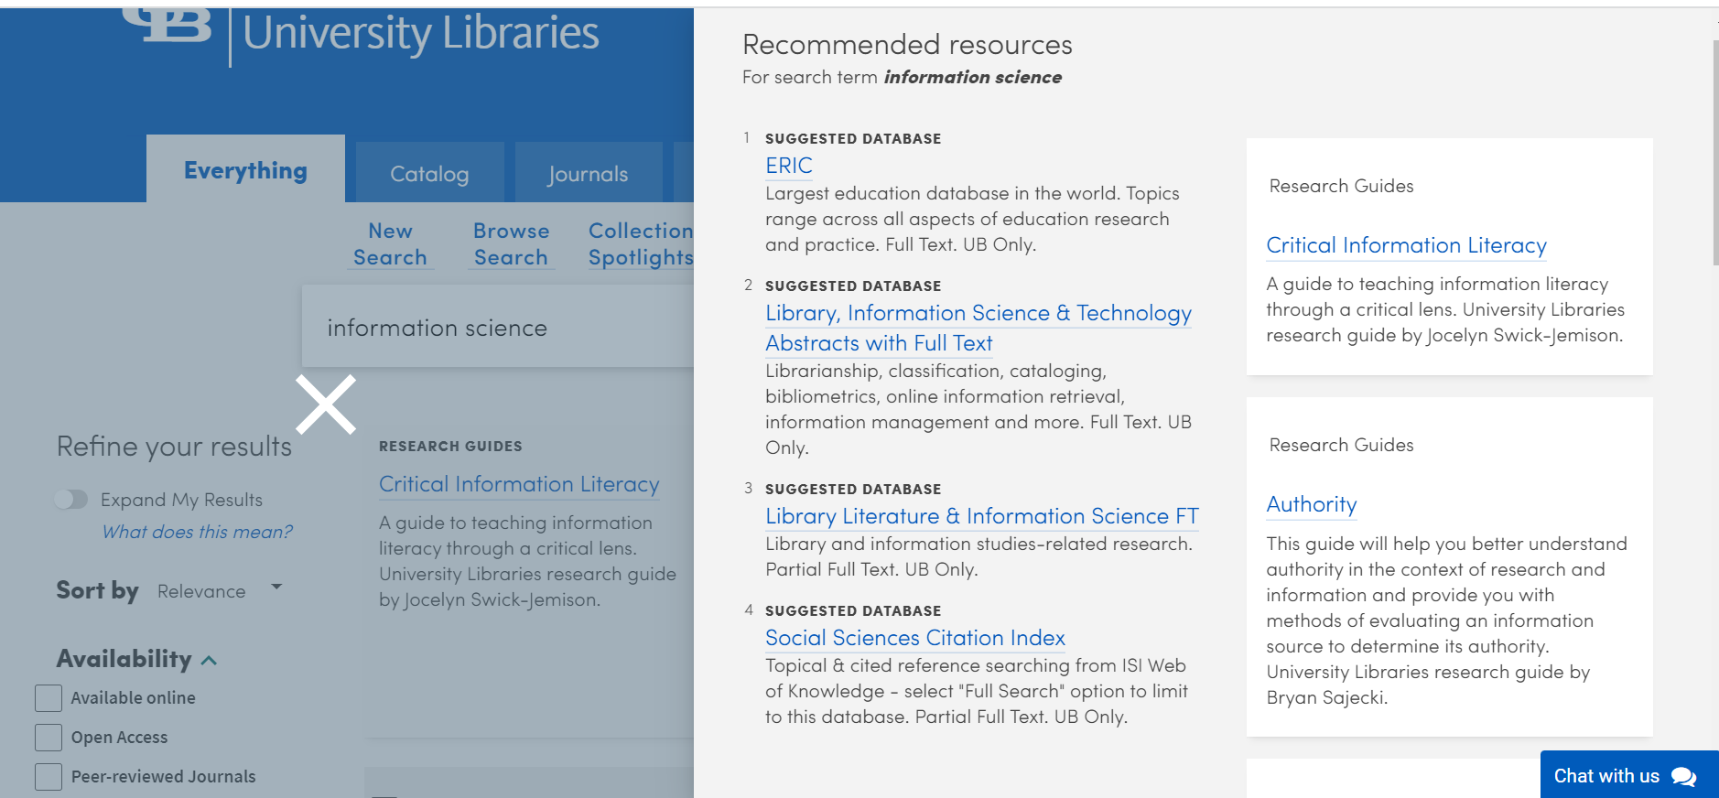
We have arrived!
However…

Slide 42
Isn’t that a lot of work?
Yes, the first time.
But just as you only need to create your Tasks in MarcEdit once to enable quick editing in the future, once you have created your original Resource Recommender from LibGuides sources, you can save time in the future by identifying only data that has changed, and then focusing only on those changes.
I was initially refreshing and replacing the guides harvest every month, but after a few months I found re-doing the tags challenging; once I had created the perfect set of tags, it seemed silly and time-consuming to re-do them every month for fields where nothing had changed.
Notepad++ to the rescue!

Slide 43
Step 7. Use Notepad++ to identify changes for selective update
Your LibGuides may be relatively static, requiring few changes, or constantly updating, requiring some vigilance to ensure that Resource Recommenders reflect the changes as quickly as possible.
Notepad++ is a free text and source code editor with some very helpful features, shortcuts, and plugins. It’s my go-to for editing everything from HTML to XML to CSV to JS to CSS to – whatever!
Notepad++ can be an especially helpful alternative to Excel when you find data being skewed in the import process – for example, those pesky MMS ID long integers!
I find Notepad++ indispensable for quickly editing and eyeballing text and I rely greatly on the COMPARE plugin, which allows you to quickly compare two files and identify the differences between them.
COMPARE* is how I save time with LibGuides > Resource Recommender updates, by quickly finding where revision is required, able to leave the
majority of entries alone.
You can do the same tasks with Excel or MarcEdit – but I use Notepad++ because it is so quick & easy, and I use it for everything.
https://notepad-plus-plus.org/
Note: Notepad++ is Windows software with no Mac version. Some Mac alternatives may be BBEdit (high-level code editor) and Brackets (lay-person level code editor) (both suggested in ELUNA Learns session), the native TextEdit, Atom, and VisualStudioCode.
* Now available - COMPAREPLUS

Slide 44
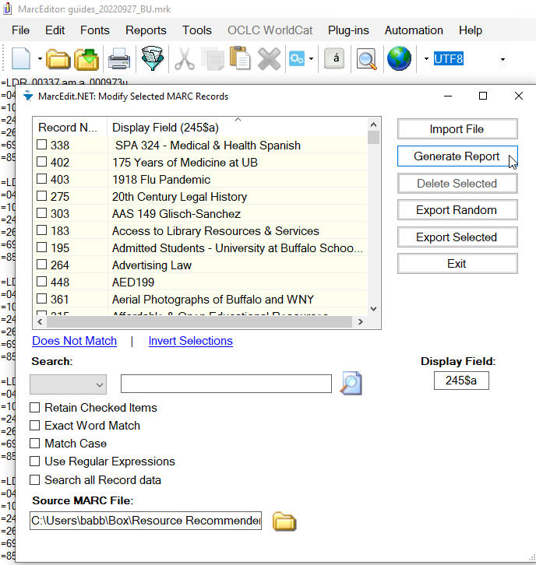
Identifying new and deleted guides
Here’s where the initially saved backup file comes in handy!
Harvest a new set of records.
In MarcEdit, select a consistent field (such as dc:title 245$a or dc:identifier 856$u) and generate a report of these values; save as a .txt file.
Repeat the process with your last backup .mrk file, saved at the last harvest.
File > Select Records for Edit > Display Field [ex: 245$a] > Import File
Sort by field > Select all records > Generate Report

Slide 45
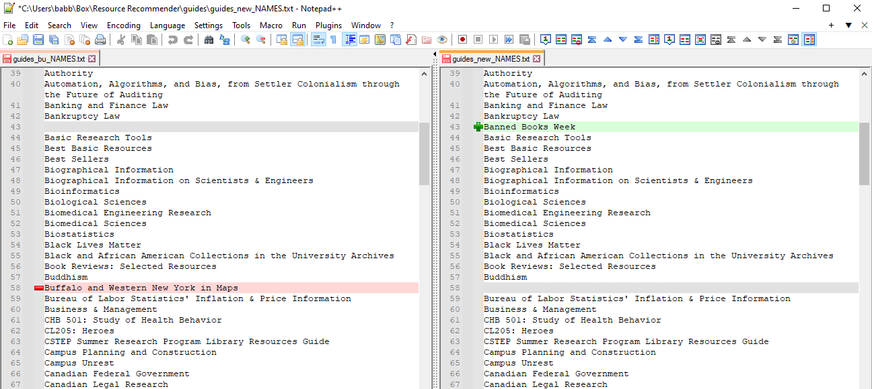
Identifying new and deleted guides - continued
Open both .txt files in Notepad++, delete the header and numbers, and run COMPARE.
Differences between the files will be highlighted.
Any entries that appear in the old file but not the new may be guides that have been unpublished that should be removed from the Resource Recommender. You can manually hide or delete these in Alma.
Any entries that appear in the new file but not the old may be newly created guides that should be added to the Resource Recommender. You can do this manually in Alma or use MarcEdit & Excel to edit & import only selected records.

Slide 46
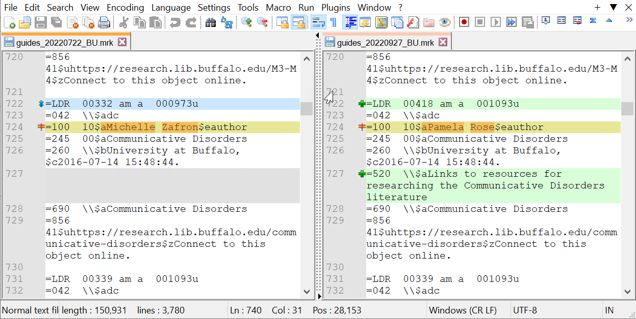
Identifying revisions to guides
Open both .mrk files in Notepad++ and run COMPARE. Differences between the files will be highlighted.
LDR changes probably not significant.
100$a change = new guide author
520$a change = description added
Revisions can be made individually in Alma or via selective record processing & upload/import via MarcEdit, Excel, etc.

Slide 47
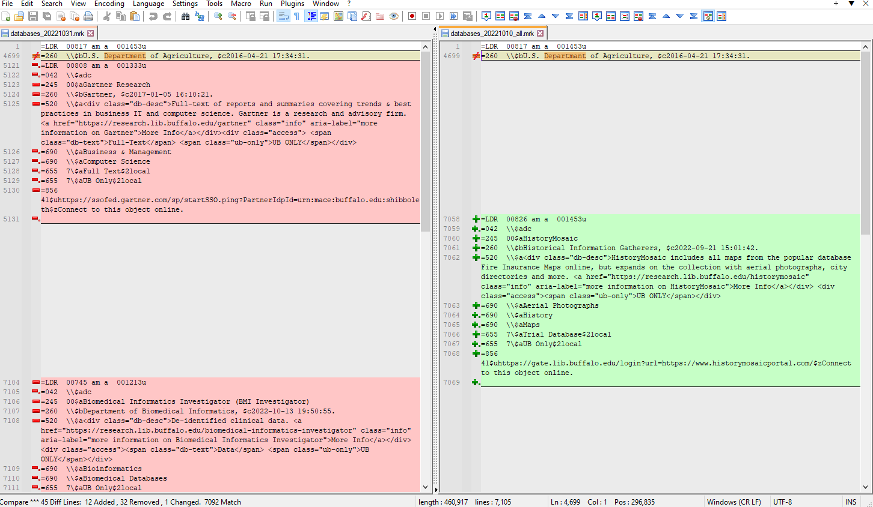
New and Improved!
Quicker identification of revisions with COMPAREPLUS
COMPAREPLUS is a newly released revision of COMPARE which includes the option of displaying ONLY the changes.

Slide 48
Initial setup
Summary
Use MarcEdit to harvest the desired set of records from LibGuides.
Edit the records in MarcEdit and Excel to fit Resource Recommender template.
Upload/import to Alma and test results in Primo VE.
Maintenance
Use MarcEdit to harvest the desired set of records from LibGuides.
Compare reports from or full text files of past and new records with Notepad++.
Make manual individual revisions in Alma or process selected records as for initial setup.

Slide 49
Additional options for automating
Batch harvesting jobs and
Scheduled Tasks

Slide 50
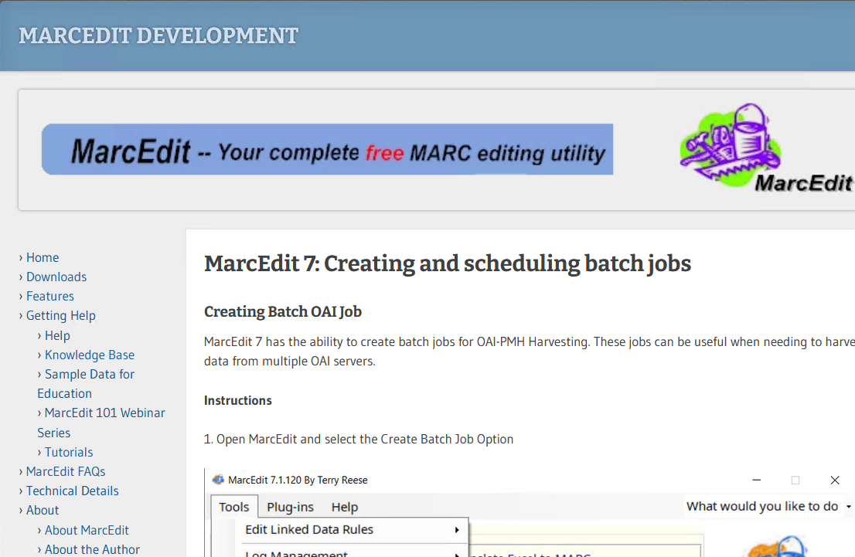
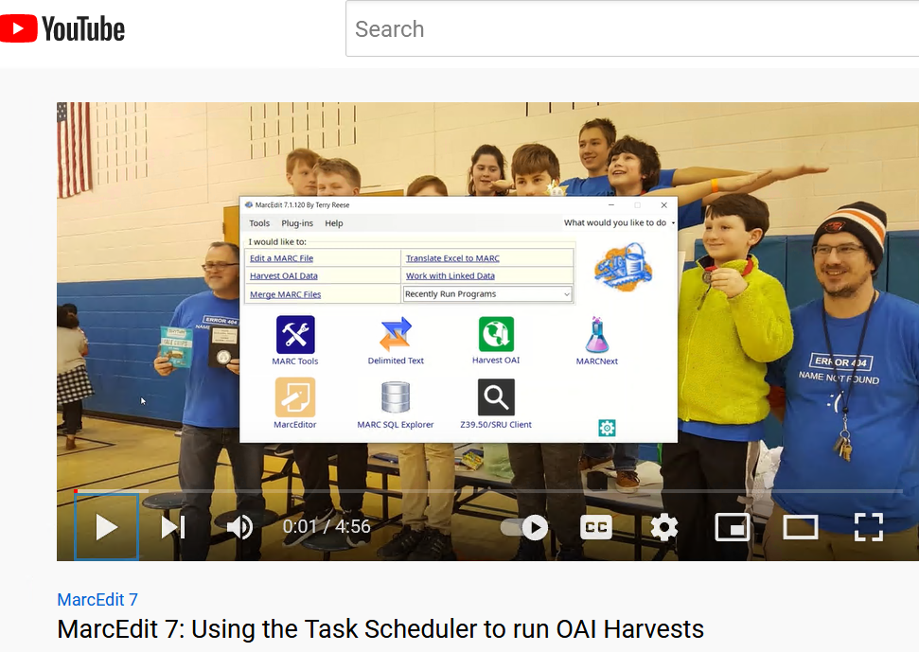
MarcEdit instructions from Terry Reese
Additional options
MarcEdit 7: Creating and scheduling batch jobs
https://marcedit.reeset.net/marcedit-7-creating-and-scheduling-batch-jobs
YouTube video: MarcEdit 7: Using the Task Scheduler to run OAI Harvests https://youtu.be/saS0WJgkOrU
MarcEdit creator Terry Reese has shared excellent instructions for creating and scheduling batch OAI harvest jobs. The following slides are examples from my library, configured per Terry’s instructions.

Slide 51
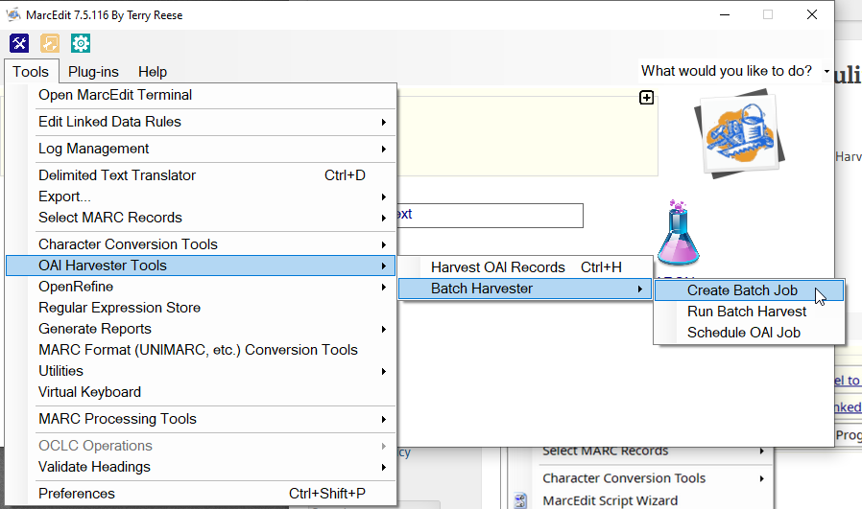
Creating a Batch OAI Job
Additional options
MarcEdit supports batch jobs for OAI-PMH Harvesting. This functionality enables harvesting data from multiple OAI servers and can also be used to further automate the harvesting process, with incremental harvesting and in support of quick data checks.
Batch jobs will be incremental from last time run unless the .ai file is revised to clear that date.

Slide 52
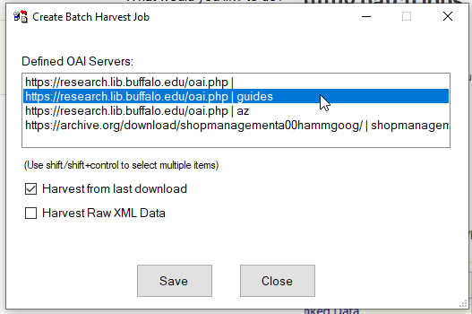
Selecting the OAI server, sets, and output type
Additional options
Select the desired servers and sets and whether to Harvest from last download or Harvest Raw XML Data.
If no set is indicated, all available sets/records will be harvested.
Ex: oai.php | guides = guides
oai.php | az = A-Z entries
oai.php | = both guides & az
Harvest from last download = .mrk output The date within the .oai file is updated each time the batch job is run, with next run incremental from that date. To reset, delete date from within the .oia file
Harvest Raw XML Data = multiple source XML files

Slide 53
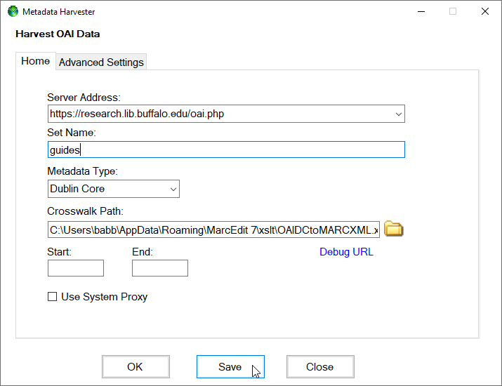
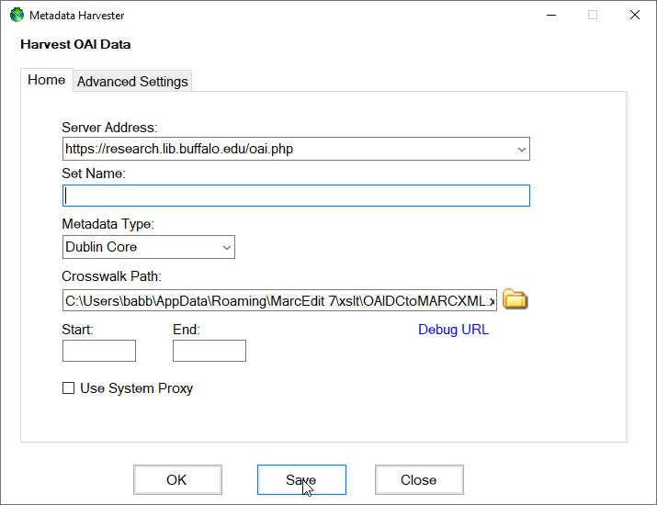
Saving settings to make them available for batch
Additional options
If the servers/sets you need aren’t displaying as Defined for selection, you can Save them – open Harvest OAI Records, enter criteria, and save. You don’t need to run the harvest. Then you should see them in the list for Batch Harvesting.
Only guides from oai.php
All available set/records from oai.php

Slide 54
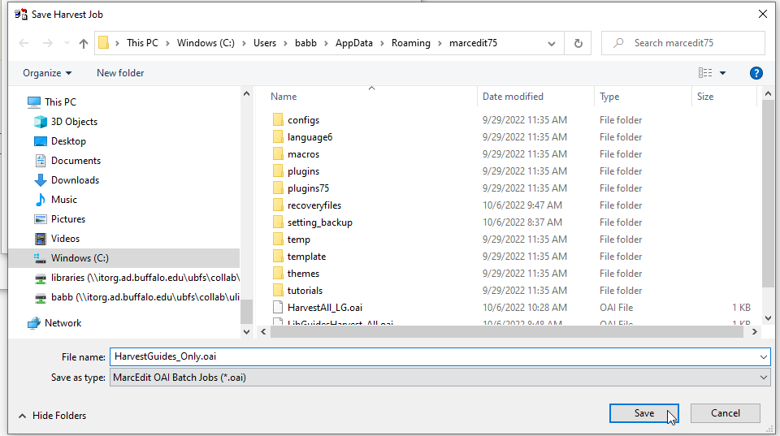
Saving the batch job
Additional options
The marcedit directory may be suggested by default; this seems reasonable unless you need to save elsewhere. You will need to be able to find and select the job to kick it off manually or to add to other processes. The extension for MarcEdit OAI Batch Jobs is .oai.

Slide 55
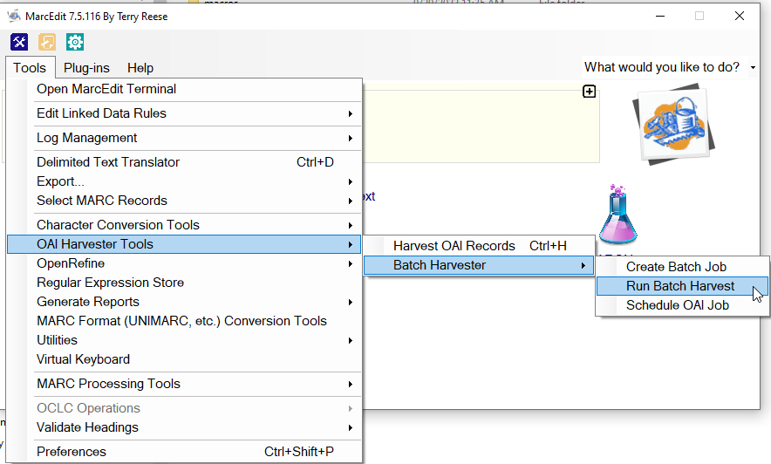
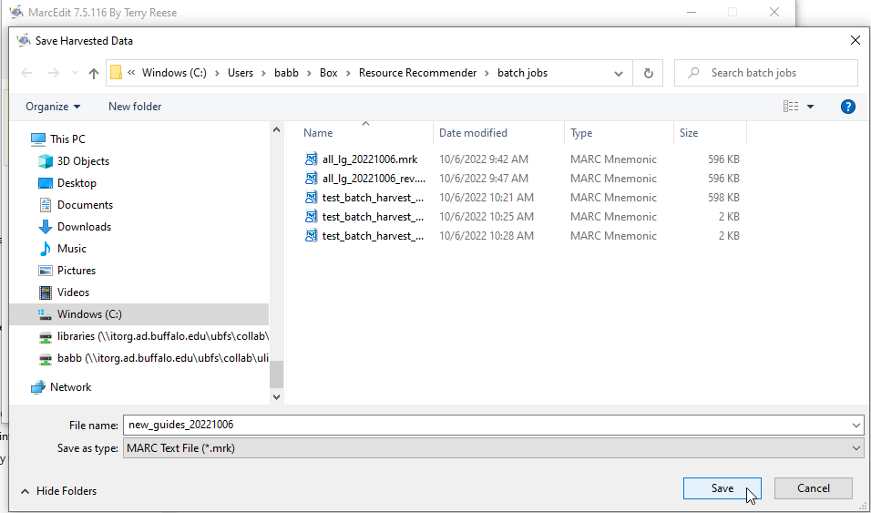
Running the batch job
Additional options
When you run a batch job or add it to a process, you’re prompted to define a destination for the output. If Harvesting from last update you should provide .mrk file name and location. If harvesting raw xml, you just need to provide a folder location.

Slide 56
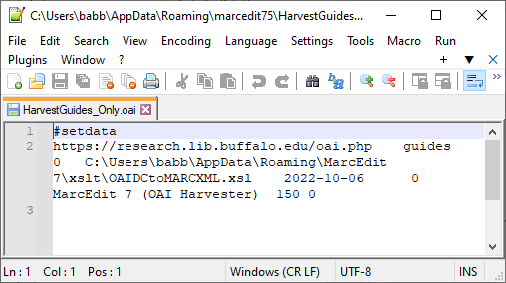
Incremental harvests and LibGuides
Additional options
The text within the batch job mirrors the fields in the Harvest OAI window.
The “From” date is populated by the current date when the batch job is run, and so the next run will harvest “From” that previous date.
In this example, the batch job was run on October 6, 2022, so the next time the job is run the harvest will include only changes since October 6, 2022.

Slide 57
Incremental harvest caveat for LibGuides
Additional options
When harvesting our “guides” set, I’ve found that revisions to any area of a guide will be noted as an update, but the only changes that impact the Resource Recommender are changes to the metadata. You can’t tell by the update date alone where the change has occurred; I don’t know of a way to limit harvest only to metadata changes. As a result, I would find many records in the incremental harvest that required no revision to the Resource Recommender.
It is more difficult and time consuming to sort out the records with metadata changes from an incremental harvest than it is to compare two sets of records that will be identical except for metadata changes. So I opt to do a full harvest instead of incremental.
The harvest of A-Z Database list entries, on the other hand, has briefer information included than the guides do, and incremental changes are more likely to signify metadata changes.
I find it simplest to harvest everything at once and compare the full lists for any metadata changes – but incremental may work well for your particular set of resources.

Slide 58
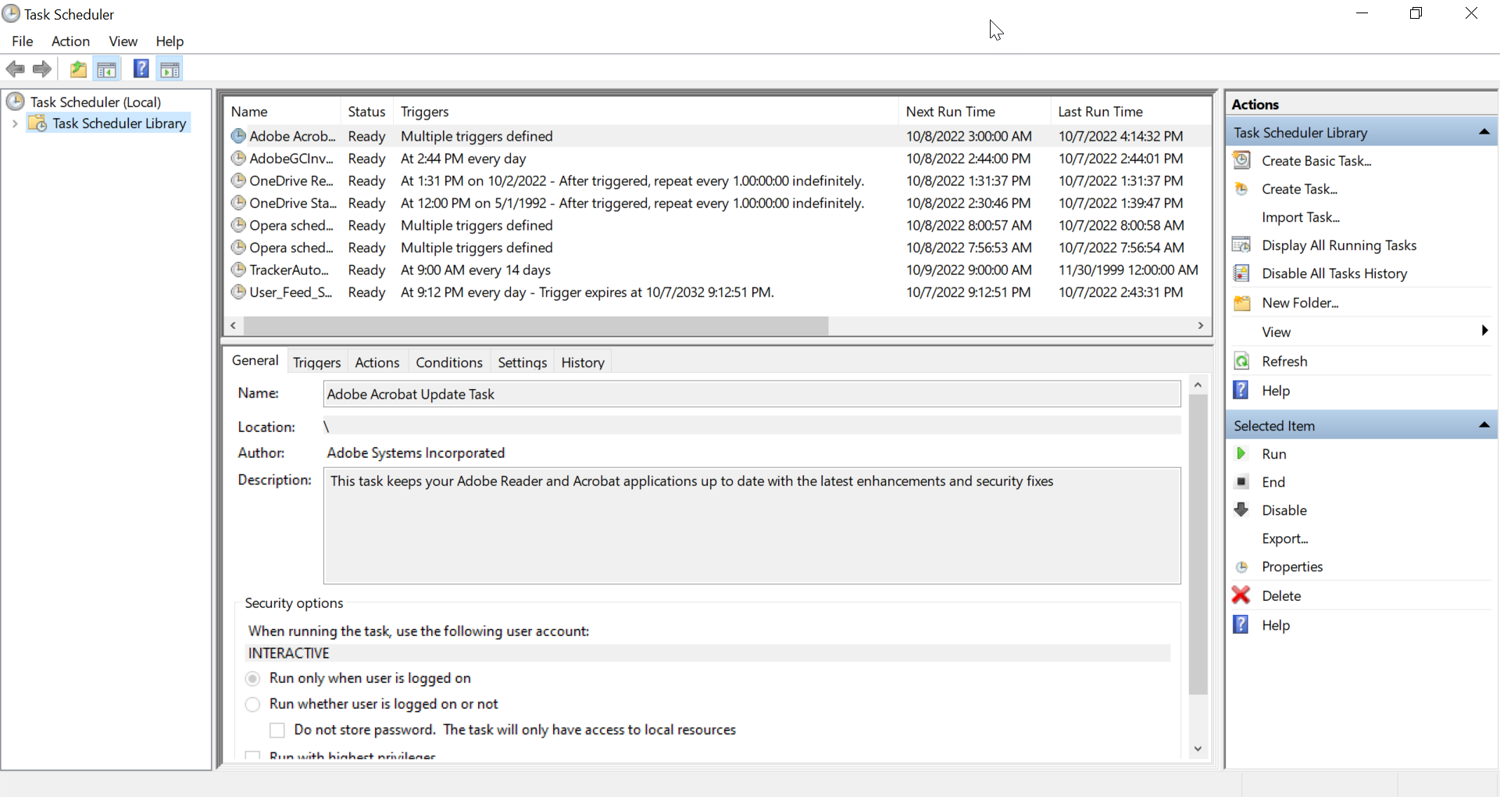
Scheduling a job in Windows Task Scheduler
Additional options
Selecting OAI Harvester Tools > Batch Harvester > Schedule OAI Job will open the Window Task Scheduler. Alternately, you can open it by going to Windows Administrative Tools > Task Scheduler.

Slide 59
Scheduling a job in Windows Task Scheduler
Additional options
The first time you schedule a MarcEdit OAI Task, you may wish to create a separate folder within the Windows Task Scheduler Library. You can then create and manage your tasks within this folder.

Slide 60
Creating the task - General
Additional options
Actions >
Create Task
General tab:
Assign a name and location. Description is optional.
Be sure to select/change to the correct version of Windows or the task won’t work.

Slide 61
Creating the task - Triggers
Additional options
Triggers tab:
Here is where you select frequency and times for the task to run.
It should be “Enabled” by default, and you can uncheck this to prevent or pause a regularly scheduled job.

Slide 62
Creating the task - Actions
Additional options
Actions tab:
Action: Start a program
Program/script: [MarcEdit]
Note: if you start Task Scheduler from MarcEdit, “Browse” should open the MarcEdit is in so you can easily select MarcEdit.exe

Slide 63
Creating the task – Add Arguments
Additional options
Actions tab:
Action: Start a program
Program/script: [MarcEdit] Add arguments
Add arguments is where you define the scheduled job and point to both program source and output destination. The source and destination are the same criteria as when Saving and Running the batch job.
For example:
/oai C:\Users\babb\AppData\Roaming\marcedit75\ HarvestAll_LG.oai C:\Users\babb\Box\MarcEdit\batch\latest.mrk
Program Source Output Destination
/oai C:\Users\babb\AppData\Roaming\marcedit75\HarvestAll_LG.oai C:\Users\babb\Box\MarcEdit\batch\latest.mrk
where you have saved your oai job and what you’ve called it the folder & file name you’ve specified

Slide 64
Additional options
Once the task has been created, enabled, and saved, you should see it in your task list, within the folder you created for OAI tasks, and if all goes well it should run as scheduled.
The output file will be changed each time the scheduled job is run.

Slide 65
Please consider sharing with the Primo/Primo VE and SUNY communities, via the Alma-L/Primo-L discussion lists, SUNY Basecamps, and other forums.
For your consideration
Are there other tools and techniques you’ve found useful?
Are there additional tips and tricks you rely on?
Have you used these tools or techniques for other developments?
!

Slide 66
References
University at Buffalo Libraries Research Guides https://research.lib.buffalo.edu/
University at Buffalo Libraries A-Z Databases https://research.lib.buffalo.edu/az.php?a=all
University at Buffalo Libraries Primo VE https://search.lib.buffalo.edu
Ex Libris documentation: Resource Recommender for Primo VE https://knowledge.exlibrisgroup.com/Primo/Product_Documentation/020Primo_VE/Primo_VE_(English)/120Other_Configurations/010Resource_Recommender_for_Primo_VE
Springshare documentation: Data Exports: Harvest your LibGuides data as XML via OAI-PMH https://ask.springshare.com/libguides/faq/804
MarcEdit https://marcedit.reeset.net/
Notepad++ https://notepad-plus-plus.org/
ELUNA listservs, including Alma-L and Primo-L https://el-una.org/about/mailing-lists/
IGeLU/ELUNA SIWG Slack https://igelu-eluna-siwg.slack.com
MarcEdit 7: Creating and scheduling batch jobs https://marcedit.reeset.net/marcedit-7-creating-and-scheduling-batch-jobs
MarcEdit 7: Using the Task Scheduler to run OAI Harvests (YouTube video) https://youtu.be/saS0WJgkOrU

Slide 67
Questions? Suggestions? Want to brainstorm or compare notes?
Nancy Babb
Discovery Services Librarian
University Libraries
University at Buffalo
State University of New York
Buffalo, New York 14260-1110
phone (716) 645-0394
e-mail babb@buffalo.edu
https://search.lib.buffalo.edu

