Slide 1


Presentation for Live Green CT
Proprietary & Confidential
JuiceBar® Copyright 2020

Slide 2
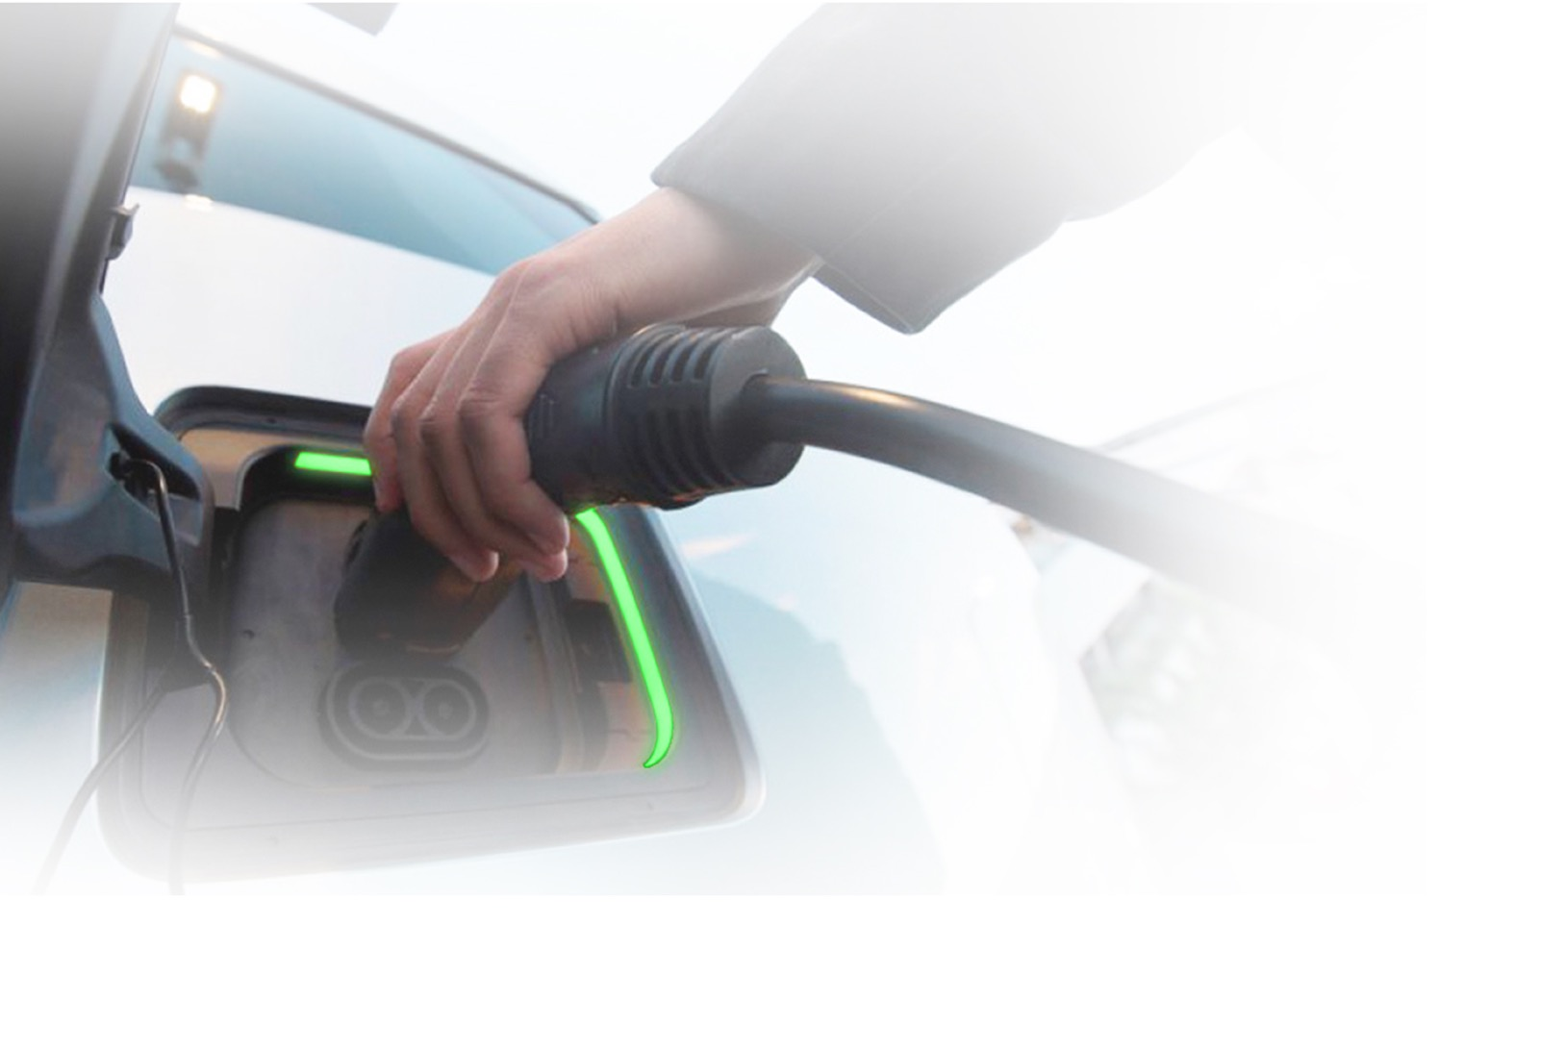

JuiceBar’s Mission
BUILD A NATIONAL EV CHARGING INFRASTRUCTURE THAT SUSTAINS THE ENVIRONMENT FOR FUTURE GENERATIONS.
EV Chargers deployed across 101 cities in the United States and Canada
Domestically sourced materials and manufacturing
Recognized for our superior customer service and our products’ elegant, timeless and resilient design
Solution-driven/education-first approach and business model
Strength is guiding our customers through a seamless and cost-effective transition to e-mobility with the highest degree of competence and integrity
JuiceBar® Copyright 2020 Confidential

Slide 3
Agenda:
EV Industry & Trends
Current Challenges
Introducing the Gen 3 Series
Special Offers
Discussion
JuiceBar® Copyright 2020 Confidential

Slide 4
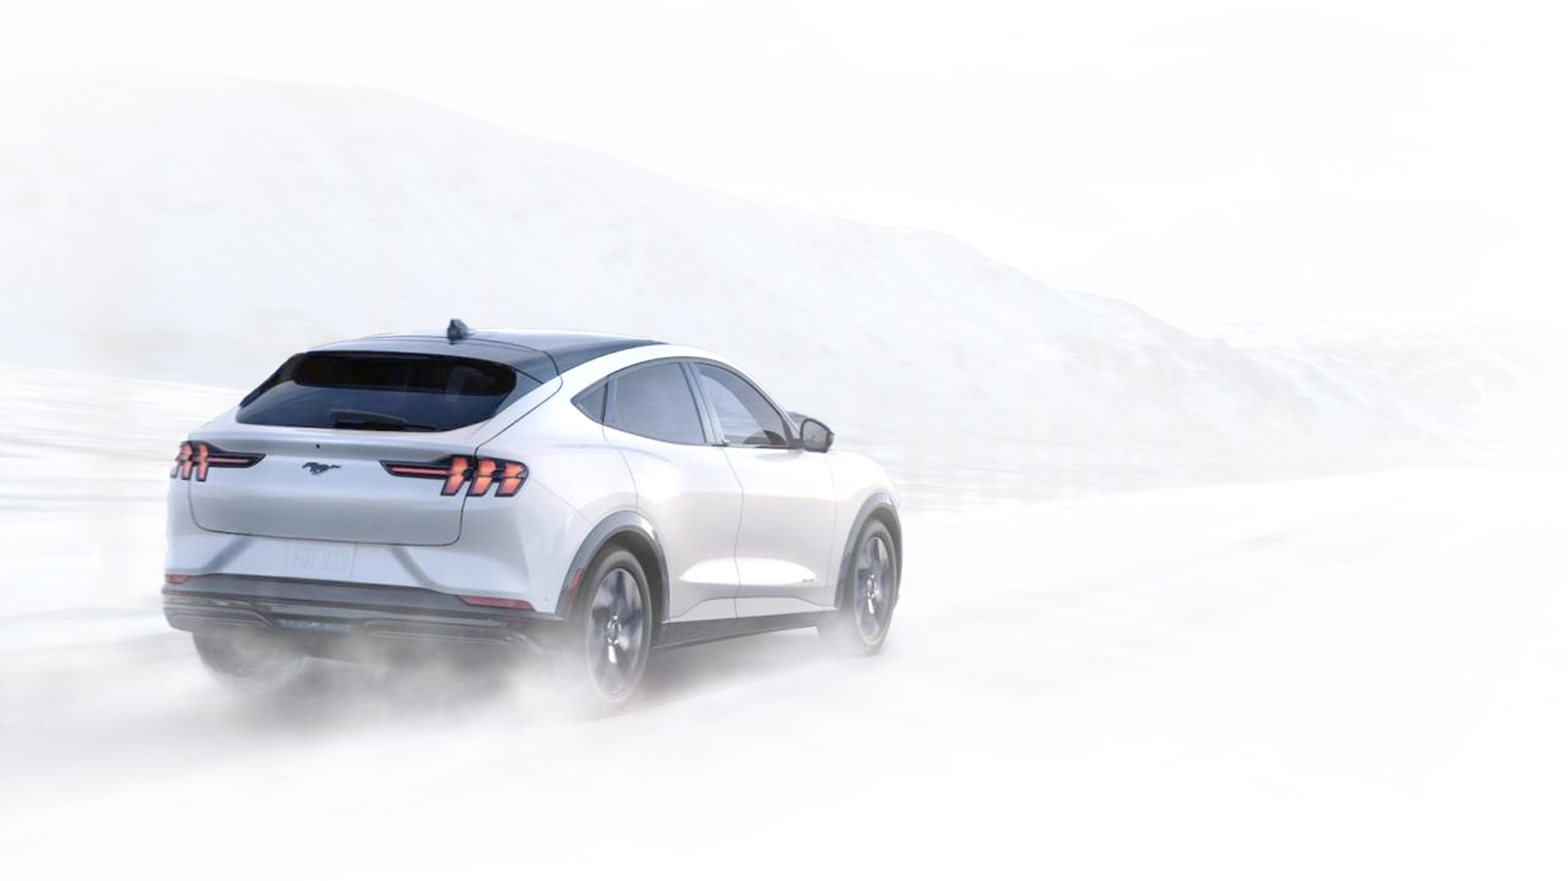
36% of U.S. drivers
will buy an EV for
their next car
200+ new EV models
launching in next 24 months
in anticipation of this demand
Consumer Reports Aug 2019
McKinsey & Company: Charging Ahead: Electric Vehicle Infrastructure
JuiceBar® Copyright 2020 Confidential

Slide 5
Automakers are investing
$300 BN in EVs & Batteries
JuiceBar® Copyright 2020 Confidential

Slide 6
Infrastructure Growth
US charger infrastructure expanding rapidly--circa 2 million U.S. connectors to be installed by close of 2020
Growing to 13 million by 2030
Estimated number of chargers ¹
(millions)
Great Success Stories: NYSERDA/NAT; GREEN NEW DEAL
¹ Figures may not sum, because of rounding.
McKinsey & Company: Charging Ahead: Electric Vehicle Infrastructure
McKinsey & Company: Charging Ahead: Electric Vehicle Infrastructure
JuiceBar® Copyright 2020 Confidential
Notes:
6:1 VS. 20:1

Slide 7
Drivers are motivated by falling prices of Electric Vehicles
Batteries represent ~33% of the cost of an EV; prices have fallen 79% in the last 7 years
EV purchase prices (before incentives) projected to reach parity with ICEs by 2024
Massive investment in the sector as significant innovation underway in battery technology
JuiceBar® Copyright 2020 Confidential

Slide 8




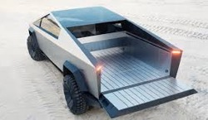



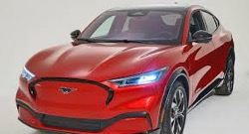


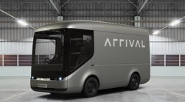

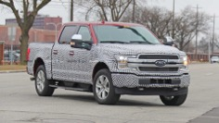




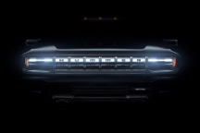
…And By New Model Choices
Kia Soul
Hyundai Kona EV
Nissan Leaf Plus
Tesla Model 3
Tesla Cybertruck
Kia Niro
Mini Electric
VW ID range
Volvo XC40
Ford Mach-E
Mercedes Esprinter
Mercedes EQC
Arrival Gen 2.0
Audi E-Tron
Ford F-150 EV
Bollinger B1
Rivian R1T
Porsche Taycan
Tesla Roadster
GMC Hummer EV
JuiceBar® Copyright 2020 Confidential

Slide 9
Yet…Too Few EV Charging Stations
20:1 Ratio EVs to Chargers
JuiceBar® Copyright 2020 Confidential

Slide 10



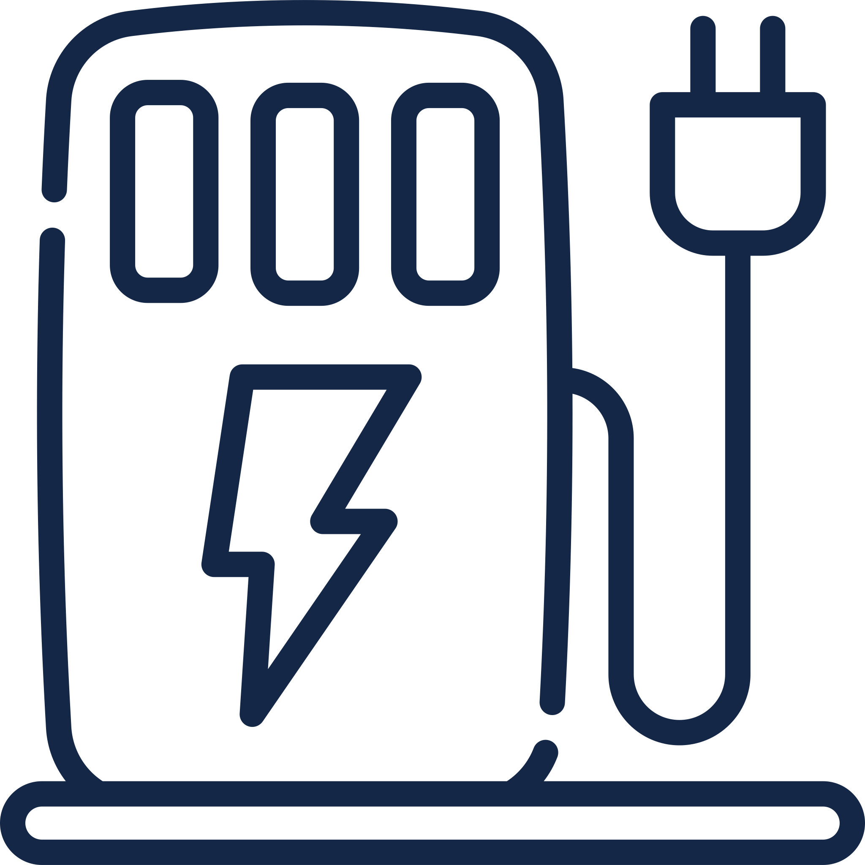
More than 50% of drivers want
EV charging stations where they
live and work
Consumer Reports Aug 2019
JuiceBar® Copyright 2020 Confidential

Slide 11
Buyers Wishlist:
EV charging solution that is:
affordable, reliable and scalable
addresses the current and future needs of their EV driving customers
JuiceBar® Copyright 2020 Confidential

Slide 12
Yet Most EV Chargers Do Not Meet These Needs
Poor user experience
General reliability and customer service is poor
Hardware is tied to proprietary networks
Difficult to integrate with building management/other systems
Equipment operating costs are high
Designs are poor
Underpowered (30 amp)
Poor cable management (from gas stations)
JuiceBar® Copyright 2020 Confidential

Slide 13
EV Charging Levels and Industry Standards:
Level 1 – 110 Volt system/15 amps – approximately 5 miles of range per hour
Level 2 – 208/240 Volt system/40 or 50 amp – approximately 25 miles of range per hour; accounts for 90% of charging needs
Level 3 (or DC Fast Charger) – 480 Volts/100 amps – will charge a car to completion in approximately 45 minutes
Industry Standards (Society of Automotive Engineers - SAE):
Level 2 is recommended form of charging for all vehicles
JuiceBar® Copyright 2020 Confidential

Slide 14



Why EV Chargers Benefit Commercial Buyers:
Apartments
Multi-family
Attract and retain tenants and customers
Generate New Revenue
Brand enhancement and first mover advantages
Add employee benefits
Fleets reduce operating expenses
Parking
Cities &
Towns
Retail &
Hotels
Workplace
Fleets
JuiceBar® Copyright 2020 Confidential

Slide 15
Introducing JuiceBar Gen 3 Series
Advancing E-Mobility
JuiceBar® Copyright 2020 Confidential

Slide 16
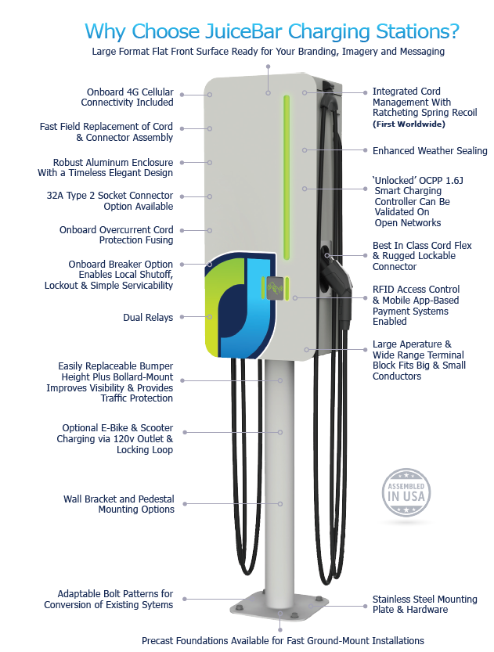
JuiceBar® Gen 3
FAST & SAFE
CUTTING-EDGE TECHNOLOGY
UNSURPASSED CUSTOMER EXPERIENCE
JuiceBar® Copyright 2020 Confidential
Notes:
DURABLE & REPAIRABLE
UNLOCKED NETWORK
Faster:
40-amp: 25% faster
50 amp: X% faster
80-amp: 200% faster
Reliable - all metal construction, built for northern winters
Choice - open network
User Experience - tested across 20,000 chargers in Europe
Advanced power management
Cost Effective to own and run
Customizable
Industry Leading Customer Support

Slide 17
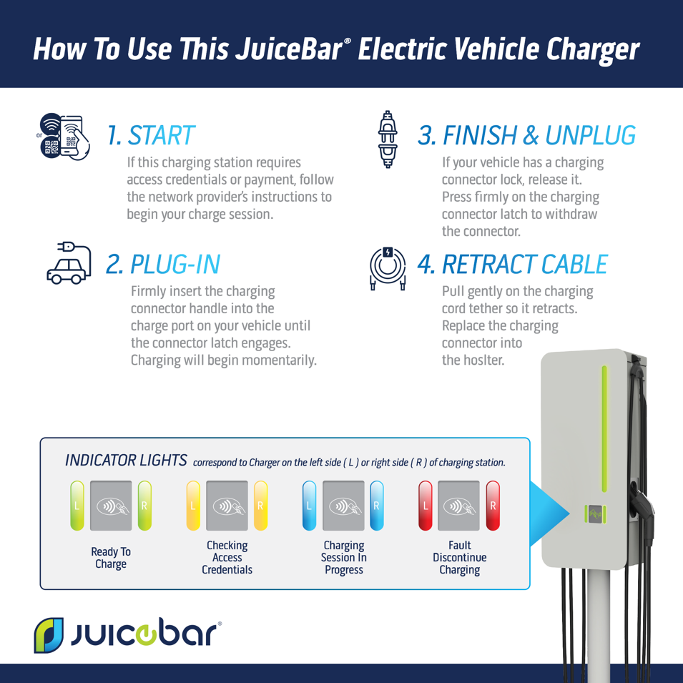
Gen 3
Advanced & Smart Charging Features, Yet
Simple To Use
JuiceBar® Copyright 2020 Confidential
Copyright JuiceBar Confidential

Slide 18
Gen 3
Meeting the need for speed for today’s and tomorrow’s EVs
JuiceBar® Copyright 2020 Confidential

Slide 19





Targeted Solutions That Match Your Customer’s Charging Time Needs
Commercial EV Charging
AC Destination
DC Destination
DC Fast
DC High Power
3-22 kW
20-25 kW
50 kW
150-350 kW
4-6 hrs
1-3 hrs
20-90 mins
10-20 mins
Single Family
Multi-Family
Workplace
Hotels
Hospitals
Recreation
Campus Charging
Retail/Grocery
Restaurant
Gym
High-Turnover Lot
Valet
Dealerships
Hospitality
Convenience Stores
Casinos
High Turnover Parking
Valet
Convenience Stores
Community Charging Hubs
Highway Corridor Travel
Commercial Vehicles
Taxi, Livery, Ride Hailing/Car Sharing Fleets
Auto Racing
JuiceBar® Copyright 2020 Confidential

Slide 20
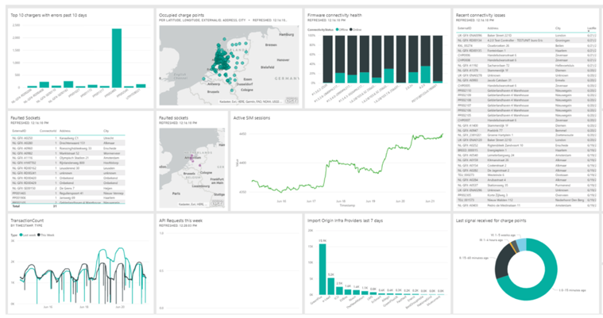
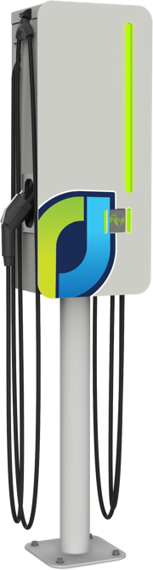
Data at Your Fingertips
JuiceBar® Copyright 2020 Confidential

Slide 21


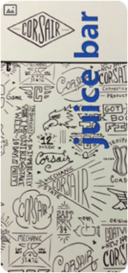
Customized Branding For Charging Stations
Customized branding via UV resistant vinyl graphics
Draw sponsorship or generate advertising revenues
Associate site host with sustainable infrastructure
Organically reach consumers in the retail environment
Add an optional branded rear marketing panel to increase brand immersion
  Trademarks appearing here are the respective property of their owners.
JuiceBar® Copyright 2020 Confidential

Slide 22

We Have Your Back with Powerful Payment Solutions
OUR BEST OFFER EVER!
Reduced Deposit Required from 50% to 15%
All Lease Payments deferred
Volume discounts
Quarterly Payment Options
JuiceBar® Copyright 2020 Confidential
Notes:
6:1 VS. 20:1

Slide 23
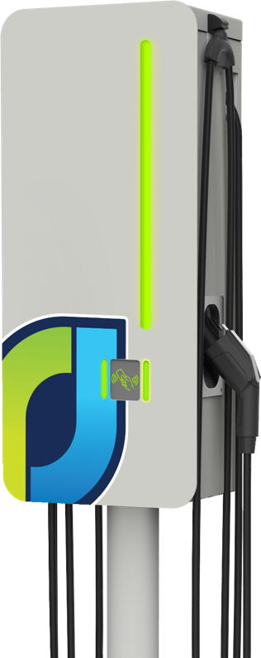
Why Leasing Is A Great Option
Less than $5/day*
Smart Charging Network is Included
5 Year Warranty
*Includes equipment and network license; does not include the cost of electricity
JuiceBar® Copyright 2020 Confidential
Notes:
Lease through Oasis Finance Corporation

Slide 24
JuiceBar’s EV Charger Leasing Solutions
JuiceBar® Gen 3 Charger | Description
One-stop Leasing/Financing | Low monthly payments Internally financed operating lease Tax advantages Ability to share total costs amongst tenants
Predictability | All inclusive smart charging network, maintenance and extended warranty
Flexible End-of-Lease Options | Continue payments Return Buyout based on residual value and/or Upgrade
Pricing Package | Latest Gen 3 dual port charger pedestal/wall mount, proprietary cord management, graphic wrap, smart network Dashboard monitoring and reporting Industry leading support and extended warranty
VIP Status | Ability to lock-in future pricing Front of the line delivery and installation
Includes
JuiceBar® Copyright 2020 Confidential
Notes:
Lease through Oasis Finance Corporation

Slide 25
Too Good To Ignore in Current Environment
VALUABLE INCENTIVES
30% Investment Tax Credit (ITC) for All States
State and utility company rebates available in many states
JuiceBar® Copyright 2020 Confidential
Notes:
6:1 VS. 20:1

Slide 26


















Thrilled To Be Working With The Best
JuiceBar® Copyright 2020 Confidential

Slide 27

National Presence in Over 100 Cities
Corporate HQ:
South Norwalk, CT
Operations Center:
East Hartford, CT
Engineering & Technology Center: Oxford, CT
Manufacturing Facility: Brockton, MA
West Coast Office: Emeryville, CA
JuiceBar® Copyright 2020 Confidential

Slide 28

Industry Leading Reputation for Customer Service
JuiceBar is assisting One Parking in delivery of our mission statement “A Partner Not a Vendor” by being a true partner at our client facilities. JuiceBar is passionate about delivering excellent service and their reputation is built on putting customers first. JuiceBar approaches each site survey and installation with the goal of helping provide a custom solution for EV Charging and other amenities.”
— William Torres, Director of Asset Management/Executive VP
JuiceBar is a reliable and responsive company. Sales support was here quickly, a detailed site survey was done, and our order was placed with forward looking features. I highly recommend JuiceBar for use in parking structures.”
— Mitch Karon, New Brunswick Parking Authority
JuiceBar® Copyright 2020 Confidential

Slide 29
Thank You
JuiceBar® Copyright 2020 Confidential

