Slide 1
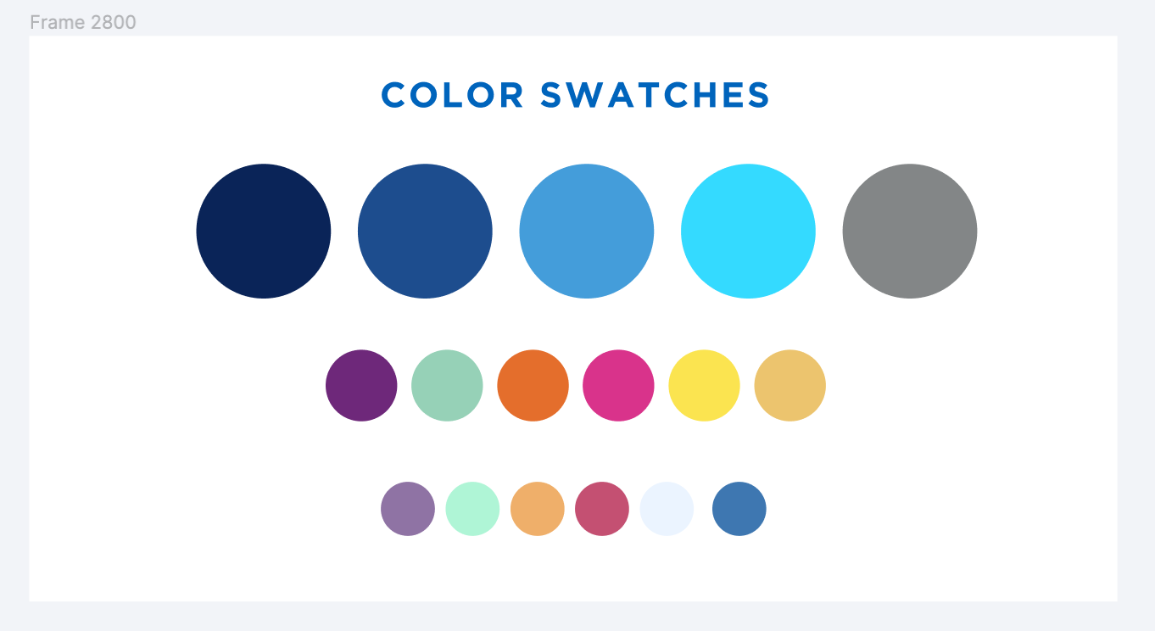

New Manage Patron Services Interface
November 14, 2024

Slide 2
New Manage Patron Services Interface
November 2024 Alma release contained an updated interface for Manage Patron Services
  used to perform circulation functions like checking items in and out and paying or waiving fines and fees
Interface for Return Items function also updated
These new interfaces are not currently the default interfaces
  You need to opt in to using the new interfaces at this time
  New interfaces will eventually become the default interfaces and old interface will be removed (currently timeline for “full activation” is May 2025)

Slide 3
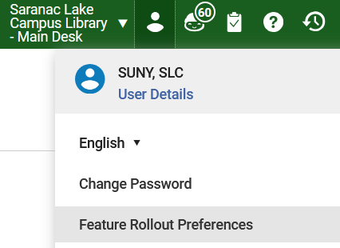
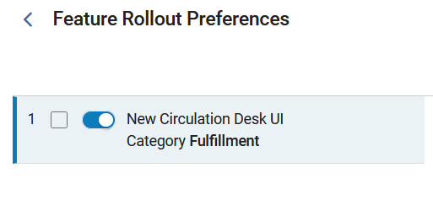
Turning the New Interfaces On
  Click on the User icon
  Click the Feature Rollout Preferences link
  Slide the button for “New Circulation Desk UI” feature to the right

Slide 4
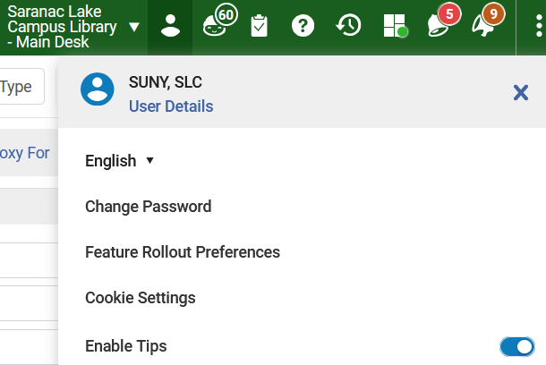
Turning the New Interfaces On
The new interface must be turned on for each staff member individually
Not everybody at your library has to be using the same interface
You can turn the new interface back off if you wish
You can disable reminders about the new interfaces by clicking the User icon and sliding the “Enable Tips” button to the left

Slide 5
New Manage Patron Services Interface
New interfaces do not contain any new functionality other than the ability to customize the layout
Known Issue with using Return Items function for resource sharing items
  Fix will be included in December 2024 Alma update
  Scan In function still works properly
Please email info@sunyolis.libanswers.com if you discover any other issues with these new interfaces
Plan to update relevant FAQs over the winter break
  Will post updated to Basecamp

